Slide 1

NSTX
Supported by
Plasma-Material Interface Development for Future Spherical Tokamak based Devices in NSTX*
College W&M
Colorado Sch Mines
Columbia U
CompX
General Atomics
INEL
Johns Hopkins U
LANL
LLNL
Lodestar
MIT
Nova Photonics
New York U
Old Dominion U
ORNL
PPPL
PSI
Princeton U
Purdue U
SNL
Think Tank, Inc.
UC Davis
UC Irvine
UCLA
UCSD
U Colorado
U Illinois
U Maryland
U Rochester
U Washington
U Wisconsin
V. A. Soukhanovskii (LLNL)
D. Battaglia, M. G. Bell, R. E. Bell, A. Diallo,
S. Gerhardt, R. Kaita, E. Kolemen, H. W. Kugel, B. P. LeBlanc, J. E. Menard, D. Mueller, S. F. Paul, M. Podesta, A. L. Roquemore, F. Scotti (PPPL)
J.-W. Ahn, R. Maingi, A. McLean (ORNL)
T. Gray (ORISE), R. Raman (U. Washington)
D. D. Ryutov, T. Rognlien, M. Umansky (LLNL)
Culham Sci Ctr
U St. Andrews
York U
Chubu U
Fukui U
Hiroshima U
Hyogo U
Kyoto U
Kyushu U
Kyushu Tokai U
NIFS
Niigata U
U Tokyo
JAEA
Hebrew U
Ioffe Inst
RRC Kurchatov Inst
TRINITI
KBSI
KAIST
POSTECH
ASIPP
ENEA, Frascati
CEA, Cadarache
IPP, Jülich
IPP, Garching
ASCR, Czech Rep
U Quebec
Poster 28-3P-10
28 September 2011
* Supported by the U.S. DOE under Contracts DE-AC52-07NA27344, DE AC02-09CH11466, DE-AC05-00OR22725, DE-FG02-08ER54989.

Slide 2
Abstract
The divertor plasma-material interface (PMI) must be able to withstand steady-state heat fluxes up to 10 MW/m² (a limit imposed by the present day divertor material and engineering constraints) with minimal material erosion, as well as to provide impurity control and ion density pumping capabilities. In spherical tokamaks (STs), the compact divertor geometry and the requirement of low core electron collisionality n_{e}* at n_{e} < 0.5-0.7 n_{G} (where n_{G} is the Greenwald density) for increased neutral beam current drive efficiency impose much greater demands on divertor and first-wall particle and heat flux mitigation solutions. In NSTX, divertor heat flux mitigation and impurity control with an innovative “snowflake” divertor configuration [1] and ion density pumping by evaporated lithium wall and divertor coatings [2] are studied. Lithium coatings have enabled ion density reduction up to 50 % in NSTX through the reduction of wall and divertor recycling rates. The “snowflake” divertor configuration was obtained in NSTX in 0.8-1 MA 4-6 MW NBI-heated H-mode lithium-assisted discharges using three divertor coils. The snowflake divertor formation was always accompanied by a partial detachment of the outer strike point with an up to 50 % increase in divertor radiation from intrinsic carbon, the peak divertor heat flux reduction from 3-6 MW/m² to 0.5-1 MW/m², and a significant increase in divertor volume recombination [3]. High core confinement was maintained with the snowflake divertor, evidenced by the t_{E}, W_{MHD} and the H98(y,2) factors similar to those of the standard divertor discharges. Core carbon concentration and radiated power were reduced by 30-70 %, apparently as a result of reduced divertor physical and chemical sputtering in the snowflake divertor and ELMs. In the SFD discharges, the MHD stability of the H-mode pedestal region was altered leading to the re-appearance of medium size (DW/W=5-10 %), Type I, ELMs otherwise suppressed due to lithium conditioning [4]. Fast divertor measurements showed that impulsive particle and heat fluxes due to the ELMs were significantly dissipated in the high magnetic flux expansion region of the snowflake divertor. The snowflake divertor configuration is being combined in experiments with extrinsic deuterium or impurity gas puffing for increased dissipative divertor power losses, additional upper divertor nulls for increased power sharing between the upper and the lower divertors, and lithium coated plasma facing components for large area ion pumping. These efforts are aimed at the development of an integrated PMI for future ST-based devices for fusion development applications. Supported by the U.S. DOE under Contract DE-AC52-07NA27344, DE-AC02-09CH11466, DE-AC05-00OR22725, DE-FG02-08ER54989.
References
[1] D. D. Ryutov, Phys. Plasmas 14, 064502 (2007)
[2] H. W. Kugel et. al, Phys. Plasma 15 (2008) 056118
[3] V.A. Soukhanovskii et. al, Nucl. Fusion 51 (2011) 012001
[4] R. Maingi et. al, Phys. Rev. Lett. 103 (2009) 075001

Slide 3
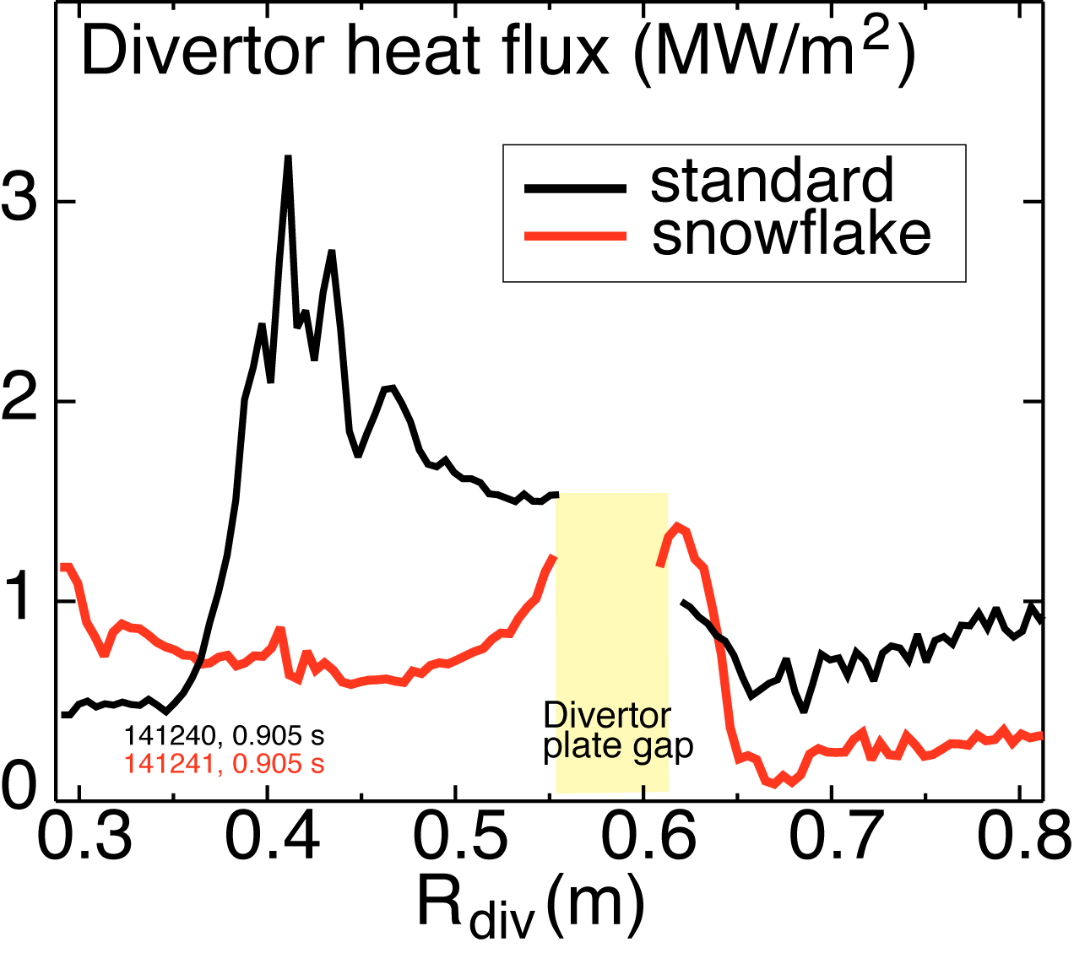
Summary: High flux expansion (snowflake) area-pumping (lithium) divertor is studied in NSTX
Evaporative lithium coatings on carbon PFCs
  Surface pumping reduced ion inventory (density) by up to 50 %
  Recycling reduced by up to 50 % in both divertors and wall
  Local recycling coefficients reduced on inner wall and far SOL, remained similar in the outer strike point region
  Parallel heat transport regime in the SOL changes from conduction-limited to sheath-limited (low-recycling)
  Core lithium density low, uncorrelated with divertor source
“Snowflake” divertor configuration
  Obtained with three existing divertor coils for up to 600 ms
  H-mode confinement maintained with significant reduction in core impurities
  Significant reduction in peak heat flux (and outer strike point partial detachment)
  Higher divertor plasma-wetted area A_{wet} and divertor volume
  Consistent with theoretical predictions and 2D fluid model
  Candidate divertor solution for NSTX-Upgrade

Slide 4
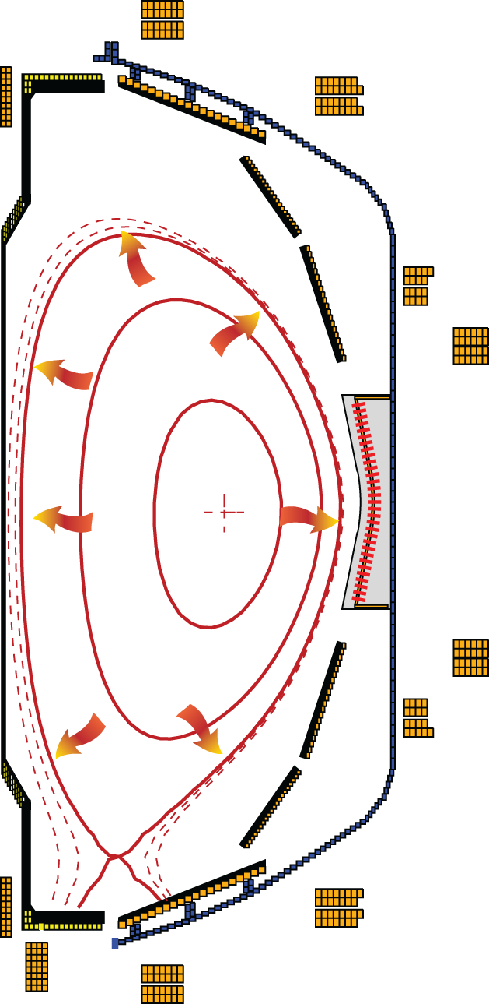
Solid lithium coatings are studied in NSTX for impurity and density control applications
Access to reduced core collisionality
  n_{e} ~ 0.6-0.9 n_{G} for transport, stability, start-up, high non-inductive current fraction scenario studies for future STs (e.g., NSTX-Upgrade)
  n_{e} ~ 0.3-0.7 n_{G} for adequate NBI current drive efficiency in scenarios relevant to fusion and nuclear science ST-based devices
Spherical tokamak: compact divertor for power and particle exhaust
NSTX (Aspect ratio A=1.4-1.5)
  I_{p} ≤ 1.4 MA, P_{in} ≤ 7.4 MW (NBI), P / R ~ 10
  q_{peak} ≤ 15 MW/m², q|| ≤ 200 MW/m²
  ATJ and CFC graphite tiles as PFCs
  Typical divertor strike point region T ≤ 500 C
  (q_{peak} ≤ 10 MW/m²) in 1 s discharges
National Spherical
Torus Experiment

Slide 5
Various techniques considered for SOL / divertor q|| and q_{pk} control
Divertor heat flux mitigation solutions:
  Divertor geometry (poloidal flux expansion)
  Strike point sweeping
  Radiative divertor (or radiative mantle)
  Divertor plate tilt and divertor magnetic balance
Candidate solutions must
  be compatible with good core plasma performance (H-mode confinement, MHD, ELM regime, density)
  be compatible with particle control (e.g., cryopump, lithium)
  scale to very high q_{peak} (15 - 80 MW/m²) for future devices

Slide 6
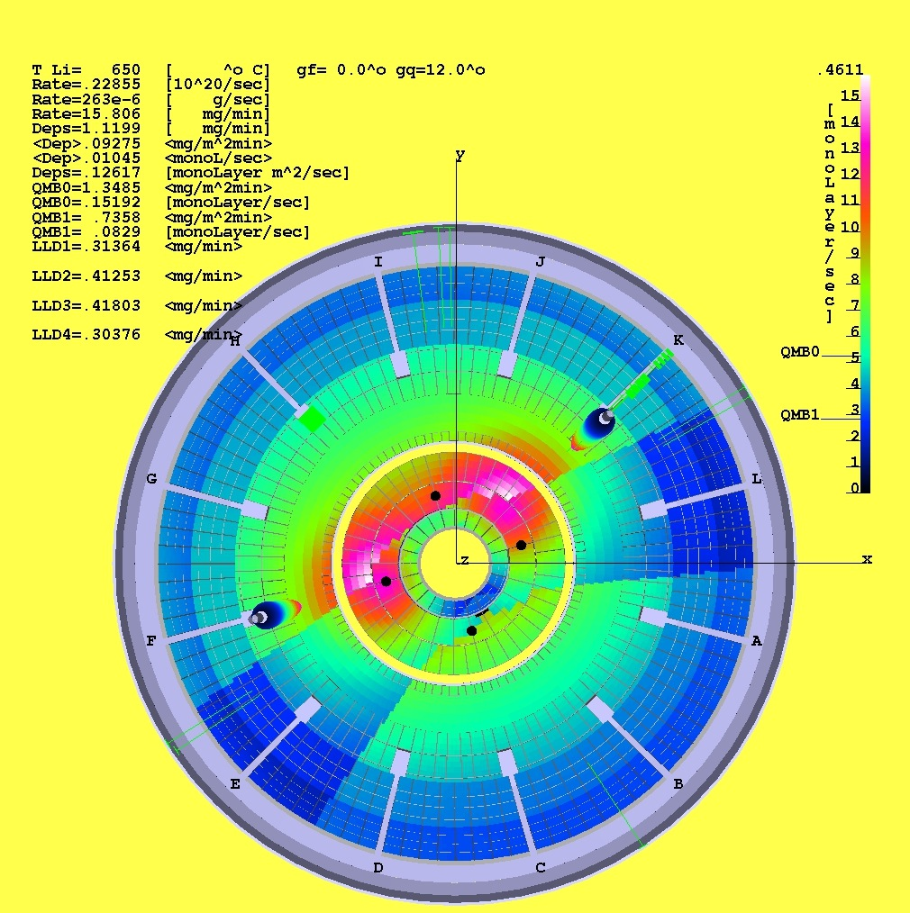
Plasma-surface interactions with solid lithium coatings on graphite plasma-facing components
Solid lithium coatings in NSTX
  deposited by two lithium ovens (LITERs)
    oven T= 600-680°C
    Evaporation rate: 1 mg/min – 80 mg/min
  divertor coating thickness up to 200-400 nm
  up to 50 % variation in toroidal thickness
Interaction of solid lithium coatings with plasma
  Physical sputtering of lithium atoms
    by D ions - 2/3 lithium sputtered as Li⁺
    by lithium (self-sputtering) and carbon
  Re-deposition
  Melting (T = 180º C) and evaporation (significant rate at T > 300º C)
  Reaction with D⁰ atoms leads to pumping of hydrogenic plasma
    Coating can bind D with all Li inventory up to a full thickness
    After saturation - high recycling, low pumping rate
  Reaction with H₂O, C and O to form various compounds

Slide 7
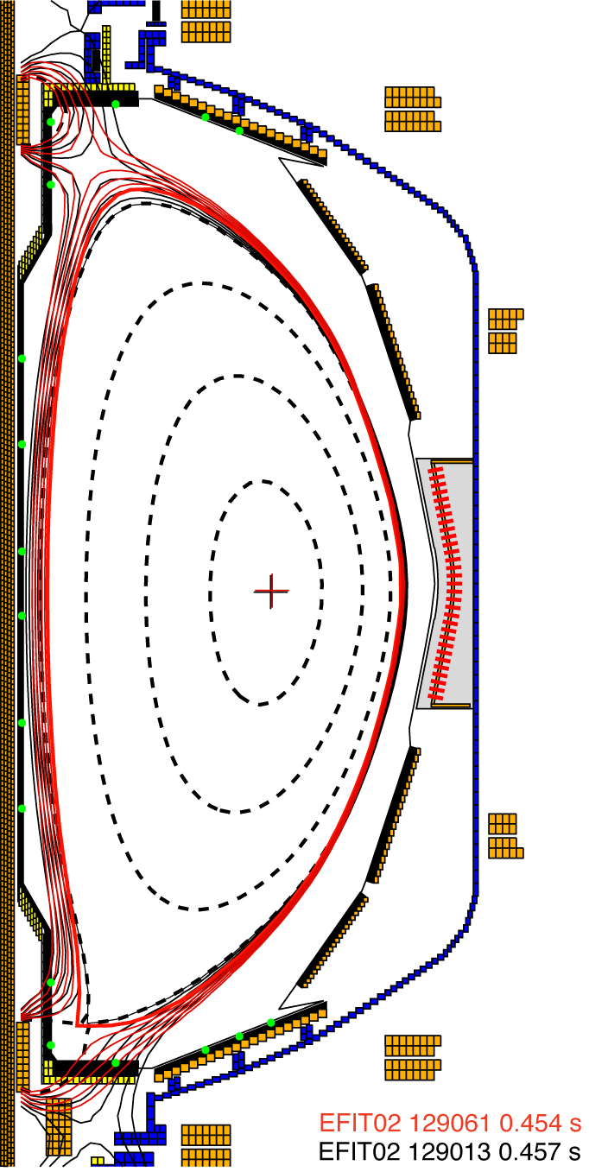
Impact of lithium conditioning was investigated in NBI-heated H-mode discharges
Pumping and recycling on PFCs
Lithium influx from PFCs and core lithium density
Control of divertor carbon influx
I_{p}=0.9 MA, B_{t}=4.5 kG, P_{NBI}=4-6 MW, high κ~2.3, δ~0.6
  Discharge without lithium (129013)
    boronized carbon, no prior lithium use
  Discharge without lithium (129059)
    prior use of lithium (~ 20 discharges, ~ 8 g)
  Discharge with 190 mg lithium (~ 190 mg total, 129061)
  Discharge with 600 mg lithium (2.2 g total, 129064)
Photometrically calibrated filtered cameras and spectrometers, tile-mounted Langmuir probes, neutral pressure gauges
Γ_{ion} [ion/m²/s] = 4 π I_{λ} [ph/m²/s/sr] S/XB [ion/ph]
  For deuterium, D_{a} and D_{b} ; for lithium, Li I λ=670 nm
  Outer SOL region only

Slide 8
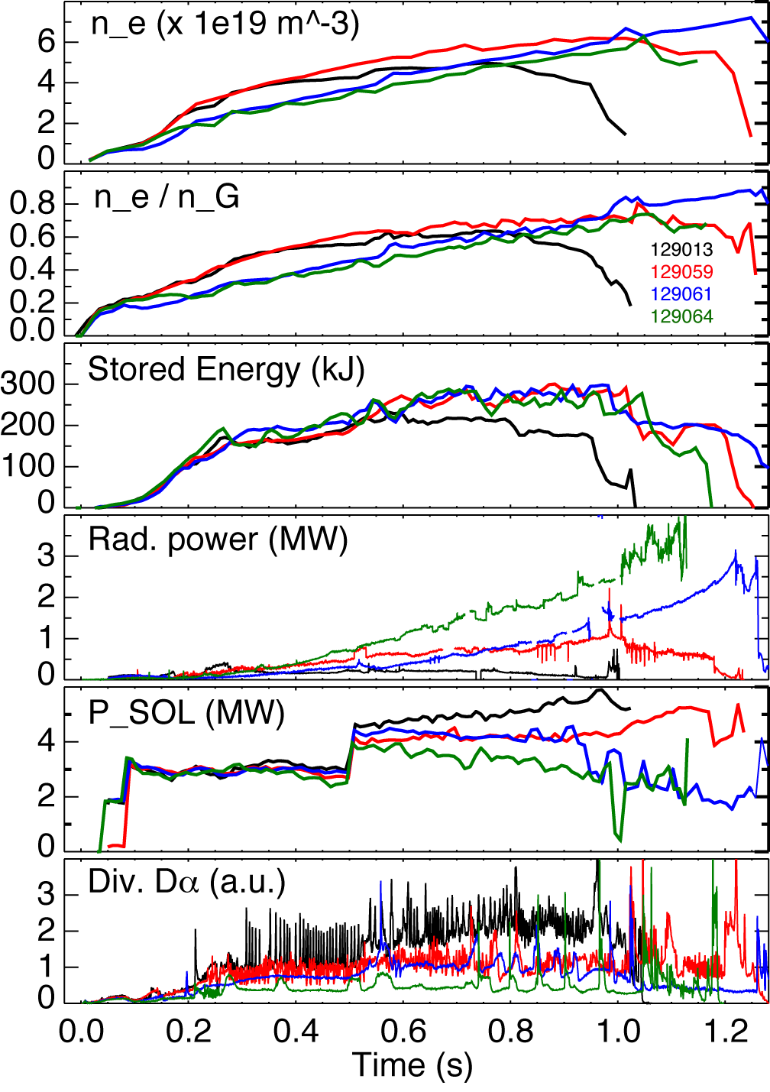
With lithium, reduced core density operation can be achieved
n_{e}/n_{G} ~ 0.2-0.7
  N_{e} and n_{e} increasing
W_{MHD} increased
P_{SOL} decreasing with lithium amount
  Core P_{rad} increasing
  P_{SOL}=P_{OH}+P_{NBI} - P_{rad} - dW/dt - P_{fast ion loss}
ELMs suppressed
  Pedestal MHD stability modified due to n_{e} (r) mod.
No lithium (129013)
No lithium (129059)
190 mg lithium (129061)
600 mg lithium (129064)

Slide 9
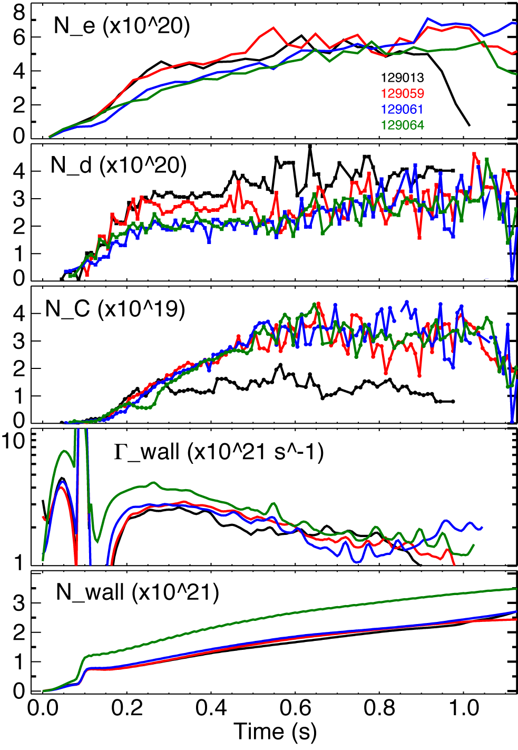
Ion density was reduced by up to 50 % by lithium conditioning in NSTX
Change in
ion
inventory
Gas feed rate
NBI
fueling
rate
NBI
cryopump
rate
Wall
loading
rate
Turbo.
pump
rate
Neutrals
build-up
rate
Particle balance equation using measured quantities
Particle inventory balance: N_{e}=6 N_{C}+N_{d}
Continuous pumping
Cumulative coatings provide higher pumping rate
Wall in pumping state far from saturation
No lithium (129013)
No lithium (129059)
190 mg lithium (129061)
600 mg lithium (129064)

Slide 10
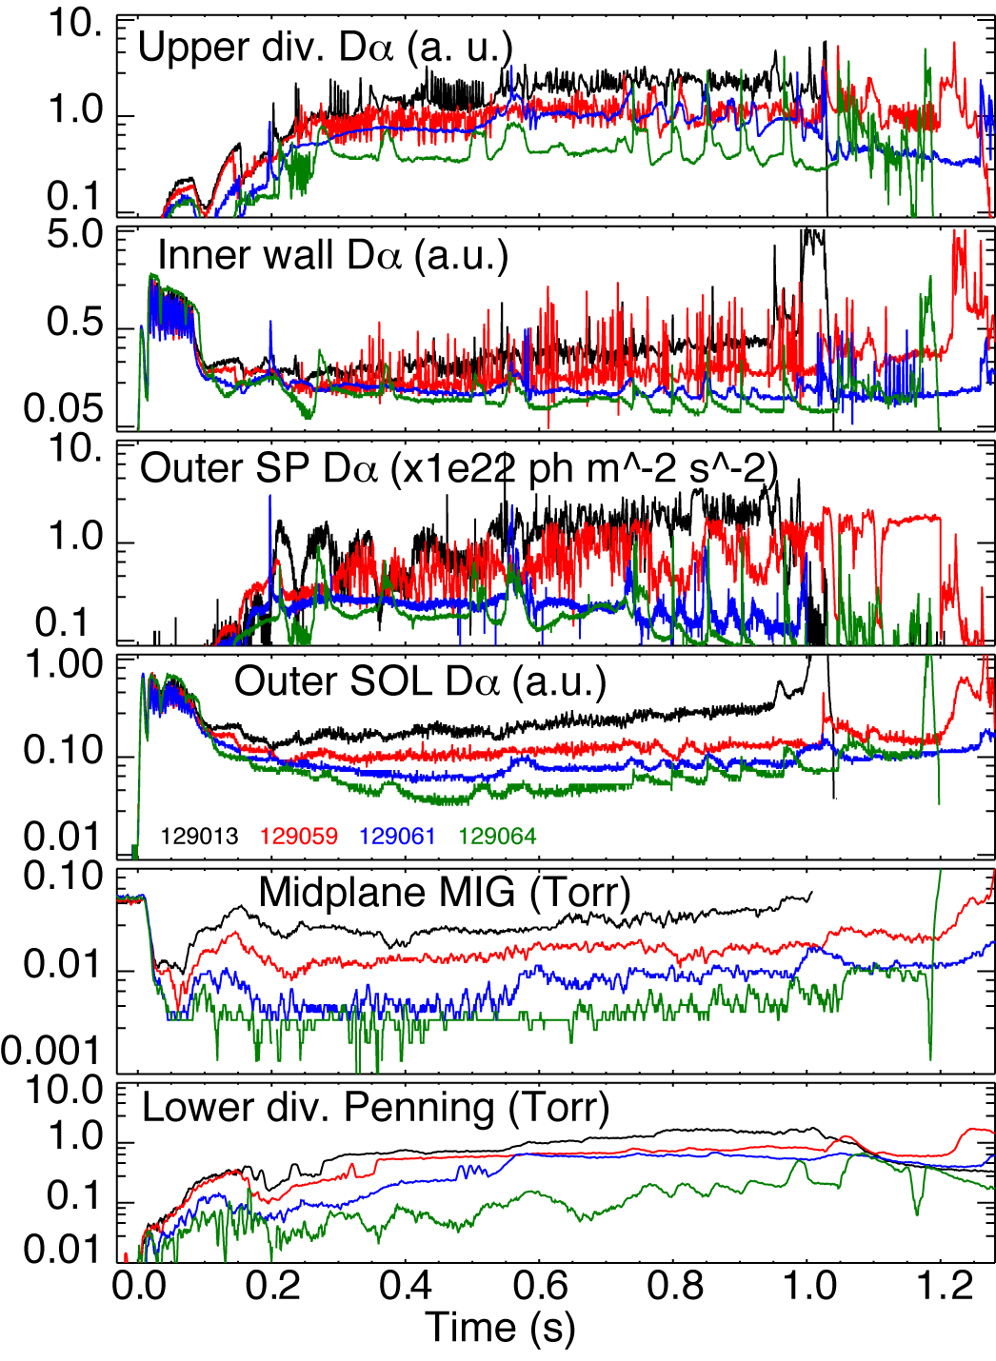
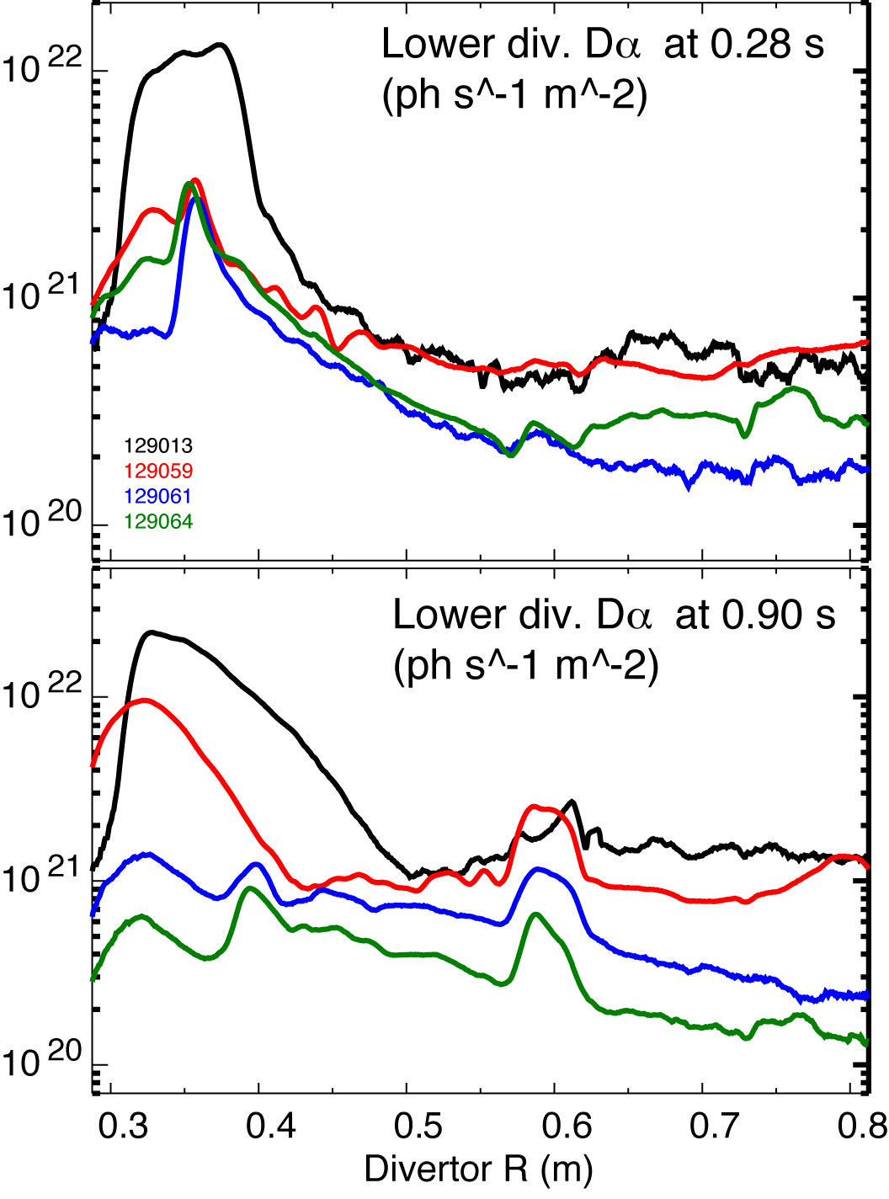
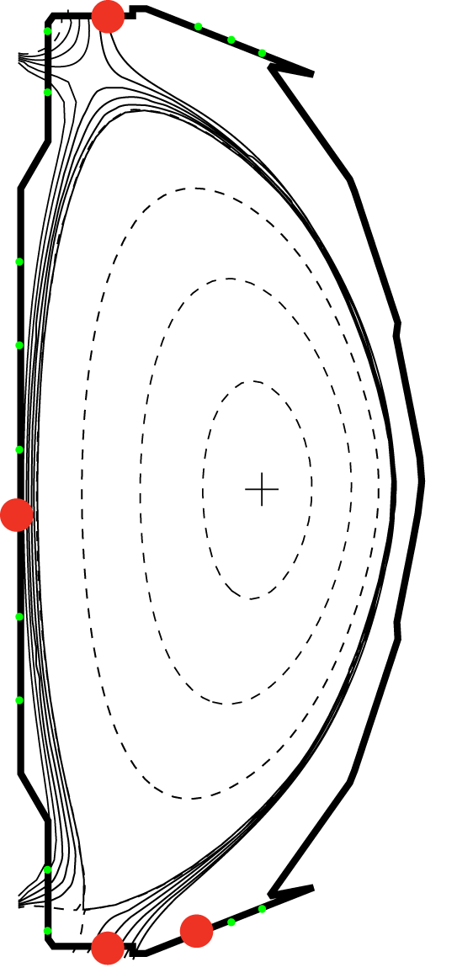
Edge neutral pressure and recycling on PFCs reduced, most strongly in lower divertor
No lithium (129013)
No lithium (129059)
190 mg lithium (129061)
600 mg lithium (129064)
Divertor ionization source reduced by up to 50 %

Slide 11
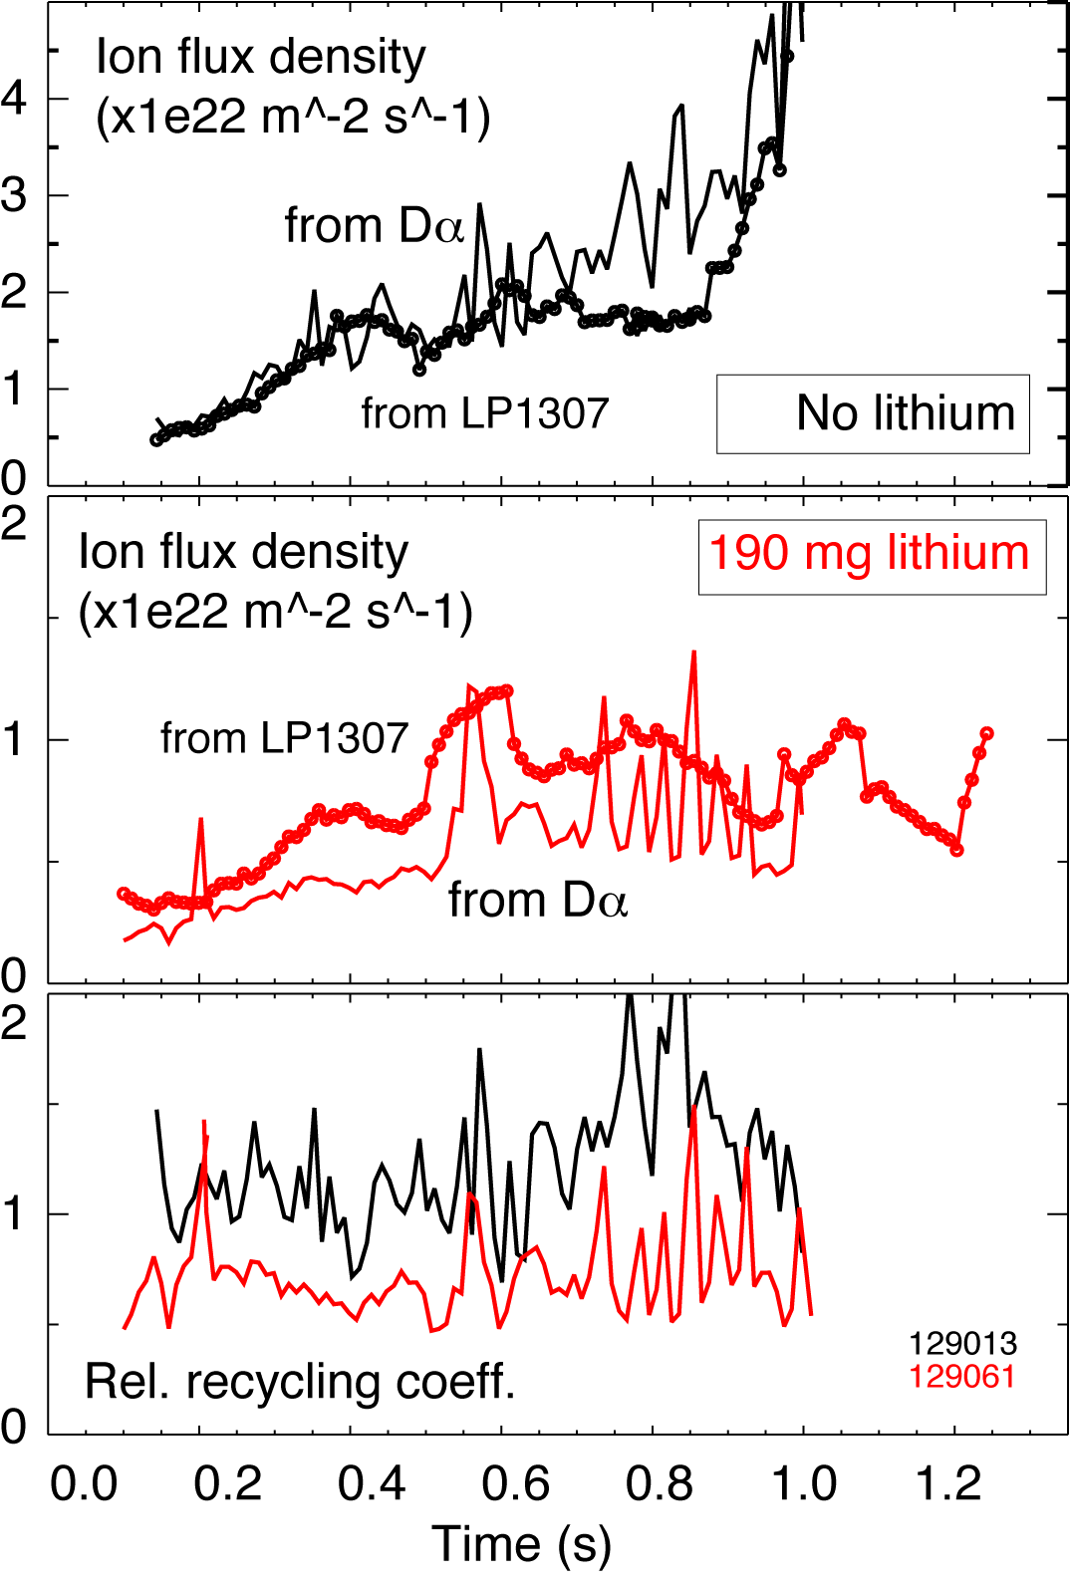
Local relative recycling coefficients reduced on all PFCs but in the near-SOL / strike point region
Relative recy. coeff.
Local recycling coefficient R_{local}=Γ_{i}^{out} / Γ_{i}^{in}
  Ion flux into surface Γ_{i}^{in} is measured by Langmuir Probes (LPs)
  Ion outflux Γ_{i}^{out} estimated from measured Dα intensity and S/XB (ionizations/photon) coefficient from ADAS

Slide 12
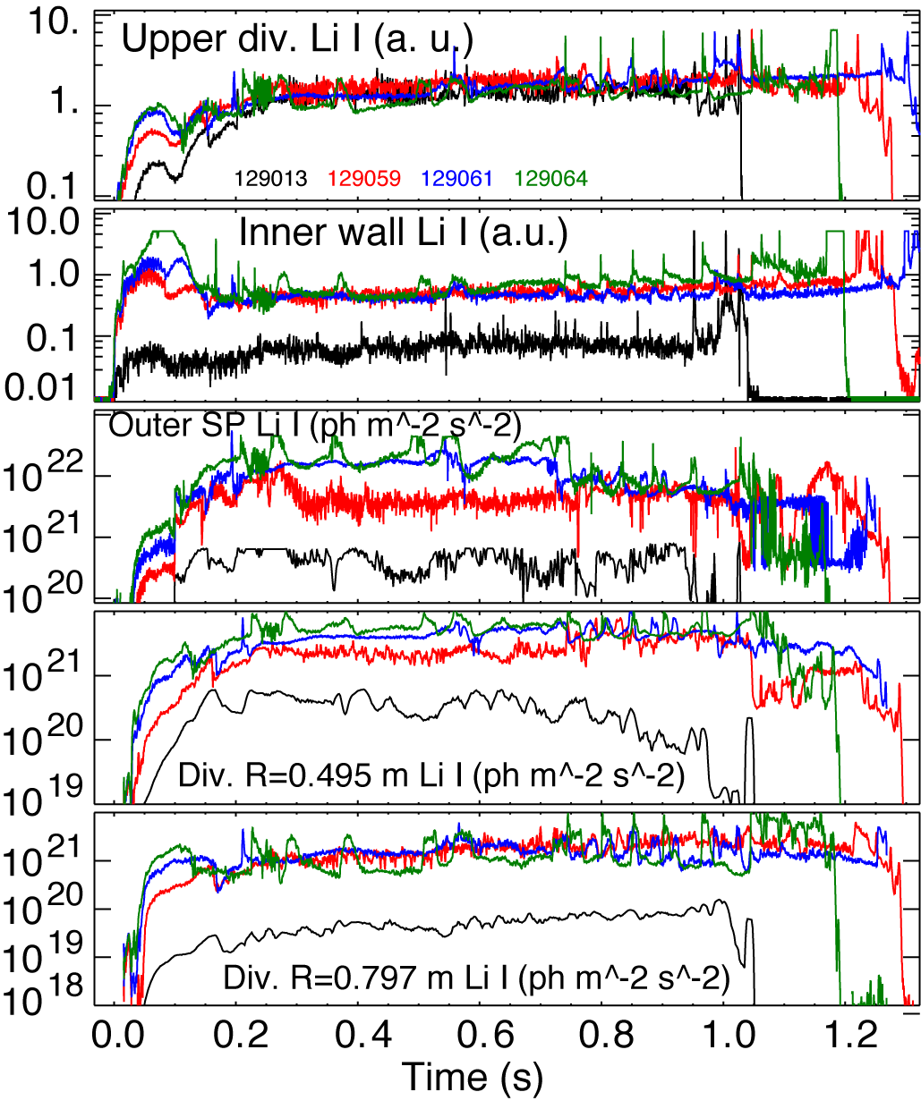
Lithium flux measurements suggest lithium source is in lower divertor, degrades in one discharge
Strong scaling of lithium fluxes with evaporated amount in early phase on all PFCs
  In later phase, no scaling in upper divertor, inner wall and far SOL
In near SOL and strike point, strong scaling until end of discharge (cumulative effect)
Large difference between “no lithium” reference discharges
No lithium (129013)
No lithium (129059)
190 mg lithium (129061)
600 mg lithium (129064)

Slide 13
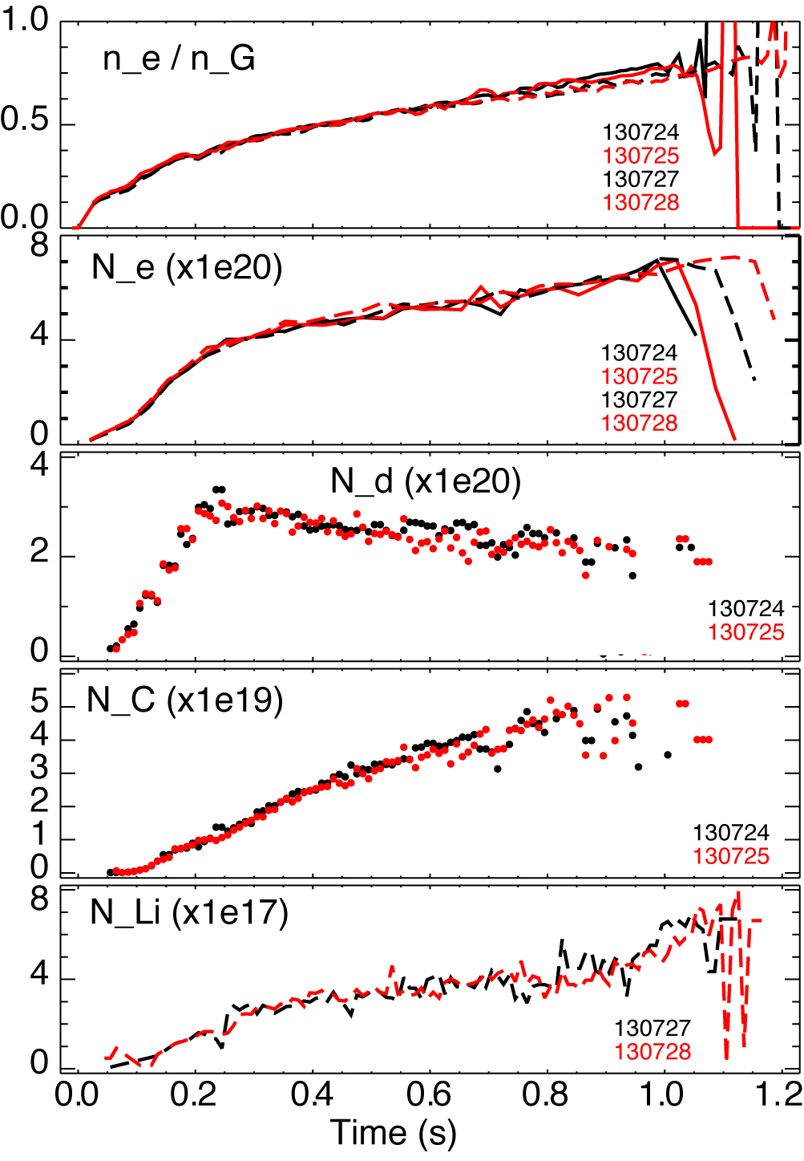
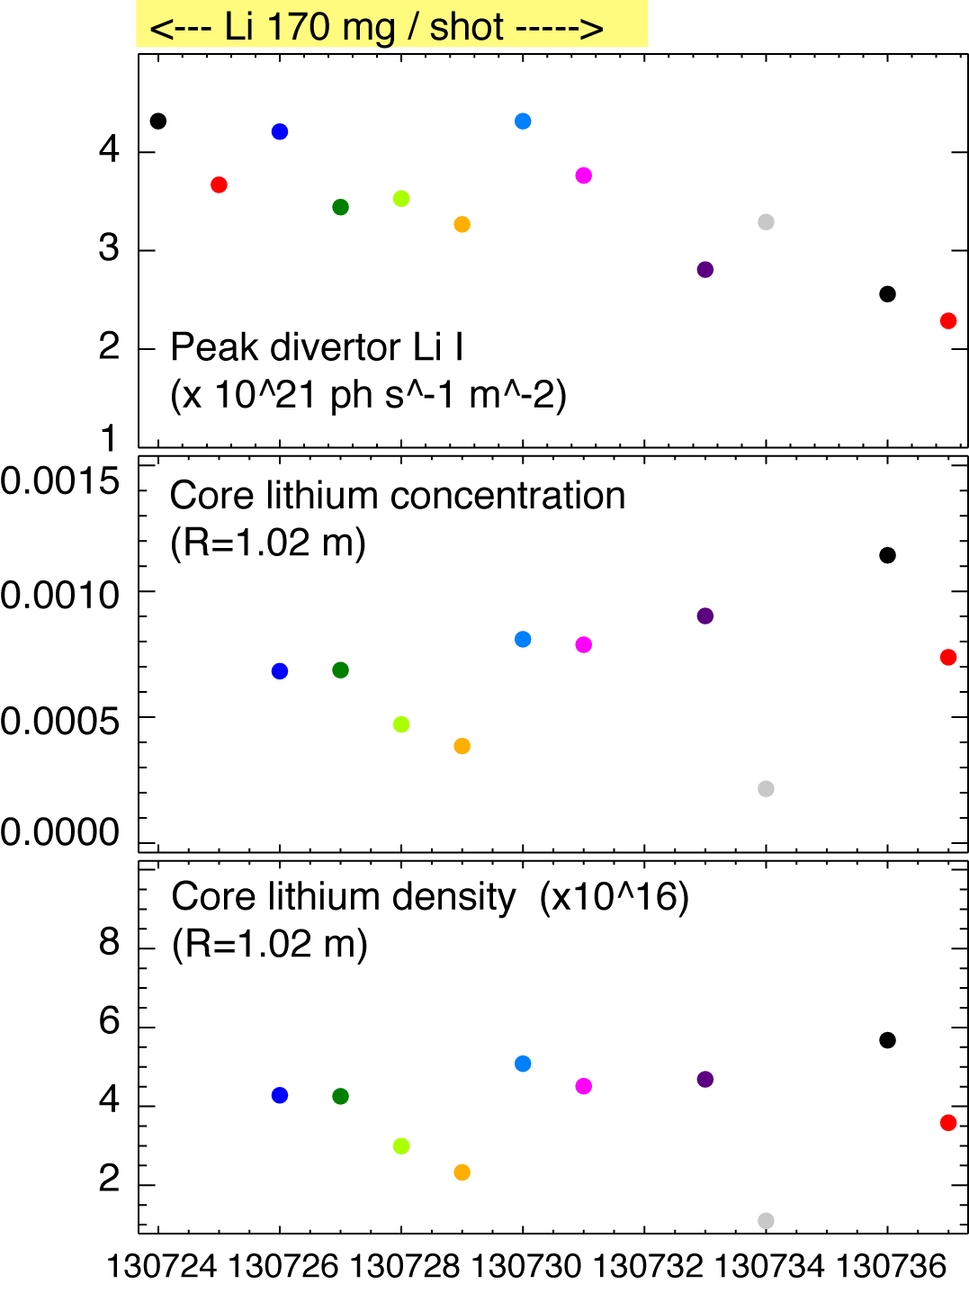
Core lithium density low, does not scale with divertor source, lithium weakly accumulates in core
Impurity density profiles from CHERS
  C VI, n = 8-7, 529.1 nm
  Li III, n = 7-5, 516.7 nm
Lithium screening efficiency high, penetration factor N_{Li} / Γ_{li} ~ 0.0001

Slide 14
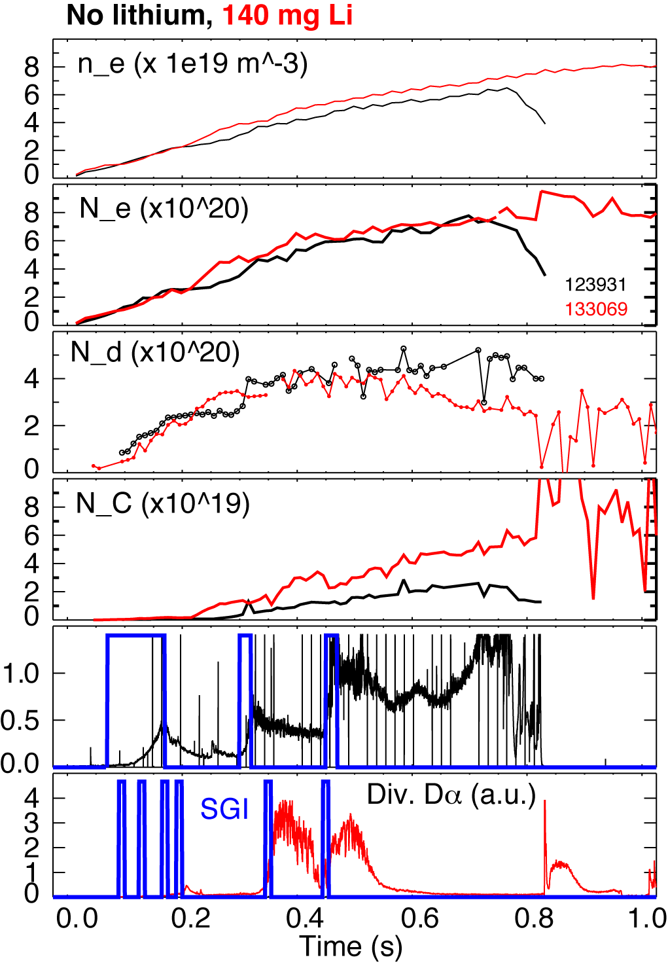
A long pulse H-mode discharge scenario with SGI fueling and lithium-controlled N_{i}
Constant N_{i}

Slide 15
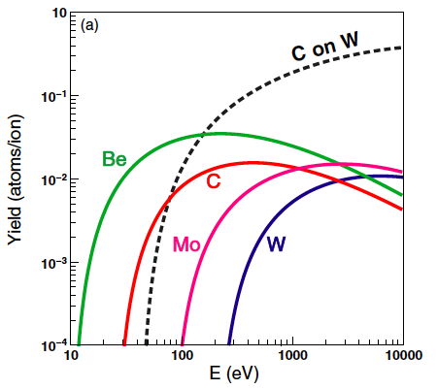
Divertor with lithium coatings provides pumping – but what about impurity and heat flux handling ?
On-going study of impurity sources and impurity parallel and radial transport in SOL and pedestal
Carbon sources: wall and divertor, physical and chemical sputtering
Reduce physical sputtering yield by lowering divertor temperature
  E_{i} = 2kT_{i} + 3 Z_{i} kT_{e}
  E_{i} ~ 50 – 300 eV -> Y_{C} ~ 0.01
  Need to obtain E_{i} ≤ 20-40 eV (T_{e} ≤ 5 eV)
Low T_{e} divertor operation established
in NSTX
  Divertor gas puffing
  Snowflake divertor
Figure from R. A. Pitts et. al, PPCF (2005) B303

Slide 16
Divertor D₂ puffing used to reduce divertor carbon source and core carbon accumulation

Slide 17
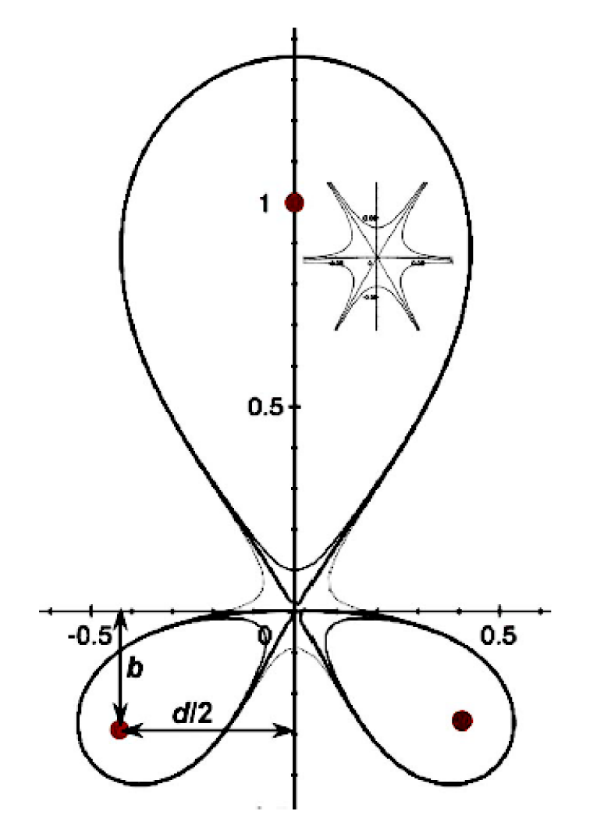
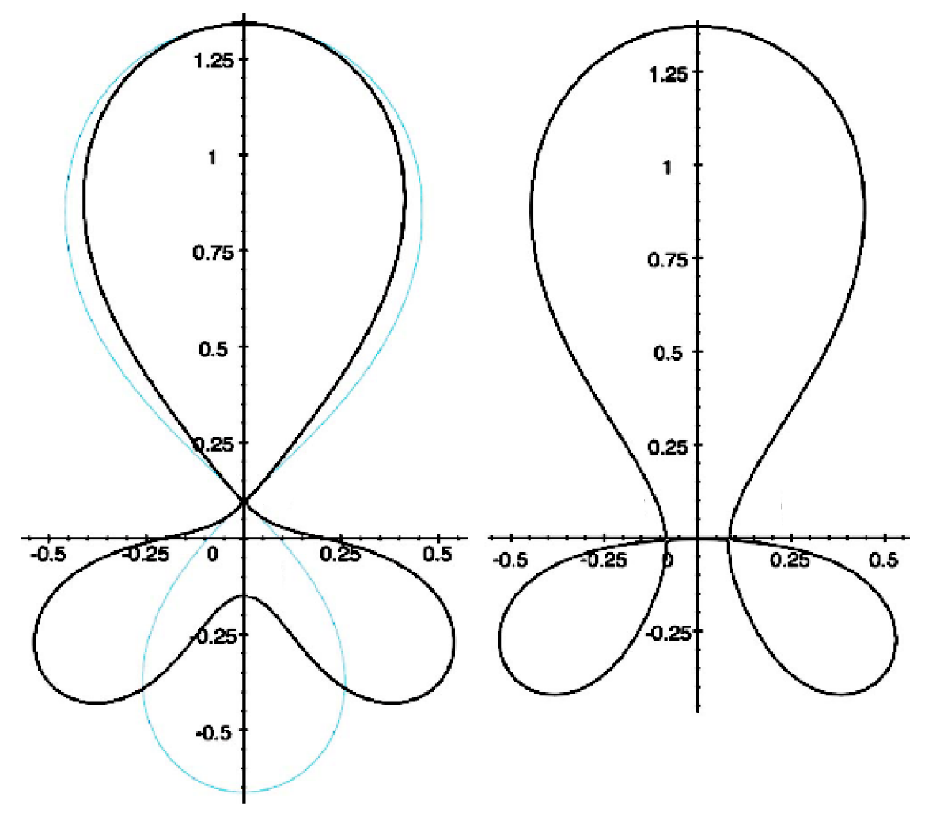
Snowflake divertor geometry attractive for heat flux mitigation
Snowflake divertor
  Second-order null
      B_{p} ~ 0 and grad B_{p} ~ 0 (Cf. first-order null: B_{p} ~ 0)
  Obtained with existing divertor coils (min. 2)
  Exact snowflake topologically unstable
Predicted geometry properties (cf. standard divertor)
  Larger region with low B_{p} around X-point: ped. stability
  Larger plasma wetted-area A_{wet} : reduce q_{div}
  Larger X-point connection length L_{x} : reduce q_{II}
  Larger effective divertor volume V_{div} : incr. P_{rad} , P_{CX}
Experiments
  TCV (F. Piras et. al, PRL 105, 155003 (2010))
  NSTX
Exact
snowflake
divertor
snowflake-minus
snowflake-plus
D. D. Ryutov, PoP 14, 064502 2007

Slide 18
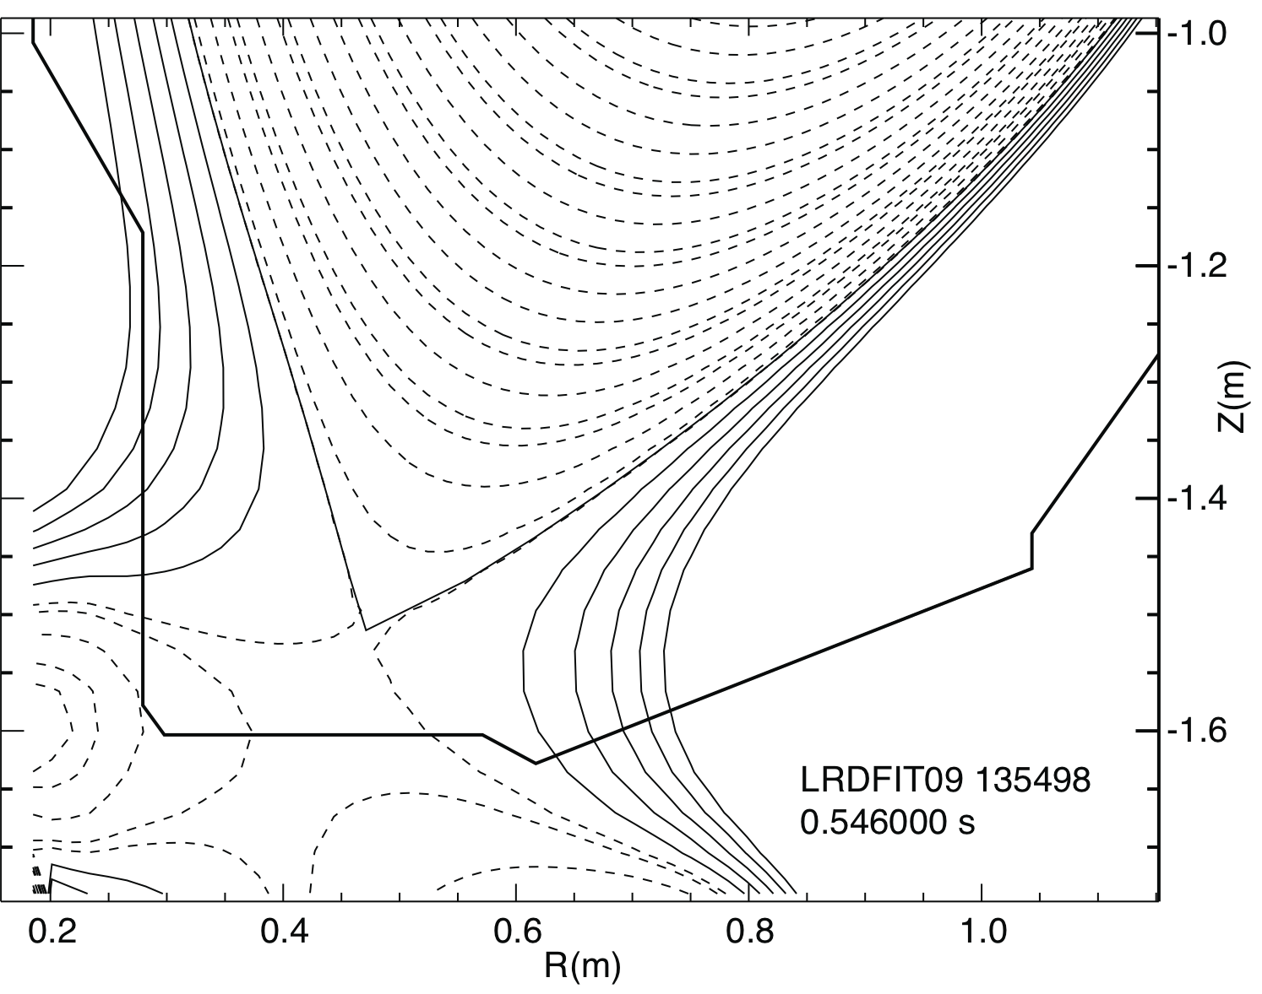
Snowflake configuration as the laboratory for pedestal MHD stability and parallel SOL transport
Obtained with three divertor coils PF1A, PF2L and rev. pol. PF1B
Properties
  Overall, same shaping and core plasma parameters as with standard divertor
  Outer SP flux expansion can be same as in standard divertor !
  Pedestal magnetic shear and SOL connection length higher than in standard divertor
Test parallel transport with 3D fields
  Role of increased line length
  Role of radial heat diffusion (to common and private flux regions)
Test pedestal stability models
  A knob to for peeling-balooning stability
✚
✚

Slide 19
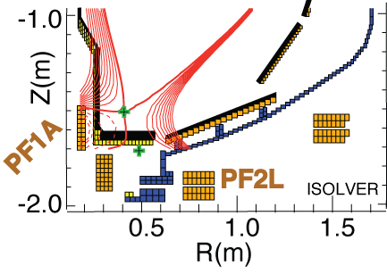
Possible NSTX snowflake divertor configurations were modeled with ISOLVER code
ISOLVER - predictive free-boundary axisymmetric Grad-Shafranov equilibrium solver
  Input: normalized profiles (P, I_{p}), boundary shape
  Match a specified I_{p} and β
  Output: magnetic coil currents
Standard divertor discharge below:
B_{t}=0.4 T, I_{p}=0.8 MA, δ_{bot}~0.6, κ∼2.1
Quantity | Standard divertor | Simulated snowflake
X-point to target parallel length L_{x} (m) | 5-10 | 10
Poloidal magnetic flux expansion f_{exp} at outer SP | 10-24 | 30-60
Magnetic field angle at outer SP (deg.) | 1.5-5 | ~1-2
Plasma-wetted area A_{wet} (m²) | ≤ 0.4 | 0.95

Slide 20
Snowflake divertor configurations obtained in NSTX confirm analytic theory and modeling
Standard
Snowflake
f_{exp}
B_{p}

Slide 21
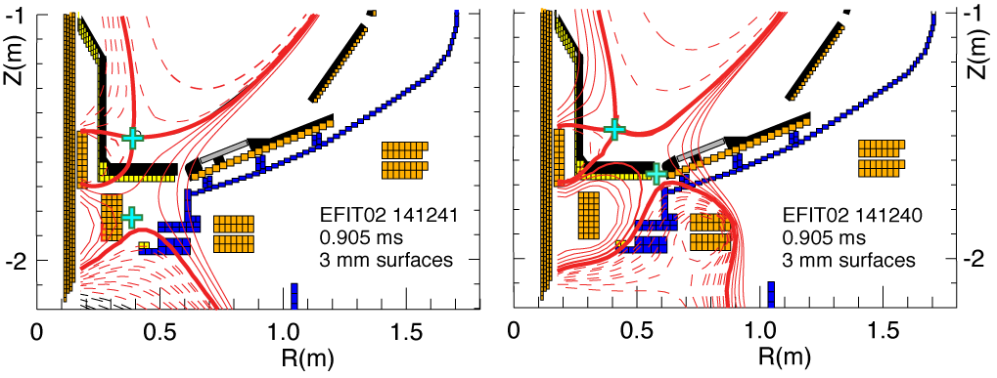
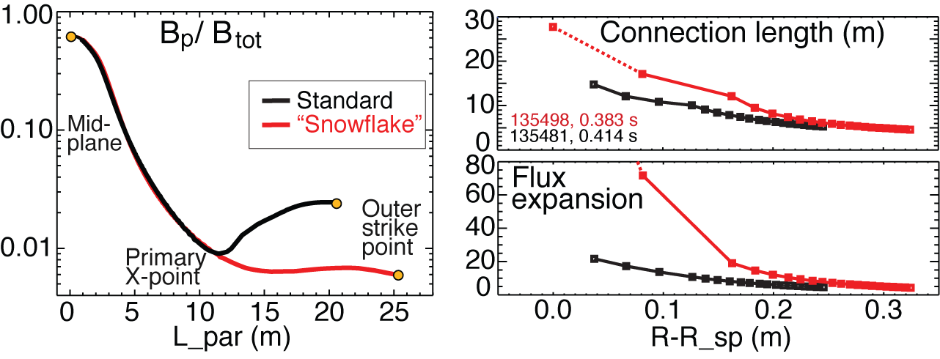
Plasma-wetted area and connection length are increased by 50-90 % in snowflake divertor
These properties observed in first 30-50 % of SOL width
B_{tot} angles in the strike point region: 1-2º, sometimes < 1º

Slide 22
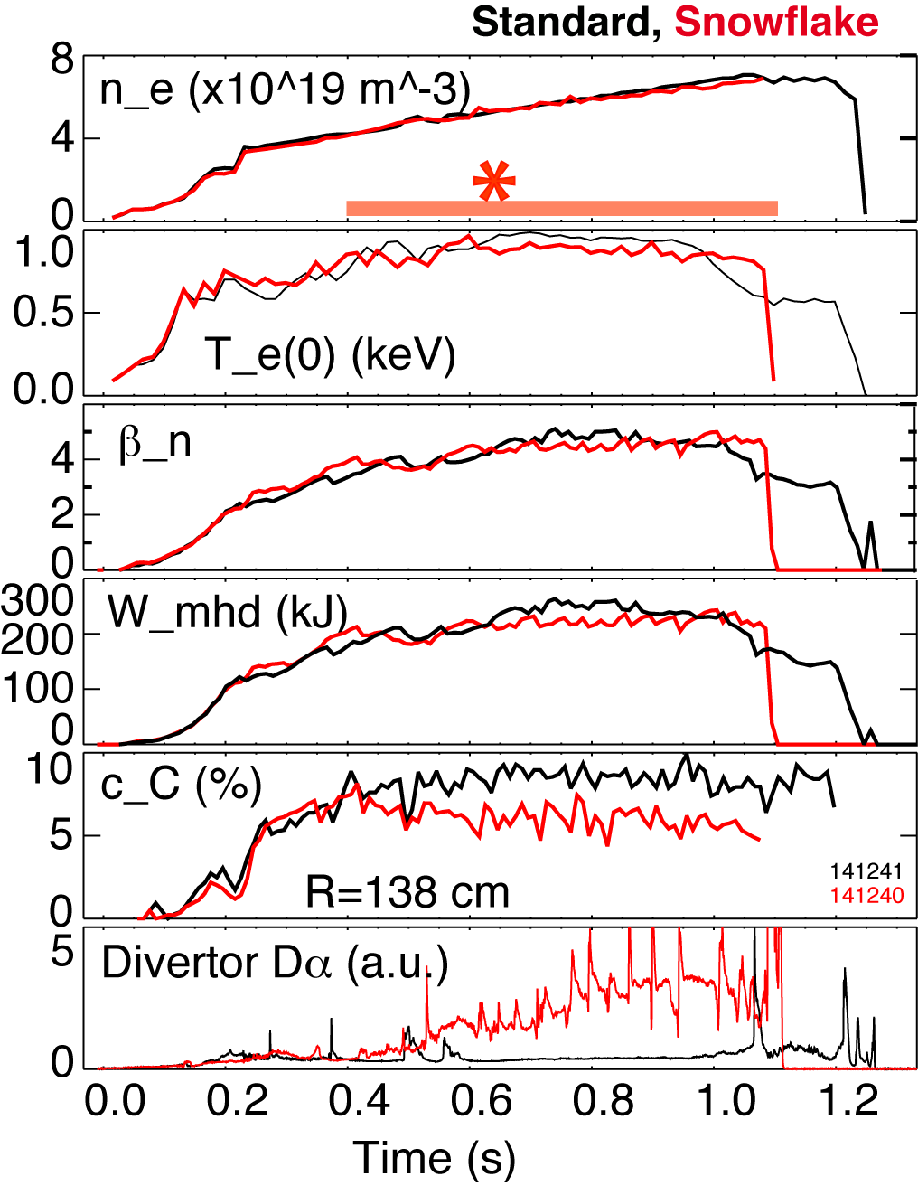
  Good H-mode confinement properties and core impurity reduction obtained with snowflake divertor
0.8 MA, 4 MW H-mode
κ=2.1, δ=0.8
Core T_{e} ~ 0.8-1 keV, T_{i} ~ 1 keV
β_{N} ~ 4-5
Plasma stored energy ~ 250 kJ
H98(y,2) ~ 1 (from TRANSP)
Core carbon reduction due to
  Type I ELMs
  Edge source reduction
    Divertor sputtering rates reduced due to partial detachment

Slide 23
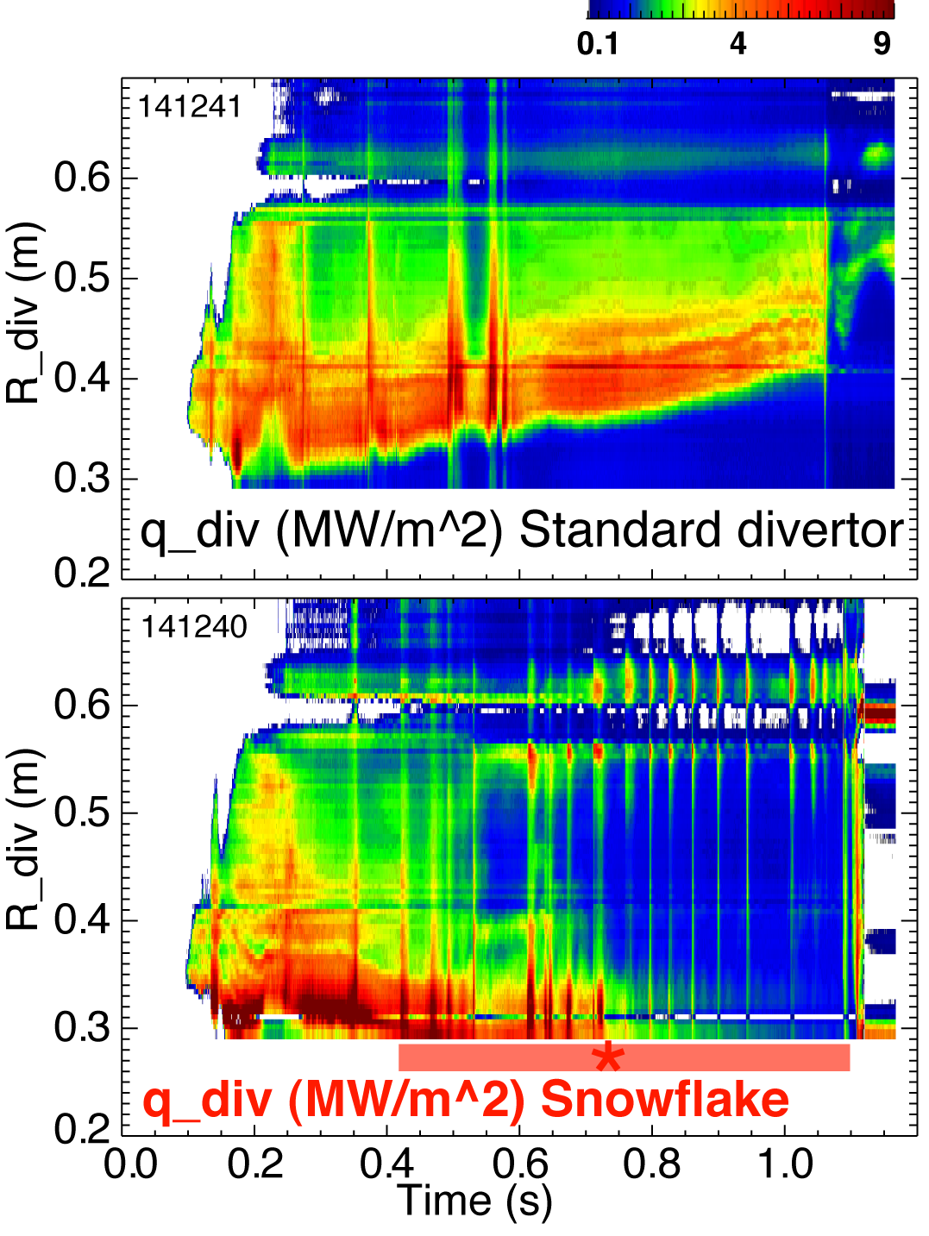
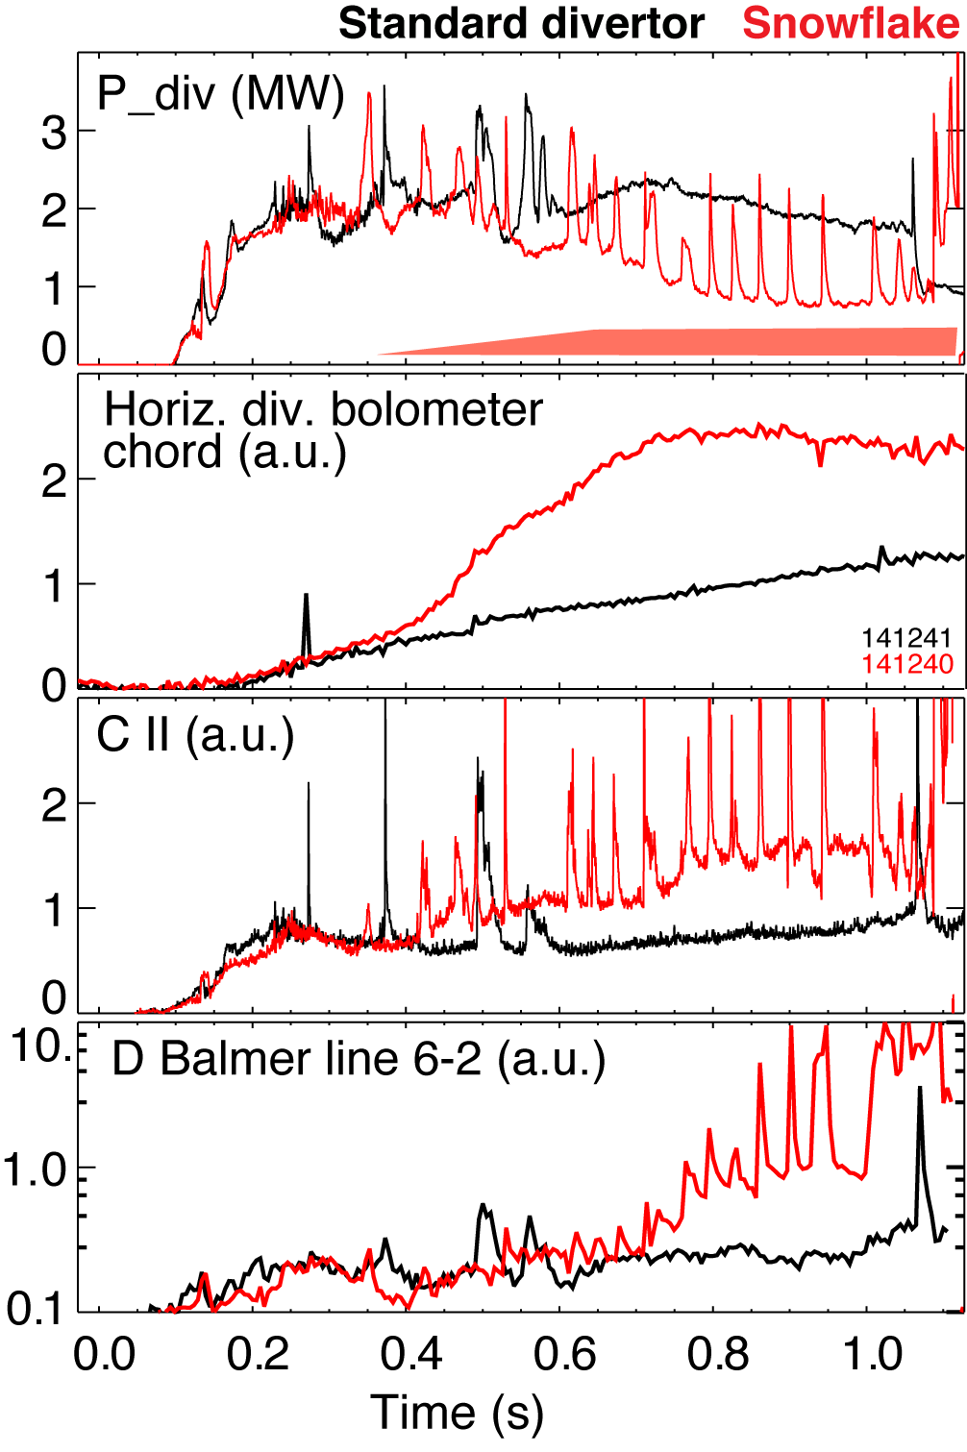
Significant reduction of steady-state divertor heat flux observed in snowflake divertor (at P_{SOL}~ 3 MW)
Partial detachment at or after snowflake formation time
  Heat and ion fluxes in the outer strike point region decreased
  Divertor recombination rate and radiated power are increased

Slide 24
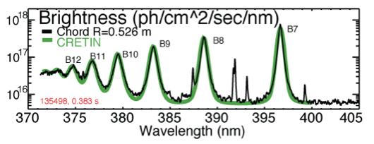
Divertor profiles show low heat flux, broadened C III and
C IV radiation zones in the snowflake divertor phase
Heat flux profiles reduced to nearly flat low levels, characteristic of radiative heating
Divertor C III and C IV brightness profiles broaden
High-n Balmer line spectroscopy and CRETIN code modeling confirm outer SP detachment with T_{e} ≤ 1.5 eV,
n_{e} ≤ 5 x 10²⁰ m⁻³
  Also suggests a reduction of carbon physical and chemical sputtering rates

Slide 25
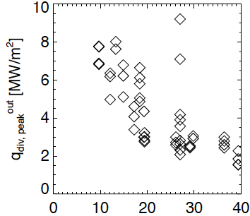
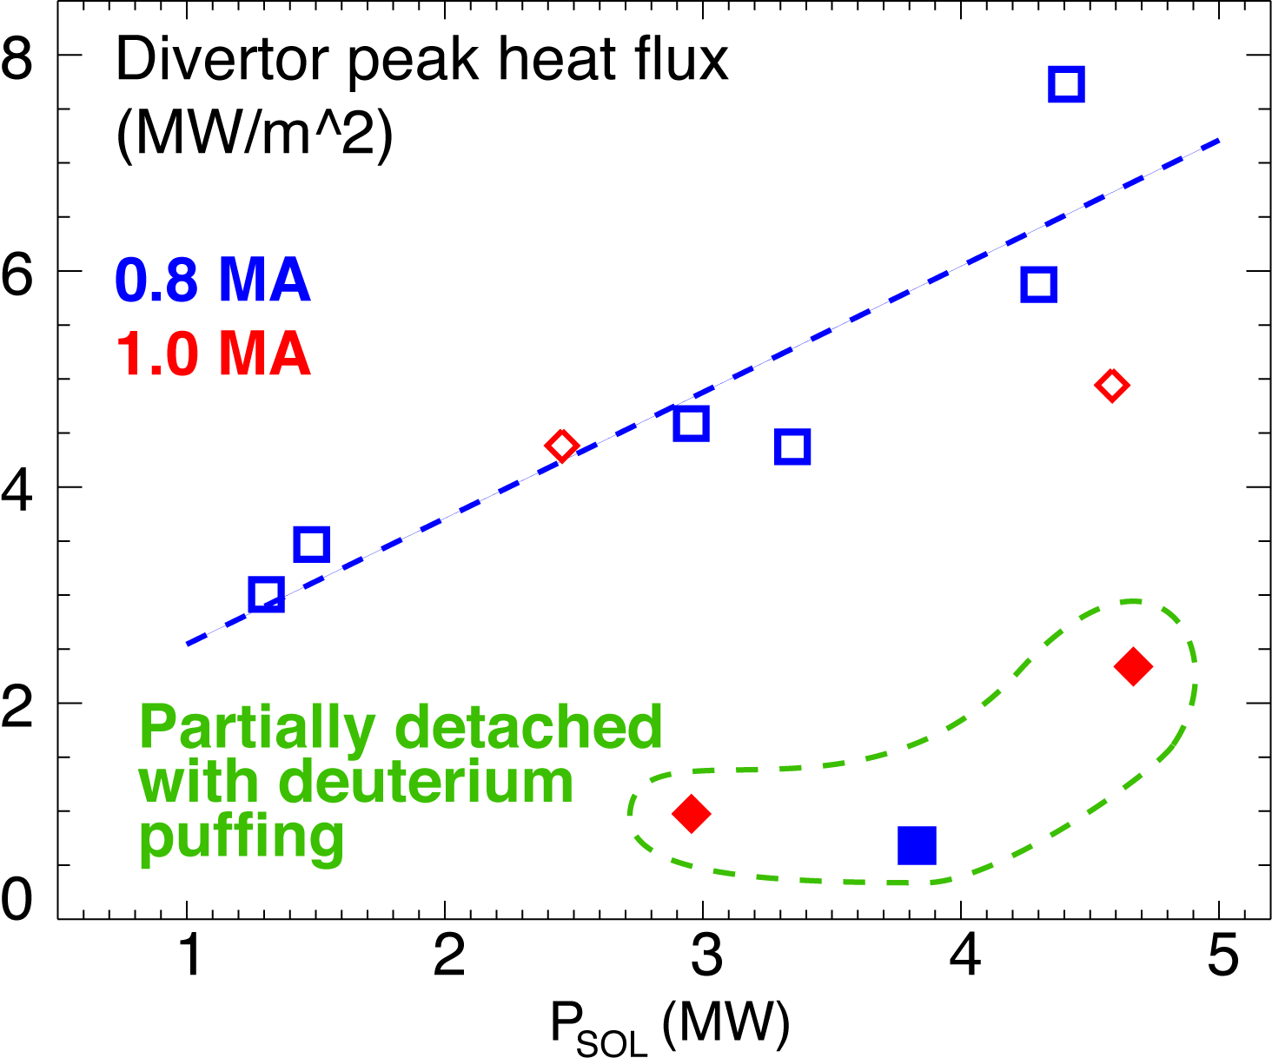
Snowflake divertor heat flux consistent with NSTX divertor heat flux scalings
0.8 MA
*
*
*
50
flux expansion
Snowflake divertor (*): P_{SOL}~3-4 MW, f_{exp}~40-60, q_{peak}~0.5-1.5 MW/m²
T. K. Gray et. al, EX/D P3-13, IAEA FEC 2010
V. A. Soukhanovskii et. al, PoP 16, 022501 (2009)

Slide 26
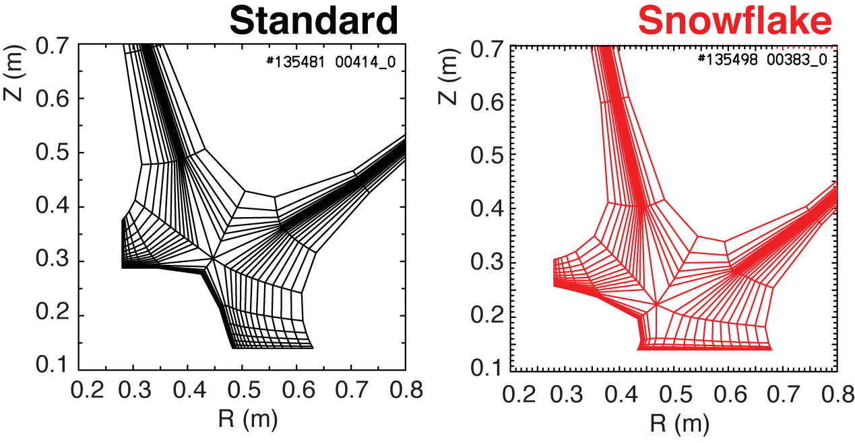
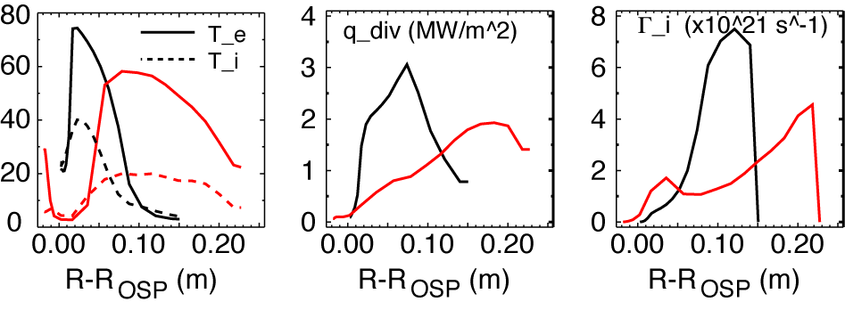
Modeling shows a trend toward reduced temperature, heat and particle fluxes in the snowflake divertor
2D multi-fluid code UEDGE
  Fluid (Braginskii) model for ions and electrons
  Fluid for neutrals
  Classical parallel transport, anomalous radial transport
    D = 0.25 m²/s
    χ_{e,i} = 0.5 m²/s
  Core interface:
    T_{e,i} = 120 eV
    n_{e} = 4.5 x 10¹⁹
  R_{recy} = 0.95
  Carbon 3 %

Slide 27
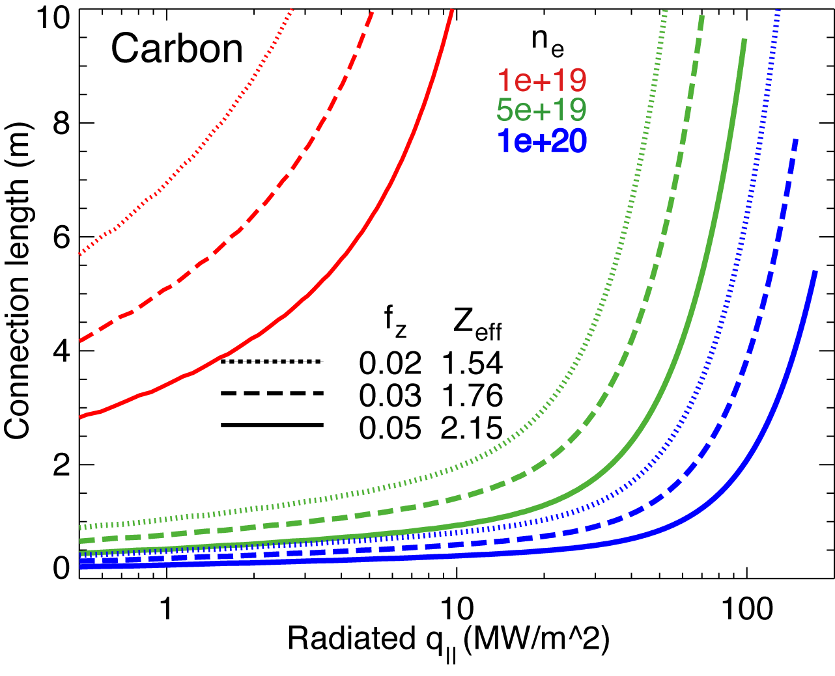
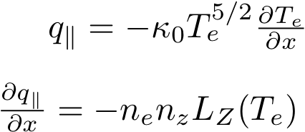
1D estimates indicate power and momentum losses are increased in snowflake divertor
1D divertor detachment model by Post
  Electron conduction with non-coronal carbon radiation
  Max q|| that can be radiated as function of connection length for range of f_{z} and n_{e}
Three-body electron-ion recombination rate depends on divertor ion residence time
  Ion recombination time: τ_{ion}~ 1−10 ms at T_{e} =1.3 eV
  Ion residence time: τ_{ion} ≤ 3-6 ms in standard divertor, x 2 in snowflake

Slide 28
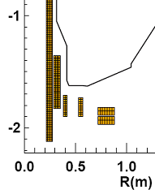
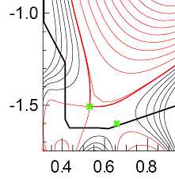
Outlook for NSTX-Upgrade
Development of divertor solutions to address
  2-3x higher input power
      P_{NBI} < 12 MW, I_{p} < 2 MA
  3-5 x longer pulse duration (t< 5 s)
  Up to 30 % reduction in Greenwald fraction
  Projected peak divertor heat fluxes up to 25 MW/m²
Heat-flux handling solutions
  Lower snowflake configuration
  Upper and lower snowflake divertor
  Snowflake + impurity radiation
Density control
  Lithium coatings or liquid lithium
  Conceptual cryo-pump design
Divertor control
  Additional divertor coil PF1C
  Developing snowflake control
  Developing plans for radiative feedback control

