Slide 1




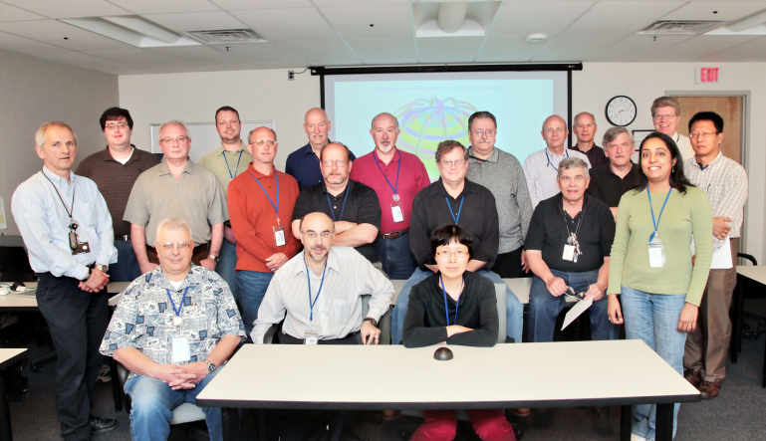
NSTX-U
Supported by
National Spherical Torus Experiment Upgrade – Status and Plans*
Coll of Wm & Mary
Columbia U
CompX
General Atomics
FIU
INL
Johns Hopkins U
LANL
LLNL
Lodestar
MIT
Lehigh U
Nova Photonics
Old Dominion
ORNL
PPPL
Princeton U
Purdue U
SNL
Think Tank, Inc.
UC Davis
UC Irvine
UCLA
UCSD
U Colorado
U Illinois
U Maryland
U Rochester
U Tennessee
U Tulsa
U Washington
U Wisconsin
X Science LLC
J. Menard, PPPL
For the NSTX-U Team
Culham Sci Ctr
York U
Chubu U
Fukui U
Hiroshima U
Hyogo U
Kyoto U
Kyushu U
Kyushu Tokai U
NIFS
Niigata U
U Tokyo
JAEA
Inst for Nucl Res, Kiev
Ioffe Inst
TRINITI
Chonbuk Natl U
NFRI
KAIST
POSTECH
Seoul Natl U
ASIPP
CIEMAT
FOM Inst DIFFER
ENEA, Frascati
CEA, Cadarache
IPP, Jülich
IPP, Garching
ASCR, Czech Rep
ANS 20th Topical Meeting on the
Technology of Fusion Energy (TOFE-2012)
Nashville, TN USA
August 27-31, 2012
*This work supported by the US DOE Contract No. DE-AC02-09CH11466

Slide 2
Outline
NSTX-U Mission
Planned NSTX Upgrade Capabilities
Progress of Upgrade Project
Summary

Slide 3
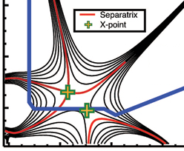
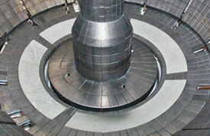
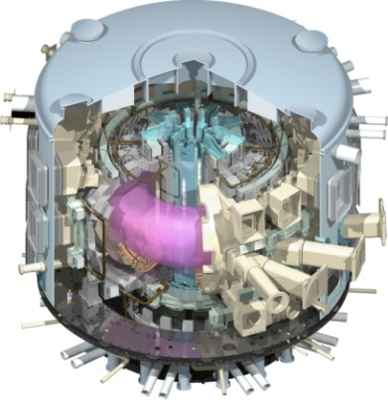
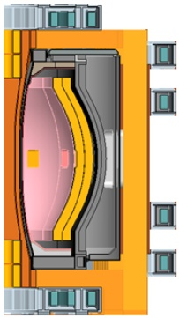
NSTX Upgrade Mission Elements
Advance ST as candidate for Fusion Nuclear Science Facility (FNSF)
Develop solutions for plasma-material interface
Advance toroidal confinement physics predictive capability for ITER and beyond
Develop ST as fusion energy system
ST-FNSF
“Snowflake”
Lithium
ITER
ST Pilot Plant

Slide 4
Mission of ST-FNSF
From M. Peng, ORNL
Provide a continuous fusion nuclear environment of copious neutrons to develop an experimental database on:
  Nuclear-nonnuclear coupling phenomena in materials in components for plasma-material interactions
  Tritium fuel cycle
  Power extraction
ST-FNSF
Complement ITER, prepare for component test facility (CTF):
  Low Q (≤ 3): 0.3 x ITER
  Neutron flux ≤ 2 MW/m²: 3 x
  Fluence = 1 MW-yr/m²: 5 x
  t_{pulse} ≤ 2 wks: 1000 x
  Duty factor = 10%: 3 x
Low-aspect-ratio “spherical” tokamak (ST) is most compact embodiment of FNSF

Slide 5
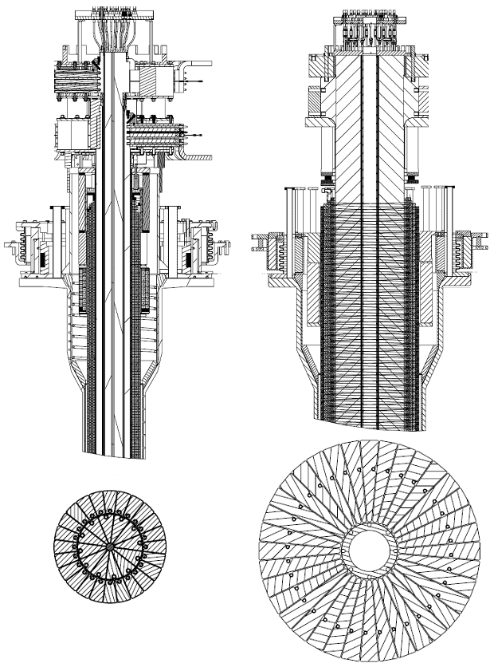
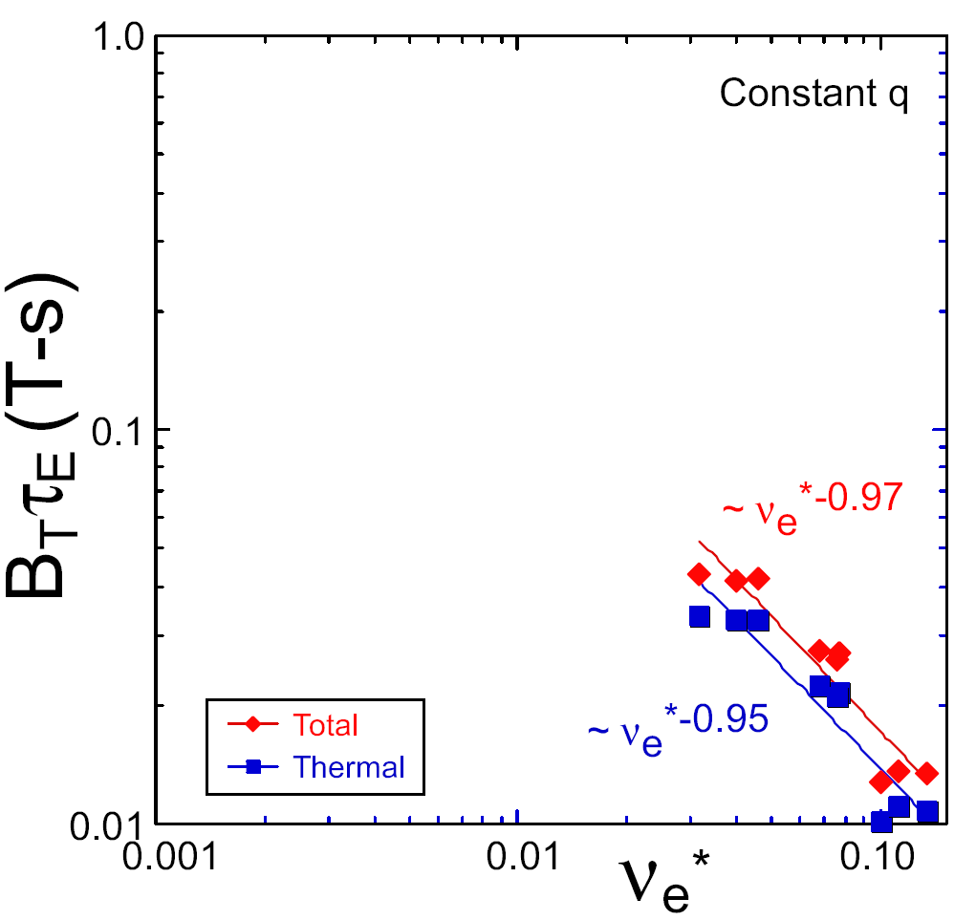
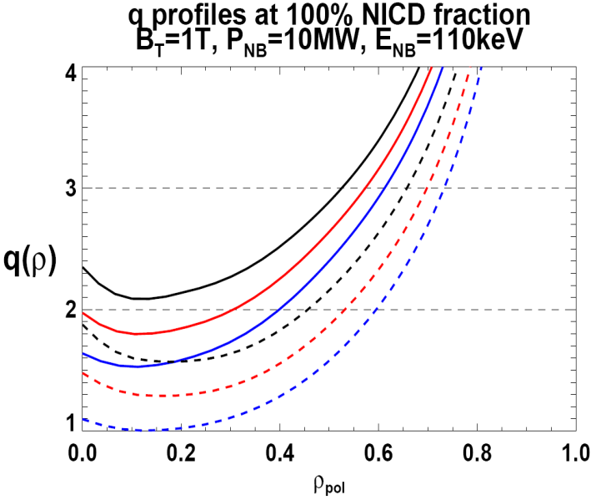
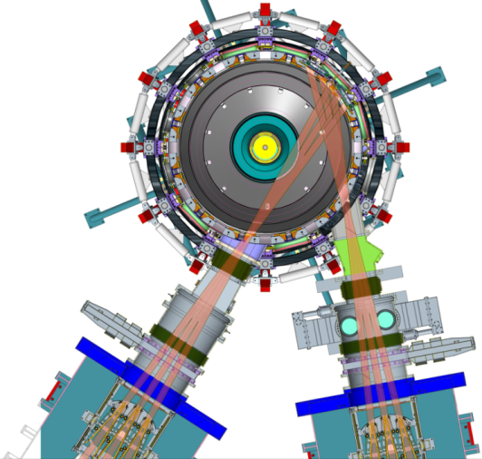
NSTX Upgrade will address critical plasma confinement and sustainment questions by exploiting 2 new capabilities
Previous
center-stack
New
center-stack
ST-FNSF
constant q, β, ρ∗
Higher B_{T} and I_{P} increases T, reduces ν* toward ST-FNSF to better understand confinement
  Provides 5x longer pulses for profile equilibration, NBI ramp-up
NSTX Upgrade
?
ITER-like scaling
TF OD = 20cm
TF OD = 40cm
Normalized e-collisionality ν_{e}* ∝ n_{e} / T_{e}²
I_{P}=0.95MA, H_{98y2}=1.2, β_{N}=5, β_{T} = 10%
B_{T} = 1T, P_{NBI} = 10MW, P_{RF} = 4MW
  2x higher CD efficiency from larger tangency radius R_{TAN}
100% non-inductive CD with q(r) profile controllable by:
  tangency radius, density, position
n
e
/
n
Greenwald
0.95
0.72
R_{TAN} [cm]
__________________
50, 60, 70, 130
60, 70,120,130
70,110,120,130
Present NBI
New 2nd NBI

Slide 6
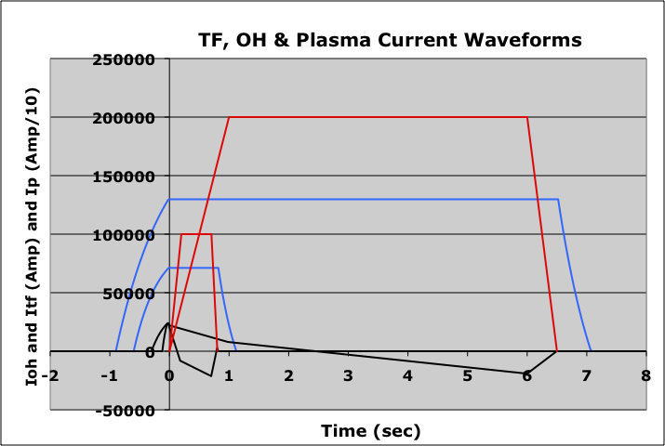
Upgrade substantially increases B_{T}, I_{p}, P_{NBI}, τ_{pulse}
Field and current will be within factor of 2 of initial operation of ST-FNSF
I_{P} = 1 → 2MA, B_{T} = 0.5 → 1T (at same major radius)
Available OH flux increased 3x, 3-5x longer flat-top
NBI power increased 2x (5→10MW for 5s, 15MW 1.5s)
Plasma stored energy increased up to 4x (0.25→ 1MJ)
Relative performance of Upgraded NSTX vs. Base:
Ip (Amp/10)
Itf (Amp)
Ioh (Amp)
Previous NSTX

Slide 7
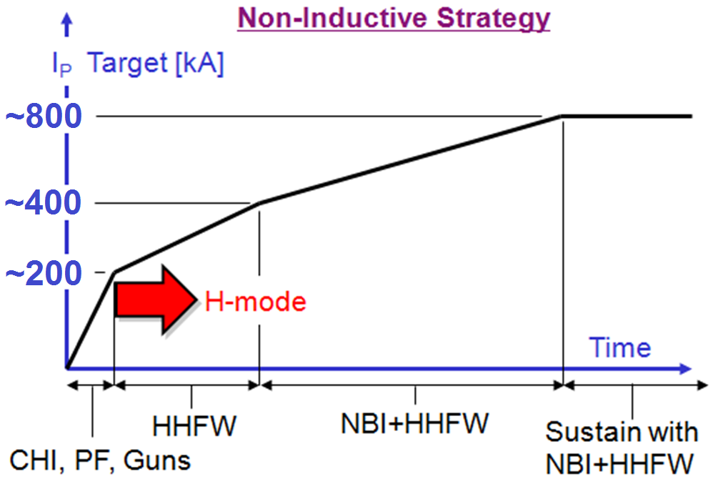
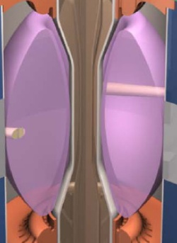
Plasma initiation with small or no transformer is unique challenge for ST-based Fusion Nuclear Science Facility
ST-FNSF has no/small central solenoid
CHI / guns, ECH
NSTX-U goals:
  Generate ~0.3-0.4MA full non-inductive start-up with helicity injection + ECH and/or fast wave heating, then ramp to ~0.8-1MA with NBI
  Develop predictive capability for non-inductive ramp-up to high performance 100% non-inductive ST plasma → prototype FNSF

Slide 8
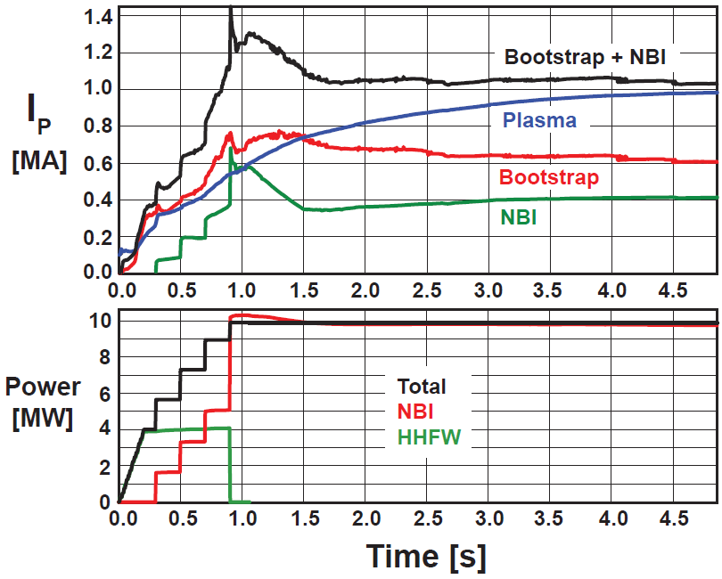
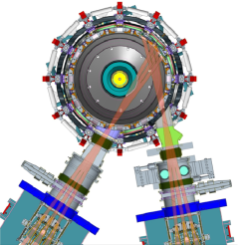
Non-inductive ramp-up from ~0.4MA to ~1MA projected to be possible with new centerstack (CS) + more tangential 2nd NBI
New CS provides higher TF (improves stability), 3-5s needed for J(r) equilibration
More tangential injection provides 3-4x higher CD at low I_{P}:
  2x higher absorption (40→80%) at low I_{P} = 0.4MA
  1.5-2x higher current drive efficiency
TSC simulation of non-inductive ramp-up from I_{P} = 0.1MA, T_{e}=0.5keV target at B_{T}=1T
Present NBI
More tangential 2nd NBI

Slide 9
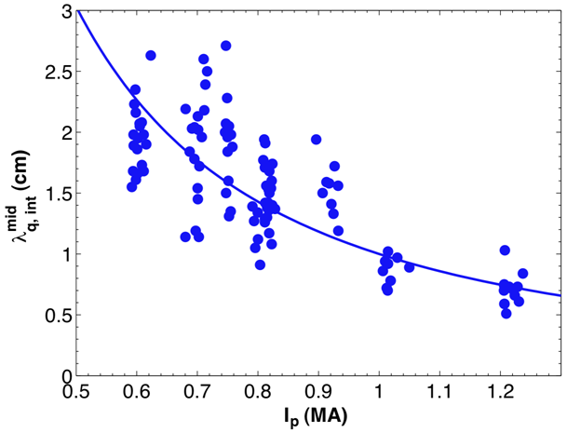
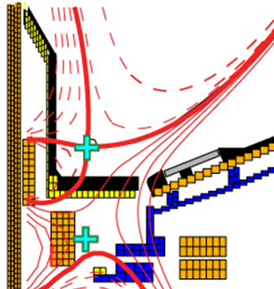
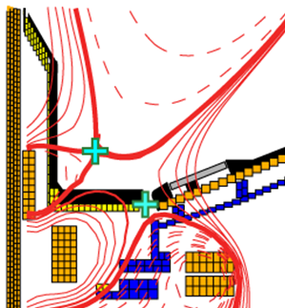
NSTX-U will investigate high flux expansion snowflake divertor + detachment for large heat-flux reduction
λ_{q}^{mid} ~ I_{p}^{-1 to -1.6}
Divertor heat flux width decreases with increased plasma current I_{P}
  Major implications for ITER, FNSF
NSTX Upgrade with conventional divertor projects to very high peak heat flux up to 30-45MW/m²
Standard Divertor
Snowflake Divertor
Divertor heat flux inversely proportional to flux expansion over a factor of five
Snowflake→ high flux expansion 40-60, larger divertor volume and radiation
U/D balanced snowflake divertor projects to acceptable heat flux < 10MW/m² in Upgrade at highest expected I_{P} = 2MA, P_{AUX}=10-15MW
Partial detachment → Additional ~2x reduction in NSTX

Slide 10
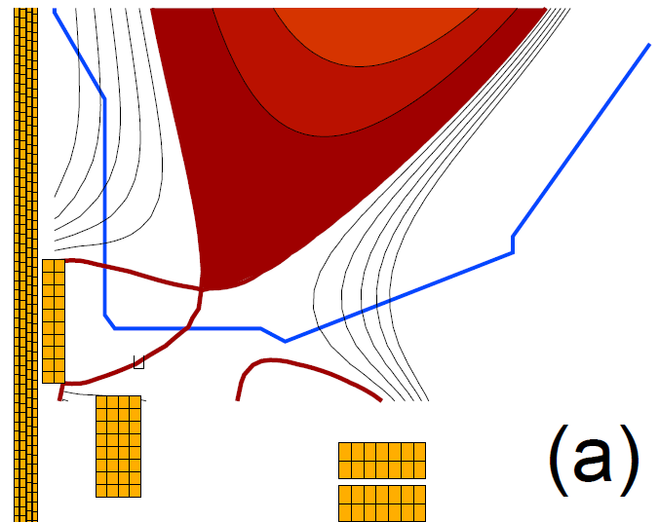
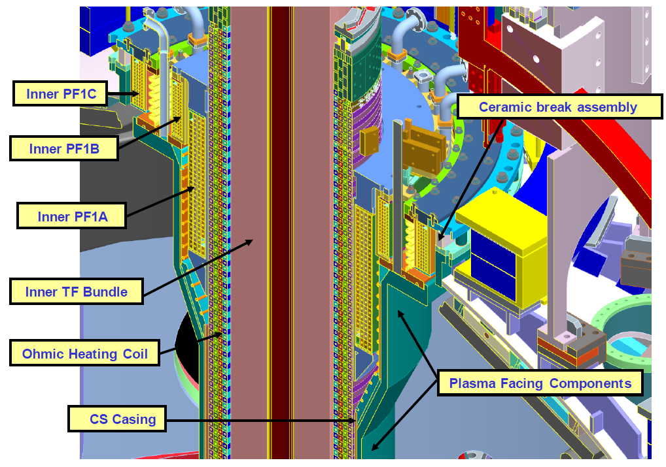
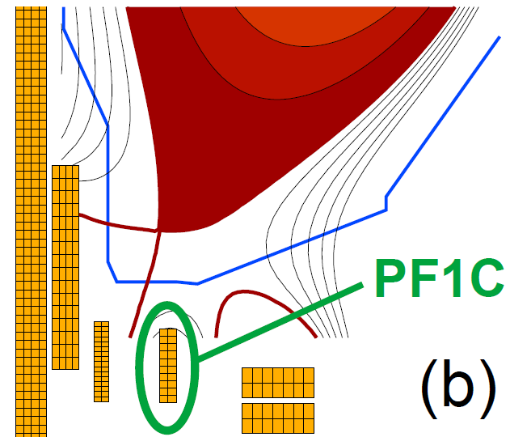
Upgrade CS design provides additional coils for flexible and controllable divertor including snowflake, and supports CHI
NSTX Snowflake
NSTX-U Snowflake
10

Slide 11
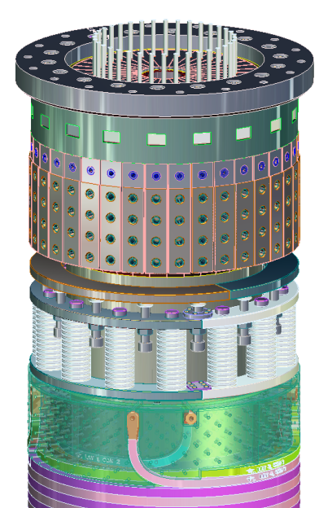
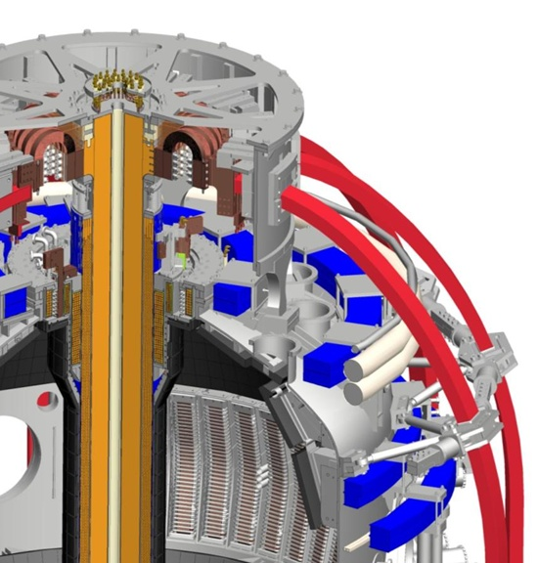
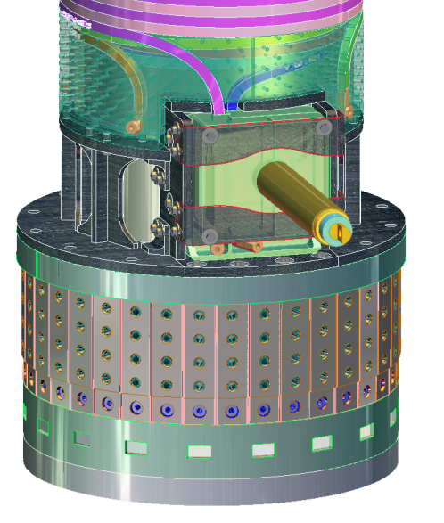
NSTX-U centerstack and vacuum vessel analysis/design are complete, component fabrication/installation has begun
B and J each increase 2x → EM forces increase 4x
Upper TF/ OH Ends
Simplified inner TF design
- single layer of TF conductors
Improved TF joint design
joint radius increased → lower B
flex-jumper improved
Reinforced umbrella structure and PF and TF coil supports
Coaxial and bottom OH lead minimizes error-fields

Slide 12
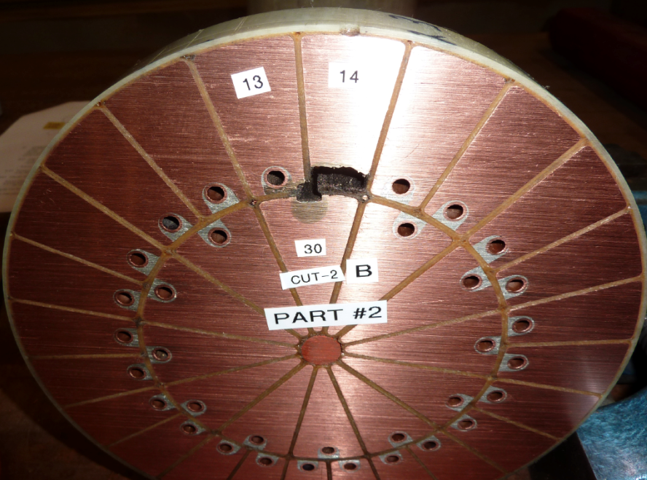
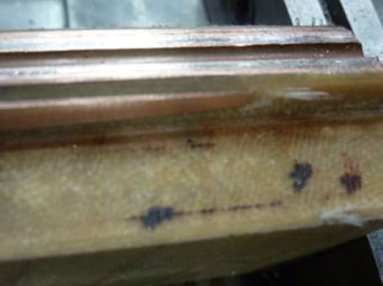
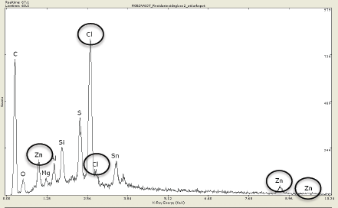
NSTX TF Fault Occurred on July 20, 2011
TF Bundle Operated for 7+ years for 20,000 shots
Dissection of shorted region
  TF bundle short occurred ~ 2 feet from the bottom in a relatively low mechanical stress area
  TF bundle dissection and analyses showed no sign of fatigue
  Zinc chloride based flux used for cooling water tube soldering was the cause of insulation failure.
TF Upgrade will use resin flux and improved procedures for removing the flux residues

Slide 13
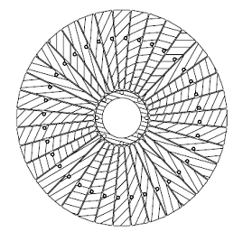
The NSTX-U center-stack design incorporates improvements that address factors contributing to NSTX center-stack failure
New
Single-layer vs. double layer design
  Reduced voltage stress between conductors (30 volts)
  Terminal voltage (1 kV) is across quadrant segments where there is increased insulation
VPI vs B-Stage glass resin system
  More homogenous insulation system without voids
Bundle manufacturing improved to address residual solder flux
  Less corrosive flux
  Post-soldering bakeout
Old

Slide 14
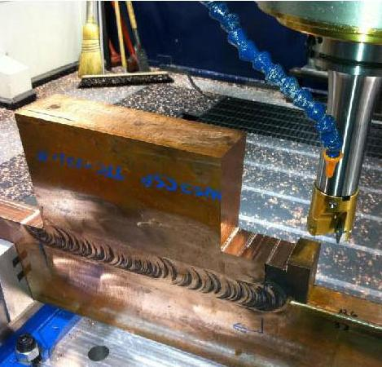
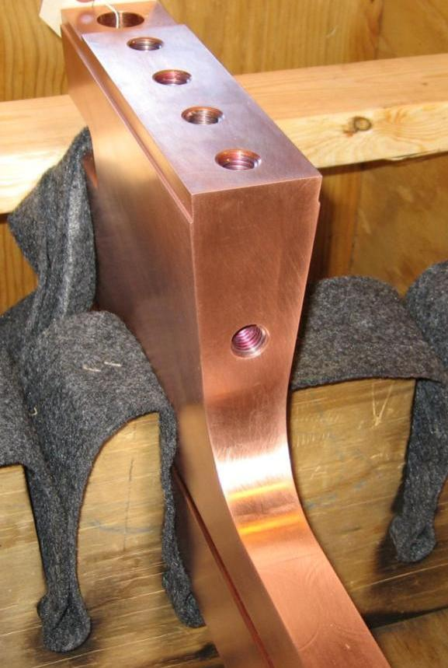
Friction stir welding of TF flags to vertical TF conductors is producing high-quality joints
Friction stir weld joint

Slide 15
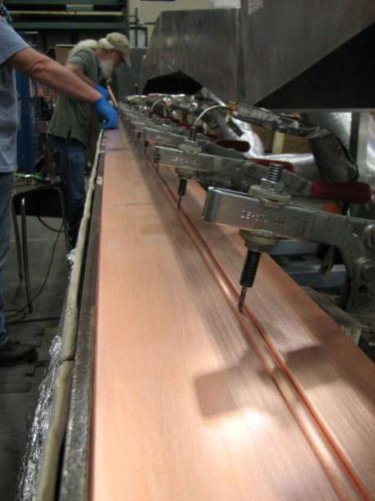
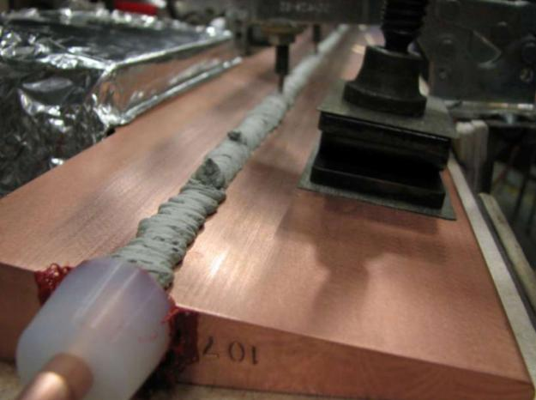
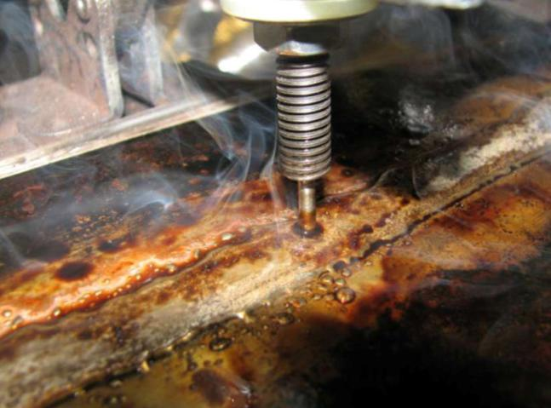
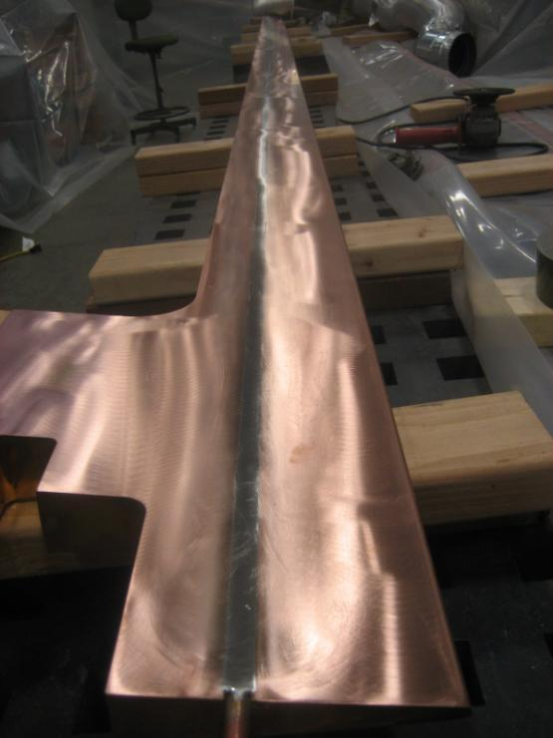
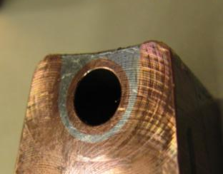
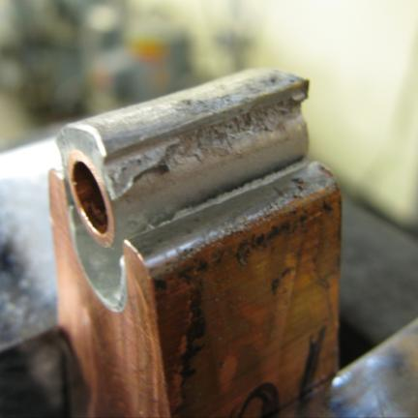
Improved soldering and flux removal process for TF cooling tubes has also been developed
Bar placed on heat plate, cooling tube inserted into grove
Solder flowing. Supplemental heat applied by torch
Bar heated, solder paste added
Good wetting of both the tube and copper bar, indicating effectiveness of flux
Bar ground smooth
Close up views of solder joint

Slide 16
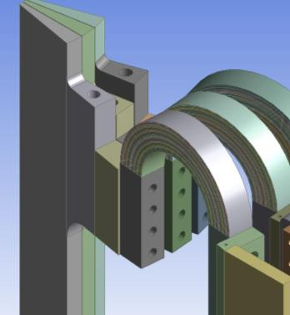
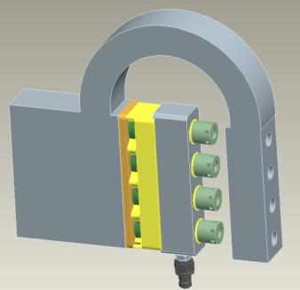
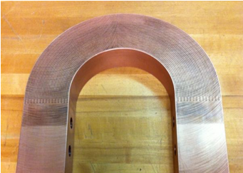
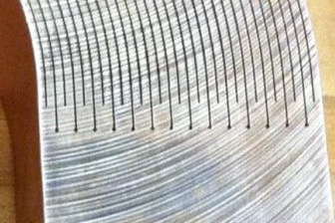
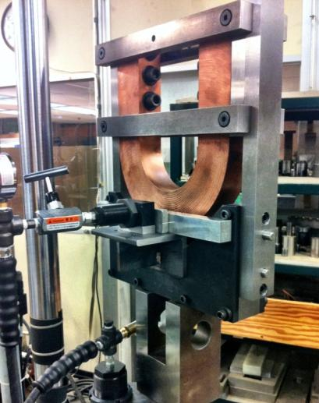
Features of TF inner/outer flex strap connector
Flex strap
Supernuts® to be used to facilitate assembly
Inner TF
Testing (60,000 cycles)
Wire EDM instead of laminated build

Slide 17
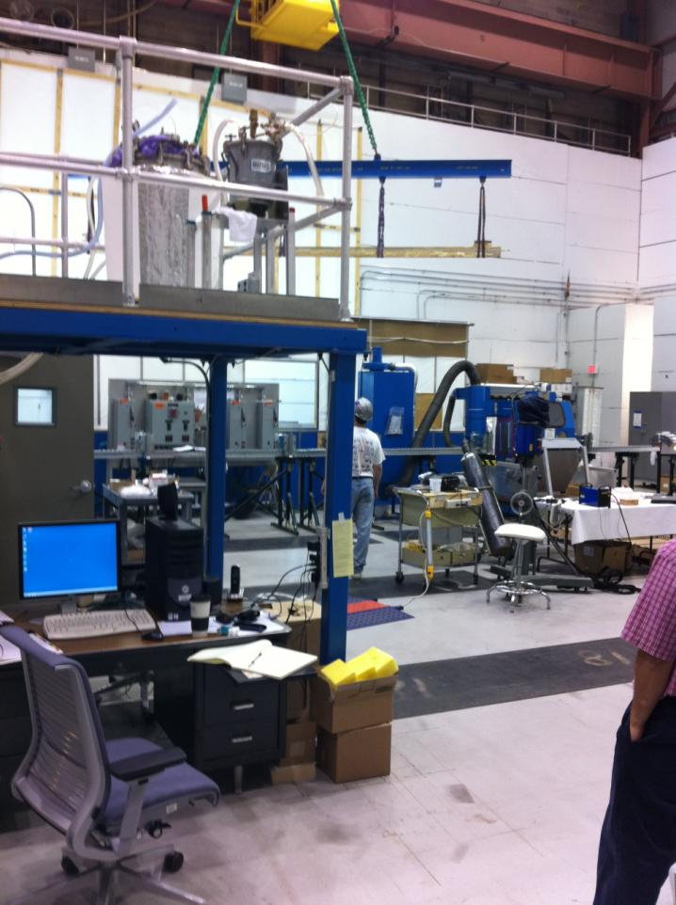
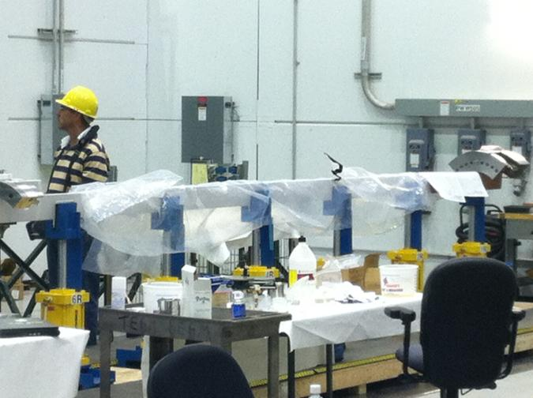
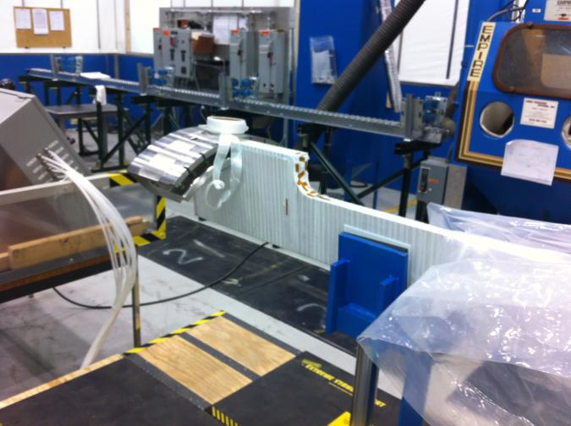
Center-stack fabrication is now underway
Conductor bar being removed from oven after post-solder bake out
Bar being wrapped with insulation
Now entering the riskiest stage of project → inner TF and OH fabrication and VPI – will VPI 1st quadrant in Sept/Oct

Slide 18
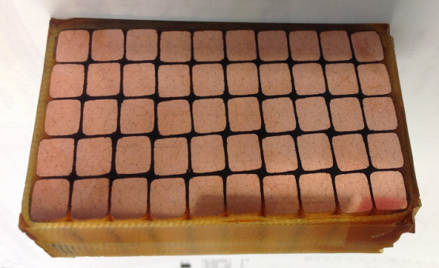
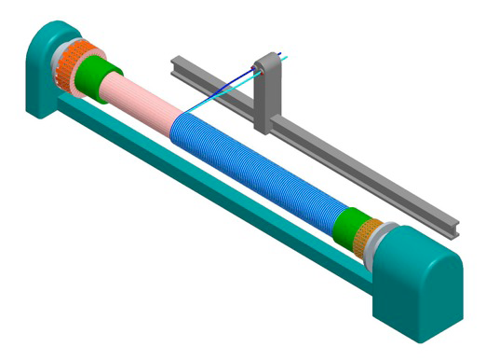
Fabrication techniques for the TF and OH coils
Epoxy VPI (CTD-425: special cyanate-ester blend) required for shear strength will be used for the inner TF assembly
Aquapour™ will be used as a temporary winding mandrel material to maintain gap between inner TF and OH of 0.1”
Recent successful VPI trials
Inner TF
OH conductor will be wound on inner TF
Inner TF
OH Conductor

Slide 19
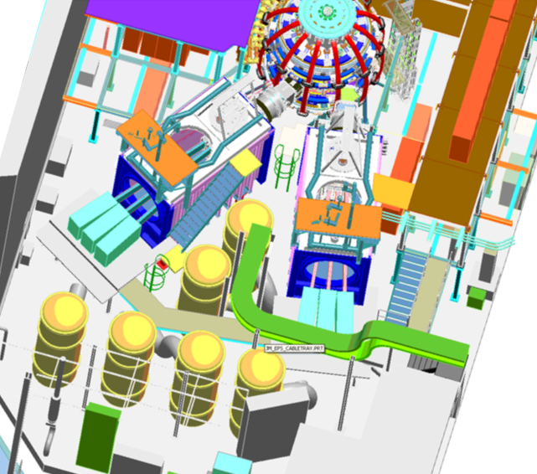
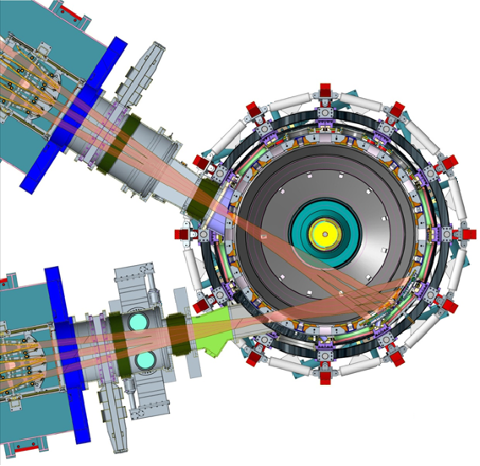
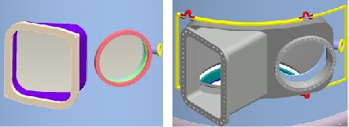
2nd NBI requires relocation of a TFTR NBI system to NSTX, diagnostic relocations, new port for more tangential NBI
NSTX
Present NBI
R_{TAN} = 50,60,70cm
New 2nd NBI
R_{TAN} = 110,120,130cm
Present NBI
New 2nd NBI
• Decontamination of 2nd Beam line successfully completed in 2010
Original NBI Port
New NBI Port

Slide 20
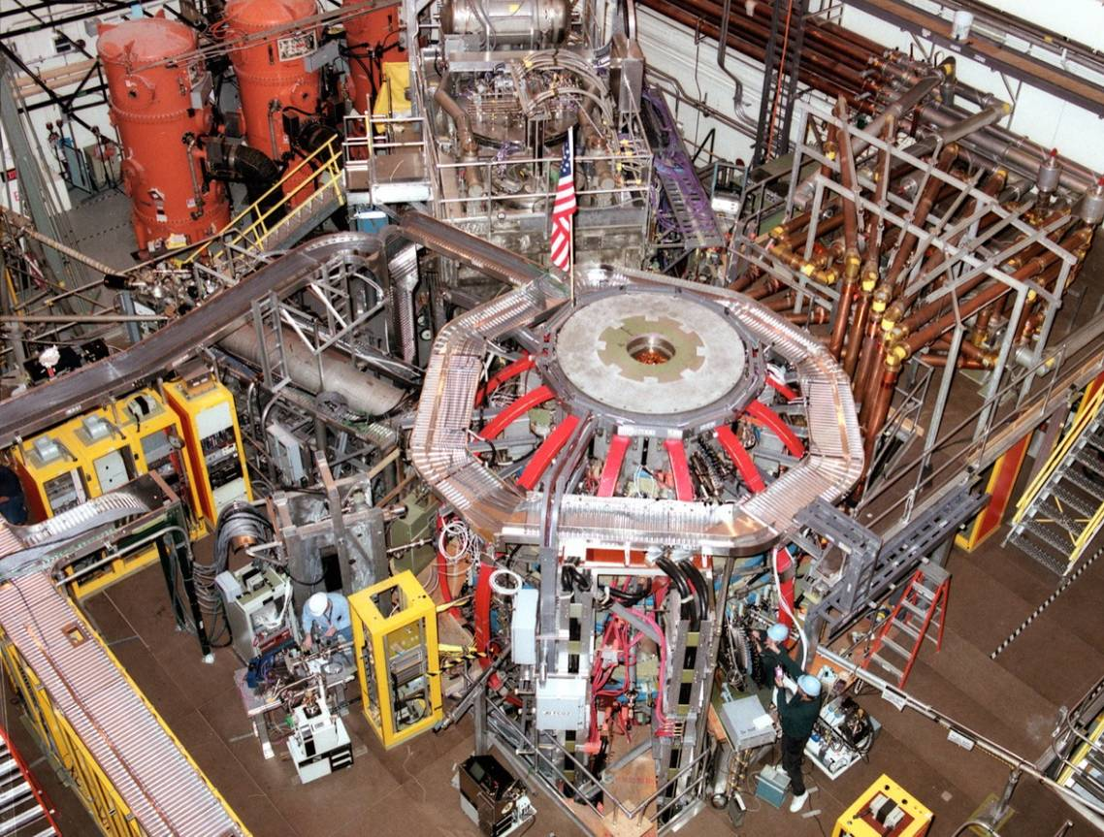
NSTX circa 2010
Neutral Beam #1 operating since September 2000
2nd NBI to be located here

Slide 21
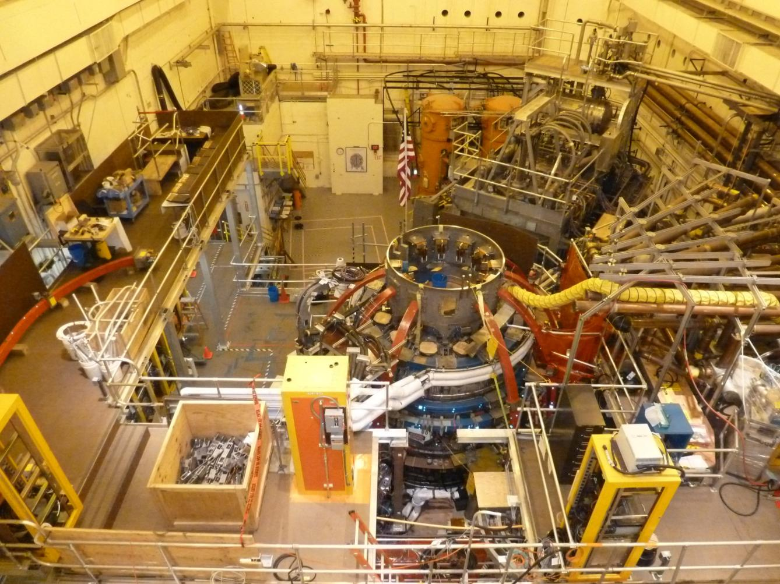
Test-cell progress since September 2011
Permanent platforms installed.
Relocation of racks started.
Neutral Beam area now cleared
Bay K nozzle removed. Vessel to be plasma cut with new NB port installed
Centerstack removed and work underway inside the vessel (passive plates, NB armor)
TF 11 and TF7 removed
Coil support modifications- Rib welding complete.
New clevis pads, PF4/5 supports, umbrella legs

Slide 22


New NBI port-cap has been received
Materials, machining meet spec (but welds being re-worked)
Preparing to plasma-cut hole in vessel for cap installation

Slide 23


2nd NBI to move to NSTX-U test-cell in Sept/Oct
Reentrant hook lift fixture designed to increase clearance over NSTX test-cell wall
Lift fixture installed, tested, and ready to go…

Slide 24

Project on-track for (early) completion: Apr-Jun 2014
President’s budget for FY2013 would delay completion by ~1 year

Slide 25
Summary
NSTX-U device and research will narrow many performance and understanding gaps to next-steps
The Upgrade Project has made good progress in overcoming key design challenges
The Project is on schedule and budget
NSTX-U team now formulating next 5 year plan (2014-18) to access new ST regimes including follow-on staged and prioritized upgrades

Slide 26
Backup slides

Slide 27
Backup slides
Program Plans

Slide 28



Formulating FY2014-18 5 year plan to access new ST regimes with Upgrade + additional staged & prioritized upgrades
2009 | 2010 | 2011 | 2012 | 2013 | 2014 | 2015 | 2016 | 2017 | 2018
1 MA Plasma
Upgrade Outage
1.5 → 2 MA, 1s → 5s
CHI Control Coils
New Center-Stack
0.5 MA CHI
1 MA CHI / Plasma Gun
LLD
Moly-tile
2nd NBI
NSTX Upgrade research goals in support of FNSF and ITER
• Low collisionality plasma regimes
• 100% non-inductive operation
• Long-pulse, high power divertor
• Advanced high-β scenarios
ECH/EBW
1MW
2 MW
HHFW Upgrade
New Center-stack
0.5 MA Plasma Gun
Long-pulse cryo-pumped divertor
Flowing Li module
“Snowflake”
NCC Upgrade
Secondary
PP option
2nd NBI
Primary
PP option
Lithium
Existing
coils
Non-axisymmetric Control Coils (NCC)

Slide 29
Developed comprehensive long-range plan for NSTX-U supporting ITER and FNSF – next step is to down-select based on priorities and budgets
2014 | 2015 | 2016 | 2017 | 2018 | 2019 | 2020 | 2021 | 2022 | 2023
Upgrade Outage
1.5 → 2 MA, 1s → 5s
Advanced PFCs, 5s → 10-20s
Start-up and ramp-up
0.3-0.5 MA CHI
0.5-1 MA CHI
0.2-0.4 MA plasma gun
up to 1 MA plasma gun
Extend NBI duration or implement 2-4 MW off-axis EBW H&CD
New
center-stack
ECH/EBW
1MW
2 MW
Boundary physics
Divertor cryo-pump
Divertor Thomson
Diagnostics for high-Z wall studies
U.S. FNSF conceptual design including aspect ratio and divertor optimization
Materials and PFCs
U or L
Mo divertor
U + L
Mo divertor
All High-Z PFCs
Hot High-Z FW PFCs
Li granule injector
Upward
LiTER
Flowing Li divertor or limiter module
Full toroidal flowing Li divertor
Lithium
MGI disruption mitigation tests
Enhanced RFA/RWM sensors
MHD
NCC coils
NCC SPA upgrade
Transport & turbulence
DBS, PCI or other intermediate-k
High k_{θ}
δB
polarimetry
Wave-particle interactions
HHFW feedthru & limiter upgrade
HHFW straps for EHO, *AE
Dedicated EHO or *AE antenna
2nd NBI
Scenarios and control
Rotation control
Snowflake
control
Divertor
radiation
control
q_{min} control
Control integration

Slide 30

Tentative plans for initial operations
NSTX-U will be brought up methodically to full performance capabilities

Slide 31
Backup slides
Upgrade Project Progress

Slide 32


NSTX operations was abruptly terminated in
July 2011 due to a failure of the inner TF bundle
An autopsy/sectioning of the failed bundle was performed
Failure of conductors was noted to be located in 1 of 3 pairs that were sub-optimal during acceptance tests
  100-3000 M-ohm versus 30,000-50,000 M-ohm during 3 kV quadrant tests
Forensics yielded convincing evidence with regard to both remaining sub-optimal pairs
  Found 1-10 M-ohm conductive path in a distinct location measured with an ohmmeter
  Discoloration of epoxy/glass insulation system
  Localized resin-poor area
Increased conductivity traced to zinc chloride in residual solder flux
→ Decided to start 2½ year Upgrade outage 6 months early

Slide 33


Developed new soldering technique with resin-based flux
in response to TF bundle fault lesson-learned
Images of tubes pull tested to ultimate strength of the solder . Note good wetting of both the tube and copper bar, indicating effectiveness of flux.
Close up views of solder joint
The manufacturing procedure and the soldering-line is nearing completion.
Solder paste injection over cooling tube

Slide 34


Friction Stir Welding
Lead Extension to Inner TF Conductor
Development trials required to prove dissimilar material welding

Slide 35

Neutral Beam refurbishment proceeding well
Neutral beam refurbishment continuing
Major components delivered (ie NB port cap, large VAT valves, power cables manufactured)
Rectangular bellows fabricated and passed leak test.
Six ion sources (for 2 beamlines) ready to go!
Lintel removed
Penetrations complete.
Relocation into NSTX TC planned for October 2012 but on track for September

Slide 36




NBI Armor fabrication and installation in progress…
Supports aligned using metrology and tack welded in place to determine field fit changes…
Bay H supports need to be
field fit and aligned using backing plates
before final welding…
OK
OK
All 4 Backing plates fabricated; final machining for manifolds in progress…
Manifolds done. Fitup on backing plates…
Carbon tile order in progress
Stiffener pieces fabrication done
Braze/weld quadrants in shop next
Align/assemble/install/leakcheck

Slide 37


Install Fabricated CS Assembly into VV
Install the completed Center Stack Assembly into the Vacuum Vessel (Spring 2014)
Have removed and re-installed CS numerous times over the last 10 years.
Notes:
Have removed and re-installed CS numerous times over the last 10 years.

Slide 38
Backup slides
Transport research

Slide 39

New NSTX turbulence simulations are advancing the understanding of ST energy confinement
Non-linear gyrokinetic turbulence simulations of micro-tearing instabilities predict τ_{E} ∝ 1/χ_{e} ∝ 1/ν_{e}*
  Predominantly electromagnetic turbulence – result of high β
  Candidate explanation for ST confinement scaling observed on NSTX and MAST
β_{e} ≈ 9%
NSTX
experiment
Lower ν* accessible in Upgrade will clarify roles of micro-tearing vs. ETG, TEM in ST e-transport

Slide 40



NSTX-Upgrade will extend diagnosis and understanding of micro-instabilities potentially responsible for anomalous transport in STs
GYRO simulations
of micro-tearing
(W. Guttenfelder)
Electrons dominant loss channel for ST thermal confinement
  Micro-tearing strong candidate for anomalous thermal e-transport at higher β
  ETG can also contribute to e-transport at lower β
  Alfvénic instabilities (GAE/CAE) can also cause core electron transport
NSTX-U goal is to study full turbulence wave-number spectrum:
  low-k – ITG/TEM/AE/μ-tearing (BES, polarimetry) + high-k – ETG (μ-wave scattering)
NSTX-U will access unique turbulence regime: high β + lower ν*

Slide 41
Backup slides
High-beta research

Slide 42

NSTX is 1st tokamak to implement advanced resistive wall mode state-space controller, utilized it to sustain high β_{N} ~ 6
Full 3-D model
State reduction (< 20 states)
~3000+ states
RWM
eigenfunction (2 phases, 2 states)
- Device R, L, mutual inductances
Instability B field / plasma response
Modeled sensor response
truncate
State space feedback with 12 states
Controller can compensate for wall currents
  Including mode-induced current
  Examined for ITER
Successful initial experiments
  Suppressed disruption due to n = 1 applied error field
  Best feedback phase produced long pulse, β_{N} = 6.4, β_{N} / l_{i} = 13

Slide 43


Upgrade structural enhancements designed to support high β at full I_{P} = 2MA, B_{T}=1T: β_{N} = 5, l_{i} ≤ 1 and β_{N} = 8, l_{i} ≤ 0.6
NSTX Upgrade
High l_{i}, high-β_{N} scenarios determine the maximum vertical field (PF5) current required

Slide 44
Backup slides
Start-up and sustainment research

Slide 45




Transient CHI: Axisymmetric Reconnection Leads to Formation of Closed Flux Surfaces
Absorber region
Current multiplication increases with toroidal field
    - Favorable scaling with machine size
    - High efficiency (10 Amps/Joule in NSTX)

Slide 46

Simulations of CHI project to increased start-up current in NSTX Upgrade, highlight need for additional electron heating
TSC simulations of transient CHI consistent with NSTX trends
Favorable projections for NSTX-U:
  TF increased to 1T and injector flux increased to about 80% of max allowed → can generate up to ~400kA closed-flux current
  Figs (a-c): T_{e} = 40 eV, Z_{eff} = 2.5
  Fig (d): T_{e} = 150 eV for t > 12 ms
T_{e} ~150-200eV needed to extend current decay time to several 10’s of ms
Low density and β of CHI plasma + transient position (i.e. outer gap) evolution → HHFW coupling and heating very challenging
NSTX CHI plasmas not over-dense → 28GHz ECH heating of 1T CHI plasma likely best option for generating non-inductive ramp-up target
See presentations by R. Raman and G. Taylor for more details

Slide 47


HHFW promising for heating low current target plasma for NBI non-inductive ramp-up
Can heat I_{P} ~ 300kA, 200eV plasma to T_{e} = 3keV w/ low P_{RF} ~1.4MW
Form core + edge transport barriers
Non-inductive fraction of 65-85%
  40-50% bootstrap, 25-35% RF-CD
Projects to 100% non-inductive at P_{RF} = 3-4MW in NSTX-U
  → Target for NBI I_{P} ramp-up

Slide 48


Scenario modeling using TRANSP projects to 100% non-inductive current at I_{P} = 0.9-1.3MA at B_{T}=1.0 T
Dashed: ITER-98 confinement scaling
Solid: ST confinement scaling
Narrow, H_{ST}=1
Broad, H_{ST}=1
Narrow, H_{ST}=1
Broad, H_{ST}=1
Broad, H₉₈=1
Broad, H₉₈=1
Narrow, H₉₈=1
Narrow, H₉₈=1
Fix: 1.0T, P_{inj}=12.6 MW, f_{GW}=0.72
Fix: A=1.75, κ=2.8
Find the non-inductive current level for 2 confinement and 2 profile assumptions…yields 4 different projections.
Broad, H_{ST}=1
Confinement | Profiles | I_{P} [kA] | β_{N}
H₉₈=1 | Broad | 975 | 4.34
H_{ST}=1 | Broad | 1325 | 5.32
H₉₈=1 | Narrow | 875 | 4.87
H_{ST}=1 | Narrow | 1300 | 5.97
Narrow, H_{ST}=1
Broad, H₉₈=1
Narrow, H₉₈=1

Slide 49
Backup slides
Cryo-pumping design

Slide 50



Optimized plenum geometry capable of pumping to low density for a range of R_{OSP}, I_{p}
Equilibrium f_{G} down to < 0.5
  Moving R_{OSP} closer to pump allows lower n_{e}, but limited by power handling
High flux expansion in SFD gives better pumping with SOL-side configuration
  More plasma in far SOL near pump
  More room to increase R_{OSP} at high I_{p}
q_{pk} > 10 MW/m²
-1.8 -1.6 -1.4 -1.2 -1.0 -0.8
Z (m)
0.4 0.6 0.8 1.0 1.2
R (m)
SOLPS geometry to be used in future calculations

Slide 51
Backup slides
Liquid metal and PFC research

Slide 52
Liquid metal PFCs should be pursued to mitigate risk of tungsten not extrapolating to fusion reactor.
Recent FESAC report: “The uncertainty in establishing PFC solutions is high, as the environment is severe and the requirements for long lifetime are challenging.”
  Tungsten is leading candidate but has issues with neutron damage, erosion, melting, brittleness, thermal fatigue.
ReNeW highlighted that DEMO PFCs are much more challenging than ITER’s.
- advocated substantial program to assess new ideas, incl. liquid metals (Li, Sn, Ga).
  No neutron damage, erosion, thermal fatigue in liquids – but technical base less mature.
Importantly, liquid flow over tungsten substrate may be unique way to eliminate net erosion and flaking to help make tungsten work
Liquid PFCs have potential to relieve over-constrained problem: they do not need to simultaneously satisfy plasma and nuclear loading constraints.
Significant uncertainties in both approaches suggest both W and liquids should be investigated
ReNeW recommended: “Liquid surface PFC operation in a tokamak environment…”

Slide 53
PPPL/PU/NSTX-U team pursuing multidisciplinary approach to developing liquid metal PFCs for NSTX-U, FNSF, beyond
Multi-scale R&D approach from atoms to PFCs:
  Understand impact of lithium on core and edge transport and stability.
  Assess D pumping vs. surface conditions:
Atomistic MD modeling (ORNL)
Lab expt. on ideal systems e.g. single xtal Mo + monolayer Li + D⁰, D⁺ beam.
detailed surface analysis via XPS, AES, TPD, SAM… (Purdue / PPPL Labs)
2. Assess Heat Flux handling in linear plasma facility:
PFC prototype tests with high power plasmas in Magnum PSI
3. Tokamak integration:
XGC Kinetic modeling, non-equilibrium Li radiation
LTX liquid Li studies, MAPP -> LTX then NSTX-U
Li granule injector tests on EAST, then NSTX-U
Divertor Li-PFC design, then testing in NSTX-U
C
Mo
Flowing Li

Slide 54


Solid Li surface coatings: pump D, increase energy confinement, eliminate ELMs, but confine impurities too well
Without Li
With Li
ELM-free, reduced divertor recycling
Lower NBI to avoid β limit
Similar stored energy
H-factor increases up to 40%
Monotonic increase in electron density
Deuterium inventory pumped out
But carbon inventory increases (Z_{eff} ~ 3-4)
Li inventory rises slowly, concentration is very low
Based on these results, NSTX is shifting emphasis from D inventory control to C impurity reduction

Slide 55


Lithium coatings will continue to be an important research tool for NSTX-U
R. Maingi, et al., PRL 107, 145004 (2011)
Work with LTX to understand Li chemistry, impact of wall temperature, Li coating thickness
Assess D pumping vs. surface conditions (MAPP), lab-based surface studies, PFC spectroscopy
Design/develop methods to increase Li coating coverage:
  upward evaporation
  evap into neutral gas
  Li paint sprayer
Assess impact of full wall coverage on pumping, confinement
Test Li coatings for pumping longer τ_{pulse} NSTX-U plasmas
Energy confinement increases continuously with increased Li evaporation in NSTX
High confinement very important for FNSF and other next-steps
what is τ_{E} upper bound?

Slide 56




NSTX is a world leader in assessing lithium plasma facing components as a possible PMI solution for magnetic fusion
Solid Li surface coatings: Pump D, increase confinement, stored energy, and pulse length, eliminate ELMs, reduce core MHD instabilities
Liquid Lithium Divertor (LLD) motivation:
  Provide volume D pumping capacity (> solid Li coatings) for increased pumping and duration
  Potential for handling high heat flux (longer term)
Average Mo porosity: 45%
LLD surface cross section: plasma sprayed porous Mo
Controlled scans of strike-point location:
On inboard divertor
On LLD (outboard divertor)
4 heatable LLD plates (Mo on Cu)
Surface temp: 160 – 350+ °C

Slide 57



Operation with outer strike-point on liquid lithium divertor (LLD)
(porous Mo coated w/ Li) compatible w/ high plasma performance
LLD FY2010 results:
LLD
LLD did not increase D pumping beyond that achieved with LiTER
No evidence of Mo from LLD in plasma during normal operation
Operation with strike-point on LLD can yield reduced core impurities
Row of inboard Mo tiles installed for FY11-12 run, can re-use in NSTX-U
Strike-point on inner C divertor (no ELMs)
Strike-point on LLD, T_{LLD} < T_{Li-melt}
Strike-point on LLD, T_{LLD} > T_{Li-melt} (+ fueling differences)
  No ELMs, no → small, small → larger
  Li + plasma-facing component research will be continued, extended in NSTX-U

Slide 58



LLD with optimized pore size and layer thickness can provide stable lithium surface
LLD
LLD surface cross section: plasma sprayed porous Mo
LLD filled with 67 g-Li by evaporation,
(twice that needed to fill the porosity).
No major Mo or macroscopic Li influx observed even with strike point on LLD.
No lithium ejection events from LLD observed during NSTX transients > 100 kA/m²
  Thin layers and small pore diameters increase critical current (J_{crit}) for ejection.
  Modelling consistent with DIII-D Li-DIMES ejection at 10kA/m² and NSTX experience.
M.A. Jaworski, et al., J. Nucl. Mater. 415 (2011) S985.
D. Whyte, et al., Fusion Eng. Des. 72 (2004) 133.

Slide 59
Flowing LLD will be studied as alternative means of particle and power exhaust, access to low recycling
LLD, LTX → liquid Li required to achieve pumping persistence
  Flowing Li required to remove by-products of reactions with background gases
Substantial R&D needed for flowing Li
Need to identify optimal choice of concept for pumping, power handling:
  Slow-flowing thin film (FLiLi)
  Capillary porous system (CPS)
  Lithium infused trenches (LiMIT)
  All systems above require active cooling to mitigate highest heat fluxes of NSTX-U
Elimination of C from divertor needed for “clean” test of LLD D pumping
  May need to remove all C PFCs?
Possible approach:
Dedicate 1-2 toroidal sectors (30-60˚ each) to LLD testing
(and/or integrate with RDM?)
Test several concepts simultaneously
Full toroidal coverage after best concept is identified
C
Mo
Flowing LLD

Slide 60
Direct comparison of cryo-pumping and flowing LLD by end of next 5 yr plan would inform FNSF divertor decisions
Partially-detached snowflake + cryo-pump may provide sufficient heat-flux mitigation and particle control for NSTX-U, FNSF
However, erosion of solid PFCs could pollute plasma, damage FNSF divertor/FW
  FNSF at 30% duty factor → ~10² - 10³ kg net erosion / year for typical FNSF size & power
  Further motivates research in flowing liquid metals
5 year plan for divertors (present thinking):
  Dedicate upper divertor to cryo-pump
  Dedicate lower divertor to flowing liquid Li tests, materials analysis particle probe (MAPP)
Cryo-pump
C
BN
Mo
(or W)
Flowing LLD, MAPP probe, possible replaceable divertor module (RDM)

Slide 61
NSTX-U 5 year plan goal: transition to (nearly) complete wall coverage w/ metallic PFCs to support FNSF PMI studies
Assess compatibility of high τ_{E} and β + 100% NICD with metallic PFCs
Baseline
W is leading candidate material for FNSF/Demo divertor
C
BN
Mo PFCs
plus W divertor
Upper
Mo divertor
All
Mo divertor
All Mo tiles
All Mo PFCs
Mo
W
Possible implementation paths for high-Z PFCs
Beginning of 5 yr plan
End of 5 yr plan

Slide 62



Simulations + lab results show importance of O in Li PMI
D
Quantum-classical atomistic simulations show that surface oxygen plays a key role in the deuterium retention in graphite.
[ORNL, submitted to Nature Comm.]
%
O
Li
C
XPS measurements (Purdue) show that 2 µm lithium increases the surface oxygen content of lithiated graphite to about 10%.
Deuterium ion irradiation of lithiated graphite greatly enhances the oxygen content to 20% - 40%.
In stark contrast, D irradiation of a graphite sample without lithium actually decreases the amount of O on the surface.
Result explains why Li on C pumps D so effectively
2 3 4 5
atomic composition

Slide 63


PPPL/PU collaboration shows lithium reacts quickly with residual gases
New Surface Analysis Labs at PPPL
Li surface oxidation time
1 monolayer of lithium on TZM Mo (AES O 1s)
– H₂O
– O₂
– air
– CO
oxide concentration (a.u.)
(TZM = 99% Mo, 0.5% Ti 0.08% Zr)
seconds at 1e-6 torr
Solid lithium (XPS Li 1s))
Surface analysis experiments show PFC oxide coverage is expected in 10s of seconds from residual H₂O at typical NSTX intershot pressures ~1e-7 torr.
Plasma facing surface after Li evaporation is a mixed material rather than ‘lithium coating’.
Short reaction times motivate
flowing Li PFCs
PU-PPPL

Slide 64

Prototype Li-PFC materials testing at Magnum-PSI
  NSTX-U PFCs (ATJ, TZM (Mo), W) will
  be tested with and without Li coatings at NSTX-U pulse lengths and power levels
  with extensive diagnostics
Planned investigations:
  Li coating lifetime
  Hydrogenic recycling/retention as a function of exposure time & temperature.
  Erosion, migration, impurity production with and without lithium.
Magnum-PSI parameters relevant to NSTX-U
1.4 T for 12 s
10 MW/m²
N_{e} ~ 1.2x10²⁰ m⁻³
T_{e} ~ 3 eV
Bias ≤ 100 V
Extensive diagnostics

Slide 65


LTX is providing all-metal-wall tokamak investigating Li chemistry, temperature, thickness…
Lithium Tokamak Experiment has: 1. 120 cm² Li-filled dendritic W limiter heatable ≤ 500 C
  Thick (>100 micron) evaporated Li films on 3,000 – 5,000 cm² upper heated liner
  Few hundred cm³ pool of liquid Li in the lower shells (total ≤ 85% of plasma surface)
  Will investigate plasma-surface interactions, Li influx vs. temp., confinement, Te profile,
  liquid metal flows in B fields up to 0.3T
Materials Analysis and Particle Probe (MAPP) will be used first on LTX in support of NSTX milestone R(13-2): “Investigate relationship between lithium-conditioned surface composition and plasma behavior” and transferred to NSTX-U later.
MAPP’s innovative design enables sample exposure to plasma and inter-shot surface analysis.
MAPP will be installed on midplane LTX port
MAPP

Slide 66


Lab-based R&D on liquid metal technology will inform long term PFC decisions:
Thin flowing Li film in FLiLi (Zakharov)
Pre-NSTX-U restart R&D initiated by PPPL:
Laboratory studies of D uptake as a function of Li dose, C/Mo substrate, surface oxidation, wetting…
Tests of prototype of scalable flowing liquid
lithium system (FliLi) at PPPL and on HT7
Basic liquid lithium flow loop on textured surfaces
Analysis and design of actively-cooled PFCs with Li flows due to capillary action and thermoelectric MHD
Magnum-PSI tests begin June 2012
Four proposals on Li-PFCs submitted to OFES Materials Solicitation to extend above work.
Preparing for upcoming international collaboration solicitation, which will include possible tests of
Li PFCs on HT-7 and EAST
Soaker hose capillary porous system concept (Goldston)
mesh
Li
Coolant
(He, supercritical CO₂, Na heatpipe…)

Slide 67

NSTX/EAST lithium collaborations
EAST is only other divertor H-mode facility using Li
NSTX Li powder dropper achieved 1st H mode on EAST and drastically reduced MHD (in backup).
2nd dropper being built by ASIPP.
Li granule injector to be installed on EAST midplane
- will be used to trigger ELMs and control MHD
Plans:
Assess interplay between cryo-pumping
and lithiumization, and high- Z PFC
interactions/synergies with lithium
Study effects of Li on thermal and
particle transport, further develop
sustained/long-pulse lithium delivery
systems (Li injector, dropper)
Continuous Li delivery may be essential for long pulses.
guide tube
1 mm spheres
@ 500Hz
Lithium granules injected using 95 m/s “impeller”
top of pedestal
separatrix

Slide 68


PPPL Lithium Granule Injector Tested on EAST
Dennis Mansfield (PPPL, retired)
Lane Roquemore (PPPL)
Jiansheng Hu and D. Mansfield
6 inch
Independent Control:
Granule Size
(change between shots)
Injection Speed
(ramp during shots)
Pacing Frequency
(ramp during shots)
Dropper
5.5 inch
10 mm
Li Granules
8 inch
V = 0 - 100 m/s
Freq = 0 - 100 Hz

Slide 69

Triggered ELMs (~ 25 Hz) with 0.7 mm Li Granules @ ~ 45 m/s → could be very useful for triggering ELMs in Li-ELM free H-modes in NSTX-U

Slide 70

NSTX Upgrade will extend normalized divertor and first-wall heat-loads much closer to FNS and Demo regimes
NSTX

