Slide 1




NSTX-U
Supported by
NSTX (National Spherical Tokamak Experiment)
Upgrade for Establishing Physics and Technology Basis for FNSF
Culham Sci Ctr
U St. Andrews
York U
Chubu U
Fukui U
Hiroshima U
Hyogo U
Kyoto U
Kyushu U
Kyushu Tokai U
NIFS
Niigata U
U Tokyo
JAEA
Tsukuba U
Hebrew U
Ioffe Inst
RRC Kurchatov Inst
TRINITI
NFRI
KAIST
POSTECH
SNU
ASIPP
ENEA, Frascati
CEA, Cadarache
IPP, Jülich
IPP, Garching
ASCR, Czech Rep
Columbia U
CompX
General Atomics
FIU
INL
Johns Hopkins U
LANL
LLNL
Lodestar
MIT
Nova Photonics
New York U
ORNL
PPPL
Princeton U
Purdue U
SNL
Think Tank, Inc.
UC Davis
UC Irvine
UCLA
UCSD
U Colorado
U Illinois
U Maryland
U Rochester
U Washington
U Wisconsin
Masayuki Ono
for the NSTX-U Team
2014 TOFE Meeting
November 10 – 13, 2014

Slide 2
Talk Outline
Introduction and Motivation for NSTX-U
NSTX Upgrade Project
NSTX-U ST-FNSF Targeted Experiments
Summary
Notes:
Here is the outline of this review to give you an overview of the world ST research.

Slide 3
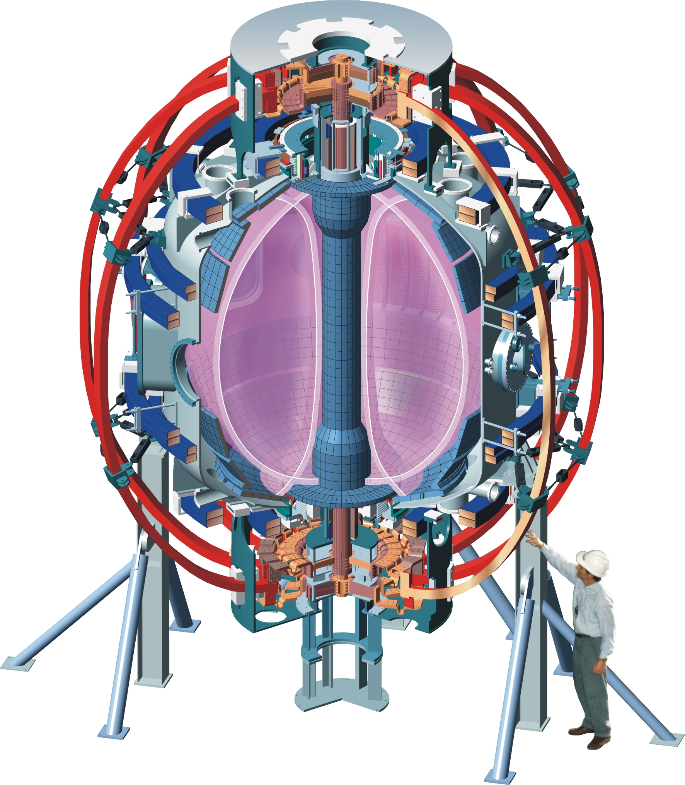
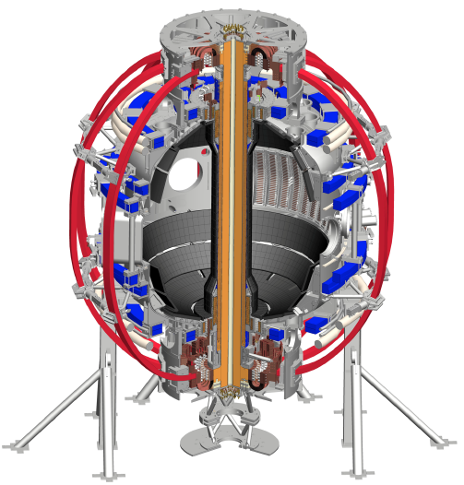
NSTX is a MA-class Spherical Tokamak (ST)
New center-stack and 2nd NBI are major upgrade scopes
Aspect Ratio A = R /a
Elongation κ = b/a
NSTX (1999 - 2011)
NSTX-U (2015 - )
Outer TF coils
Removable Center-Stack includes inner TF, OH, PF coils and casing
PF coils
0.5 T, 1 MA, R₀ ~ 0.85 m, A ≥ 1.32
1T, 2 MA, R₀ ~ 0.90m, A ≥ 1.5

Slide 4
An ST is a low-aspect-ratio (A ≤ 2), high β_{T} tokamak
Higher β_{T} enables higher fusion power and compact FNSF
Toroidal Beta β_{T} = ⟨p⟩ / (B_{T0}²/ 2μ₀)
P_{fusion} ∝ ⟨p⟩ ² x Vol
Data base from START, MAST, PEGASUS and NSTX
β_{N} = 6
P_{fusion} ∝ β_{T}² B_{T0}⁴ x Vol
40
5
β_{T} (%)
4
ST-FNSF
Product
Physics Knob
Investment
3
20
Tokamak
2
High neutron wall loading W_{n} possible in a compact FNSF
ITER
W_{n} ∝ P_{fusion} / Area
0
8
0
4
I_{p}/aB_{T0} (MA/mT)
W_{n} ∝ β_{T}² B_{T0}⁴ a (not strongly size dependent)
W_{n} ~ 1 - 2 MW/m² with R ~ 1 – 1.8 m Compact ST-FNSF feasible

Slide 5
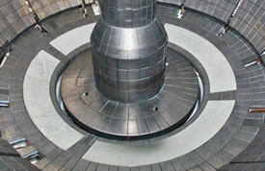
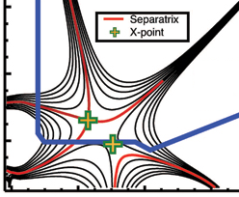
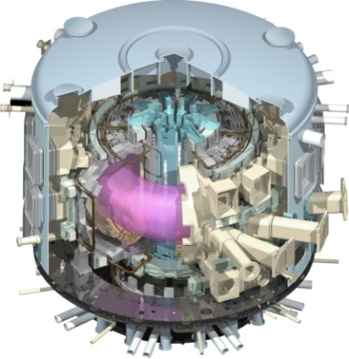
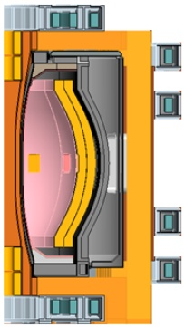
NSTX Upgrade Mission Elements
Advance ST as candidate for Fusion Nuclear Science Facility (FNSF)
Develop solutions for the plasma-material interface challenge
Explore unique ST parameter regimes to advance predictive capability - for ITER and beyond
Develop ST as fusion energy system
ST-FNSF
Liquid Lithium
“Snowflake”
ITER
ST Pilot Plant

Slide 6
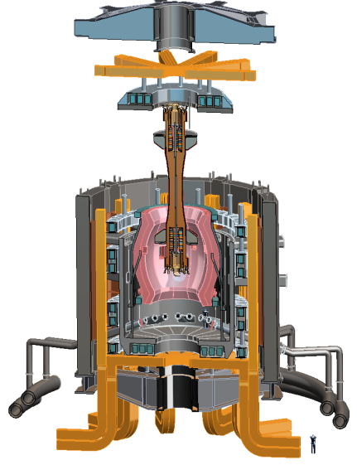
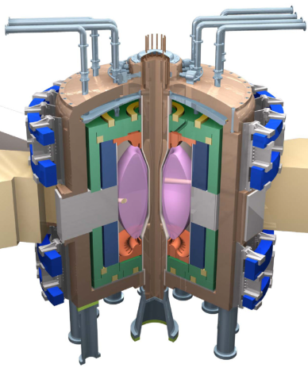
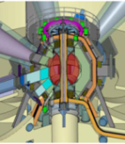
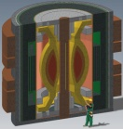
Several studies of ST-FNSF showing the potential attractiveness of this approach
Projected to access high neutron wall loading at modest R₀, P_{fusion}
  W_{n} ~ 1-2 MW/m² , P_{fus} ~ 50-200MW, R₀ ~ 0.8-1.8m
Modular, simplified maintenance
Tritium breeding ratio (TBR) near 1
  Requires sufficiently large R₀, careful design
NSTX-U to address ST-FNSF R&D needs
  Non-inductive start-up, ramp-up, sustainment
  Confinement scaling (especially electrons)
  Stability and steady-state control
  Divertor solutions for (ss) high heat flux
  Radiation-tolerant magnets, design
Example ST-FNSF concepts
PPPL
ORNL
Culham (UK)
UT Austin
ST-FNSF by T.G. Brown and J. Menard at this conference

Slide 7
Talk Outline
Introduction and Motivation for NSTX-U
NSTX Upgrade Project
NSTX-U ST-FNSF Targeted Experiments
Summary
Notes:
Here is the outline of this review to give you an overview of the world ST research.

Slide 8
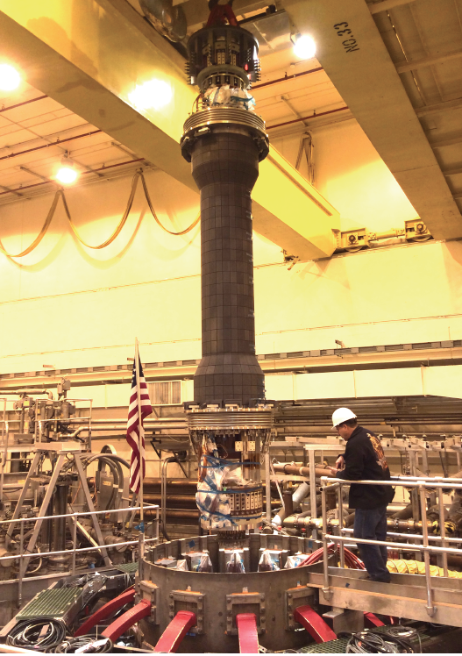
New Center-Stack Installed on NSTX-U
Center-stack defines device and plasma performance
NSTX-U (2015 - )
R₀ ~ 0.90 m

Slide 9
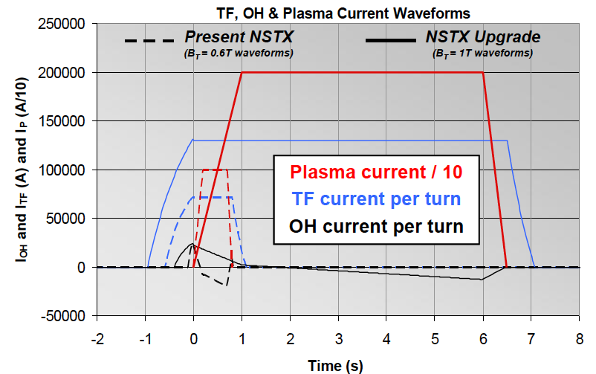
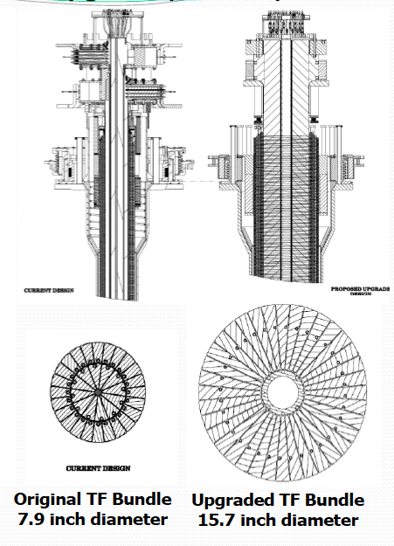
Substantial Increase in NSTX-U Device / Plasma Performance
~ X 2 B_{T}, I_{p} and ~ x 5 pulse length from NSTX
Previous
center-stack
New
center-stack
TF OD = 20cm
TF OD = 40cm
NSTX
 | R₀ (m) | A_{min} | I_{p}(MA) | B_{T} (T) | T_{TF}(s) | R_{CS} (m) | R_{OB} (m) | OH flux (Wb)
NSTX | 0.854 | 1.28 | 1 | 0.55 | 1 | 0.185 | 1.574 | 0.75
NSTX-U | 0.934 | 1.5 | 2 | 1 | 6.5 | 0.315 | 1.574 | 2.1

Slide 10
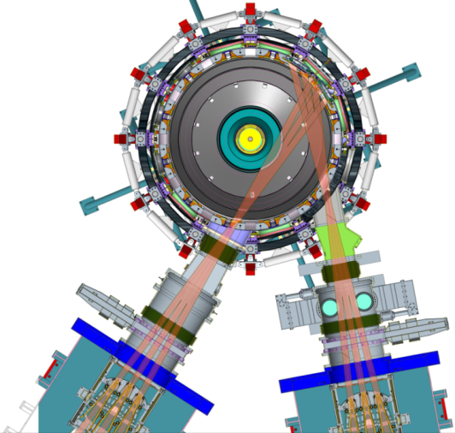
Substantial Increase in NSTX-U Device / Plasma Performance
~ X 2 B_{T}, I_{p} and P_{NBI} and ~ x 5 pulse length from NSTX
Previous
center-stack
New
center-stack
TF OD = 20cm
TF OD = 40cm
NSTX
 | R₀ (m) | A_{min} | I_{p}(MA) | B_{T} (T) | T_{TF}(s) | R_{CS} (m) | R_{OB} (m) | OH flux (Wb)
NSTX | 0.854 | 1.28 | 1 | 0.55 | 1 | 0.185 | 1.574 | 0.75
NSTX-U | 0.934 | 1.5 | 2 | 1 | 6.5 | 0.315 | 1.574 | 2.1
New CS together with highly tangential NBI injection provides ~ 2x higher CD efficiency for sustained 100% non-inductive operations needed for FNSF
Present NBI
New 2nd NBI

Slide 11
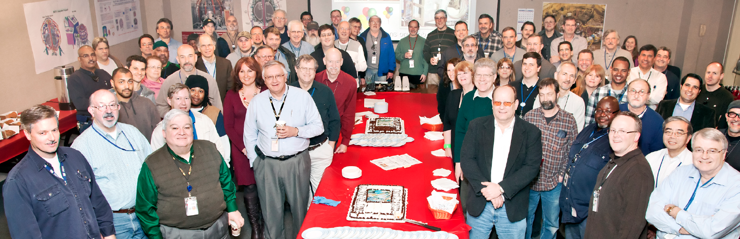
NSTX Upgrade Project Progress Overview
R. Strykowsky, E. Perry, T. Stevenson, L. Dudek, S. Langish, T. Egebo, M. Williams and the Project Team
New Center Stack Project Scope
2nd NBI Project Scope
Inner TF bundle
TF Flex bus
OH coil
Inner PF coils
Enhance outer TF supports
Enhance PF supports
Reinforce umbrella structure
New umbrella lids
Power systems
I&C, Services, Coil protection
Decontaminate TFTR beamline
Refurbish for reuse
Relocate pump duct, 22 racks and numerous diagnostics to make room in the NSTX Test Cell
Install new port on vacuum vessel to accommodate NB2
Move NB2 to the NSTX Test Cell
Install power, water, cryo and controls
Center stack
Structure
Ancillary Sys
NSTX-U Analyses – P. H.Titus at this conference
11

Slide 12
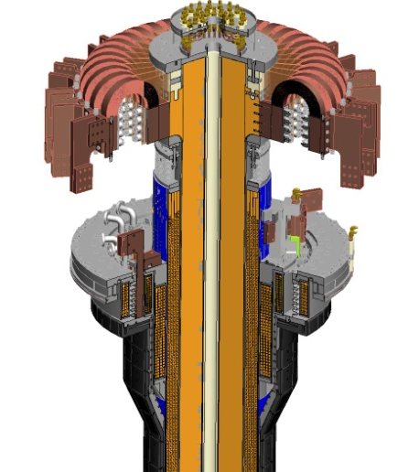
Engineering Innovations and Challenges in Manufacturing New Center-Stack
TF cooling lines
TF Flex-bus - EDM cuts from solid copper chromium zirconium block
Friction stir welding enabled joining of two different copper alloys without annealing in TF lead area.
Copper cooling tubes were soldered into the TF conductor assemblies using solder paste with non-ionic “R” flux (instead of Zn-Cl-based flux) .
Six VPI performed with CTD-425 (Cyanate Ester / Epoxy Blend Resin) (highly exothermic).
Radially very thin Rogowski (2.5mm) and magnetic sensors (5mm).
TF Coil
CHI bus
PF Coil 1c
PF Coil 1b
PF Coil 1a
OH Coil
CS Casing

Slide 13
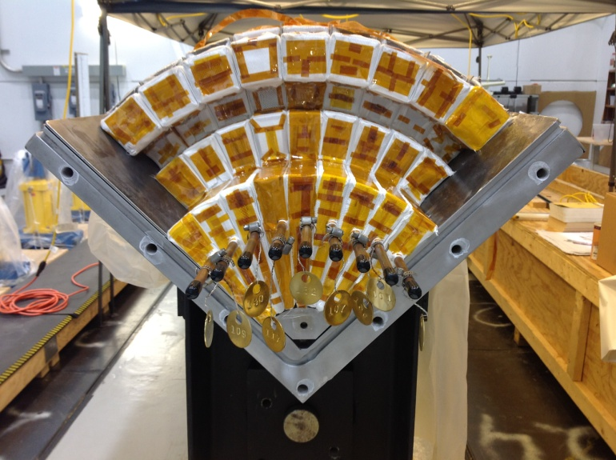
Assembly of Inner TF Quadrants
(9) individual conductors into each Quadrant mold
Quadrant manufacturing technique was used to maintain precision for the long length and relative ease of assembly

Slide 14
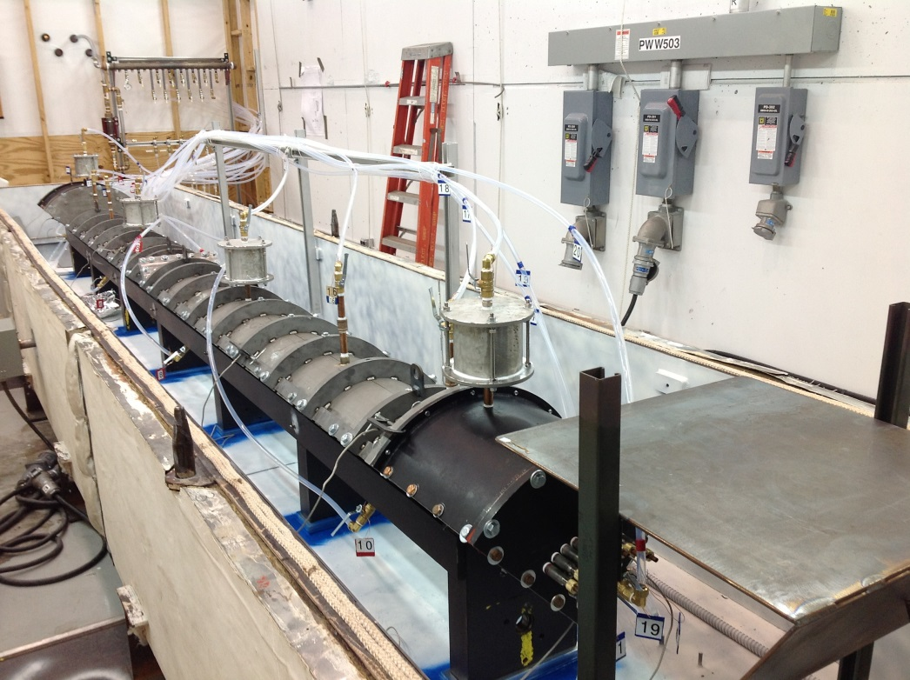
Assembled TF mold at point of Vacuum Pressure Impregnation with CTD-425 resin
This is first of six VPI operation conducted on NSTX-U. Care must be taken due to the highly exothermic nature of the Cyanate Ester / Epoxy Blend Resin. Raised temperature very slowly ~ 2 days.

Slide 15
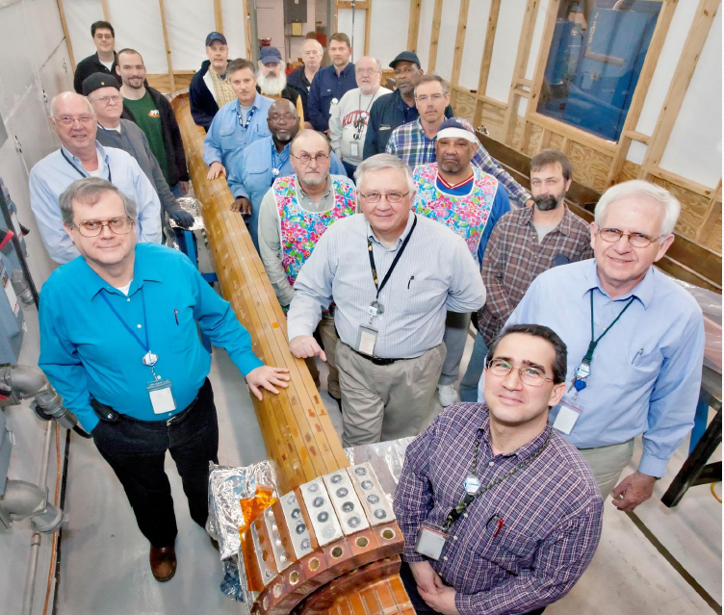
Completion of First TF Quadrant
NSTX-U PPPL Magnet Fabrication Team

Slide 16
Much thanks to Jim Chrzanowski for 40 years of pioneering fusion magnet manufacturing

Slide 17
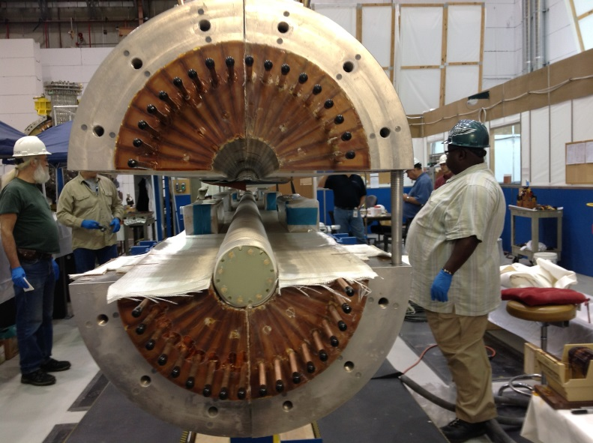
The quadrants assembled with S-2 glass tape between layers & pre-insulated G-10 core

Slide 18
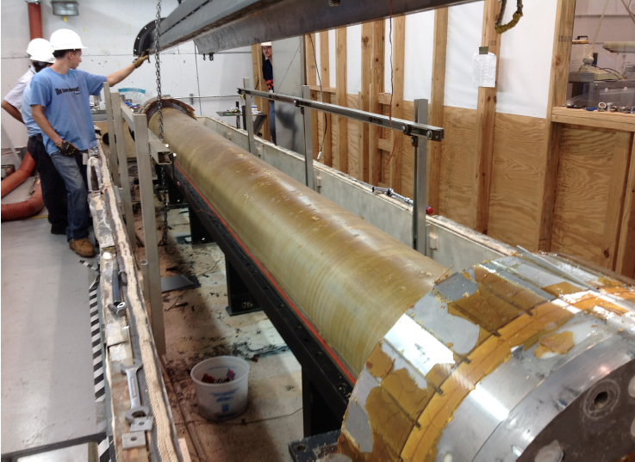
Full TF Bundle in oven after successful VPI

Slide 19
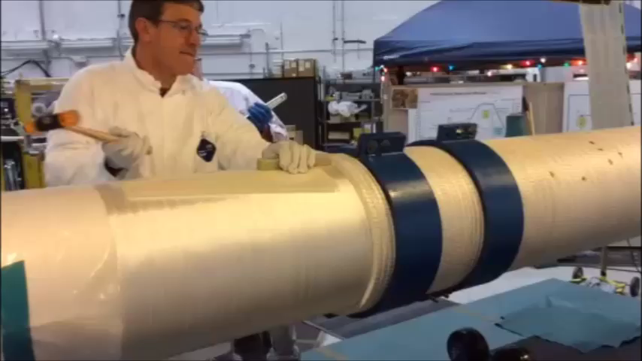
A movie of OH coil winding at PPPL

Slide 20
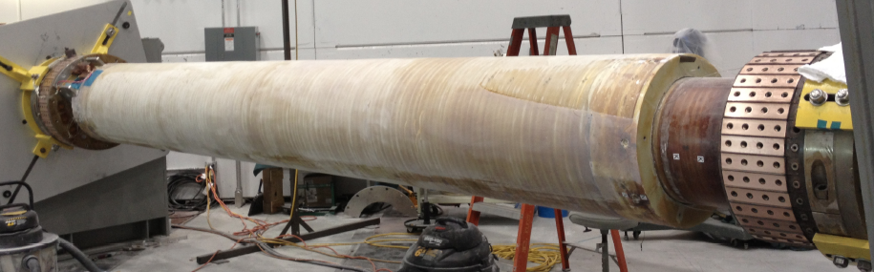
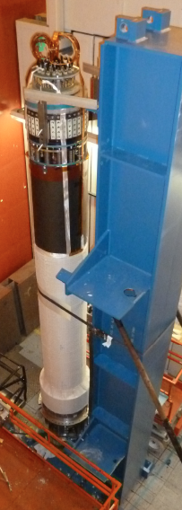
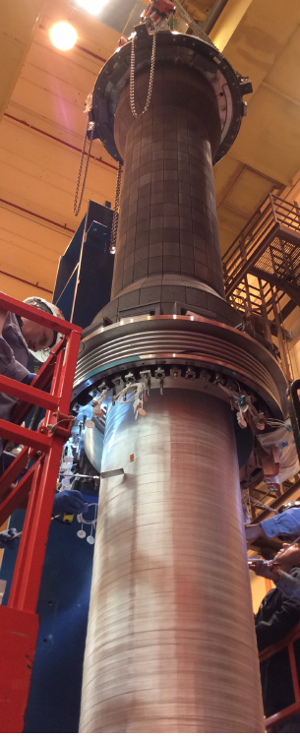
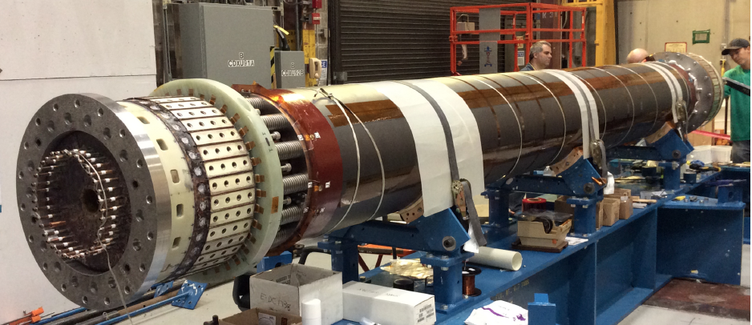
Center-stack Components Fabricated
Center-stack assembly complete
Vacuum Pressure Impregnation
of OH Complete
CS casing installed over the TF/OH coil bundle
Inner TF/OH coil bundle complete

Slide 21
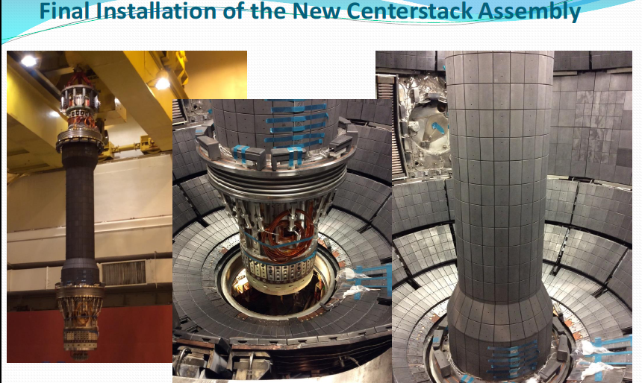
New Center-Stack Installed In NSTX-U
(October 24, 2014)
First plasma scheduled in Mar. 2015 and research operation in May 2015.

Slide 22
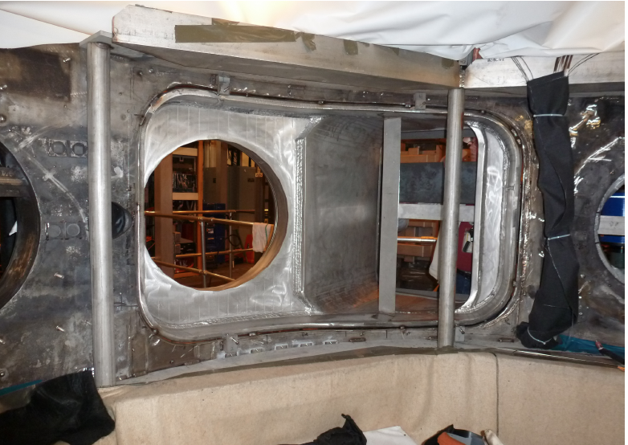
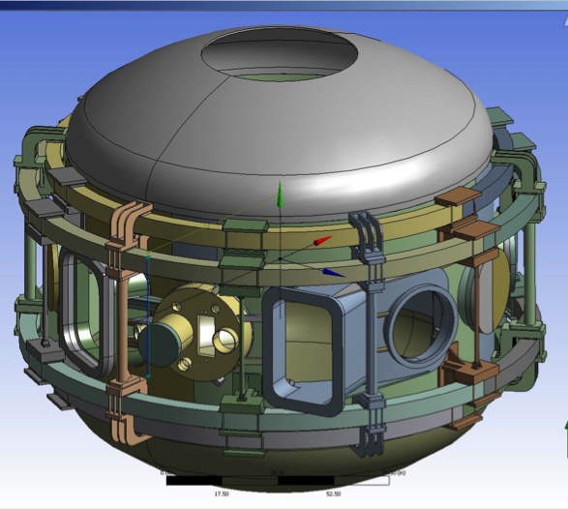
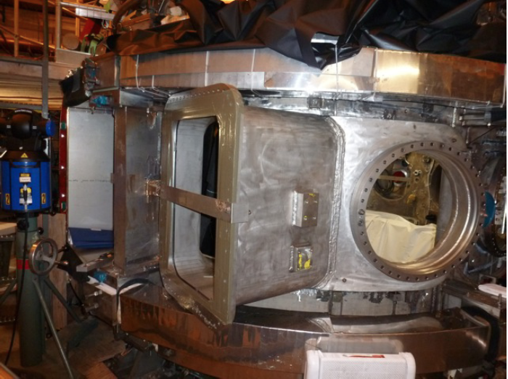
Highly Tangential 2nd NBI Enabled by JK-Cap
Outer Wall Radius Moved Outward to Avoid Beam Clipping
Interior View of Bay J-K
Exterior View of Bay J-K
JK cap

Slide 23
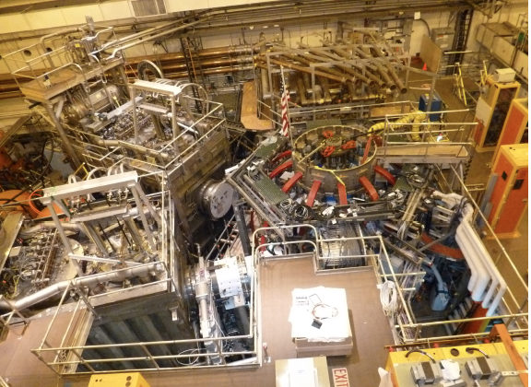
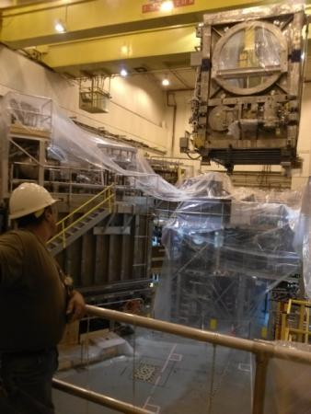
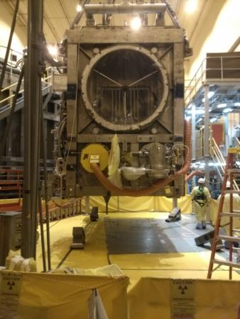
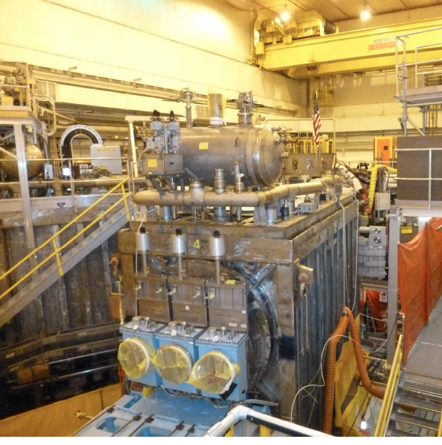
NSTX Upgrade Project Is Nearly Complete
Recent aerial view of NSTX-U Test Cell (Oct. 27, 2014)
HHFW System
1st NBI
NSTX-U
CS Casing
2nd NBI

Slide 24
Talk Outline
Introduction and Motivation for NSTX-U
NSTX Upgrade Project
NSTX-U ST-FNSF Targeted Experiments
Summary
Notes:
Here is the outline of this review to give you an overview of the world ST research.

Slide 25
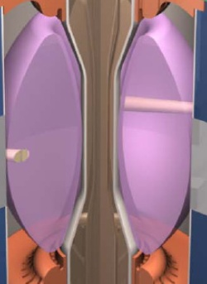
NSTX-U Addressing Critical Issues for FNSF
Solenoid-free high beta operation
Compact ST-FNSF has no/small central solenoid
ST-FNSF Scenarios to be tested in NSTX-U
high β_{T}, β_{N}, κ, disruption avoidance, high H, heat flux mitigation
I_{P} [MA]
Current ramp-up and profile control
NBI
Solenoid-free
Start-up
HHFW
,
CHI, EHC/EBW
Time
• Tools are in place in NSTX-U to test:
  Coaxial Helicity Injection for start-up
  HHFW for current ramp-up
  NBI for 100 % non-inductive operation
  High Confinement with EPH-mode
  Innovative divertor heat flux mitigation
~ 1-2 MA of solenoid-free start-up current needed for FNSF
Notes:
ST has been addressing critical issues for FNSF: A compact FNSF facility does not have solenoid. So, the solenoid-free start-up is a critical issue for ST-FNSF. But solenoid-free start-up is attractive for tokamak reactor design as well. Other issues are ramp-up….

Slide 26

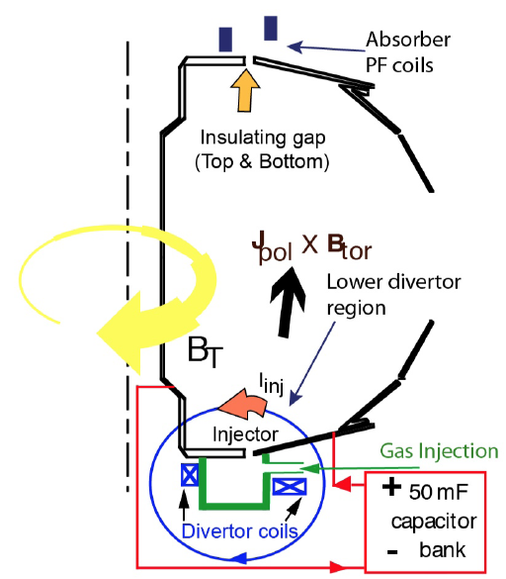
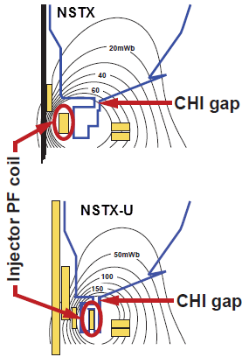
Helicity Injection Is an Efficient Method for Current Initiation
FNSF needs ~ 1-2 MA of start-up current
CHI achieved solenoid-free 160 kA ST plasma in NSTX
Injector flux in NSTX-U is ~ 2.5 times higher than in NSTX → supports ~ 0.4 MA current
R. Raman at this conference
CHI projects to achieve ~0.4 MA of start-up current in NSTX-U
R. Raman et al., PRL (2006)

Slide 27
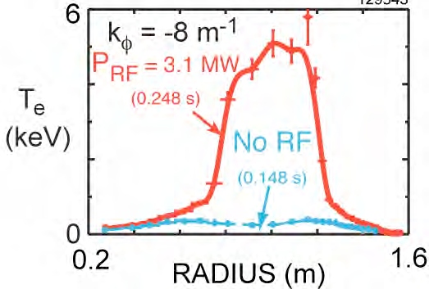
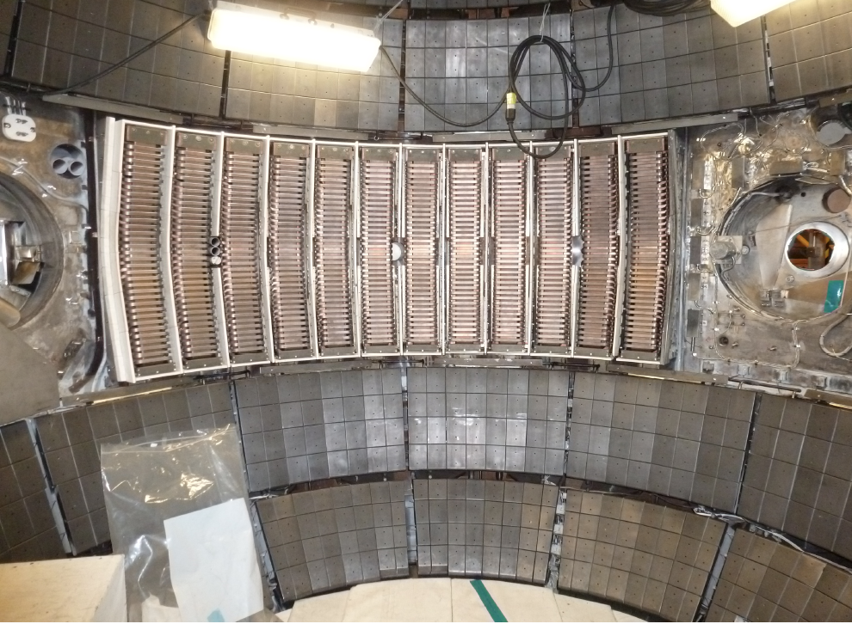
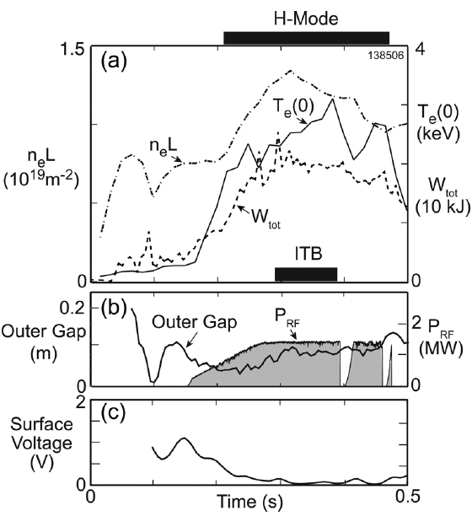
Current Ramp-Up with HHFW for FNSF
Up to Ip level sufficient for NBI heating and CD
Antennas were re-installed with the new compliant feeds and back-plate grounding
Efficient HHFW electron heating due to high β_{e} achieved in NSTX.
Near sustained discharges obtained with modest HHFW power.
NSTX
Prototype compliant feeds tested to 46 kV in the RF test-stand. Benefit of back-plate grounding for arc prevention found.
G. Taylor et al., PoP (2010), (2012)
HHFW current ramp-up will be tested in NSTX-U at higher power ~ 4 MW.

Slide 28
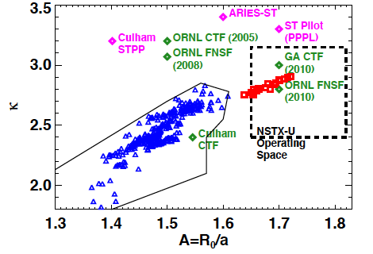
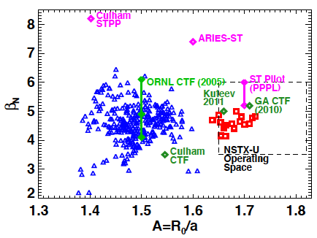
NSTX has accessed A, β_{N}, κ needed for ST-based FNSF
Requires f_{BS} ≥ 50% for plasma sustainment
f_{BS} ≡ I_{BS} / I_{p} = C_{BS} β_{p} / A^{0.5} = (C_{BS}/20) A^{0.5} q* β_{N} ∝ A^{5} (1+κ²) β_{N}² / β_{T}
SC-ST
S.P. Gerhardt et al., NF (2011)
NSTX achieved f_{BS} ~ 50% and f_{NI} ~ 65-70% with beams.
NSTX-U expects to achieve f_{NI} ~100% with the more tangential (~ x1.5- 2 more current drive efficient) NBI.

Slide 29
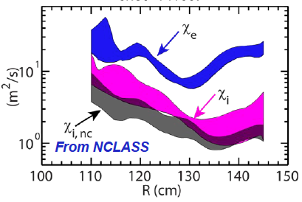
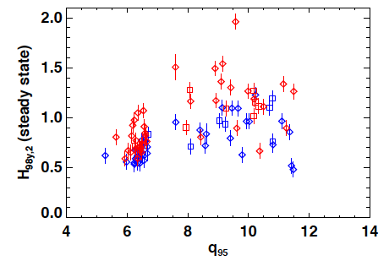
High Confinement Needed for Compact FNSF
High confinement H-mode in the range of FNSF obtained
Fusion gain Q depends strongly on “H”, Q ∝ Η ⁵⁻⁷
Higher H enables compact ST-FNSF H = 1.2 – 1.3
Higher H gives more reactor design flexibility and margins.
• Ion energy transport in H-mode ST plasmas near neoclassical level due to high shear flow and favorable curvature.
• Electron energy transport anomalous
H-mode confinement in STs H ~ 1 (ITER98_{y,2}) but enhanced pedestal H-mode (EPH) has 50% higher H up to H ~ 2
NSTX
NSTX
EPH
FNSF
H-mode
Y. Ren.
S. Gerhardt NF (2014)
R. Maingi, PRL (2010)

Slide 30
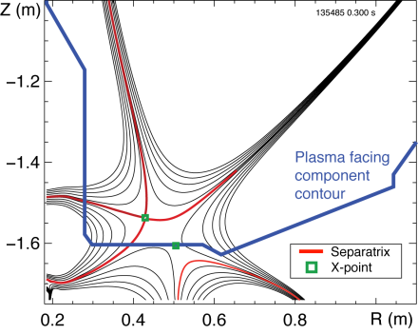
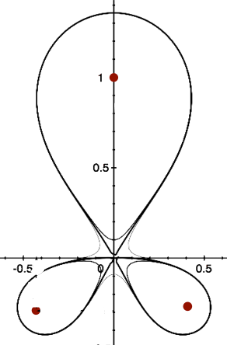
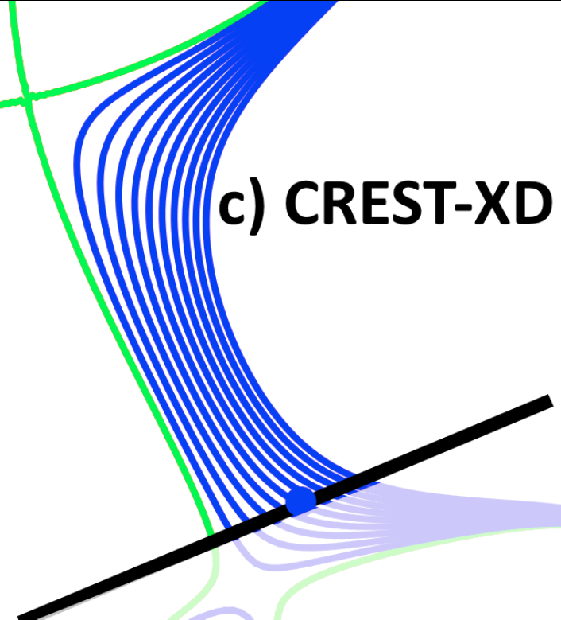
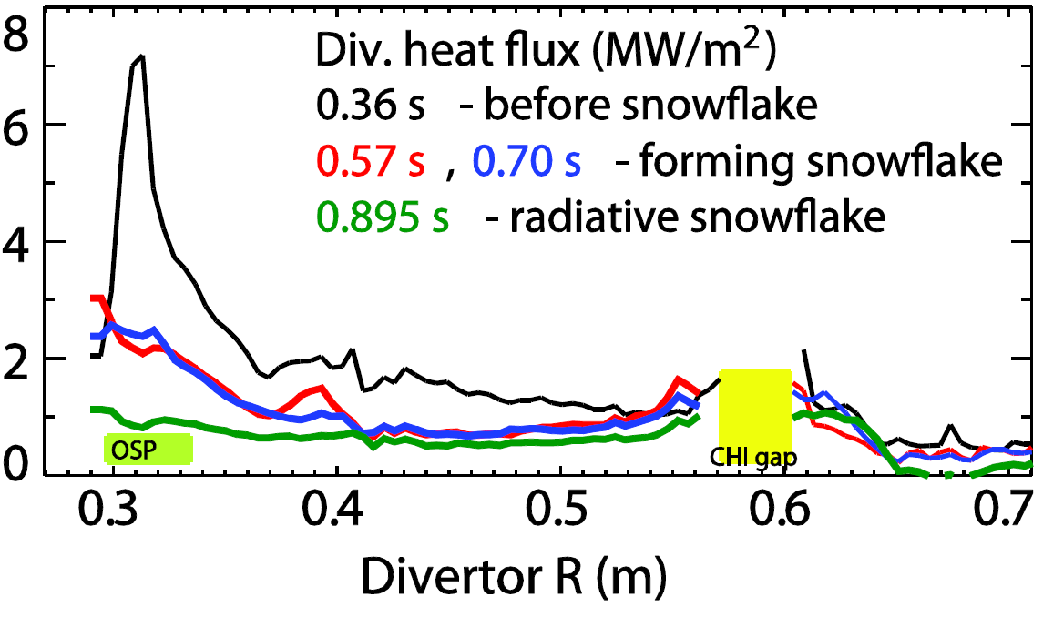
Divertor flux expansion of ~ 50 achieved with
Snow Flake Divertor with large heat flux reduction in NSTX
Snowflake divertor in NSTX
Snow-flake
X-Divertor: CREST
OSP
Divertor heat flux (MW/m²)
D. Ryutov, et al., PoP (2007)
P.M. Valanju, et al., PoP (2009).
V. A. Soukhanovskii et al., PoP (2012)
NSTX-U will investigate novel divertor heat flux mitigation concepts needed for FNSF and Demo.
    • Up-and-down symmetric Snow Flake / x-Divertors
    • Lithium + high-z metal PFCs M. Jaworski,et al., and Y. Hirooka et al., at this conference

Slide 31
Summary of NSTX-U
• NSTX-U’s main mission is to establish basis for FNSF while providing data for ITER operation and innovative PMI solutions.
• Unique ST features include high beta and compact geometry which would be suitable for compact FNSFs.
• ST-FNSF can be compact, low tritium consumption, and lower cost, satisfying the FSNF criteria of Abdou report.
• With new center-stack and 2nd tangential NBI, NSTX-U plans to demonstrate 100% non-inductive operation at high beta needed for FSNF.
• The new center-stack was completed and installed in NSTX-U. The pump down is planned this month.
• 2nd NBI is nearly complete and the commissioning is planned in Jan. 2015.
• NSTX-U plan is to have the first plasma in Mar. 2015 and commence research operation in May 2015.

Slide 32
Back-up Slides

Slide 33
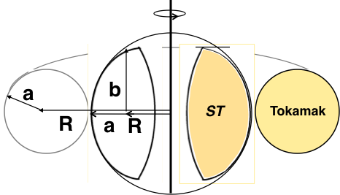
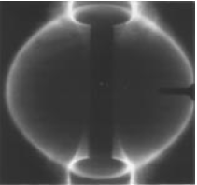
ST is a low aspect ratio tokamak with A < 2
Natural elongation makes its spherical appearance
Aspect Ratio A = R /a
Elongation κ = b/a
“natural” = “without active shaping”
Camera image from START
B_{TF} ∝ I_{TF}/R
I_{p}
I_{TF}
I_{TF}
I_{p}
I_{p}
x
I_{p}
I_{p}
I_{p}
x
x
A. Sykes, et al., Nucl. Fusion (1999).
Note: ST differs from FRC, spheromak due to B_{TF}
Y-K.M. Peng, D.J. Strickler, NF (1986)

Slide 34

ST can be compact, high beta, and high confinement
Higher elongation κ and low A lead to higher I_{p}, β_{T} and τ_{E}
Aspect Ratio A = R /a
Elongation κ = b/a
Toroidal Beta β_{T} = ⟨p⟩ / (B_{T0}²/ 2μ₀)
• ST has high Ip due to high κ and low A
High κ ∼ 3.0 equilibrium in NSTX.
I_{p} ~ I_{TF} (1 + κ² / (2 A² q*)
S. Jardin et al., FS&T (2003)
• Ip increases tokamak performance
τ_{E} ∝ I_{p}
β_{T  }≡ β_{N} I_{p} / (aB_{T0})
• ST can achieve high performance cost effectively
I_{p} ~ I_{TF} for ST due to low A and high κ
D.A. Gates et al., NF (2007).
$
Notes:
A spherical tokamak is a low aspect ratio tokamak. Tokamak is a donut like aspect ratio of about 3 where as ST is aspect ratio of about 1.5. As the aspect ratio is reduced, the hole of the donut is reduced and it disappears entirely at A = 1. As the aspect ratio is reduced, the plasma elongate naturally takes on the spherical shape due to self fields. Another important property is the magnetic field line. The tokamak magnetic field line goes around torus at relatively constant pitch where as the ST geometry, the field line transit the outboard unstable region quickly but spend many toroidal transits in the inboard stable region. This makes ST plasma stable for high beta and also makes the edge safety factor high ~ 10 compared to ~ 3 for tokamak.
As a result, there are a number of new unique physics regimes which can be accessed at low aspect ratio, which can be utilized to enhance the understanding of toroidal confinement physics and improve predictive capabilities for ITER and future fusion facilities.

Slide 35

Fusion needs FNSF(s) (modest cost, low T, and reliable) to Test and Qualify Fusion Components
Fusion needs to develop reliable/qualified components which are unique to fusion:
Divertor/PFC
Blanket and Integral First Wall
Tritium Fuel Cycle
Remote Maintenance Components
Advanced Power Generation
FNSFs
FNSF-ST
FNSF-AT
Without R&D, fusion components could fail prematurely which often requires long repair/down time. This would cripple the DEMO operation.
FNSF can help develop reliable fusion components.
Such FNSF facilities must be modest cost, low T, and reliable.
If the cost of volume neutron source (FNSF) facility is “modest” << ITER, DEMO, it becomes highly attractive development step in fusion energy research. M.A. Abdou, et al., FTS (1996)

Slide 36
Inner TF Bundle Comparisons- Physical
Description | Present Design | Upgrade Design
Operating Current | 1013 volts | 1013 volts
Number of Turns | 36 | 36
Number of Layers | Double | Single
Cooling | water | water
Maximum T/T Voltage stress | 970 volts | 28 volts
Maximum T/T voltage/mil | 14.9 volts/ mil | 0.432 volts /mil
Maximum volt/mil across leads | 14.9 volts/mil | 9.65 volts/mil
Turn to Turn Insulation thickness | 0.0648 inch | 0.0648 inch
Groundwrap insulation thickness | 0.054 inch | 0.222 inch
Insulation Scheme | B-stage (Pre-preg) | Vacuum Pressure Impregnation
Outside Diameter | 7.866 inch | 15.572 inch
Cooling Hole Inside Diameter | 0.186 inch | 0.305 inch
TF Conductor material | C10700 | C10700
Current TF Bundle 7.9 inch diameter
Upgraded TF Bundle 15.7 inch diameter

Slide 37
TF Bundle Comparisons- Materials
Material | Existing TF Bundle | Upgraded TF Bundle
Copper Conductor | C10700 (OFHC w/ Silver) | C10700 (OFHC w/Silver)
Primer | DZ-80 (Ciba-Geigy) | CTD-450 (Cyanate-Ester primer)
Insulation Scheme | CTD-112P B-stage tape B-stage did not have ample resin to fill all voids between conductor corners | VPI w/CTD-425 Cyanate Ester Hybrid Provides good resin fill minimizing/eliminating void areas between conductor corners
Solder | 95%-5% Tin-Antimony | 95%-5% Tin-Antimony
Cooling tube | ACR (0.032 inch wall) | Type K (0.035 inch wall)
Flux | “NOKORODE” Paste flux (Contains Chlorides that may of contributed to insulation failure) | Rosin Flux (Does not contain Chlorides- organic material)

Slide 38


Improved Center-Stack Design to Handle Increased Forces
Identical 36 TF Bars and Innovative Flex-Bus Design
TF cooling lines
TF flex-bus
EDM cuts from solid
copper chromium zirconium block
TF Coil
CHI bus
PF Coil 1c
PF Coil 1b
PF Coil 1a
OH Coil
Tested for
300 k cycles
CS Casing

Slide 39


Upgrade Design- Insulation Scheme
Maximum turn to turn insulation voltage <30 volts turn to turn
(< 0.5 volts per mil)
TF leads will be located across the quadrant region where additional insulation is present < 10 volts per mil
S-2 glass tape insulation will be used for the turn and groundwall insulation.

Slide 40


36 TF Bars manufactured with friction stir weld performed by Edison Welding Institute
Friction stir weld joint

Slide 41

Friction stir welding enabled joining of two different copper alloys without annealing!
Friction stir weld joint

Slide 42

Copper cooling tubes were soldered into the TF conductor assemblies using solder paste with non-ionic “R” flux
Contaminant from the flux containing Zn and Cl caused gradual insulation deterioration which led to the TF coil failure in NSTX

Slide 43

Applying S-2 Glass TF Turn Insulation

Slide 44


Limited Center Stack Space Requires Compact Designs
for Magnetic Sensors
Maximize “gain” – wire turns x area – by flattening cross sections
Fewer turns on edge with more area to measure normal to plane
More turns around body with less area to measure parallel to plane
Coil dimensions: 3.8 x 2.3 x 0.5 cm
Rogowski coil for measuring plasma currents wound around thin teflon mandrel
  - 30 turns of AWG 30 wire per cm
  - Thickness kept at ~2.5 mm over ~11 m length
Magnetic pickup coils fit in pockets in graphite plasma-facing components
  - AWG 26 copper wire around MACOR mandrel and coated with high temperature adhesive
  - Capable for use up to 800°C

Slide 45

New Digital Coil Protection System (DCPS)
Provides Comprehensive Coil Protection
Protects the NSTX-U coils and mechanical structure against electromagnetic loads
Computes forces and stresses in realtime based on reduced models of the full mechanical structure
Redundant systems
Full commissioning system will be a key part of early operations
Power Supply Suppress and Bypass
Coil and Plasma Current Measurements
Realtime Acquisition #1
Realtime Acquisition #2
Stand Alone Digital Coil Protection Computer
Digital Coil Protection & Plasma Control Computer
Level-1 Fault Interface
Rectifier Hardware Controls
Integrated DCPS software/hardware testing is being performed now in anticipation of FCPC dummy load testing in December.
Notes:
A bunch of sensors give conditioned current inputs
Output is Go/NoGo… Fault/No Fault

Slide 46
Formulating Strategy Toward Full NSTX-U Parameters
After CD-4, the plasma operation could enter quickly into new regimes
 | NSTX (Max.) | Year 1 NSTX-U Operations (2015) | Year 2 NSTX-U Operations (2016) | Year 3 NSTX-U Operations (2017) | Ultimate Goal
I_{P} [MA] | 1.2 | ~1.6 | 2.0 | 2.0 | 2.0
B_{T} [T] | 0.55 | ~0.8 | 1.0 | 1.0 | 1.0
Allowed TF I²t [MA²s] | 7.3 | 80 | 120 | 160 | 160
I_{P} Flat-Top at max. allowed I²t, I_{P}, and B_{T} [s] | ~0.4 | ~3.5 | ~3 | 5 | 5
1st year goal: operating points with forces up to ½ the way between NSTX and NSTX-U, ½ the design-point heating of any coil
  Will permit up to ~5 second operation at B_{T}~0.65
2nd year goal: Full field and current, but still limiting the coil heating
  Will revisit year 2 parameters once year 1 data has been accumulated
3rd year goal: Full capability

Slide 47
NSTX-U diagnostics to be installed during first 2 years
Half of NSTX-U Diagnostics Are Led by Collaborators
MHD/Magnetics/Reconstruction
  Magnetics for equilibrium reconstruction
  Halo current detectors
  High-n and high-frequency Mirnov arrays
  Locked-mode detectors
  RWM sensors
Profile Diagnostics
  MPTS (42 ch, 60 Hz)
  T-CHERS: T_{i}(R), V_{φ}(r), n_{C}(R), n_{Li}(R), (51 ch)
  P-CHERS: V_{θ}(r) (71 ch)
  MSE-CIF (18 ch)
  MSE-LIF (20 ch)
  ME-SXR (40 ch)
  Midplane tangential bolometer array (16 ch)
Turbulence/Modes Diagnostics
  Poloidal FIR high-k scattering
  Beam Emission Spectroscopy (48 ch)
  Microwave Reflectometer,
  Microwave Polarimeter
  Ultra-soft x-ray arrays – multi-color
Energetic Particle Diagnostics
  Fast Ion D_{α} profile measurement (perp + tang)
  Solid-State neutral particle analyzer
  Fast lost-ion probe (energy/pitch angle resolving)
  Neutron measurements
Edge Divertor Physics
  Gas-puff Imaging (500kHz)
  Langmuir probe array
  Edge Rotation Diagnostics (T_{i}, V_{φ}, V_{pol})
  1-D CCD H_{α} cameras (divertor, midplane)
  2-D divertor fast visible camera
  Metal foil divertor bolometer
  AXUV-based Divertor Bolometer
  IR cameras (30Hz) (3)
  Fast IR camera (two color)
  Tile temperature thermocouple array
  Divertor fast eroding thermocouple
  Dust detector
  Edge Deposition Monitors
  Scrape-off layer reflectometer
  Edge neutral pressure gauges
  Material Analysis and Particle Probe
  Divertor VUV Spectrometer
Plasma Monitoring
  FIReTIP interferometer
  Fast visible cameras
  Visible bremsstrahlung radiometer
  Visible and UV survey spectrometers
  VUV transmission grating spectrometer
  Visible filterscopes (hydrogen & impurity lines)
  Wall coupon analysis
New capability, Enhanced capability

Slide 48


Facility and Diagnostic Enhancements
to support the exciting 5 year research plan
2014 | 2015 | 2016 | 2017 | 2018
Upgrade Outage
1.5 → 2 MA, 1s → 5s
Run Weeks:
16
14
14
16
Cryo-pump, high-Z tile row on cryo-baffle, and partial NCC would be installed in-vessel during ~1 year outage between FY2016 and FY2017
  NSTX-U would operate 1st half of FY2016 and 2nd half of FY2017
New
center-stack
Start-up and Ramp-up
Upgraded CHI for ~0.5MA
up to 0.5 MA plasma gun
0.5-1 MA CHI
1 MW ECH/EBW
Boundary Physics
Lower divertor cryo-pump
Divertor Thomson
Materials and PFCs
High-Z tile row on lower OBD
High-Z tile row on cryo-baffle
High-Z PFC diagnostics
All high-Z PFCs
Day 1 scope
Liquid
metals / lithium
Upward
LiTER
LLD using bakeable cryo-baffle
Flowing Li divertor
or limiter module
Priority scope
Li granule injector
Incremental scope
MGI disruption mitigation
Partial NCC
NCC SPA upgrade
MHD
Enhanced MHD sensors
Transport & Turbulence
δB polarimetry
DBS, PCI, or other intermediate-k
High k_{θ}
Waves and Energetic Particles
HHFW limiter upgrade
HHFW straps to excite EHO
2nd NBI
1 coil AE antenna
4 coil AE antenna
Charged fusion product, neutron-collimator
Scenarios and Control
Establish control of:
Control integration, optimization
n_{e}
q_{min}
Divertor P_{rad}
Snowflake
Rotation

Slide 49



Schematics of OH-TF bundle configuration
100 mil gap between OH and TF to provide free OH-TF operation
TF-OH Gap Details
487.5 mil
TF Copper
11.5 mil
12 <–> 100°C
187.5 mil
Glass Epoxy Insulation
Aquapour
108 mil
Glass Epoxy
Ground Insulation
OH Copper
11.9 mil
12 <–> 100°C
Preload Mechanism Springs
100 mil
36 mil
TF-turn Insulation
8 mil Teflon Slip Plane
48 mil OH turn Insulation with kapton
Aqua Cement- Teflon Layer With Friction Elements, Mu=.1 and Mu=.3
Both TF and OH expand about 12 mils during the full parameter operation reaching ~ 100 °C from 12 °C.
If TF expands more than OH, the gap region could be compressed leading to insulation stress as the TF and OH grow radially and axially.
• The full 1 T, 2 MA, 5 sec (third year) scenario maybe affected since TF temperature could exceed OH by as much 19°C which could cause insulation stress.
• Bringing the temperature gap down to 10°C range reduces the stress to acceptable range.
• This can be accomplished by pre-heating the OH with respect to TF by ~ 10°C.
49

Slide 50






Support Structural and VV Enhancements Complete
Must handle 4 x higher electromagnetic loads
Upper Al Block Internal Reinforcements
Upper Al Block External Reinforcements
Upper Umbrella Arch Reinforcements
Bay-L Cap
TF-VV Clevis &TF Outer Leg Support
See back-up slides 44 for more detail

Slide 51
Relocation of the 2nd NBI beam line box from the TFTR test cell into the NSTX-U Test Cell Complete.
TFTR NBI beam box / components successfully tritium decontaminated.
Beam Box being lifted over NSTX
Beam Box placed in its final location and aligned
Beam Box being populated with components

Slide 52


Final 2nd NBI Component being Installed
2nd NBI duct with pumping section and NBI armor installed
Neutral Beam & TIV valve
Vacuum Vessel Bay J/K port
Neutral Beam Armor Installed
2nd NBI Commissioning planned in Jan. 2015

Slide 53

HHFW System for Electron Heating and Current Ramp-up
Improved Antennas were installed on NSTX-U
New Compliant Antenna Feeds
Will allow HHFW antenna feedthroughs to tolerate 2 MA disruptions
Antennas were re-installed with the new compliant feeds and back-plate grounding
Additional ground installed
Prototype compliant feeds tested to 46 kV in the RF test-stand. Benefit of back-plate grounding for arc prevention found.
4 MW is available for HHFW heating and current ramp-up

Slide 54

OH Winding Station
Taping Machine

Slide 55

On-line Brazing: 32 in line induction brazes were performed during the OH winding operations
Each braze joint was mechanically loaded (stretched) and helium leak tested to ensure a quality braze joint.

Slide 56

Inconel Center-Stack Casing Fabrication
56

Slide 57
100% non-inductive operating points projected for a
range of toroidal fields, densities, and confinement levels
B_{T} = 1.0 T, I_{P} = 1MA, P_{inj} = 12.6MW
Projected Non-Inductive Current Levels for κ~2.85, A~1.75, f_{GW}=0.7
Contours of Non-Inductive Fraction
B_{T} [T] | P_{inj} [MW] | I_{P} [MA]
0.75 | 6.8 | 0.6-0.8
0.75 | 8.4 | 0.7-0.85
1.0 | 10.2 | 0.8-1.2
1.0 | 12.6 | 0.9-1.3
1.0 | 15.6 | 1.0-1.5
Contours of q_{min}
From GTS (ITG) and GTC-Neo (neoclassical):
  χ_{i,ITG}/χ_{i,Neo} ~ 10⁻²
  Assumption of neoclassical ion thermal transport should be valid
S. Gerhardt, et al., Nucl. Fusion 52 (2012) 083020

