Slide 1









Configuration Studies for an ST-Based Fusion Nuclear Science Facility (FNSF)
Dr. Jonathan Menard
on behalf of:
M. Boyer¹, T. Brown¹, J. Canik², B. Covele³, C. D’Angelo⁴, A. Davis⁴, L. El-Guebaly⁴,
S. Gerhardt¹, S. Kaye¹, C. Kessel¹, M. Kotschenreuther³, S. Mahajan³, R. Maingi¹, E. Marriott⁴,
L. Mynsberge⁴, C. Neumeyer¹, M. Ono¹, R. Raman⁵, S. Sabbagh⁶, V. Soukhanovskii⁷, P. Valanju³,
R. Woolley¹, A. Zolfaghari¹
¹Princeton Plasma Physics Laboratory, Princeton, NJ 08543
²Oak Ridge National Laboratory, Oak Ridge, TN, USA
³University of Texas, Austin, TX, USA
⁴University of Wisconsin, Madison, WI, USA
⁵University of Washington, Seattle, WA, USA
⁶Columbia University, New York, NY, USA
⁷Lawrence Livermore National Laboratory, Livermore, CA, USA
American Nuclear Society
21st Topical Meeting on the Technology of Fusion Energy (TOFE)
9-13 November 2014, Anaheim, CA
This work supported by the US DOE Contract No. DE-AC02-09CH11466

Slide 2
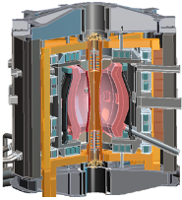
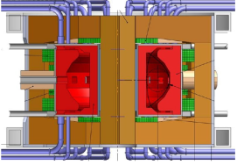
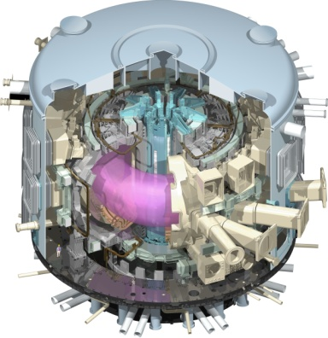
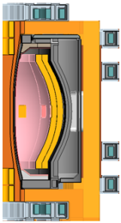
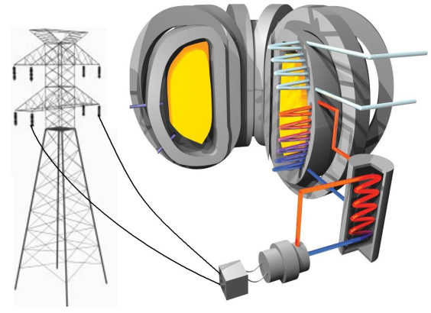
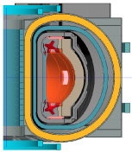
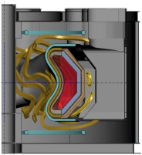
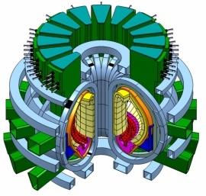
There are several possible pathways from ITER to a commercial fusion power plant
FNSF = Fusion Nuclear Science Facility
CTF = Component Test Facility
DEMO
ITER
FNSF/CTF
Blanket R&D, T self-sufficiency
First of a kind
Power Plant
Pilot Plant
FNSF/CTF with power-plant like maintenance, Q_{eng} ≥ 1
Supporting Physics and Technology
Core Physics
Materials R&D
Plasma Material Interface
Q_{eng} = 3-5
e.g. EU DEMO

Slide 3
This talk considers possible spherical tokamak (ST) Fusion Nuclear Science Facility (FNSF) options
FNSF = Fusion Nuclear Science Facility
CTF = Component Test Facility
DEMO
ITER
FNSF/CTF
Blanket R&D, T self-sufficiency
First of a kind
Power Plant
Pilot Plant
FNSF/CTF with power-plant like maintenance, Q_{eng} ≥ 1
Supporting Physics and Technology
Core Physics
Materials R&D
Plasma Material Interface
Q_{eng} = 3-5
e.g. EU DEMO

Slide 4
Overview
Recent U.S. studies for ST-FNSF have focused on assessing achievable missions versus device size
Possible missions:
  Electricity break-even
    Motivated 2010-12 analysis of R=2.2m ST Pilot Plant
  Tritium self-sufficiency (tritium breeding ratio TBR ≥ 1)
    Motivates present (2013-14) analysis of R=1m, 1.7m ST FNSF devices to address key questions:
      How large must ST device be to achieve TBR ≥ 1?
      How much externally supplied T would be needed for smaller ST?
      What are device and component lifetimes?
  Fusion-relevant neutron wall loading and fluence
    STs studied here access 1MW/m², 6MW-yr/m² (surface-avg. values)

Slide 5
Outline
Physics design
Configuration, shielding, tritium breeding
Conclusions

Slide 6
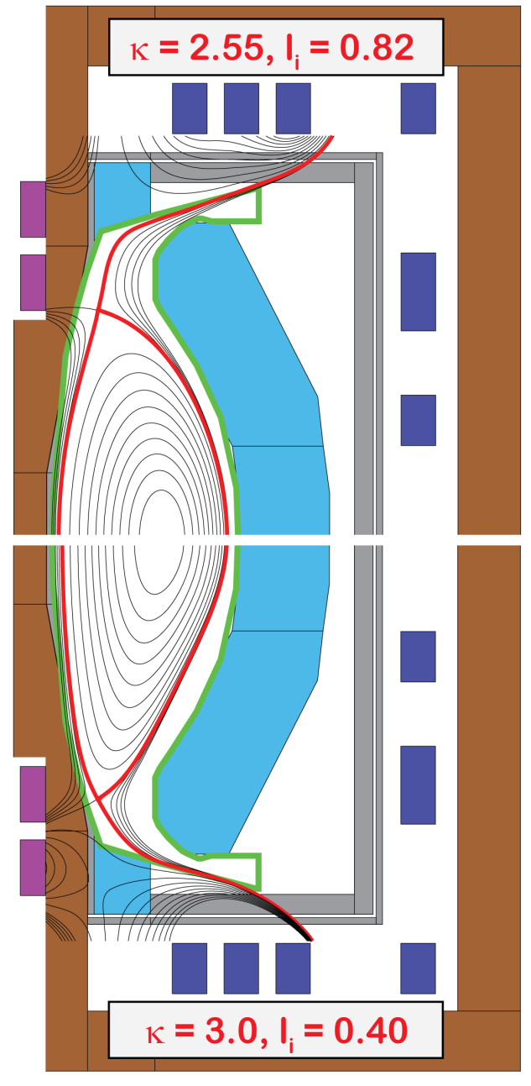
PF coil set identified that supports combined
Super-X + snowflake divertor for range of equilibria
Components:
TF coil
PF coil
Vessel
Blanket
All equilibrium PF coils outside vacuum vessel
Increased strike-point radius reduces B, q||
Strike-point PFCs also shielded by blankets
2nd X-point/snowflake increases SOL line-length
PF coil set supports wide range of l_{i}: 0.4 – 0.8
  Elongation and squareness change with l_{i} variation
  Fixed strike-point R, controllable B-field angle of incidence (0.5-5˚)
Divertor coils in TF coil ends for equilibrium, high δ
Breeding in CS ends important for maximizing TBR

Slide 7
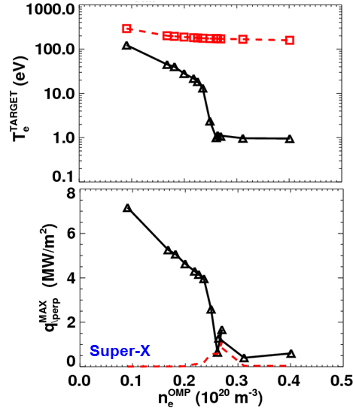
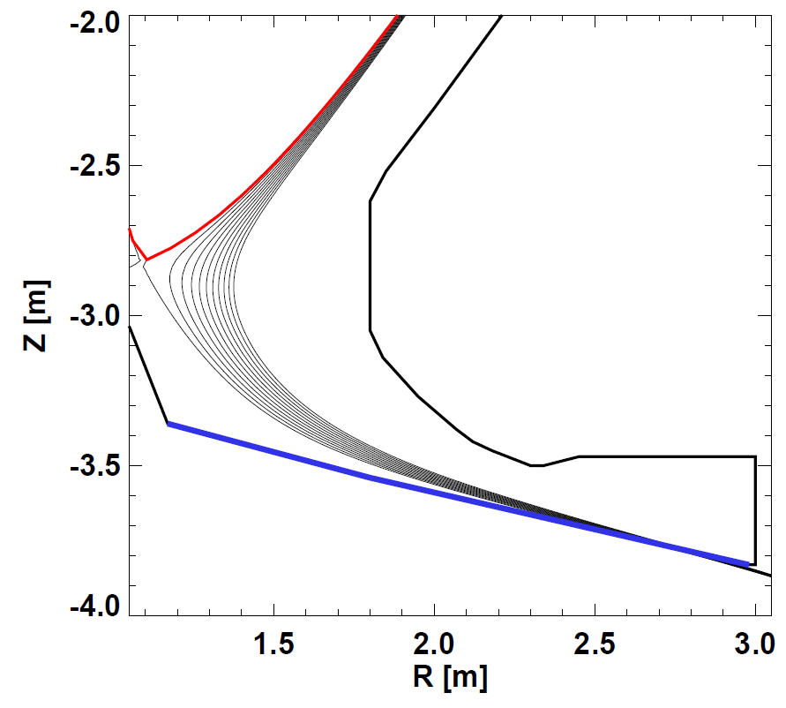
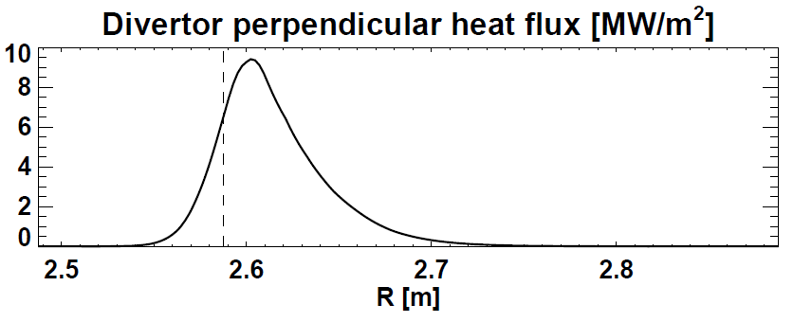
Up/down-symmetric Super-X/snowflake projected to maintain peak divertor heat flux below material limits
λ_{q} = 0.8mm, assume S ≈ λ_{q} (closed divertor)
(T. Eich NF 2013)
λ_{q} ≈ 1.2mm (J. Canik IEEE 2013)
Upstream
T_{e}
[eV]
Divertor
Target
Max.
q⊥
[MW/m²]
Conducted
Peak q⊥ < 10MW/m²
Radiation
(Partial) detachment projected
to reduce peak q⊥ to < 2MW/m²

Slide 8
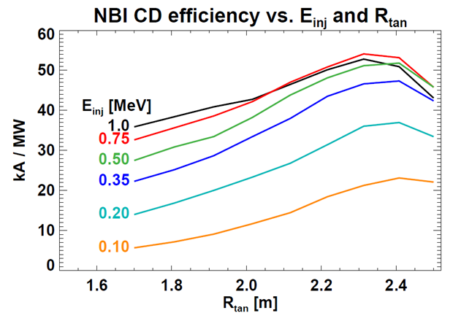
0.5 MeV NNBI favorable for heating and current drive (CD) for R=1.7m ST-FNSF
NBCD increases for E_{inj} ≤ 0.5 MeV but saturates for E_{inj} = 0.75 – 1MeV
0.50
Maximum efficiency: R_{tan}=2.3-2.4m
Fixed target parameters in DD:
  I_{P} = 7.5MA, β_{N} = 4.5, l_{i} = 0.5
  n_{e} / n_{Greenwald} = 0.75, H_{98y,2} = 1.5
  A=1.75, R=1.7m, B_{T} = 3T, κ = 2.8
  ⟨T_{e}⟩=5.8keV, ⟨T_{i}⟩=7.4keV
Optimal tangency radii:
1.7m ≤ R_{tan} ≤ 2.4m
Control q(0), q_{min}
Shine-thru limit

Slide 9
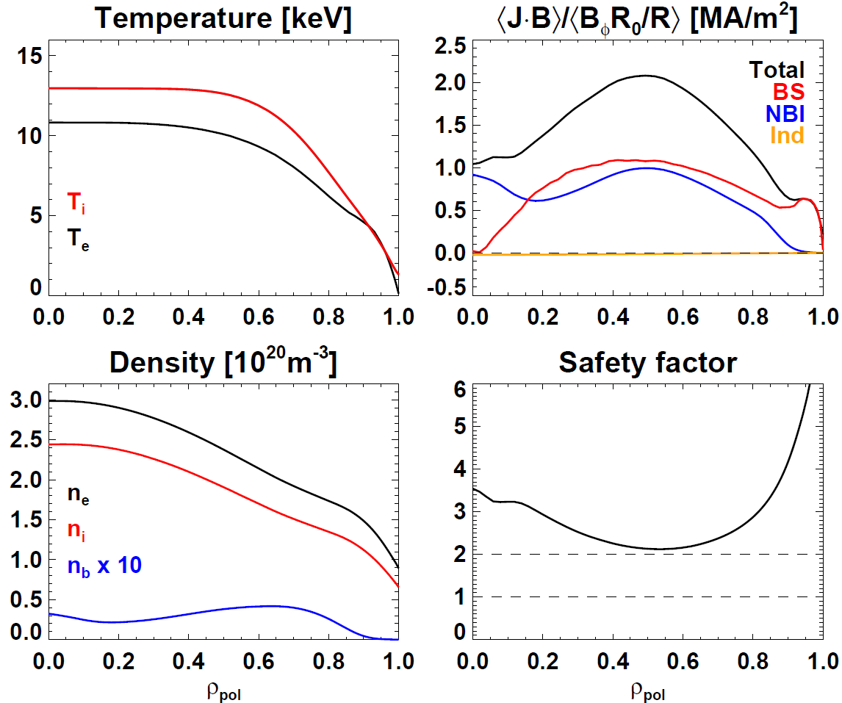
Free-boundary TRANSP/NUBEAM used to compute profiles for 100% non-inductive plasmas with Q_{DT} ~2
Neoclassical χ_{ion}
n_{e} / n_{Greenwald} = 0.7
H_{98,y2} = 1.4
I_{P} = 8.9MA, B_{T} = 2.9T
f_{NICD} = 100%, f_{BS} = 65%
P_{NNBI} = 80MW (0.5MeV)
P_{fus} = 200MW (50-50 DT)
  2.6% alpha bad orbit loss
Q_{DT} = 2.5
β_{N} = 5.5, W_{tot} = 58MJ
  W_{fast} / W_{tot} = 14%
Maintain q_{min} > 2
q(0) / q_{min} controllable via R_{tan} and density

Slide 10
Outline
Physics design
Configuration, shielding, tritium breeding
Conclusions

Slide 11
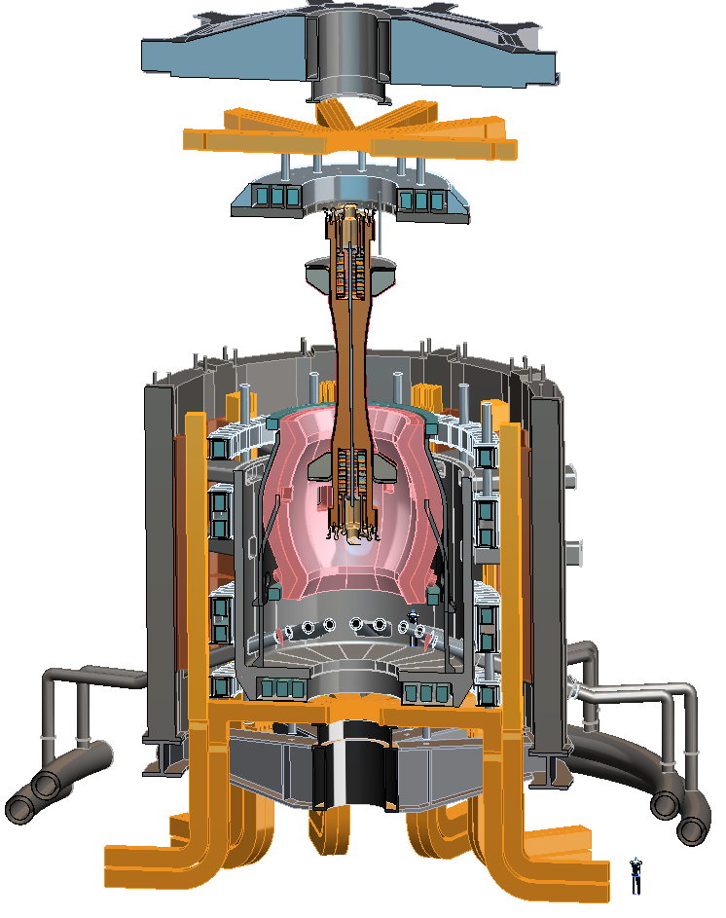
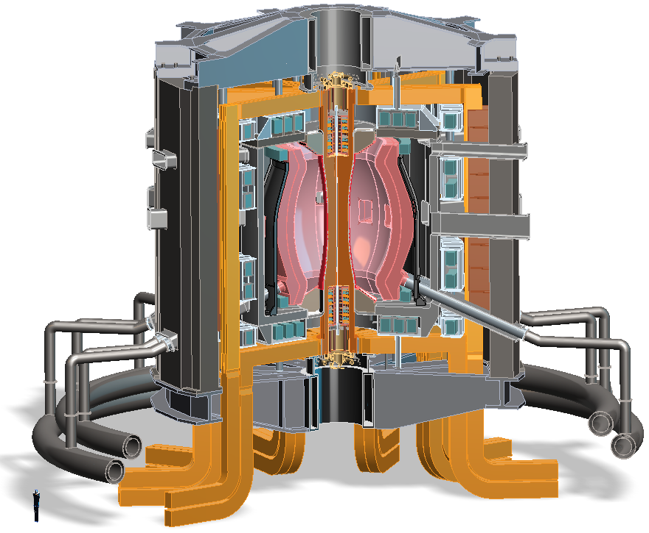
R=1.7m configuration with Super-X divertor
Design features
Vertical maintenance
TF coils
Cu/SC PF coils housed in VV upper lid
SC PF coils pairs located in common cryostat
VV outer shell w/ shield material
Cu/SC PF coils housed in VV lower shell structure
Ports for TBM, MTM, NBI
Blankets
TF leads
Angled DCLL concentric lines to external header

Slide 12
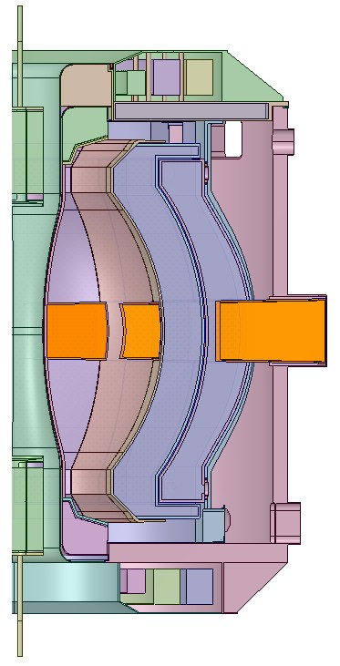
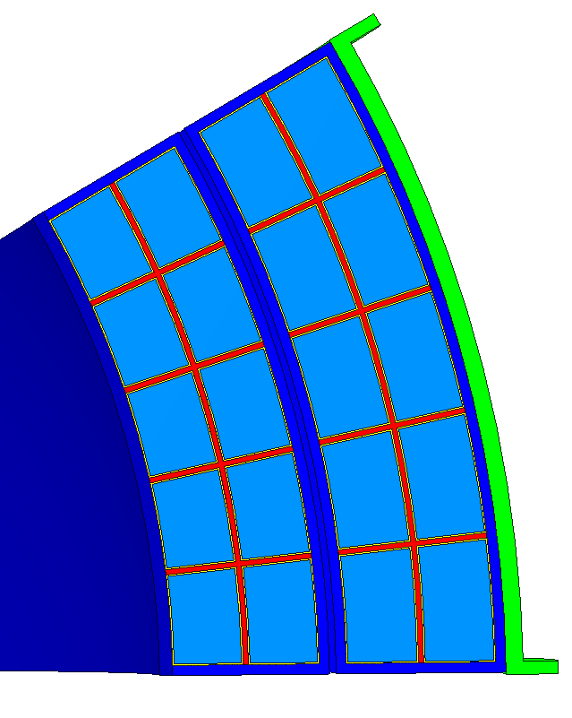
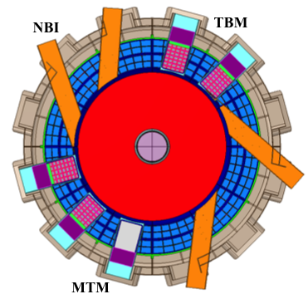
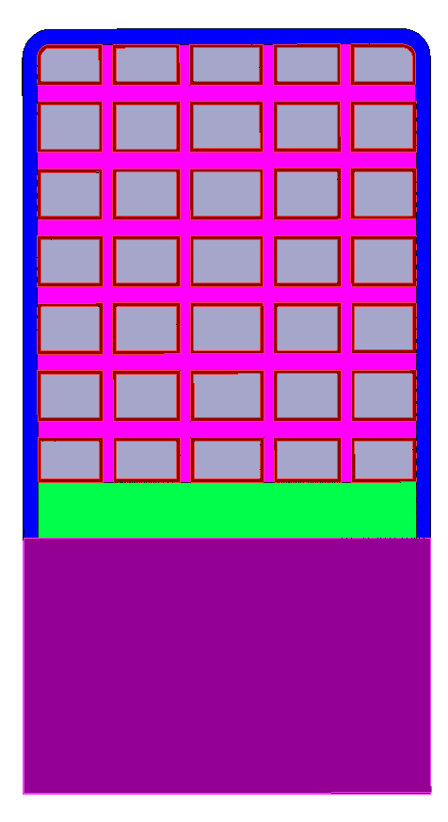
ST-FNSF shielding and TBR analyzed with sophisticated 3-D neutronics codes
CAD coupled with MCNP using UW DAGMC code
Fully accurate representation of entire torus
No approximation/simplification involved at any step:
  Internals of two OB DCLL blanket segments modeled in great detail, including:
    FW, side, top/bottom, and back walls, cooling channels, SiC FCI
  2 cm wide assembly gaps between toroidal sectors
  2 cm thick W vertical stabilizing shell between OB blanket segments
  Ports and FS walls for test blanket / materials test modules (TBM/MTM) and NNBI
LiPb,
cooling channel,
FCI
TBM
NBI
Heterogeneous OB Blanket Model,
including FW, side/back/top/bottom walls, cooling channels, and SiC FCI

Slide 13
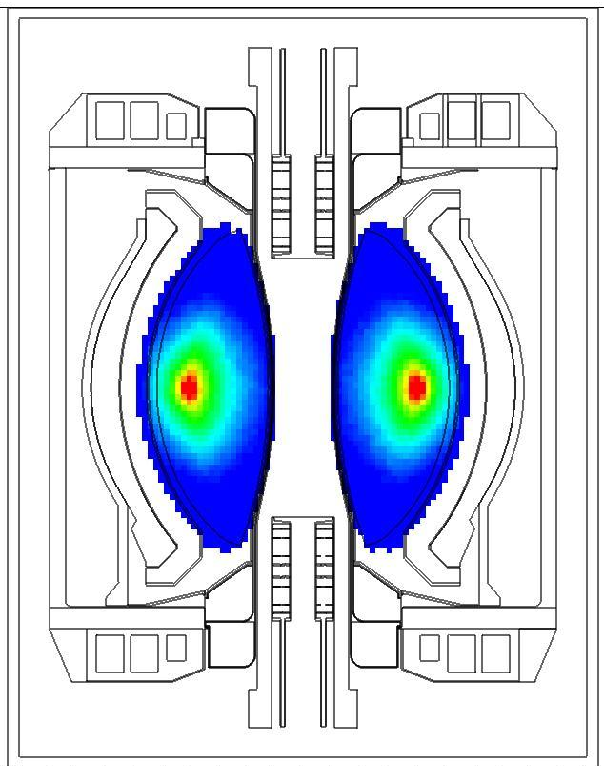
Two sizes (R=1.7m, 1m) assessed for shielding, TBR
Parameter:
Major Radius 1.68m 1.0m
Minor Radius 0.95m 0.6m
Fusion Power 162MW 62MW
Wall loading (avg) 1MW/m² 1MW/m²
TF coils 12 10
TBM ports 4 4
MTM ports 1 1
NBI ports 4 3
Plant Lifetime ~20 years
Availability 10-50%
30% avg
6 Full Power Years
(FPY)
Neutron source distribution

Slide 14
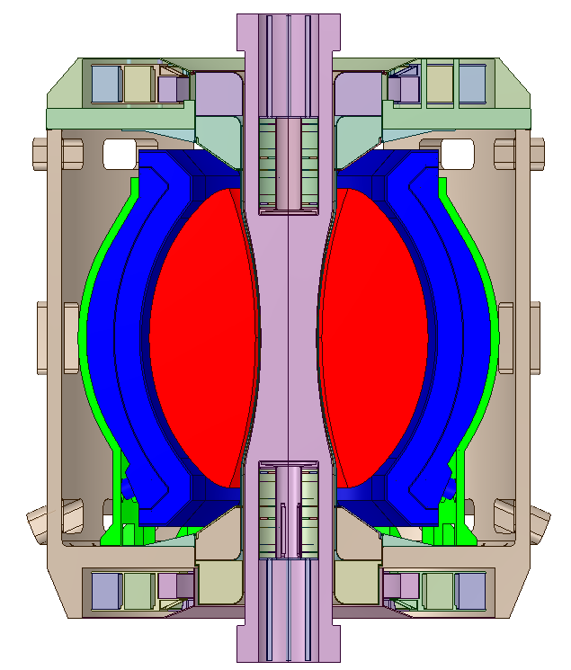
Peak Damage at OB FW and Insulator of Cu Magnets
R=1.7m configuration
Dose to MgO insulator = 2x10⁸ Gy @ 6 FPY < 10¹¹ Gy limit
Dose to MgO insulator = 6x10⁹ Gy @ 6 FPY < 10¹¹ Gy limit
OB Blanket
Center Stack
Peak dpa at OB midplane = 15.5 dpa / FPY
Peak He production at OB midplane = 174 appm/FPY
He/dpa ratio = 11.2
3-D Neutronics Model of Entire Torus

Slide 15
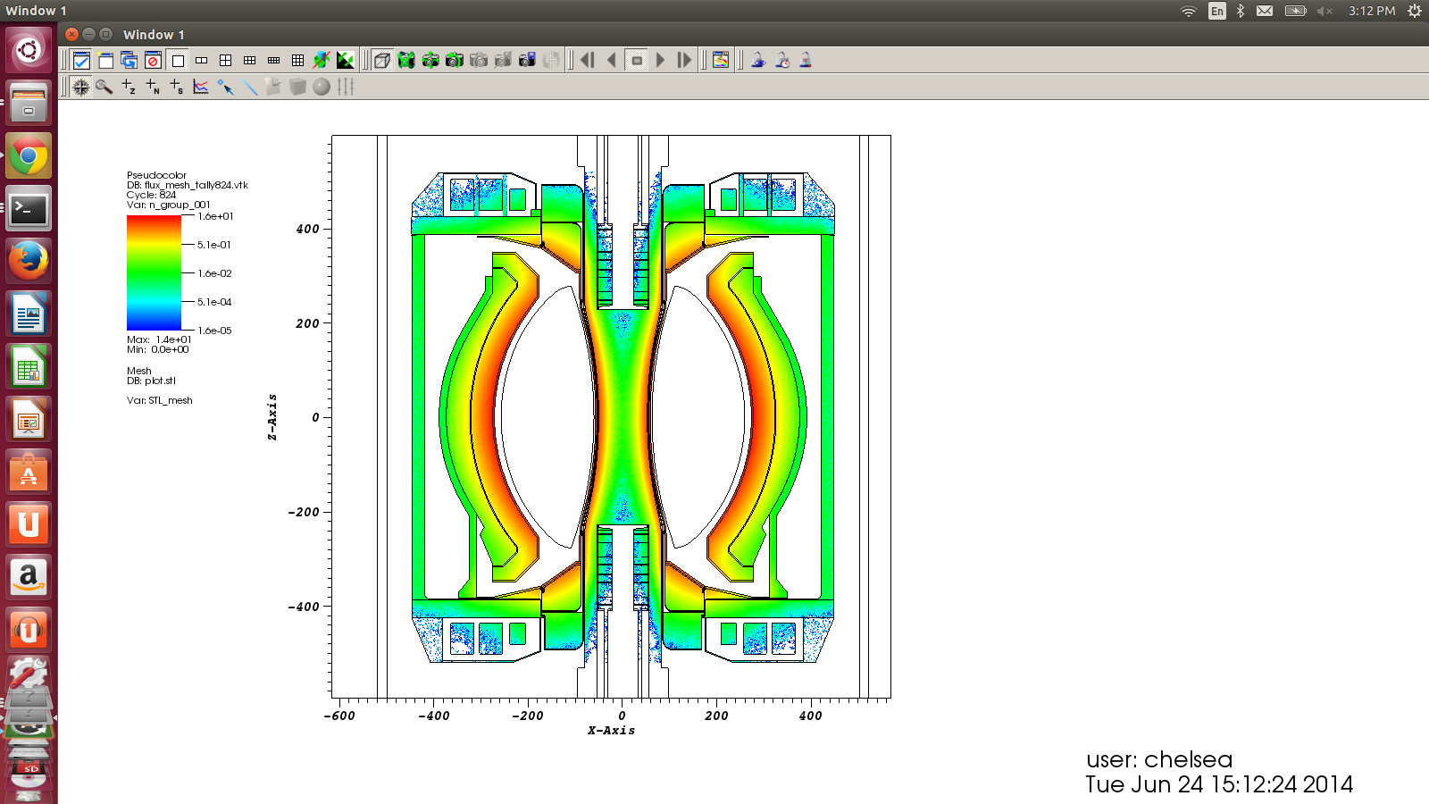
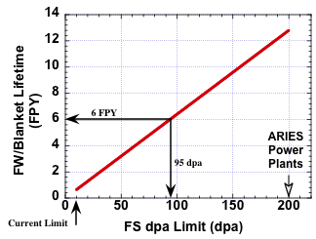
Mapping of dpa and FW/blanket lifetime
(R=1.7 m Device)
R=1.7m configuration
Peak =
15.5 dpa / FPY
FW/blanket could operate for 6 FPY
if allowable damage limit is 95 dpa
dpa / FPY
→ Peak EOL Fluence = 11 MWy/m²

Slide 16
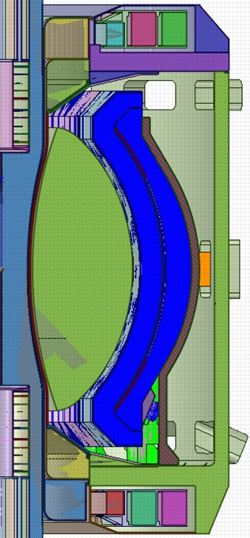
TBR contributions by blanket region
0.0004
Breeding at CS ends important:
ΔTBR = +0.07
0.034
Inner Blanket Segment = 0.81
Outer Blanket Segment = 0.15
Total TBR ~ 1.03 with no penetrations or ports
(heterogenous outboard blanket)
0.034
0.0004
R=1.7m configuration

Slide 17
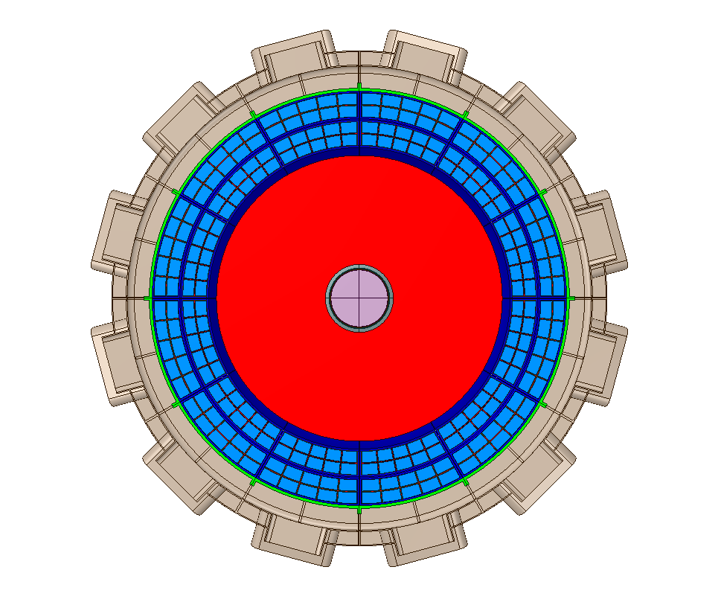
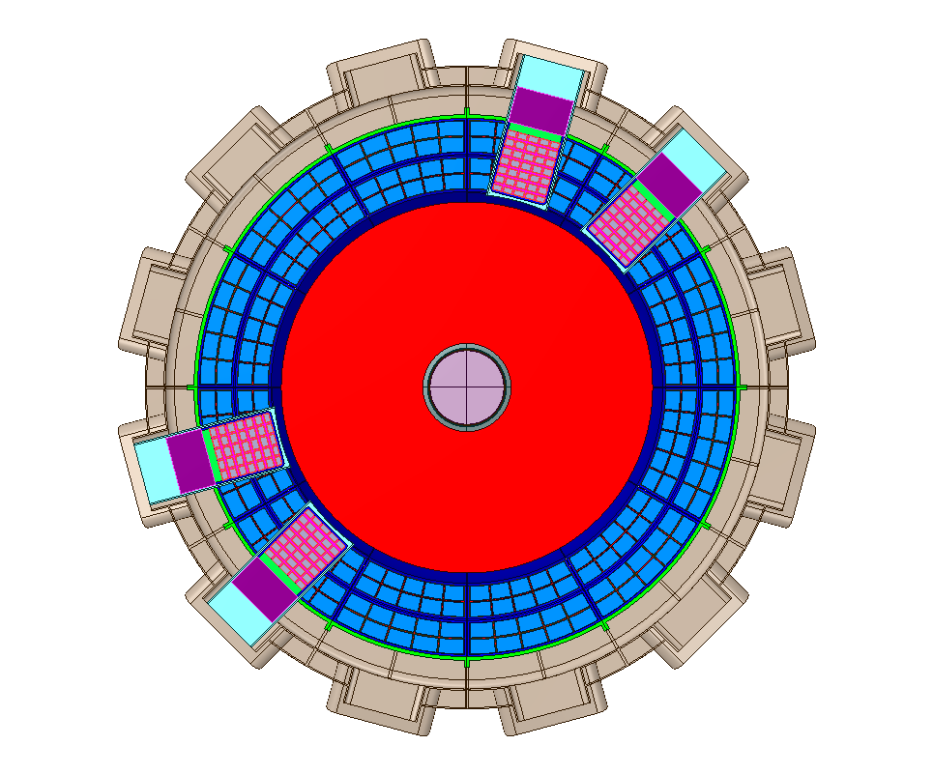
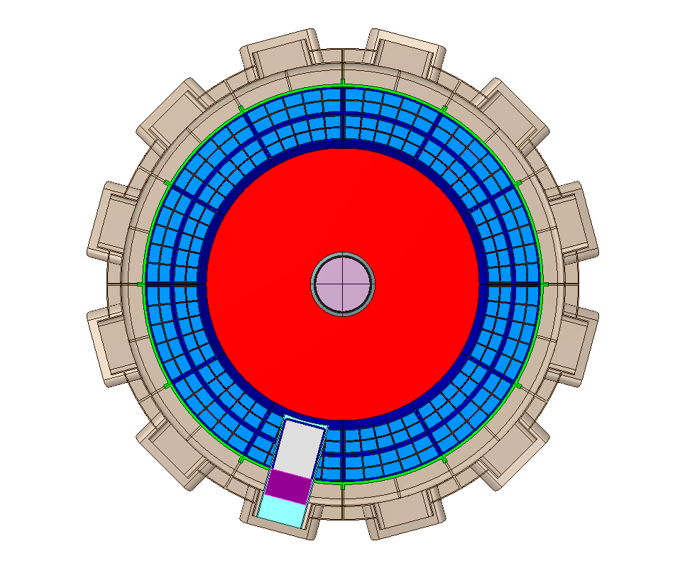
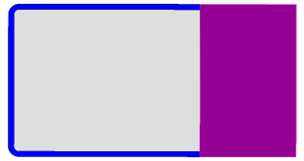
Impact of TBM, MTM, NBI ports on TBR
No ports or penetrations,
homogeneous breeding zones:
TBR = 1.03
Add 4 Test Blanket
Modules (TBMs)
TBR = 1.02 (ΔTBR = -0.01)
TBM
LiPb,
cooling channel,
FCI
Approx. ΔTBR per port:
TBM: -0.25%
MTM: -2.0%
NBI: -0.75%
MTM
Ferritic Steel
1 Materials Test Module (MTM)
TBR = 1.01 (ΔTBR = -0.02)
4 TBM + 1 MTM + 4 NBI
TBR = 0.97

Slide 18
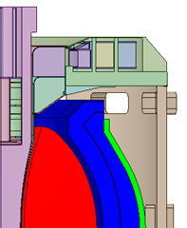
Options to increase TBR > 1
PF Coils
Add to PF coil shield a thin breeding blanket (ΔTBR ~ +3%)
Smaller opening to divertor to reduce neutron leakage
Uniform OB blanket (1m thick everywhere; no thinning)
Reduce cooling channels and FCIs within blanket (need thermal analysis to confirm)
Thicker IB VV with breeding
Potential for TBR > 1 at R=1.7m

Slide 19
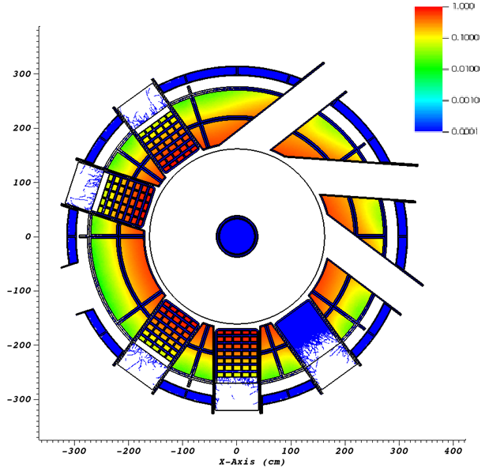
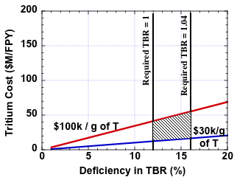
R₀ = 1m ST-FNSF achieves TBR = 0.88
Distribution of T production
TBM
NBI
1m device cannot achieve TBR > 1 even with design changes
Solution: purchase ~0.4-0.55kg of T/FPY from outside sources at $30-100k/g of T, costing $12-55M/FPY
MTM

Slide 20
Summary: R = 1m and 1.7m STs with Γ_{n} = 1MW/m² and Q_{DT} = 1-2 assessed for FNS mission
Ex-vessel PF coil set identified to support range of equilibria and Super-X/snowflake divertor to mitigate high heat flux
0.5MeV NNBI optimal for heating & current drive for R=1.7m
Vertical maintenance approach, NBI & test-cell layouts identified
Shielding adequate for MgO insulated inboard Cu PF coils
  Outboard PF coils (behind outboard blankets) can be superconducting
Calculated full 3D TBR; TBR reduction from TBM, MTM, NBI
Threshold major radius for TBR ~ 1 is R₀ ≥ 1.7m
R=1m TBR = 0.88 → 0.4-0.55kg of T/FPY → $12-55M/FPY
R=1m device will have lower electricity and capital cost → future work could assess size/cost trade-offs in more detail

Slide 21
Backup slides

Slide 22
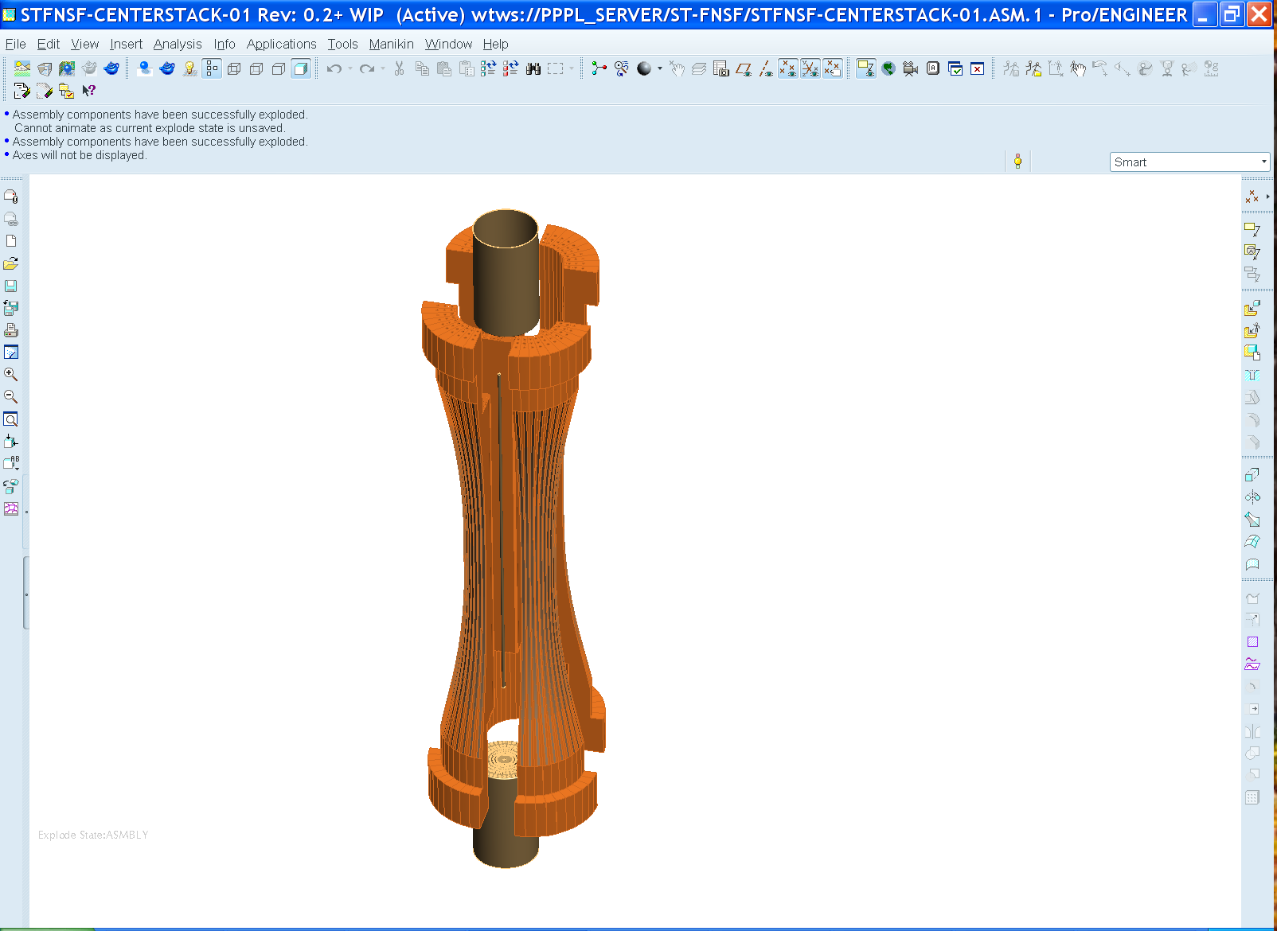
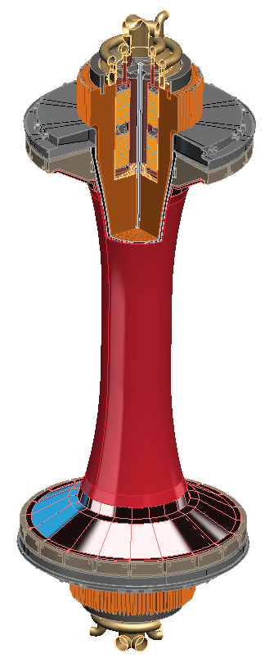
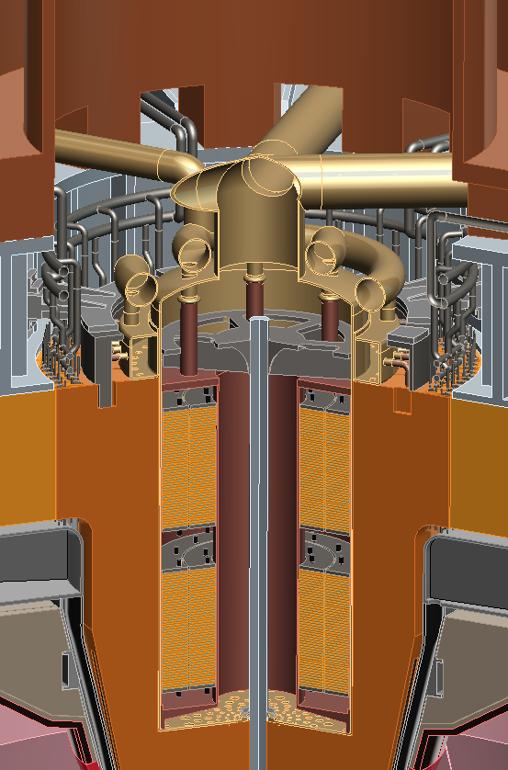
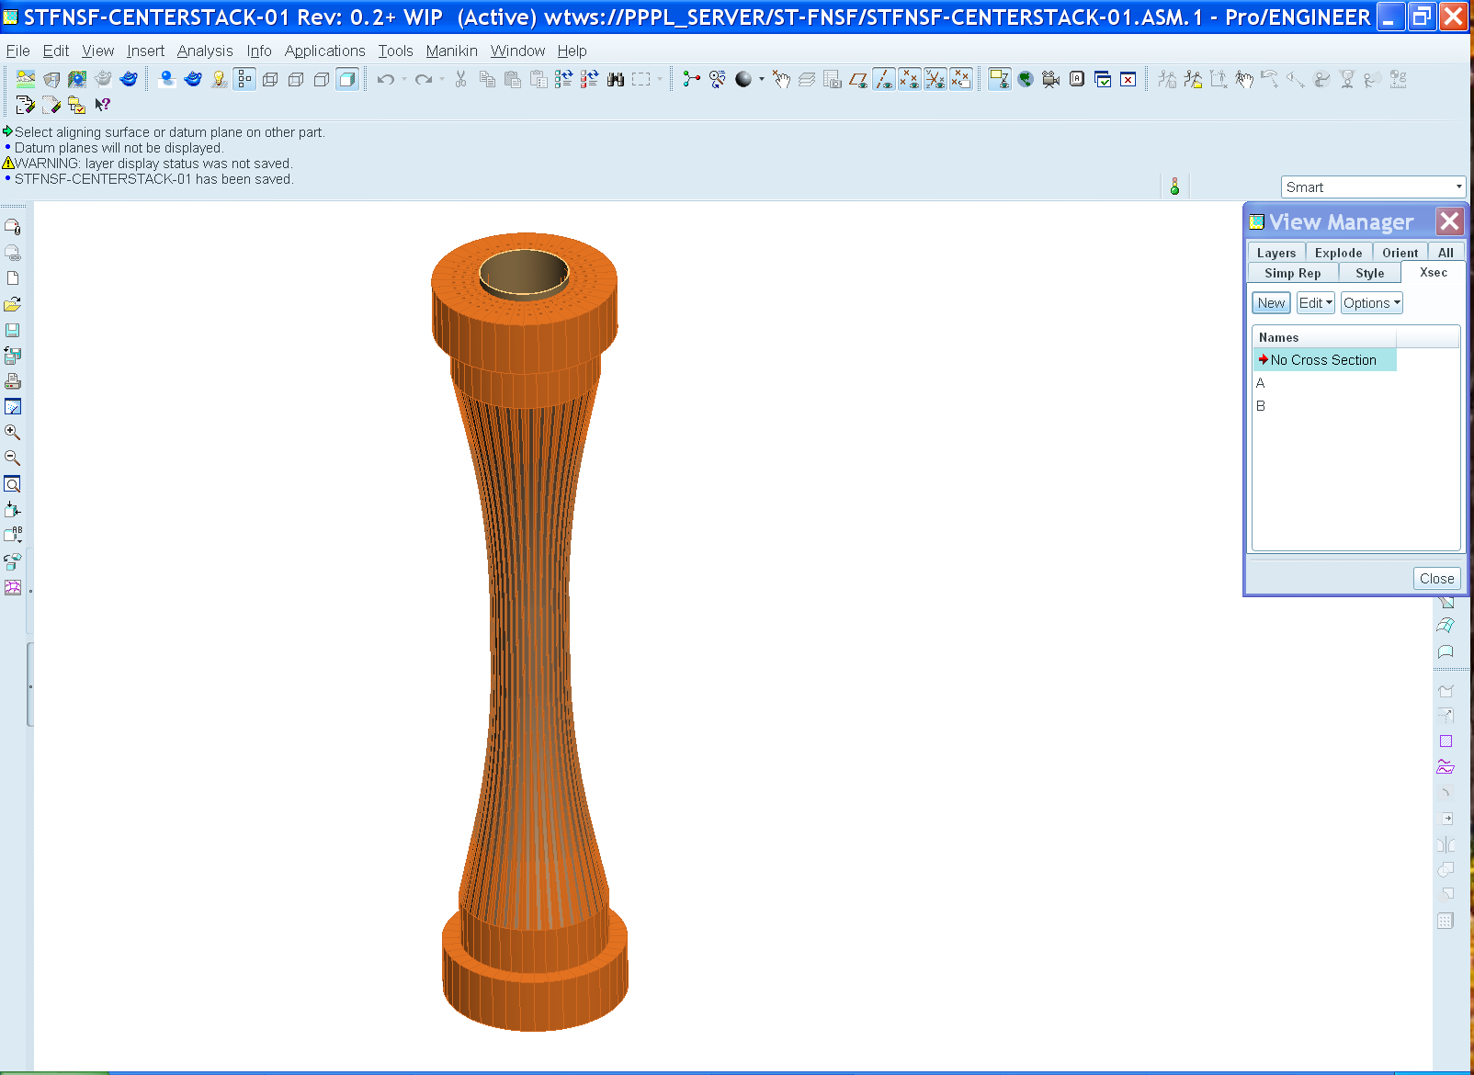
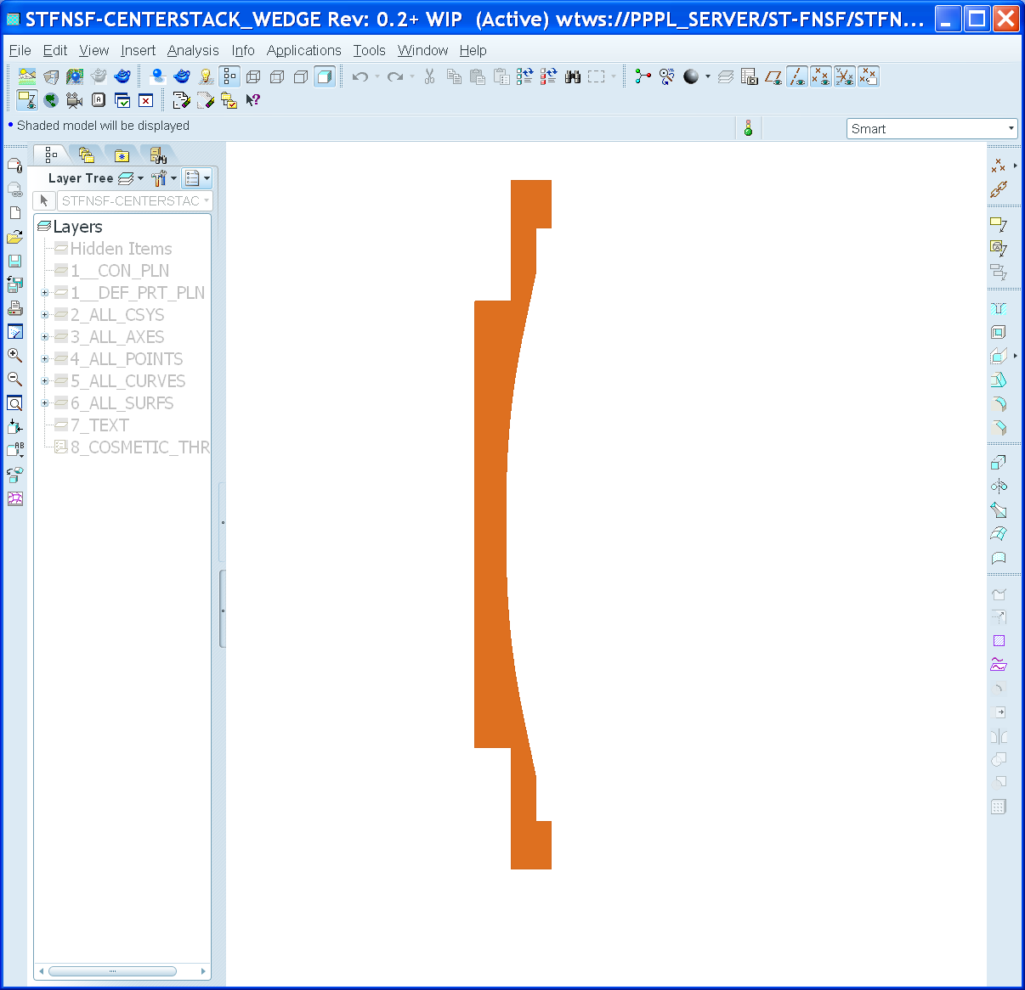
FNSF center-stack can build upon NSTX-U design and incorporate NSTX stability results
Like NSTX-U, use TF wedge segments (but brazed/pressed-fit together)
  Coolant paths: gun-drilled holes or grooves in side of wedges + welded tube
Bitter-plate divertor PF magnets in ends of TF achieve high triangularity
  NSTX data: High δ > 0.55 and shaping S ≡ q₉₅I_{P}/aB_{T} > 25 minimizes disruptivity
  Neutronics: MgO insulation can withstand lifetime (6 FPY) radiation dose

Slide 23
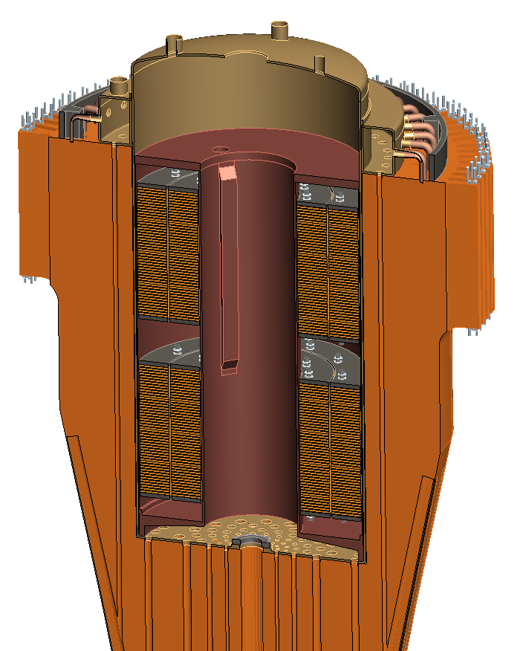
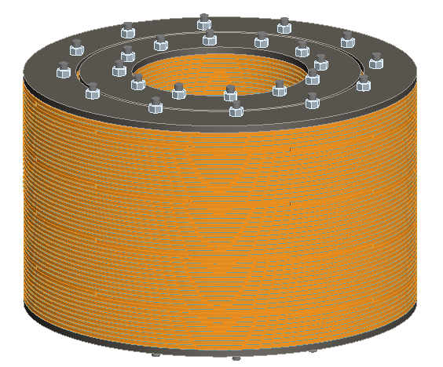
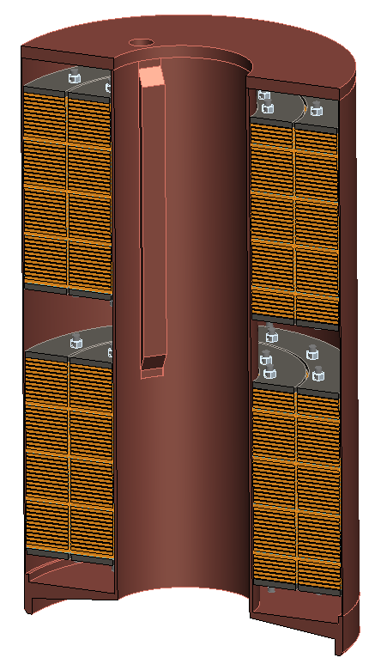
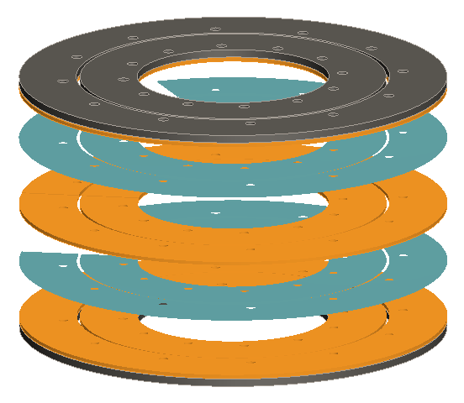
Bitter coil insert for divertor coils in ends of TF
Insulator
Glidcop plates

Slide 24

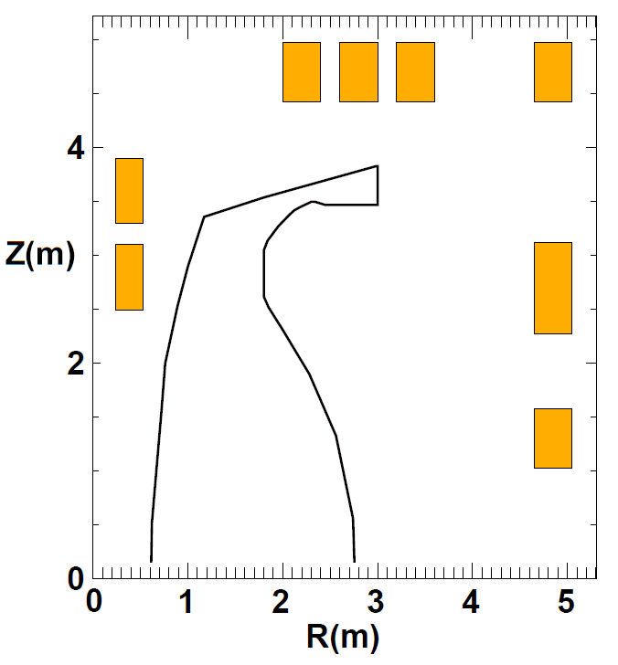
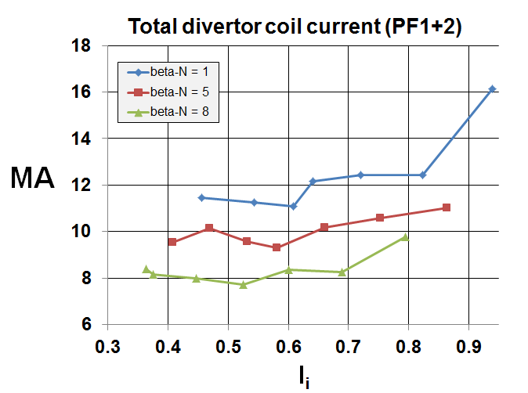
PF coil currents and current densities
β_{N} = 5
l_{i} = 0.58
3
4
5
6
2
1
7
8

Slide 25
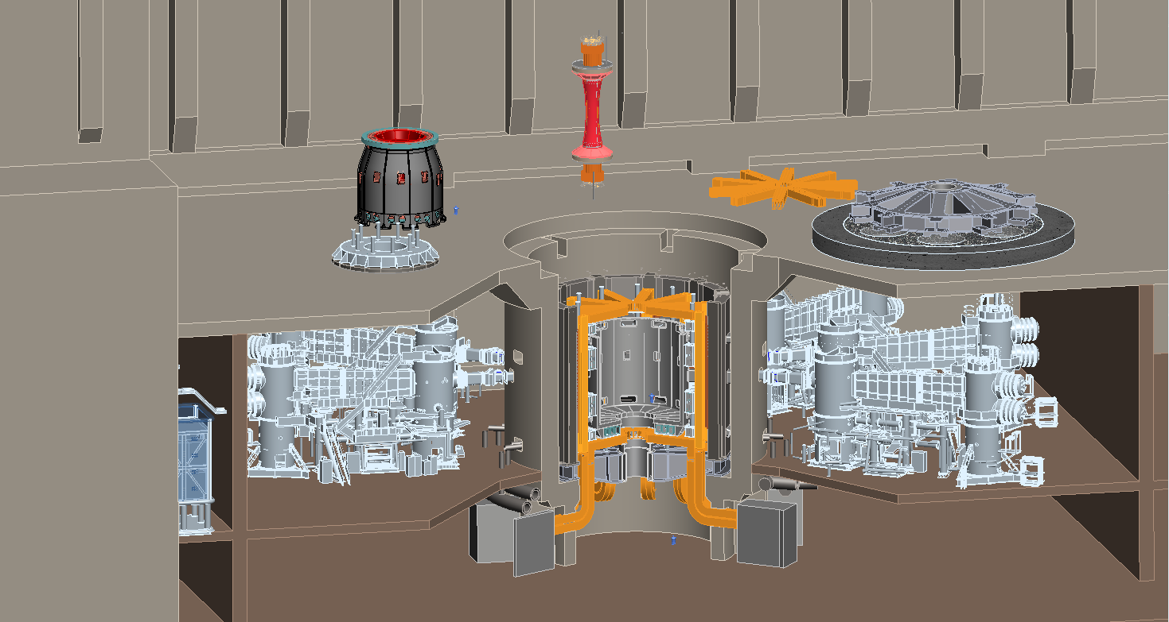
R=1.7m ST-FNS facility layout
using an extended ITER building
TF center-stack
Upper TF horizontal legs
Full blanket assembly
Upper dome structure located on test cell shield plug
VV lid / PF cryostat enclosure
TF power supplies
JT-60SA NNBI

Slide 26
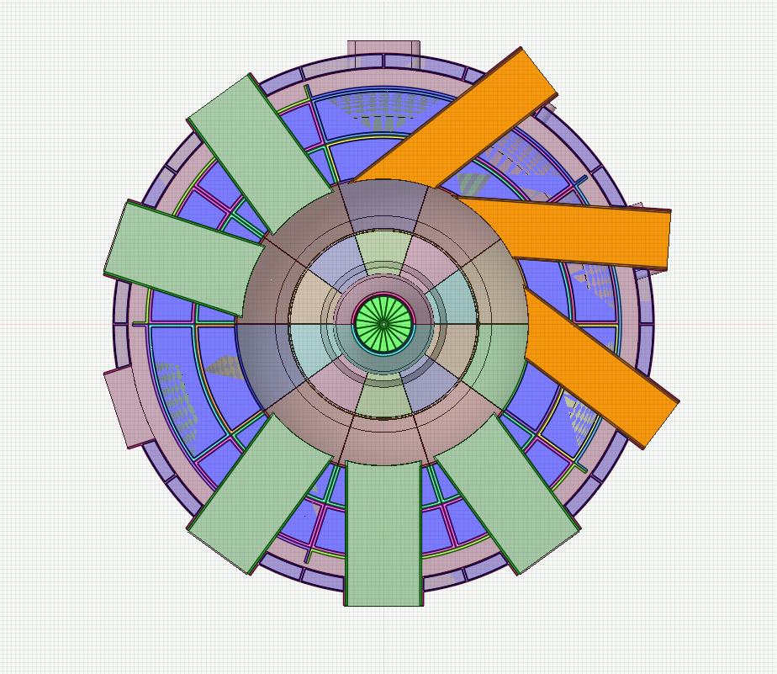


Summary of ST-FNSF TBR vs. device size
R=1.7m: TBR ≥ 1
R=1.0m: TBR < 1 (≈ 0.9)
TBM
NBI
NBI
TBM
MTM
1m device cannot achieve TBR > 1 even with design changes
Solution: purchase ~0.4-0.55kg of T/FPY from outside sources at $30-100k/g of T, costing $12-55M/FPY
MTM

Slide 27
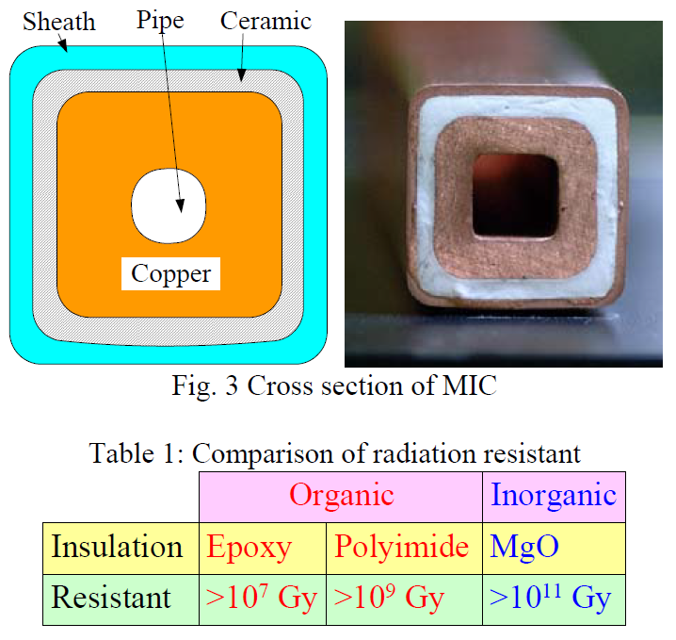
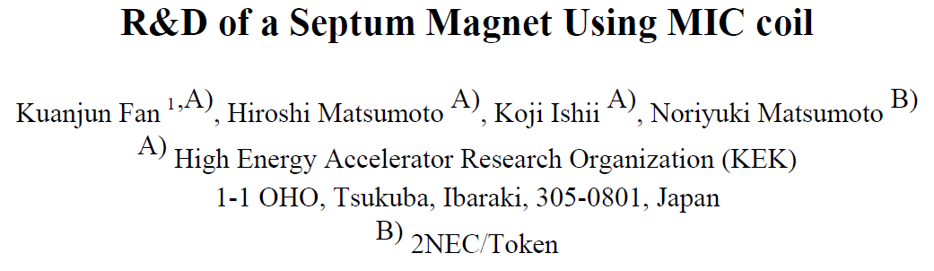
MgO insulation appears to have good radiation resistance for divertor PF coils

Slide 28
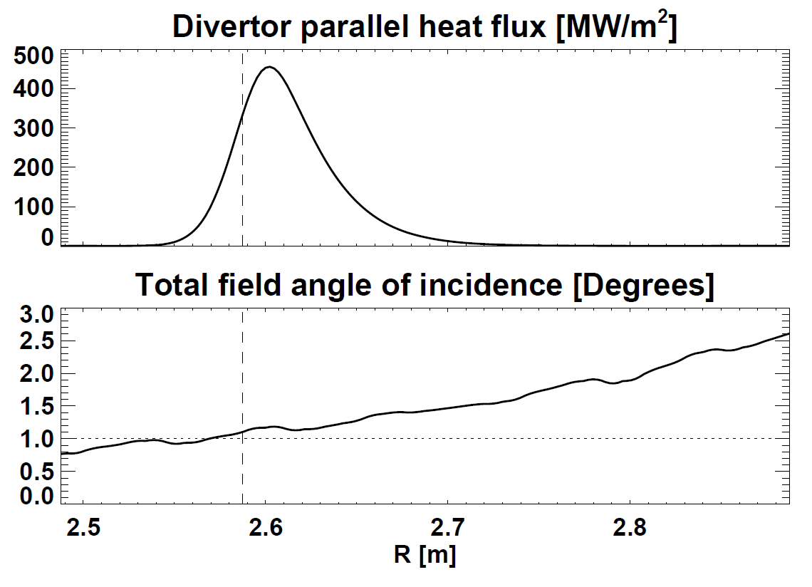
Up/down-symmetric Super-X/snowflake → q_{⊥-divertor} < 10MW/m² even under attached conditions (if integral heat-flux width λ_{q-int} > 2mm)
Peak q|| = 0.45GW/m²
1^{ᵒ} angle of incidence
Peak q⊥ < 10MW/m²
P_{heat} = 115MW, f_{rad}=0.8, f_{obd}=0.8, θ_{pol} = 2.1^{ᵒ}
R_{strike} = 2.6m, f_{exp} = 1.4, λ_{q-int} =2.05mm, N_{div} = 2
P_{heat} (1-f_{rad}) f_{obd} sin(θ_{pol})
2πR_{strike} f_{exp} λ_{q-int} N_{div}
q_{⊥-strike} ≈
Partial detachment expected to further reduce peak q⊥ factor of 2-5×
Eich NF 2013: λ_{q-int} = λ_{q} + 1.64 × S, λ_{q} = 0.78mm, S ≈ λ_{q} (closed divertor)

