Slide 1



Studies of Next-Step Spherical Tokamaks Using High-Temperature Superconductors
Jonathan Menard (PPPL)
22nd Topical Meeting on the Technology of Fusion Energy (TOFE)
Philadelphia, PA
August 22-25, 2016

Slide 2
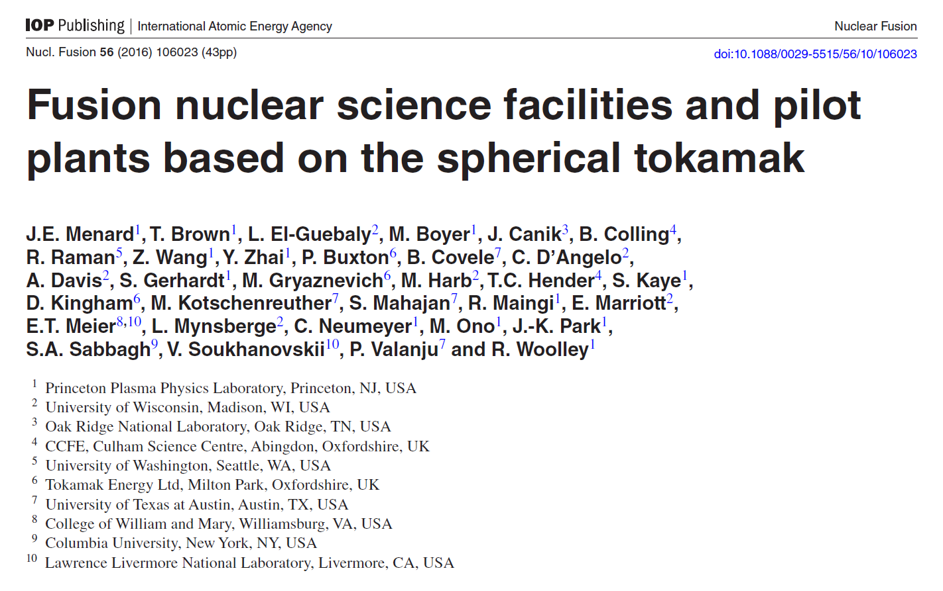










PPPL leading multi-institutional collaborative effort exploring low aspect ratio tokamak concepts
Paper summarizing 5 year study of Cu and HTS STs recently published in Nuclear Fusion

Slide 3
Possible missions for next-steps
Integrate high-performance, steady-state, exhaust
  Divertor test-tokamak - DTT
Fusion-relevant neutron wall loading
  Γ_{n} ~ 1-2MW/m², fluence: ≥ 6MW-yr/m²
Tritium self-sufficiency
  Tritium breeding ratio TBR ≥ 1
Electrical self-sufficiency
  Q_{eng} = P_{electric} / P_{consumed} ~ 1
Large net electricity generation
  Q_{eng} >> 1, P_{electric} = 0.5-1 GWe
This talk will discuss PPPL-led studies of how low-A “spherical” tokamaks could fulfill these missions

Slide 4
What is optimal A for HTS FNSF / Pilot Plant?
P_{fus} / V ~ ε(β_{N} κ B_{T} )⁴ at fixed bootstrap fraction
β_{N} and κ increase at lower aspect ratio
B_{T} decreases at lower A – depends strongly on:
  Inboard shielding, HTS allowable field and current density
Approach:
Fix plasma major radius and heating power (50MW)
  R₀ = 3m – smallest size for Q_{eng} > 1 and high fluence
Apply magnet & plasma constraints (see backup)
  HTS strain: 0.3%, β_{N}: n=1 no-wall, κ: 0.95×limit, f_{GW} = 0.8
Vary aspect ratio from A = 1.6 to 4
Vary HTS current density, peak field
  Also scan inboard shielding thickness
Compute Q_{DT}, Q_{eng}, and required H₉₈ (unconstrained)

Slide 5
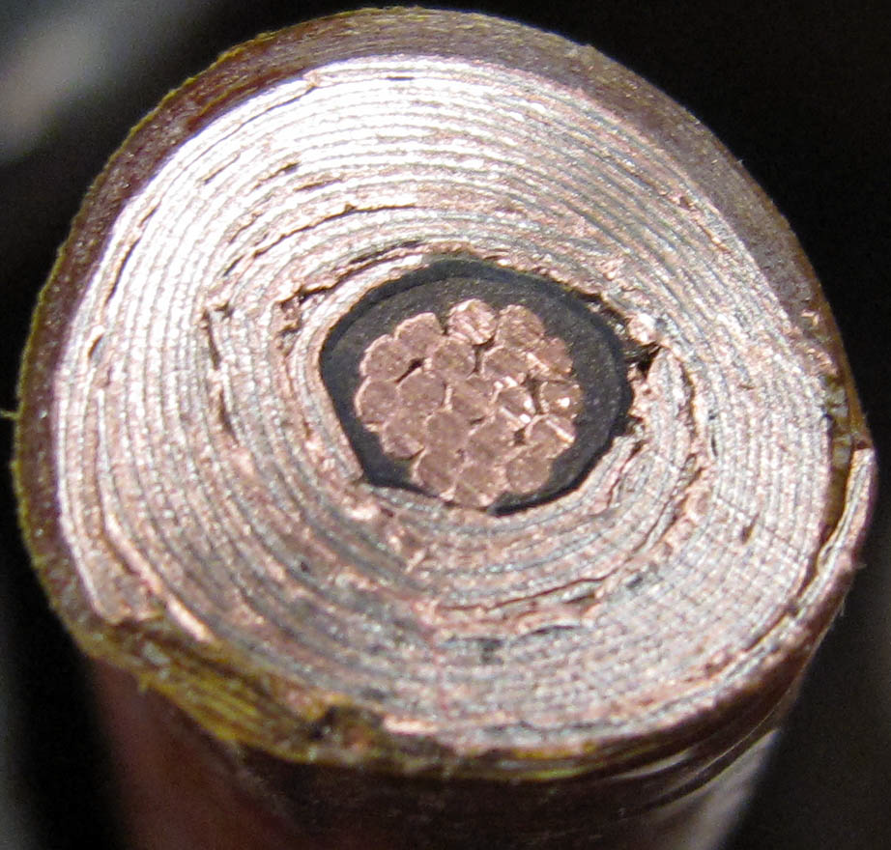
HTS cables using REBCO tapes achieving high winding pack current density at high B_{T}
10 mm
Conductor on Round Core Cables (CORC)
J_{WP} ~ 70MA/m² 19T
6 mm
10 mm
7 kA CORC (4.2K, 19 T) cable
Base cable: 50 tapes YBCO Tapes with 38 μm substrate (Van Der Laan, HTS4Fusion, 2015)
7 mm
Base Conductor
He Gas Cooled
8kA,
J_{WP} ~ 160MA/m²
Higher J_{cable} HTS cable concepts under development:
Copper
7 mm
SS conductor jacket for strength

Slide 6
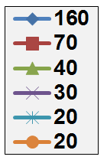
High TF winding-pack current density required to access highest B_{T} at lower A
19T: Present CORC HTS limit
J_{WP} [MA/m²]
12T: ITER-like TF coil limit
(Nb₃Sn, 11.8T)
Coil structure sized to maintain ≤ 0.3% strain on winding pack for all cases shown here
Effective inboard WC neutron shield thickness = 60cm

Slide 7
High current density HTS cable motivates consideration of low-A tokamak pilot plants
J_{WP} [MA/m²]
ITER-like TF constraints:
  J_{WP}=20MA/m², B_{max} ≤ 12T
  P_{fusion} ≤ 130MW
  P_{net} < -90MW
J_{WP} ~ 30MA/m², B_{max} ≤ 19T
  P_{fusion} ~ 400MW
  Small P_{net} at A=2.2-3.5
J_{WP} ≥ 70MA/m²,B_{max} ≤ 19T
  P_{fusion} ~500-600MW
  P_{net} = 80-100MW at A=1.9-2.3
(12T)
A ~ 2 attractive at high J_{WP}

Slide 8
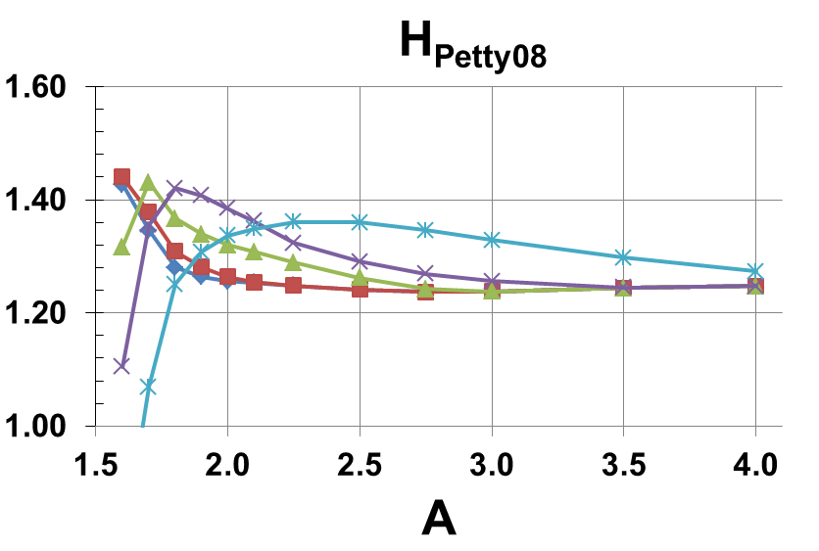
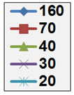
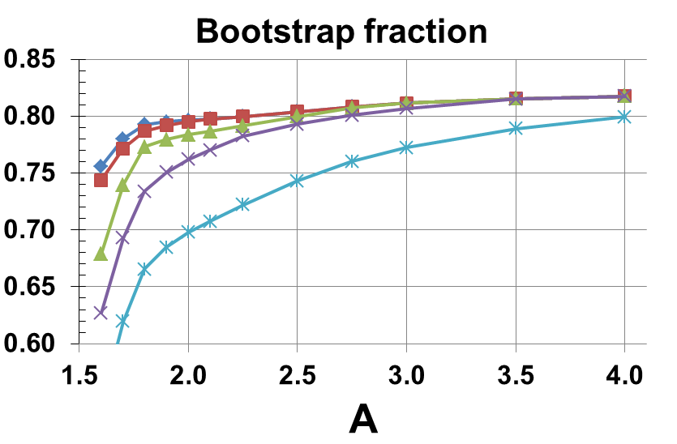
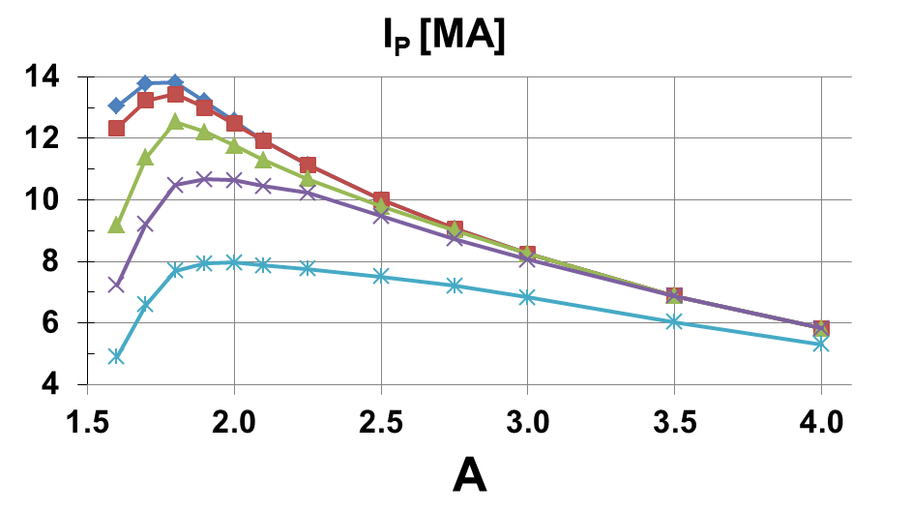
A ≥ 2 pilot plant scenarios have elevated H > 1, f_{BS} ~ 80%, I_{P} = 6-12MA
J_{WP} [MA/m²]
Effective inboard WC neutron shield thickness = 60cm

Slide 9
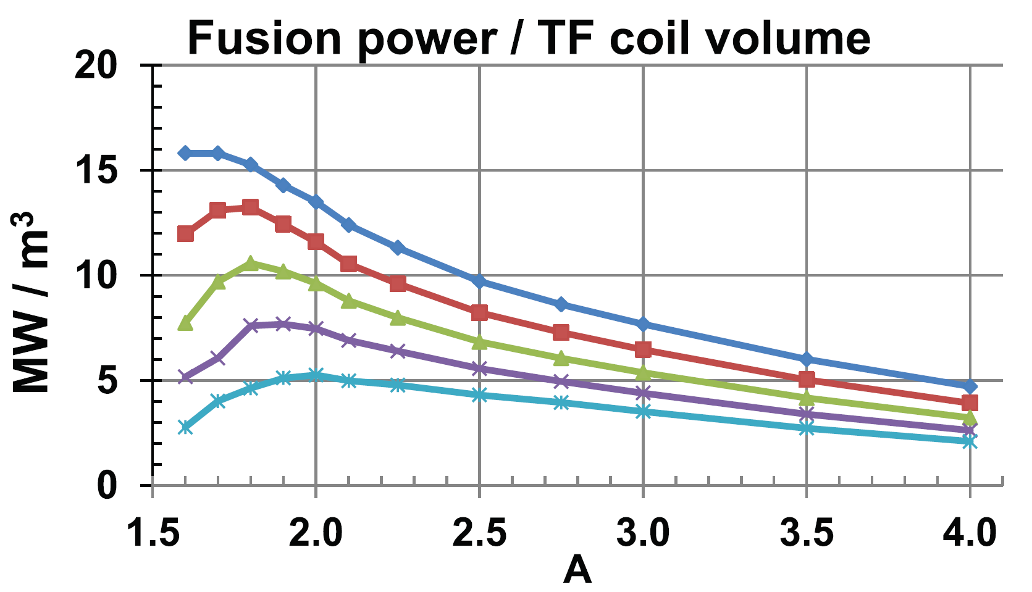
A ≤ 2 maximizes TF magnet utilization
Eff. shield
thickness:
0.3m
0.4m
0.5m
0.6m
0.7m
J_{WP} = 70MA/m²

Slide 10
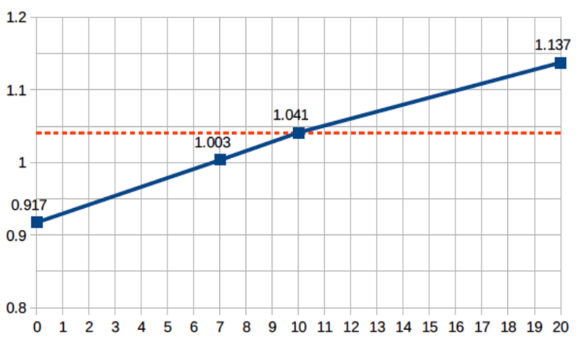

Need inboard breeding for TBR > 1 at A=2
TBR
Required TBR = 1.04
(4% margin)
Outboard TBR ~ 0.92
10cm IB shield sufficient for TBR > 1.04

Slide 11
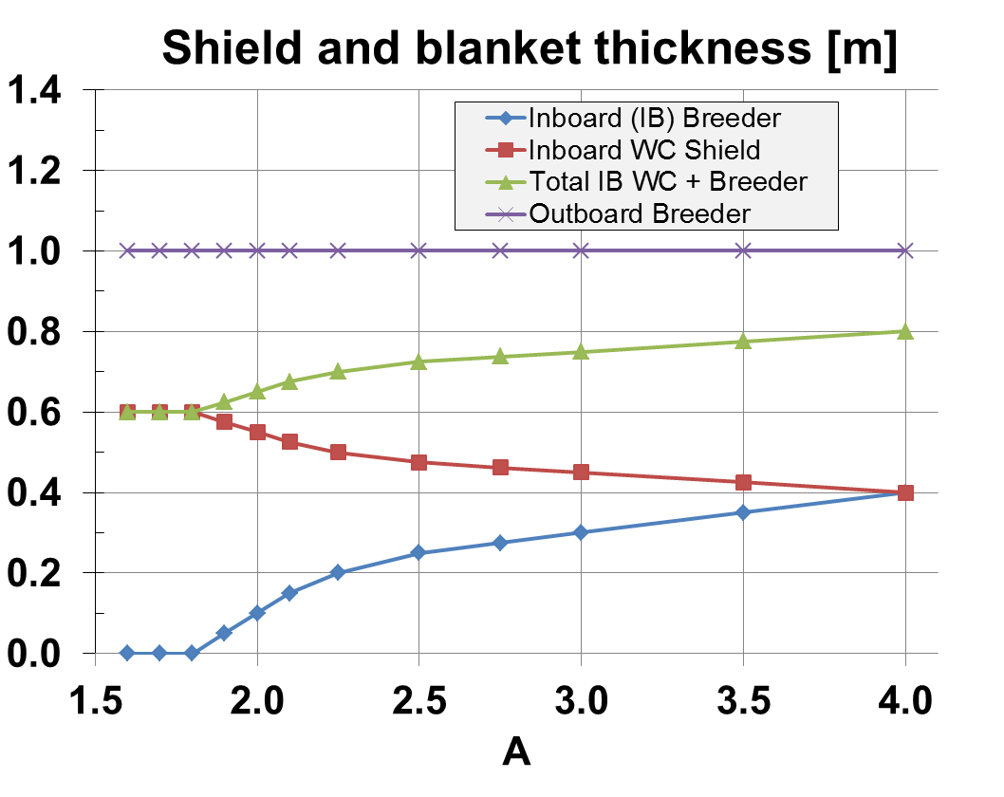
Breeding blanket thickness model

Slide 12
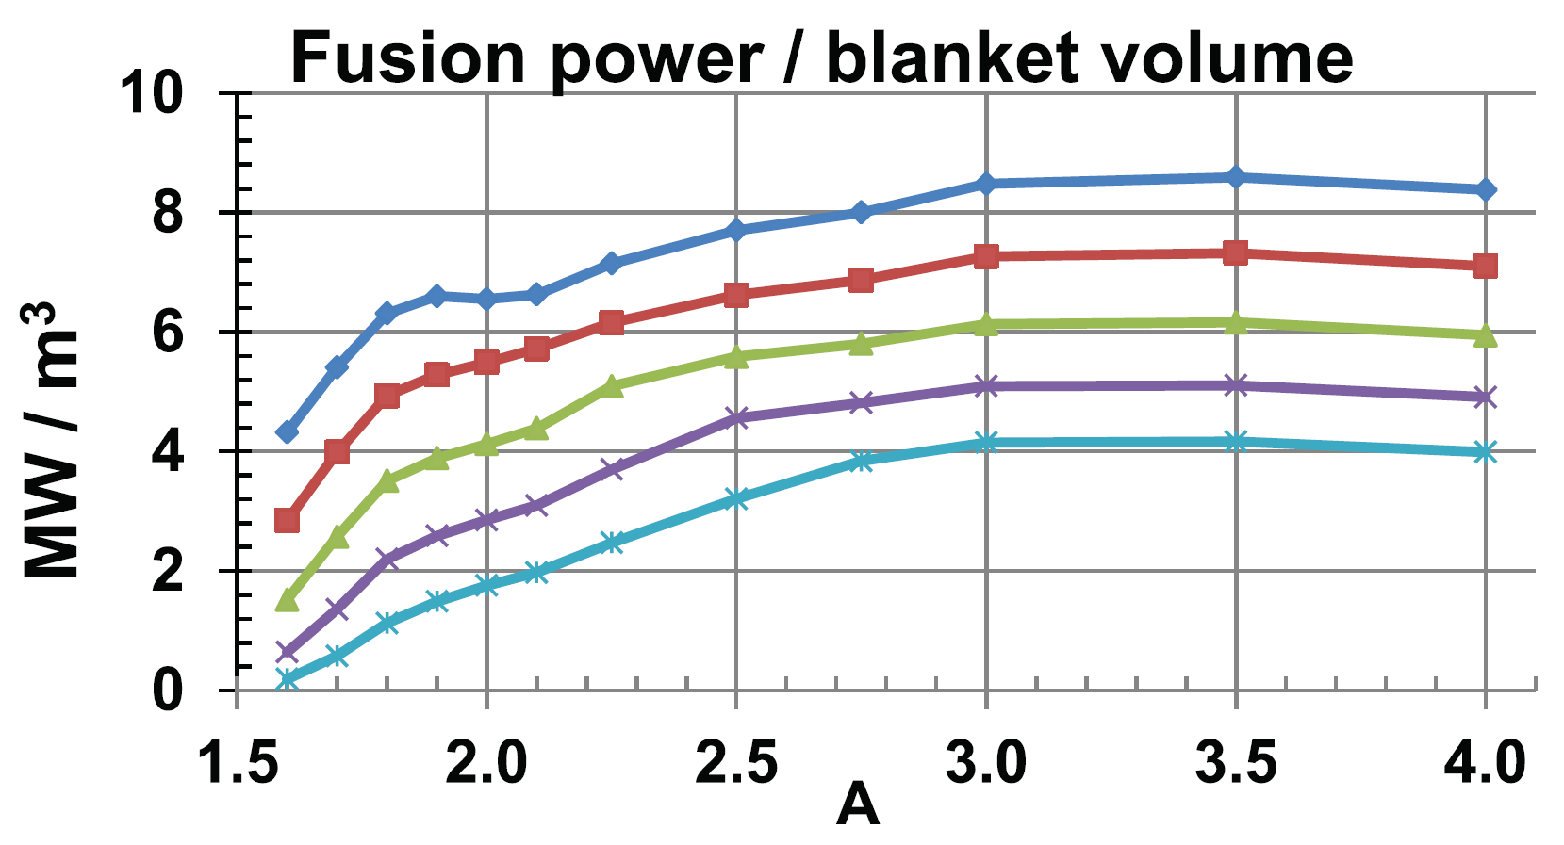
A ≥ 3 maximizes blanket utilization
Eff. shield
thickness:
0.3m
0.4m
0.5m
0.6m
0.7m
J_{WP} = 70MA/m²

Slide 13
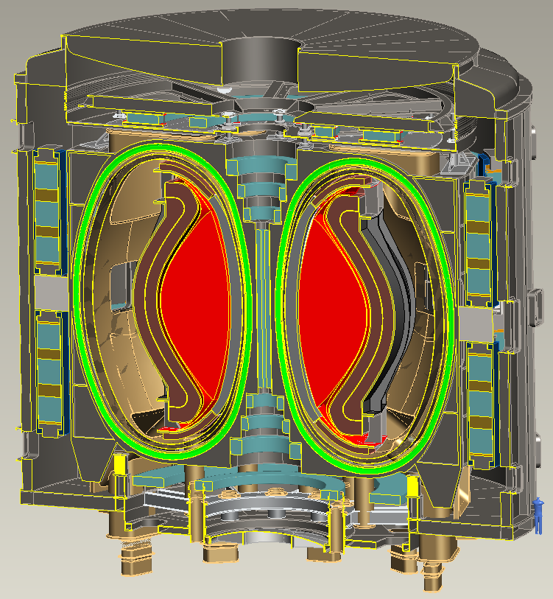
A=2, R₀ = 3m HTS-TF FNSF / Pilot Plant
B_{T} = 4T, I_{P} = 12.5MA
κ = 2.5, δ = 0.55
β_{N} = 4.2, β_{T} = 9%
H₉₈ = 1.8, H_{Petty-08} = 1.3
f_{gw} = 0.80, f_{BS} = 0.76
Startup I_{P} (OH) ~ 2MA
J_{WP} = 70MA/m²
B_{T-max} = 17.5T
No joints in TF
Vertical maintenance
P_{fusion} = 520 MW
P_{NBI} = 50 MW, E_{NBI} = 0.5MeV
Q_{DT} = 10.4
Q_{eng} = 1.35
P_{net} = 73 MW
⟨W_{n}⟩ = 1.3 MW/m²
Peak n-flux = 2.4 MW/m²
Peak n-fluence = 7 MWy/m²
Cryostat volume ~ 1/3 of ITER

Slide 14
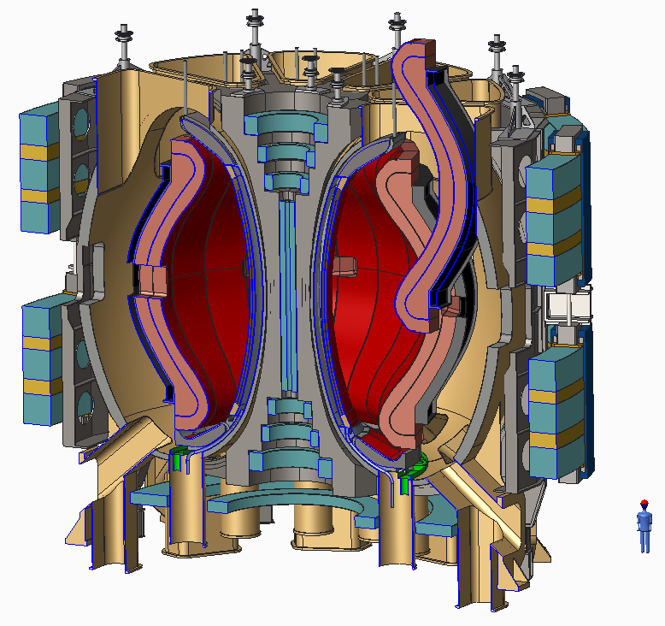
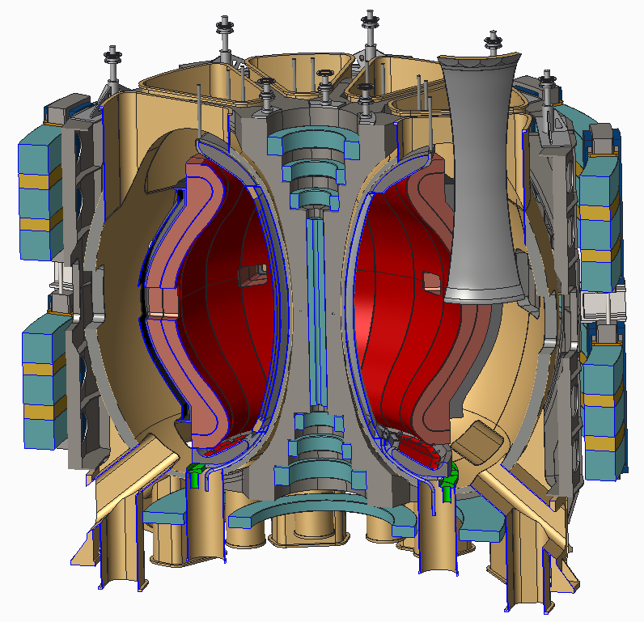
Inboard and outboard blanket vertical maintenance
Outboard blanket removed
Inboard blanket removed once outboard blanket sectors removed – depending on the toroidal extent of the inboard blanket

Slide 15
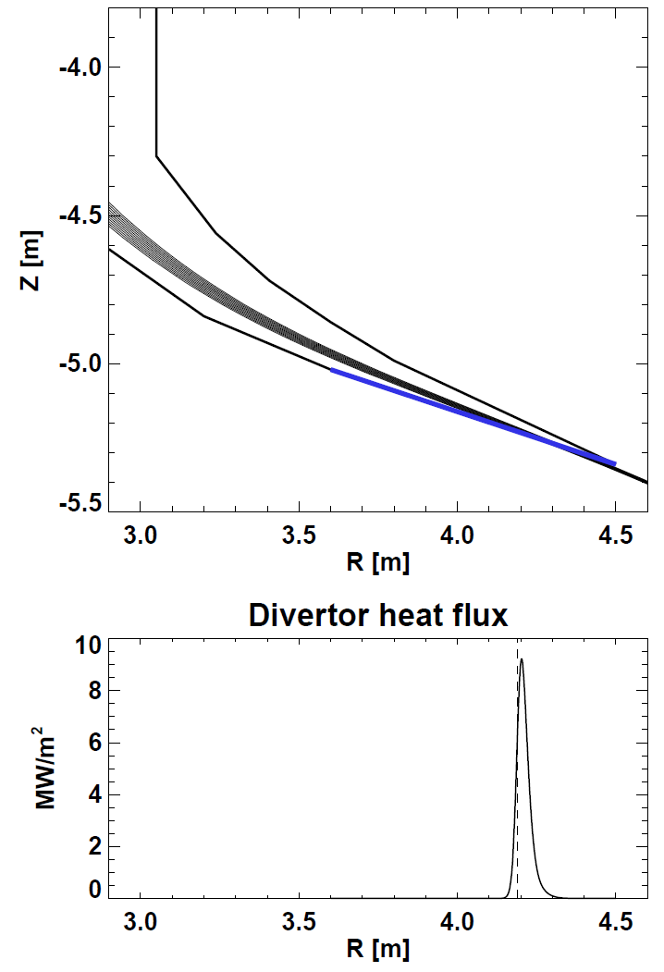
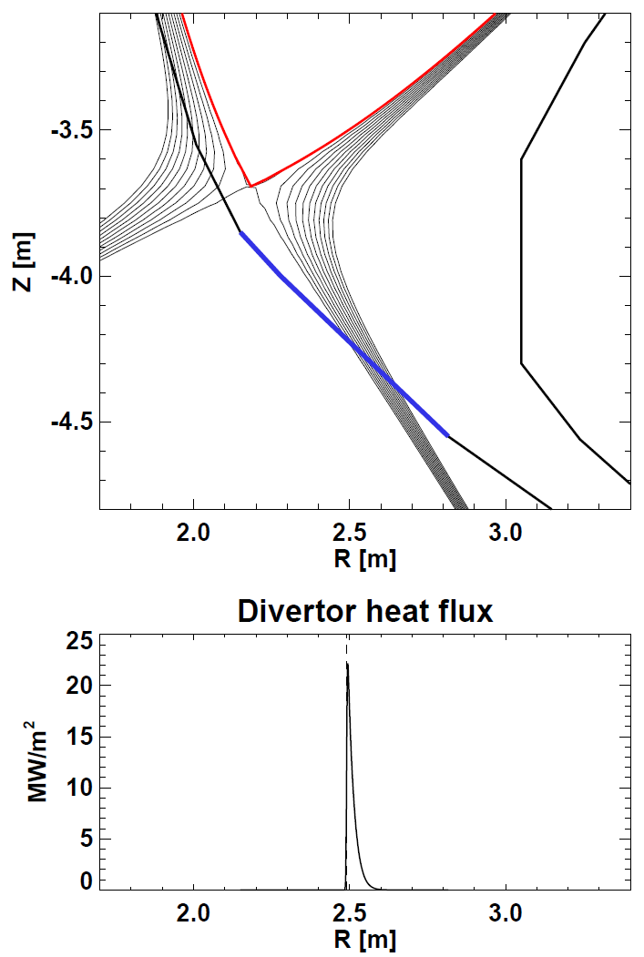
Long-leg divertor
P_{div} = 9MW/m², R_{strike} = 4.2m
Liquid metal (short-leg)
P_{div} = 21MW/m², R_{strike} = 2.5m
Long-leg / Super-X
Shorter leg LM divertor
Geometry also compatible with
“vapor box” concepts (Ono / Goldston)

Slide 16

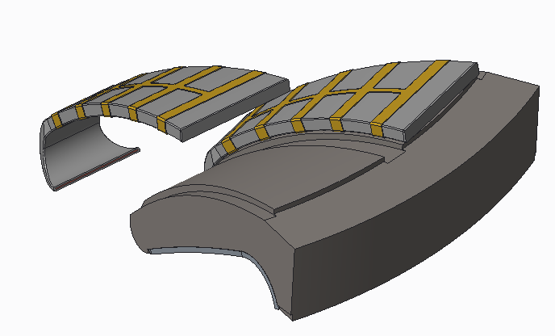
Exploring liquid metal divertor design similar to flowing water curtain systems
LM injector system can be assembled in a single or double unit
LM containment structure
Shield block
Ferritic steel backing plate

Slide 17
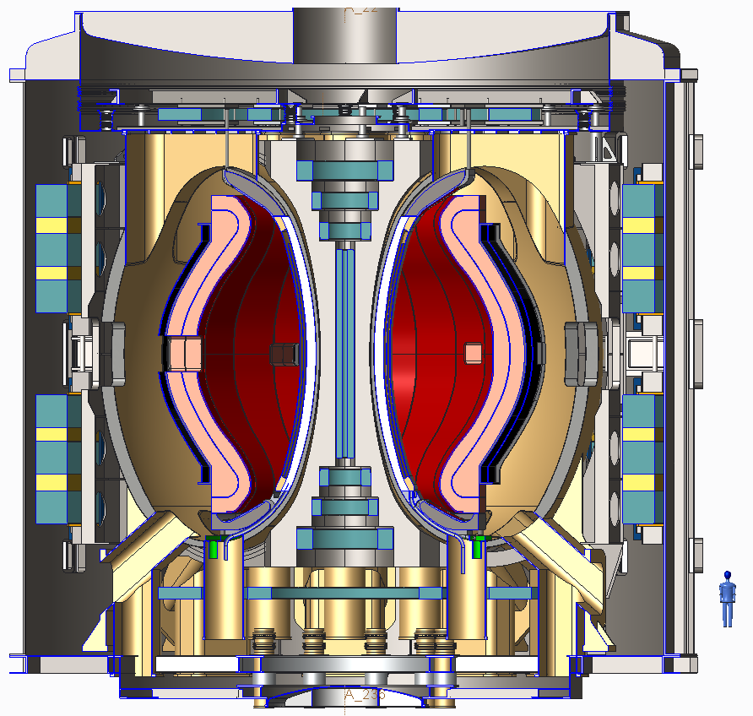
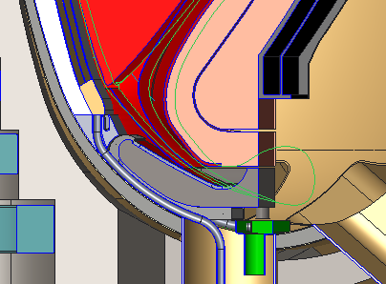
HTS ST-FNSF design with Li flow on divertor and inboard surfaces
Double null liquid metal divertor system
Li flows from upper divertor down the inboard wall, exiting just after the lower inboard divertor.
Separate Li cooling of lower divertor

Slide 18
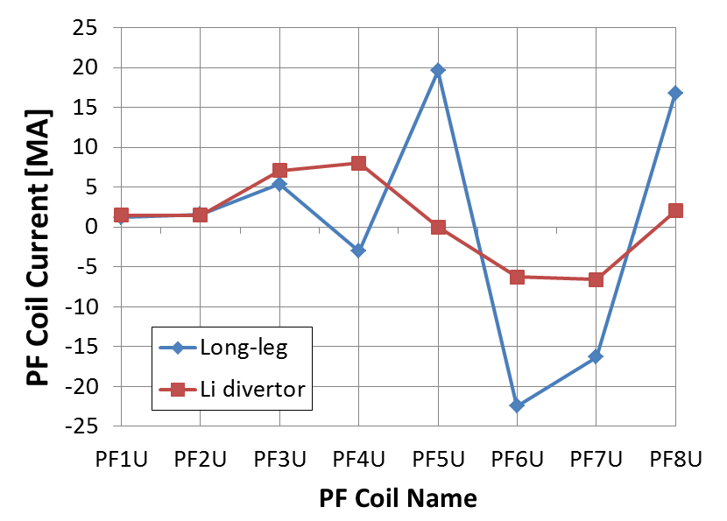
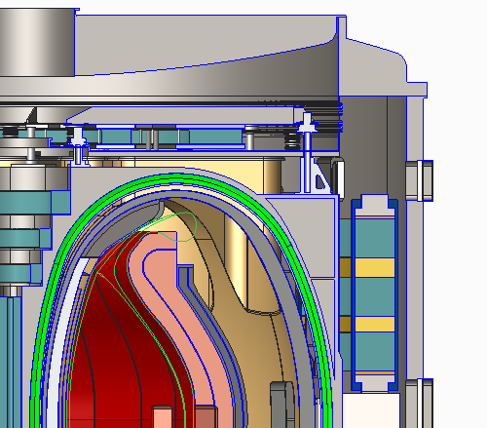
Benefits of shorter-leg LM high-heat-flux divertor:
Significantly reduce outboard PF coil current
  Reduced PF size, force, structure
Eliminate separate upper cryo-stat (for PF5U)
4
5
3
2
6
1
7
8
Li wall pumping could help increase H

Slide 19
Summary
Developed new self-consistent configurations for low-A FNSFs / Pilot Plants
  Long-leg and/or LM divertor, T self-sufficient, only ex-vessel TF and PF coils, vertical maintenance
Compact Pilot Plants achievable by combining improved stability of low-A + advanced magnets
  Optimal A will be informed by results from NSTX-U and MAST-U and REBCO TF magnet development
Liquid metal divertors for high heat flux could simplify cryostat, reduce coil currents/forces
  Higher confinement from liquid Li also beneficial

Slide 20
Backup slides

Slide 21
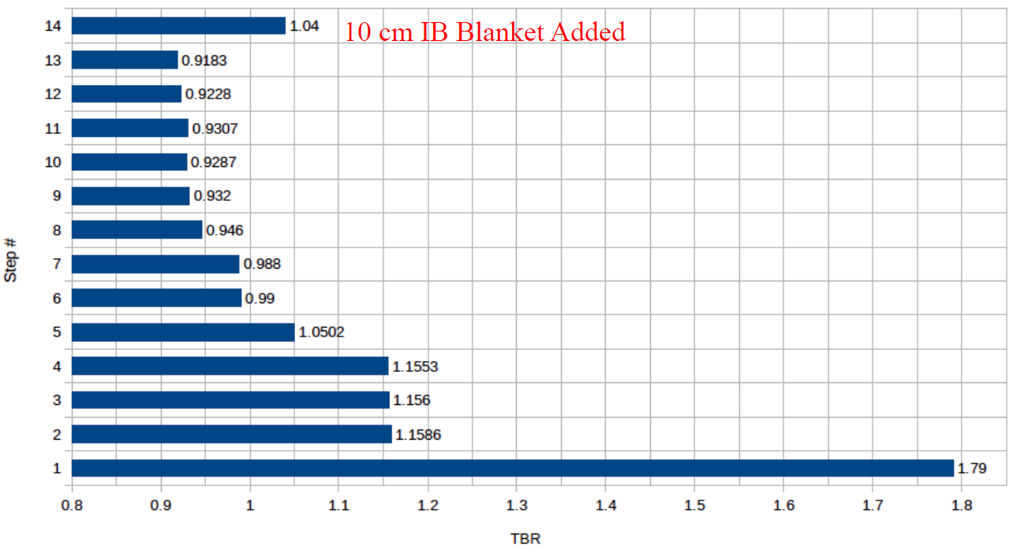

Detailed breeding calculations completed for A=2
Step 1- Infinite media of LiPb
Step 2- LiPb confined to OB FW/blanket
Step 3- Assembly gaps added
Step 4- Homogeneous mixture of blanket in upper and lower ends of OB blanket
Step 5- FW material added
Step 6- Side, back, and front walls added
Step 7- Cooling channels added
Step 8- SiC FCI added
Step 9- Stabilizing shells added
Step 10- MTM only inserted (TBR relative to Step #9)
Step 11- 4 TBMs only inserted (TBR relative to Step #9)
Step 12- 4 NBIs only inserted (TBR relative to Step #9)
Step 13- all MTM, 4 TBMs, and 4 NBIs inserted
Step 14 – include inboard breeding blanket

Slide 22
Comparison of low-A FNSF / Pilot Plants

Slide 23
Plasma constraints
Fix plasma major radius at R₀ = 3m
  Chosen to be large enough to allow space for HTS neutron shield and access Q_{eng} > 1 for range of A
Inboard plasma / FW gap = 4cm
Use ε-dependent κ(ε), β_{N} (ε) (see next slide)
Greenwald fraction = 0.8
q* not constrained
  q* is better ε-invariant than q₉₅ for current limit
  Want to operate with q* > 3 to reduce disruptivity
0.5 MeV NNBI for heating/CD – fixed P_{NBI} = 50MW
H_{98y2} adjusted to achieve full non-inductive CD

Slide 24
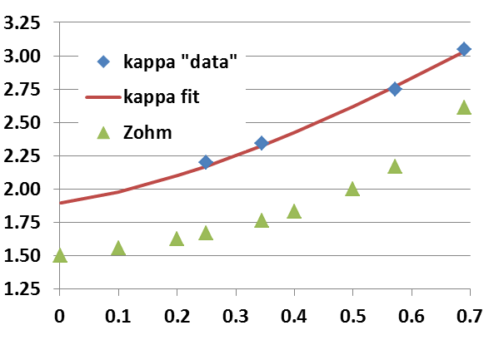
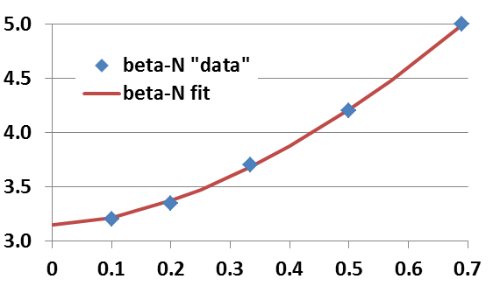
Aspect ratio dependence of limits: κ(ε), β_{N}(ε)
Pilot study uses 0.95×κ value shown here:
NSTX data at low-A
  Also NSTX-U/ST-FNSF modelling
DIII-D, ARIES-AT for higher A
  κ → 1.9 for A → ∞
Profile-optimized no-wall stability limit at f_{BS} ≈ 50%
  Menard PoP 2004
β_{N} → 3.1 for A → ∞
β_{T} ∝ A^{-1/2} (1+κ²) β_{N}² / f_{BS}
→ P_{fus} ∝ ε [κ(ε) β_{N}(ε) B_{T}(ε)]⁴
ε = A⁻¹

Slide 25
Engineering constraints
Magnet constraints
  Maximum stress in TF magnet structure = 0.66 GPa
  HTS tape/cable strain limit 0.3% (equivalent to 0.4 GPa)
  Winding pack current density (CORC 2015) 70 MA/m²
  OH at small R → higher solenoid flux swing for higher A
Shielding / blankets
  HTS fluence limit: 3.5-5 x 10²² n/m²
  Shield:10x n-shielding factor per 15-16cm WC for HTS TF
  Include inboard & outboard breeder thickness for TBR ~ 1
    “Effective shield thickness” includes shield + DCLL blanket
Electrical system efficiency assumptions:
  30% wall plug efficiency for H&CD - typical of NNBI
  ≥ 45% thermal conversion efficiency - typical of DCLL
    Also include pumping, controls, other sub-systems
    See Pilot Plant NF 2011 paper for more details

Slide 26
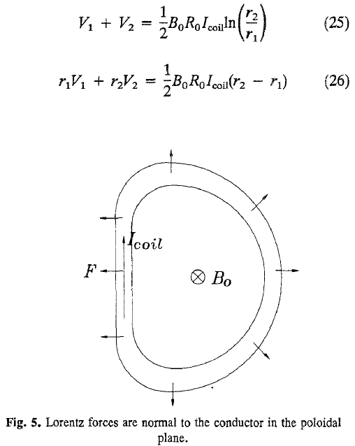
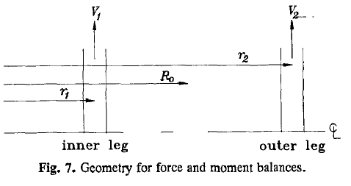
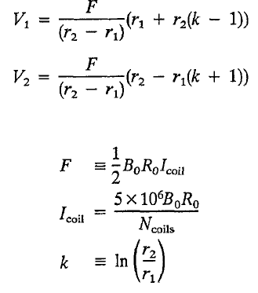
Simplified TF magnet design equations
From J. Schwartz, Journal of Fusion Energy, Vol. 11, No. 1, 1992

Slide 27
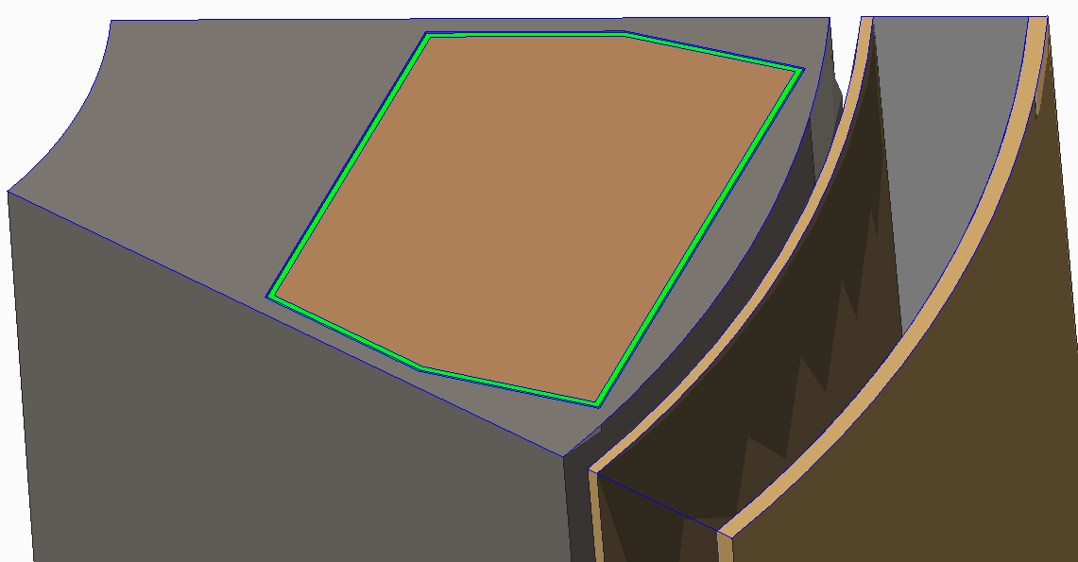
A=2, R₀ = 3m device TF inboard leg showing
allocated space for case and winding
Current per coil: 6 MA
Winding Cd: 35.9 MA/m²
0.167 m² winding area

Slide 28
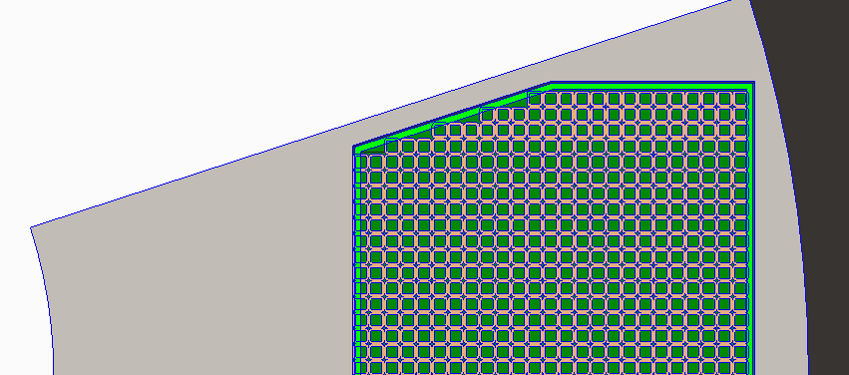
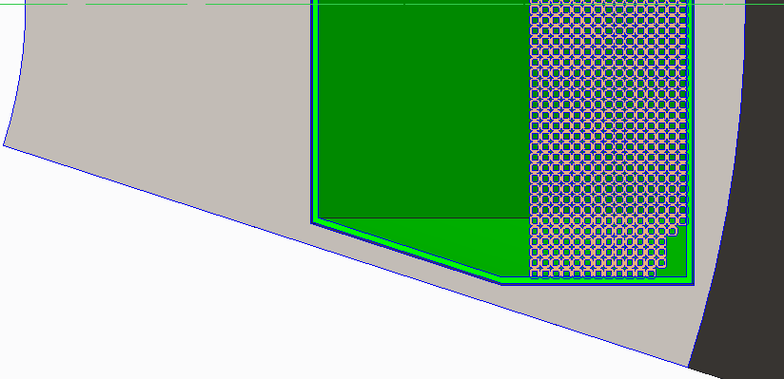
CORC Conductor – Achieved now
857 turns @ 7 kA
(848 turns shown; a few additional turns required)
10 mm
10 mm
6 mm
Base Conductor – Helium Gas Cooled
7 mm
Copper
7 mm
750 turns @ 8 kA
(750 turns shown)
SS conductor jacket for strength

Slide 29
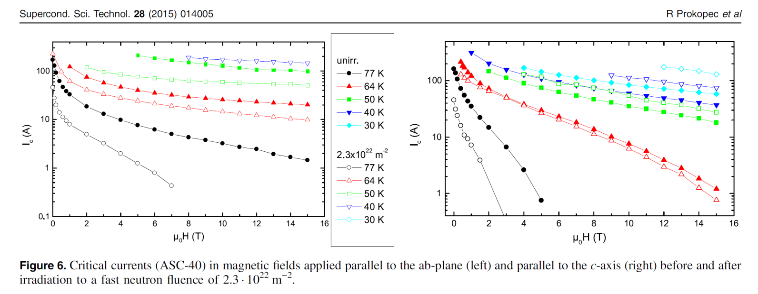
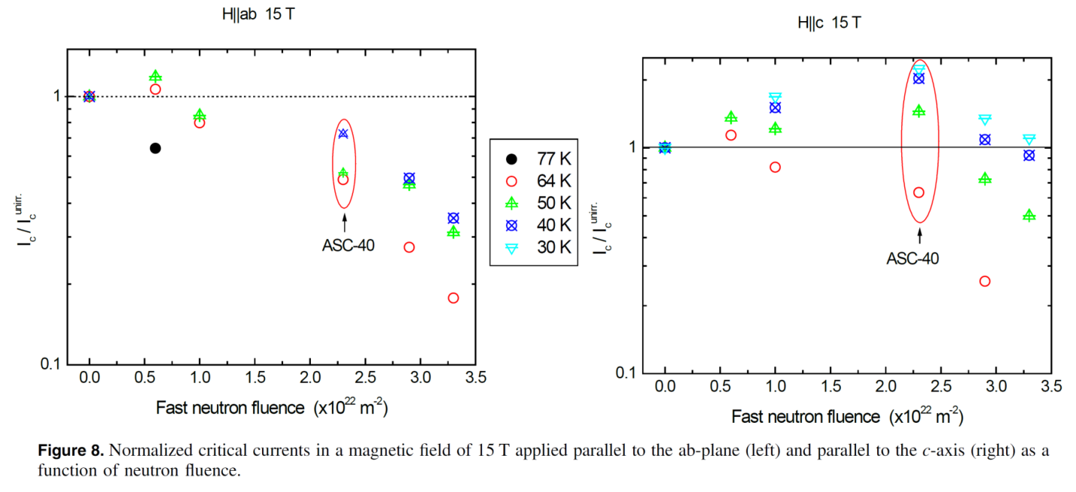
HTS performance vs. field and fast neutron fluence

Slide 30
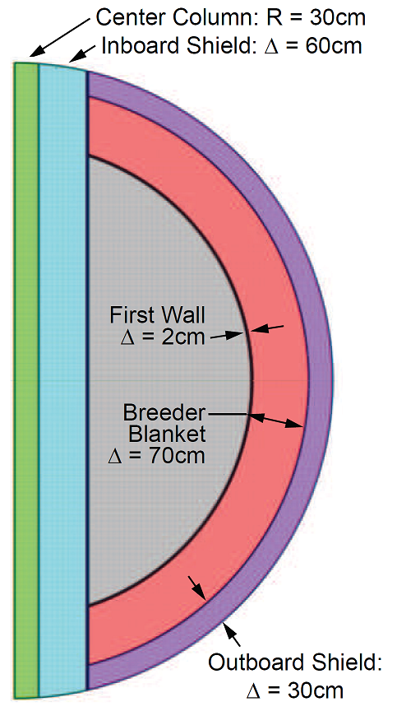
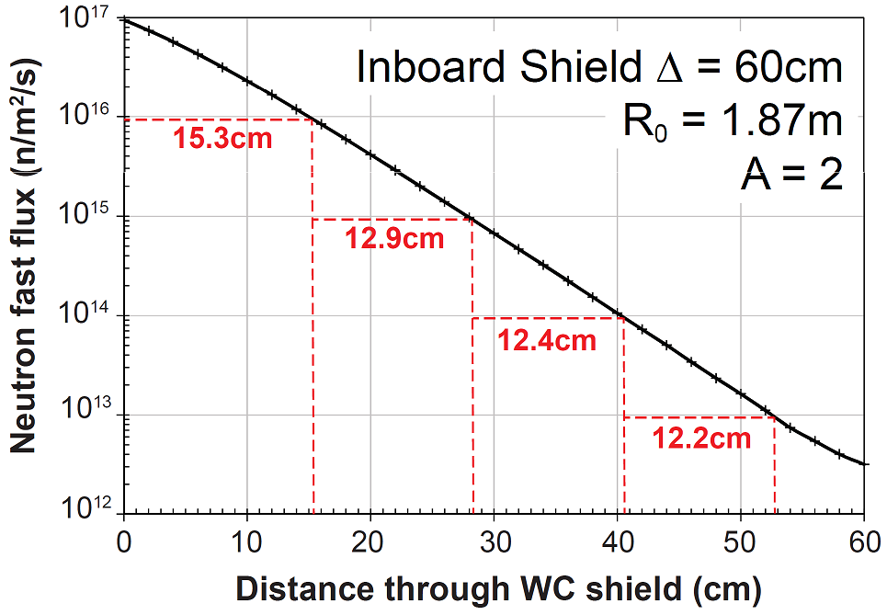

Neutronics analysis for HTS TF shielding

Slide 31
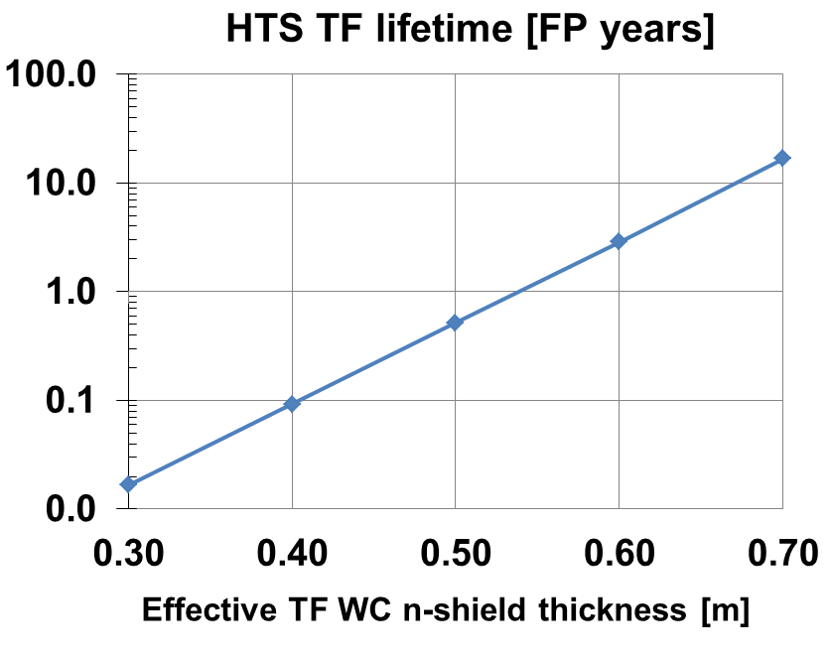
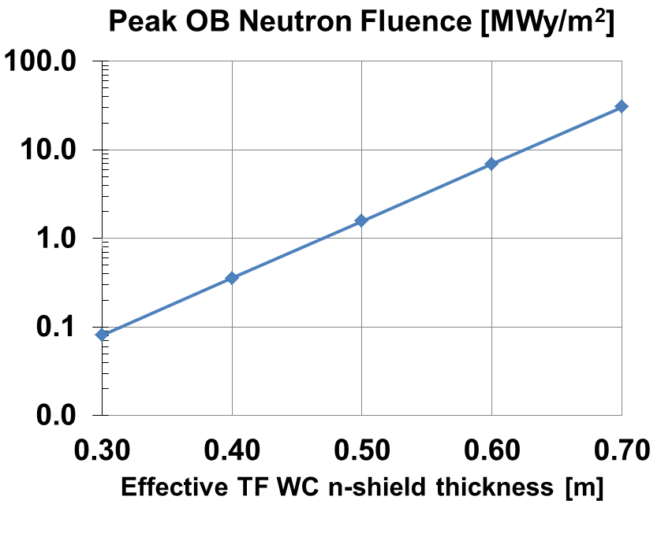
HTS TF lifetime is very strong function of inboard shielding thickness
Inboard shield + blanket equivalent to 60cm WC →
3FPY → 6-7MWy/m² → fulfill FNSF requirement

Slide 32
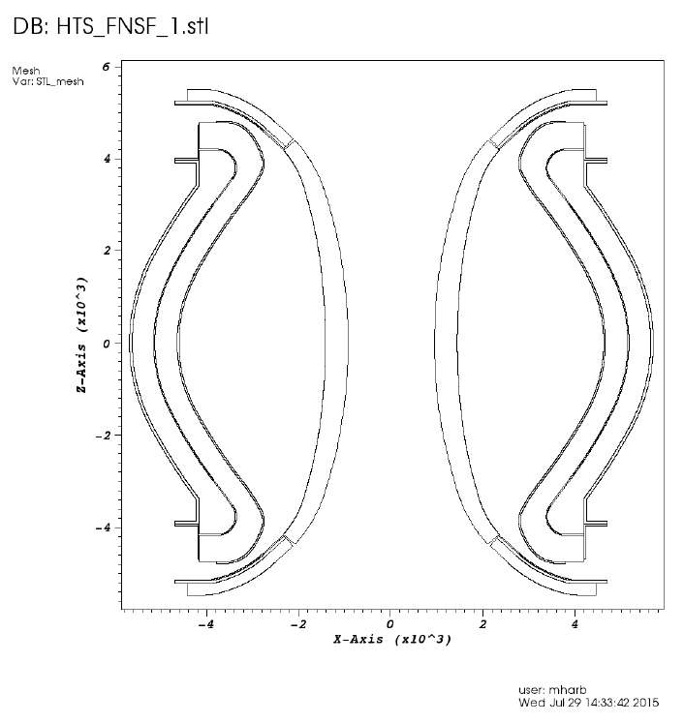
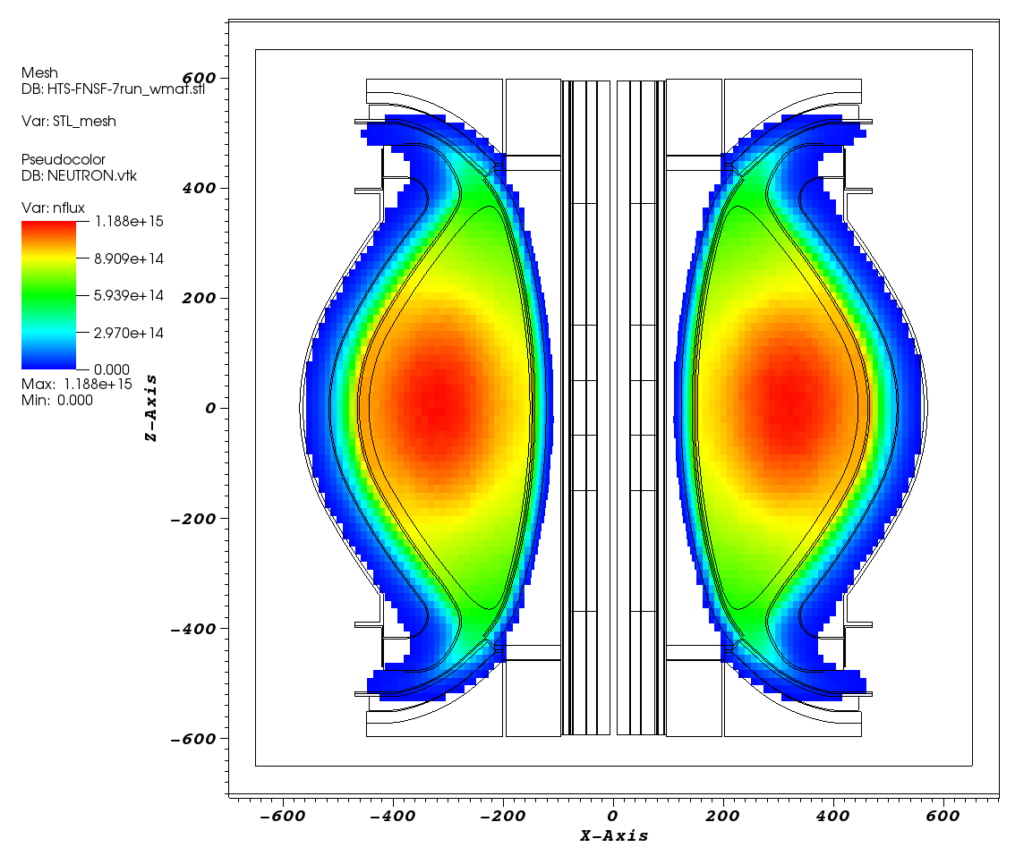
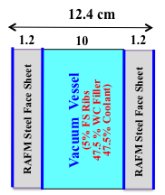
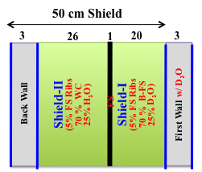
3-D Neutronics Model
Simple CAD Model outlining components (from T. Brown):
  10 cm IB modules
  20 cm OB modules
R-Z neutron source
IB shield and VV optimization and composition by UW.
OB blanket internals and composition by UW
Detailed CAD of blanket by UW
UW DAGMC code couples CAD to 3D MCNP neutronics code.

Slide 33
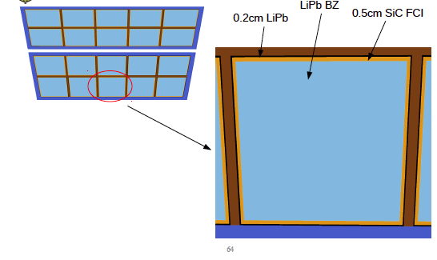
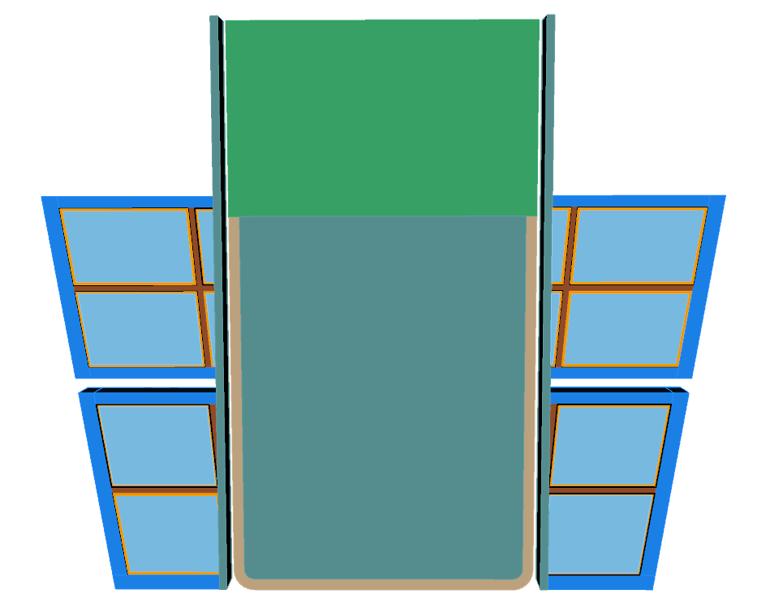
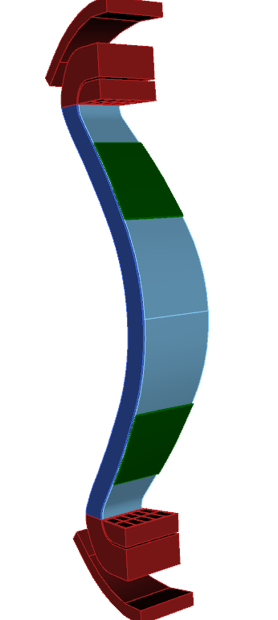
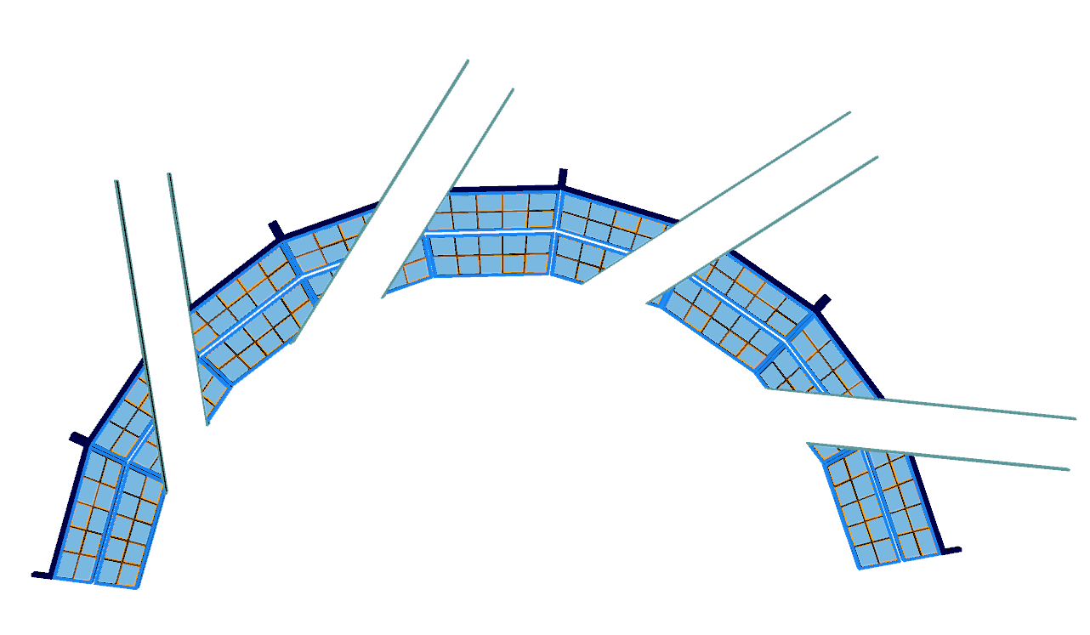
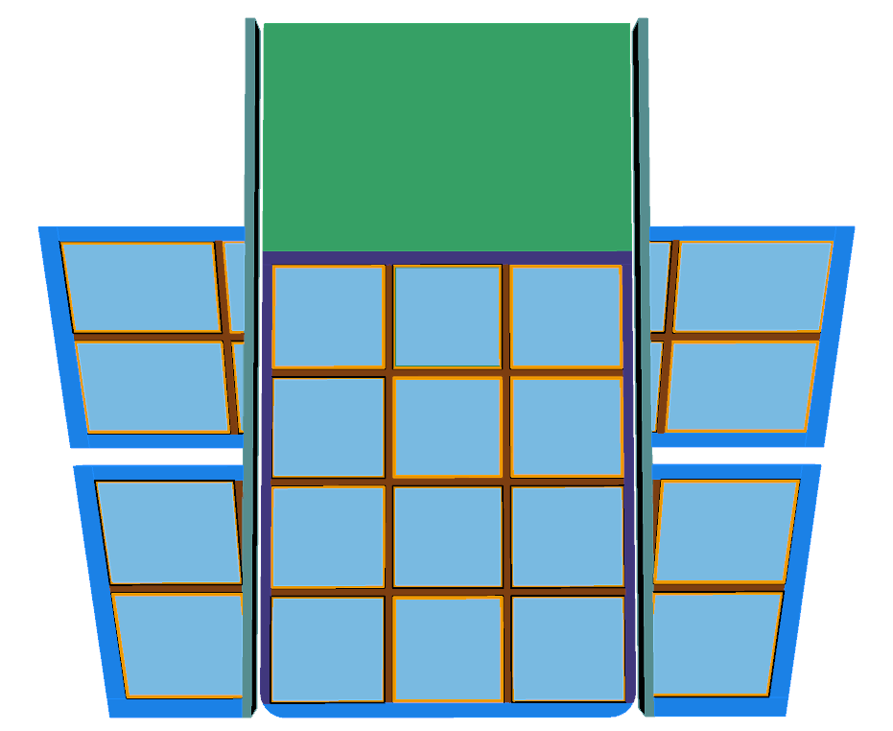
CAD Geometry of OB Blanket with Ports
Detailed Blanket Internals
MTM
Stabilizing
Shells
4 NBIs
TBM

Slide 34
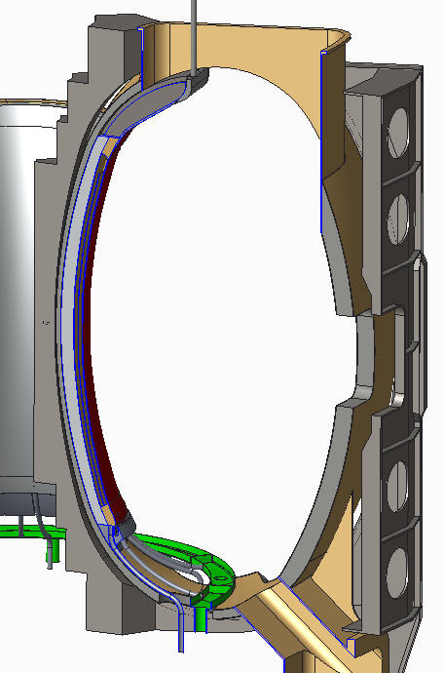
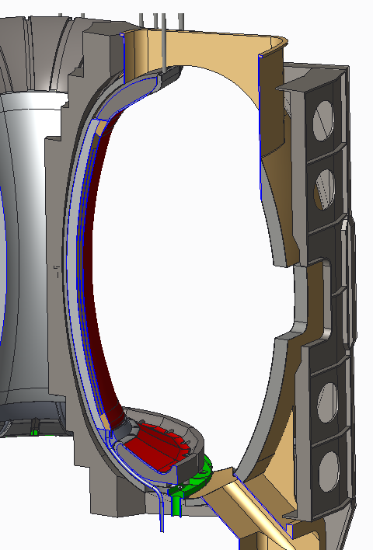
Local details of Li divertor / inboard FW
Inboard shield
Upper Li feed
Li flow on girdle shell
Li and inboard component piping
Inboard DCLL blanket
Li drain plenum
Lower divertor

Slide 35
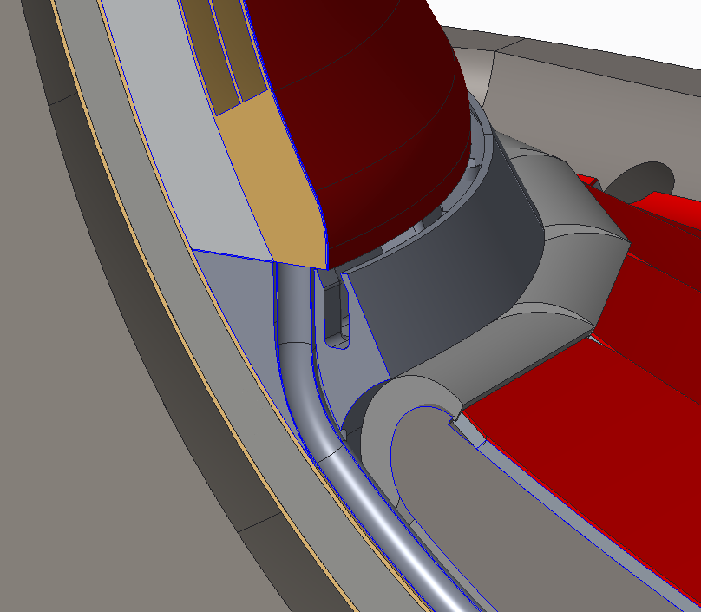
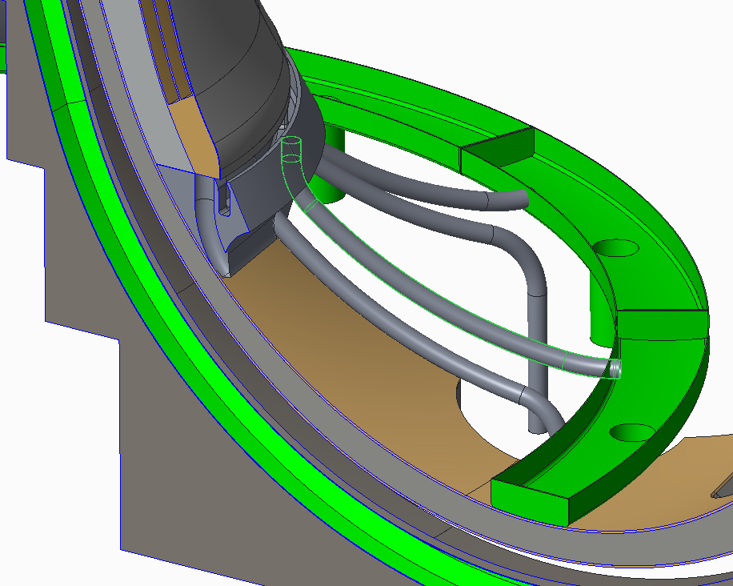
Lower Li containment system
Base Li return trough
Li flows over inboard surface to a continuous trough that feeds ten Li drain lines.
One of ten 100 mm ID Li inboard drain lines

Slide 36
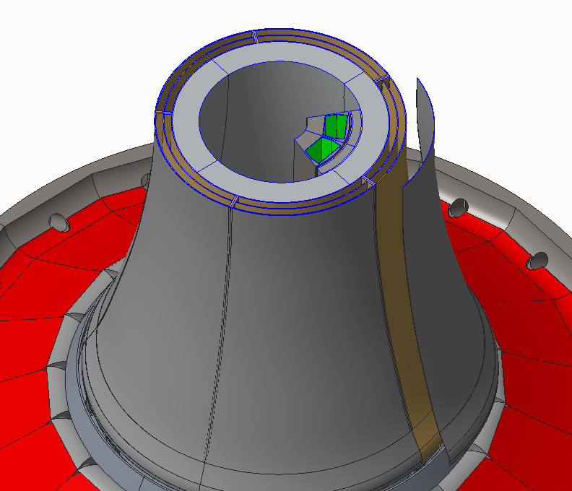
Inboard FW / DCLL / shield components
300 mm WC inboard shield
200 mm DCLL blanket system
10 mm Li surface metal structure (girdle)
As a first pass design it is assumed that these components will be electrically continuous
…analysis will follow.

Slide 37

Assessing long-leg / deep-V slot divertor
PF coils outside TF
Increase strike-point radius ~2× to reduce q|| and peak heat flux
Divertor PFCs in region of reduced neutron flux
Narrow divertor aperture for increased TBR
More space for breeding at top/bottom of device

Slide 38



Long-leg / Super-X aids heat flux reduction
A=2 HTS TF FNSF/Pilot
λ_{q} ~ 1mm, assume S ≈ λ_{q} (closed divertor)
(T. Eich NF 2013)
(Partial) detachment likely reduces peak q⊥ by further factor of 2-4

