Slide 1




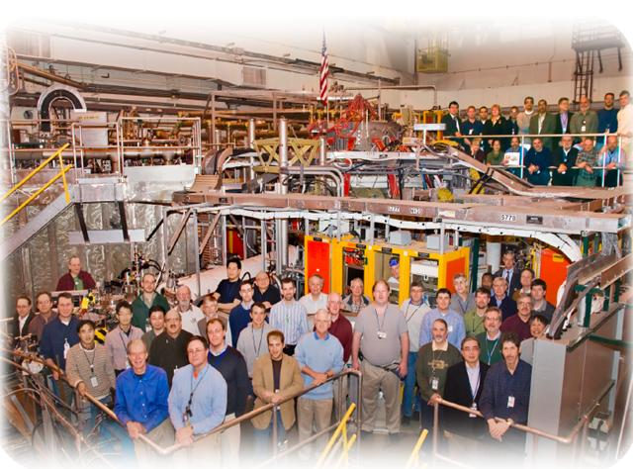
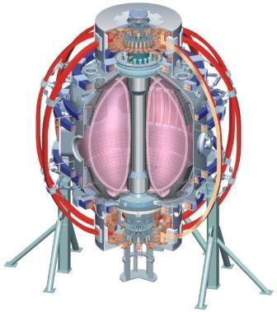
Density fluctuation measurements from the NSTX
Beam Emission Spectroscopy (BES) diagnostic system
College W&M
Colorado Sch Mines
Columbia U
CompX
General Atomics
INL
Johns Hopkins U
LANL
LLNL
Lodestar
MIT
Nova Photonics
New York U
Old Dominion U
ORNL
PPPL
PSI
Princeton U
Purdue U
SNL
Think Tank, Inc.
UC Davis
UC Irvine
UCLA
UCSD
U Colorado
U Illinois
U Maryland
U Rochester
U Washington
U Wisconsin
D. R. Smith¹, R. J. Fonck¹, G. R. McKee¹, D. S. Thompson¹, I. U. Uzun-Kaymak¹, and B. C. Stratton²
¹University of Wisconsin-Madison
²PPPL
Culham Sci Ctr
U St. Andrews
York U
Chubu U
Fukui U
Hiroshima U
Hyogo U
Kyoto U
Kyushu U
Kyushu Tokai U
NIFS
Niigata U
U Tokyo
JAEA
Hebrew U
Ioffe Inst
RRC Kurchatov Inst
TRINITI
KBSI
KAIST
POSTECH
ASIPP
ENEA, Frascati
CEA, Cadarache
IPP, Jülich
IPP, Garching
ASCR, Czech Rep
U Quebec
Joint US-EU Transport Task Force Workshop
San Diego, CA
April 6-9, 2011
Notes:
A beam emission spectroscopy system has been commissioned on NSTX, and today I will present a summary of initial measurements.

Slide 2
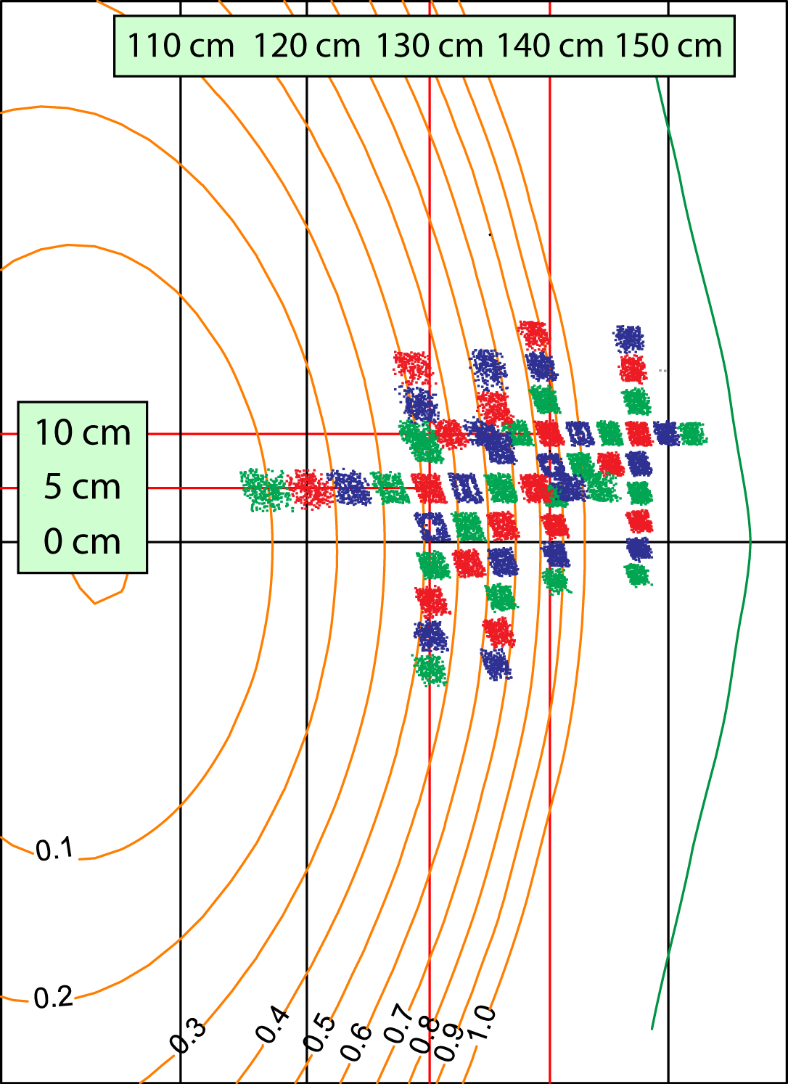
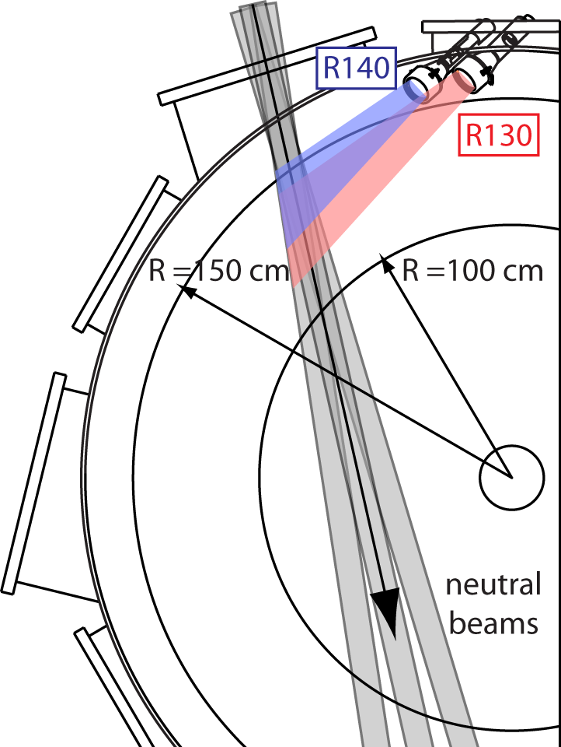
Beam emission spectroscopy (BES) provides low-k fluctuation measurements for studying plasma turbulence in NSTX
ITG/TEM
ETG
μ-TEARING
0.1
1
k (cm⁻¹)
10
⊥
1
k
ρ_{s}
10
100
⊥
Low-k BES
Notes:
BES: image NB D-alpha emission
High-k: tangential microwave scattering

Slide 3
Outline
BES diagnostic overview
  Optical and detection system
  Measurement capabilities
Initial observations
  Fluctuations decrease at LH transition
  Eddy poloidal motion reverses after LH transition
  Large poloidal correlation lengths
  Correlation lengths depend on |B| and Ip
  Post-ELM harmonic features localized at top of pedestal
  GAE and TAE mode structure observed
Summary and plans

Slide 4
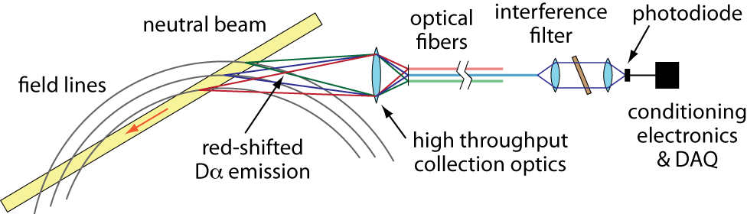
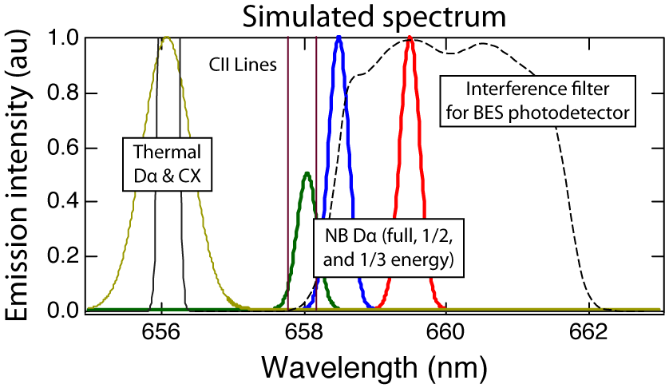
BES provides long-wavelength density fluctuation measurements with k┴ρ_{i} < 1
BES measurements contribute
to several NSTX research areas
  Turbulence and transport
    ITG/TEM turbulence
    ZFs and GAMs
    Flow fluctuations
  Boundary physics
    LH transition
    Edge & SOL fluctuations
    ELMs and EHOs
  Waves-particle interactions
    TAE/EP/GAE mode structure
Doppler shift and optical filter isolate NB D_{α} emission from thermal D_{α}
neutral beam
D_{α} emission
ion density
fluctuation
C ≈ 1/2

Slide 5
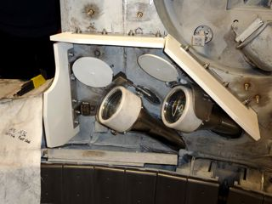
NSTX BES system was commissioned in 2010
Doppler shift and optical filter isolate NB D_{α} emission from thermal D_{α}
Two optical views are aligned to steep pitch angles in NSTX plasmas
Collection optics
R140
R130
D. R. Smith et al, RSI 81, 10D717 (2010)
N. Schoenbeck et al, RSI 81, 10D718 (2010)
Notes:
The NSTX BES system will investigate long wavelength density fluctuations. The system measures Doppler-shifted d-alpha emission from deuterium neutral beams. The Doppler shift isolates NB d-alpha emission from thermal d-alpha emission. The system includes two optical views shown in the figures below. The R140 view is centered at r/a~0.85 and the R130 view is centered at r/a~0.4. As shown in the picture, the optical views are aligned to steep NSTX pitch angles to optimize cross-field spatial resolution. The system employed up to 24 channels in 2010, and 32 channels are planned for 2011. The DAQ provides sampling at a 1 MHz Nyquist frequency, and a digital filter eliminates enoise above 1 MHz. The photodetectors are cooled to -20 degrees C to reduce thermal noise. The system is describedin two recent RSI papers and in a poster on Monday.

Slide 6
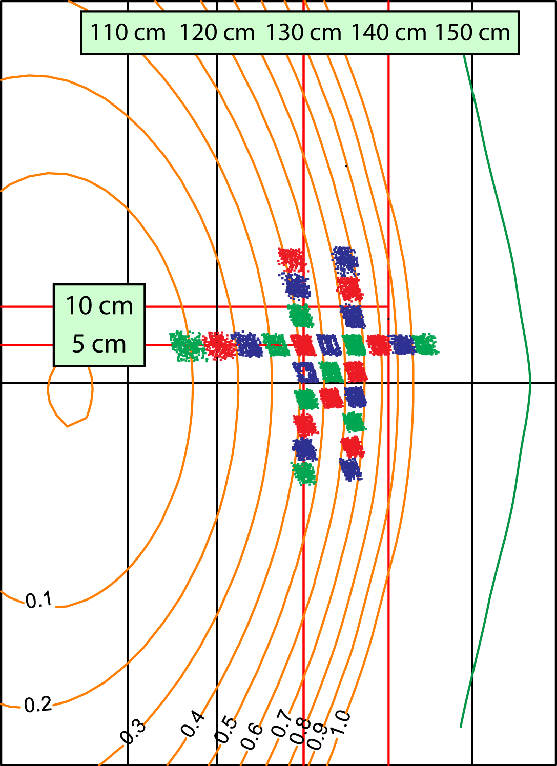
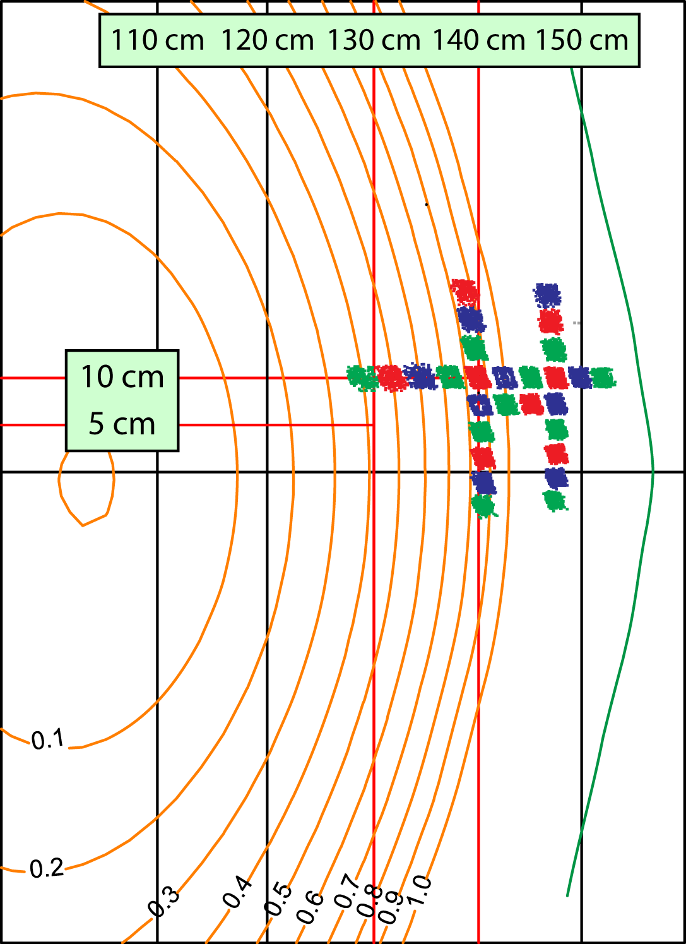
Two optical views and 32 detection channels provide radial coverage from r/a ≈ 0.1 to SOL with 2-3 cm spot sizes
Image patterns provide radial and poloidal correlation lengths,
k-spectra, and flow fluctuations
R130: 130 cm and r/a~0.4
R140 : 140 cm and r/a~0.85
Notes:
The two optical views are equipped with 56 fiber bundles, and provide radial coverage from r/a~0.1 to the SOL with 2-3 cm spot sizes. In the left figure, you can see the R130 view is centered at a major radius of 130 cm. The view includes a radial array and two poloidal arrays curved to match typical NSTX flux surfaces. In the right figure, you can see the R140 view is centered at a major radius of 140 cm. The view includes another radial array and two more poloidal arrays again curved to typical NSTX flux surfaces.

Slide 7
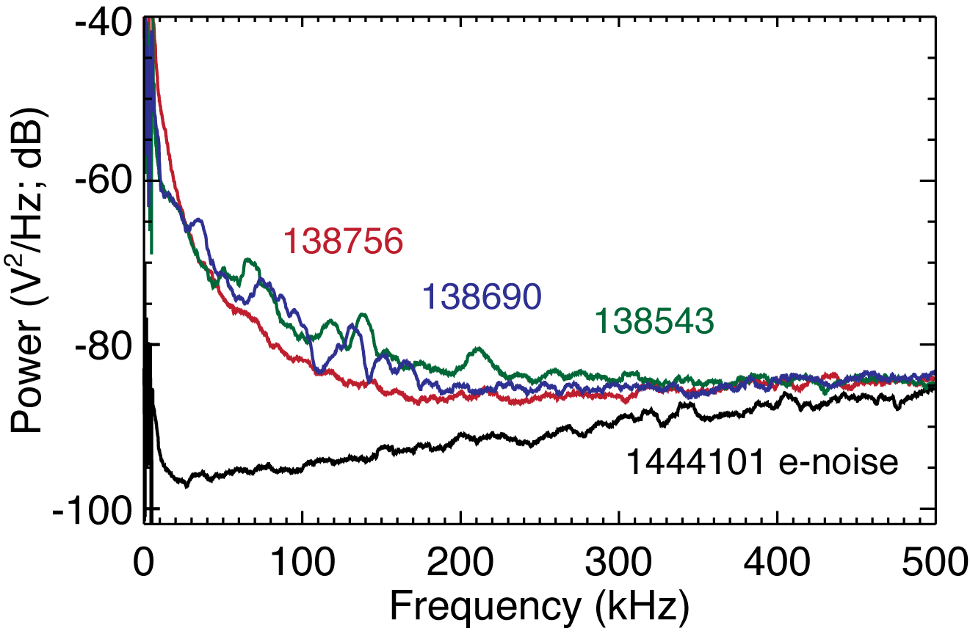
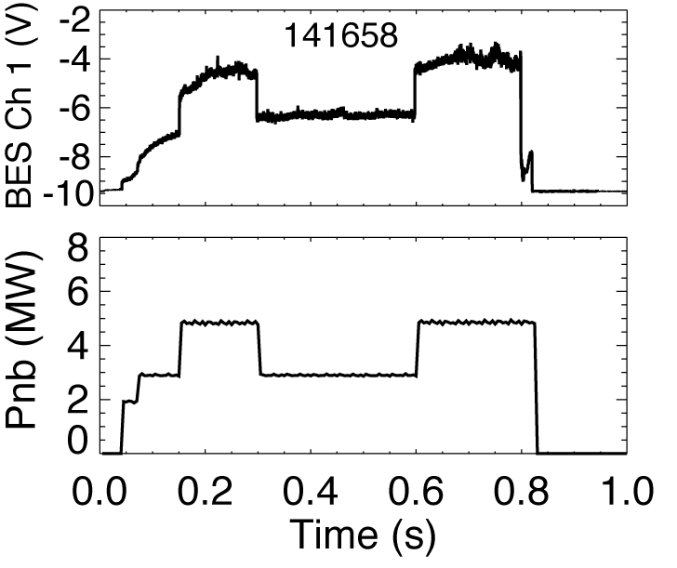
Measured signals exceed amplifier noise and respond to NB power
Optical design
  Red shift view
  2.3 mm²-ster etendue
  4 nm optical filter at 661 nm
Photodetector
  PIN PD and low-noise amplifier
  85% QE and 4.5 mV/nW response
  Refrigerant cooling at -20° C
  Evacuated enclosure
Digitizer
  32 channels
  32 MHz input sampling
  Onboard FPGA provides 950 kHz low-pass FIR filter
  2 MHz output sampling
  16 bit resolution

Slide 8
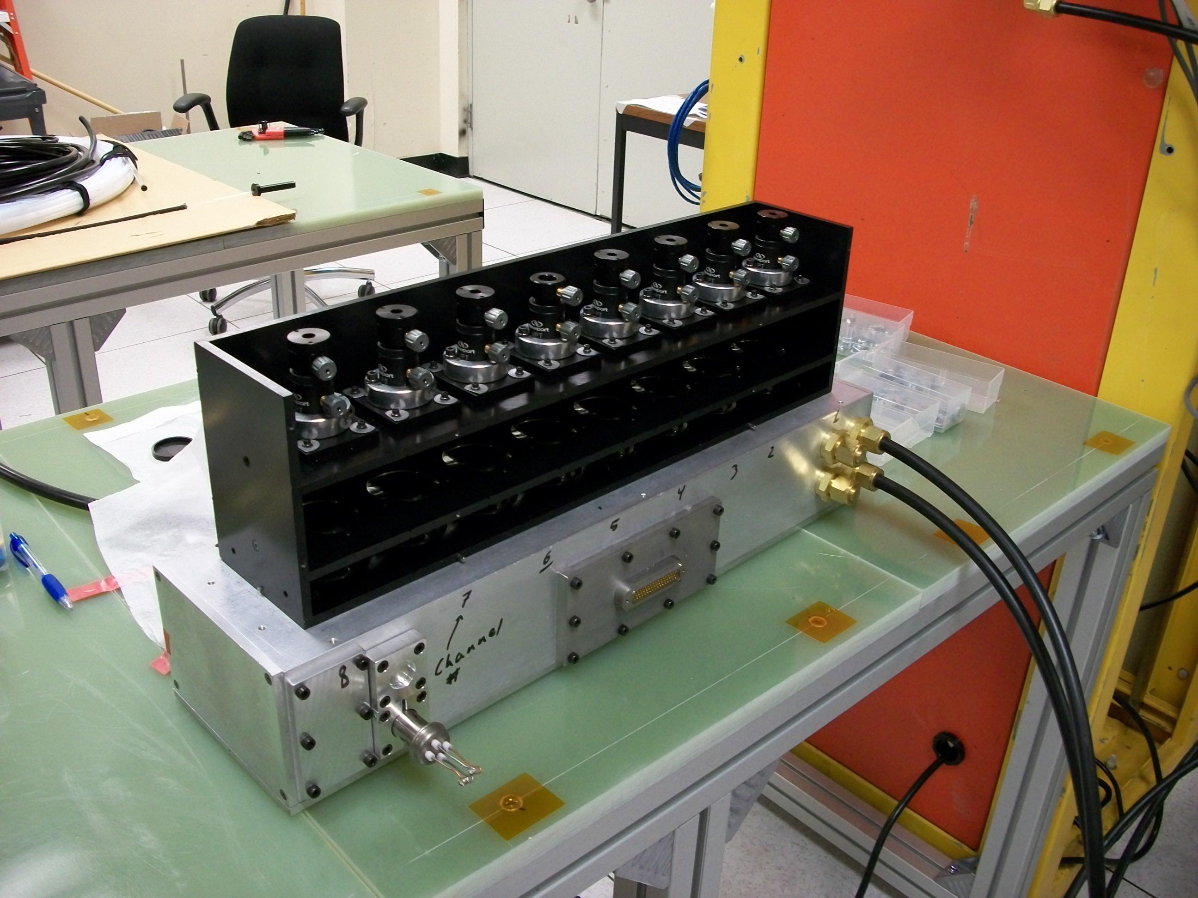
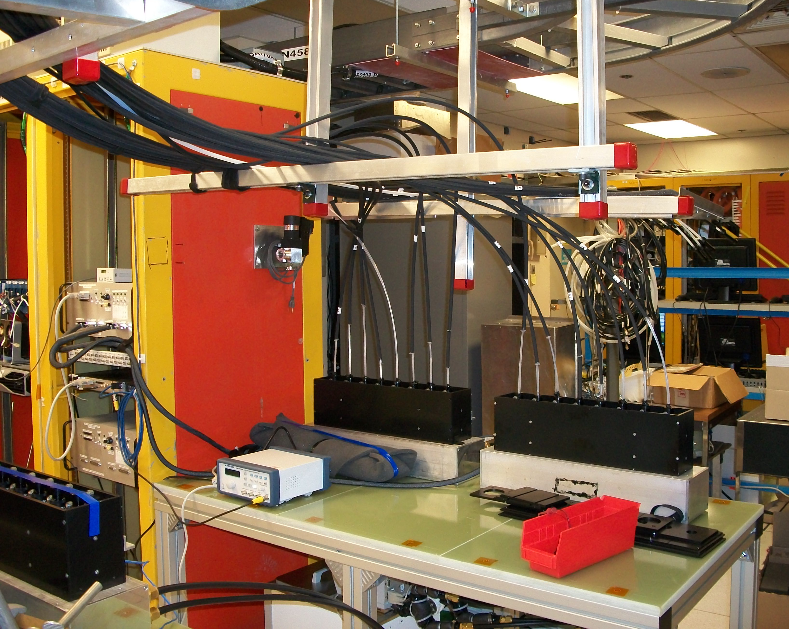
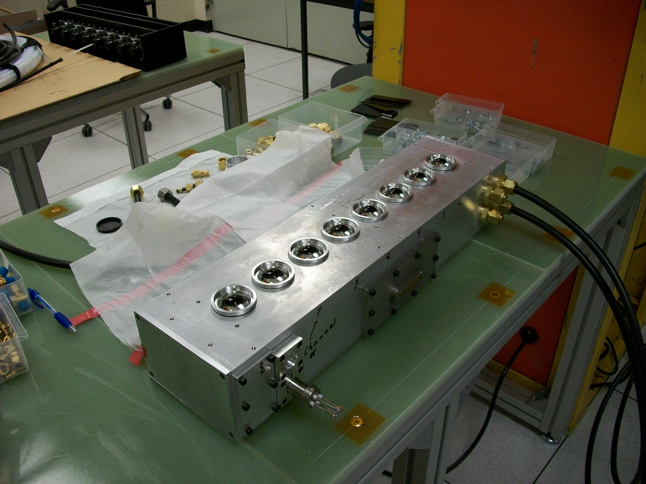
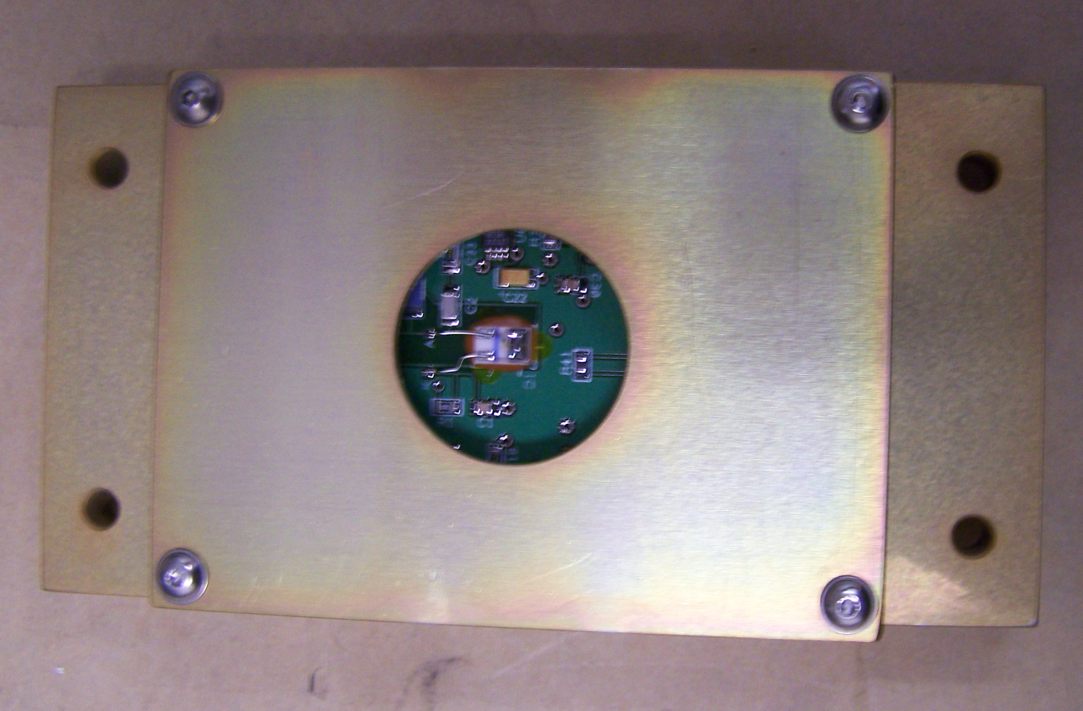
Photodetectors, detector box, and optics module
optics module
vacuum/cooling lines
8-channel detector box
asphere lenses
data/power feedthru
photodetector

Slide 9
General characteristics of low-k turbulence in NSTX
Poloidal correlation lengths on the order of 10 cm
Broadband turbulence with frequencies up to 100 kHz
Poloidal flow speeds in the range 5-10 km/s and consistent with ExB flows
Fluctuations can decrease at LH transition, but subsequently increase during H-mode evolution
Reduced fluctuations at LH transition can extend into core region

Slide 10
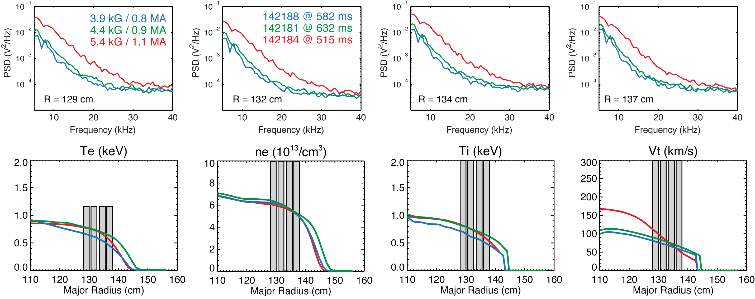
BES power spectra consistent with larger fluctuation amplitudes at higher |B|
NSTX confinement scaling (Kaye et al, NF (2007)):

Slide 11
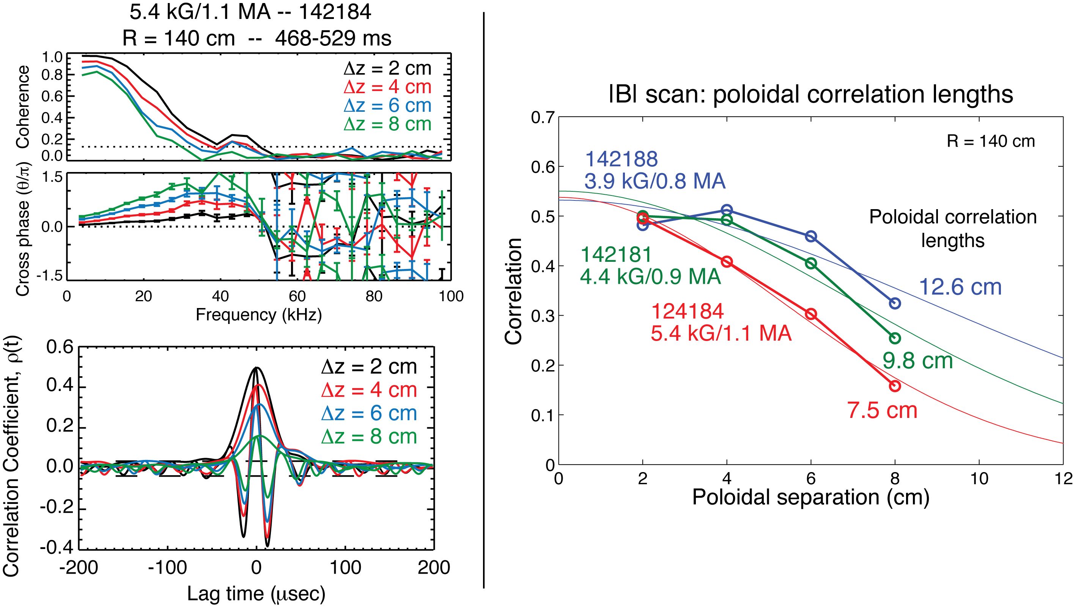
Poloidal correlation lengths decrease at higher |B|
Intuitively consistent with NSTX scaling:

Slide 12
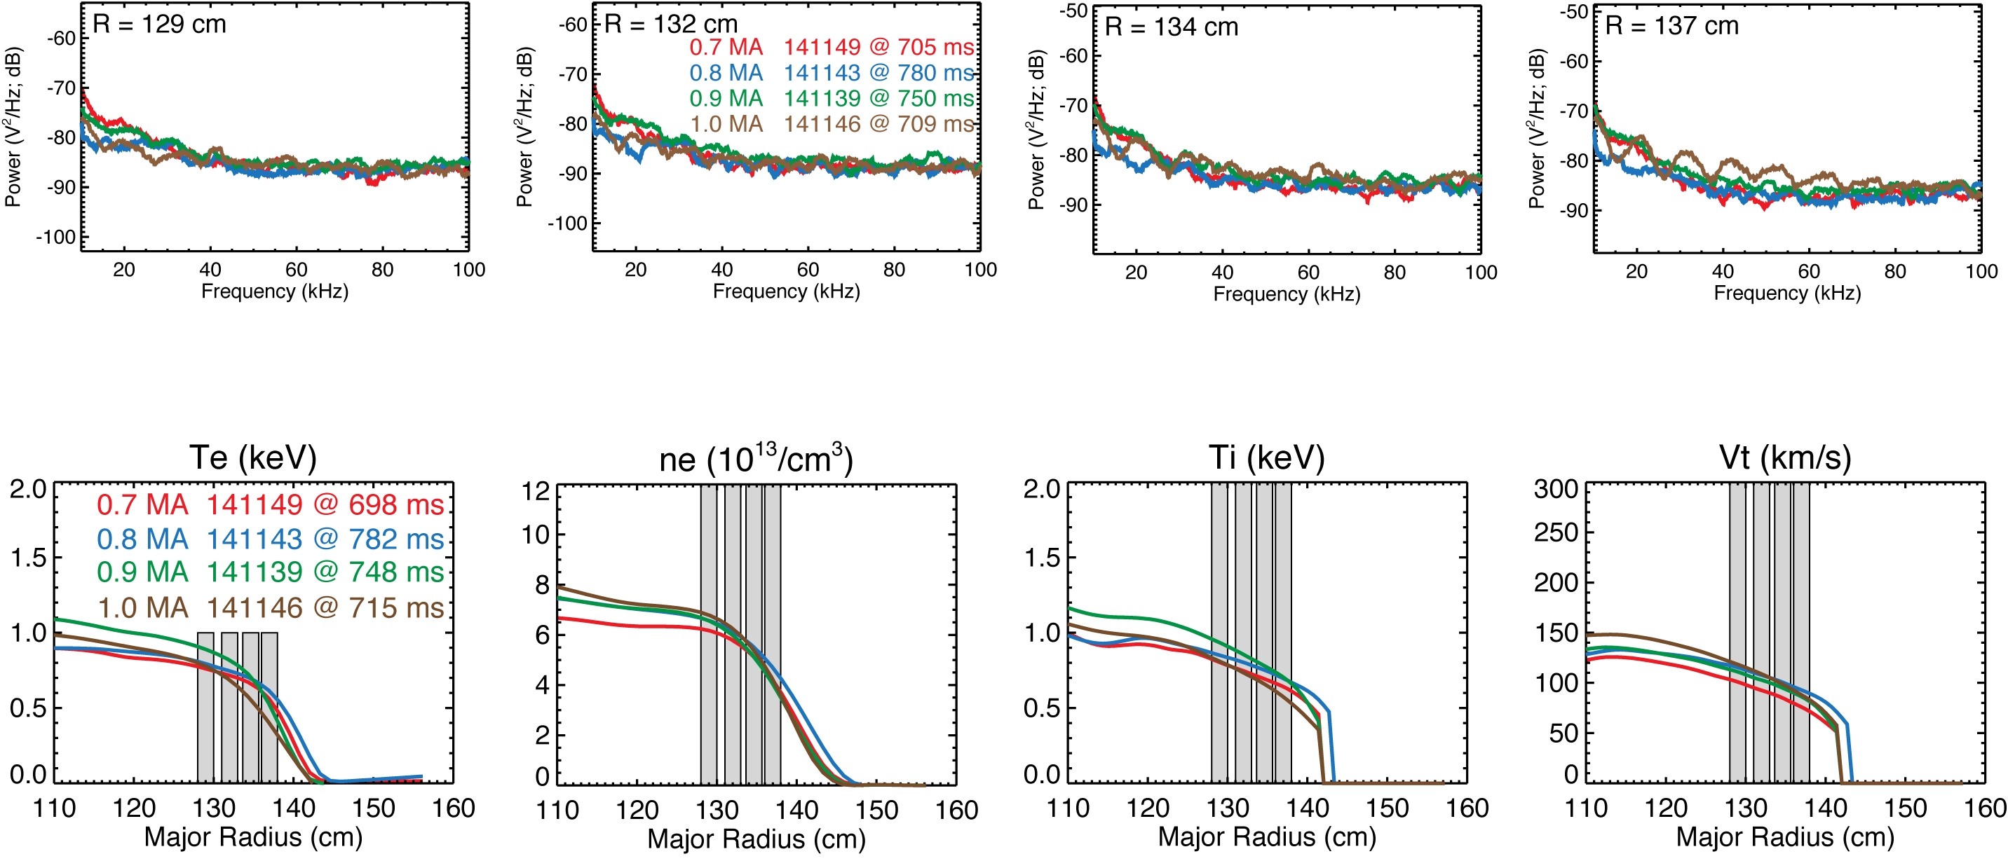
BES power spectra do not show a clear trend with Ip

Slide 13
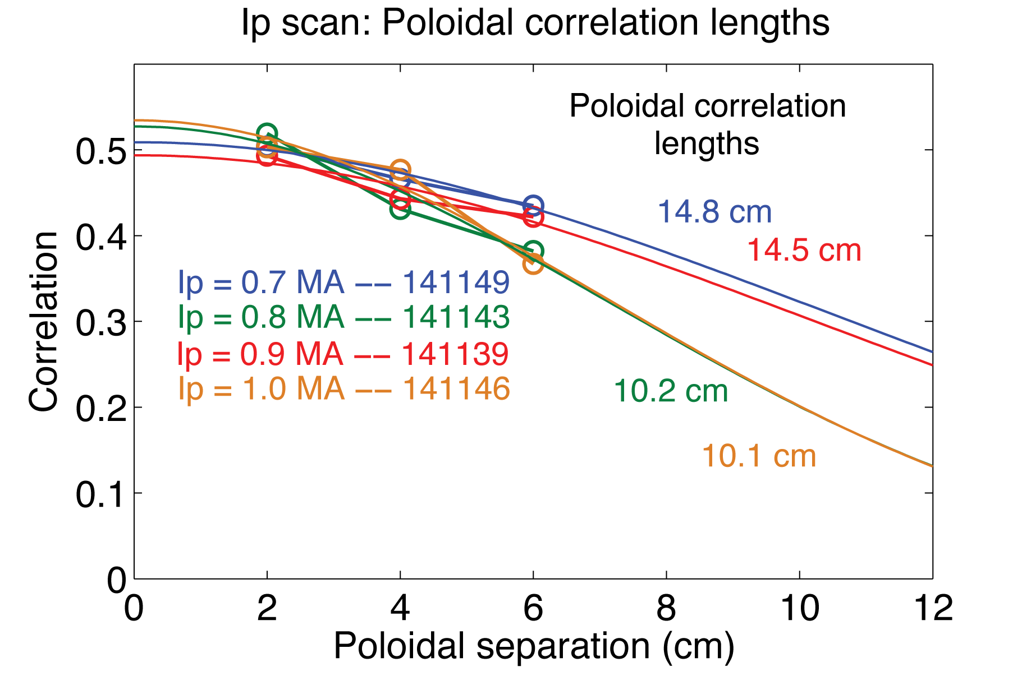
Poloidal correlation lengths do not show a clear trend with Ip

Slide 14
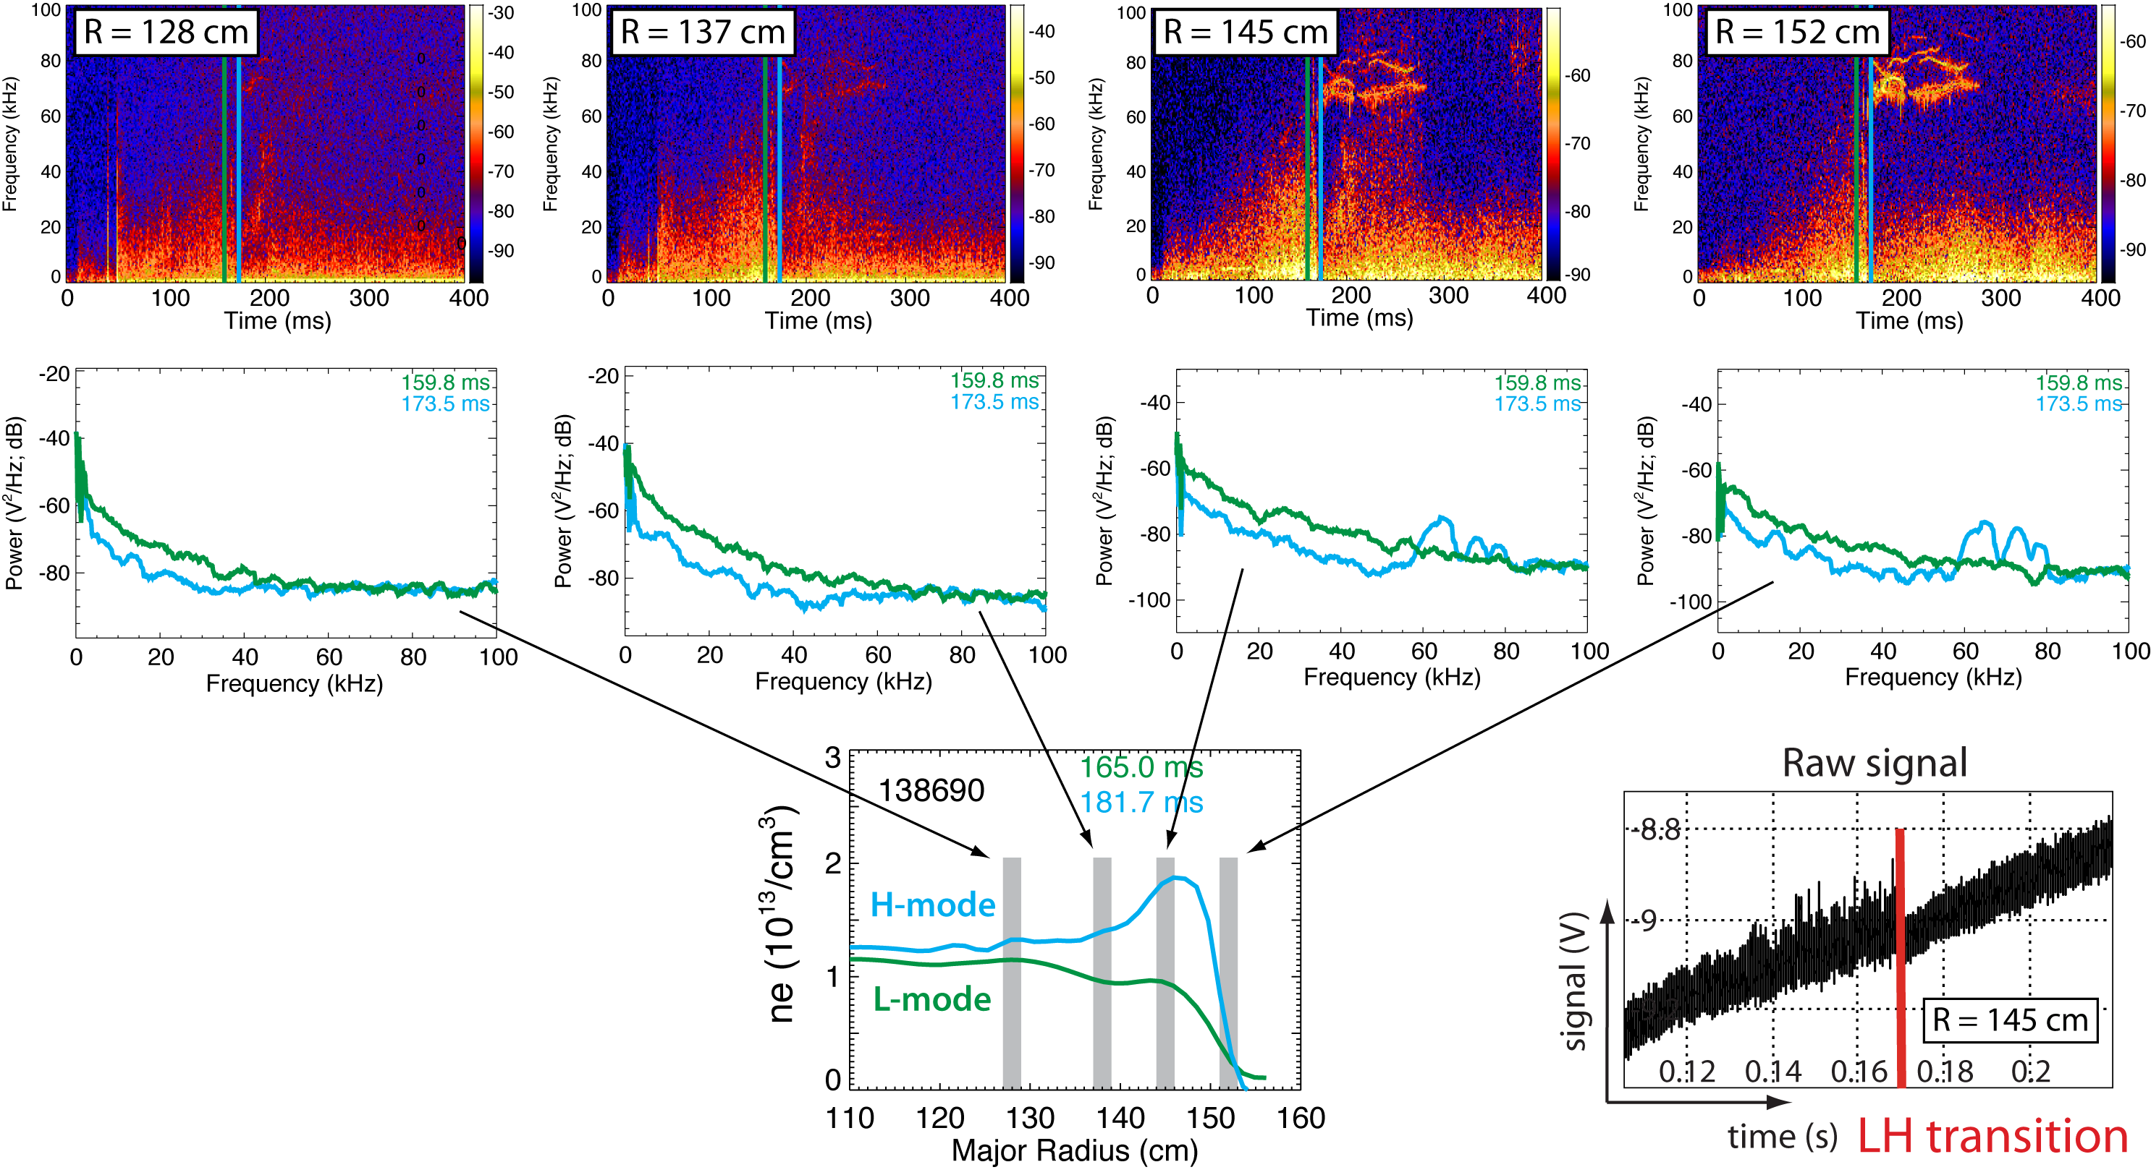
Decrease in fluctuations at LH transition observed from edge to core in some discharges

Slide 15
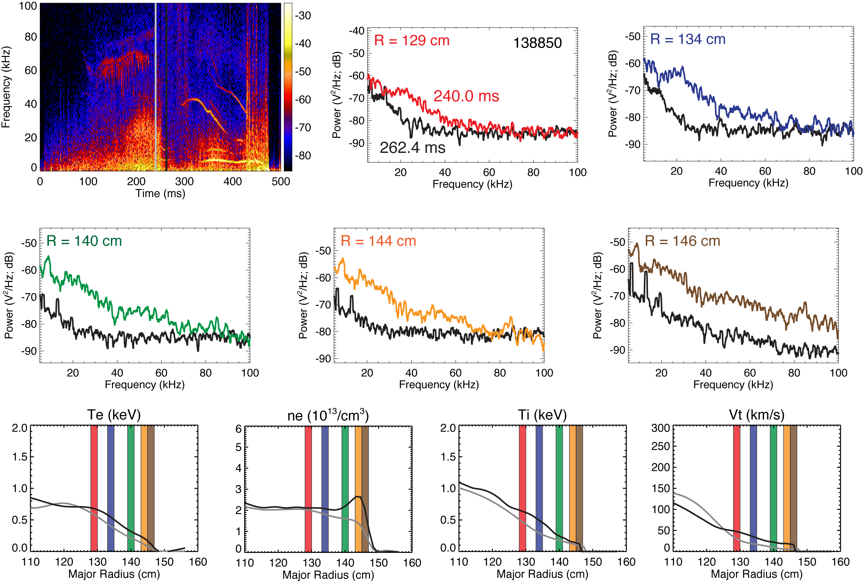
Decrease in fluctuations at LH transition observed from edge to core in some discharges

Slide 16
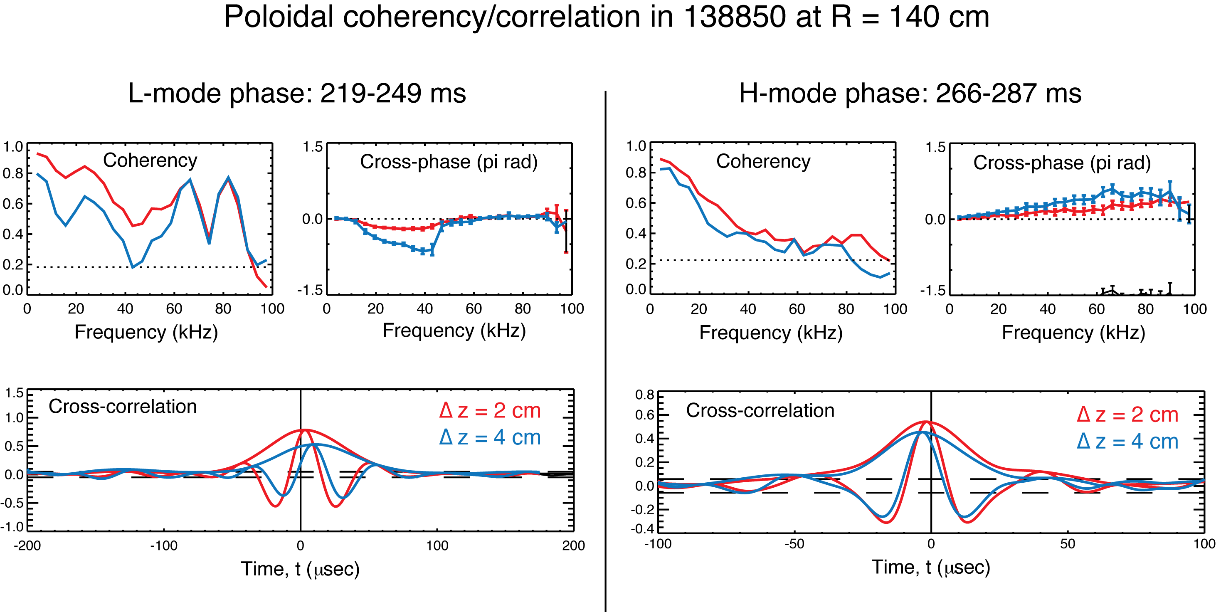
Correlation analysis indicates the apparent motion of eddies changes from electron to ion directions at the LH transition
Time lag indicates motion
in the electron drift direction
Time lag indicates motion
in the ion drift direction;
Er increases at LH, so greater ExB
in ion drift direction

Slide 17
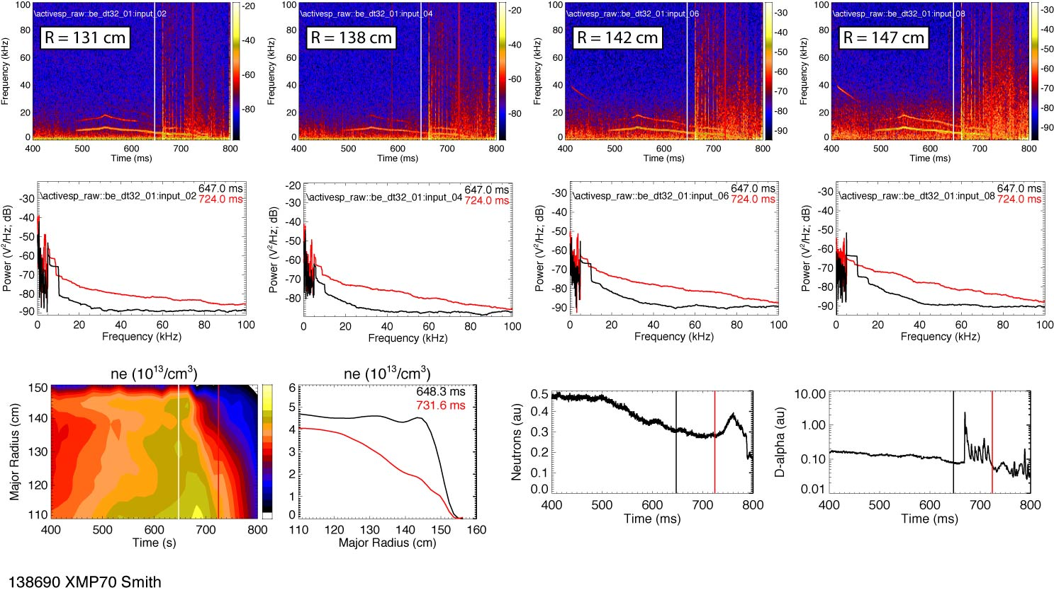
Fluctuations increase following HL back-transition

Slide 18
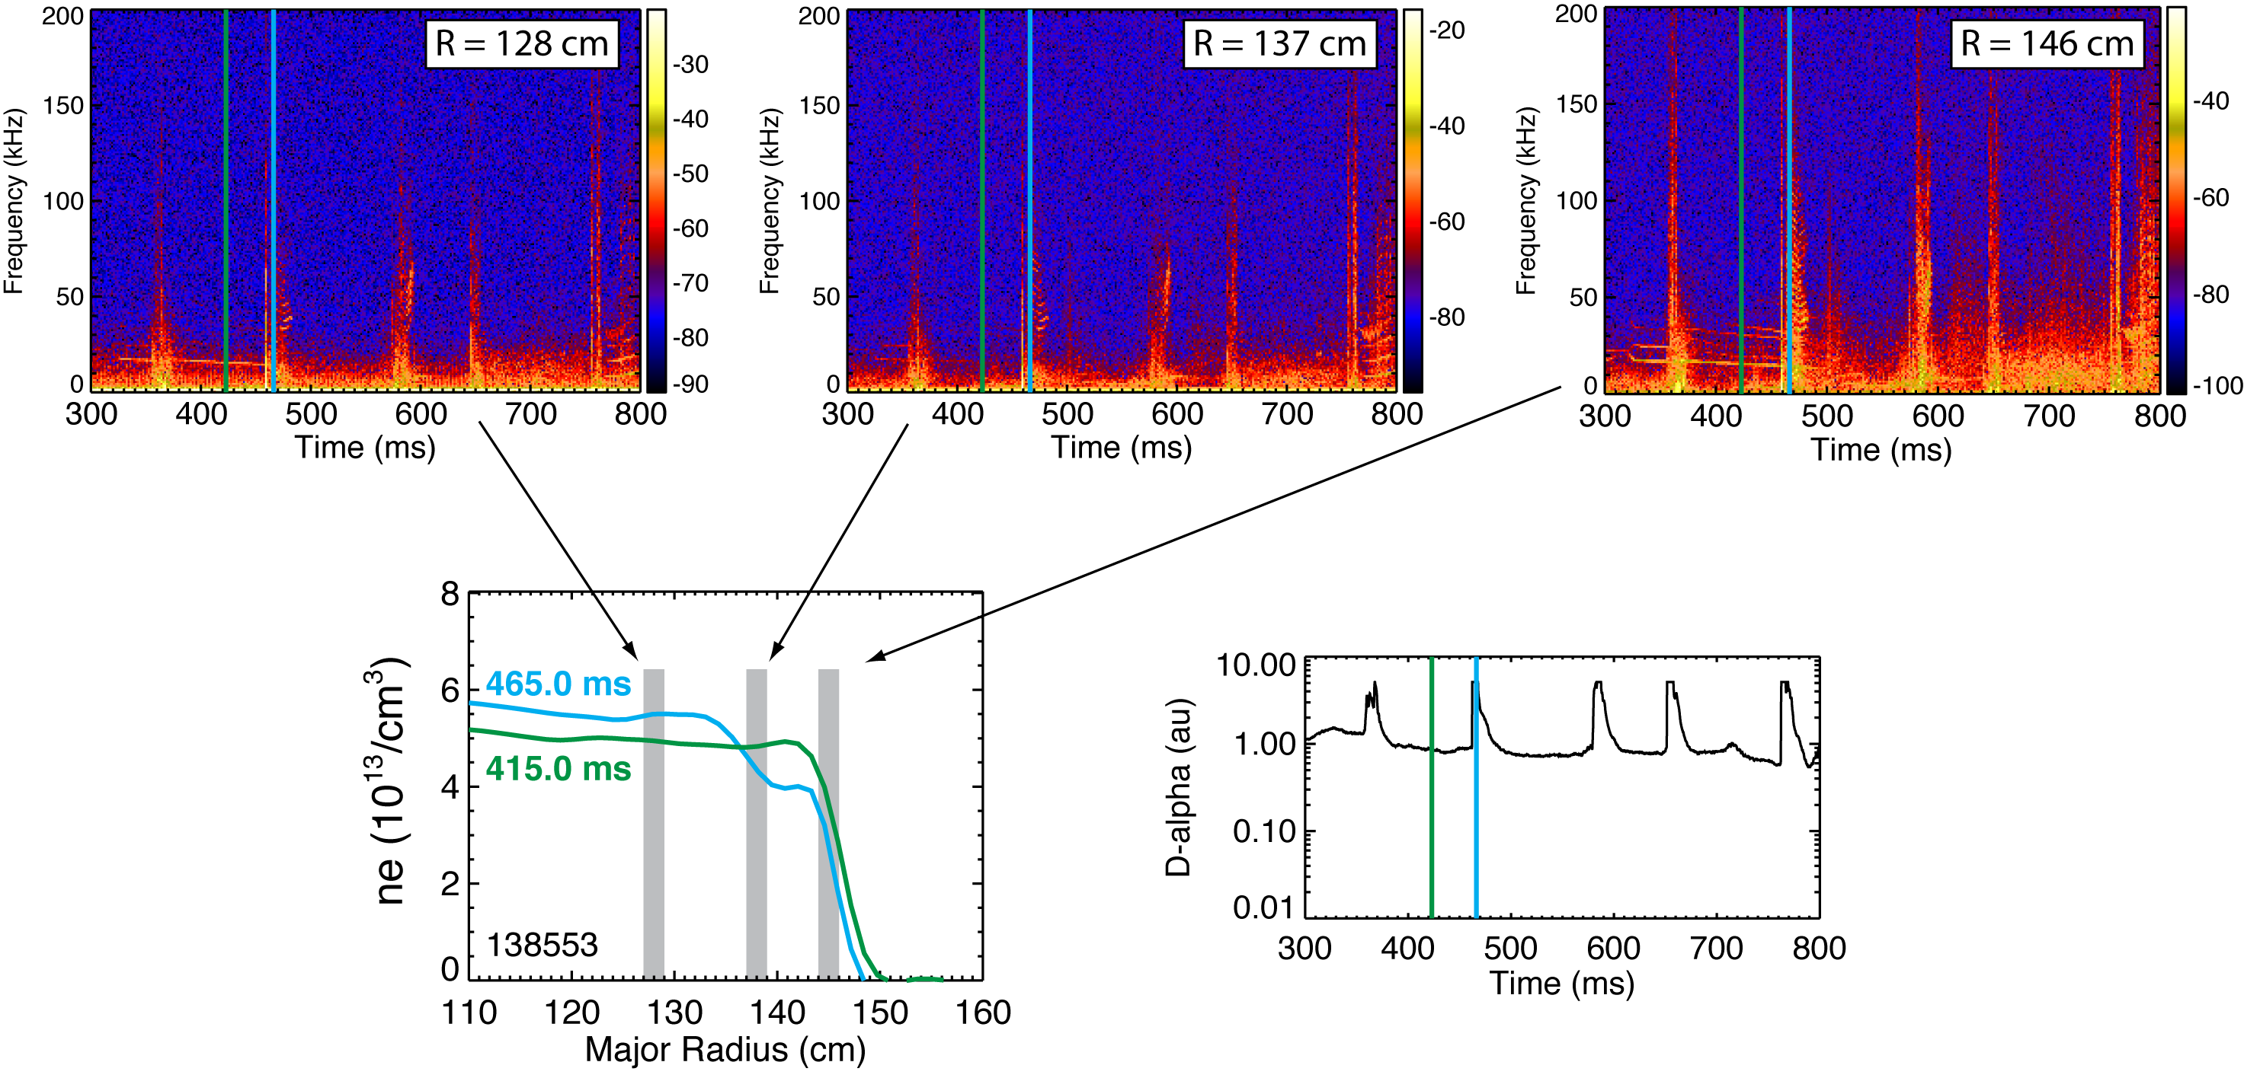
Fluctuations increase during large ELM events

Slide 19
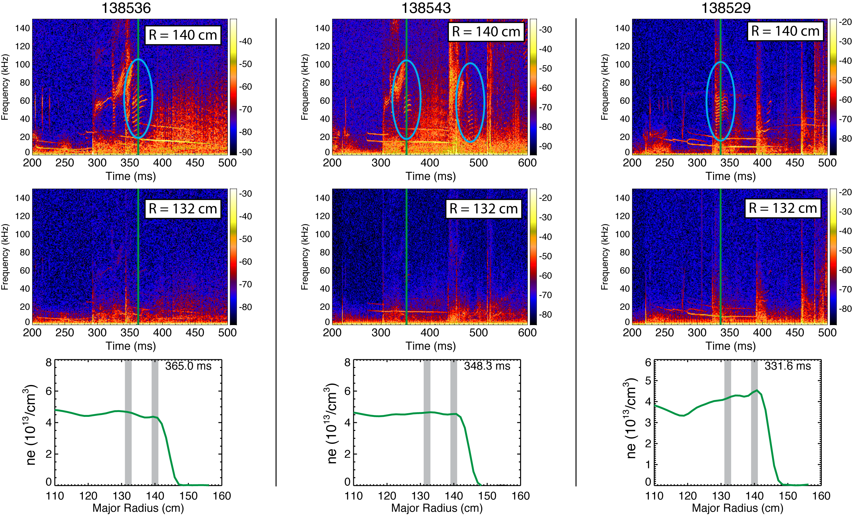
Post-ELM harmonic features at 50-100 kHz are localized at the top of the pedestal
Harmonic features are either absent from or weakly present in magnetic spectra
Notes:
Initial measurements have also shown the existence of inte-ELM harmonic features around 100 kHz, as shown in the top row of spectrograms. The harmonic features are not observed in channels located radially inboard of the pedestal, so the modes are localized near the top of the pedestal.

Slide 20
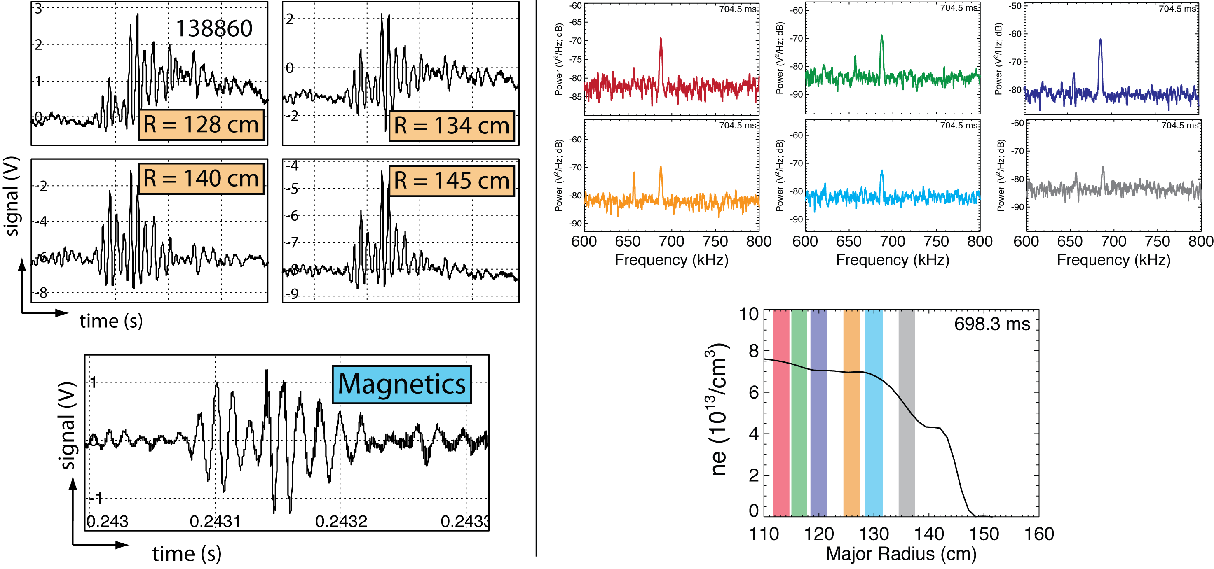
TAEs and GAEs have been observed in extended radial regions
TAE burst
GAE mode
Heidbrink, CO4
Tritz, PI2
Notes:
Finally, initial measurements have begun documenting the radial structure of TAE and GAE modes. On the left, you see BES data from 4 radial locations during a TAE burst and the corresponding mirnov signal. On the right, you see a coherent GAE mode at several radii. The mode exhibits larger amplitudes in core channels. Also, note that the 1 MHZ Nyquist frequency enables measurements of GAE modes at 700 kHz. These measurements will be valuable for validating the radial mode structure of TAE and GAE modes.

Slide 21
Summary
NSTX BES system commissioned in 2010
System measures fluctuations with kρ_{i}< 1
  32 detection channels (56 fiber views)
  Radial and poloidal arrays covering core to SOL
  2 MHz sampling
  2-3 cm spot sizes at NB
Initial observations
  Poloidal correlation lengths on the order of 10 cm
  Broadband turbulence up to 100 kHz observed
  Poloidal flows in the range 5-10 km/s
  Fluctuations decrease at LH transition
  Post-ELM harmonic features (50-150 kHz) localized to pedestal
Notes:
In summary…

