Slide 1
Low-wavenumber pedestal turbulence in NSTX: measurements, parametric scalings, and simulations
David R. Smith¹, W. Wan², R. Fonck¹, S. Kaye³, G. McKee¹,
S. Parker², R. Bell³, Y. Chen², A. Diallo³, B. Dudson⁴,
B. LeBlanc³, and M. Podesta³
¹ University of Wisconsin-Madison
² University of Colorado-Boulder
³ Princeton Plasma Physics Lab
⁴ University of York
US-EU Joint TTF Workshop
Santa Rosa, CA
April 8-12, 2013
Notes:
Thank you for this opportunity to tell you about recent measurements and simulations of pedestal turbulence in NSTX.

Slide 2
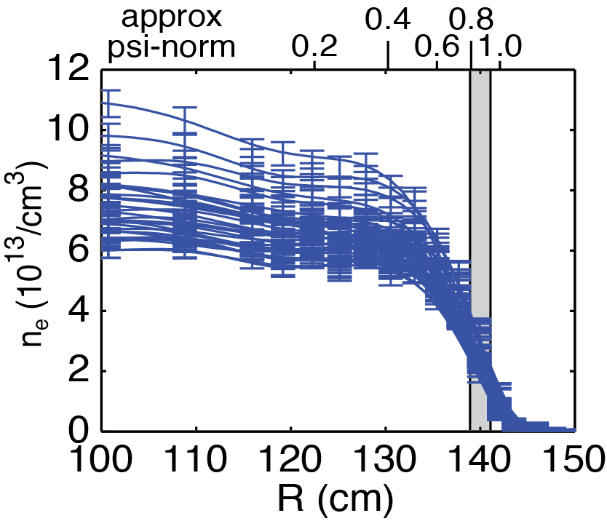
The pedestal sets boundary conditions for the core and ejects structures that damage plasma-facing components
Projections for ITER depend on accurate pedestal models
  ST parameter regime (large ρ*, high β, shaping, beam-driven flow)
  is a challenging environment for pedestal simulations
Pedestal turbulence measurements in NSTX H-mode plasmas during ELM-free, MHD quiescent periods
  Identify parametric dependencies between turbulence quantities and transport-relevant plasma parameters
  Compare to turbulence models ➞ scalings point to TEM turbulence
  Compare to pedestal turbulence simulations
Turbulence measurements
in steep gradient region
Notes:
The pedestal region is important because… Also performance projections for ITER and next-step devices depend
Here, we measure pedestal turbulence quantities…
We identify parametric dependencies with transport-relevant plasma parameters and compare the scalings to turbulence models and pedestal turbulence simulations
In the bottom plot you see the measurement region of interest in the steep gradient region of the pedestal

Slide 3
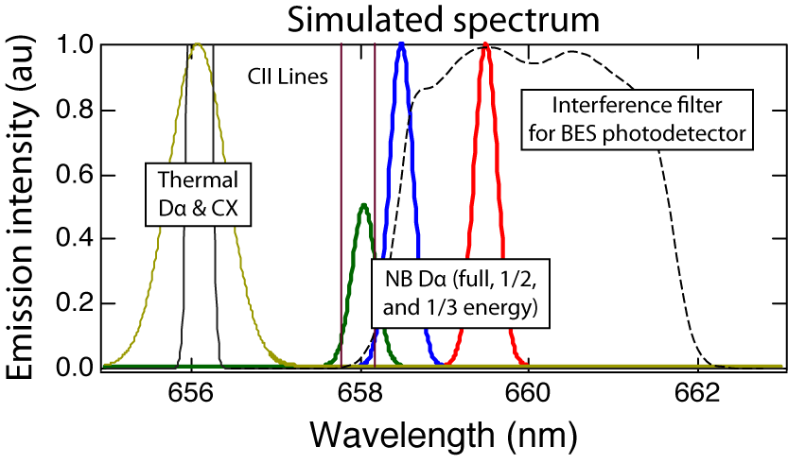
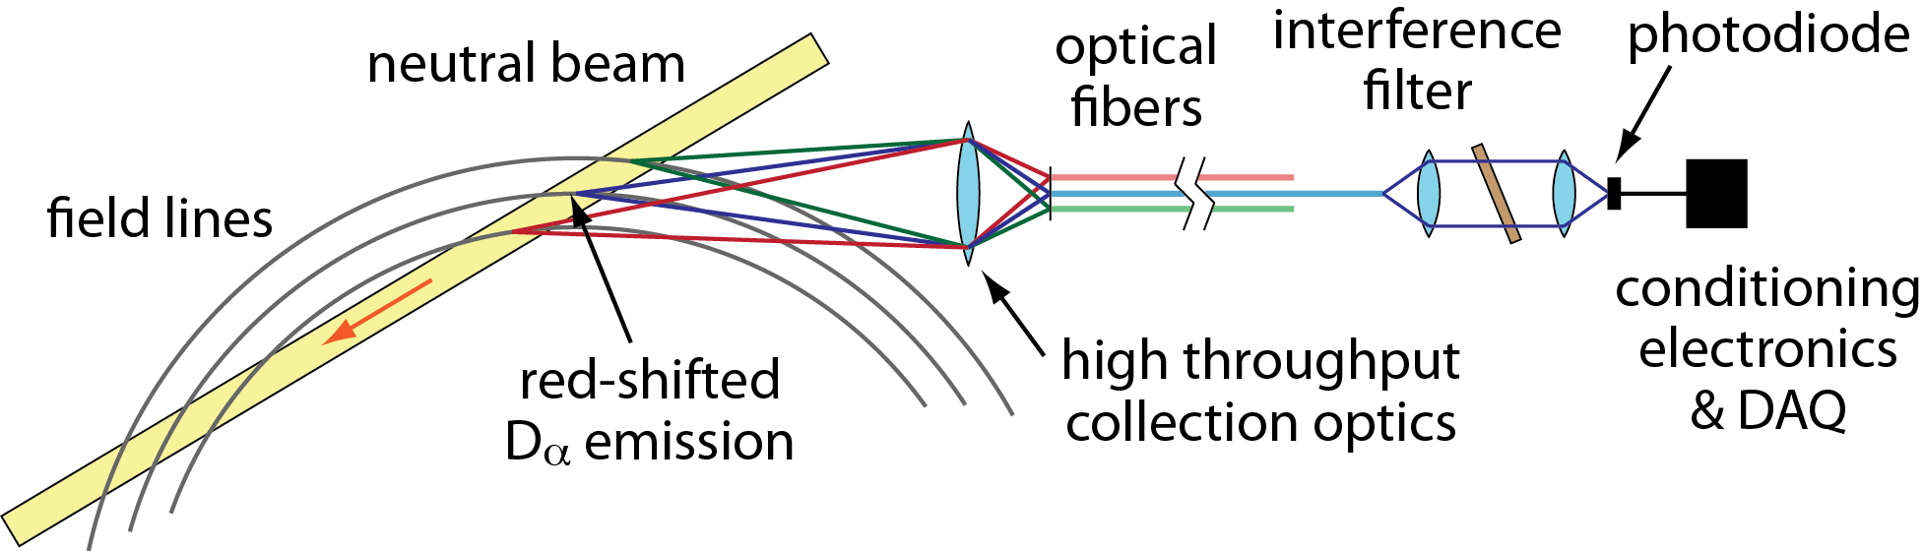
Beam emission spectroscopy (BES) measures
Doppler-shifted D_{α} emission from neutral beam particles
C ≈ 1/2
neutral beam
D_{α} emission
density
fluctuation
Notes:
D-alpha emission from NB particles are doppler shifted relative to thermal D-alpha emission (plot).
The BES interference filter selectively passes NB D-alpha emission (plot and diagram).
The NB D-alpha emission is primarily sensitive to density fluctuations and weakly sensitive to other plasma parameters (equation).

Slide 4
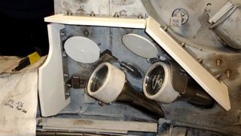
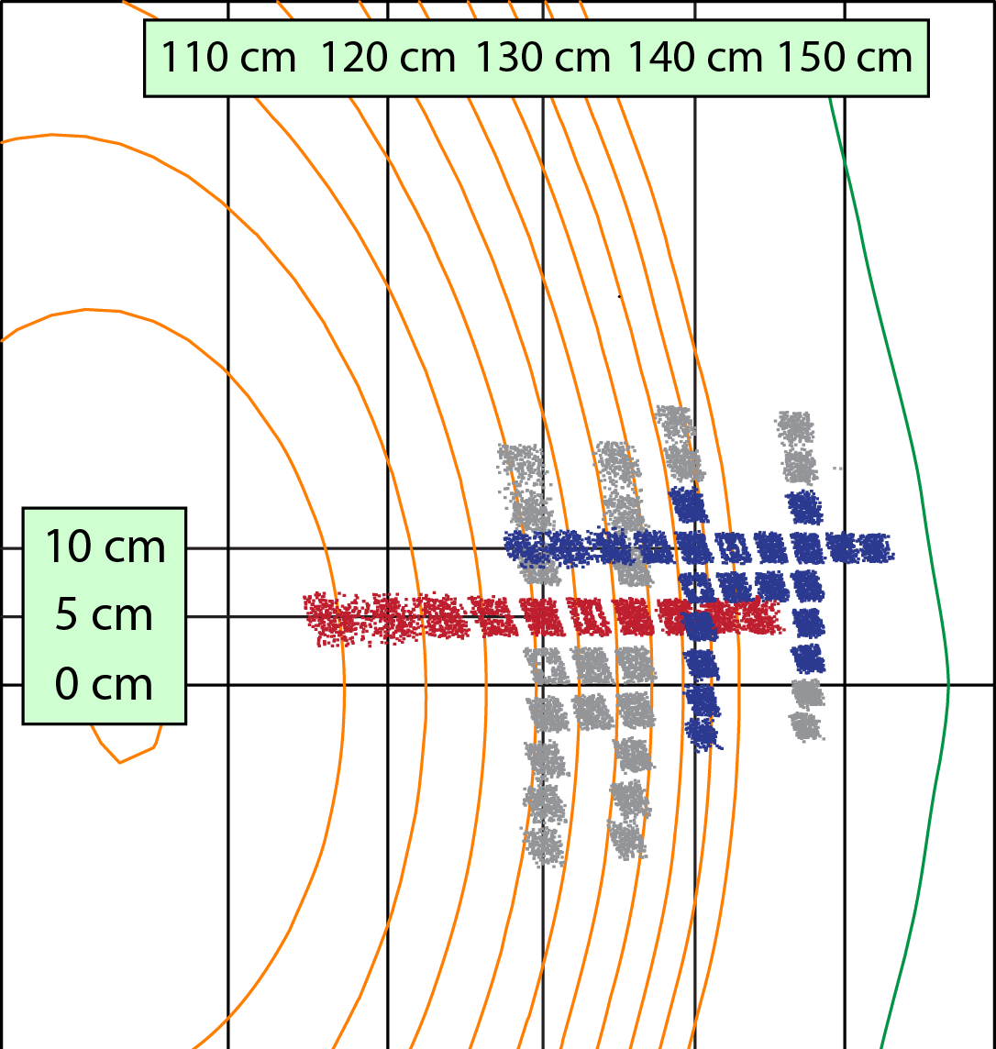
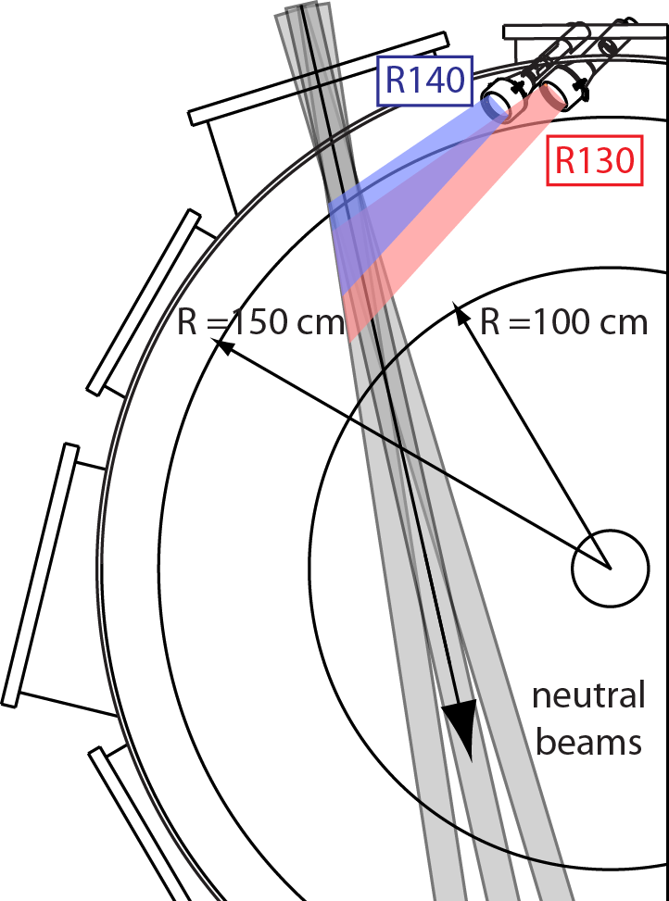
The beam emission spectroscopy (BES) system on NSTX measures fluctuations on the ion gyroscale with k⊥ρ_{i} ≤ 1.5
Radial and poloidal arrays spanning core to SOL
32 detection channels
2-3 cm spot size and k┴ρ_{i} ≤ 1.5
ρ_{i}
Notes:
The NSTX BES system includes 56 sightlines that span the core to SOL pictured at right.
The image spots are 2-3 cm, so measurements are sensitive to k-rho-i<1.5.
The red and blue images represent measurement locations for 2010 data.
On the bottom you see the geometry of BES collection optics and a picture of the optical heads.

Slide 5
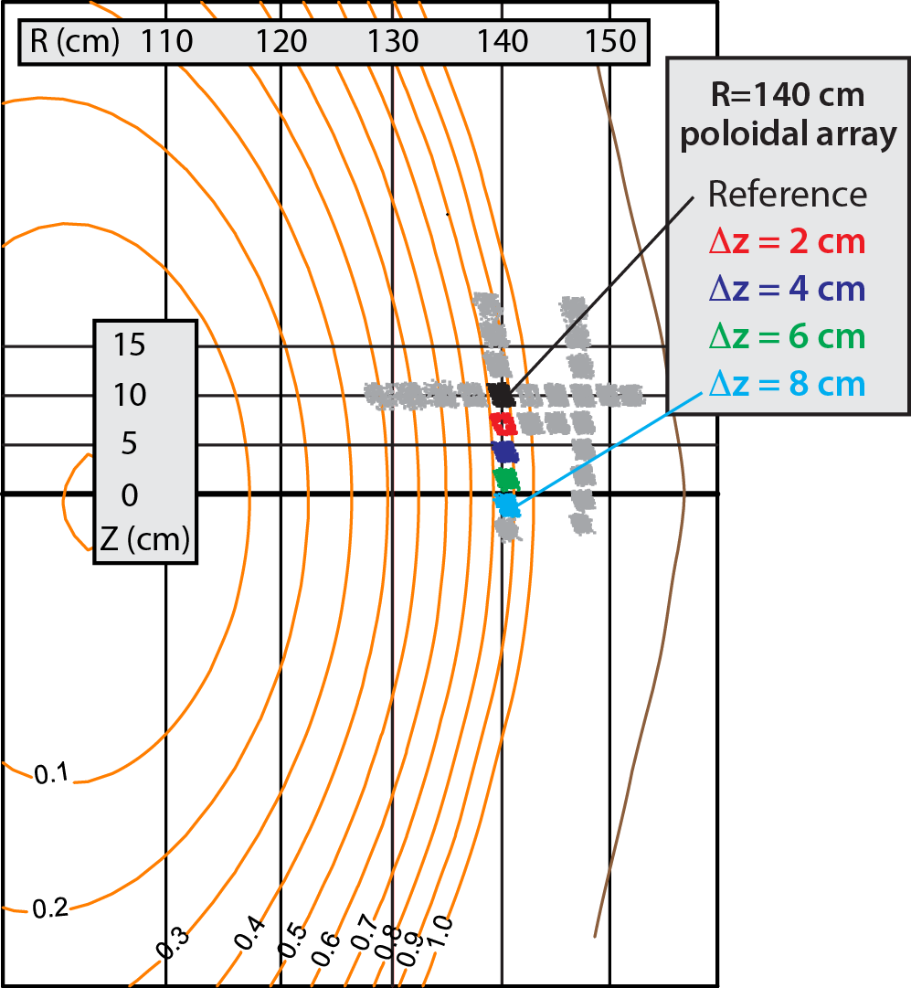
Pedestal turbulence measurements
ELM-free, MHD quiescent H-mode with Li conditioning
Ψ_{N} ≈ 0.8 – 0.95 in steep gradient region
Notes:
Now I’d like to tell you about pedestal turbulence measurement in ELM-free, MHD quiescent H-mode plasmas.
The measurements are obtained form a poloidal array of BES channels shown by the colored spots, and you can see the measurement location relative to density profiles.
The poloidal array was generally located between psi-norm = 0.8-0.95 in the bottom portion of the pedestal.

Slide 6
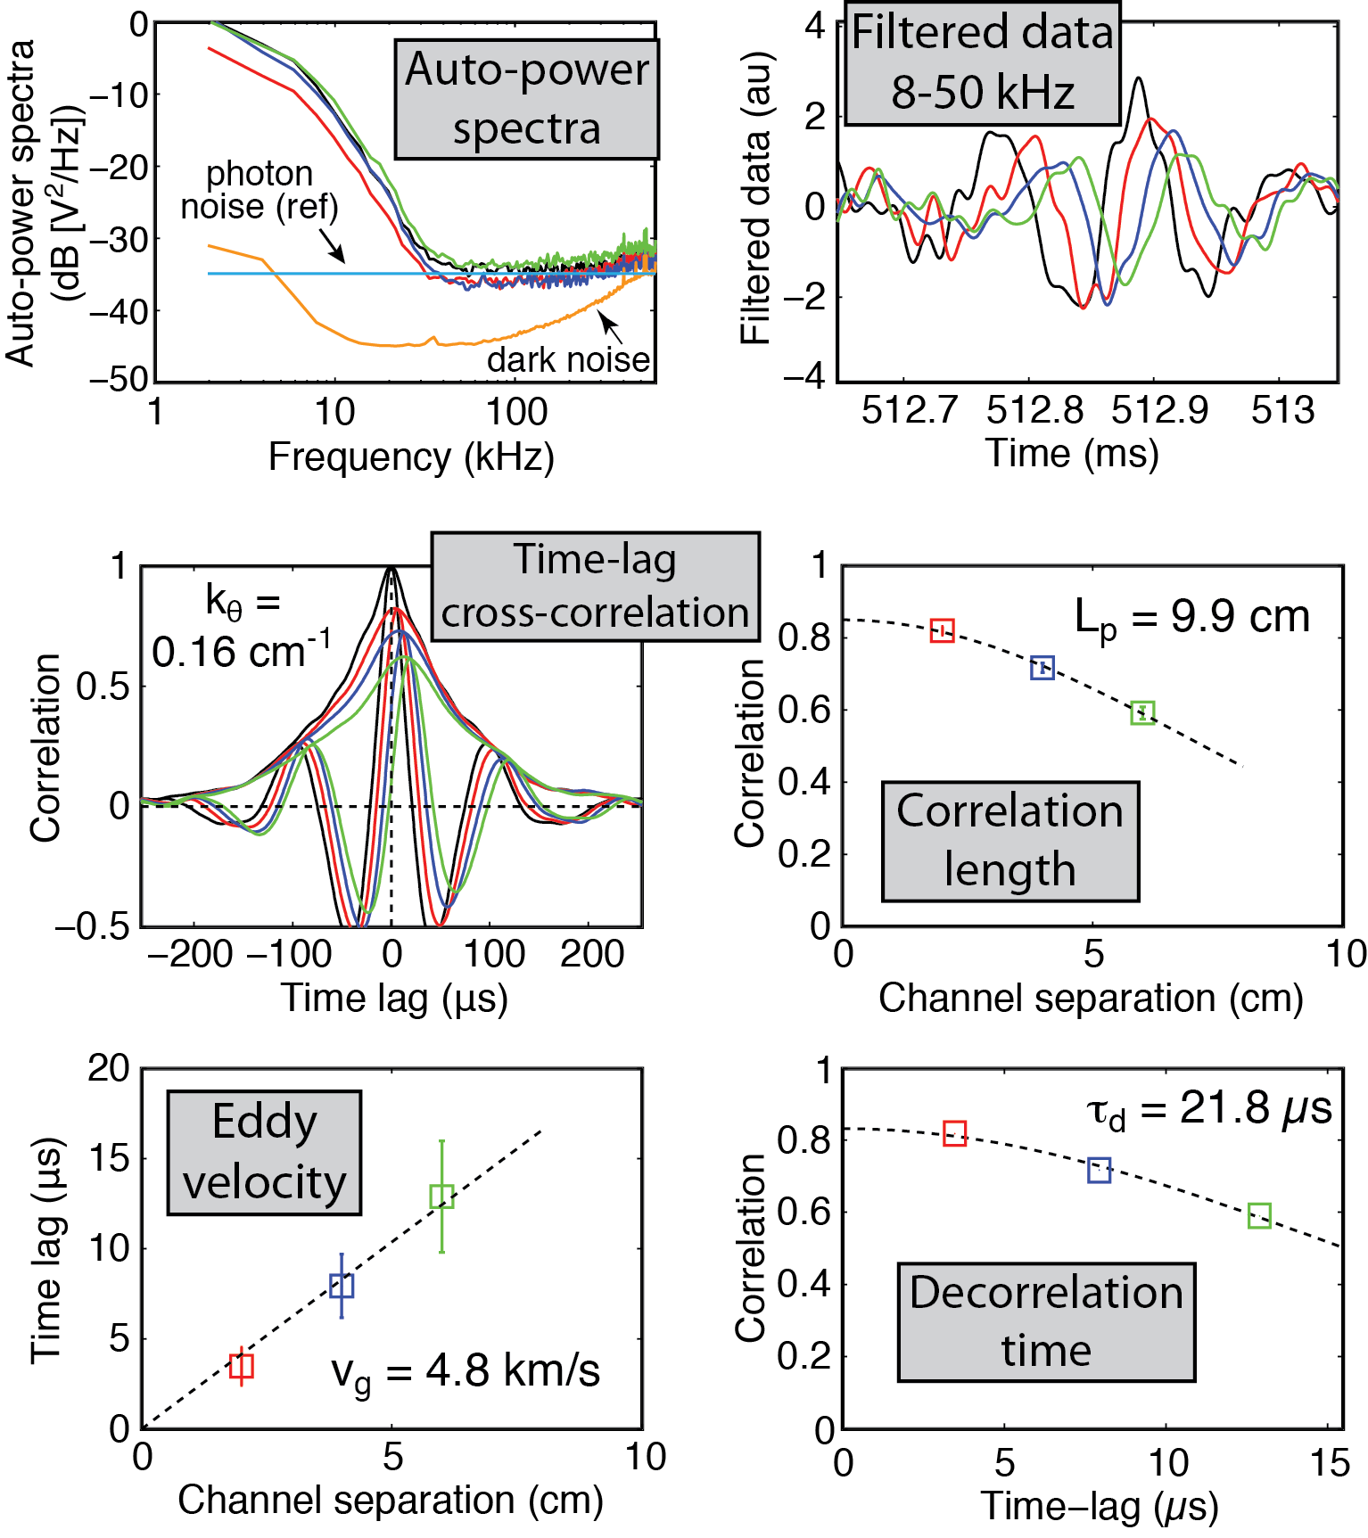
BES can measure poloidal correlation lengths (L_{c}), poloidal wavenumbers (k_{θ}), decorrelation times (τ_{d}), and amplitude (ñ/n)
Auto-power spectra show plasma turbulence signals above detector noise levels
Filtered data (8-50 kHz) show eddies moving down BES array
Time-lag cross-correlation gives:
Correlation length C(x,τ=0)
Decorrelation time C_{max}(τ)
Eddy velocity ∆z/∆τ_{lag}
Dominant wavenumber
  Inferred from auto-correlation and eddy velocity
Notes:
BES power spectra show plasma turbulence in the BES signal exceeds detector dark noise and photon noise by several orders of magnitude.
Filtered data show turbulent eddies propagating down the BES poloidal array.
The time-lag cross-correlation function shows the decrease in correlation with channel separation and time-lag.
The correlation length is the correlation decrease with channel separation at zero time lag.
The decorrelation time is the decrease in maximum correlation with time lag.
The inferred dominant wavenumber is obtain from the cross-correlation anti-nodes and the eddy velocity.

Slide 7
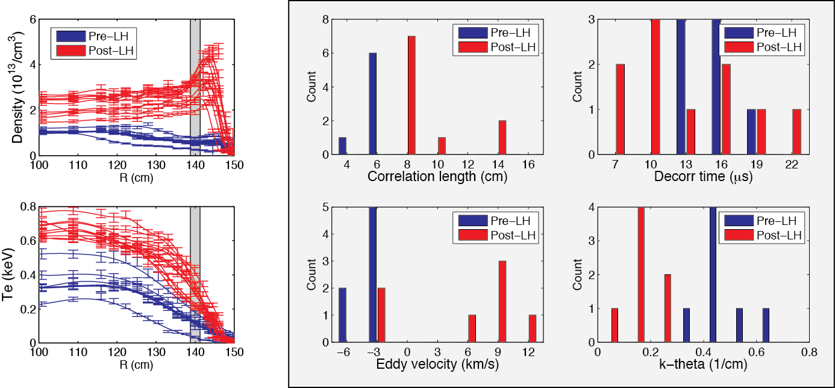
At the LH transition, L_{pol} increases and k_{θ} decreases
Also, measurements suggest eddy advection in lab frame
shifts from electron to ion diamagnetic direction

Slide 8
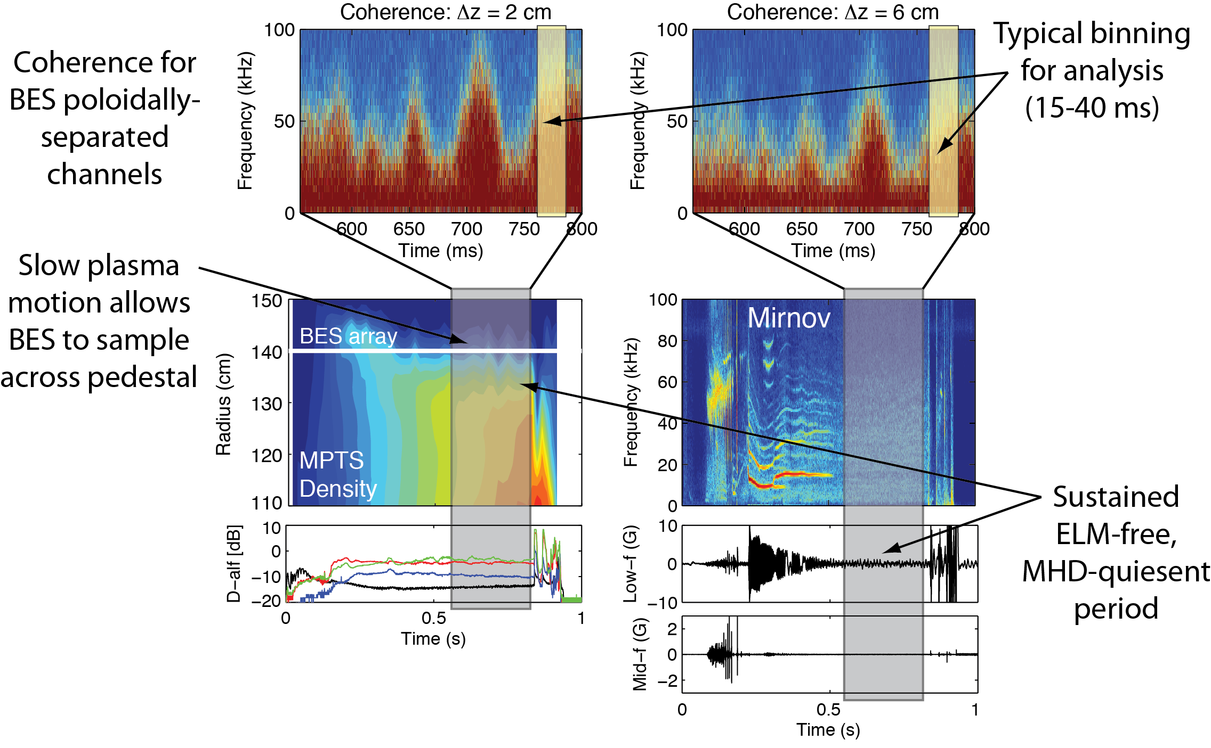
ELM-free, MHD quiescent periods > 150 ms were identified and partitioned into 15-40 ms bins for turbulence analysis
Notes:
ELM-free, MHD quiescent H-mode periods > 150 ms were identified and partitioned into 15-40 ms bins for turbulence analysis
In the BES coherence spectra, you see broadband turbulence activity during an ELM-free, MHD quiescent period.
Note that slow motion of the plasma boundary moves the pedestal relative to the fixed measurement location, so we can obtain measurements in a broader region of the pedestal

Slide 9
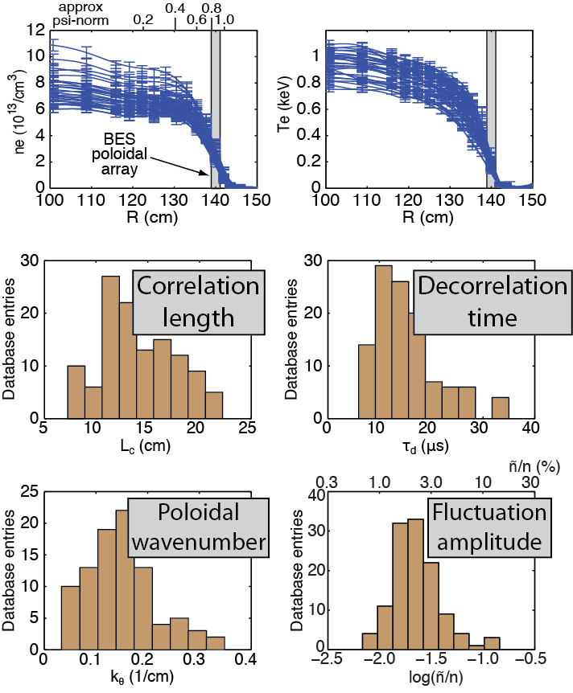
Populated database with pedestal turbulence measurements and transport-relevant plasma parameters
∆R_{ped} ≈ 15 cm
Database with 129 observations from 29 discharges
  B_{T0} = 4.5 kG
  I_{p} = 700-900 kA
  15-45 ms averaging
Turbulence quantities are consistent with DW turbulence
  L_{c}/ρ_{i} ≈ 8 – 18
  k_{θ}ρ_{i} ≈ 0.07 – 0.31
  τ_{d}/(a/c_{s}) ≈ 2.6 – 6.5
  τ_{d}ω*_{pi} ≈ 0.04 – 0.28
  ñ/n ≈ 1%-4%
Transport-relevant parameters
  n_{e}, ∇n_{e}, 1/L_{ne}, T_{e}, ∇T_{e}, 1/L_{Te},
  Ti, ∇T_{i}, 1/L_{Ti}, v_{t}, ∇v_{t}, q, ŝ, ν_{e}, ν_{i}, β, β_{e}, n_{ped}, ΔR_{ped}, δ_{r}^{sep}
  generally 50%-300% variation
Notes:
We identified ELM-free, MHD quiescent periods in 29 discharges, we populated a database with turbulence quantities and transport-relevant plasma parameters.
On the right you see density and Te profiles for the database, and below you see the distribution of turbulence correlation lengths, decorr times, and wavenumbers.
The turbulence quantities are consistent with generic drift-wave turbulence with k*rho-I ~ 0.2.
As mentioned, we included transport-relevant plasma parameters in the database including both normal gradients and inverse scale lengths.

Slide 10
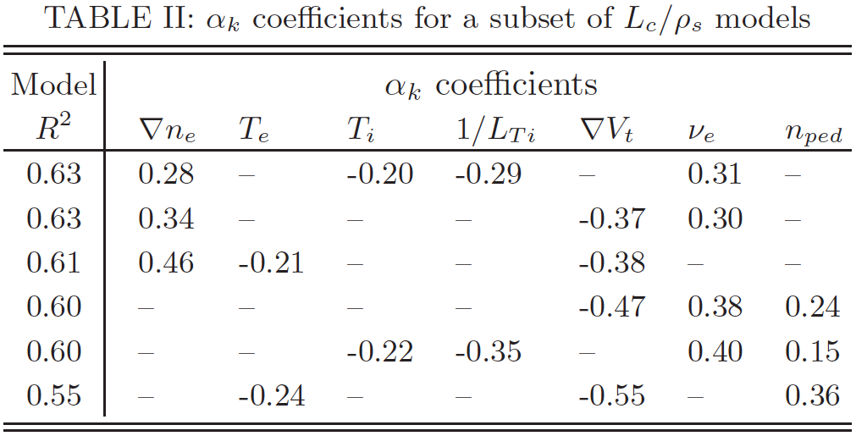
A search algorithm identified many linear regression models among turbulence quantities and plasma parameters
6 representative models for L_{c}/ρ_{s}
plasma
parameters
turbulence
quantities
scaling
coefficient
Many models exist in high dimensional x_{k} space
  Models are error local minima
Screen models for good statistics
  High statistical significance
  t-statistics ➞ P(H₀: α_{k}=0) < 5%
  Low multicollinearity
  Pair-wise corr. ➞ max(|C_{jk}|) < 0.6
  Var. inflation factor ➞ max(VIF_{k}) < 5
  Normally distributed residuals
  P(ε) ➞ Skew and Ex. Kurt. within 2σ
  Studentized residuals ➞ no outliers
Should we try to identify a single “best” model?
Not a good idea because…
Highly subjective
Each model contains only a few (3-4) plasma parameters
Is there a better method?
Notes:
We used a search algorithm to identify regression models among turbulence quantities and plasma parameters.
The algorithm identified many models because each valid model is an error local minima in the high dimensional parameter space.
Only models with good statistical qualities were retained for analysis.
On the right you see 6 of 40 models for the correlation length normalized to rho-s.
Note that different models contain different parameter combinations.
Can or should we identify a single “best” model?
This is not a good idea because the selection is highly subjective due to numerous statistical metrics.
Also, each model contains only a few plasma parameters.
Is there a better method for identifying scalings among the turbulence quantities and plasma parameters?

Slide 11
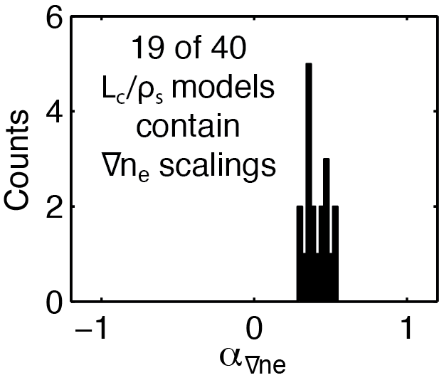
Model aggregation is helpful when working with many possible predictor variables with complex interdependencies
Scalings are robust across models, regardless of number or combination of parameters in models
Model aggregation advantages:
Identify more parameter scalings than single model
Scalings are robust across different models
Notes:
Yes, there is. Model aggregation is helpful when working with many predictor variables with complex interdependencies, as with plasma turbulence.
On the right, we see that scalings are consistent across models with different parameter combinations.
We can collect the scalings from different models to create a histogram of scalings for each plasma parameter.
On the left you see scaling coefficients from 19 models for Lc/rho-s with grad-ne scalings. You can see that the scalings cluster around 0.4, regardless of the number or combination of parameters in the model.

Slide 12
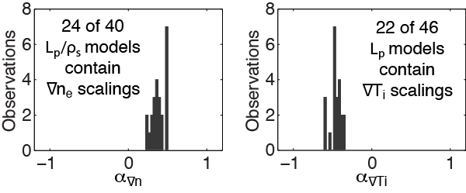
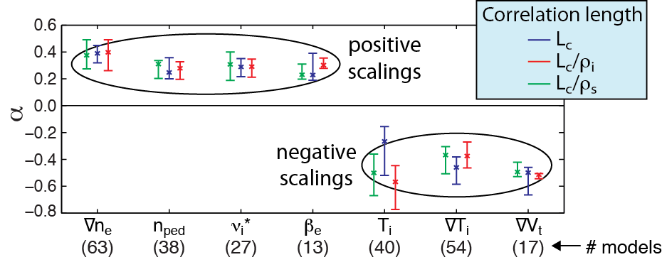
Model aggregation for L_{c} increases (α>0) with ∇n_{e}, ν, β_{e}, and n_{ped}; L_{c} decreases (α<0) with T_{i}, ∇T_{i}, and ∇V_{t}
Scalings are robust
across models with
different parameter
combinations
Notes:
We’ll now apply model aggregation to measured correlation lengths in the database.
On the top you see histograms for grad-ne and grad-Ti scalings. Again, note that the scalings cluster around typical values despite different model compositions.
Below we see positive scalings for grad-ne, 1/LTe, and collisionality, and negative scalings for Ti, grad-Ti, and toroidal flow shear.
Below the plasma parameters you see the number of models for each scaling. In general, we can associate greater confidence in scalings that appear in more models.

Slide 13
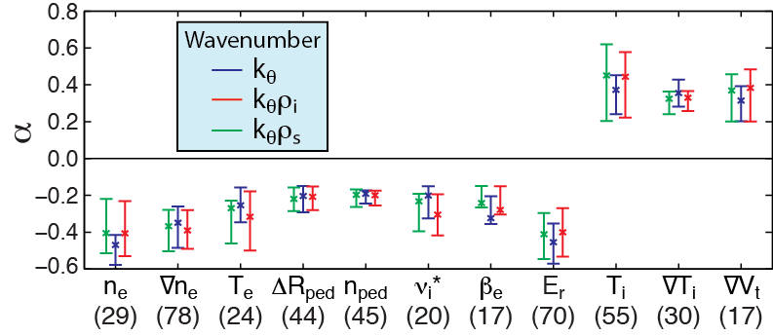
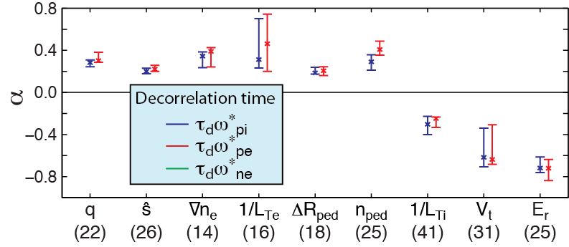
Observed scalings can help identify turbulent modes
k_{θ} scalings are opposite to L_{c} scalings as expected (k_{θ}~1/L_{c} for broadband turbulence)
That’s a lot of scalings, but what does it all mean?
Notes:
Here are scalings for poloidal wavenumber and decorrelation time.
Note that wavenumber scalings are opposite of correlation length scalings, as expected.
Again we see numerous scalings for wavenumber and decorrelation time.
So what does it all mean? We can utilize the observed scalings to draw inferences about the turbulent modes active in the pedestal.

Slide 14
Transport models link transport and turbulence quantities
Transport models (crude, but useful)
assume L_{r}∝L_{p} (random walk) and ignore cross-phases (nonlinear mixing)
Random walk
Quasi-linear
Nonlinear mixing
Trapped electron mode (TEM) turbulence
  Theory (Peeters et al, PoP, 2005 and Lang et al, PoP 2007)
    Driven by ∇n_{e} and ∇T_{e}
    Stabilized by collisions and low T_{e}/T_{i}
    Dissipative TEM (DTEM) requires collisions
  Observed scalings
    L_{c} increases and k_{θ} decreases with ∇n_{e}, consistent with
    TEM-driven transport
    ν scalings point to DTEM, not collisionless TEM
    T_{e} and T_{i} scalings are also consistent with TEM
Notes:
Transport models, however crude, provide a link between transport and turbulence quantities. The various models tell a similar story: transport increases at higher L and lower k. Also, transport increases at higher gamma and lower tau-d. We can use the transport models and the observed scalings to infer turbulence mechanisms in the pedestal.
From theory, we know that TEM turbulence is driven by grad-ne and grad-Te, and stabilized by collisions and low Te/Ti. However, note that dissipative TEM requires collisions.
The grad-ne scalings for L and k are consistent with enhanced TEM-driven transport at higher grad-ne, but the collisionality scalings are consistent with DTEM, not collisionless TEM.
Also, we see mixed agreement between 1/LTe and Te/Ti scalings and TEM-driven transport.

Slide 15
ITG and KBM turbulence assessment
Ion temperature gradient (ITG) turbulence
  Theory (Kotschenreuther et al, PoP, 1995)
    Driven by ∇T_{i}
    Collisions, low T_{e}/T_{i}, and high ∇n_{e} are stabilizing
  Observed scalings
    ∇T_{i}, ∇n_{e}, and ν_{i}∗ scalings are inconsistent with ITG-driven transport
    However, T_{i} scalings are consistent with ITG
Kinetic ballooning mode (KBM) turbulence
  Theory (Snyder et al, PoP, 2001 and Guttenfelder et al, PoP, 2012)
    Driven by ∇P with critical β_{e}
  Observed scalings
    β_{e} scalings are consistent with KBM-driven transport
    ∇T_{i}, 1/L_{Te}, and ∇n_{e} scalings show mixed agreement
Notes:
ITG turbulence is driven by grad-Ti, and is stabilized by collisions, low Te/Ti, and high grad-ne.
The grad-Ti and grad-ne scalings for L and k are inconsistent with ITG-driven transport. Also, all collision scalings are inconsistent with ITG-driven transport.
Finally, the Te/Ti and Ti scalings show mixed agreement with ITG-driven transport.
KBM theories indicate the mode is driven by any pressure gradient and it exhibits a critical beta-e value.
The beta-e scalings for k and tau-d are consistent with KBM driven transport, note that pressure gradient terms from grad-Ti, 1/LTe, and grad-ne show mixed agreement.

Slide 16
μ-tearing assessment and recap
Microtearing (MT) turbulence
  Theory (Guttenfelder et al, PoP, 2012)
    Driven by ∇T_{e}
    Enhanced with collisions and higher β_{e}
  Observed scalings
    β_{e} and ν scalings are consistent with MT-driven transport
    1/L_{Te} scalings τ_{d} are inconsistent with MT-driven transport
  Note: NSTX core turb. simulations indicate BES would be insensitive to μ-tearing, but pedestal simulations point to mixed-parity modes
Recap: Observed scalings are …
  Partially consistent with TEM, KBM, and MT-driven transport
  Least consistent with ITG-driven transport
Notes:
Microtearing theory indicates the mode is driven by grad-Te and enhanced with collisions and beta-e.
All observed scalings for beta-e and collisions are consistent with m-tearing-driven transport, but 1/Lte scalings show mixed agreement.
I’ll note that NSTX core mu-tearing sims indicate BES would not be sensistive to mu-tearing due to high kr values, but pedestal simulations point to mixed-parity hybrid modes.
To recap, in my subjective assessment, the observed scalings are…

Slide 17
Turbulence reduction by equilibrium and zonal E×B flows can be inferred from observed scalings
∇v_{t} scalings for L_{c} and k_{θ} consistent with turbulence suppression by equilibrium E×B flow shear
  L_{c} decreases and k_{θ} increases at higher ∇v_{t}
E_{r} sclaings for τ_{d} are consistent with turbulence decorrelation by ExB flow shear
Collisionality scalings consistent with collisionally-damped zonal flows
  L_{c} increases at higher ν
n_{ped} and ∆R_{ped} scalings consistent with empirical relationship between wider pedestals and larger turbulent structures (Z. Yan et al., PoP 18, 056117 (2011))
Notes:
The observed scalings can also lead to inferences about equilibrium and zonal ExB flows.

Slide 18
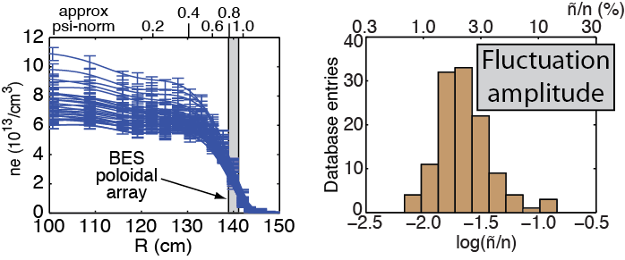
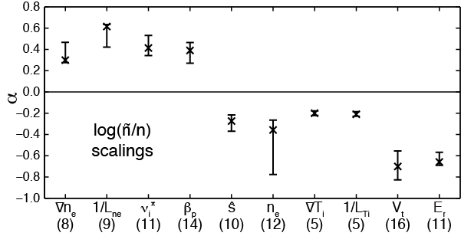
Recent ñ/n scalings reinforce previous results
Most consistent with TEM, KBM, and MT instabilities
Least consistent with ITG
Positive scalings with
  ∇n_{e} and 1/L_{ne}
  ν_{i}* (and other ν quantities)
  β_{p}
Negative scalings with
  ∇T_{i} and 1/L_{Ti}
  ŝ
  E_{r} and V_{t}
Scalings consistent with equilibrium and zonal ExB turbulence suppression.
Scalings consistent with larger ñ/n at edge.

Slide 19
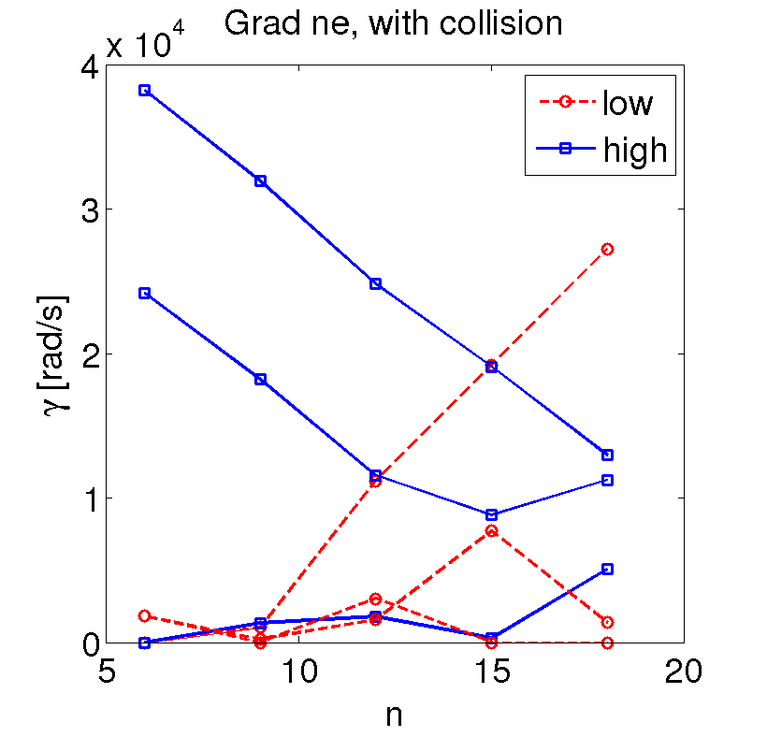
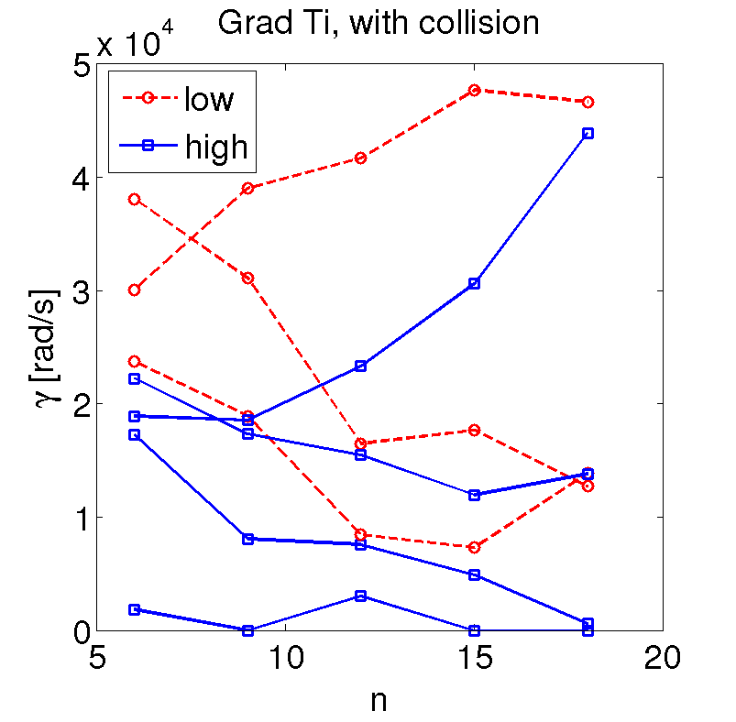
Linear growth rates from GEM gyrokinetic simulations show scalings consistent with measured L_{c} scalings
GEM* global (pedestal) simulations with 6 ≤ n ≤ 15 and k_{θ}ρ_{s} ~ 0.2
indicate instabilities are electromagnetic, destabilized by collisions,
and exhibit both ballooning and tearing parity
∇n_{e}
∇T_{i}
larger
observed L_{c}
larger L_{c}
smaller L_{c}
smaller L_{c}
5 of 6 ∇n_{e} scenarios indicate low-n
growth rates increase at higher ∇n_{e}
7 of 7 ∇T_{i} scenarios indicate low-n
growth rates decrease at higher ∇T_{i}
GEM γ dependencies on ∇n_{e} and ∇T_{i} are consistent with observed L_{c} scalings
* Y. Chen and S. Parker, J. Comp. Phys. 220, 839 (2007)
Notes:
We start with linear gyrokinetic simulations from GEM. The simulations are global across the pedestal.
The simulations point to electromagnetic modes that are destabilized by collisions and show mixed ballooning and tearing parity.
On the left, we see higher growth rates at higher density gradient for low-n modes. On the right, we see lower growth rates at higher Ti gradient for low-n modes.
The linear growth rate dependencies for density and Ti gradient are consistent with observed scalings for correleation length in the sense that transport models associate higher transport with higher gamma and higher L.

Slide 20
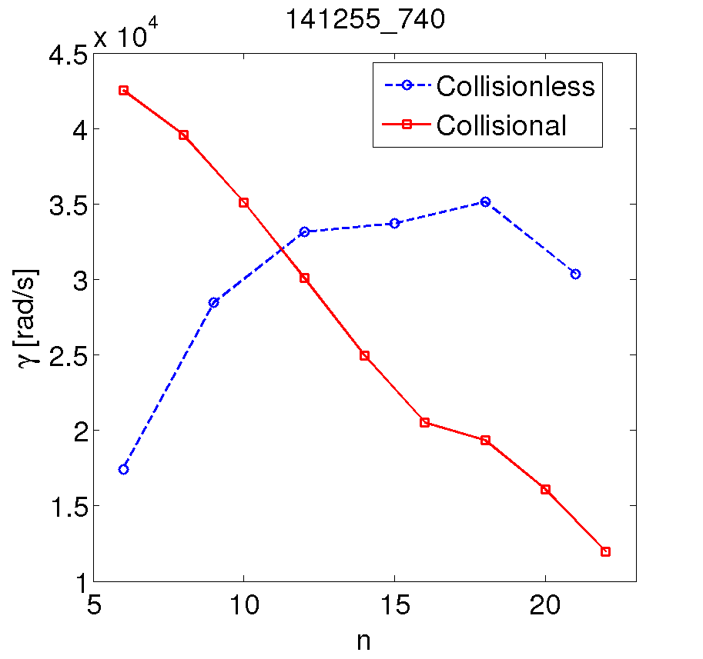
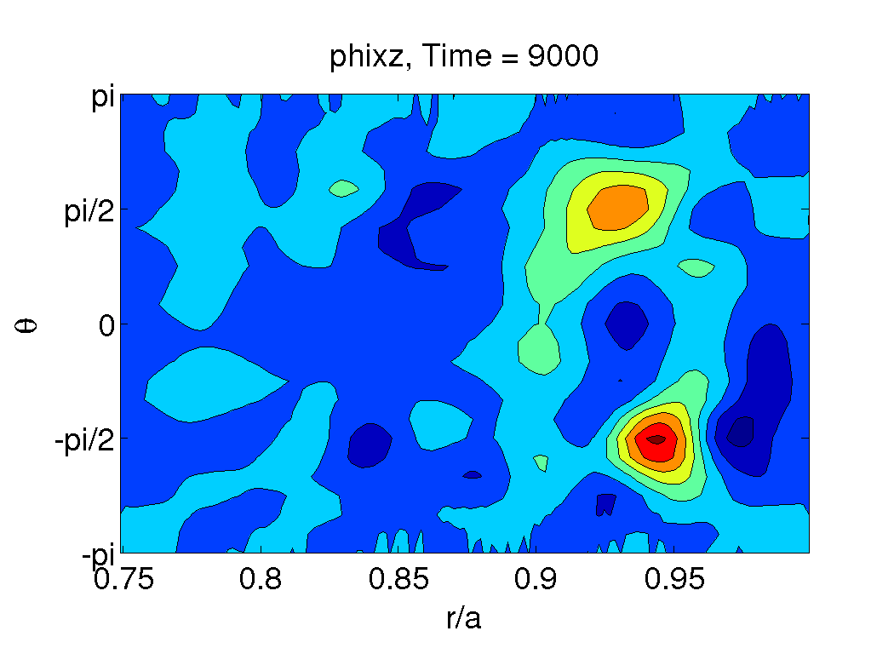
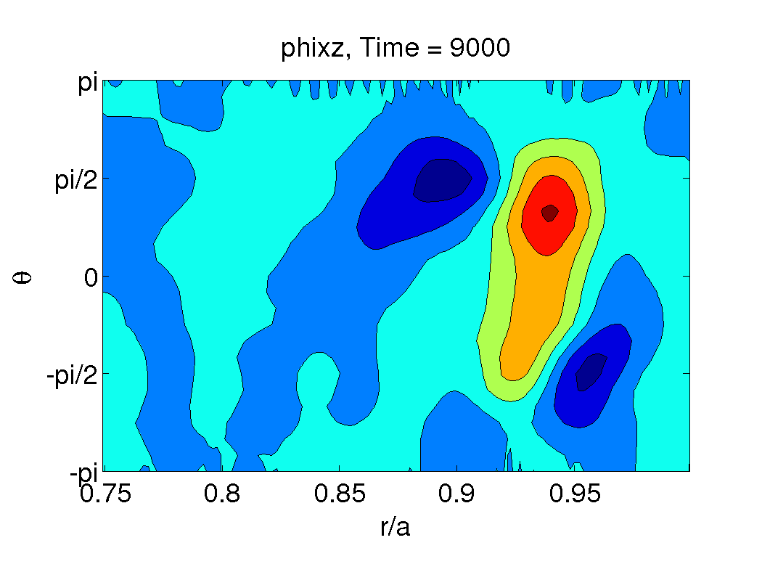
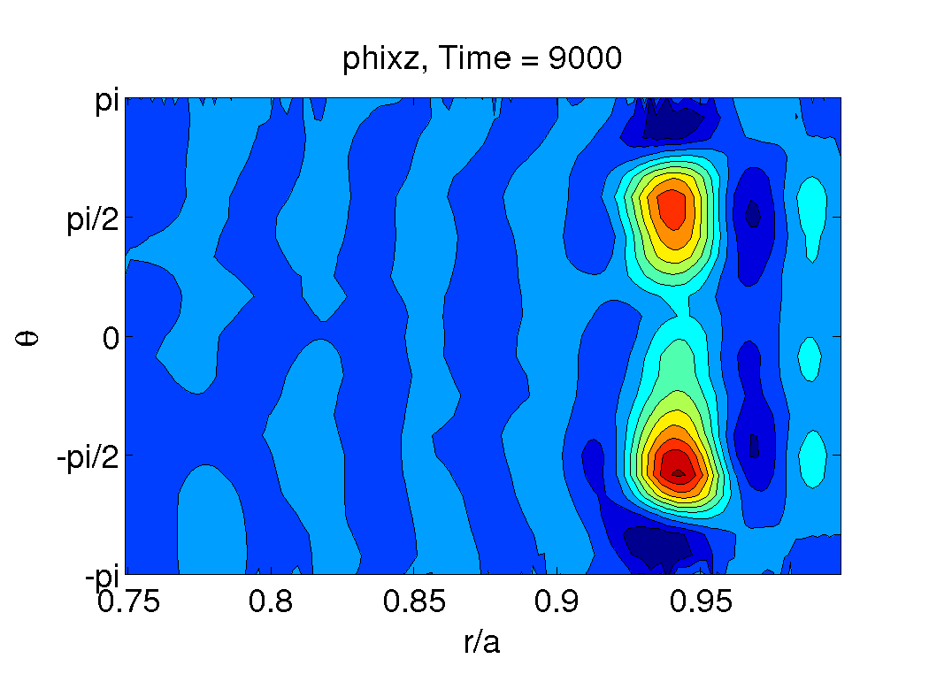
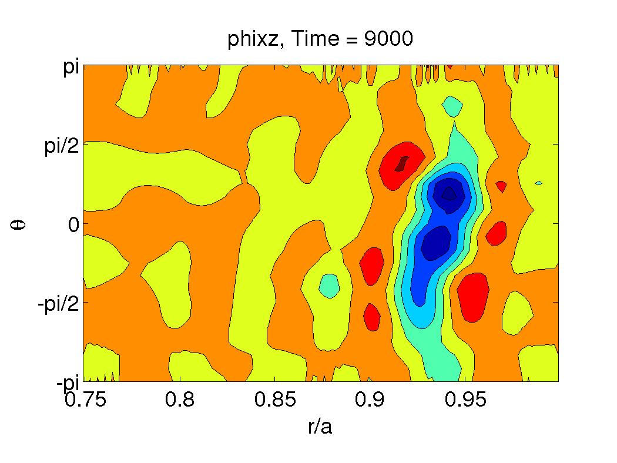
Linear GEM simulations point to mixed-parity modes and highlight the importance of collisions
GEM φ contours in plane ⊥ B (n=6)
Collisions increase γ at low-n
(decrease γ at high-n)
Collisionless
Collisional
n=6
low k
high k
n=24
Low-n modes consistent with observed scalings that show lower k_{θ} at higher ν
even parity
mixed parity
Notes:
Turning collisions off in the simulation reduces growth rates at low-n, the k range of interest.
In another sense, the unstable modes shift to low-n with collisions. This pattern is consistent with the observed scaling of lower k at higher nu.
Also, we note that collisionless simulations show pure even parity modes, but simulations with collisions show mixed-parity modes.

Slide 21
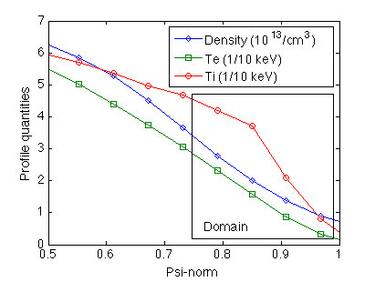
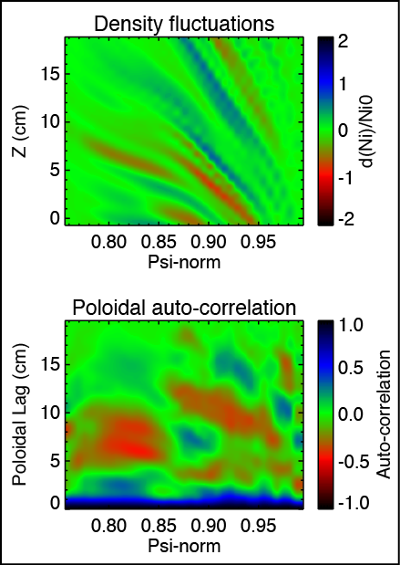
L_{c} and k_{θ} from BOUT++ pedestal simulations compare favorably with measurements
Initial value 3D Braginskii fluid simulations evolve n_{i}, ω, j||, A||, T_{i}, and T_{e}
with collisionality, E×B advection, field line curvature, and drive terms for j|| and ∇P. Simulations do not include toroidal rotation and parallel advection.
L_{c}/ρ_{i} ~ 8 is in line with measurements, but
k_{θ}ρ_{i} ~ 0.7-1.4 is higher than measurements

Slide 22
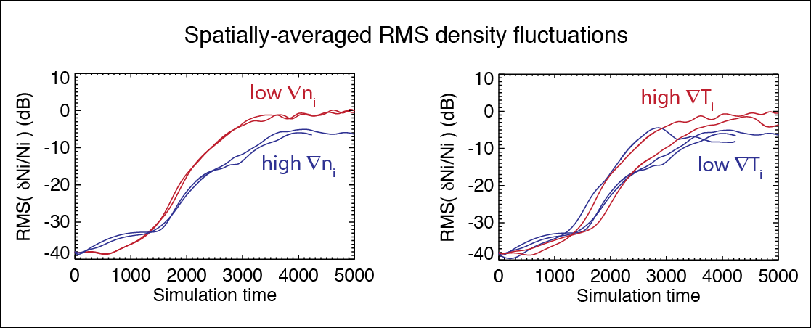
BOUT++ parameter scans point to larger fluctuation amplitudes at lower ∇n_{i} and higher ∇T_{i}
∇n_{i} and ∇T_{i} trends from Braginskii model do not reproduce observed scalings
  Highlights the importance of electron dynamics for TEM and MT physics
  Demonstrates that simple, order-of-magnitude comparisons (e.g. correlation length) can lead to erroneous inferences
  Will benefit from BOUT++ gyrofluid model ➞ X. Xu et al, in press, PoP (2013)

Slide 23
Summary
ST parameter regime can extend the parameter space and confidence in pedestal models
We measured pedestal turbulence parameters in NSTX
H-mode plasmas during ELM-free, MHD quiescent periods (with Li conditioning)
  L_{c}/ρ_{i} ~ 12 k_{θ}ρ_{i} ~ 0.2 τ_{d}/(a/c_{s}) ~ 5 ñ/n ~ 1%-4%
Parametric dependencies for pedestal turbulence meas-urements are most consistent with TEM turbulence and partially consistent with KBM and μ-tearing turbulence
  GEM gyrokinetic simulations show linear γ scalings consistent with measure L_{c} scalings for ∇n_{e} and ∇T_{i}

Slide 24
Future work
Extend measurements and analysis to radial L_{r} and k_{r}
Radial and poloidal wavenumber spectra
Flow fluctuations and time-delay estimation
  Predator-prey model between flow fluctuations and turbulence parameters
Nonlinear global (pedestal) gyrokinetic and gyrofluid simulations

