Slide 1




NSTX-U
Supported by
Development of a new reduced model for fast ion transport in TRANSP
M. Podestà
M. Gorelenkova, R. B. White,
NSTX-U Energetic Particles Topical Science Group
and NSTX-U Team
Coll of Wm & Mary
Columbia U
CompX
General Atomics
FIU
INL
Johns Hopkins U
LANL
LLNL
Lodestar
MIT
Lehigh U
Nova Photonics
Old Dominion
ORNL
PPPL
Princeton U
Purdue U
SNL
Think Tank, Inc.
UC Davis
UC Irvine
UCLA
UCSD
U Colorado
U Illinois
U Maryland
U Rochester
U Tennessee
U Tulsa
U Washington
U Wisconsin
X Science LLC
Culham Sci Ctr
York U
Chubu U
Fukui U
Hiroshima U
Hyogo U
Kyoto U
Kyushu U
Kyushu Tokai U
NIFS
Niigata U
U Tokyo
JAEA
Inst for Nucl Res, Kiev
Ioffe Inst
TRINITI
Chonbuk Natl U
NFRI
KAIST
POSTECH
Seoul Natl U
ASIPP
CIEMAT
FOM Inst DIFFER
ENEA, Frascati
CEA, Cadarache
IPP, Jülich
IPP, Garching
ASCR, Czech Rep
US TTF 2014
San Antonio, TX
April 23rd, 2014
Supported by DOE contract no. DE-AC02-09CH11466

Slide 2
New model introduces selectivity in phase space, generalizes ad-hoc (diffusive) models in TRANSP
Info on phase space dynamics is of paramount importance for Verification&Validation of codes, theory-experiment comparison
“Fluid” (integral) quantities do not provide enough information
  Re-computed (“inverted”) F_{nb} based on measured integral quantities (f.i. density, neutrons, E_{r}/rotation, NB-driven J_{nb}, ...) is not unique
Need details on fast ion energy, pitch and their (consistent) evolution
  E.g. *AE bursts transiently (and selectively) modify phase space; effects propagate during slowing-down
The new model must be “simple enough” to be included in TRANSP/NUBEAM for routine use reduced model
see M. Podestà et al., PPCF 56 (2014) 055003

Slide 3
Outline
New ‘kick model’: basic ideas
Verification against full ORBIT simulations
Example from NSTX case w/ TAE avalanche
Summary

Slide 4
Outline
New ‘kick model’: basic ideas
Verification against full ORBIT simulations
Example from NSTX case w/ TAE avalanche
Summary

Slide 5
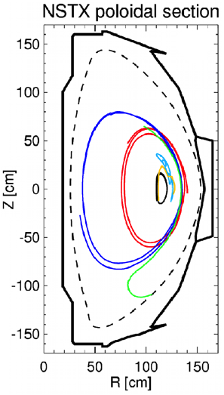
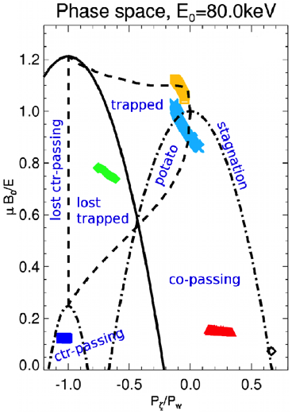
‘Constants of motion’ are the natural variables to describe resonant wave-particle interaction
Each orbit is fully characterized by:
    E, energy
    P_{ζ}∼mRv_{par}-Ψ, canonical ang. momentum
    μ∼v_{perp}²/(2B), magnetic moment
R. B. White, Theory of toroidally confined plasmas,
Imperial College Press (2001)

Slide 6
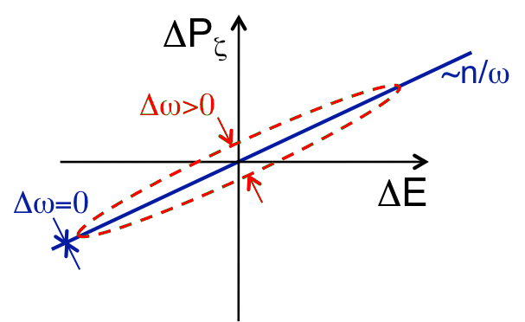
Resonances introduce fundamental constraints on particle’s trajectory in (E,P_{ζ},μ)
From Hamiltonian formulation – single resonance:
ω=2πf, mode frequency n, toroidal mode number
Multiple modes, resonances can lead
to complicated (ΔE,ΔP_{ζ}) distributions

Slide 7
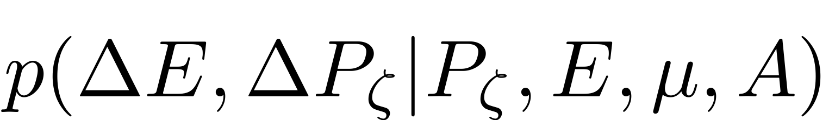
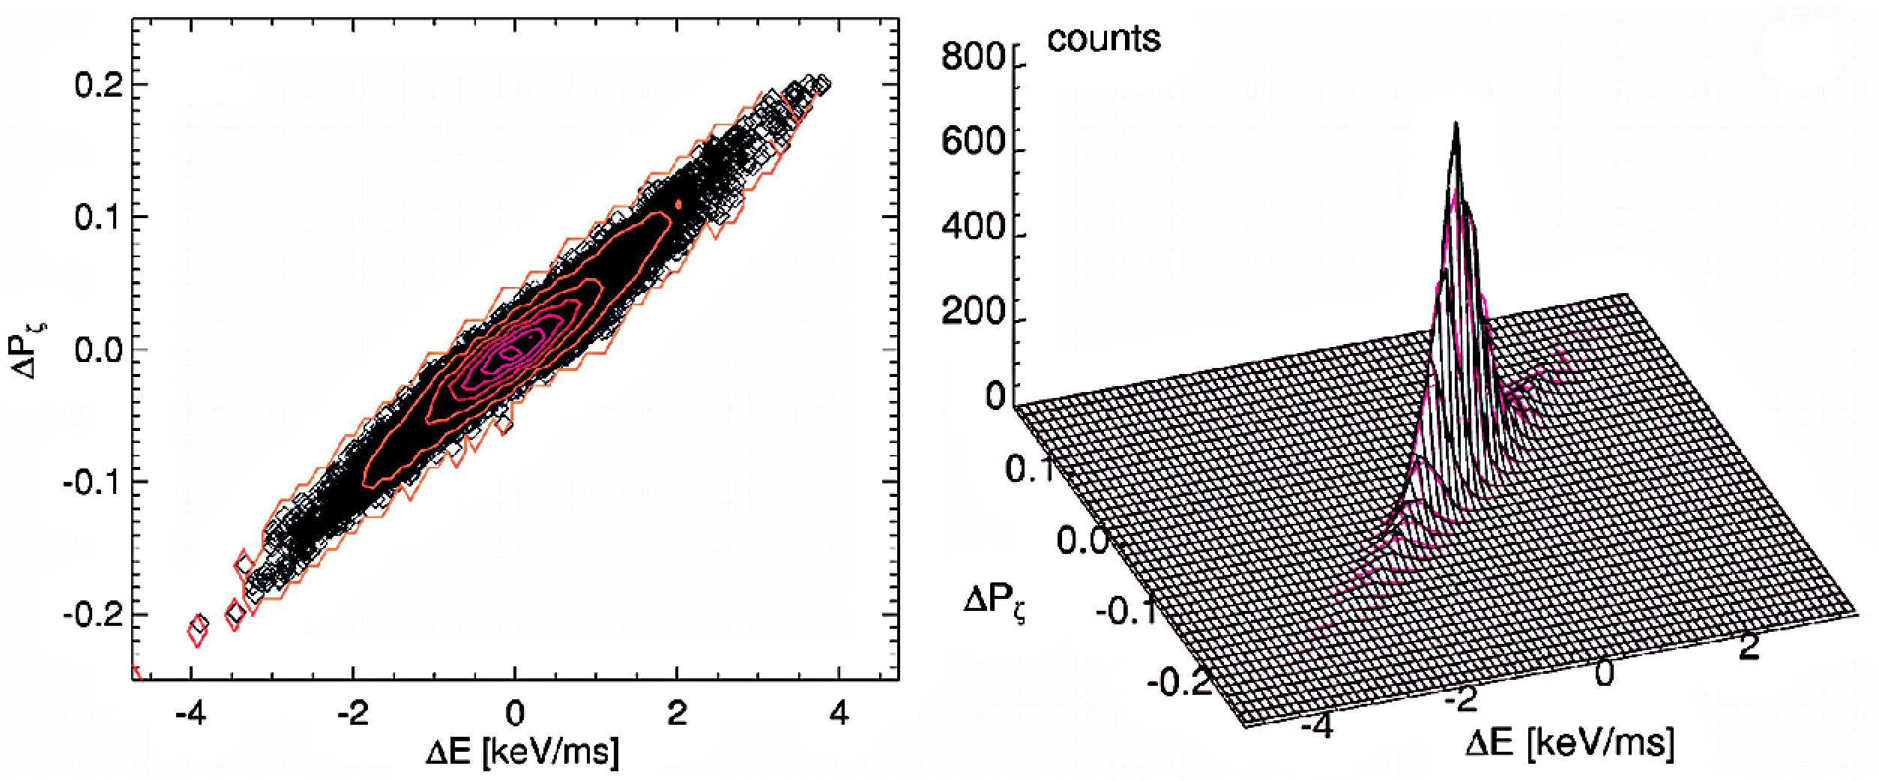
New ‘kick model’ is based on a probability distribution function for particle transport
For each “orbit” in (E,P_{ζ},μ), describe steps in ΔE,ΔP_{ζ} by
which can include the effects of multiple modes, resonances: correlated random walk in E, P_{ζ}
3 TAE modes
(ORBIT modeling)
In practice, will use the full 5D matrix for p(ΔE,ΔP_{ζ}|P_{ζ},E,μ) plus a time-dependent “mode amplitude scaling factor”

Slide 8
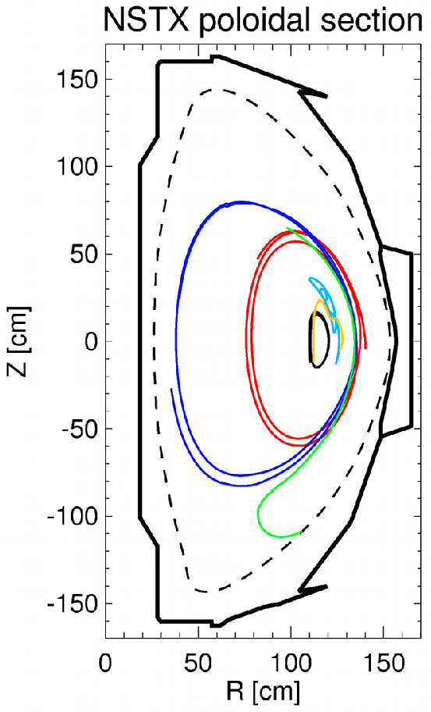
‘Transport probability’ p(ΔE,ΔP_{ζ}|P_{ζ},E,μ) can be computed through numerical codes (e.g. ORBIT) or theory
Compute modes, e.g. through NOVA + measurements
Run ORBIT with A_{mode}=1, constant
Track (P_{ζ},E,μ) in time for each particle, steps δt_{sim}~25-50μs
Compute steps ΔE,ΔP_{ζ},Δμ
Re-bin over (P_{ζ},E,μ) space
Obtain p(ΔE,ΔP_{ζ}|P_{ζ},E,μ) for each bin in phase space

Slide 9
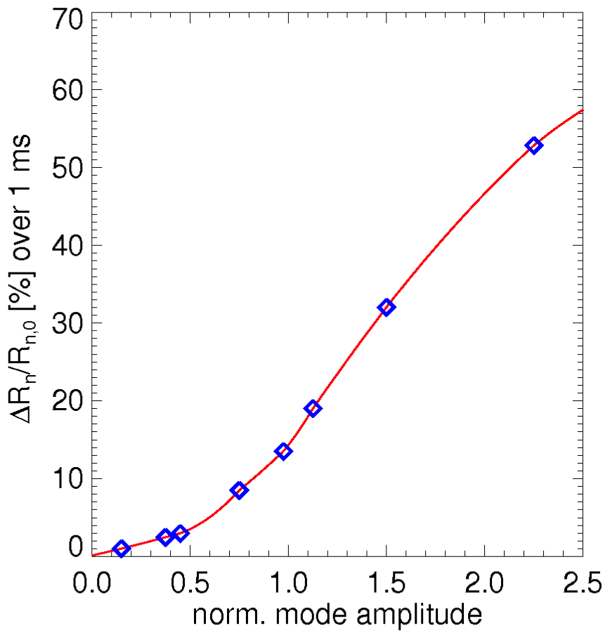
Scaling factor A_{mode}(t) is obtained from measurements, or from other observables such as neutron rate + modeling
Best option: use experimental data (e.g. reflectometers, ECE)
If no mode data directly available, A_{mode} can be estimated based on other measured quantities
Example: use measured neutron rate
  Compute ideal modes through NOVA
  Rescale relative amplitudes from NOVA according to reflectometers
  Rescale total amplitude based on computed neutron drop from ORBIT
  Scan mode amplitude w.r.t. experimental one, A_{mode}=1: get table
  Build A_{mode}(t) from neutrons vs. time, table look-up
NSTX #139048, t~270ms
ORBIT,
constant A_{mode}
interpolation

Slide 10
Scheme to advance fast ion variables according to transport probability in NUBEAM module of TRANSP
re-compute sources, scattering, slowing down
NUBEAM step k
NUBEAM step k+1
read Plasma
State, F_{nb} info
convert F_{nb}(E,P_{ζ},μ)
to F_{nb}(E,p,R,Z)
read A_{mode},
p(ΔE,ΔP_{ζ}|E,P_{ζ},μ)
convert F_{nb}(E,p,R,Z)
to F_{nb}(E,P_{ζ},μ)
loop – MC mini-steps
sample
ΔE_{j},ΔP_{ζ,j}
evolve
E_{j},P_{ζ,j}
diagnostics
(e.g. classify
orbit)
loop – F_{nb} particles
add “kicks” to F_{nb} variables

Slide 11
Scheme to advance fast ion variables according to transport probability in NUBEAM module of TRANSP
re-compute sources, scattering, slowing down,
E,P_{ζ} “kicks”
NUBEAM step k
NUBEAM step k+1
read Plasma
State, F_{nb} info
convert F_{nb}(E,P_{ζ},μ)
to F_{nb}(E,p,R,Z)
read A_{mode},
p(ΔE,ΔP_{ζ}|E,P_{ζ},μ)
convert F_{nb}(E,p,R,Z)
to F_{nb}(E,P_{ζ},μ)
loop – MC mini-steps
sample
ΔE_{j},ΔP_{ζ,j}
evolve
E_{j},P_{ζ,j}
diagnostics
(e.g. classify
orbit)
loop – F_{nb} particles
add “kicks” to F_{nb} variables

Slide 12
Outline
New ‘kick model’: basic ideas
Verification against full ORBIT simulations
Example from NSTX case w/ TAE avalanche
Summary

Slide 13
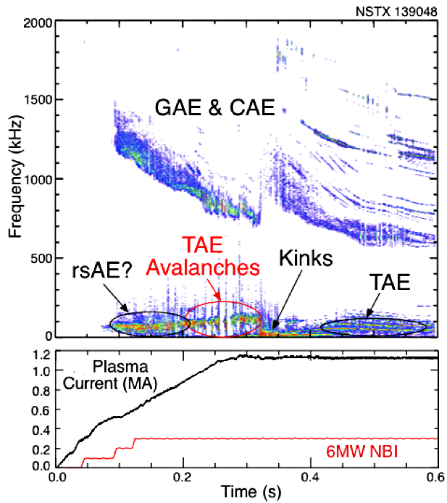
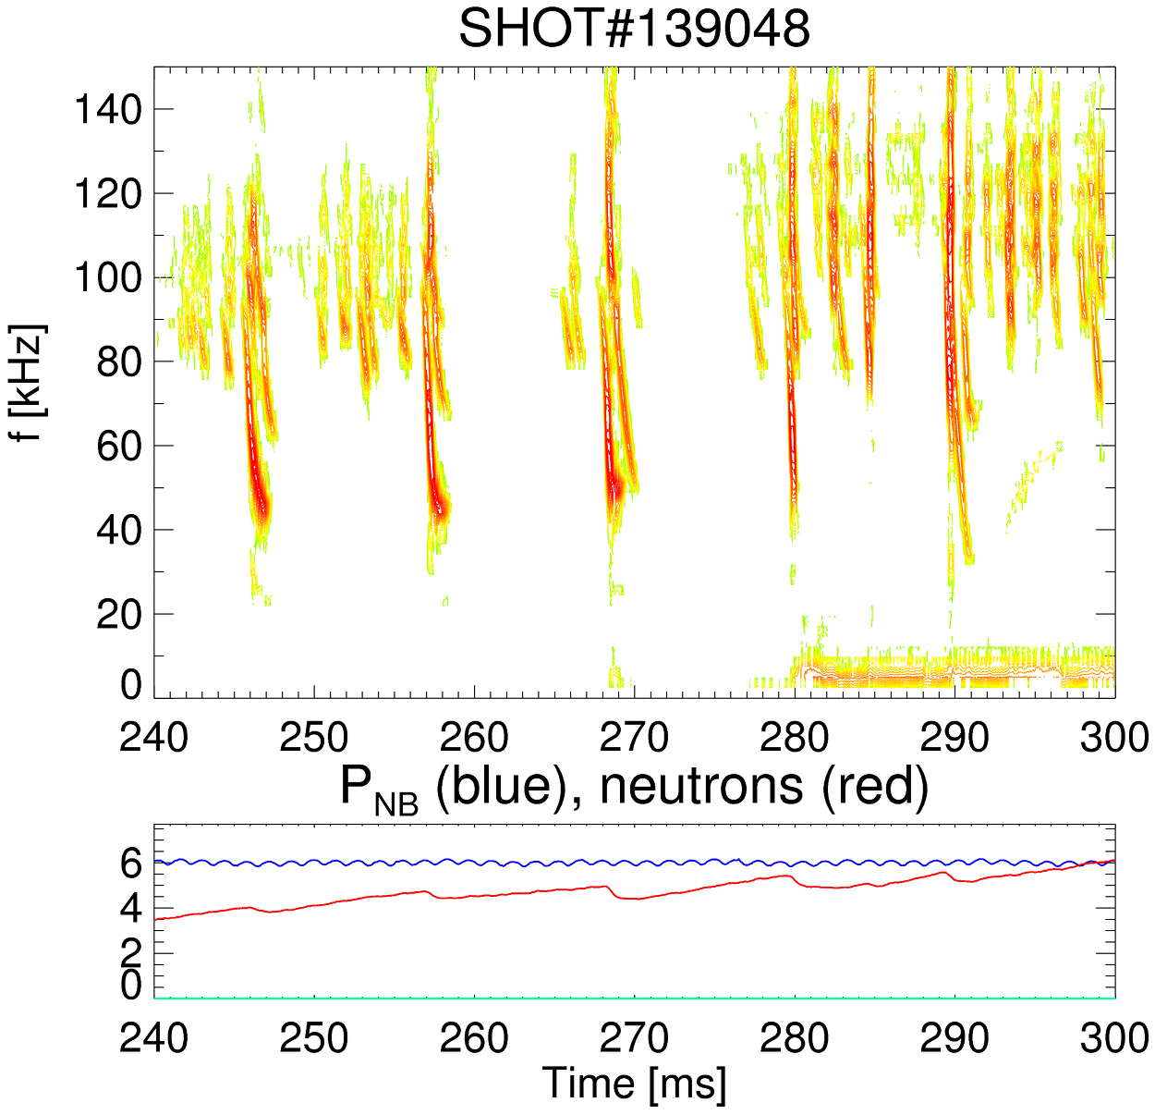
Experimental scenario for initial verification:
NSTX H-mode plasma with bursts of TAE activity
E. Fredrickson et al., Nucl. Fusion 2013
TAE Avalanches:
Focus on this event

Slide 14
Evolve F_{nb} from NUBEAM assuming fixed background, compare with ORBIT
loop – MC mini-steps
read A_{mode},
p(ΔE,ΔP_{ζ}|E,P_{ζ},μ)
sample
ΔE_{j},ΔP_{ζ,j}
evolve
E_{j},P_{ζ,j}
diagnostics
(e.g. classify
orbit)
convert F_{nb}(E,P_{ζ},μ)
to F_{nb}(E,p,R,Z)
F_{nb}(E,P_{ζ},μ) from NUBEAM
loop – F_{nb} particles
add “kicks” to F_{nb} variables
  Verify agreement for :
  Single particle orbits
  Whole ensemble of particles (preserve statistics)
  Global quantities: density profile

Slide 15
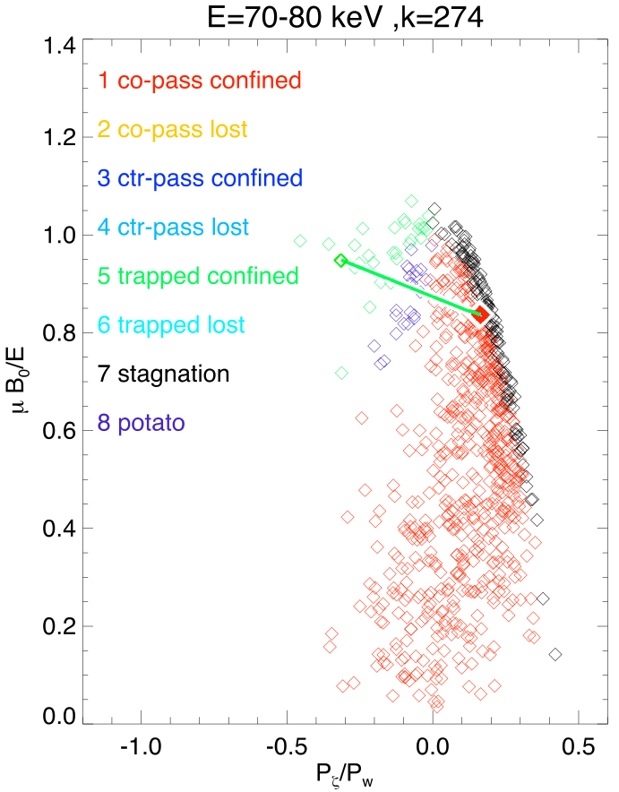
Change in orbit type observed for some particles: fast ions are kicked around in phase space by TAEs
blue: initial orbit
red: final orbit

Slide 16
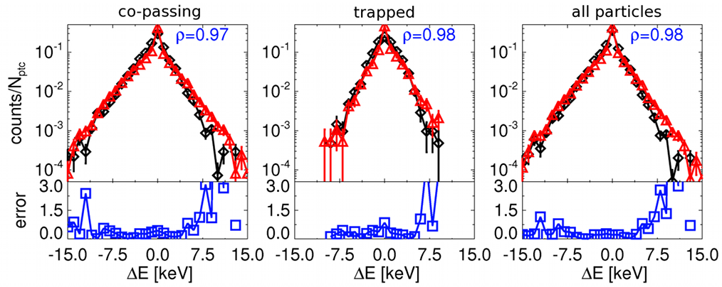
Good agreement with ORBIT is preserved when evolving F_{nb} over 5 ms, typical macro-step of NUBEAM
black: ORBIT red: Kick Model ρ: correlation coefficient error: (ORBIT-model)/ORBIT
Similar results for P_{ζ}
Satisfactory reconstruction over ~3 orders of magnitude for
co-, trapped (, counter- not present in this input F_{nb}) particles

Slide 17
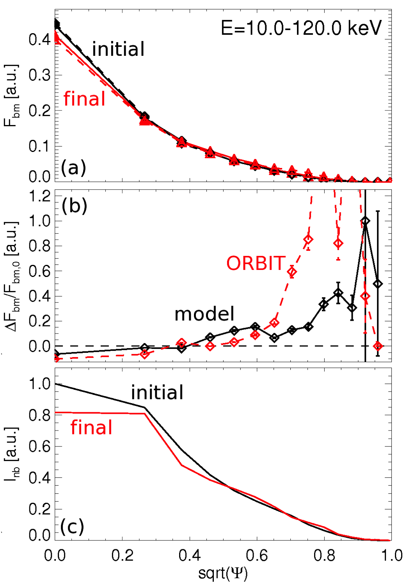
F_{nb} after 5ms shows fast ion redistribution, only modest losses; NB driven “current” also affected.
solid: model
dashed: ORBIT
Compare full ORBIT simulation with reconstructions from reduced model
F_{nb} drops in the core, fast ions redistributed to larger radii
Define rough proxy for NB-driven (parallel) current, I_{nb}~F_{nb} p v
  Larger (relative) variations for I_{nb} than for F_{nb} in the core
  Need NUBEAM/TRANSP for more quantitative calculations of I_{nb}

Slide 18
Outline
New ‘kick model’: basic ideas
Verification against full ORBIT simulations
Example from NSTX case w/ TAE avalanche
Summary

Slide 19
Next step: use stand-alone NUBEAM and IDL scripts to simulate F_{nb} evolution for >>5 ms
IDL scripts
re-compute sources, scattering, slowing down
after “kicks”
NUBEAM step k
NUBEAM step k+1
read Plasma
State, F_{nb} info
convert F_{nb}(E,P_{ζ},μ)
to F_{nb}(E,p,R,Z)
read A_{mode},
p(ΔE,ΔP_{ζ}|E,P_{ζ},μ)
add “kicks” to F_{nb} variables
convert F_{nb}(E,p,R,Z)
to F_{nb}(E,P_{ζ},μ)
loop – MC mini-steps
sample
ΔE_{j},ΔP_{ζ,j}
evolve
E_{j},P_{ζ,j}
diagnostics
(e.g. classify
orbit)
loop – F_{nb} particles

Slide 20
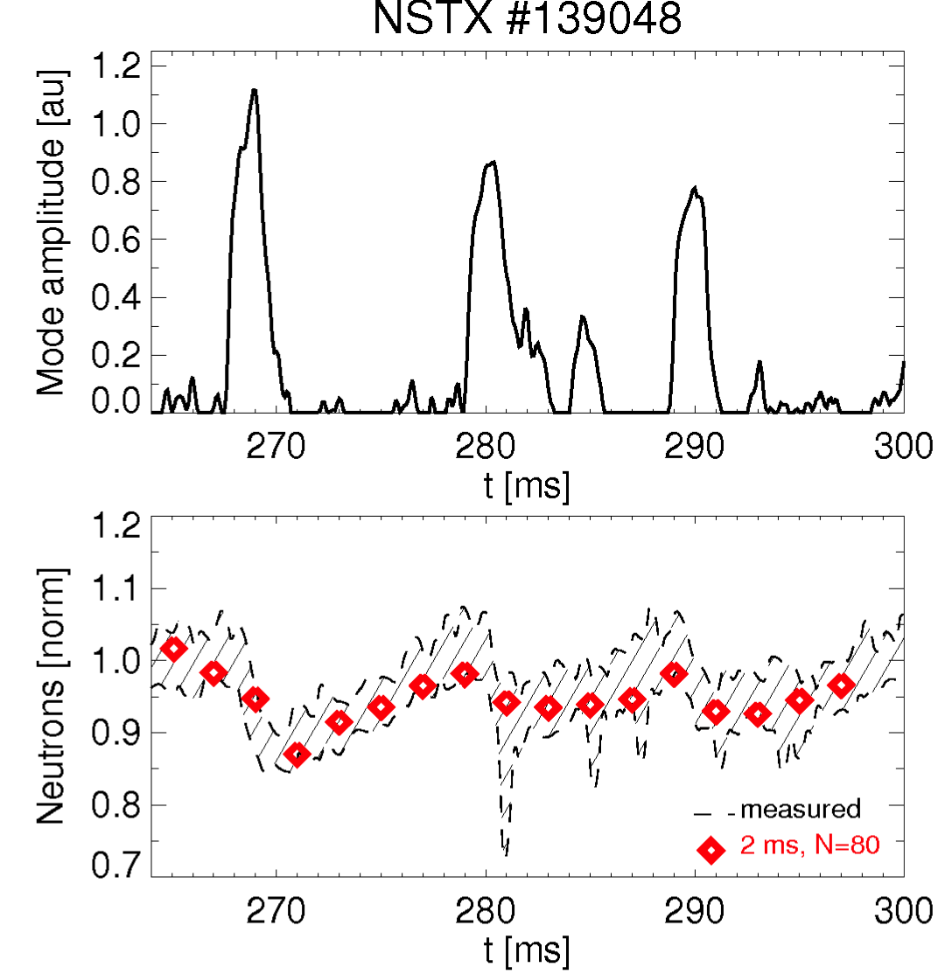
Reduced model reproduces neutron evolution for nominal A_{mode}(t) from neutrons, Mirnovs
Initial comparison of model predictions w/ experimental neutron rate
Use stand-alone version of NUBEAM, iterate with reduced model (IDL scripts)
Background plasma is fixed
  Normalize exp. neutron rate to central ion density vs. time
  Normalize all neutron rates at t=267 ms (before first burst)
model
Satisfactory agreement for A_{mode}(t) from neutron rate, Mirnovs

Slide 21
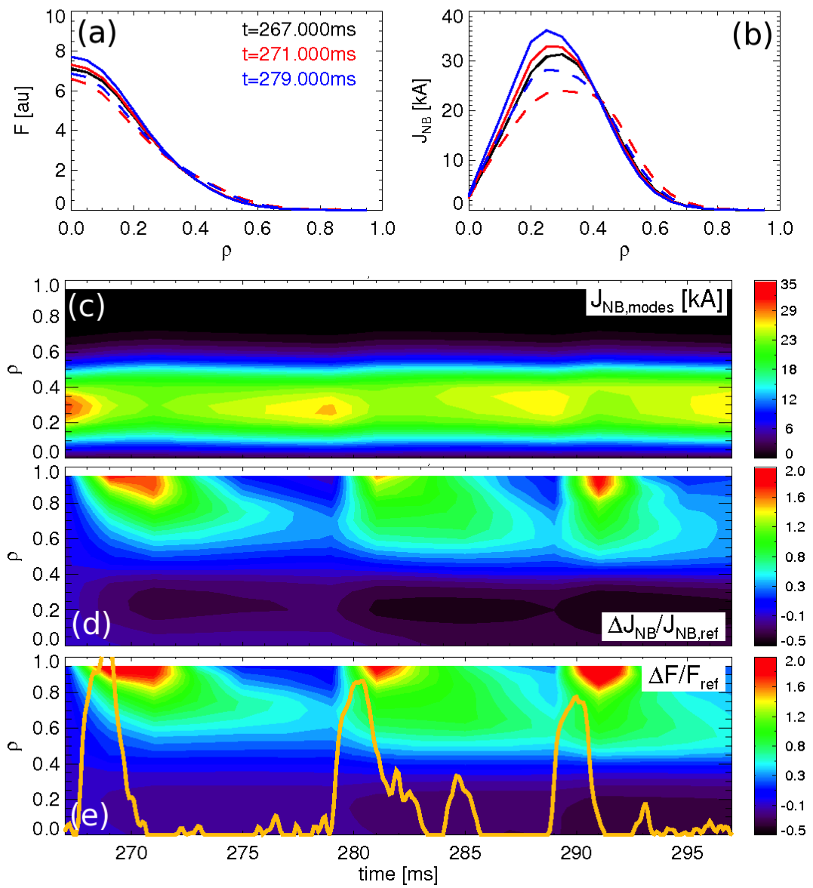
Reduced model + NUBEAM reproduces fast ion redistribution; NB-driven current strongly affected, too
solid: classical w/ AFID
dashed: w/ MHD
267 ms
271 ms
279 ms
Initial tests show fast ion redistribution induced by each TAE avalanche
Clear effects on NB-driven current, J_{nb}
    Stronger effect than on F_{nb}
AE effects persist on slowing down time scales
Constant NB injection counteracts F_{nb}, J_{nb} depletion

Slide 22
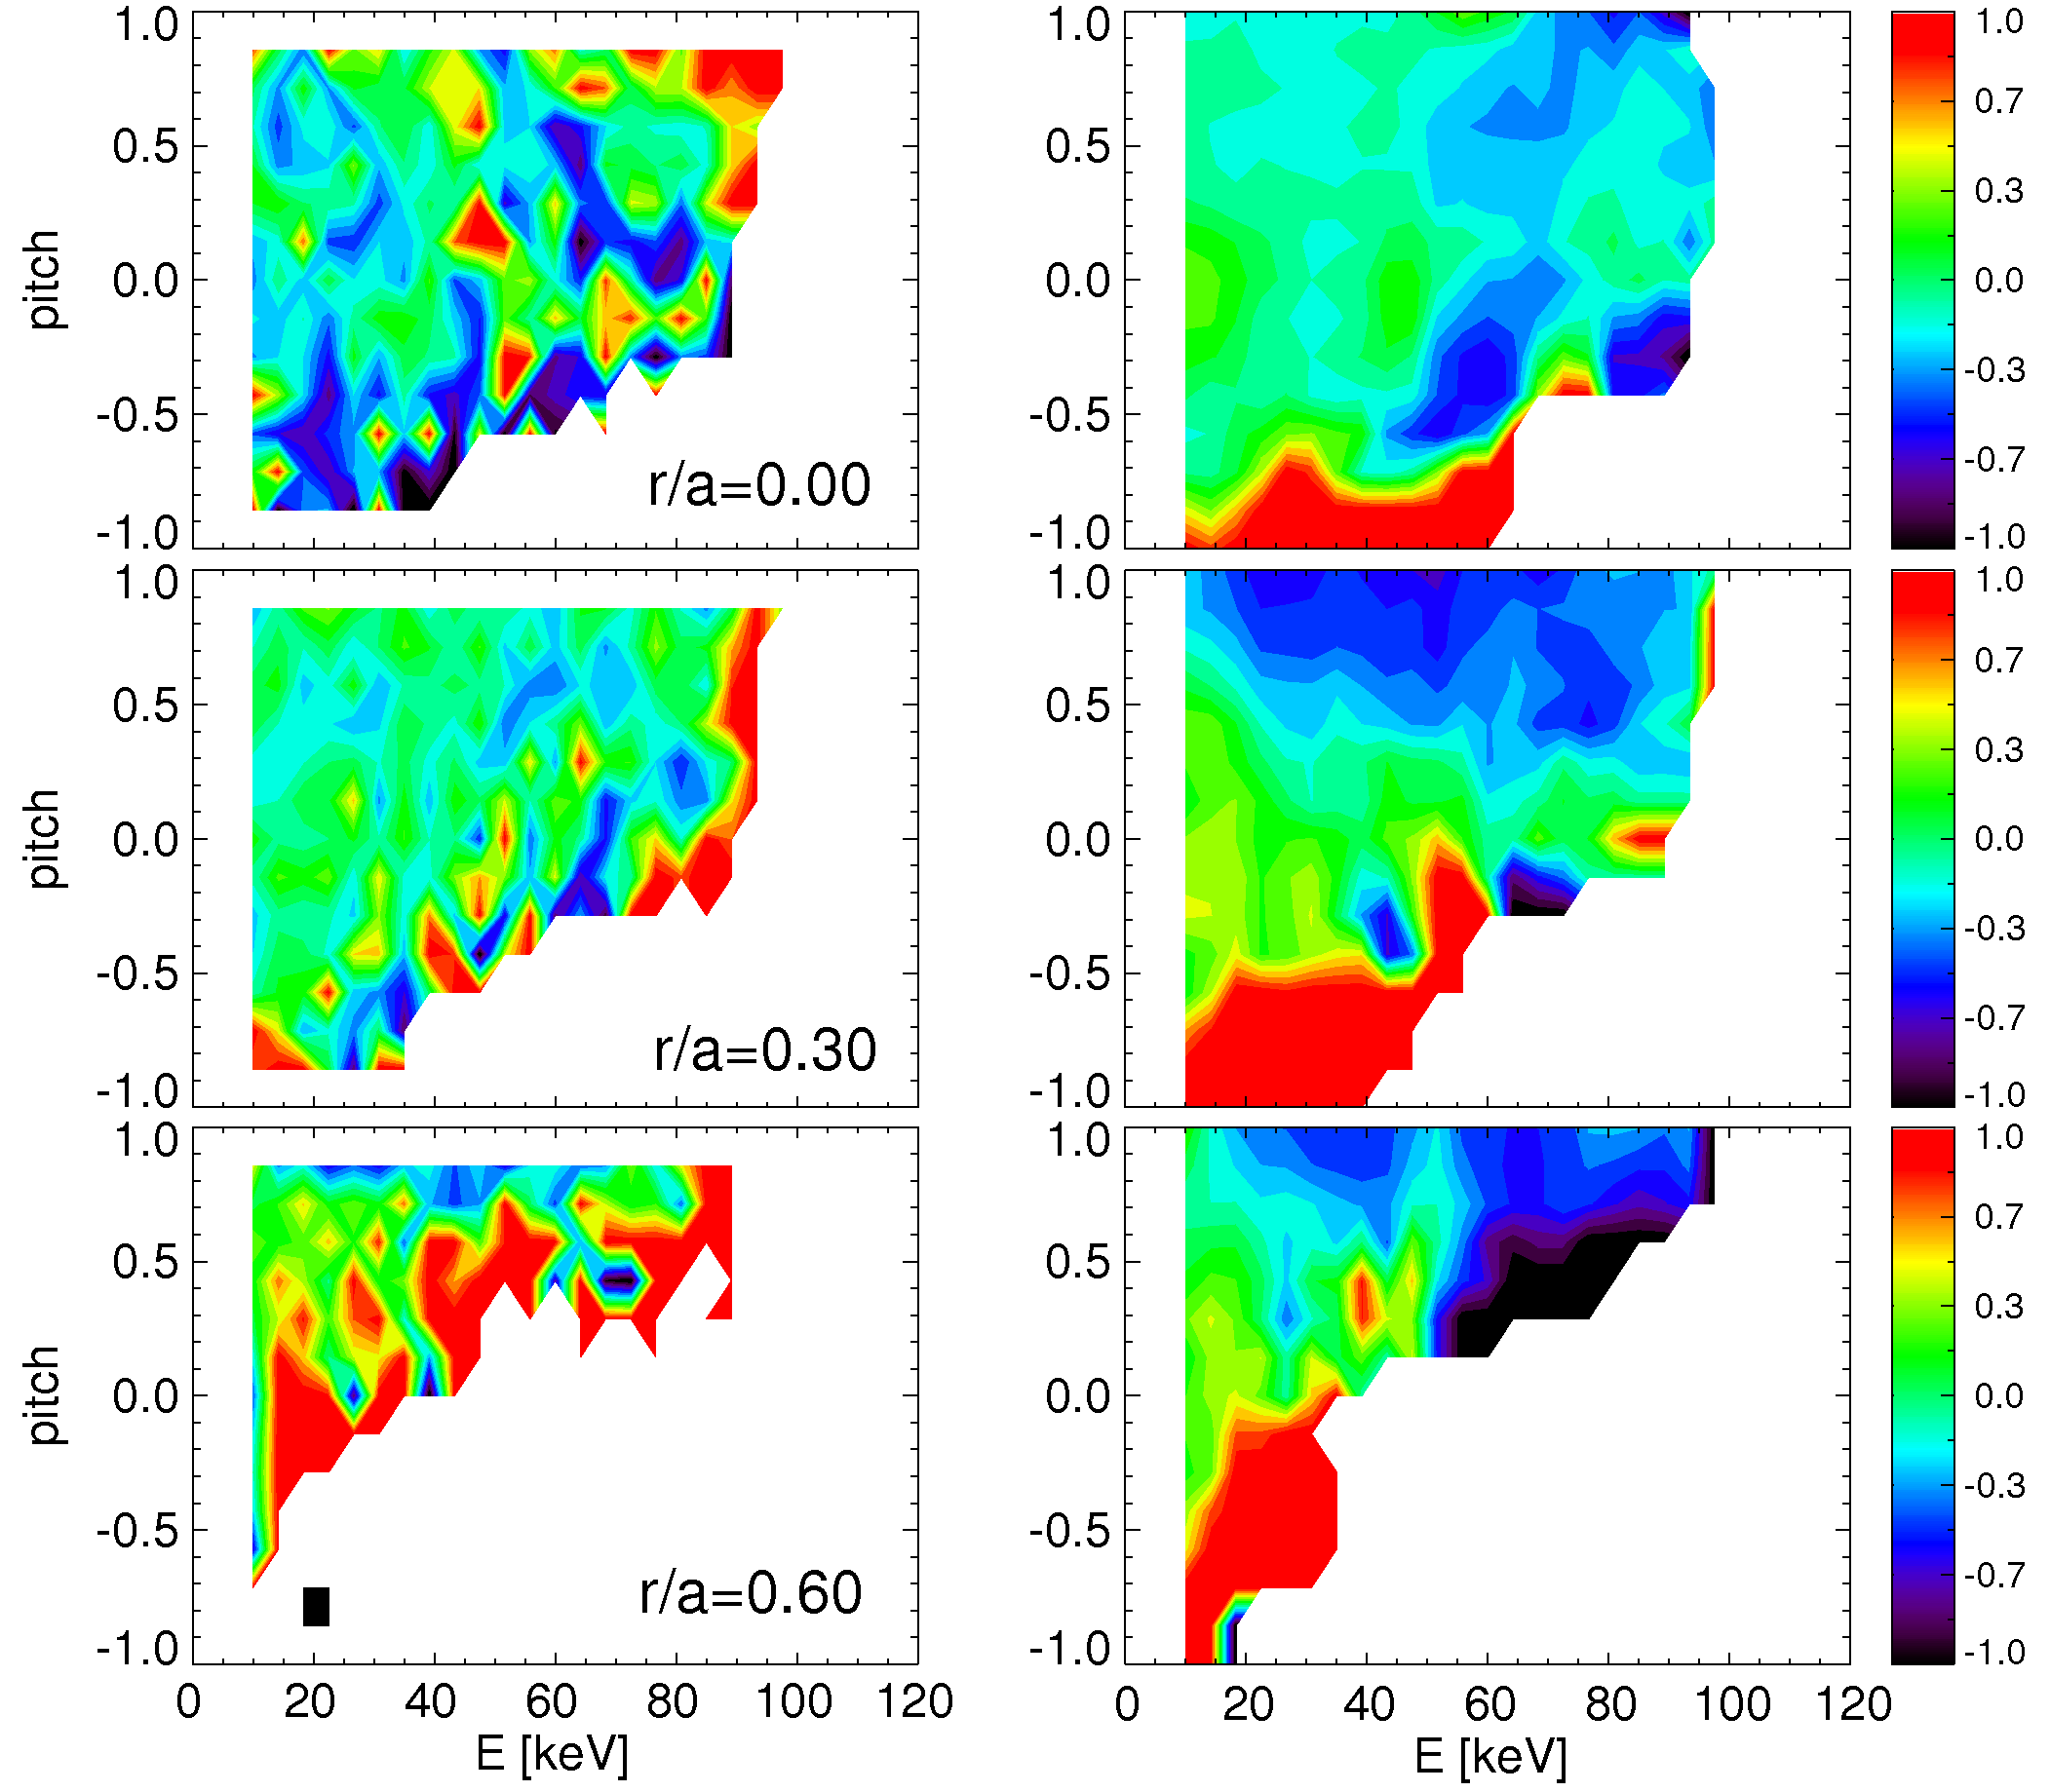
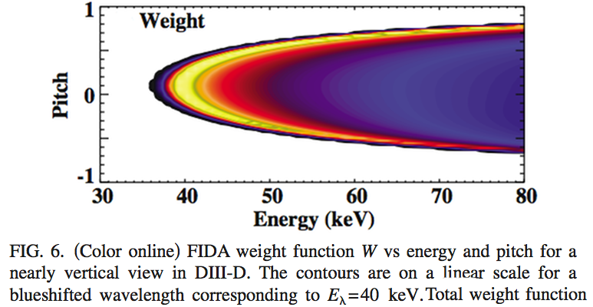
Clear resonance patterns seen on F_{nb} modified through kick model – not seen in “standard” TRANSP
Relative variation (F_{nb,1}-F_{nb,0})/F_{nb,0} , t=265-275ms
  Resonances appear as localized in energy, pitch
  Simple diffusion not adequate to reproduce this
  Will enable more direct comparison with measurements sensitive to phase space modifications
TRANSP w/ AFID
kick model
Example: weight function for FIDA measurements
[Heidbrink, RSI 2010]

Slide 23
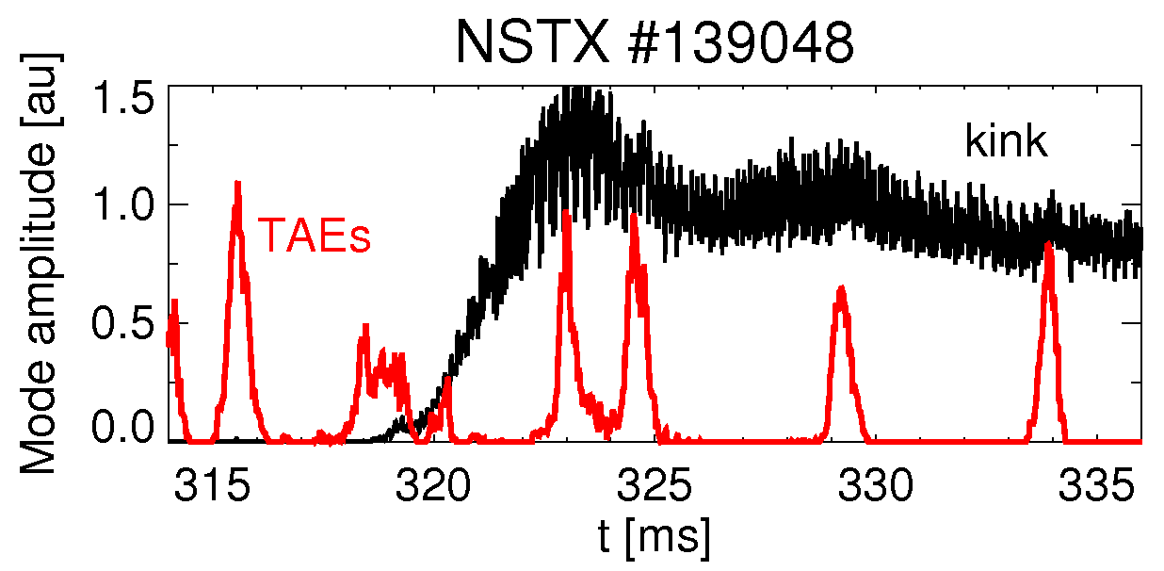
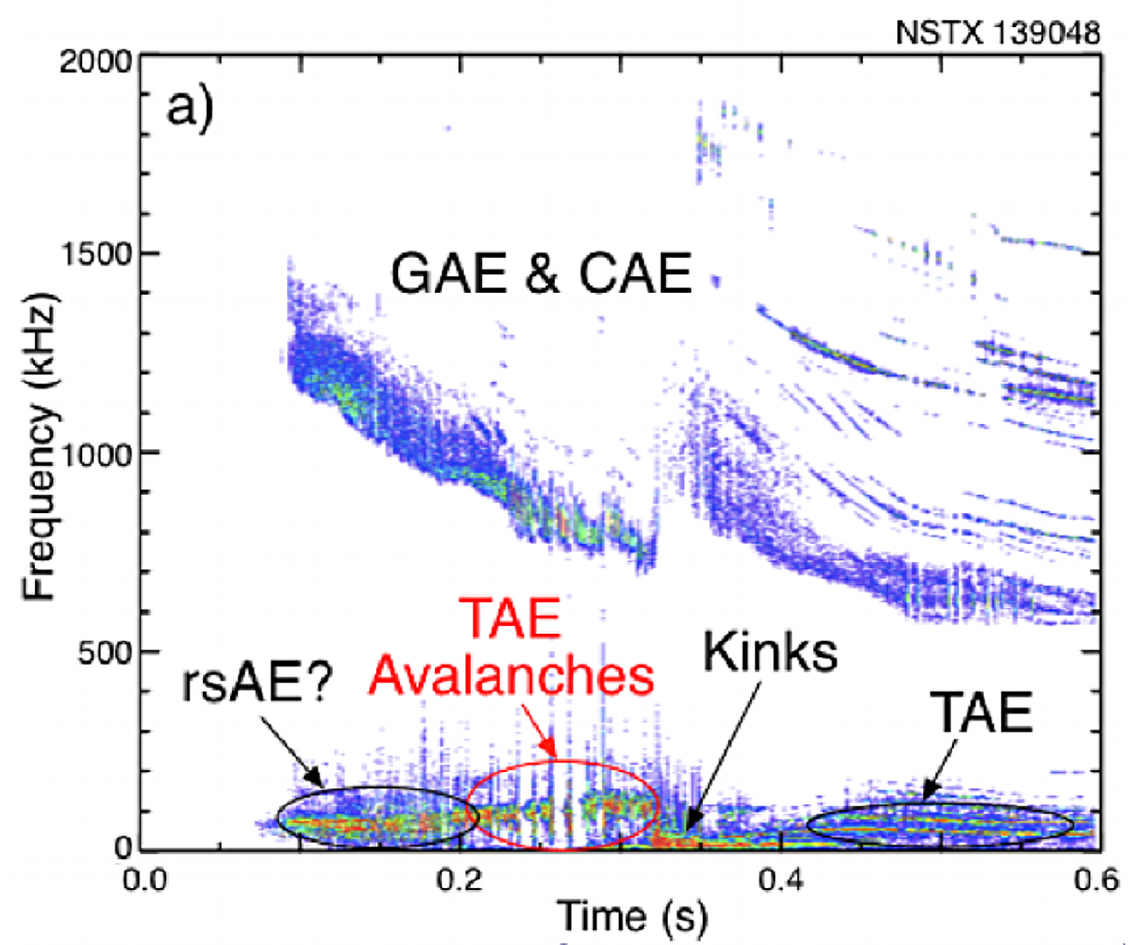
The model has been recently improved to account for multiple “classes” of modes in same discharge
Quite common scenario:
  Provides more realistic F_{nb} evolution when modes have comparable amplitude
  Account for differences in equilibrium, modes at different stages of the discharge
Each “class” is modeled by p_{k}(ΔE,ΔP_{ζ}), weighted by A_{mode,k}
  Total kicks result from Σ_{k} A_{mode,k}(t) x p_{k}(ΔE,ΔP_{ζ})

Slide 24
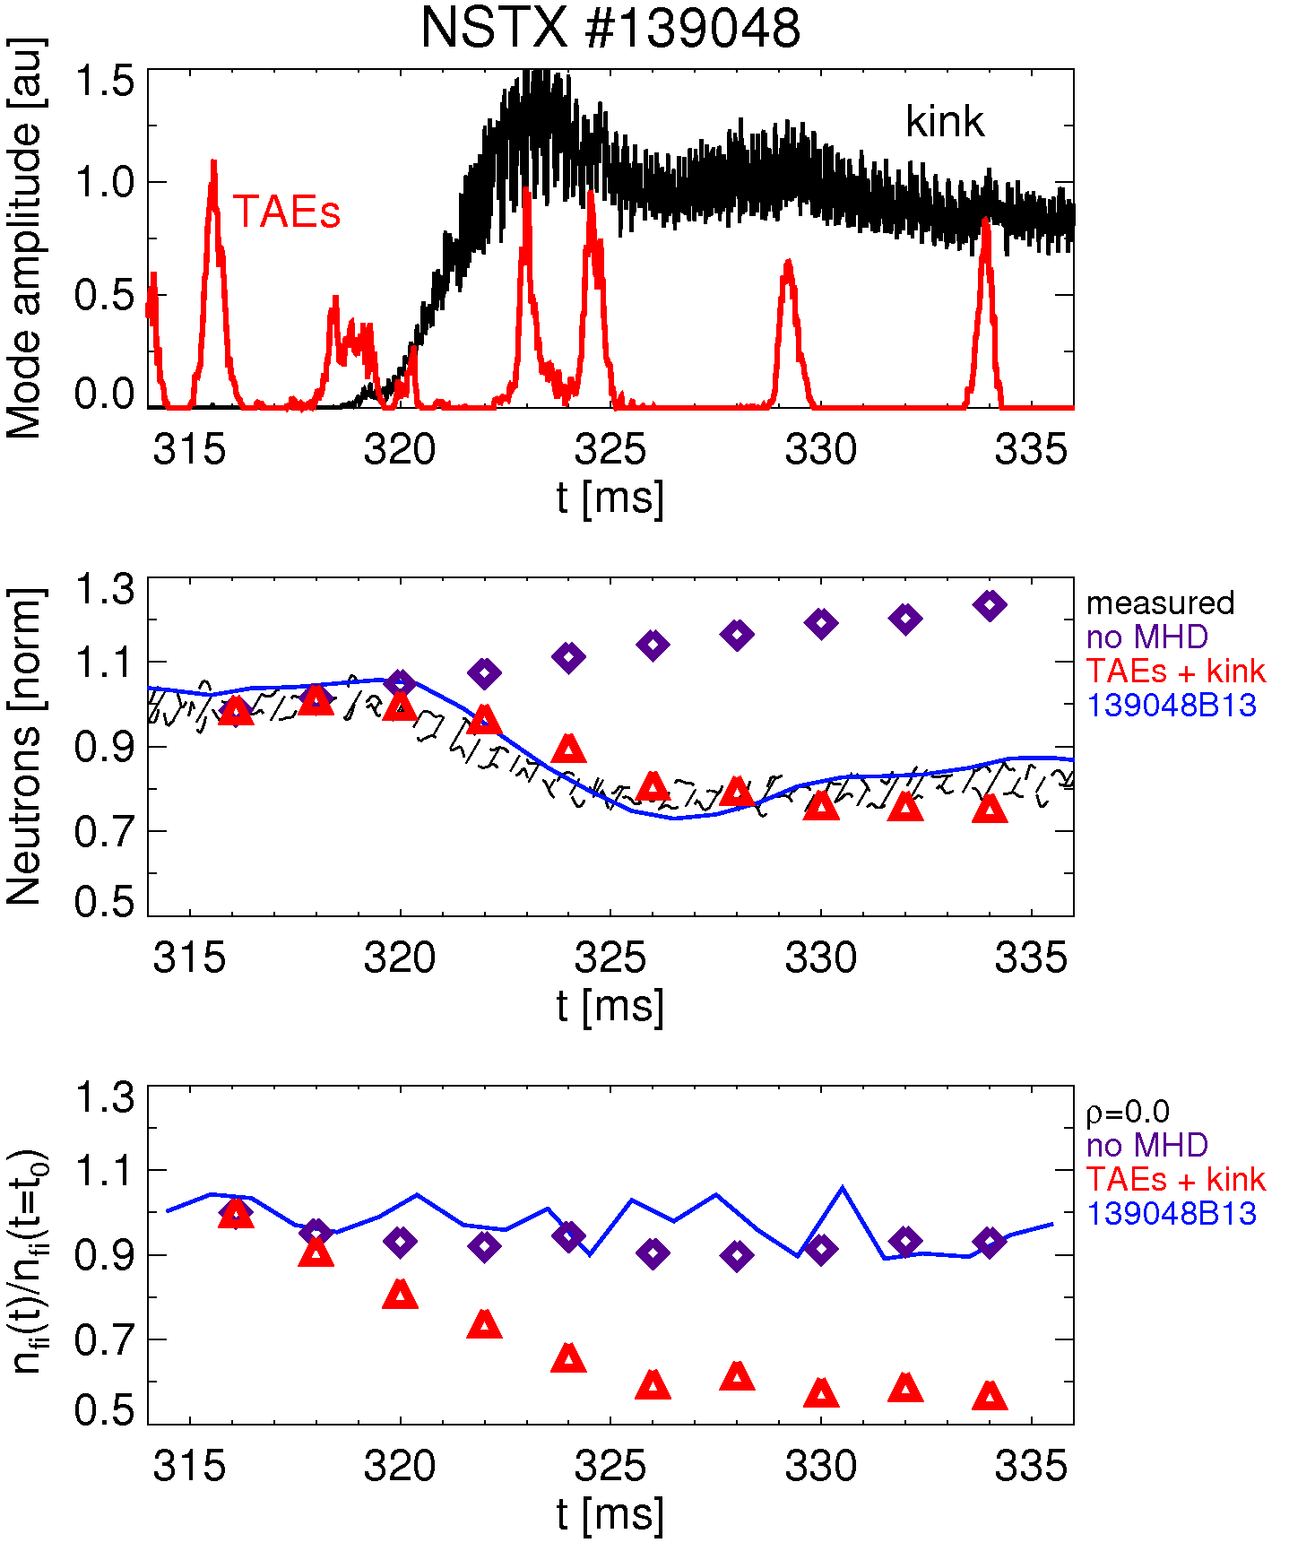
Preliminary example: NSTX scenarios with simultaneous TAEs and kink-like modes
TAEs + kink-like:
Anomalous diffusivity (AFID) up to t=320ms to match neutrons
Set AFID=0 after 320ms
Keep profiles fixed
Use p₁(ΔE,ΔP_{ζ}) for TAEs, same as for avalanches
Use p₂(ΔE,ΔP_{ζ}) for kink-like modes
  Crude model w/ n=1,2,3
  Just a test case!
  Analysis in progress to obtain “real” kink structure
w/ AFID

Slide 25
Outline
New ‘kick model’: basic ideas
Verification against full ORBIT simulations
Example from NSTX case w/ TAE avalanche
Summary

Slide 26
Summary
Test algorithm for reduced fast ion transport model developed, being verified
  Results compared with full ORBIT runs
  Confirmed validity of approach for practical case
Successful preliminary tests for NSTX case with TAE modes (avalanches)
  Shot#139048, t~265-320 ms: H-mode avalanches
  Strong redistribution (energy, radius) of fast ions inferred
  Modest losses, consistent with previous detailed modeling
  NB-driven current J_{nb} is strongly perturbed
Implementation in NUBEAM under way
  Extensive Verification & Validation planned (multi-machine, multi-mode)
  Identify issues, possible improvements to the model
more details: M. Podestà et al., PPCF 56 (2014) 055003

Slide 27
Backup

Slide 28
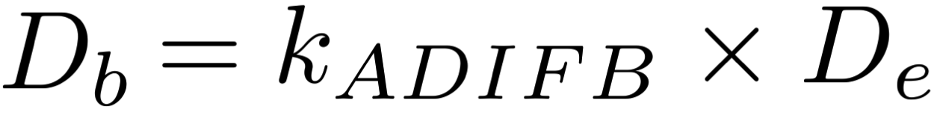
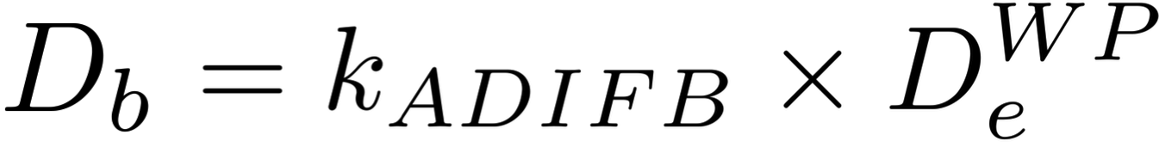
Four models are presently implemented in TRANSP for fast ion diffusion/convection coefficients, D_{b} & v_{b}
All have diffusive/convective nature in radial coordinate; little/no phase space selectivity:
1)
2)
3)
4)
[from http://w3.pppl.gov/~pshare/help/transp.htm]
k_{ADIFB} : multiplier
D_{e}(x,t) : electron particle diffusivity
D_{e}^{WP}(x,t) : electron particle diffusivity from Ware-pinch corrected flux
diffusion/convection model
D_{k}(E,x,t): diffusivity for deeply trapped, barely trapped, co- barely passing, ...

Slide 29
For low-frequency *AEs with ω<<ω_{ci} such as TAEs, magnetic moment μ is conserved (...but maybe it’s not)
In this presentation, it is assumed that Δμ=0
However: Δμ=0 hypothesis can break down if
  ρ_{f} ~ radial width of the modes
  ρ_{f} ~ scale-length of equilibrium profiles
  Both conditions are likely to be met in spherical tokamaks (e.g. NSTX)
Proposed model can be generalized to cases where μ is not conserved
  Also important for ω_{ci}-range instabilities: GAE/CAEs

Slide 30
Example for single-resonance case: analytical probability distribution function
ΔP_{ζ}
For each bin in (E,P_{ζ},μ), steps in ΔE,ΔP_{ζ} are approximated by a bivariate
~n/ω
ΔE
normalization
correlation parameter,
such that
...and all parameters depend, in principle, on the mode amplitude A=A(t)

Slide 31
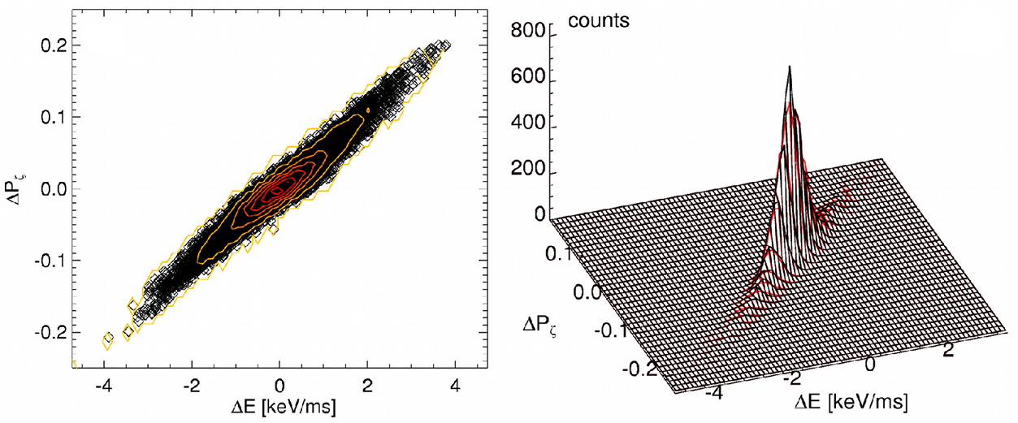
Single (isolated) resonances introduce fundamental constraints on particle’s trajectory in (E,P_{ζ},μ)
From Hamiltonian formulation:
ω=2πf, mode frequency n, toroidal mode number
4 TAE modes,
“large” amplitude:
broadening
multiple n/ω’s
(from ORBIT simulation)
Presence of multiple modes/resonances distorts
the ‘ideal’ (linear) relationship

Slide 32
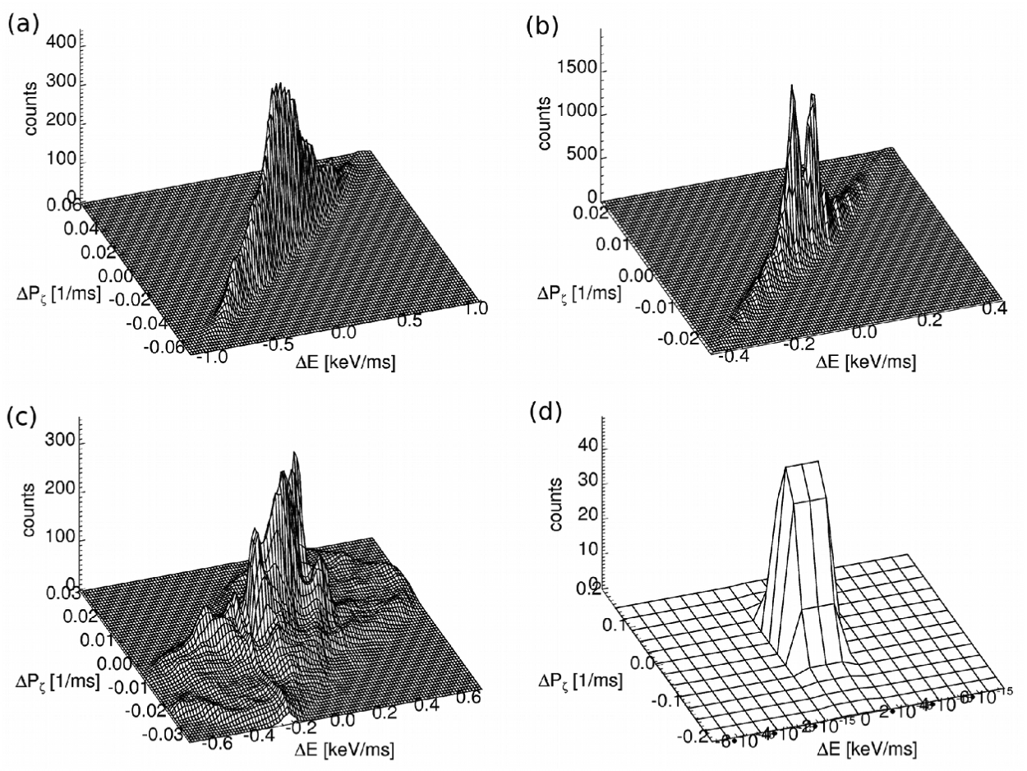
An analytical formulation for p(ΔE,ΔP_{ζ}|P_{ζ},E,μ) could be developed – but it would be quite unpractical
E.g., use:
1 TAE, large amplitude
4 TAEs, small amplitude
2 TAEs, A₁≃A₂, ω₂<0
no TAEs, large (unphysical) ν_{scattering}
In practice, will use the full 5D matrix for p(ΔE,ΔP_{ζ}|P_{ζ},E,μ)

Slide 33
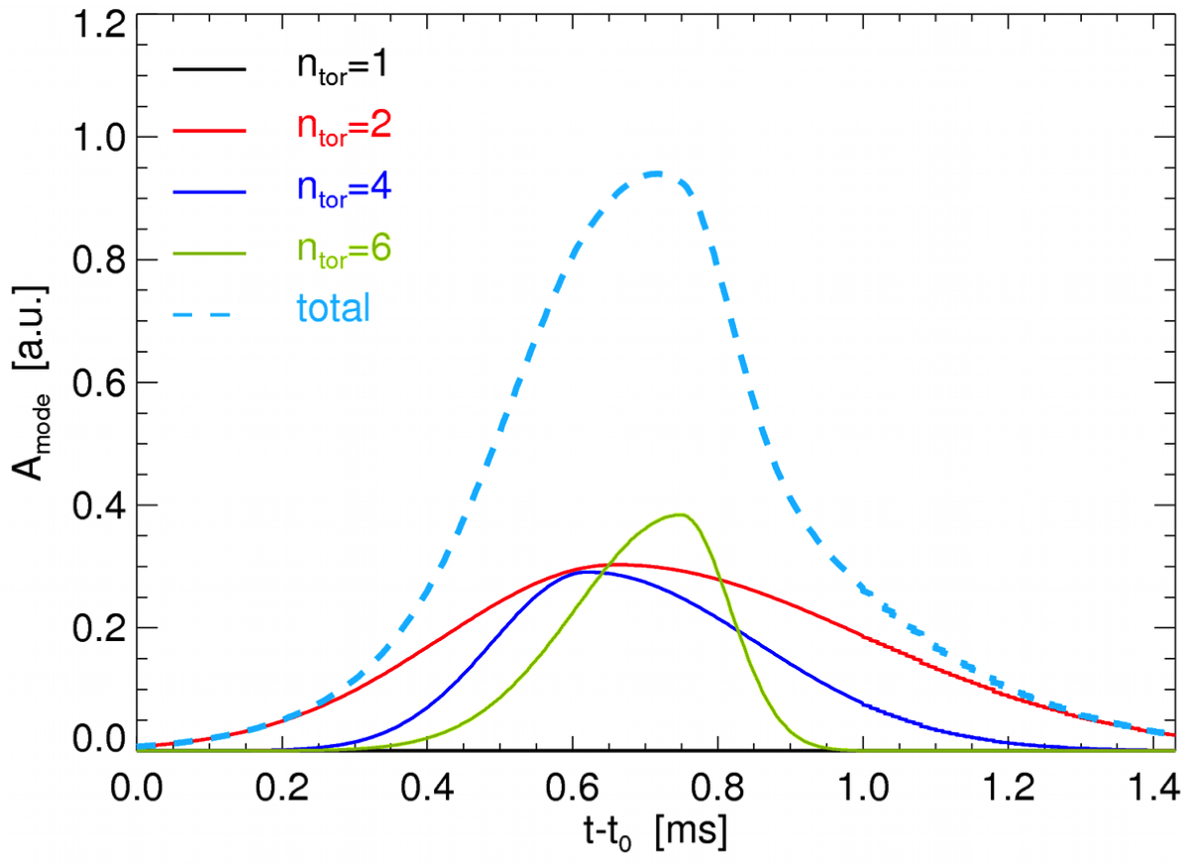
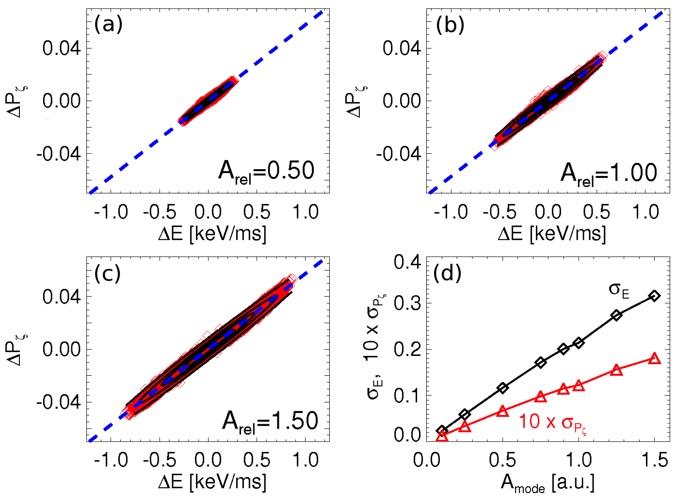
Mode amplitude can evolve on time-scales shorter than typical TRANSP/NUBEAM steps of ~5-10 ms
F_{nb} evolution must be computed as a sequence of sub-steps
  Duration δt_{step} sufficiently shorter than time-scale of mode evolution
  Examples here have δt_{step}~25-50 μs
NSTX, TAE avalanche
Energy and P_{ζ} steps assumed to scale linearly with mode amplitude
  Roughly consistent with ORBIT simulations

Slide 34
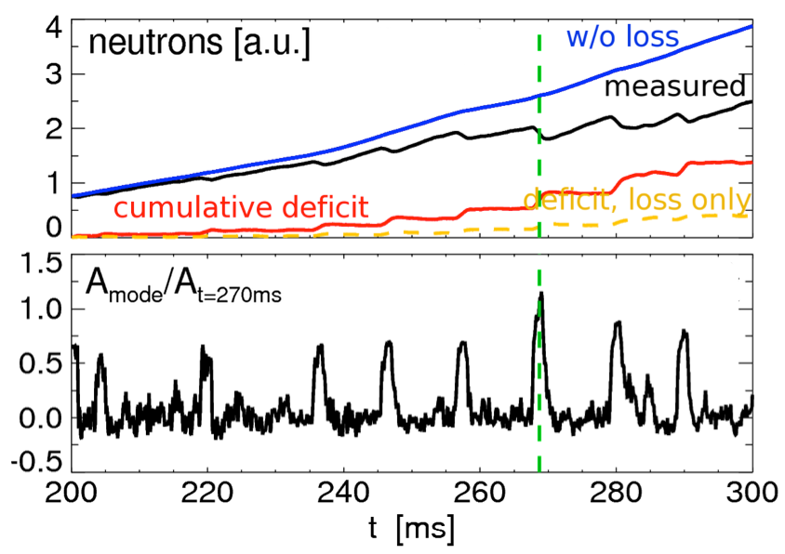
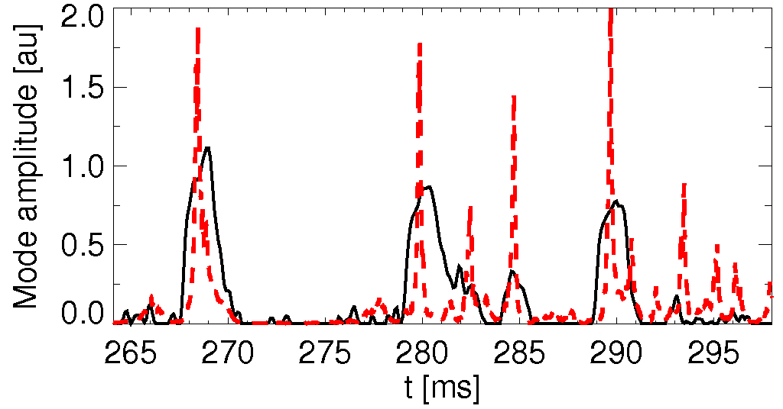
Example: A_{mode}(t) computed from measured neutron rate or Mirnov coils’ signal
Get A(t) from measured neutrons+table look-up:
Compute fractional R_{n} drops vs. time
Use table R_{n} vs A_{mode} to find corresponding (normalized) mode amplitude
Comparison w/ A_{mode}(t) from Mirnov coils
Do different waveforms lead to differences in fast ion evolution? Not on relevant time scales > 1ms
Mirnovs
neutrons

Slide 35
Scheme to advance fast ion variables according to transport probability in NUBEAM module of TRANSP
re-compute sources, scattering, slowing down
after “kicks”
NUBEAM step k
NUBEAM step k+1
read Plasma
State, F_{nb} info
convert F_{nb}(E,P_{ζ},μ)
to F_{nb}(E,p,R,Z)
read A_{mode},
p(ΔE,ΔP_{ζ}|E,P_{ζ},μ)
convert F_{nb}(E,p,R,Z)
to F_{nb}(E,P_{ζ},μ)
loop – MC mini-steps
sample
ΔE_{j},ΔP_{ζ,j}
evolve
E_{j},P_{ζ,j}
diagnostics
(e.g. classify
orbit)
loop – F_{nb} particles
add “kicks” to F_{nb} variables

Slide 36
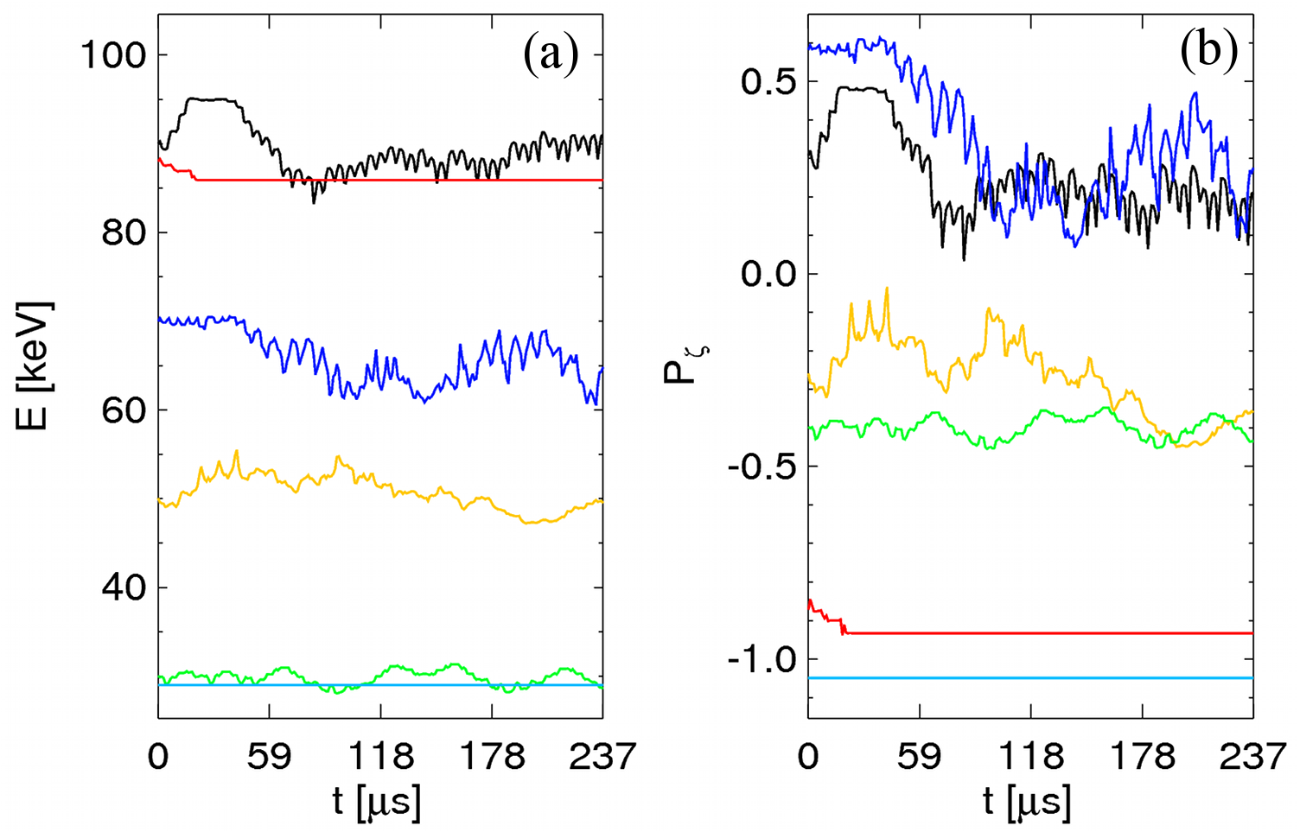
Scheme to evolve F_{nb} takes into account (in a semi-empirical way) constraints of resonant interaction
Particle’s motion is characterized by different time-scales:
  Fast oscillation in wave field – neglected
  ‘Jumps’ ΔE,ΔP_{ζ} around instantaneous energy, P_{ζ}
  Slow (secular) drift from initial energy, P_{ζ}
lost

Slide 37
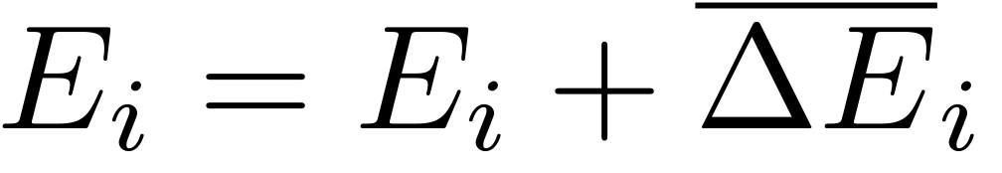
Putting all together
At each ‘macroscopic’ NUBEAM step:
  Re-normalize bins (P_{ζ},E,μ) based on q-profile, fields, ...
  Identify ‘bin’ in (P_{ζ},E,μ) for current ‘particle’ (i.e. orbit)
  Extract steps σ_{E},σ_{Pζ} (σ_{μ}) from multivariate p(ΔE,ΔP_{ζ},Δμ)
  Compute sign S_{r,i} from p(ΔE,ΔP_{ζ}): positive or negative kicks
  Rescale steps based on A_{modes}(t)
  Advance E, P_{ζ} (μ):
  Advance particle’s trajectory in phase space for next step
  Compute slowing down, scattering (NUBEAM)
  where steps II-VII are divided in sub-steps for each particle
  Required input, e.g. through ‘Ufiles’:
  scaling factor (“mode amplitude”) A_{mode}, probability p(ΔE,ΔP_{ζ})
Loop over particles

Slide 38
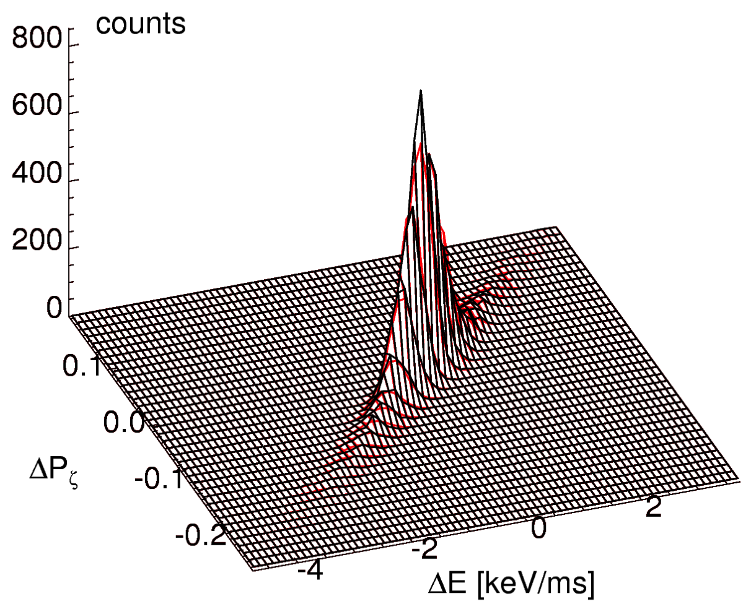
Discrete bins in (P_{ζ},E,μ) can contain both resonant and non-resonant particles
p(ΔE,ΔP_{ζ})
‘Non-resonant’ particles have small fluctuations around initial (E, P_{ζ})
‘Resonant’ particles can experience large ΔE, ΔP_{ζ} variations
To keep track of particle’s class:
  Sample steps σ_{E}, σ_{Pζ} at first step only
  This mimic the “correlated random walk” experienced by the particles
  Exception: particle move to a different bin -> re-sample

Slide 39
p(ΔE,ΔP_{ζ}|P_{ζ},E,μ) can be skewed to positive/negative ΔE,ΔP_{ζ}, causing overall “drift” of F_{nb}(P_{ζ},E,μ)
Introduce ‘random sign’ for i-th step in MC procedure, S_{r,i}
For each particle (e.g. pair of correlated steps σ_{E}, σ_{Pζ}), calculate S_{r,i} from probability of positive vs. negative steps
  From p(ΔE,ΔP_{ζ}) compute
  Then define f_{sign}:
  Finally, use 0<f_{sign}<1 to bias random extraction of S_{r,i}=+1,-1

Slide 40
Only a few particles (~0.1%) are actually lost for the cases examined here; redistribution dominates
blue/green: initial orbits
red/yellow: final orbits

Slide 41
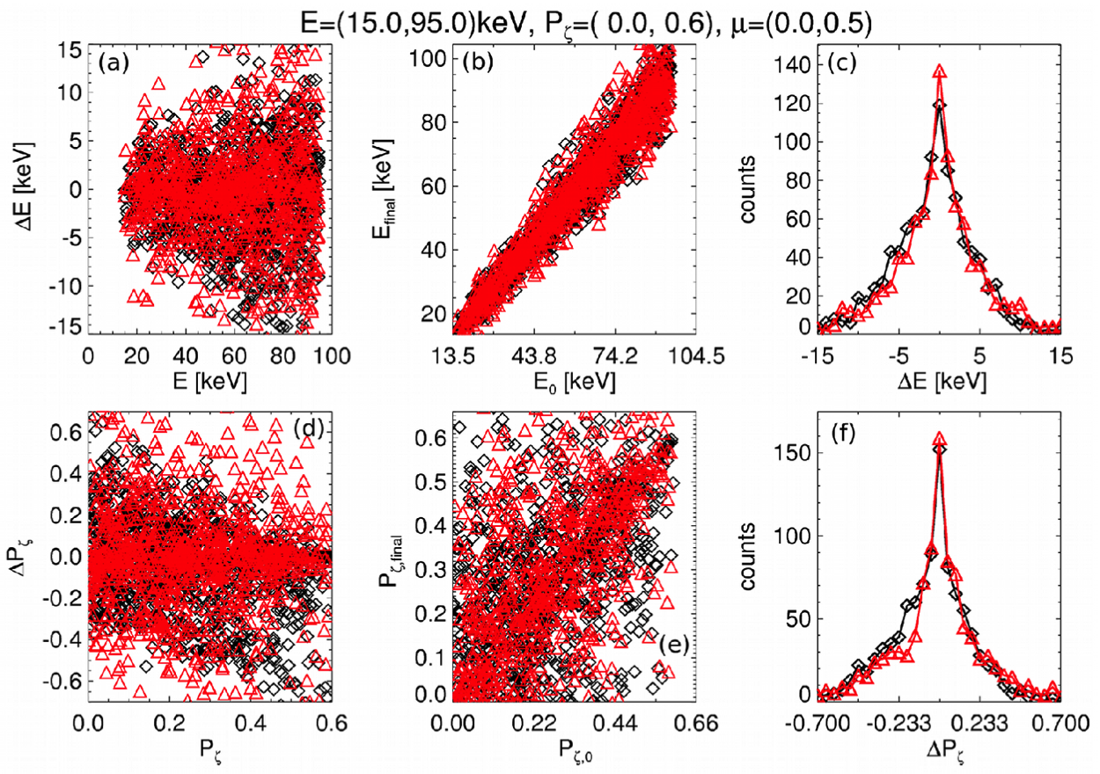
Example: evolving F_{nb} over 270 μs in 5 sub-steps
black: ORBIT
red: Model

Slide 42
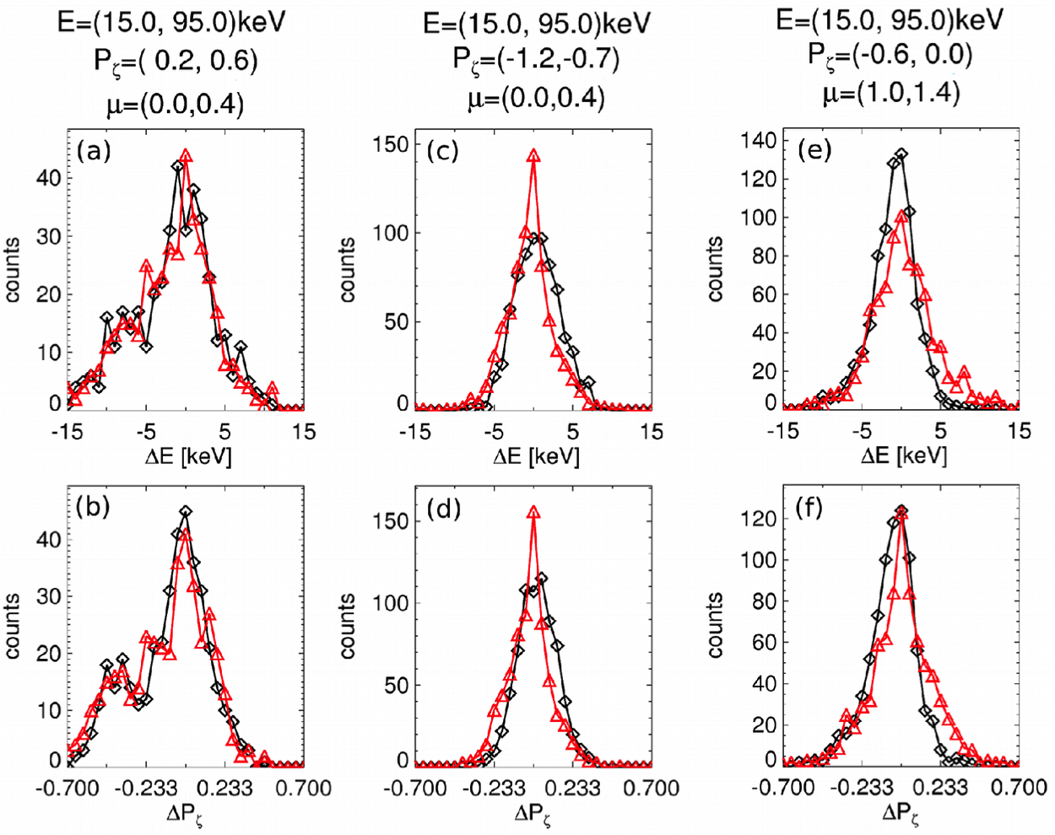
Reconstruction works for different classes: co-, counter-, trapped
co-passing
counter-passing
trapped
black: ORBIT
red: Model

Slide 43
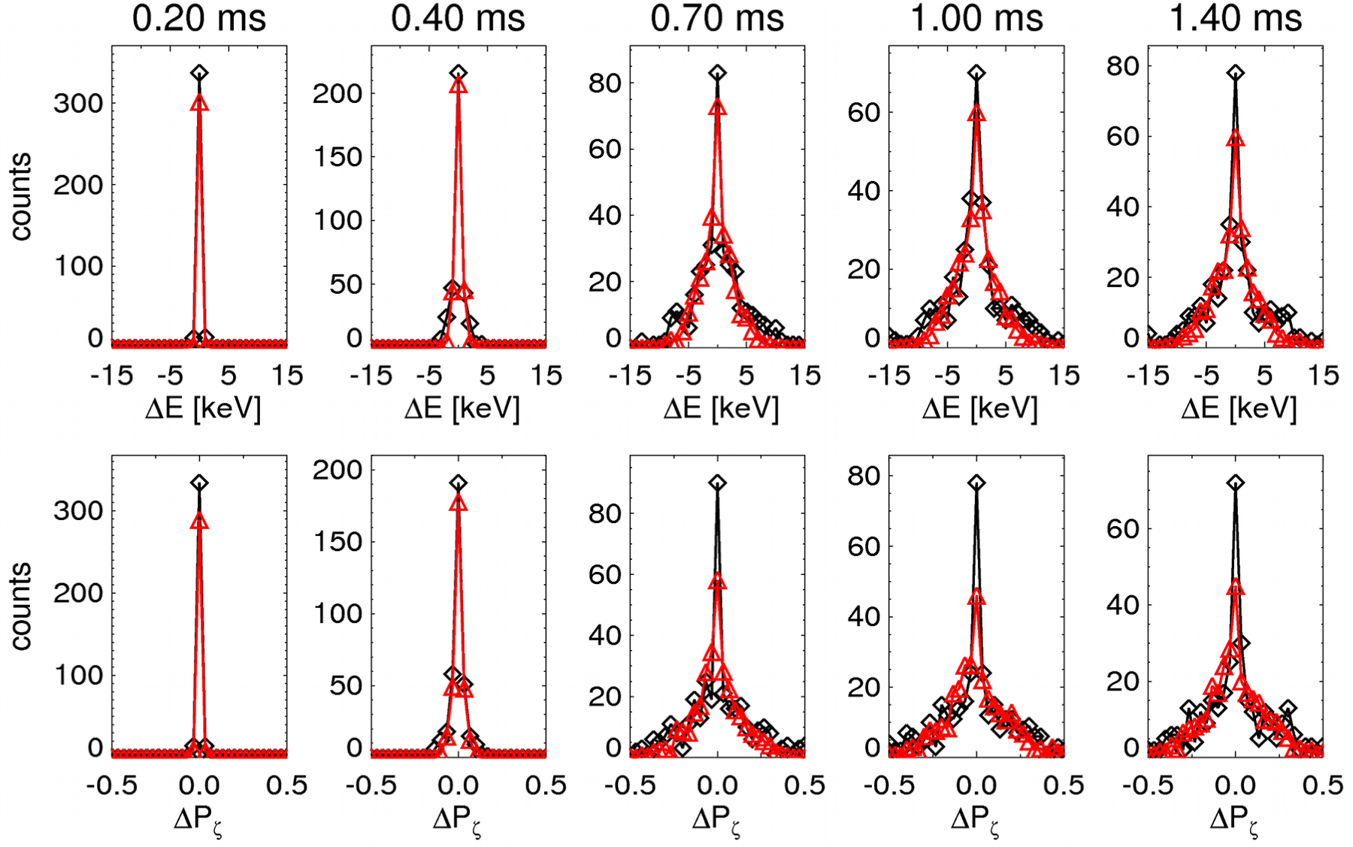
Reconstruction works at different sub-steps
black: ORBIT red: Model

Slide 44
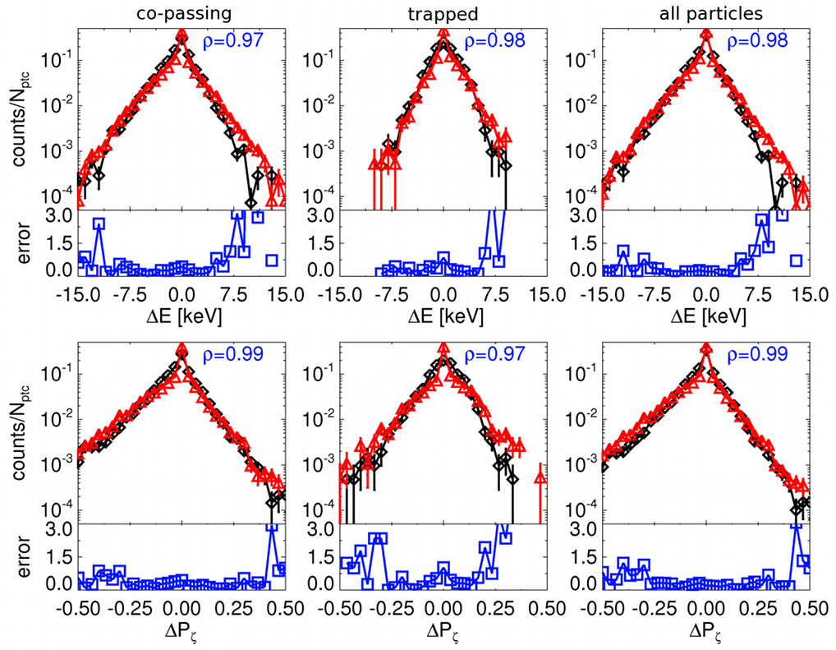
Good agreement with ORBIT is preserved when evolving F_{nb} over 5 ms, typical macro-step of NUBEAM
black: ORBIT
red: Kick Model
ρ: correlation coefficient
error: (ORBIT-model)/ORBIT
Satisfactory reconstruction over 3 orders of magnitude for
co-, trapped (, counter- not present in this input F_{nb}) particles

Slide 45
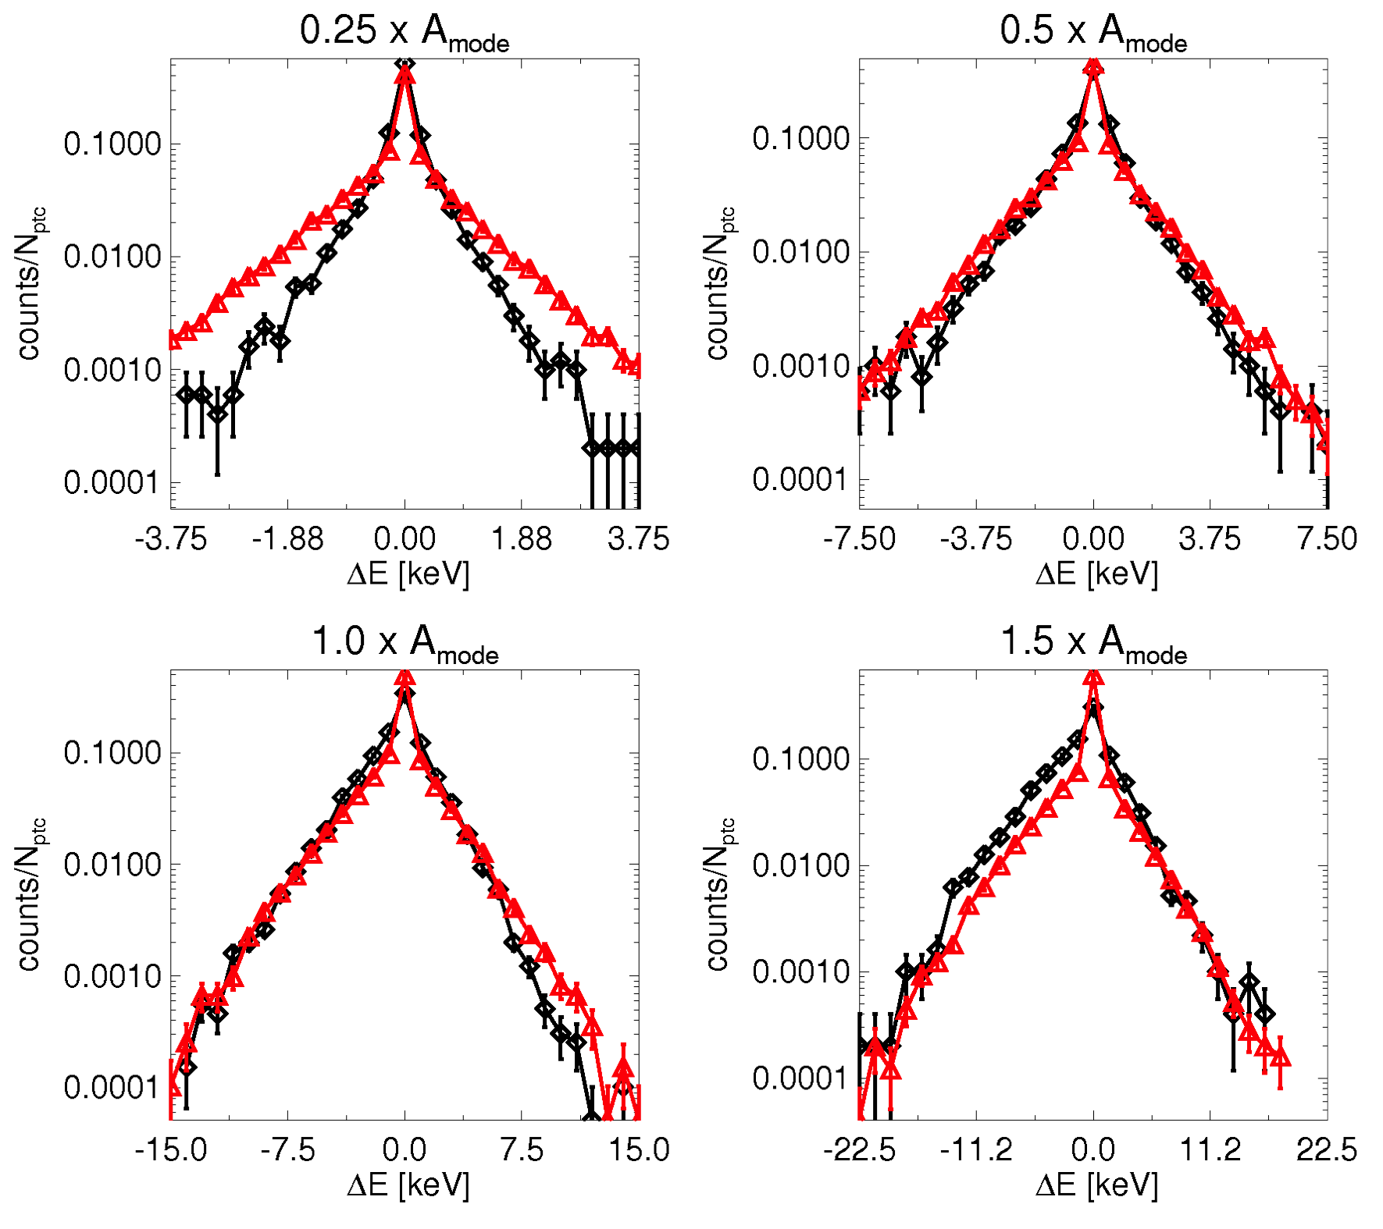
Tests assuming different mode amplitudes are satisfactory, though not perfect...
black: ORBIT
red: Kick Model
Reconstruction vs. amplitude is satisfactory

Slide 46
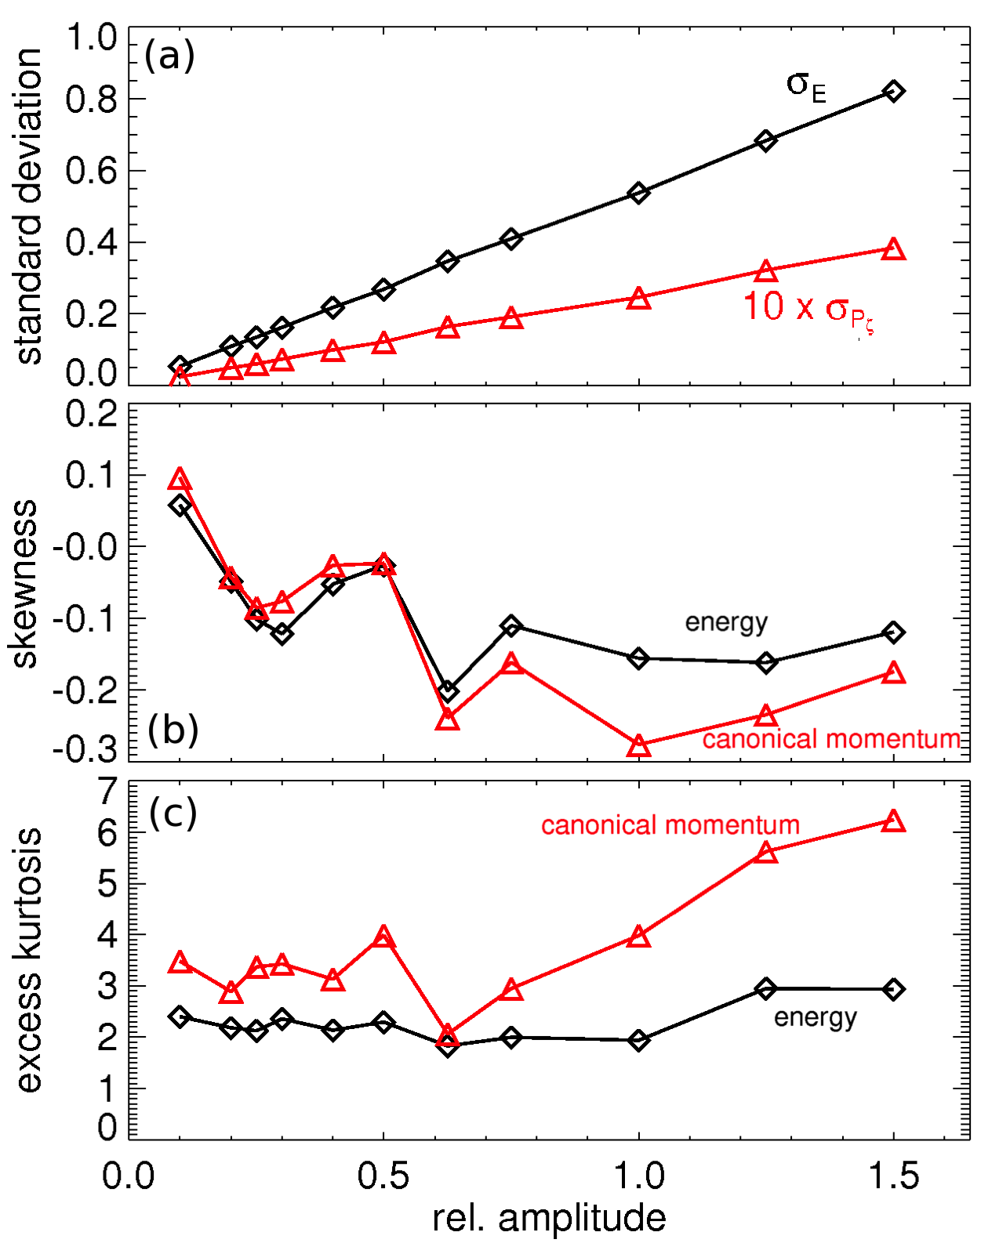
Tests assuming different mode amplitudes are satisfactory, though not perfect...
black: ORBIT
red: Kick Model
Reconstruction vs. amplitude is satisfactory
Differences ascribed to simplifications in p(ΔE,ΔP_{ζ}) scaling with A_{mode}: shape does change

Slide 47
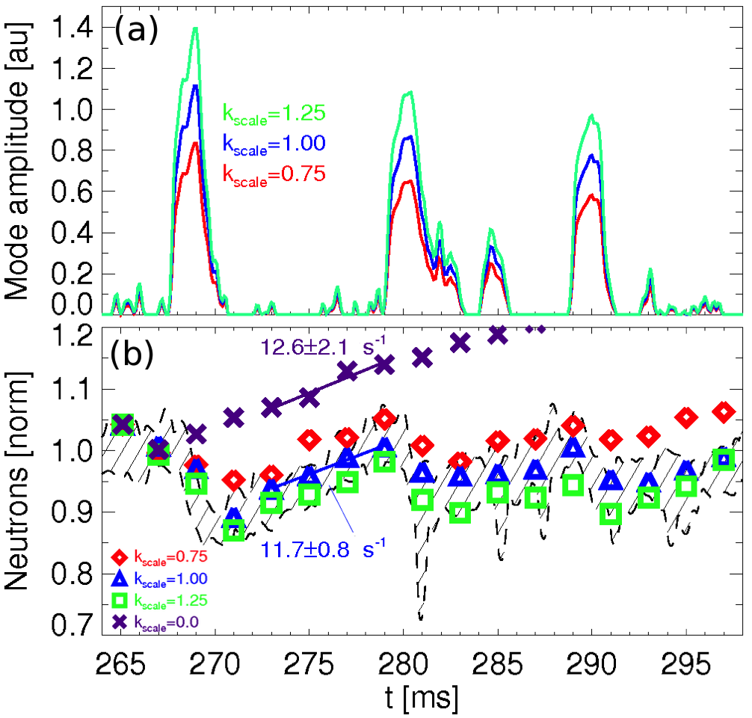
Results are sensitive to input mode amplitude; time steps must be chosen to satisfy “statistical” approach
A_{mode}(t) from neutron rate
Typical time scales:
  Slowing down: 15-30ms
  Collisions: 2-5ms
  AEs: 0.1-2ms

Slide 48
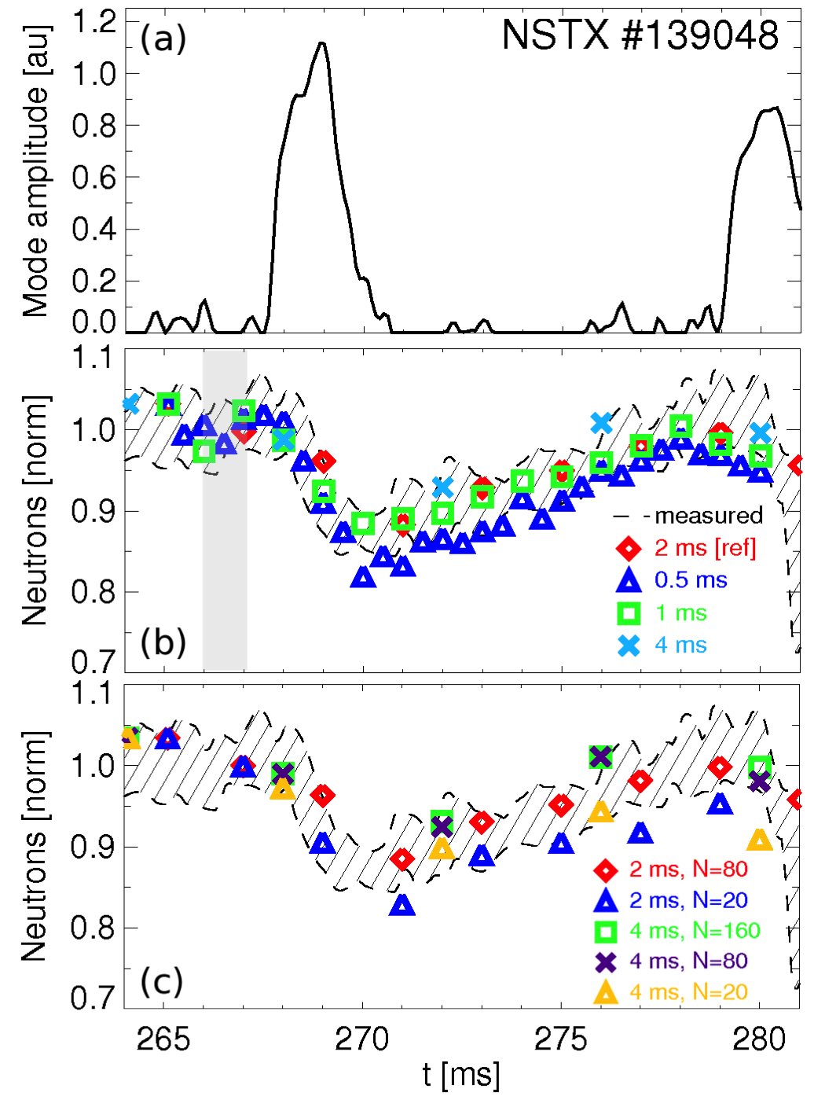
Results are sensitive to input mode amplitude; time steps must be chosen to satisfy “statistical” approach
A_{mode}(t) from neutron rate
Typical time scales:
  Slowing down: 15-30ms
  Collisions: 2-5ms
  AEs: 0.1-2ms
N: number of micro-steps for MC particle evolution, duration 25μs

Slide 49
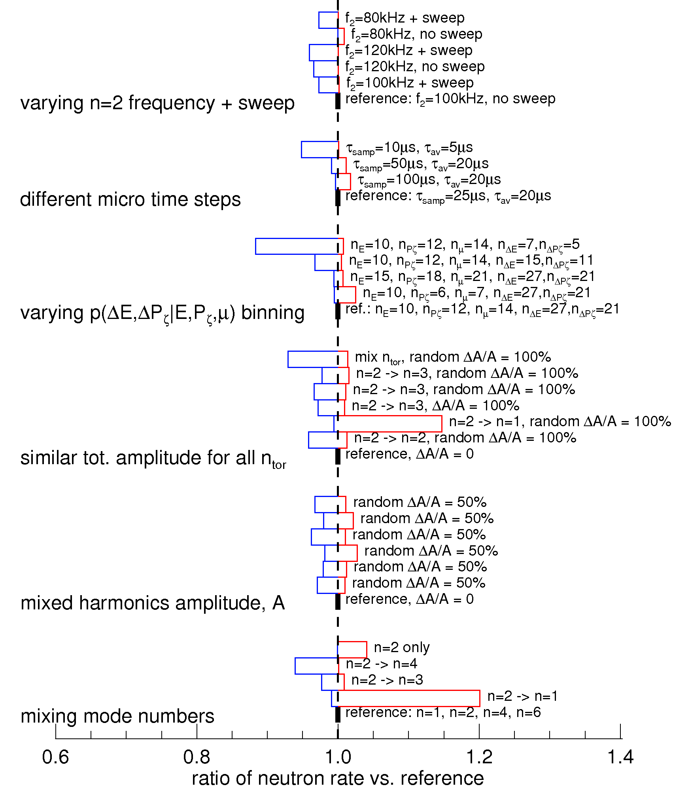
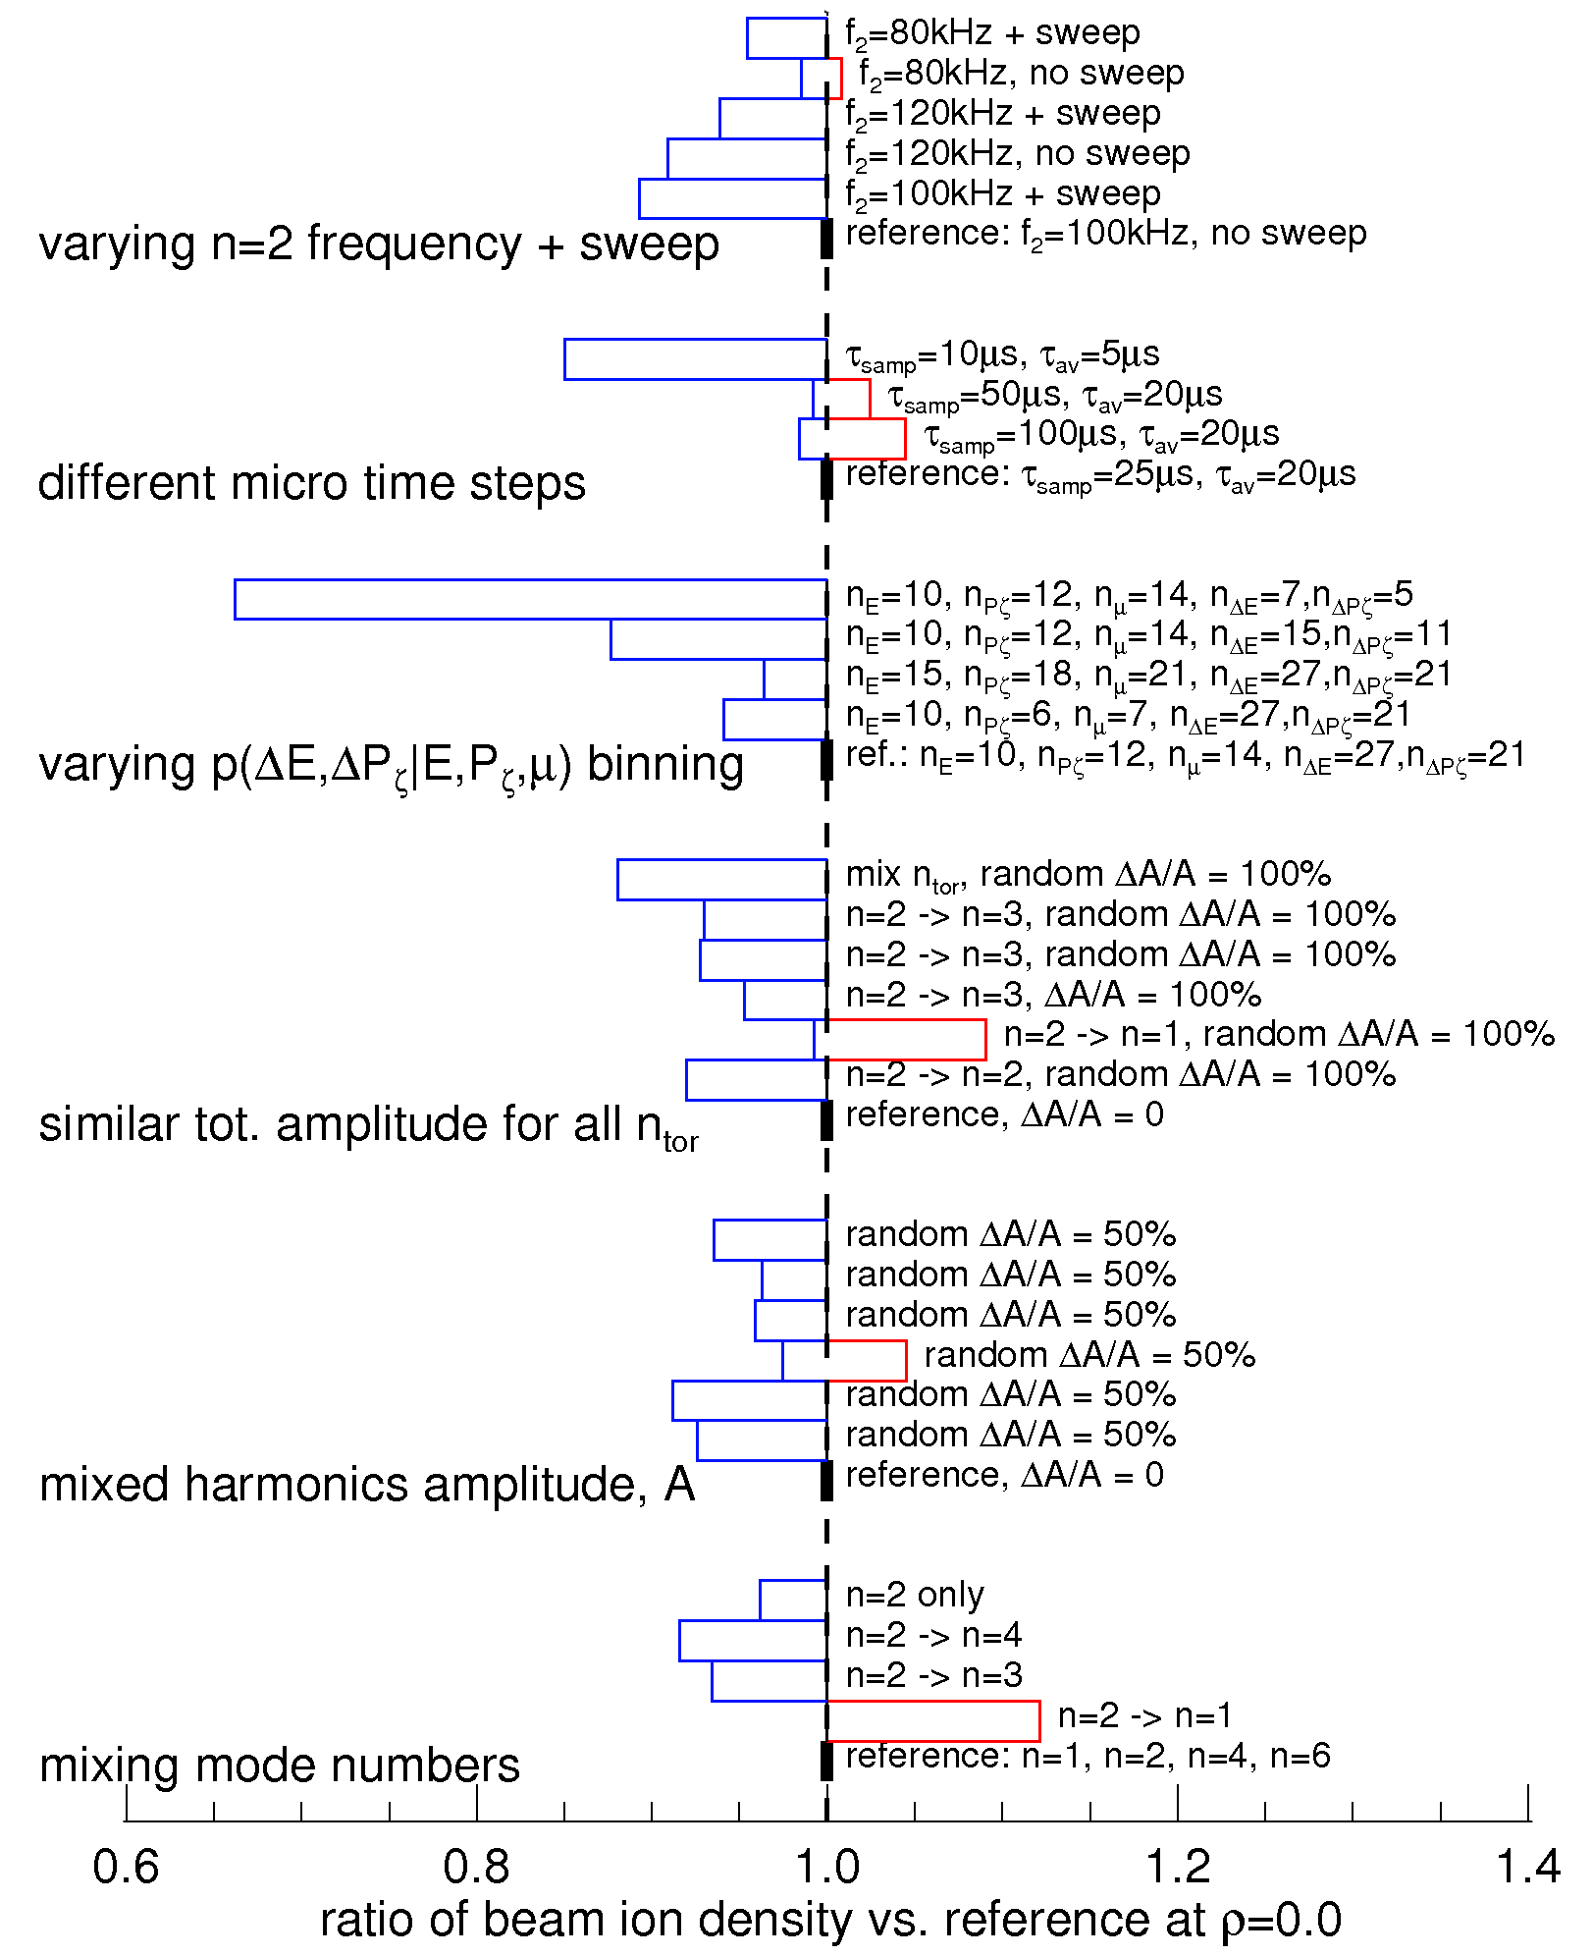
Sensitivity study suggests fast ion density is good candidate for thorough model-experiment comparison
neutron rate / reference
fast ion density / reference
Neutrons:
Mostly indicative of high-energy fast ions
Limited/no information on other portions of phase space
Density:
All energies matter; more sensitive
Accessible through FIDA, NPA diagnostics w/ spectral information

Slide 50
Summary of sensitivity study – neutron rate

Slide 51
Summary of sensitivity study – beam ion density

Slide 52
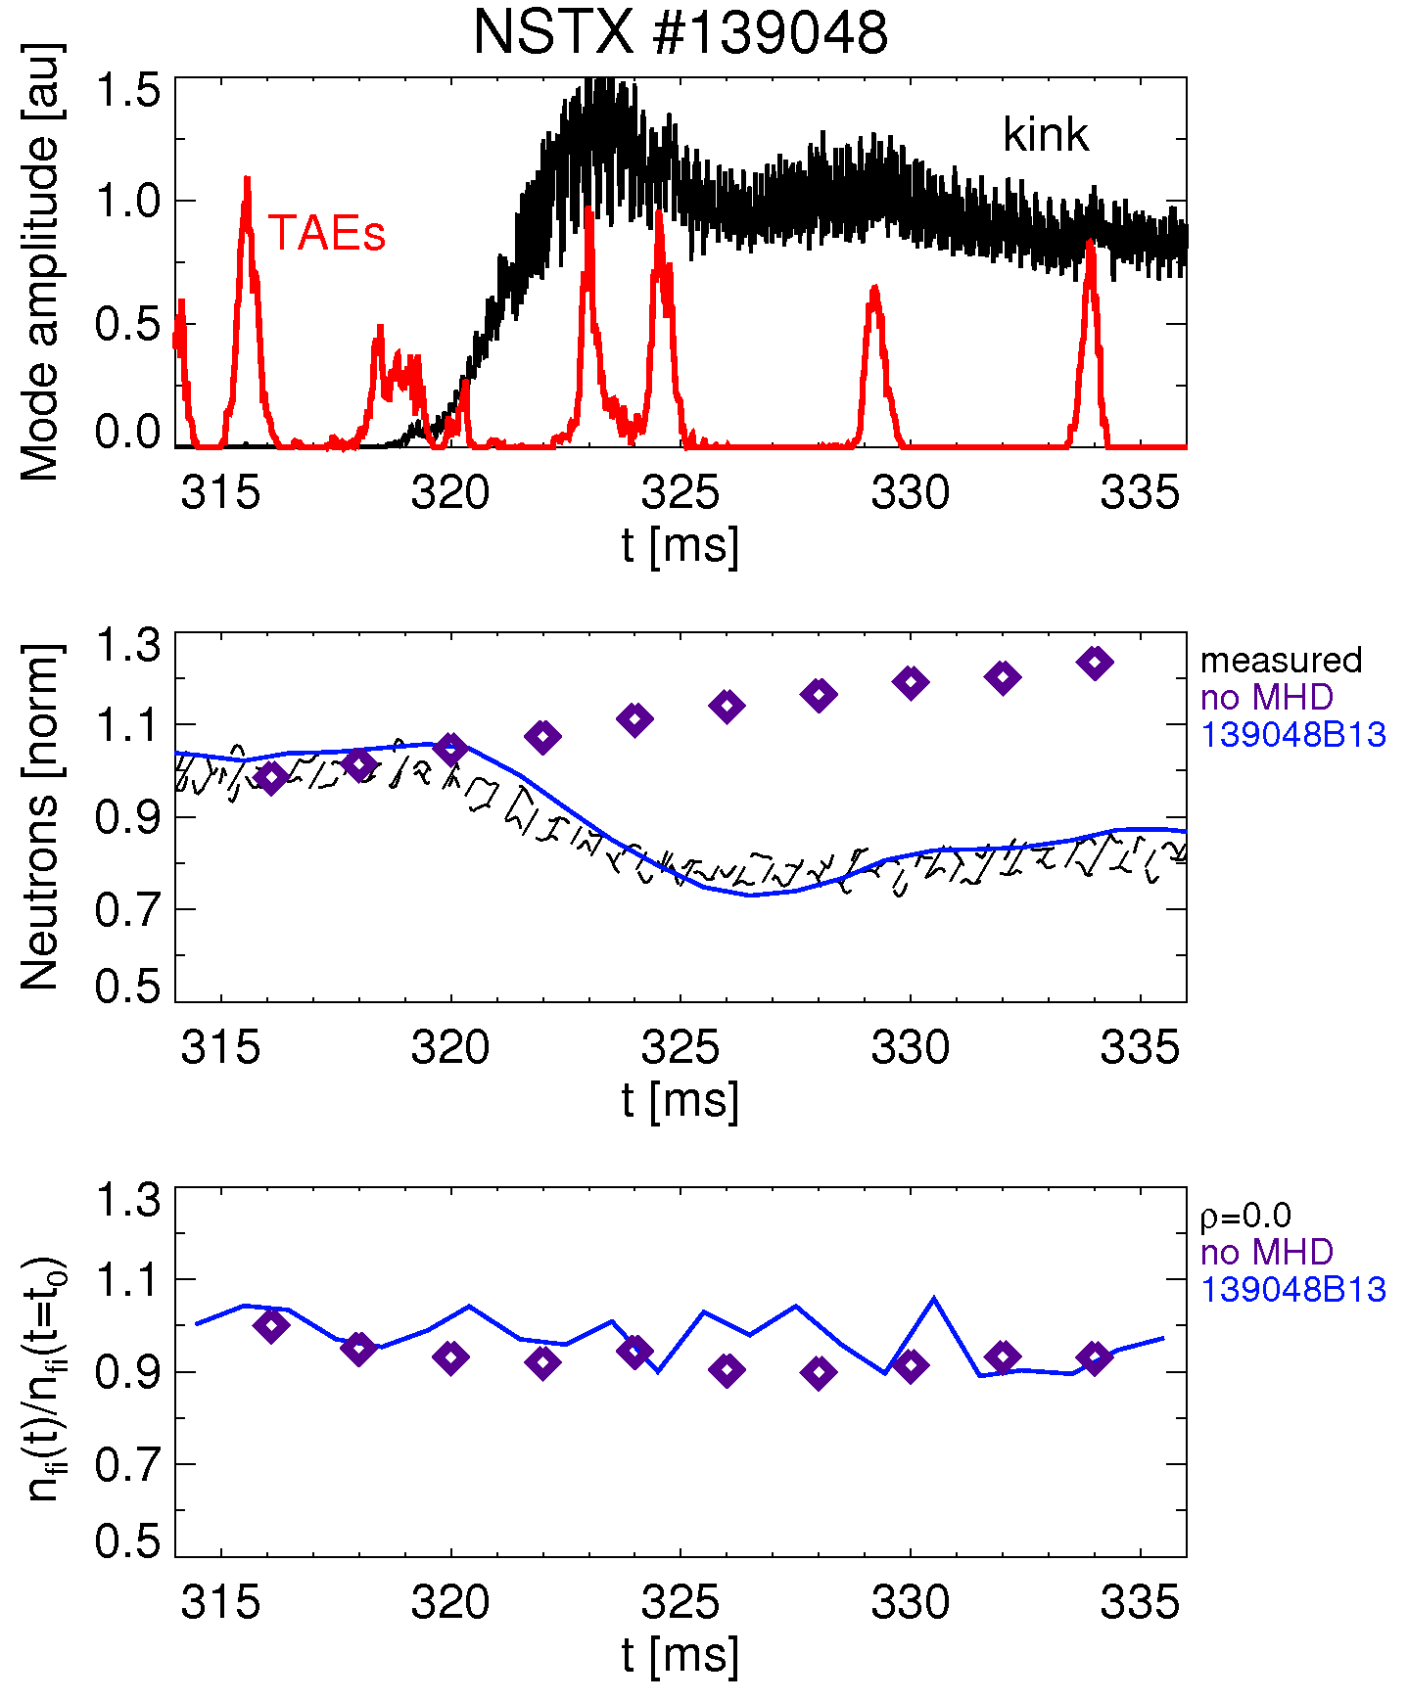
Preliminary example: NSTX scenarios with simultaneous TAEs and kink-like modes
Baseline:
Anomalous diffusivity (AFID) up to t=320ms to match neutrons
Set AFID=0 after 320ms
Keep profiles fixed
AFID
AFID=0, use new model
TRANSP w/ AFID
new model

Slide 53
Preliminary example: NSTX scenarios with simultaneous TAEs and kink-like modes
TAEs + kink-like:
Anomalous diffusivity (AFID) up to t=320ms to match neutrons
Set AFID=0 after 320ms
Keep profiles fixed
Use previous p₁(ΔE,ΔP_{ζ}) for TAEs
Use p₂(ΔE,ΔP_{ζ}) for kink-like modes
  Crude model w/ n=1,2,3
  Just a test case!
  Analysis in progress to obtain “real” kink structure

Slide 54
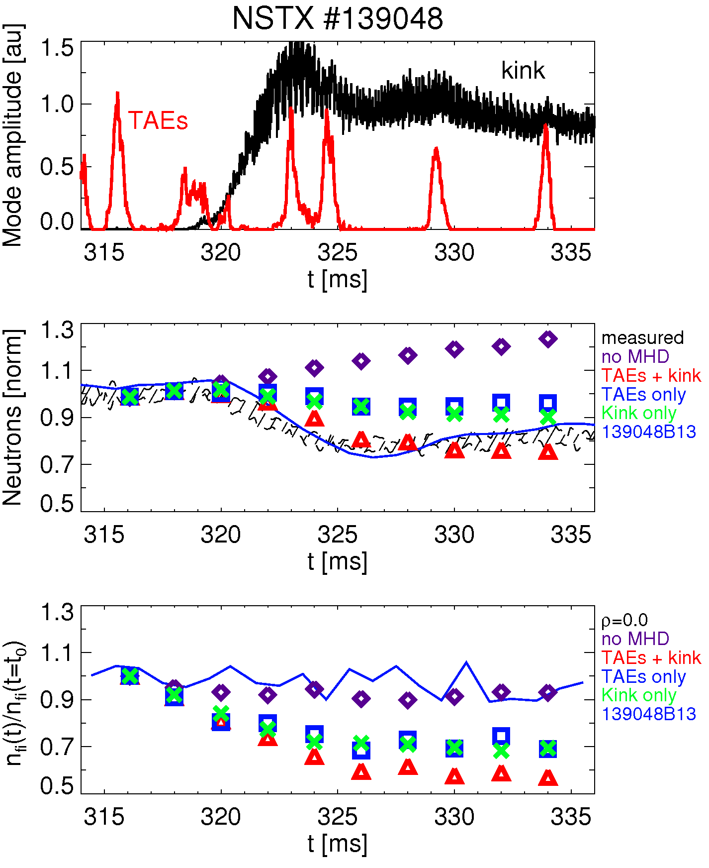
Preliminary example: NSTX scenarios with simultaneous TAEs and kink-like modes
TAEs + kink-like:
Anomalous diffusivity (AFID) up to t=320ms to match neutrons
Set AFID=0 after 320ms
Keep profiles fixed
Use previous p₁(ΔE,ΔP_{ζ}) for TAEs
Use p₂(ΔE,ΔP_{ζ}) for kink-like modes
  Crude model w/ n=1,2,3
  Just a test case!
  Analysis in progress to obtain “real” kink structure

Slide 55
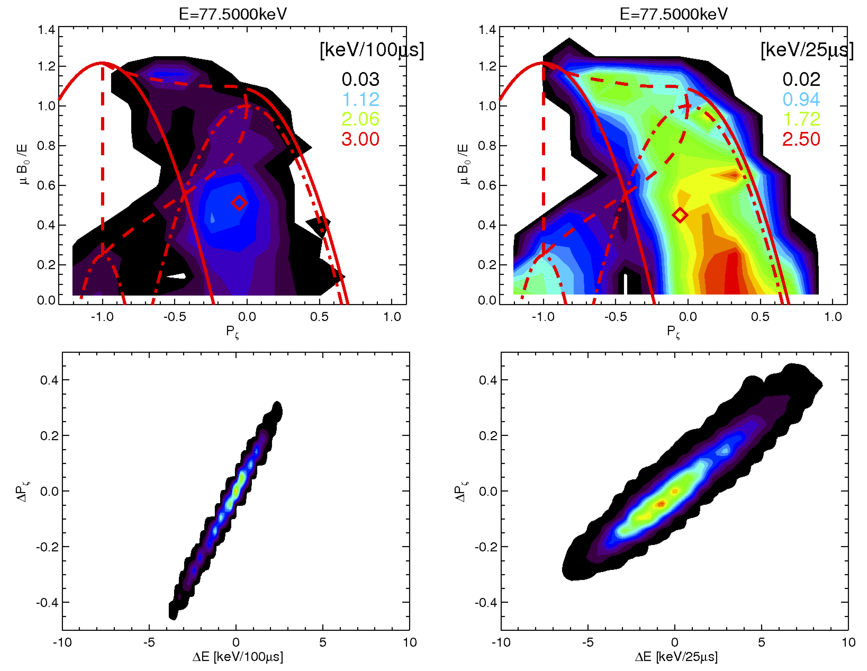
Preliminary example: NSTX scenarios with simultaneous TAEs and kink-like modes
Multi-mode case can account for (some type of) synergy between different modes
kink-like,
finite freq.
TAEs

Slide 56
Can the model be used in predictive mode?
As it is, the model is OK to analyze ‘real’ discharges
  Need mode structure to calculate p(ΔE,ΔP_{ζ}), e.g. from NOVA-K and reflectometers’ data + ORBIT
  Need data (Mirnovs, neutrons, etc.) to infer A_{modes}(t)
Two possibilities for ‘predictive’ runs:
  Find reasonable guess for unstable modes (e.g. NOVA-K)
  Explore different scenarios w/ scan of A_{modes}(t): weak *AE activity, bursts/avalanches, etc.
  or:
  Have an additional module to compute A_{modes}(t) self-consistently?
  Still requires mode structure, probably estimates for γ_{drive}, γ_{damp}
  Let A_{modes}(t) evolve according to F_{nb} evolution – but how?
  Couple to other reduced models, e.g. Critical Gradient Model?

