Slide 1




NSTX-U
Supported by
Experimental Observation of High-k Turbulence Evolution across L-H Transition in NSTX
Y. Ren¹
R.E. Bell¹, Linming Shao², D.R. Smith³, S. Zwenben¹, W. Guttenfelder¹, S.M. Kaye¹, B.P. LeBlanc¹, E. Mazzucato¹, K.C. Lee⁴, C.W. Domier⁵, H. Yuh⁶ and the NSTX Team
1. PPPL 2. ASIPP 3. UW-Madison 4. NFRI 5. UC-Davis 6. Nova Photonics
Coll of Wm & Mary
Columbia U
CompX
General Atomics
FIU
INL
Johns Hopkins U
LANL
LLNL
Lodestar
MIT
Lehigh U
Nova Photonics
Old Dominion
ORNL
PPPL
Princeton U
Purdue U
SNL
Think Tank, Inc.
UC Davis
UC Irvine
UCLA
UCSD
U Colorado
U Illinois
U Maryland
U Rochester
U Tennessee
U Tulsa
U Washington
U Wisconsin
X Science LLC
Culham Sci Ctr
York U
Chubu U
Fukui U
Hiroshima U
Hyogo U
Kyoto U
Kyushu U
Kyushu Tokai U
NIFS
Niigata U
U Tokyo
JAEA
Inst for Nucl Res, Kiev
Ioffe Inst
TRINITI
Chonbuk Natl U
NFRI
KAIST
POSTECH
Seoul Natl U
ASIPP
CIEMAT
FOM Inst DIFFER
ENEA, Frascati
CEA, Cadarache
IPP, Jülich
IPP, Garching
ASCR, Czech Rep
2014 U.S. Transport Task Force Workshop, San Antonio, Texas, April 22-25, 2014
TexPoint fonts used in EMF.
Read the TexPoint manual before you delete this box.: A

Slide 2
Highlights
First detailed measurement of high-k (electron-scale) turbulence across L-H transition in NSTX
  L-H transition at current flattop
  Measuring 3 ≤ k┴ρ_{s} ≤ 12 in the core-edge transition region (r/a ~ 0.7-0.8)
  High-k turbulence quasi-stationary before L-H transition, intermittent after L-H transition and significantly suppressed ~15 ms after L-H transition
  Suppression of high-k turbulence at lower wavenubmer, i.e. k┴ρ_{s} ≤ 9
Low-k turbulence measured by GPI and BES at different radii but similar temporal behavior with high-k measurement
  Showing suppression of low-k turbulence into H-mode at r/a>0.8
Linear stability analysis using GS2 code showing some consistency with turbulence measurements
  Decreased ETG growth rate into H-mode
  Low-k turbulence more suppressed by ExB shear into H-mode

Slide 3
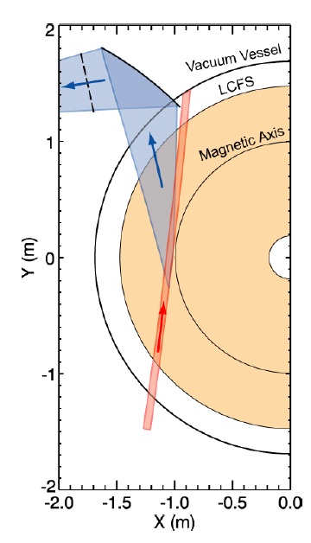
A High-k Microwave Scattering System was Used to Measure Electron-Scale Turbulence
280 GHz microwave is launched as the probe beam.
Coherent scattering by plasma density fluctuations occurs when the three-wave coupling condition is satisfied:
Bragg condition determines k_{p}:
k_{p}=2k_{i}sin(θ_{s}/2)
The scattered light has a frequency of:
ω_{s}=ω_{p}+ω_{i}
with ω_{s} and ω_{i} >> ω_{p}
The scattering system characteristics are:
  Frequency bandwidth: 5 MHz
  Heterodyne receiver: Wave propagation direction resolved
  Measurement: k_{r} spectrum
  Wavenumber resolution: 0.7 cm⁻¹ (2/a with a ≈ 3 cm)
  Wavenumber range (k_{r}): 5-30 cm⁻¹ (~5-30 )
  Radial resolution: ±2 cm
  Tangential resolution: 5-15 cm
  Radial range: R=106 – 144 cm
  Minimal detectable density fluctuation:
Spherical mirror
Scattered light
k_{p}
k_{s}
k_{p}
=
+
k_{i}
θ_{s}
k_{s}
k_{i}
2a
Probe beam
Probe beam
D.R. Smith, PhD thesis, 2009

Slide 4
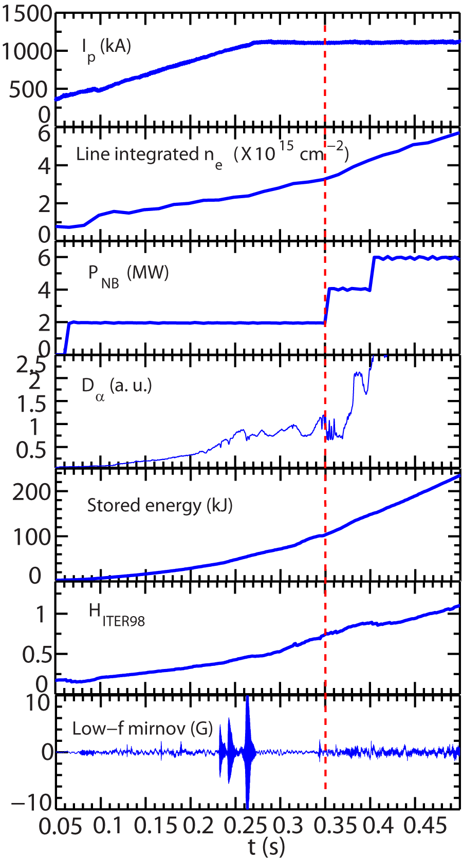
L-H Transition is Triggered by NBI Power Step-up during Current Flattop
Shot=139442
B_{T} =5.5 kG
L-H Transition at current flattop reduces measurement complications
Better high-k measurement due to favorable Doppler frequency shift
Less MHD activity
L-H transition
From TRANSP

Slide 5
L-H Transition is Triggered by NBI Power Step-up during Current Flattop
Shot=139442
B_{T} =5.5 kG
L-H Transition at current flattop reduces measurement complications
Better high-k measurement due to favorable Doppler frequency shift
Less MHD activity
Time range of interest
L-H transition
From TRANSP

Slide 6
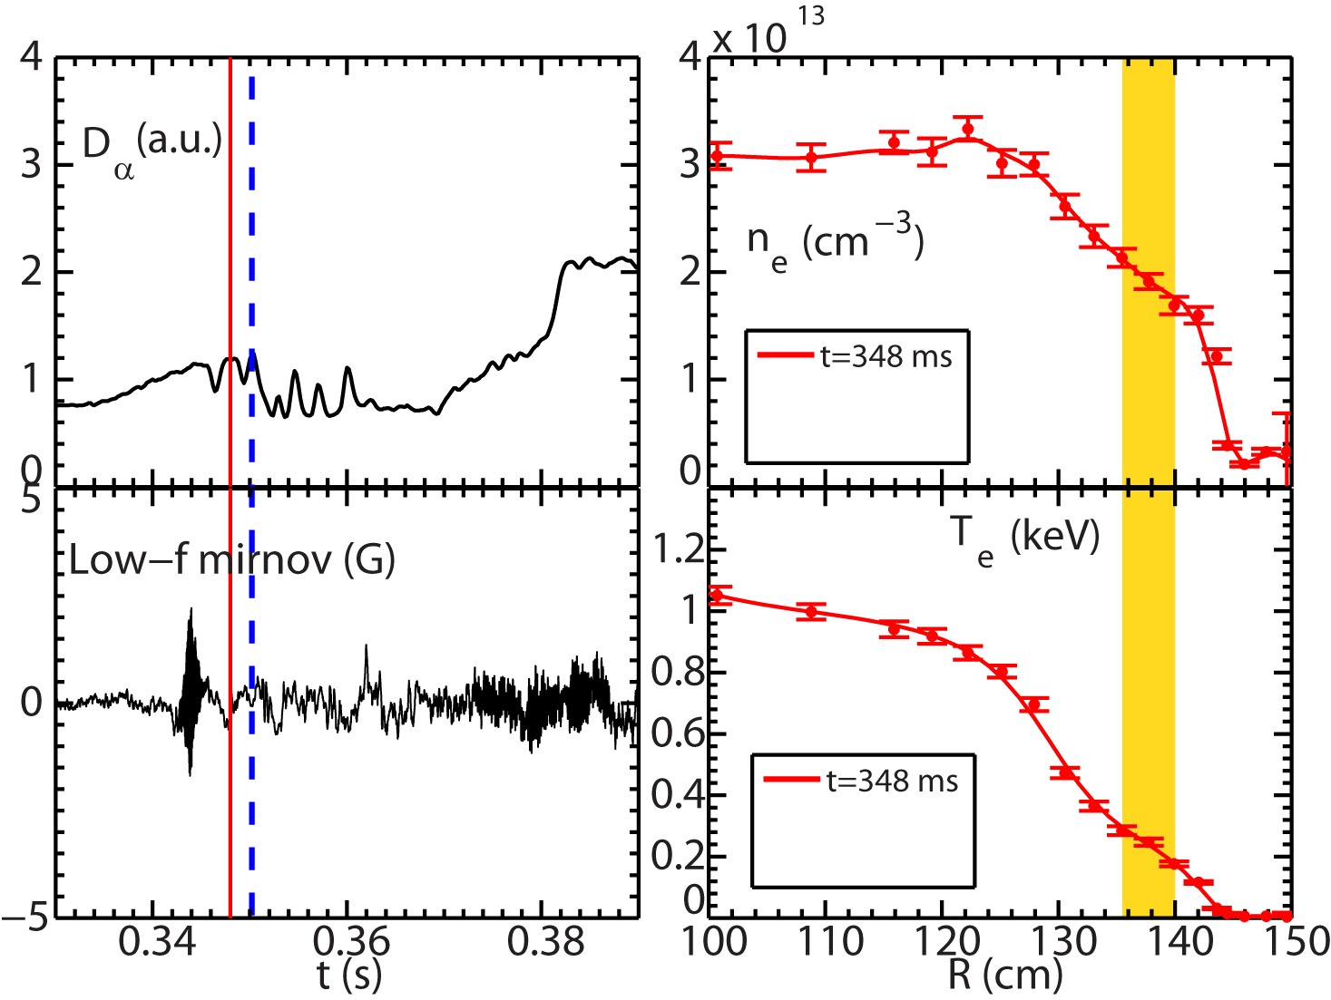
D_{α} Dithering is Observed after the L-H Transition at t≈350 ms
Spikes in divertor D_{α} after the L-H transition show the dithering feature of the L-H transition
Low-f MHD activity is relatively benign after the L-H transition
High-k measurement region (r/a~0.7-0.8)
L-H transition
D-alpha dithering
LCFS at R=146 cm

Slide 7
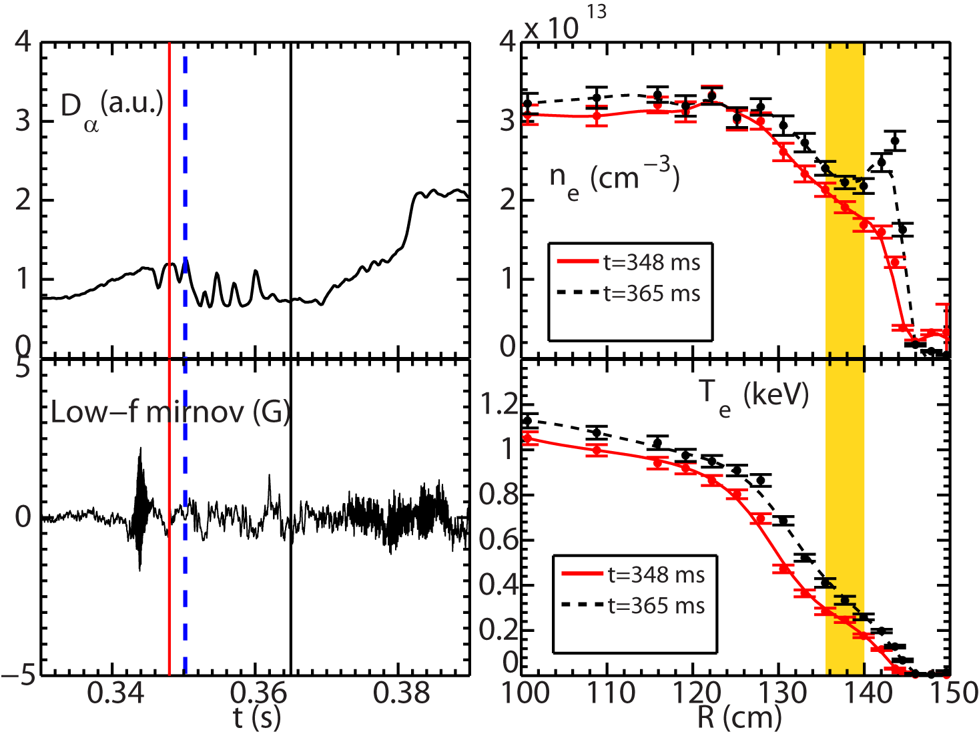
Edge Transport Barrier (ETB) is Established after the Dithering Phase
Clear H-mode density ear appears at t=365 ms, showing the establishment of ETB
  The density ear from edge accumulation of carbon impurity
High-k measurement region (r/a~0.7-0.8)
L-H transition
LCFS at R=146 cm

Slide 8
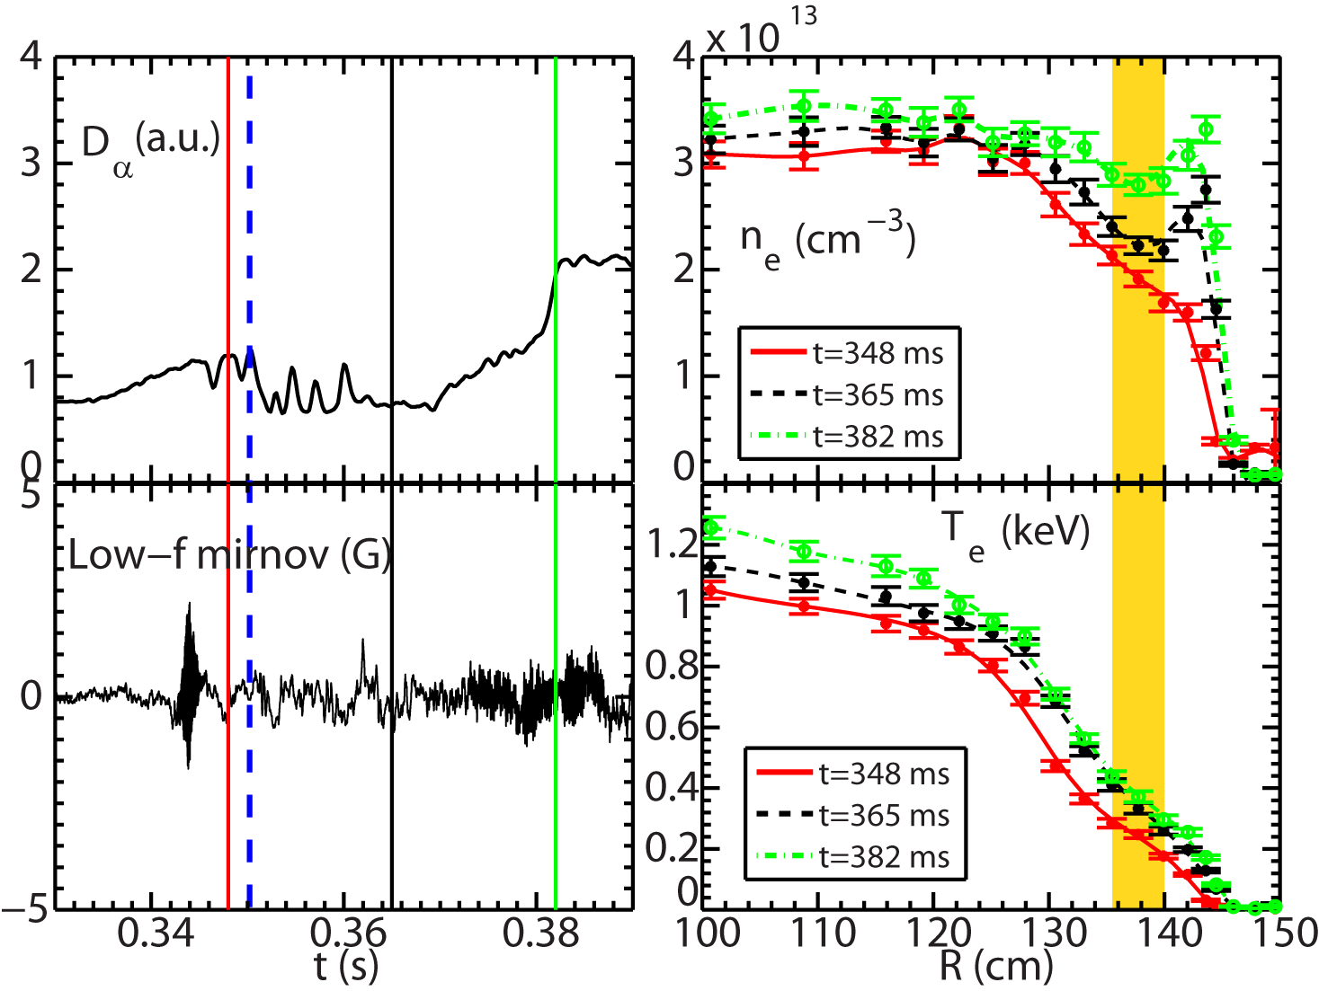
Edge Transport Barrier (ETB) is Established after the Dithering Phase
H-mode pedestal continuously builds up after the dithering phase
  Electron density and temperature increase
High-k scattering system measures turbulence k spectrum at r/a~0.7-0.8 and ETB is at r/a>0.9
High-k measurement region (r/a~0.7-0.8)
LCFS at R=146 cm

Slide 9
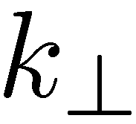
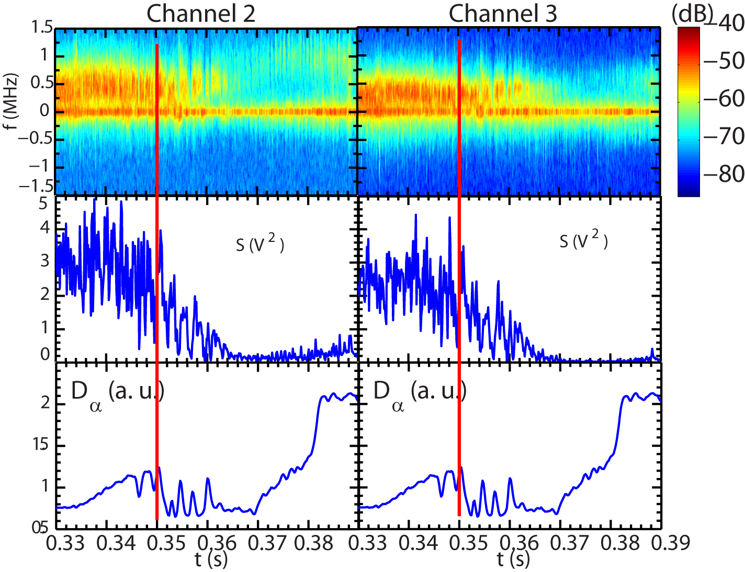
Clear Suppression of High-k Turbulence into L-H Transition from the High-k Scattering System
Off-center peak denotes the scattered signal
f=0 peak is from stray radiation
L-H transition

Slide 10
Clear Suppression of High-k Turbulence into L-H Transition from the High-k Scattering System
Dithering in high-k spectral power observed after L-H transition
Off-center peak denotes the scattered signal
f=0 peak is from stray radiation
L-H transition
Dithering
Dithering

Slide 11
Clear Suppression of High-k Turbulence into L-H Transition from the High-k Scattering System
Dithering in high-k spectral power observed after L-H transition
Significant suppression of turbulence in 365<t<380 ms
Off-center peak denotes the scattered signal
f=0 peak is from stray radiation
L-H transition

Slide 12
Clear Suppression of High-k Turbulence into L-H Transition from the High-k Scattering System
Dithering in high-k spectral power observed after L-H transition
Significant suppression of turbulence in 365<t<380 ms
Some increase in turbulence at t>380 ms
Off-center peak denotes the scattered signal
f=0 peak is from stray radiation
L-H transition

Slide 13
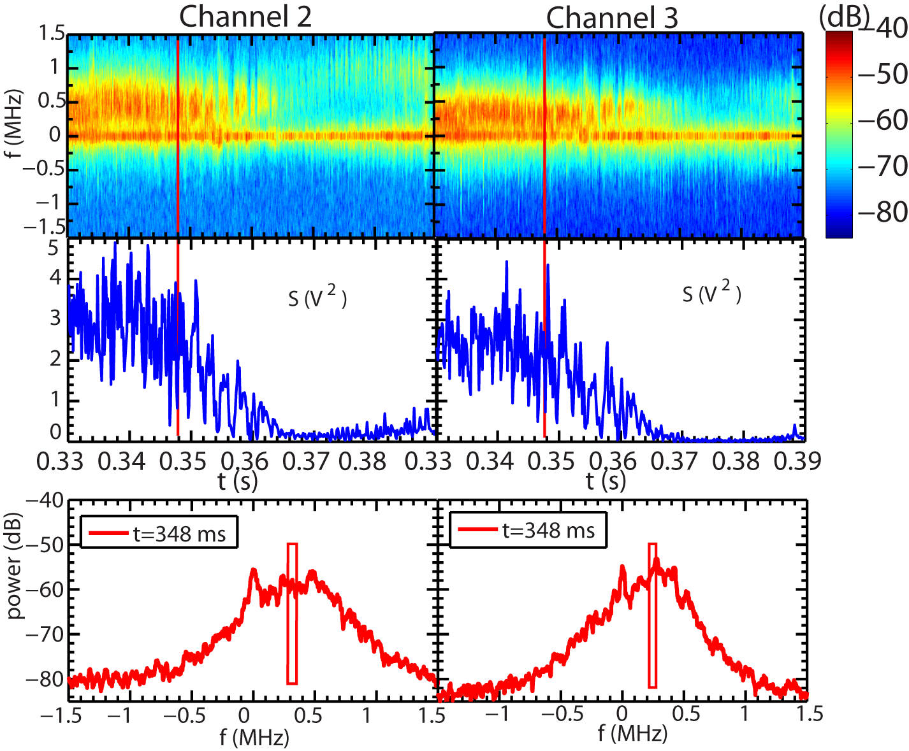
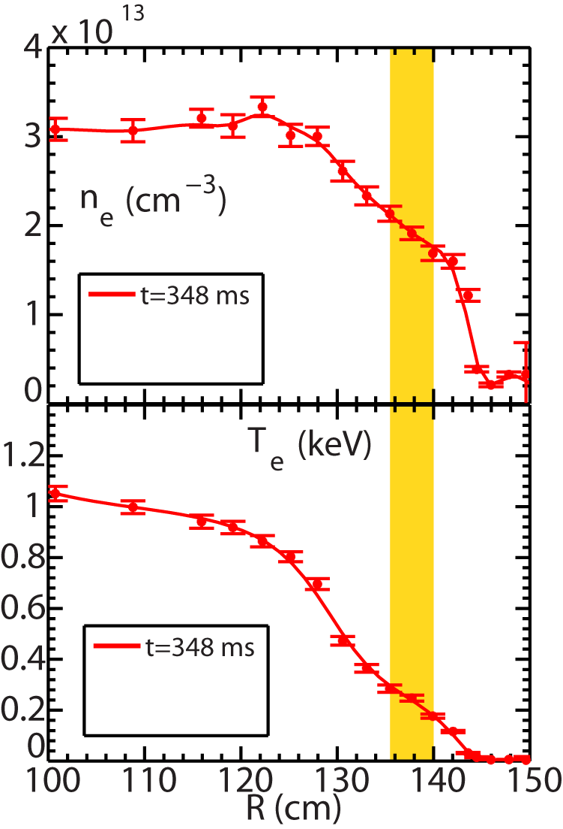
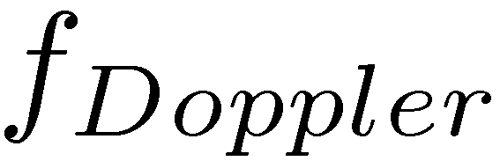
Broad Band High-k Turbulence is Seen across the L-H Transition
Frequency spectra are shown for an exact Thomson time point: t=348 ms
Mean real frequency much smaller than Doppler frequency shit
Electron direction

Slide 14
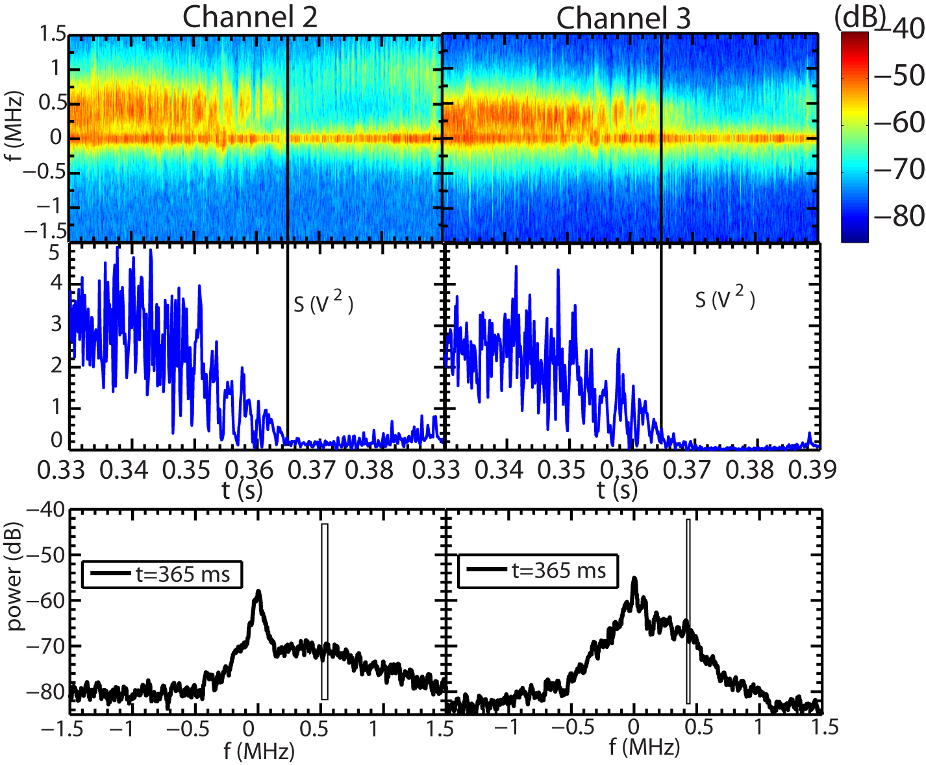
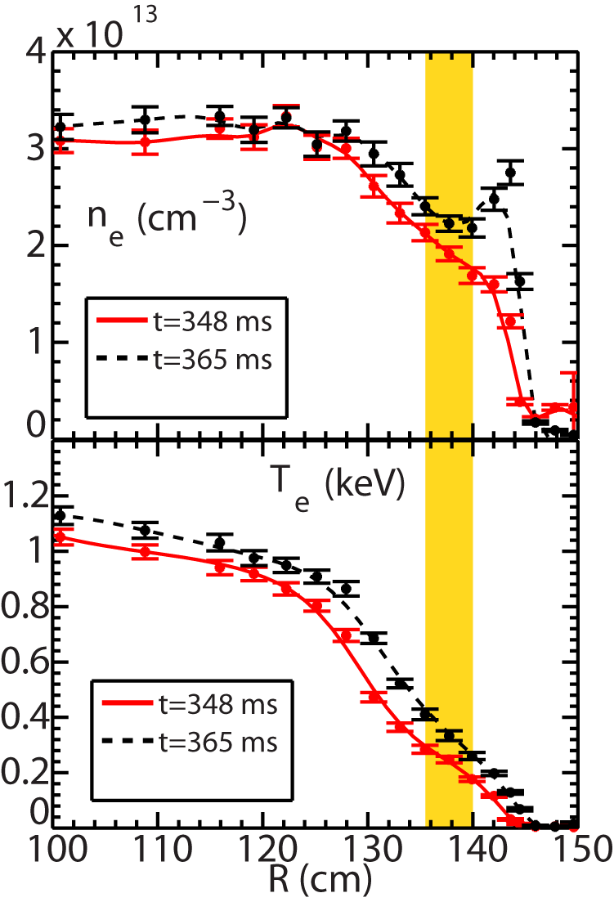
Broad Band High-k Turbulence See across the L-H Transition
Frequency spectra are shown for an exact Thomson time point: t=365 ms
Turbulence propagates in the electron diamagnetic direction
Electron direction

Slide 15
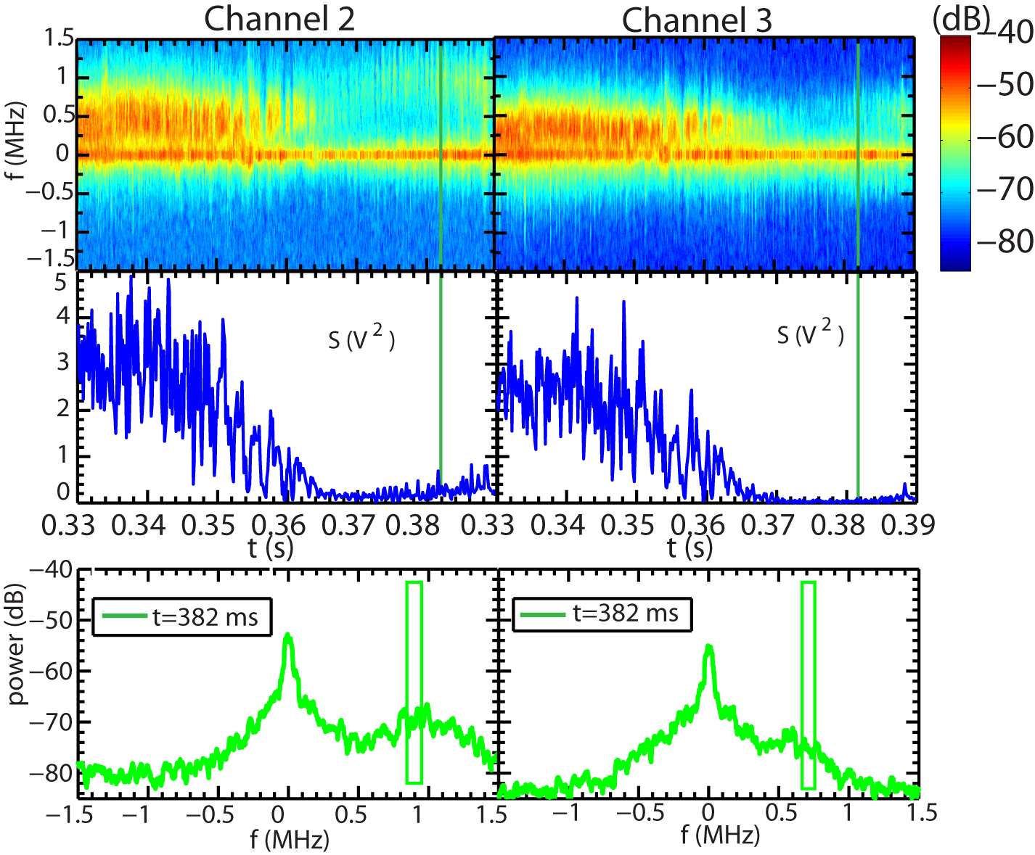
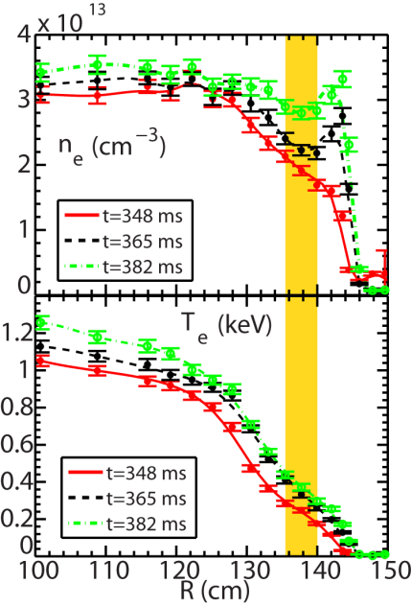
Broad Band High-k Turbulence See across the L-H Transition
Frequency spectra are shown for an exact Thomson time point: t=382 ms
Real frequency distinguishable from the Doppler frequency shift for channel 3
Electron direction

Slide 16
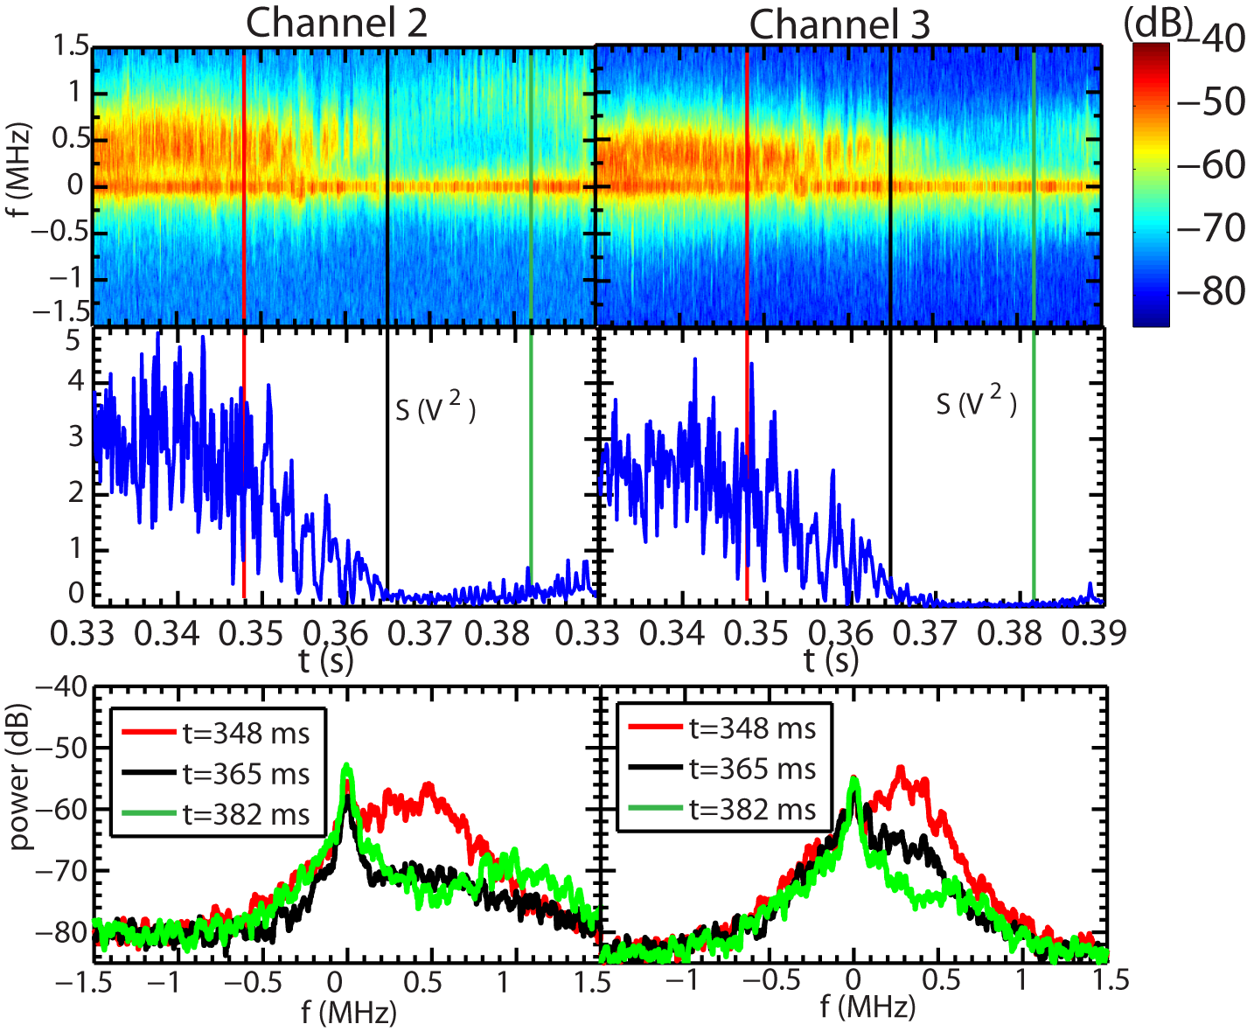
High-k Turbulence Changes in Amplitude and Frequency across the L-H Transition

Slide 17
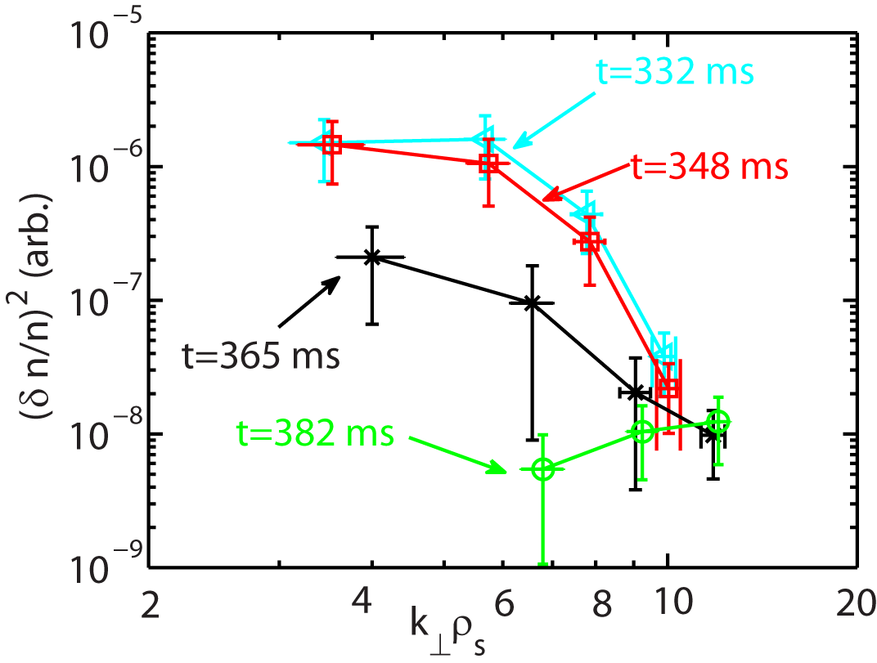
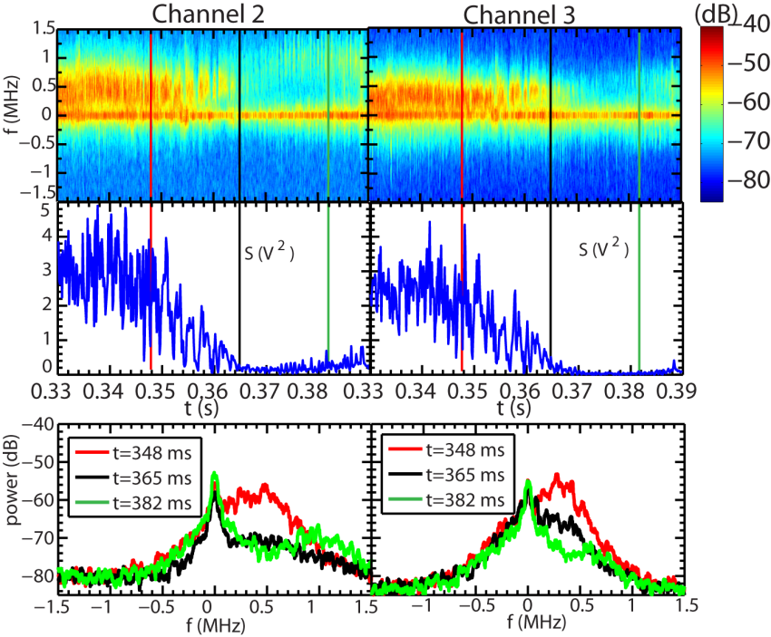
Significant Drop of Spectral Power in Lower Wavenumber is Observed in the High-k Spectrum
No large variation before the L-H transition
Significant drop, i.e. a factor of about 7, in peak spectral power at t=365 ms after the L-H transition
  Even smaller at 382 ms

Slide 18
Significant Drop of Spectral Power in Lower Wavenumber is Observed in the High-k Spectrum
No large variation before the L-H transition
Significant drop, i.e. a factor of about 7, in peak spectral power at t=365 ms after the L-H transition
  Even smaller at 382 ms
The drop in spectral power only occurs at k┴ρ_{s} <9-10

Slide 19
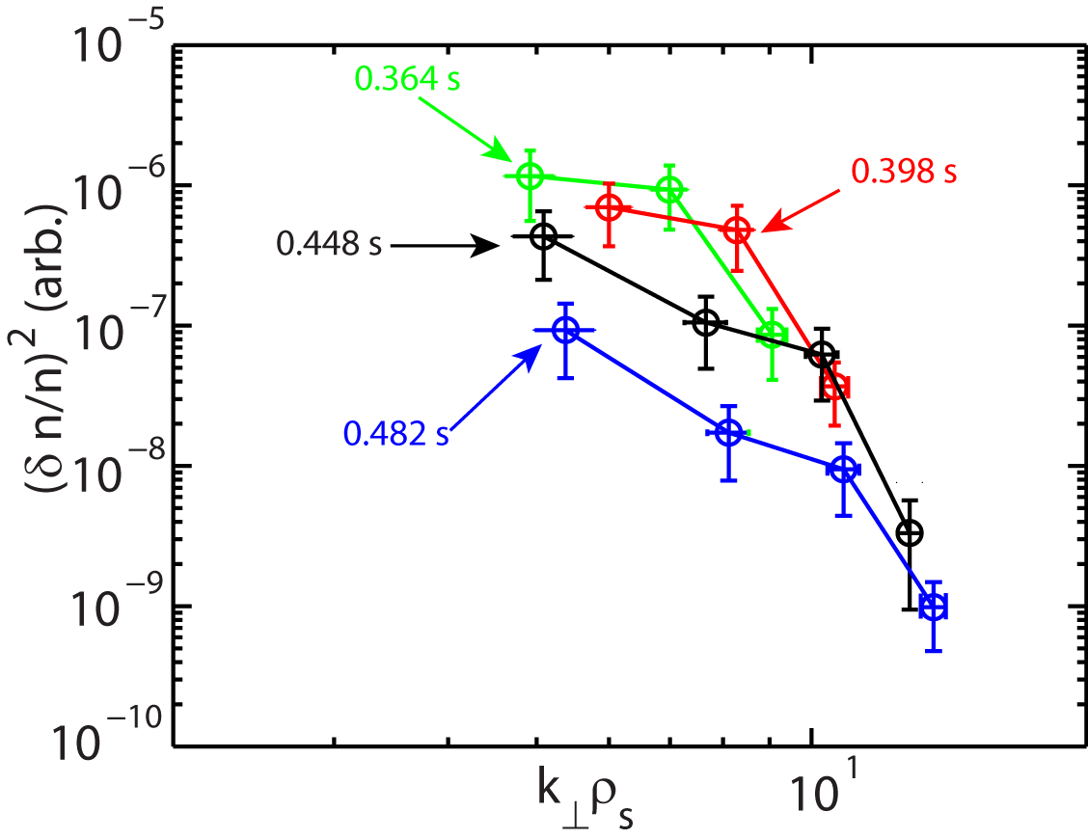
Similar Observations in Spectral Power Drop in Lower Wavenumbers in Different NSTX Scenarios
Ren et al., NF 2013
Before L-H transition
NBI-heated L-mode
Increase of ExB shear
After L-H transition

Slide 20
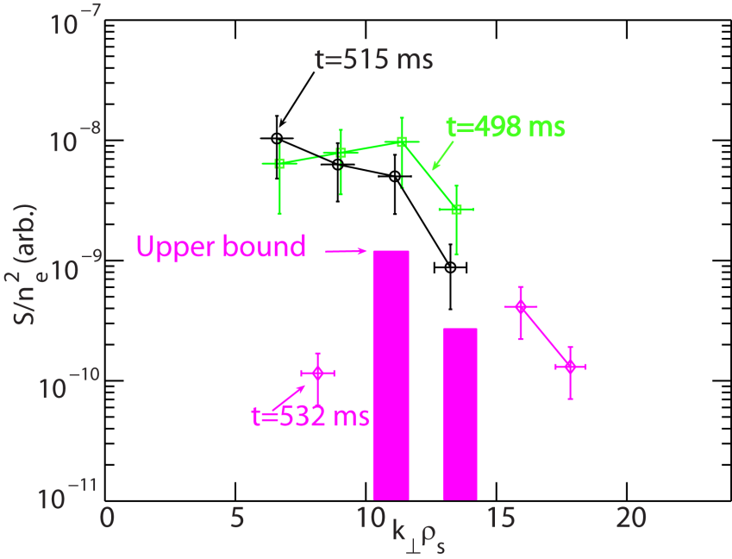
Similar Observations in Spectral Power Drop in Lower Wavenumbers in Different NSTX Scenarios
Ren et al., NF 2013
Before L-H transition
NBI-heated L-mode
Increase of ExB shear
After L-H transition
Ren et al., PRL 2011
NBI-heated H-mode
Increase of density gradient

Slide 21
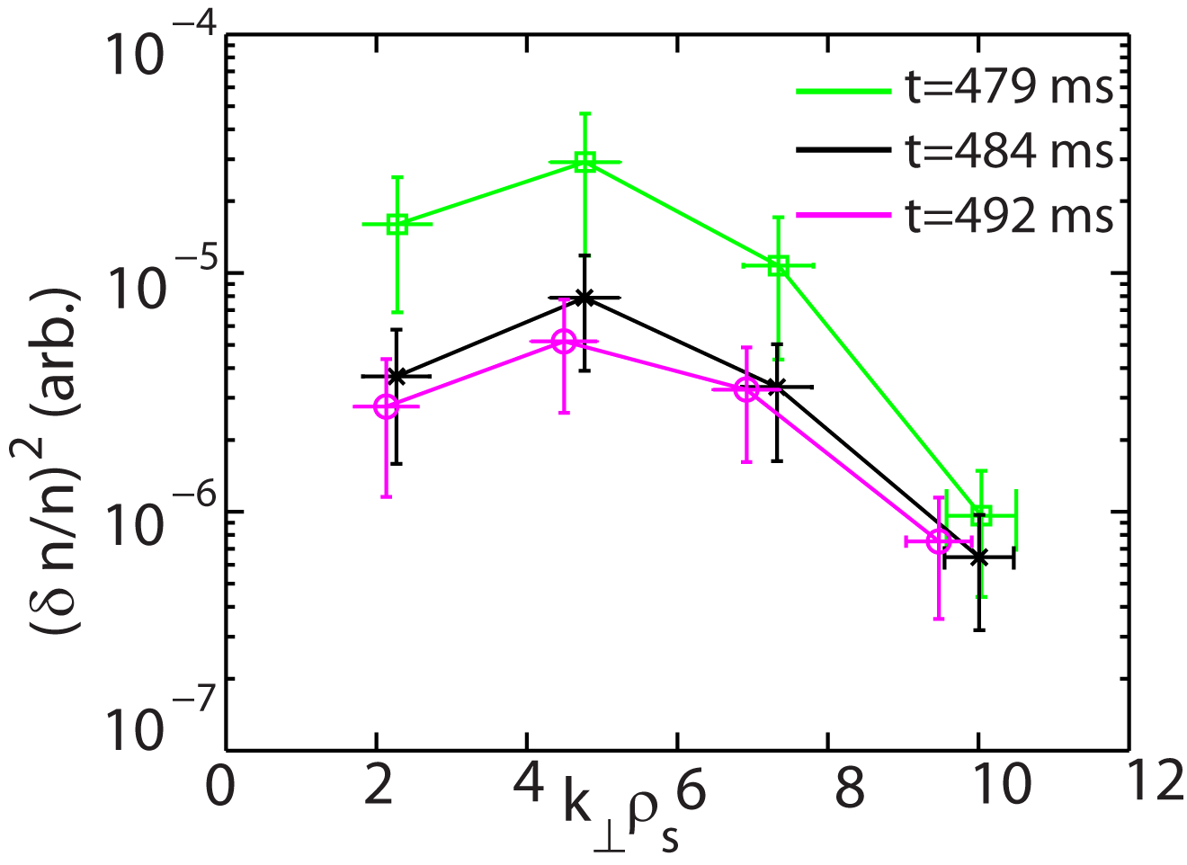
Similar Observations in Spectral Power Drop in Lower Wavenumbers in Different NSTX Scenarios
Ren et al., NF 2013
Before L-H transition
NBI-heated L-mode
Increase of ExB shear
After L-H transition
Ren et al., PRL 2011
NBI-heated H-mode
RF-heated L-mode
Increase of density gradient
RF heating turned-off

Slide 22
Similar Observations in Spectral Power Drop in Lower Wavenumbers in Different NSTX Scenarios
The drop in spectral power only occurs at k┴ρ_{s} <9-10
Ren et al., NF 2013
NBI-heated L-mode
Ren et al., PRL 2011
NBI-heated H-mode
RF-heated L-mode

Slide 23
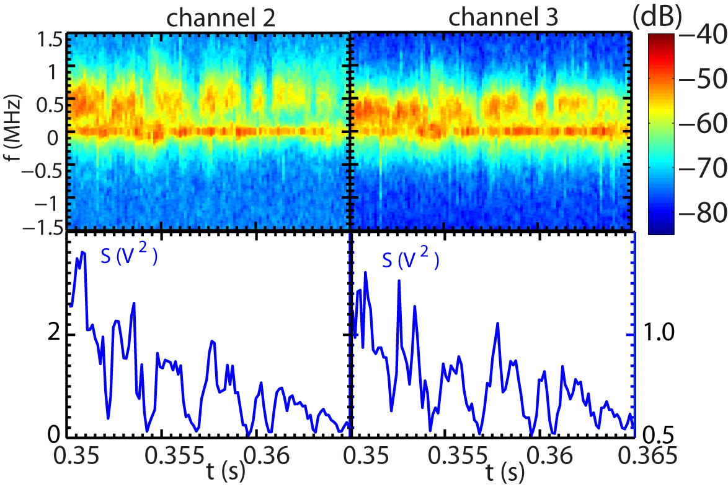
Large Intermittency (Dithering) in High-k Turbulence from t=350 to 365 ms
Overall turbulence power decreases into H-mode
Off-center peak denotes the scattered signal
f=0 peak is from stray radiation

Slide 24
Large Intermittency (Dithering) in High-k Turbulence from t=350 to 365 ms
Overall turbulence power decreases into H-mode
Periods of minimum turbulence appear intermittently (~1-1.5 ms)

Slide 25
Large Intermittency (Dithering) in High-k Turbulence from t=350 to 365 ms
Overall turbulence power decreases into H-mode
Periods of minimum turbulence appear intermittently (~1-1.5 ms)
  Fast decrease and rise of turbulence power in 0.5-1 ms

Slide 26
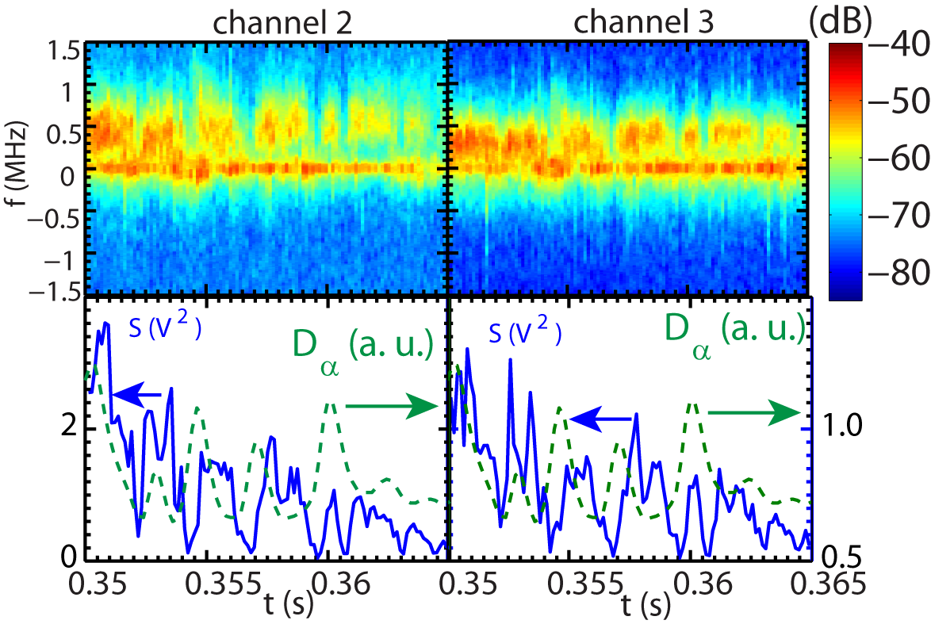
Large Intermittency (Dithering) in High-k Turbulence from t=350 to 365 ms is Similar to Divertor D_{α}
High-k turbulence intermittency is on the same time scale as the dithering of divertor D_{α}
A definite correlation is not yet established

Slide 27
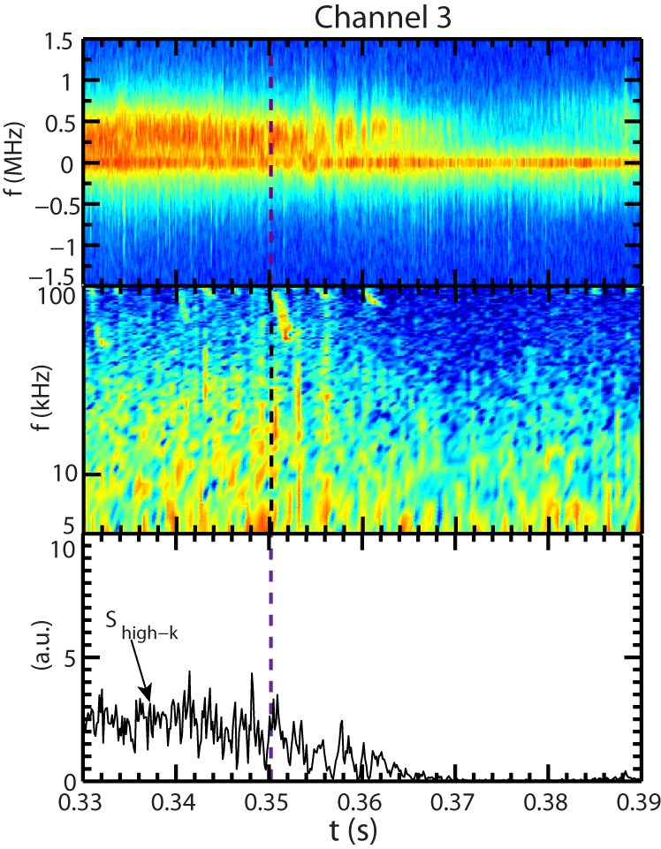
Low-k Turbulence Measured by BES Shows Similar Temporal Behavior as High-k Turbulence
High-k channel 3 measuring k┴ρ_{s} ~6-7 is compared with BES measurement at R=142 cm (top of the H-mode pedetsal)
L-H transtion
High-k measurement region
High-k channel 3
k┴ρ_{s} ~6-7
R=135.5-140
BES channel location
A BES channel at R=142 cm

Slide 28
Low-k Turbulence Measured by BES Shows Similar Temporal Behavior as High-k Turbulence
High-k channel 3 measuring k┴ρ_{s} ~6-7 is compared with BES measurement at R=142 cm (top of the H-mode pedetsal)
L-H transtion
Quasi-stationary turbulence before the L-H transition
  from BES
High-k channel 3
k┴ρ_{s} ~6-7
A BES channel at 142 cm

Slide 29
Low-k Turbulence Measured by BES Shows Similar Temporal Behavior as High-k Turbulence
High-k channel 3 measuring k┴ρ_{s} ~6-7 is compared with BES measurement at R=142 cm (top of the H-mode pedetsal)
L-H transtion
Semi-stationary turbulence before the L-H transition
  from BES
Reduced turbulence into H-mode
  from BES
High-k channel 3
k┴ρ_{s} ~6-7
A BES channel at 142 cm

Slide 30
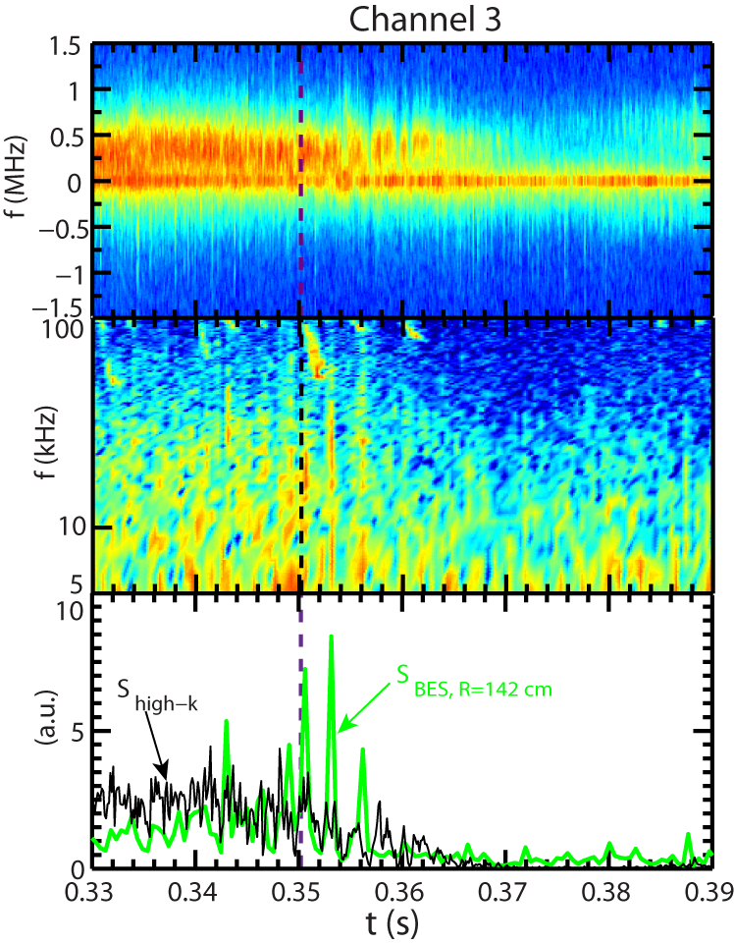
Low-k Turbulence Measured by BES Shows Similar Temporal Behavior as High-k Turbulence
High-k channel 3 measuring k┴ρ_{s} ~6-7 is compared with BES measurement at R=142 cm (top of the H-mode pedetsal)
Semi-stationary turbulence before the L-H transition
  from BES
Reduced turbulence into H-mode
  from BES
Intermittent turbulence right after the L-H transition
      t ~ 350-365 ms
      Similar temporal intermittency in low-k and high-k
High-k channel 3
k┴ρ_{s} ~6-7
A BES channel at 142 cm

Slide 31
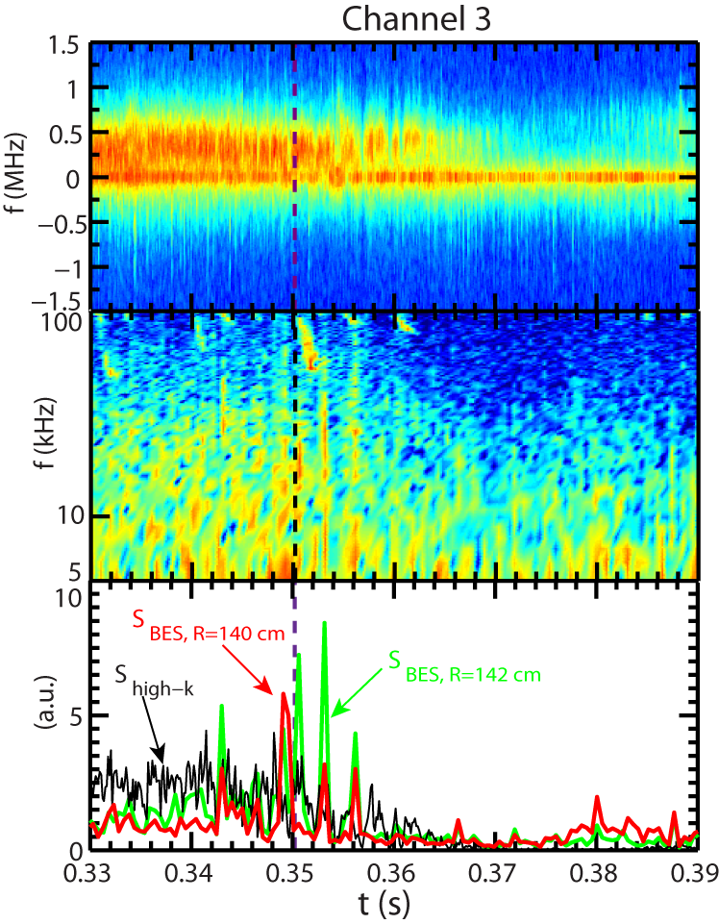
Low-k Turbulence Measured by BES Shows Similar Temporal Behavior as High-k Turbulence
High-k channel 3 measuring k┴ρ_{s} ~6-7 is compared with BES measurement at R=142 cm (top of the H-mode pedetsal)
Semi-stationary turbulence before the L-H transition
  from BES
Reduced turbulence into H-mode
  from BES
Intermittent turbulence right after the L-H transition
      t ~ 350-365 ms
      Similar temporal intermittency in low-k and high-k
High-k channel 3
k┴ρ_{s} ~6-7
A BES channel at 142 cm

Slide 32
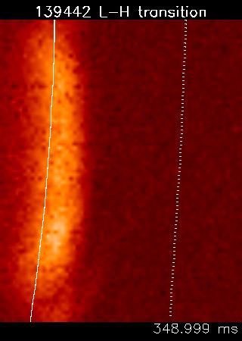
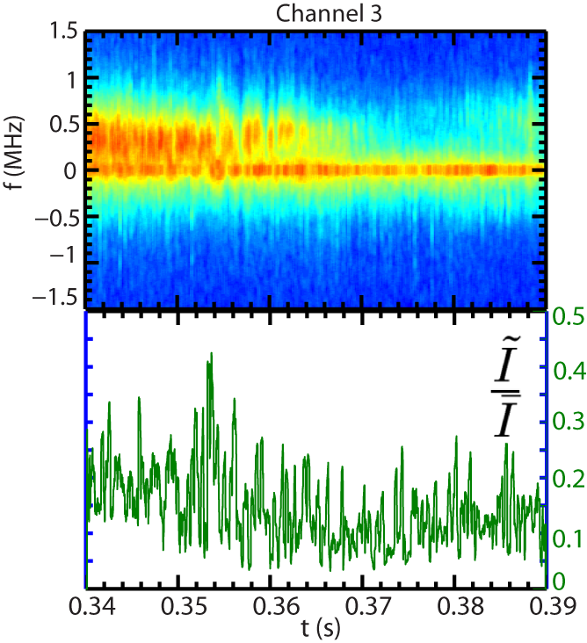


GPI Measurements also Show Similar Overall Temporal Behavior as the High-k Turbulence
L-H transtion
is the RMS value of the GPI emission fluctuation over every 0.13 ms
is the mean of the GPI emission over every 0.13 ms
GPI emission at R=144 cm

Slide 33
GPI Measurements also Show Similar Overall Temporal Behavior as the High-k Turbulence
Quasi-stationary turbulence before the L-H transition
L-H transtion
is the RMS value of the GPI emission fluctuation over every 0.13 ms
is the mean of the GPI emission over every 0.13 ms
GPI emission at R=144 cm

Slide 34
GPI Measurements also Show Similar Overall Temporal Behavior as the High-k Turbulence
Intermittent and decreasing turbulence right after the L-H transition
L-H transtion
is the RMS value of the GPI emission fluctuation over every 0.13 ms
is the mean of the GPI emission over every 0.13 ms
GPI emission at R=144 cm

Slide 35
GPI Measurements also Show Similar Overall Temporal Behavior as the High-k Turbulence
Suppressed turbulence in 365 ms<t<380 ms
L-H transtion
is the RMS value of the GPI emission fluctuation over every 0.13 ms
is the mean of the GPI emission over every 0.13 ms
GPI emission at R=144 cm

Slide 36
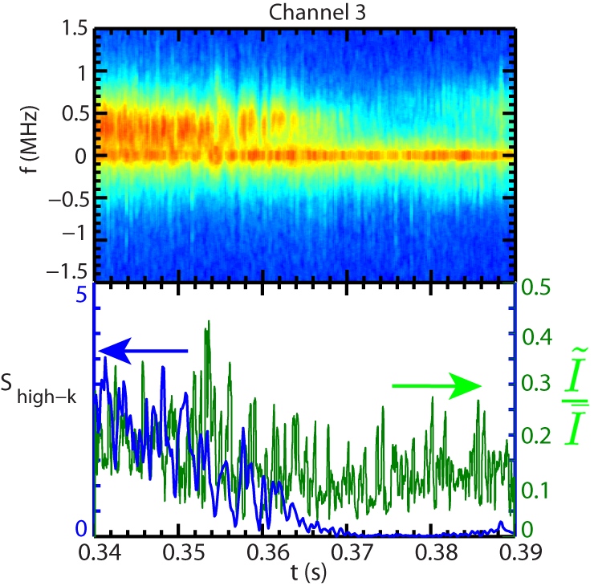
GPI Measurements are more Intermittent than the High-k Turbulence
L-H transtion
is the RMS value of the GPI emission fluctuation over every 0.13 ms
is the mean of the GPI emission over every 0.13 ms
GPI emission at R=144 cm

Slide 37
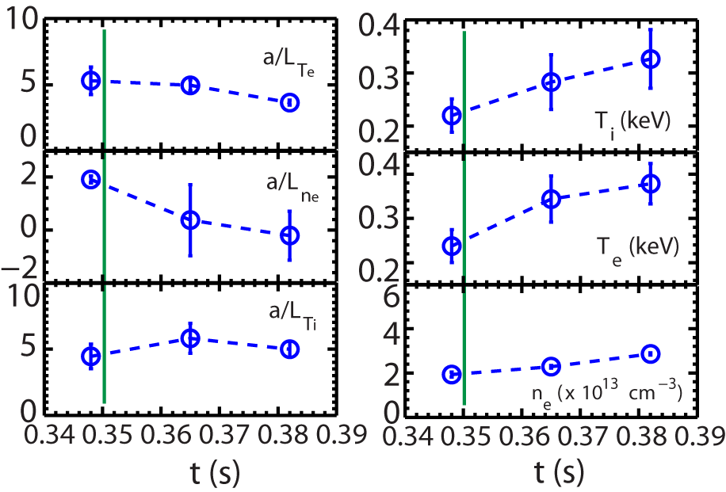
Equilibrium Profiles Changes can be Significant across the L-H Transition
The time of L-H transition
~30% decrease in normalized inverse ETG scale length
~30% variation in decrease in normalized inverse ITG scale length
Significant decrease in density gradient
Significant increase in T_{e}, T_{i} and n_{e} (~45-60%)
Quantities averaged in the high-k measurement region

Slide 38
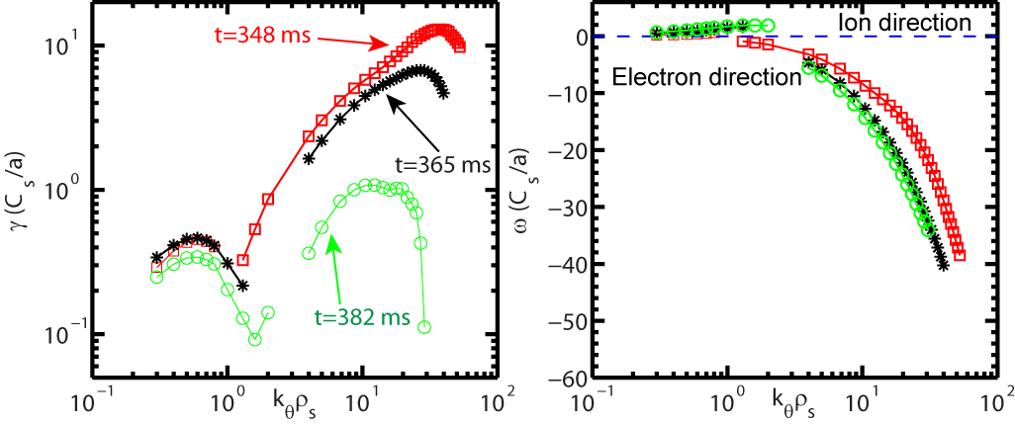
Linear Stability Analysis Shows that ITG and ETG are both Unstable
ETG linear growth rates decrease into H-mode
  ETG mode real frequency increases
ITG growth rates vary much less significantly
R=138 cm
Before L-H transition
ETG
ITG
Stability Analysis was performed with the GS2 code (Kotschenreuther et al., 1995) with Miller local equilibrium

Slide 39
ETG Stability across L-H Transition is Consistent with Measured High-k Turbulence Variation
ETG linear growth rates decrease into H-mode
Measured high-k turbulence also decreases into H-mode
The observed intermittency requires nonlinear processes
R=138 cm
ETG
ITG
Stability Analysis was performed with the GS2 code (Kotschenreuther et al., 1995) with Miller local equilibrium

Slide 40
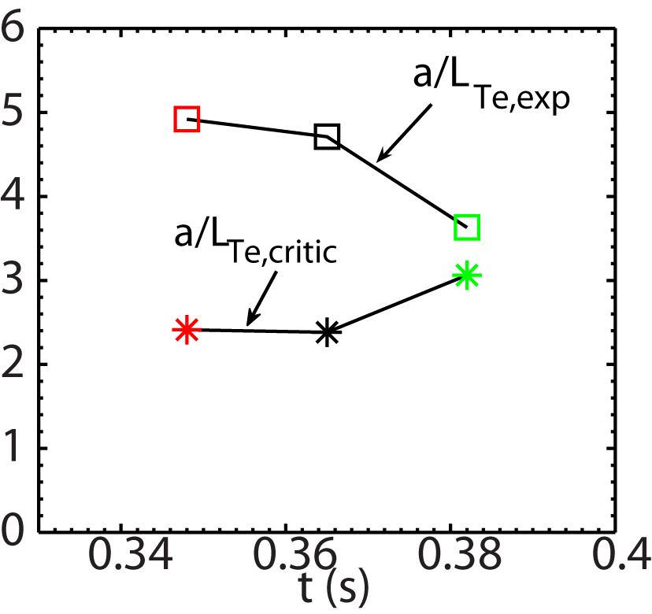
ETG Close to Marginal Stability in the High-k Measurement Region Further into H-mode
The decrease of ETG linear growth rates is due to the decrease of ETG and increase of critical temperature gradient
The time of L-H transition
R=138 cm
ETG
ITG
Stability Analysis was performed with the GS2 code (Kotschenreuther et al., 1995) with Miller local equilibrium

Slide 41
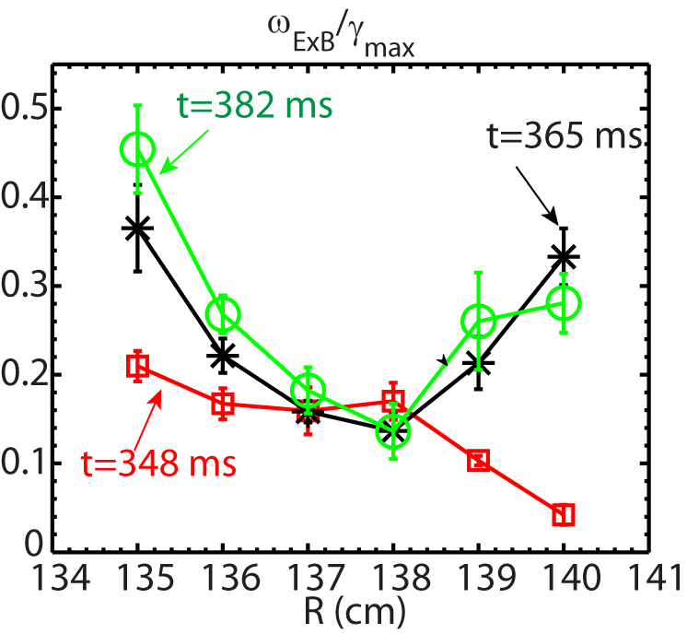
Ion-scale Modes are more Suppressed into H-mode
!_{E£ B,WM} /°_{max} is used to assess ExB shear effect on ion-scale instabilities
!_{E£ B,WM} /°_{max} increases in the high-k measurement region into H-mode
R=138 cm
ETG
After L-H transition
ITG
Before L-H
Stability Analysis was performed with the GS2 code (Kotschenreuther et al., 1995) with Miller local equilibrium

Slide 42
Summary
First detailed measurement of high-k (electron-scale) turbulence across L-H transition in NSTX
  Quasi-stationary high-k turbulence before L-H transition, intermittent after L-H transition and significantly suppressed ~15 ms after L-H transition
  Suppression of high-k turbulence at lower wavenubmer, i.e. k┴ρ_{s} ≤ 9, similar observations in different NSTX scenarios
Low-k turbulence measured by GPI and BES at different radii but similar temporal behavior as high-k turbulence observed
  Intermittency observed after L-H transition, similar to high-k turbulence
  Showing suppression of low-k turbulence into H-mode at r/a>0.8
Linear stability analysis using GS2 code showing some consistency with turbulence measurements
  Decreased ETG growth rate into H-mode
  Low-k turbulence more suppressed by ExB shear into H-mode
  Nonlinear processes needed for explaining the observed intermittency
Acknowledgement: Work supported by DoE

Slide 43
Backup Slides

