Slide 1
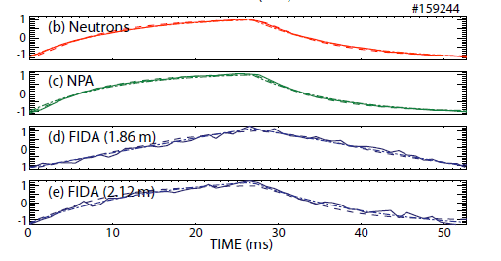

TRANSP Modeling of Fast-ion D_{α} (FIDA) Signals
Beam modulation experiments with active FIDA and NPA signals
Passive FIDA Signals
Bill Heidbrink, Nathan Bolte, Cami Collins, Deyong Liu, Guangzhou Hao, Luke Stagner

Slide 2
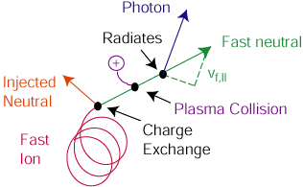
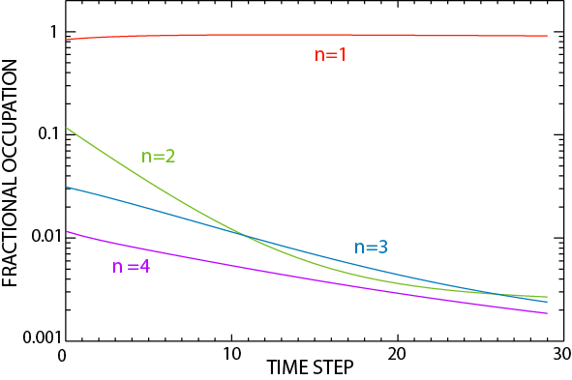
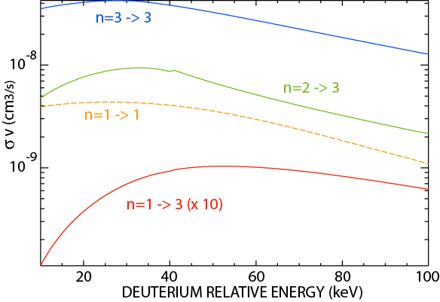
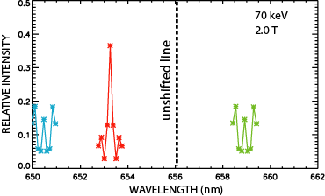
FIDA is an application of Charge Exchange Recombination Spectroscopy
The fast ion exchanges an electron with a neutral
Neutrals in the n=3 state relax to an equilibrium population; some radiate
The Doppler shift of the emitted photon depends on a component of the fast-ion velocity
3 cm
Heidbrink, RSI 81 (2010) 10D727

Slide 3
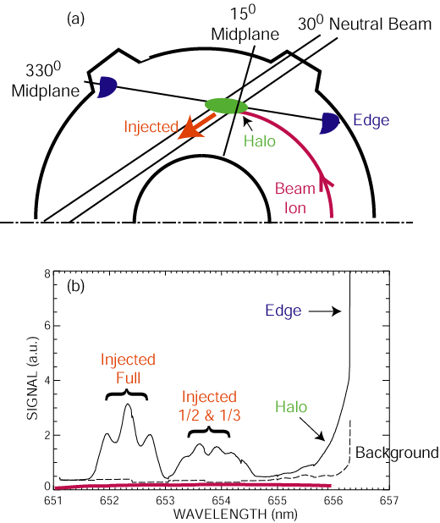
Active FIDA measurements use an injected neutral beam
Reactions with edge neutrals produce passive FIDA light

Slide 4
FIDASIM is a synthetic diagnostic code
A calculated fast-ion distribution function is input to the code—often use “dumped” TRANSP NUBEAM distributions
Computes four neutral populations: Full, half, & third energies from injected beam + halo
Solves energy-level resolved time-dependent collisional-radiative equations
Doppler shift and Stark splitting of radiated photons
Heidbrink, Comm. Comp. Phys. 10 (2011) 716

Slide 5

Experiment compares modulated fast-ion signals to “classical” TRANSP predictions
Transport by Alfven eigenmodes causes differences between measured & calculated signals
Modulated Neutrons
Collins NF 57 (2017) submitted

Slide 6
Conditionally average signals & predictions for FIDA & neutral particle analyzer (NPA) signals
TRANSP Workflow
Special run with only the modulated beam & 10⁶ markers (good MC statistics)
Dump distribution function every 2.5 ms for 6 beam cycles (~ 120 times)
Run FIDASIM for each timeslice
Conditionally average FIDASIM output
2.4 MW
Solid = Data
Dashed = TRANSP
Heidbrink, NF 56 (2016) 112011

Slide 7
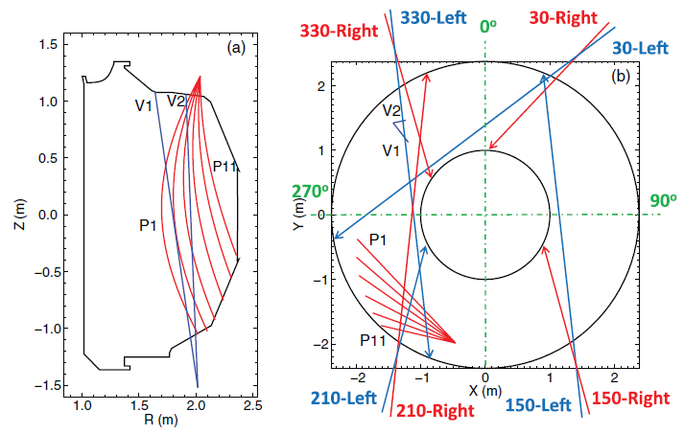
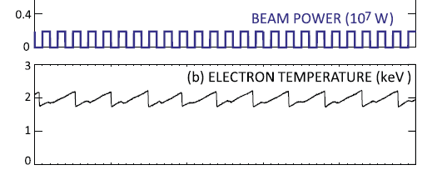
A dedicated study of passive FIDA light was performed on DIII-D
The active beams were always off → no active signal
Other beams were modulated to produce fast ions
Bolte, NF 56 (2016) 112023
Conditionally average the signals on either the beam modulation or the sawteeth

Slide 8
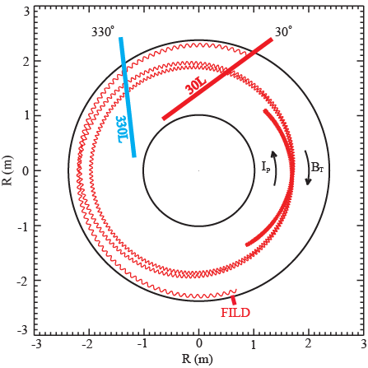
Three distinct fast-ion populations produce the measured signals: First orbit
Plan view of DIII-D
“Light-ion beam probe” technique: arrange conditions so orbit passes close to a loss detector → measure displacement of orbit by instabilities
Orbits that traverse edge produce passive FIDA light
FIDA
TRANSP does not compute this fast-ion population
Xi Chen, Phys. Rev. Lett. 110 (2013) 065004

Slide 9
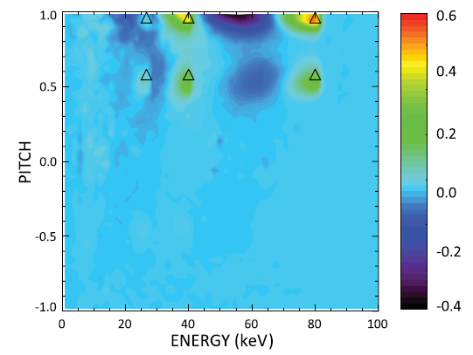
Three distinct fast-ion populations produce the measured signals: Edge axisymmetric
Conditionally averaged modulated distribution function (with average subtracted)
Bolte, NF 56 (2016) 112023

Slide 10
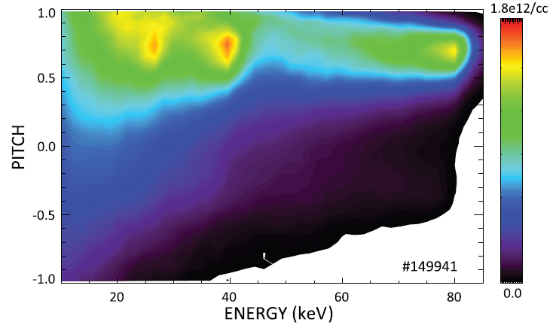
Three distinct fast-ion populations produce the measured signals: Expelled by sawtooth
Use TRANSP sawtooth model to predict # that are expelled
Estimate expected signal using core distribution function
Core fast-ion population prior to sawtooth
Bolte, NF 56 (2016) 112023

Slide 11
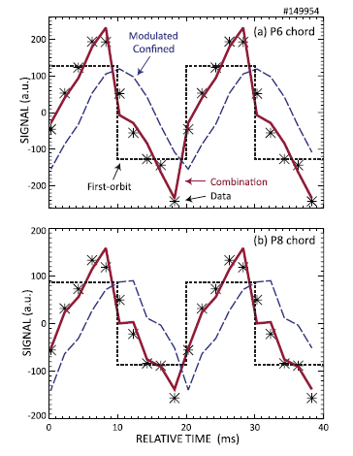
Use TRANSP cold neutrals to estimate passive FIDA signal
Analysis Workflow
Dump distribution function every few ms
Extract 1D neutral profile from TRANSP output
Insert as a cold neutral population into FIDASIM
Conditionally average FIDASIM output
Bolte, NF 56 (2016) 112023

Slide 12
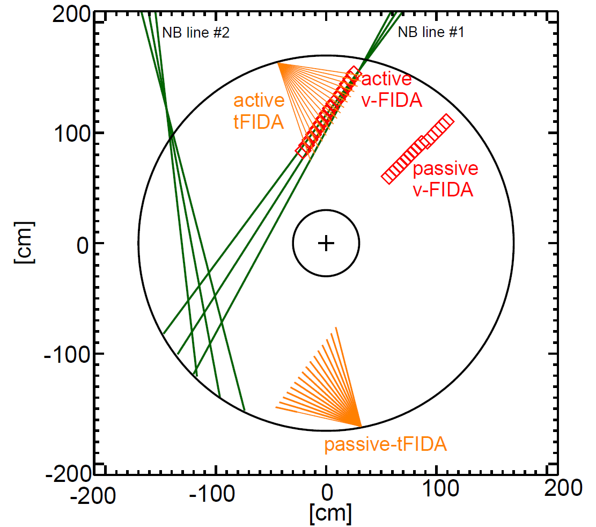
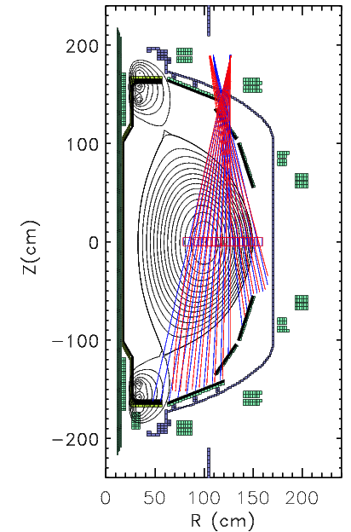
Passive signals are relatively large on NSTX-U
Elevation view of FIDA geometry
Plan view of FIDA geometry
NSTX-U#205080
V-FIDA passive
V-FIDA active
T-FIDA passive
T-FIDA active
Active views of Beamline #1
Large orbit & gyroradius → many ions traverse cold-neutral region

Slide 13
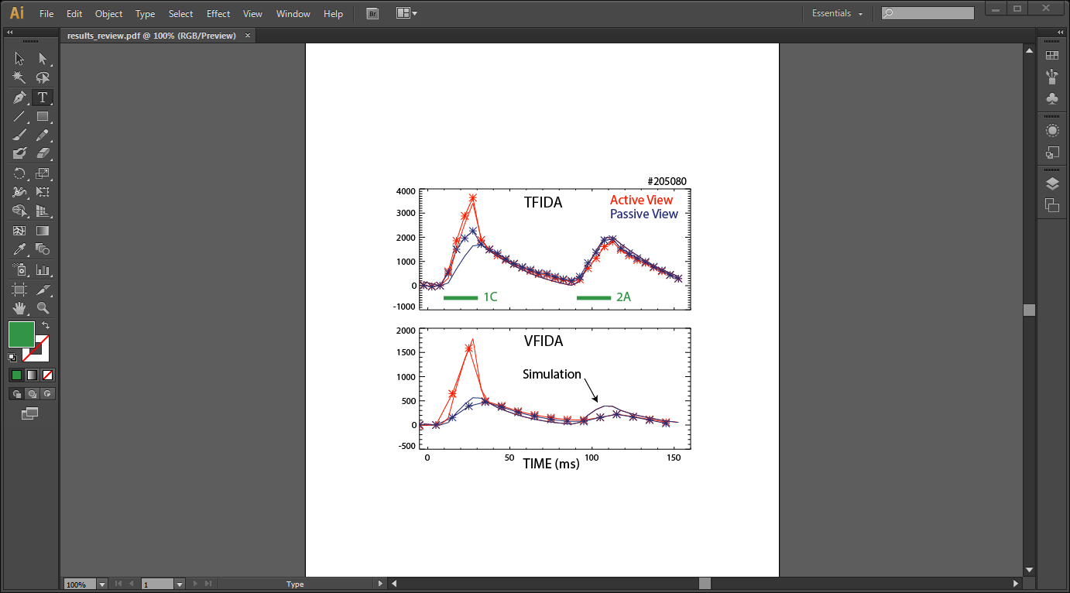
Injected and Edge Neutrals Produce FIDA Signals
Use “passive FIDA” workflow developed for DIII-D
T-FIDA: the active and passive signals are comparable in magnitude.
For geometrical reasons, the passive contribution is smaller on V-FIDA
Note: Not all chords agree this well

Slide 14
Conclusions & Outlook
TRANSP-based workflow works well for modeling active FIDA & NPA data in modulation experiments
Passive signals can be significant
A better neutral density model within TRANSP is desirable
FIDASIM will be modified to include cold neutrals as a standard neutral species

Slide 15
Desired TRANSP Upgrades
2D “cold” neutral density model (? & ?)
Beam deposition outside the Last Closed Flux Surface (Gorelenkova & Van Zeeland)
Fast-ion distribution function in constants-of-motion coordinates, including smooth derivatives (Breslau & Liu)

