Slide 1
Overview of TRANSP use and needs for JET
M. Fitzgerald on behalf of JET TRANSP users. See slides for names of some contributors

Slide 2
Topics
“Bread and butter” interpretive modelling
JET neutron deficit and the resulting NBI benchmarking activity
D-T ad-hoc extrapolation and non DD Gas mixtures
Metallic impurities
Synthetic diagnostics
ICRH synergy
Fast particle distribution function
OMFIT submission system and virtual machine and BEAST plans

Slide 3
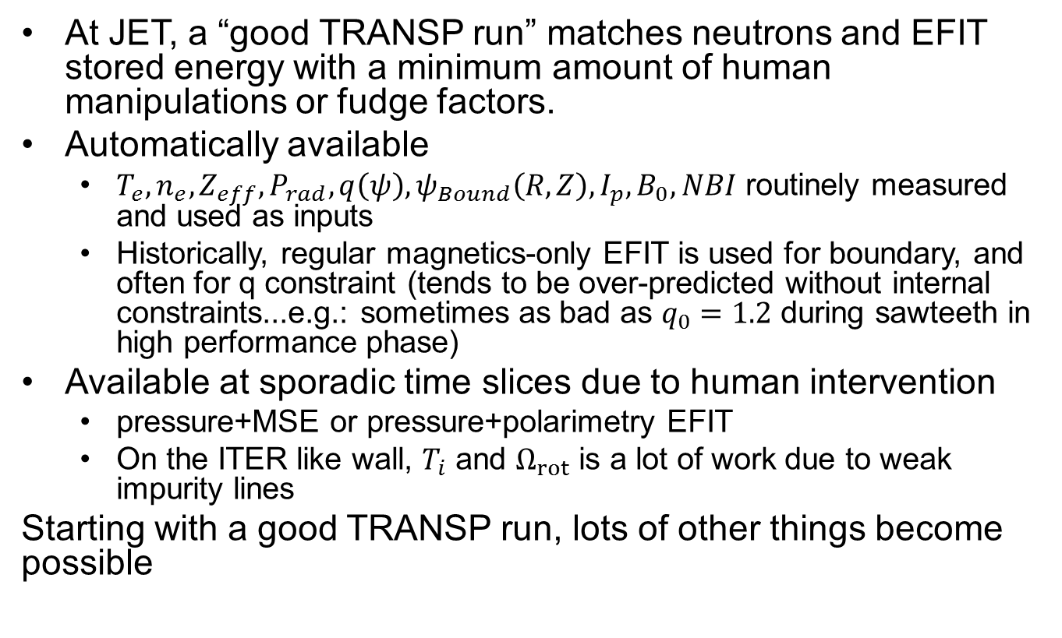
A good TRANSP run at JET
At JET, a “good TRANSP run” matches neutrons and EFIT stored energy with a minimum amount of human manipulations or fudge factors.
Automatically available
  $T_{e}, n_{e},Z_{eff},P_{rad},q\left(ψ\right),ψ_{Bound}\left(R,Z\right), I_{p},B_{0}, NBI$ routinely measured and used as inputs
  Historically, regular magnetics-only EFIT is used for boundary, and often for q constraint (tends to be over-predicted without internal constraints...e.g.: sometimes as bad as $q_{0}=1.2$ during sawteeth in high performance phase)
Available at sporadic time slices due to human intervention
  pressure+MSE or pressure+polarimetry EFIT
  On the ITER like wall, $T_{i}$ and $Ω_{rot}$ is a lot of work due to weak impurity lines
Starting with a good TRANSP run, lots of other things become possible

Slide 4
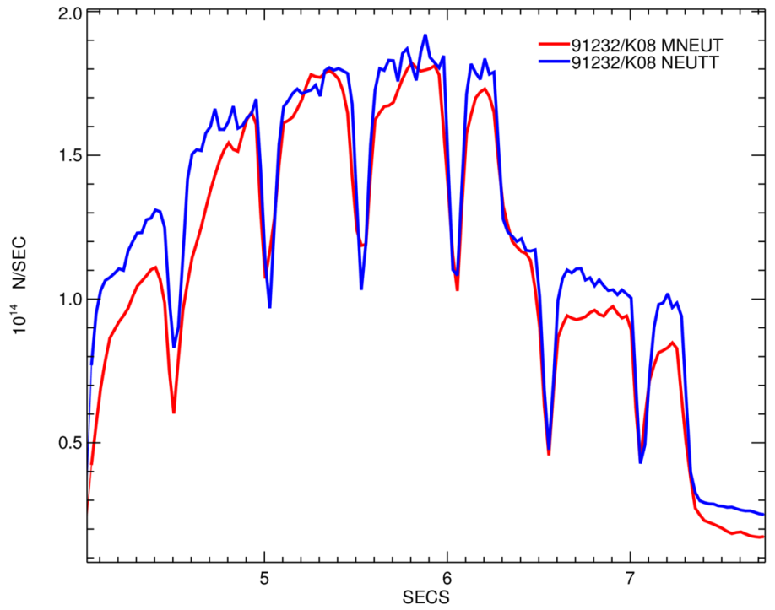

“Bread and butter” interpretive modelling
M Maslov D Keeling et al.
D
H
NEUTRONS
measured vs TRANSP
D/(H+D)=0.18
D/(H+D)=0.15
Transport coefficients
TRANPS run 91232 K08 – good match with measured neutrons, large transport coefficients
D > 2.5*χ_{eff} and V~-3m/s
In all TRANSP runs Be impurity is present, with flat Zeff profile. Zeff is measured but very small in these pulses, ~1.05
D, m²/s
χ_{eff}, m²/s
V, m/s

Slide 5
D-T ad-hoc extrapolation
TRANSP is the key tool for extrapolating JET experiments to D-T scenarios. This is because of TRANSPs high standing and long history at calculating fusion rates and products.
The ad-hoc D-T extrapolation procedure
Begin with a good DD TRANSP run
Convert plasma and beams to DT
Scale up beam power to full DT level
Use appropriate scaling laws to increase Ip, Bt, Te, Ti, Ne.
M.Fitzgerald| TUG 2017| PPPL| Thursday May 4th 2017| Page 5

Slide 6
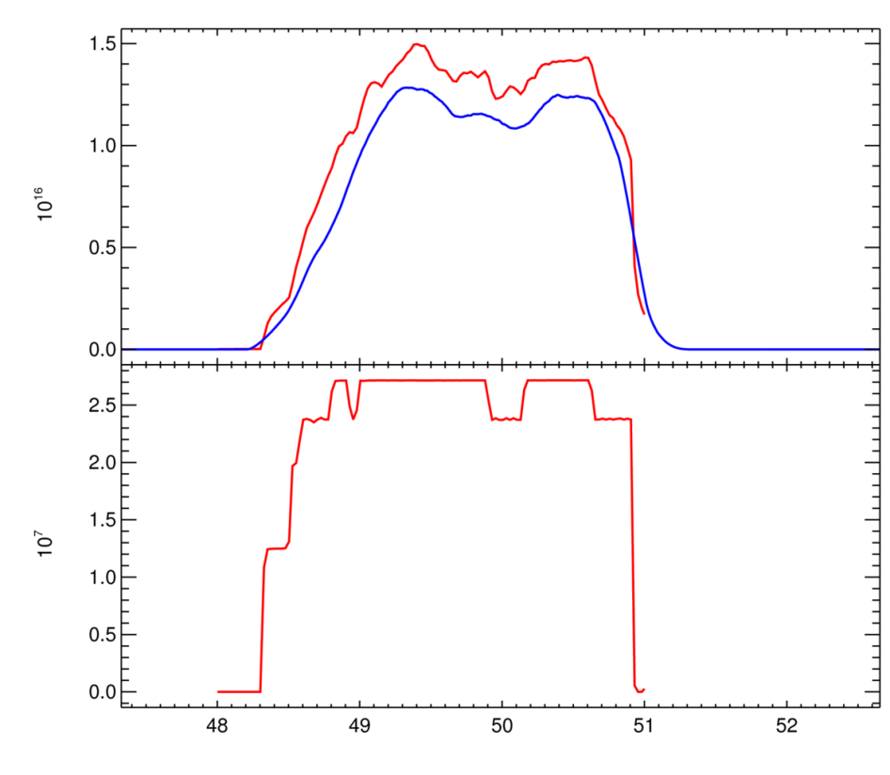
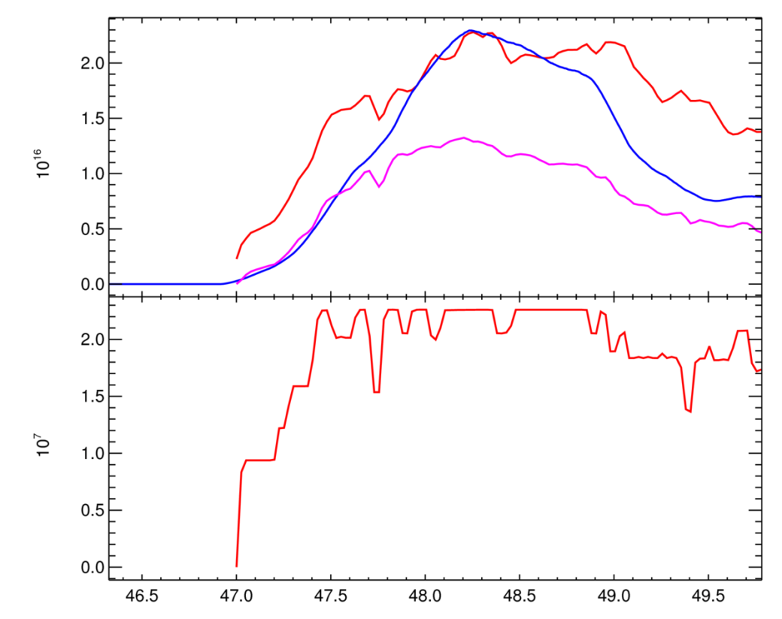
DD Interpretive runs
Begin with interpretive DD runs to ensure neutron prediction for pulse is reasonable.
Baseline #87412 (3.5MA/3.2T t=10.4s)
Hybrid #86614 (2.5MA/2.9T t=8.2s)
D01 Ti=Te
D17 Ti CX
measured
neutrons(x10¹⁶/s)
neutrons(x10¹⁶/s)
measured
D08 Ti=Te
PNBI (x10MW)
PNBI (x10MW)
M.Fitzgerald| TUG 2017| PPPL| Thursday May 4th 2017| Page 6

Slide 7
Getting a 50:50 DT gas mixture for extrapolation and other gas issues
Need
A switch that takes DD and makes DT assuming no change in confinement
Often when a mixture of gases is used for JET TRANSP runs, the user wishes to specify the concentration directly rather than solve fuelling equations using sources or have consistency. This is because concentration at JET is controlled by a number of factors, which are all fiddled in the control room until the desired concentration is measured.
Here is how it is currently fudged for ad-hoc DT extrapolation:
APLASM=2.0,3.0
BACKZ= 1.0,1.0
NG=2
FRAC =0.5,0.5
GFRAC=0.5,0.5
RFRAC=0.5,0.5
NGMAX=2
PREGAS='GDK'
EXTGAS='MAJR_0171 UFL:1:dking:0171:$TDD:
DIFFUS=1.5E+5
DFIMAX=2.0E+5
Need
DD TRANSP runs are well understood and trusted, but mixed H-D or T plasma are also important for some campaigns and these are less well understood/trusted at JET
Are the T-T cross-sections most up to date?
When modelling ICRH with a hydrogen minority, what happens when the minority is scanned to a high value? Hydrogen can’t be both minority and bulk species
M.Fitzgerald| TUG 2017| PPPL| Thursday May 4th 2017| Page 7

Slide 8
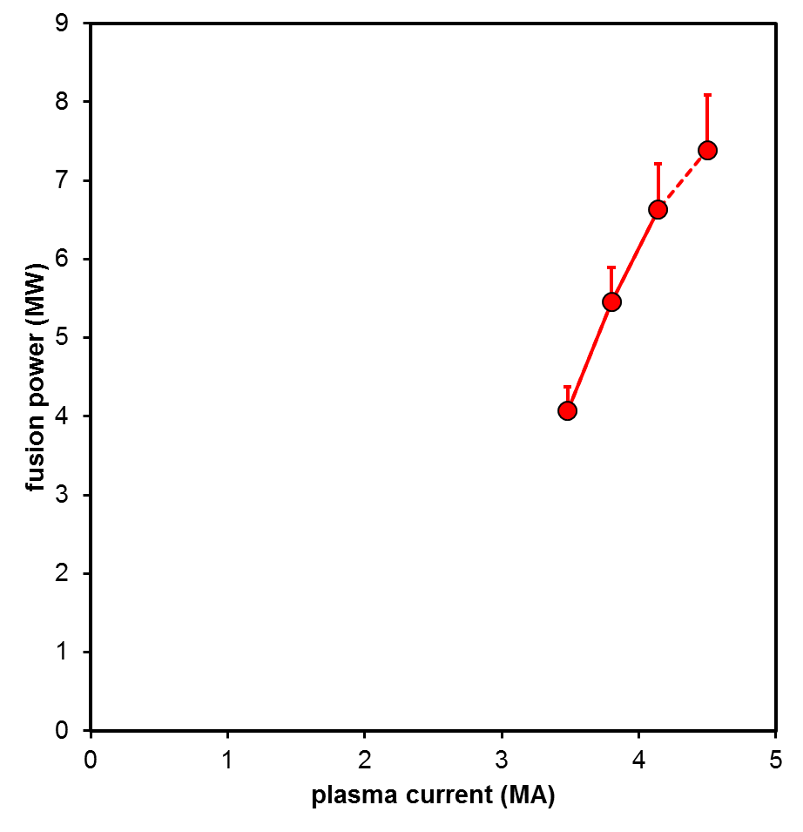
Scaling Laws - Baseline
Assumed parameter limits:
• IP,max=4.5MA
• Bmax=3.83T
• PNBI,max=34MW
Set in TRANSP using SC_NER etc.
Assumptions for projection:
• Temperature & density profile shapes constant
• n/nGreenwald=constant
• H₉₈=constant
• q₉₅ constant unless B limit reached
• BetaN constant unless power limit reached
• PRF/PNBI=constant
• No credit for alpha-heating or isotope effects
Baseline projection (assuming Ti=Te)
max B
achieved plasma parameters
symbol: no isotope scaling
error-bar: IPB98(y,2) isotope scaling
M.Fitzgerald| TUG 2017| PPPL| Thursday May 4th 2017| Page 8

Slide 9
D-T results with TRANSP are important to planning future D-T campaigns
Henri Weisen
Pulse # Transp ID | type | Paux (MW) | IP (MA) | BT (T) | Te(0) (keV) | NeL 10¹⁹m⁻² | P_{α} (MW) | P_{α} simple (100*R_{n}*3.5MeV*e ) | q_{e,α}/q_{e,NBI} ρ_{tor}≤0.3 | β_{α}/β_{NBI} ρ_{tor}≤0.3
90188 Q14 | AT-like | 21 | 2.5 | 3.4 | 7 | 9.7 | 0.41 | 0.5 | 0.35 | 0.1
92395 D10 | Hybrid | 31.5 | 2.2 | 2.76 | 8 | 13.3 | 1.15 | 1.44 | 0.32 | 0.12
92436 D09 | baseline | 32.7 | 3.0 | 2.77 | 6.3 | 18 | 1.11 | 1.31 | 0.75 | 0.25
42856 Budny NF 2016 | DT hot ion* | 10.4 | 3.5 | 3.5 | 11 | 11 | ~1.1 | 1.24 | ~1 | 0.33

Slide 10
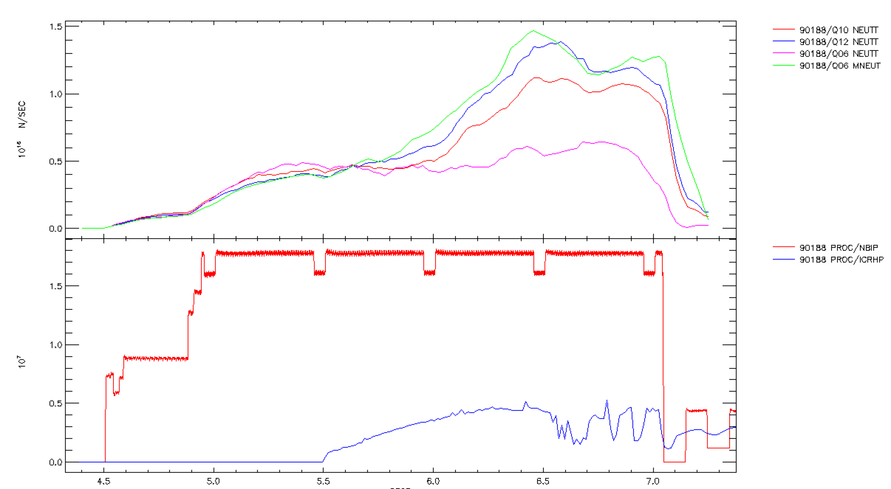
Metallic impurities
MEASURED
NBI+ICRH+KICK
BEAM ONLY METALLIC
BEAM ONLY Be
Need: Details of impurity radiation model in
TRANSP

Slide 11
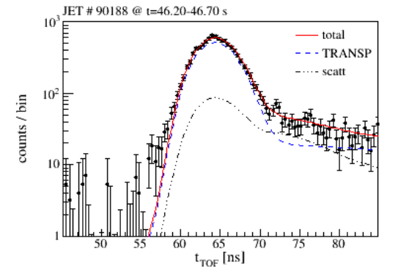
Use of TORIC and the kick operator
J. Eriksson M. Fitzgerald
Y. Baranov
Unphysical cut-off issue
Jetto-Pion, Pnb-exp~27MW, Prf-exp~5MW. (sn401)
Transp, Pnb-exp~27MW, Prf-exp.~5MW (C37 ),
3) Transp, Pnb-exp~27MW, Prf~50kW, (C37 )
Jetto-Pion, Pnb-exp~27MW, Prf-~50kW. (sn402)
Jetto-Pecil, Pnb-exp~27MW
TIN/RNT –exp.
Jetto-Ascot Pnb-exp~27MW
A big short-coming in using TRANSP for DT extrapolations is the lack of experience/trust of TRANSP TORIC among experienced TRANSP users.
Need:
Clear established recipes on how to use TORIC at JET and benchmarking with ICRH codes

Slide 12
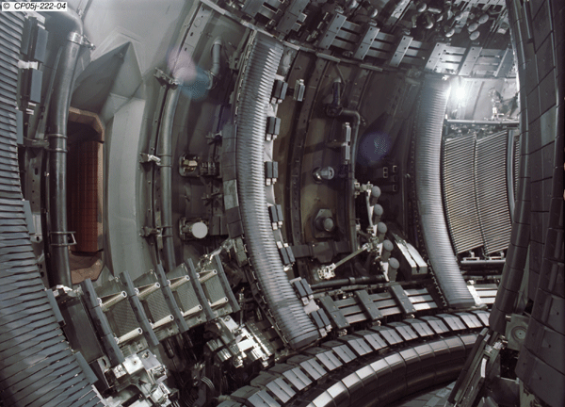
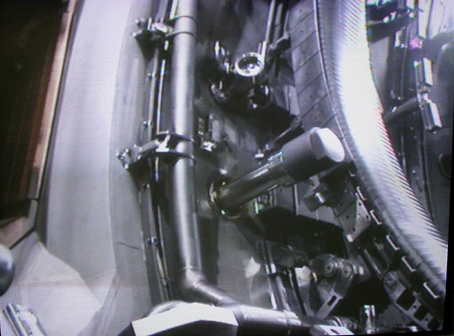
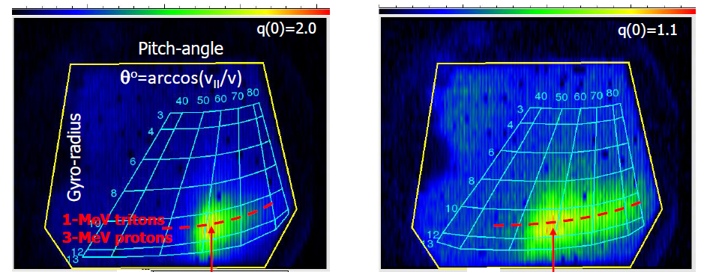
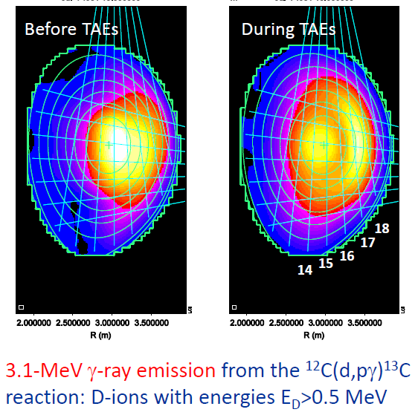
Synthetic diagnostics for fast ions
V. Kiptily
Faraday Cups (KA2)
FILD (KA3)
Neutron &
Gamma Cameras
Darrow D. et al RSI 75 (2004) 3566
Darrow D. et al. RSI 77 (2006) 10E701
Neutron
spectrometer
Neutron spectrometers (V & H)
Gamma spectrometers (V & H)
Neutron camera
Gamma camera (V & H)
NPAs (V & H)
Faraday Cups (5 poloidal & 3 radial )
FILD (E & θ)
Gammas
Gammas
  NEED: Collimated neutron predictions are routinely used by a wide audience. Can we work together on other diagnostics?

Slide 13
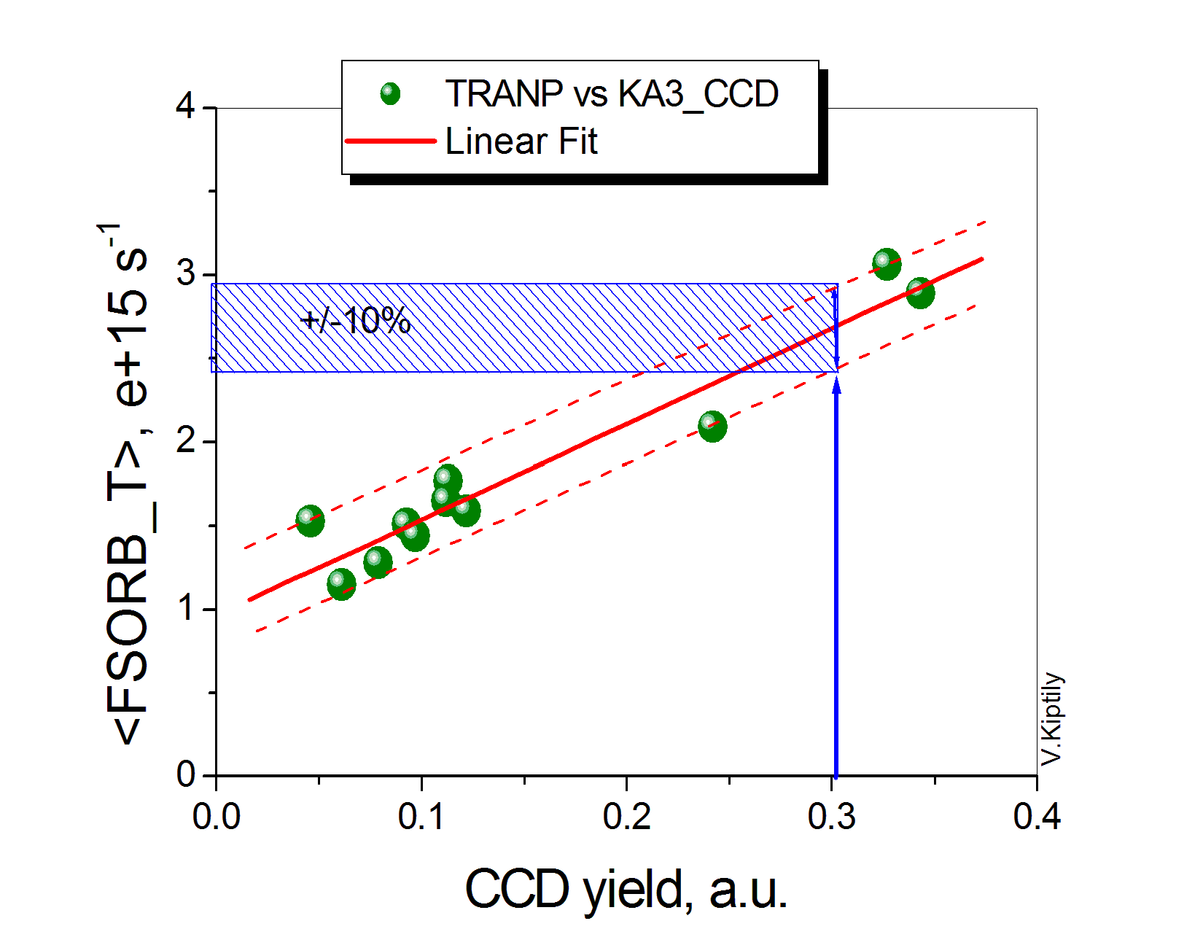
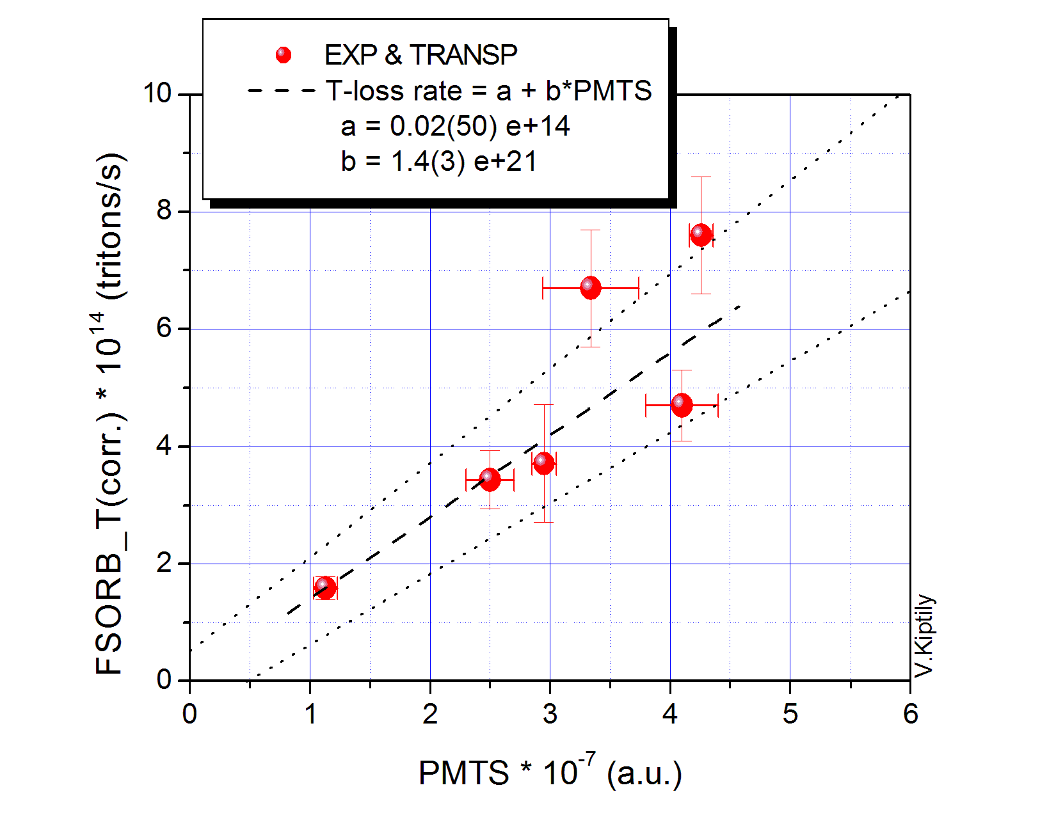
Scintillator fusion product loss calibration against TRANSP
V. Kiptily and M. Fitzgerald
2009, C-JET
2017, ILW-JET
The KA3-CCD data did not corrected on the dark current
TRANSP data corrected to experimental neutron rate, RNT
The KA3-PMT data corrected on the dark current
TRANSP data corrected to experimental neutron rate, RNT

Slide 14
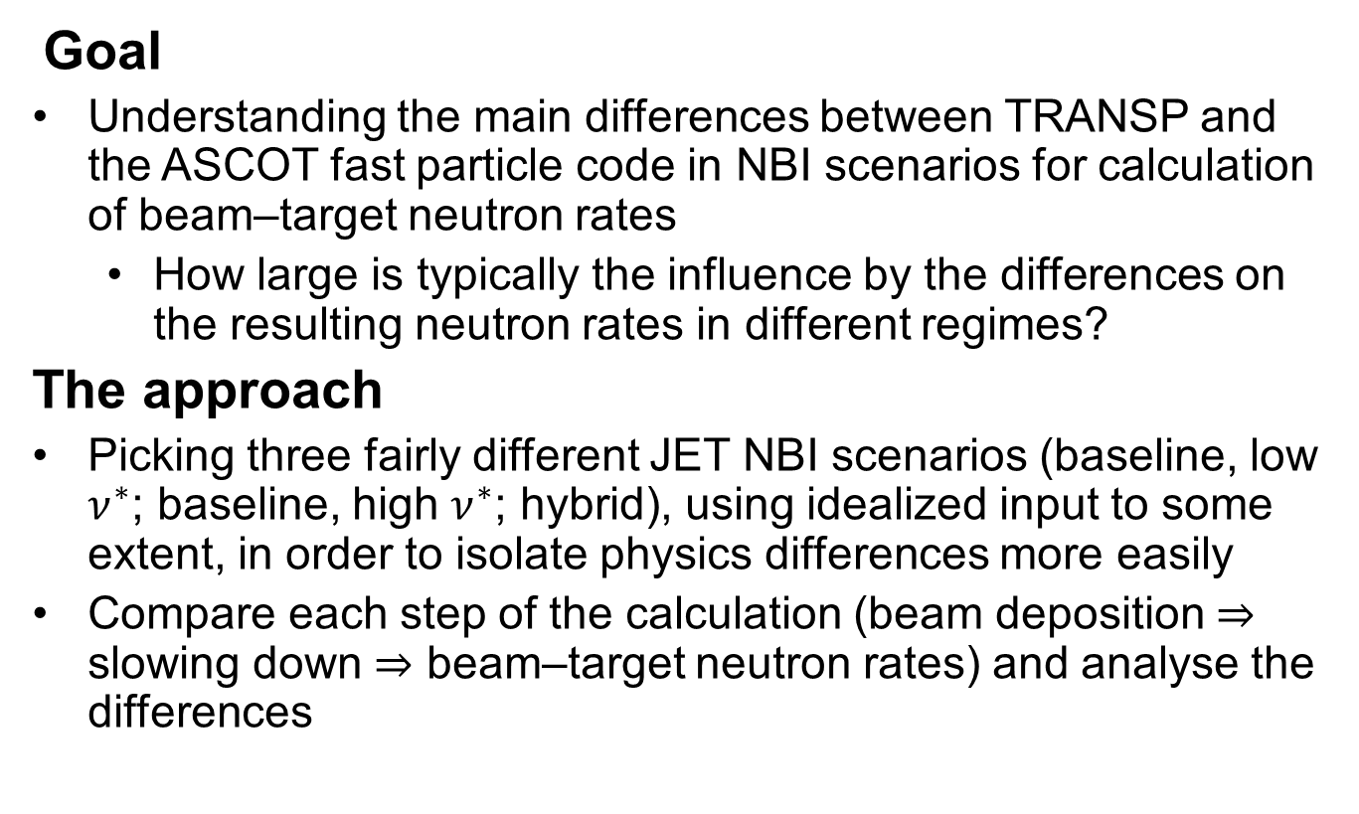
TRANSP/ASCOT benchmark of neutron rate calculation
E. Tholerus and H.-T. Kim
Goal
Understanding the main differences between TRANSP and the ASCOT fast particle code in NBI scenarios for calculation of beam‒target neutron rates
  How large is typically the influence by the differences on the resulting neutron rates in different regimes?
The approach
Picking three fairly different JET NBI scenarios (baseline, low $ν^{∗}$; baseline, high $ν^{∗}$; hybrid), using idealized input to some extent, in order to isolate physics differences more easily
Compare each step of the calculation (beam deposition $⇒$ slowing down $⇒$ beam‒target neutron rates) and analyse the differences

Slide 15
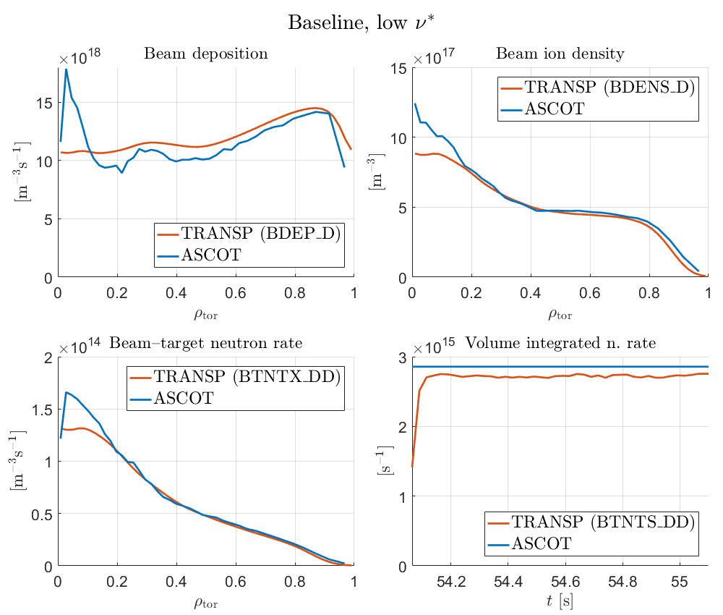
TRANSP/ASCOT benchmark of neutron rate calculation
E. Tholerus and H.-T. Kim
The “neutron deficit” issue on JET is forcing us to look carefully again at the physics model in the beam in NUBEAM and to benchmark.
We would like to go beyond default TRANSP settings to get a better understanding of the differences between the codes. For instance:
ASCOT does not (yet) include charge exchange between fast ions and thermal neutrals.
Need: Can various physics contributions such as charge exchange be individually disabled in TRANSP for benchmarking with other codes?

Slide 16
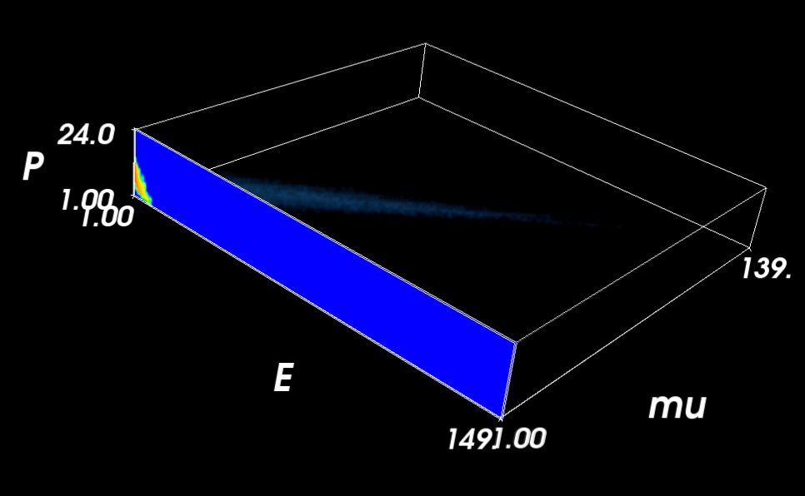
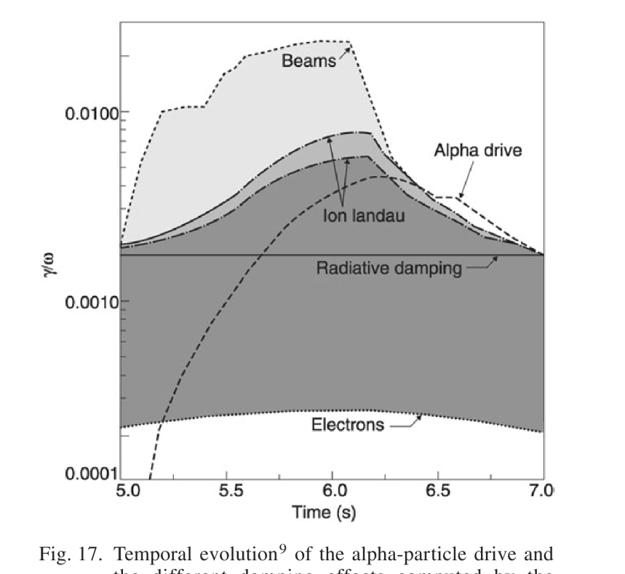
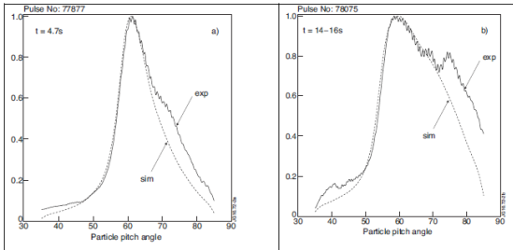
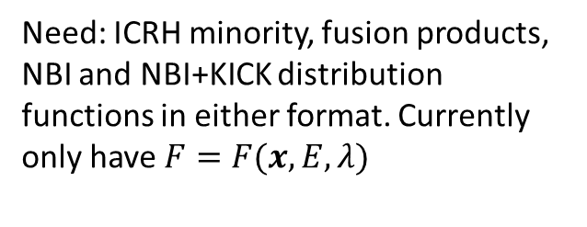


Fast ion distribution
Theory and stability workflows use invariants of motion
T. Jonsson and M.Fitzgerald
$$F=F\left(E,μ,P_{φ};σ=sgn\left(v_{∥}\right)\right)$$
ICRH from SELFO
S. Sharapov
Experimentalists often use
$$F=F(x,E,λ)$$
Need: ICRH minority, fusion products, NBI and NBI+KICK distribution functions in either format. Currently only have $F=F(x,E,λ)$
Y.Baranov

Slide 17
OMFIT submission system and virtual machine
J. Buchanan and M. Fitzgerald
Also has functionality for fitting / plotting.
NTCC Tr_Client
OMFIT
Provide high level API for handling GUI interface / file parsing / conversions etc.
Contains minimal required TRANSP scripts : scrunch2, tr_start, tr_send etc.
globus
TRANSP @ PPPL
VM (dev/backup/intershot)
Need: up-to-date and tested (offsite!) globus functionality
JET Data storage

Slide 18
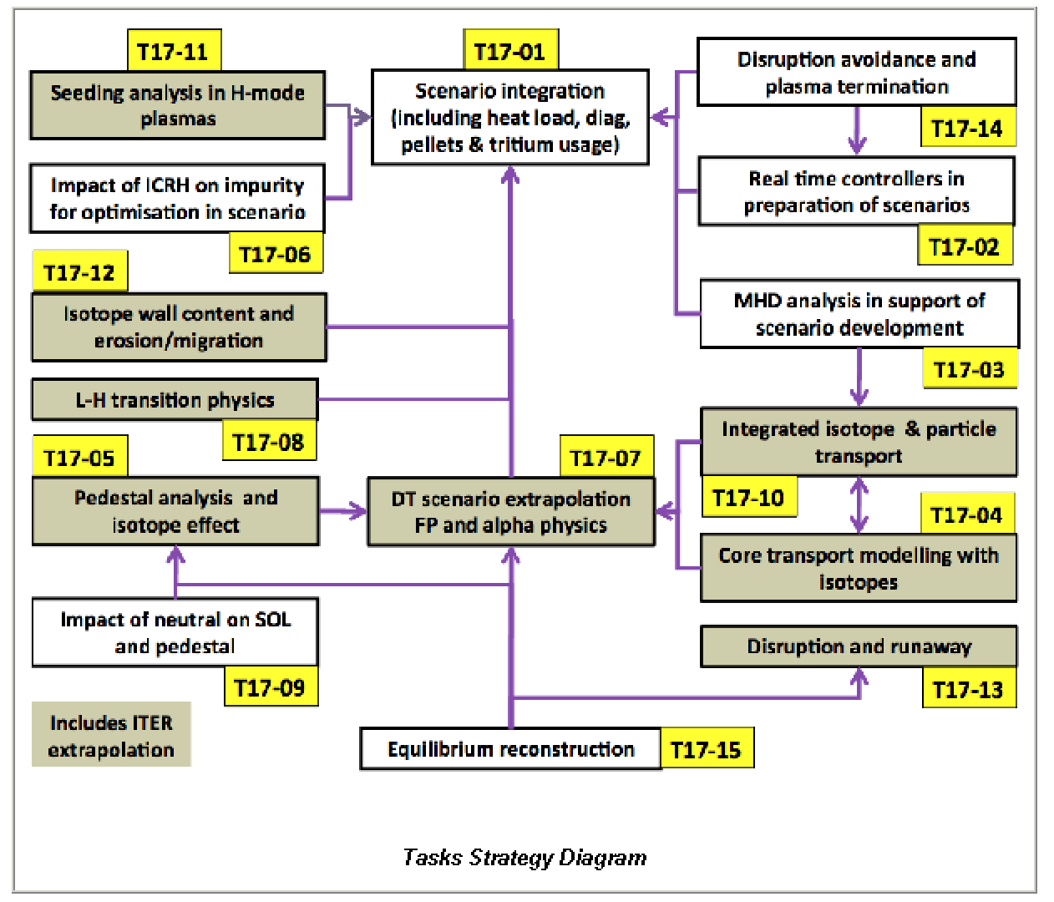
Summary JET needs and areas for collaboration
  ICRH model with kick operator (T17-07)
  Establish the correct numerical recipe for routine JET usage
  Explain/remove differences with other ICRH codes e.g.: PION
  Non D-D bulk plasma mixtures and tritium readiness (T17-07)
  Are the T-T cross-sections up to date?
  Total control of bulk plasma concentration: e.g.: a switch that takes DD and makes 50:50 DT assuming no change in confinement. Don’t care about modelling fuelling!
  When modelling ICRH with a hydrogen minority, what happens when the minority is scanned to a high value? Do the equations solved change?
Intershot and BEAST
Synthetic diagnostics (T17-01)
  Metallic impurities. Is TRANSP predicting the radiation and what is the model?
NBI benchmark calculations and neutron deficit (T17-07)
Fast distribution function (T17-07)

