Slide 1
Theory and Modeling Needs For Improved Kinetic Treatments of High-Beta Pressure Limits
J. Menard, Z. Wang, Y. Liu (CCFE), J-K Park
Theory and Simulation of Disruptions Workshop
Princeton Plasma Physics Laboratory
Princeton, New Jersey
July 13-15, 2015

Slide 2
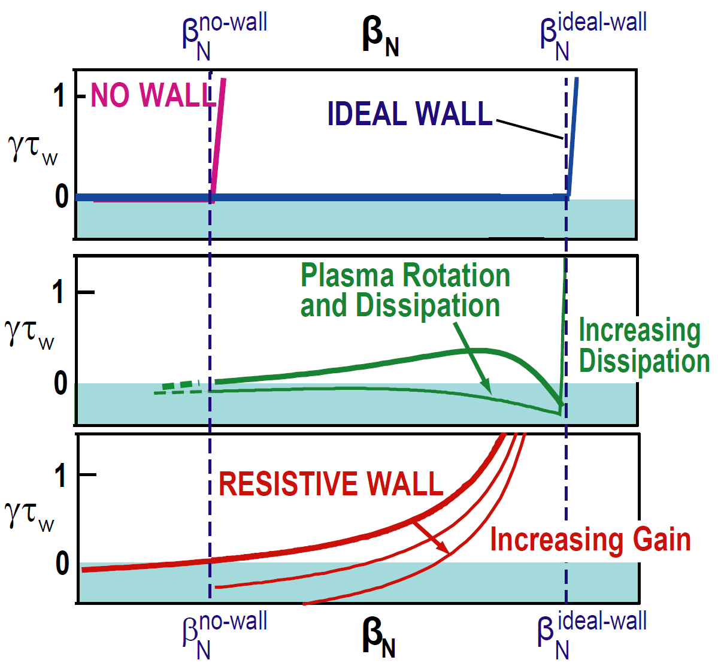
Pressure-driven kink / tearing are strong physics constraints on maximum fusion performance
P_{fusion} ∝ n²⟨σv⟩ ∝ p² ∝ β_{T}² B_{T}⁴ ∝ β_{N}⁴ B_{T}⁴ (1+κ²)² / A f_{BS}²
Modes grow rapidly above kink limit:
  γ ~ 1-10% of τ_{A}⁻¹ where τ_{A} ~ 1μs
Superconducting “ideal wall” can increase stable β_{N} up to factor of 2
Real wall resistive → slow-growing “resistive wall mode” (RWM)
  γ τ_{wall} ~ 1 →
  ms instead of μs time-scales
RWM can be stabilized with:
  kinetic effects (rotation, dissipation)
  active feedback control
M. Chu, et al., Plasma Phys. Control. Fusion 52 (2010) 123001
Here we focus on ideal-wall mode (IWM) and TM triggering

Slide 3
Background
Characteristic growth rates, frequencies of RWM and IWM
  RWM: γτ_{wall} ~ 1 and ωτ_{wall} < 1
  IWM: γτ_{A} ~ 1-10% (γτ_{wall} >> 1) and ωτ_{A} ~ Ω_{φ}τ_{A} (1-30%) (ωτ_{wall} >> 1)
Kinetic effects important for RWM
  Publications: Berkery, et al. PRL 104 (2010) 035003, Sabbagh, et al., NF 50 (2010) 025020, etc…
Rotation + kinetic effects beginning to be explored for IWM
  Such effects generally higher-order than fluid terms (∇p, J||, |δB|², wall)
Calculations for NSTX indicate both rotation and kinetic effects can modify IWM limits and tearing triggering
  High toroidal rotation generated by co-injected NBI in NSTX
    Fast core rotation: Ω_{φ} / ω_{sound} up to ~1, Ω_{φ} / ω_{Alfven} ~ up to 0.1-0.3
  Fluid/kinetic pressure is dominant instability drive in high-β ST plasmas

Slide 4


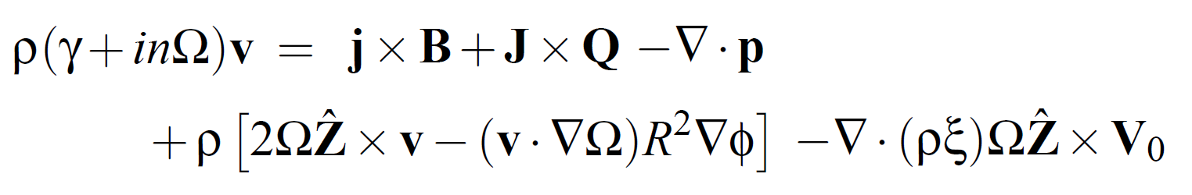
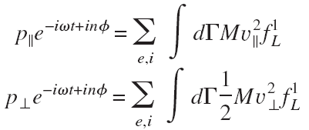
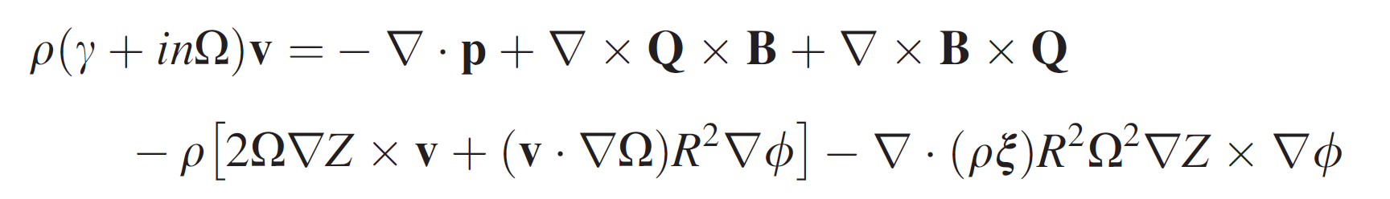

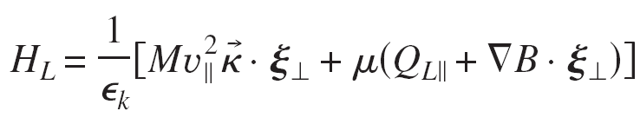
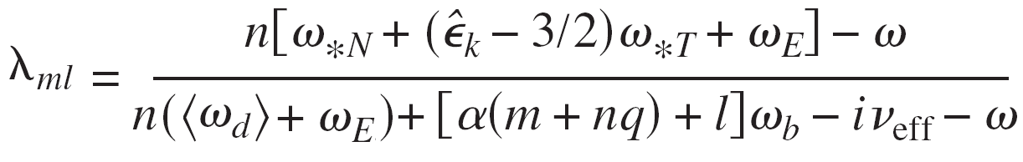
MARS-K: self-consistent linear resistive MHD including toroidal rotation and drift-kinetic effects
Perturbed single-fluid linear MHD:
Y.Q. Liu, et al., Phys. Plasmas 15, 112503 2008
Drift-kinetic effects in perturbed anisotropic pressure p:
Rotation and rotation shear effects:
Diamagnetic
Mode-particle resonance operator:
Precession
ExB
Transit and bounce
Collisions
Fast ions: analytic slowing-down f(v) model – isotropic or anisotropic
Include toroidal flow only: v_{φ} = RΩ_{φ}(ψ) and ω_{E} = ω_{E}(ψ)
This work

Slide 5
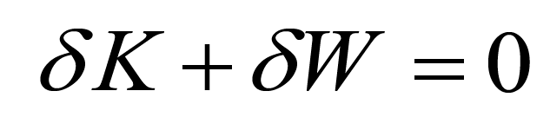
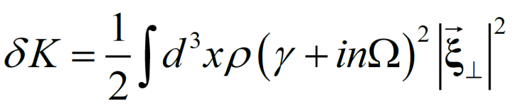
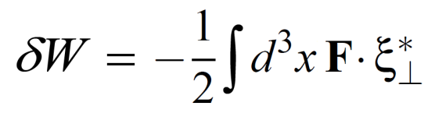
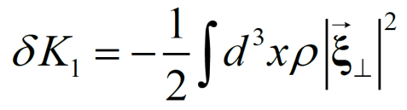
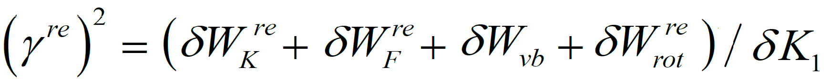
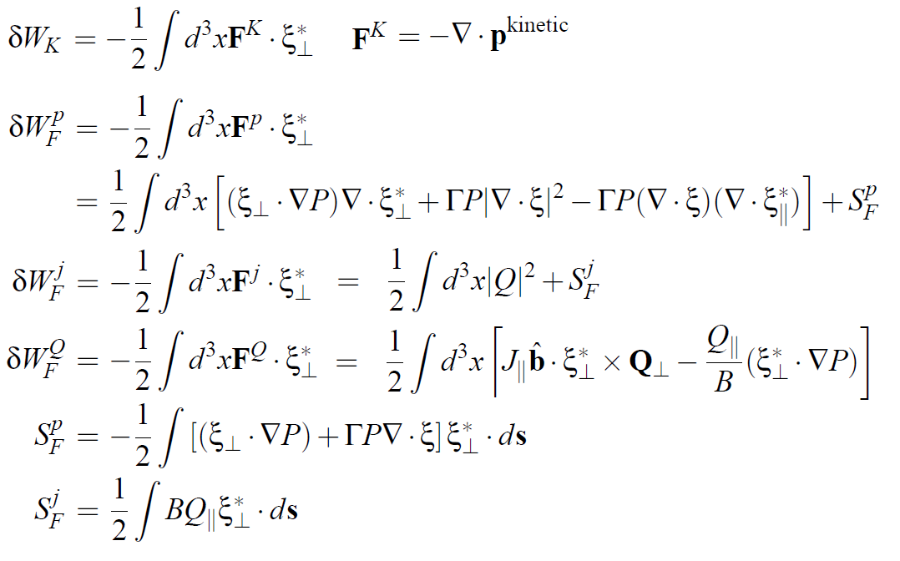
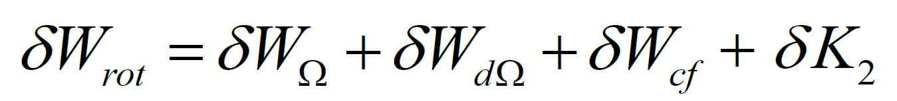
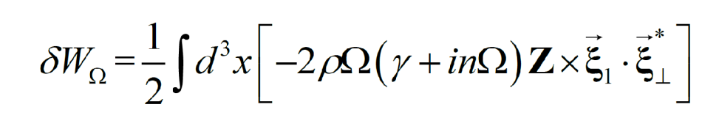
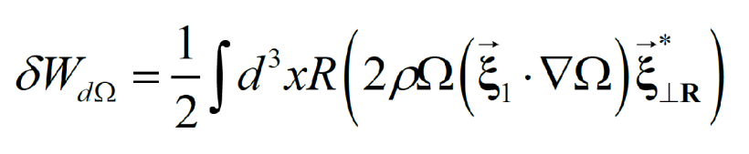
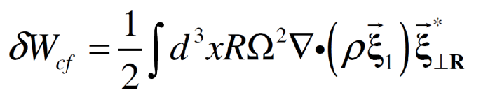
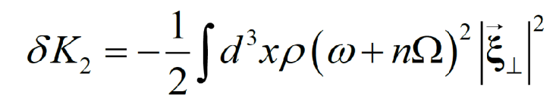
Real part of complex energy functional provides equation for growth-rate useful for understanding instability sources
Dispersion relation
Kinetic energy
Potential energy
Growth rate equation: mode growth for δW^{re} < 0
Coriolis - Ω
Coriolis - dΩ/dρ
Centrifugal
Differential kinetic
Note: n = -1 in MARS

Slide 6
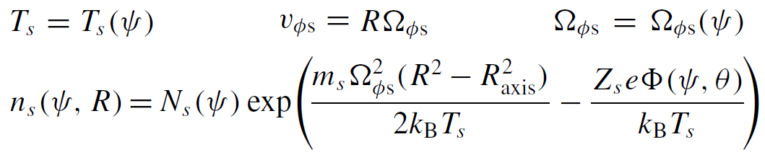
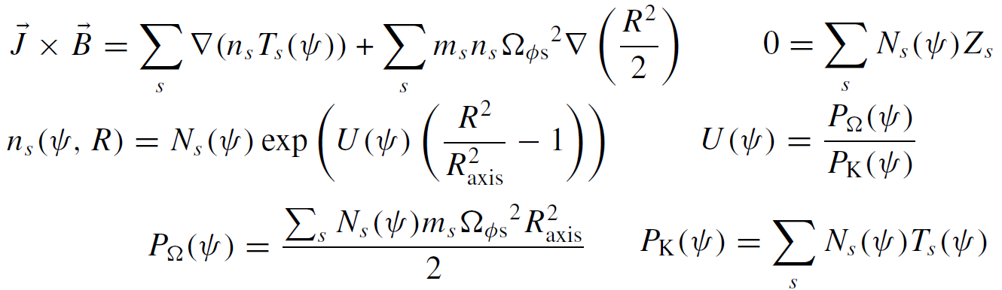
Equilibrium force balance model including toroidal rotation
Force balance for species s:
Assume:
B• above →
Exact multi-species solution requires iteration to enforce quasi-neutrality → simplify → intrinsically quasi-neutral if all n_{s} have same exponential dependence.
This approximate solution assumes main ions dominate centrifugal potential.

Slide 7
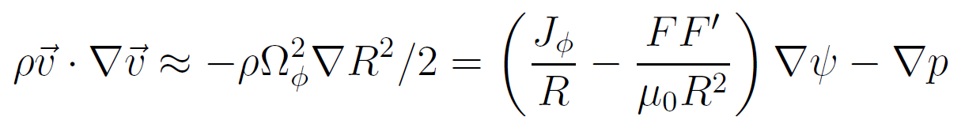

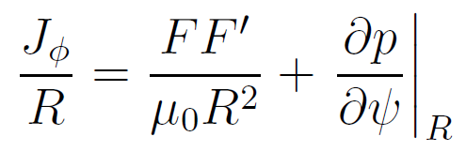
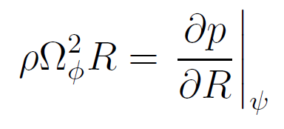
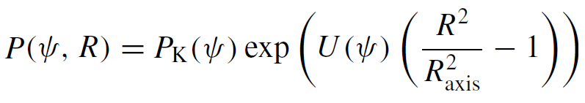

Grad-Shafranov Equation (GSE) including toroidal rotation
Total force balance:
Rotation-modified GSE:
LRDFIT reconstructions with rotation determine 3 flux functions:
U(ψ) - based on fitting electron density profile asymmetry (not C⁶⁺ rotation data)
P_{K}(ψ) and FF’(ψ) – full kinetic reconstruction → fit to magnetics, iso-T_{e}, MSE with E_{r} corrections, thermal pressure between r/a = 0.6-1.

Slide 8
Study 2 classes of IWM-unstable plasmas spanning low to high β_{N}
Low β_{N} limit ~3.5, often saturated/long-lived mode
  q_{min} ~ 2-3
  Common in early phase of current flat-top
  Higher fraction of beam pressure, momentum (lower n_{e})
Intermediate β_{N} limit ~ 5
  q_{min} ~1.2-1.5
  Typical good-performance H-mode, H₉₈ ~ 0.8-1.2

Slide 9
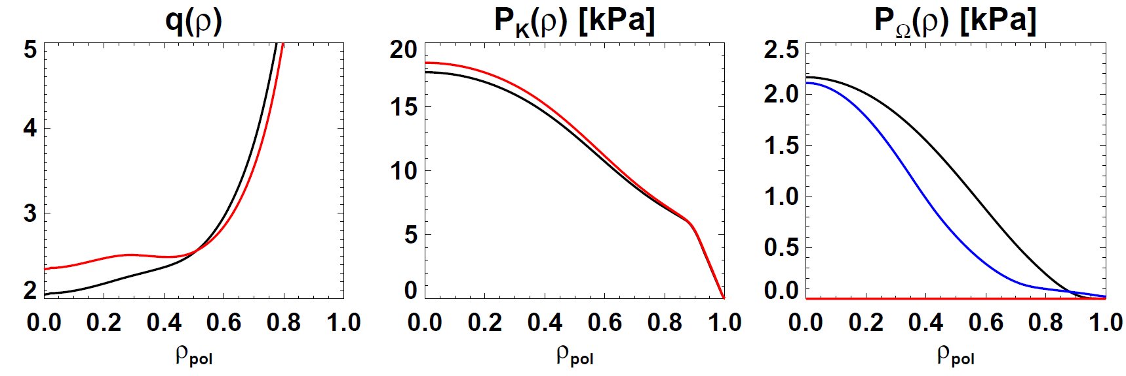
Impact of including rotation on q, P_{K}, P_{Ω}
Black – rotation included (from fit to n_{e} profile asymmetry)
Red – rotation set to 0 in reconstruction
138065, t=0.374s
LRDFIT15
Reconstructed core q(ρ) lower with rotation included
Reconstructed core P_{K}(ρ) slightly lower w/ rotation included
Reconstructed core P_{Ω}(ρ) comparable to measured thermal ion rotation pressure (they should be similar)

Slide 10
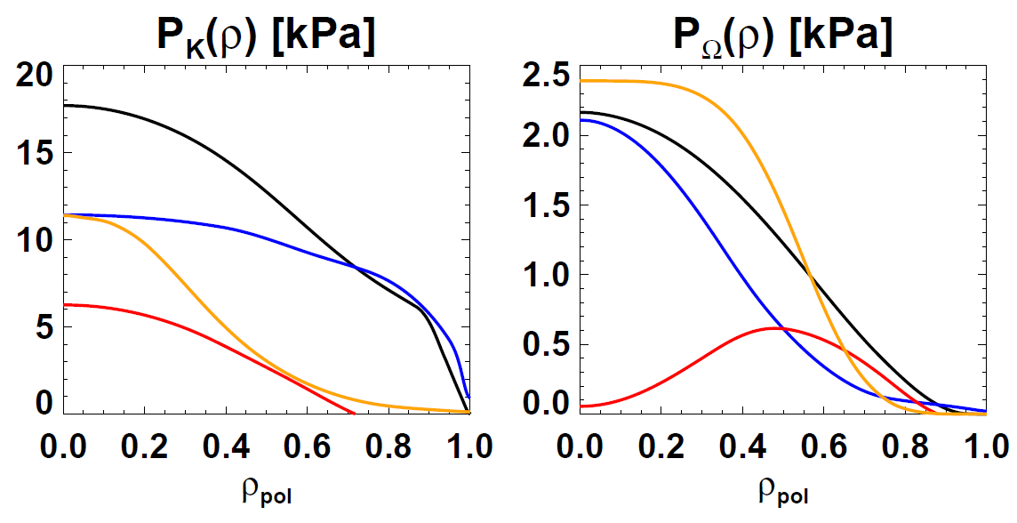
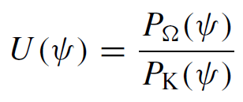
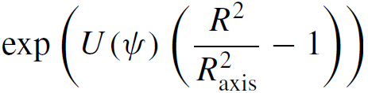
Reconstructions imply significant fast-ion profile broadening
Black: reconstruction with rotation included (n_{e} asymmetry)
Blue: measured thermal
Red: recons. minus thermal, Orange: TRANSP (no FI diffusion)
NOTE: there is substantial uncertainty in P_{Ω} near the magnetic axis since U is indeterminate there, i.e. U could be much larger or smaller w/o impacting the density asymmetry fit
Reconstructed core fast ion P_{K}(ρ) significantly lower than TRANSP calculation
Reconstructed fast ion P_{Ω}(ρ) significantly broader, lower than TRANSP calculation

Slide 11
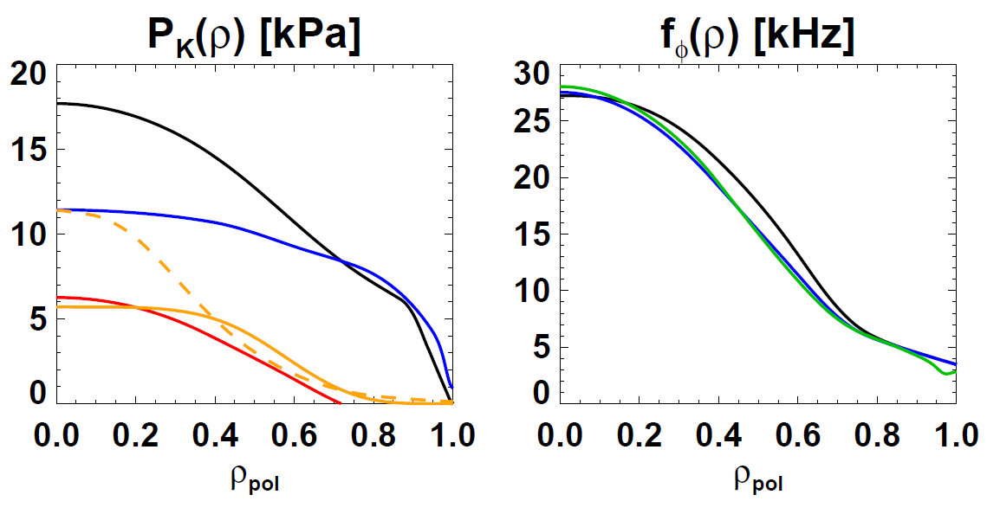
Profiles after fast-ion density profile broadening
Black: reconstruction with rotation included (n_{e} asymmetry)
Blue: measured thermal, Red: recons. minus thermal
Orange: TRANSP with FI density profile broadening (post-facto)
Because fast ion density is low, the impact of fast-ions on total toroidal rotation f_{φ} is weaker than impact on P_{Ω}
Implication: fast-ion redistribution or loss likely more important for pressure than rotation
Dash → Solid = fast-ion density broadening: conserve FI stored energy, number, also T_{fast} (ρ)
f_{φ}(r) including fast ions is broader than f_{φ−Carbon}(ρ) & f_{ExB}
MARS-K uses P_{K}, f_{φ} , f_{ExB}

Slide 12
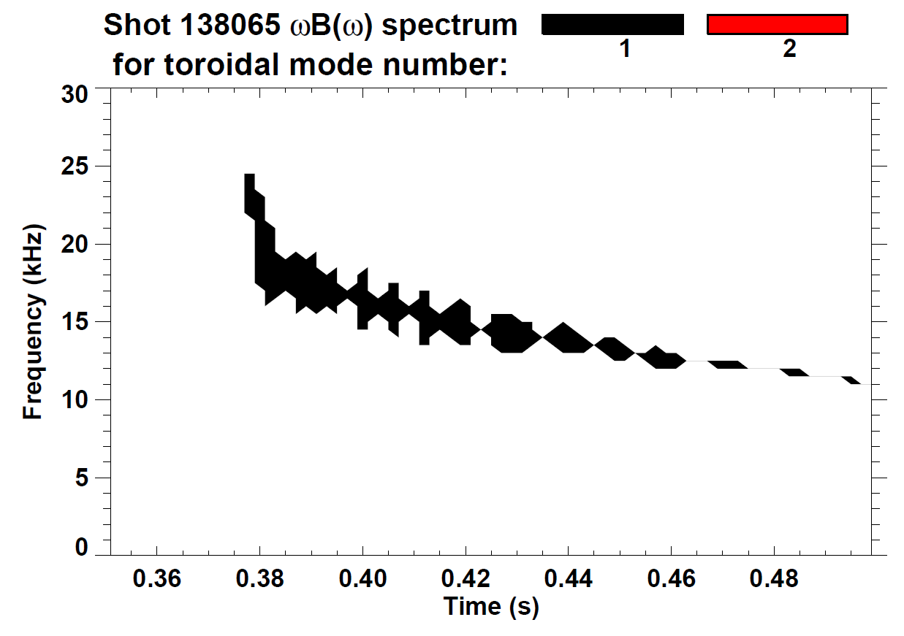
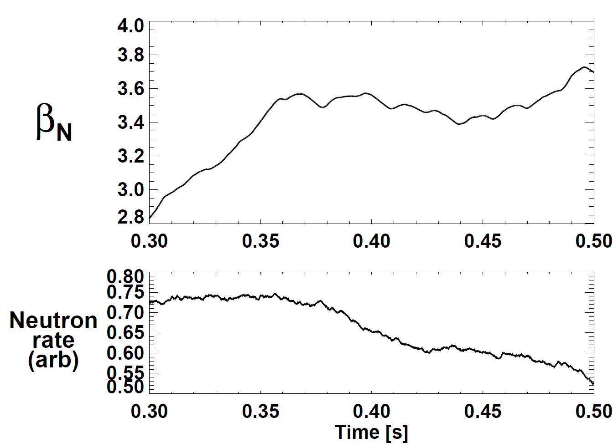
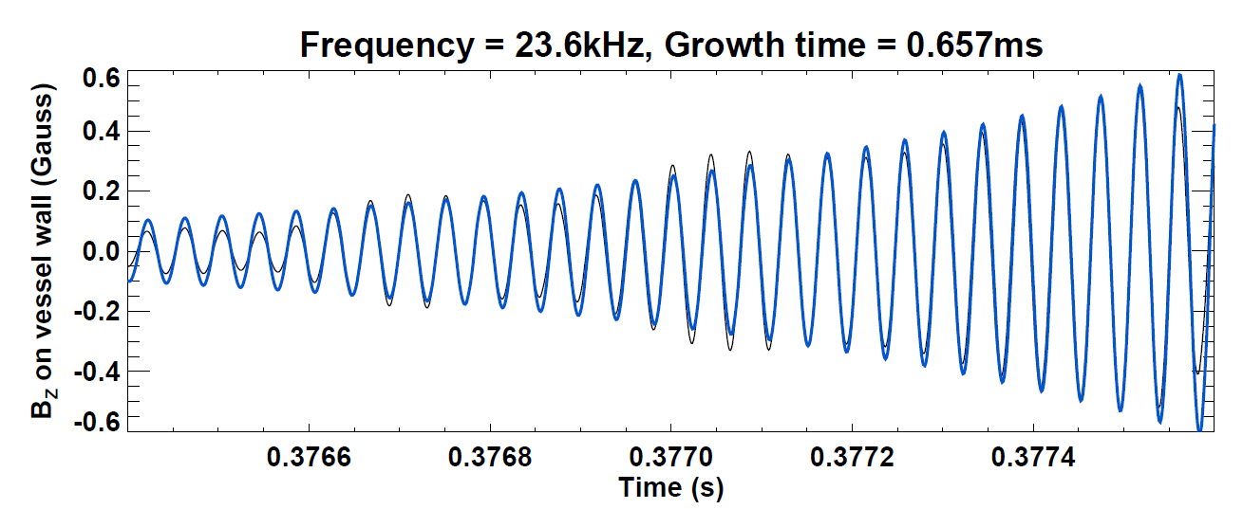
Low β_{N} limit ~ 3.5: Saturated f=15-30kHz n=1 mode common during early I_{P} flat-top phase
Fixed P_{NBI} = 3MW, I_{P} = 800kA, β_{T}=10-15%
n=1
n=2
NSTX shot 138065
γ_{eff} τ_{A} ~ 1×10⁻³
Mode clamps β_{N} to ~3.5, reduces neutron rate ~20%
sometimes slows → locks → disrupts

Slide 13
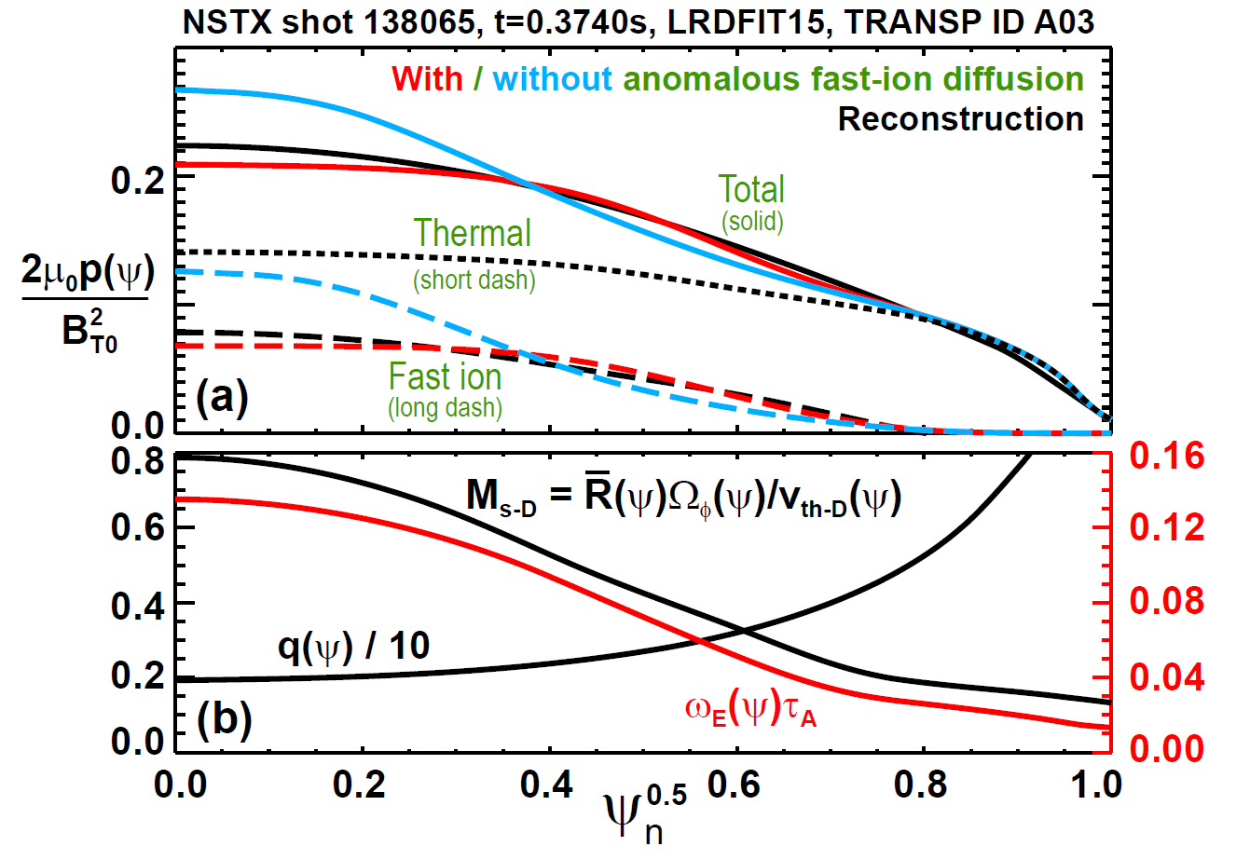
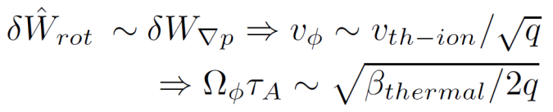
Kinetic profiles used in analysis
Use broadened fast-ion n, p profiles (red curves) (consistent w/ reconstruction)
q ≈ 2 in core
D sound Mach number M_{s-D} → 0.8 on-axis → significant drive for rotational instability

Slide 14
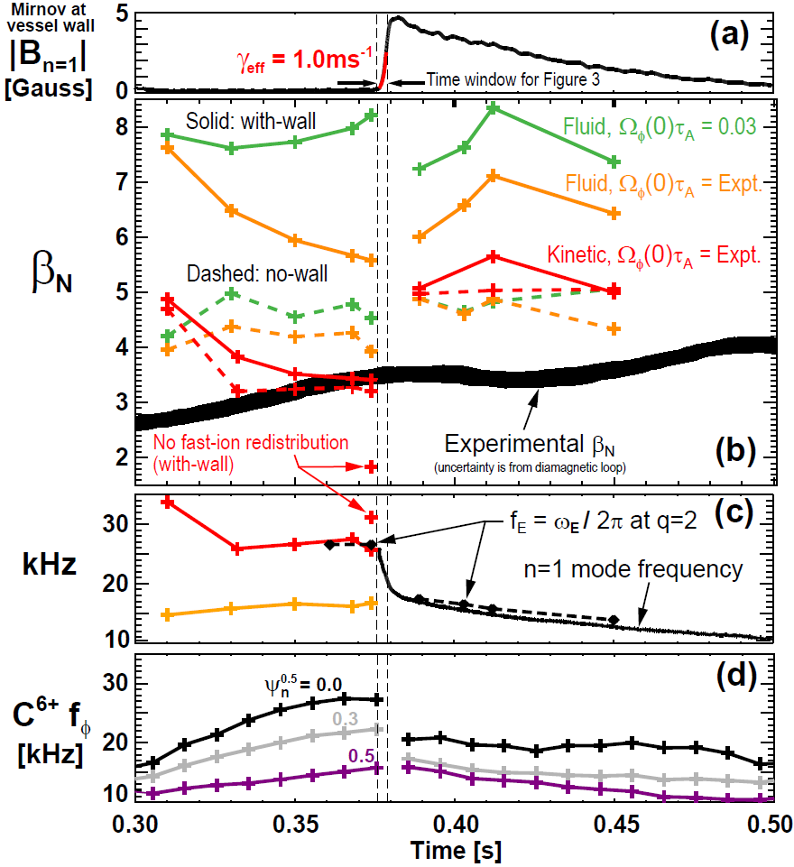
Predicted stability evolution using MARS-K compared to experiment
Mode grows quickly, but decays slowly – kink or tearing mode?
Low-rotation fluid with-wall limit is very high → marginal β_{N} ~ 7-8
Increasing rotation lowers max β_{N} to ~5.5 at mode onset time
Full kinetic treatment including fast-ions → marginal β_{N} ~3.5 → most consistent with experiment
Full kinetic: predicted mode f matches measured f ~ 26kHz
Fluid model under-predicts f
Rotation increasing until mode onset, then drops, then remains lower while mode is present.

Slide 15
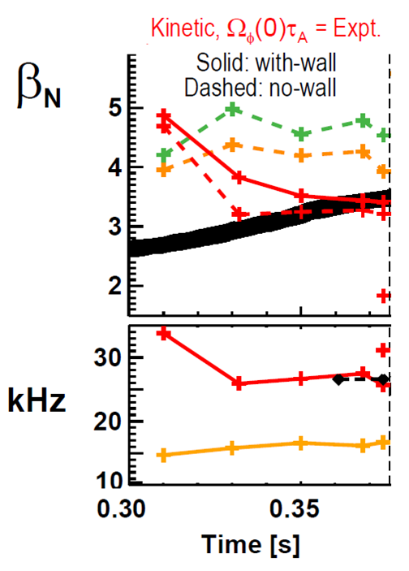
Fast ion broadening has significant impact on predicted stability
With fast-ion redistribution
Without broadening, predicted marginally stable β_{N} would be much lower than experiment
And predicted frequency would be higher than observed
Without
With

Slide 16
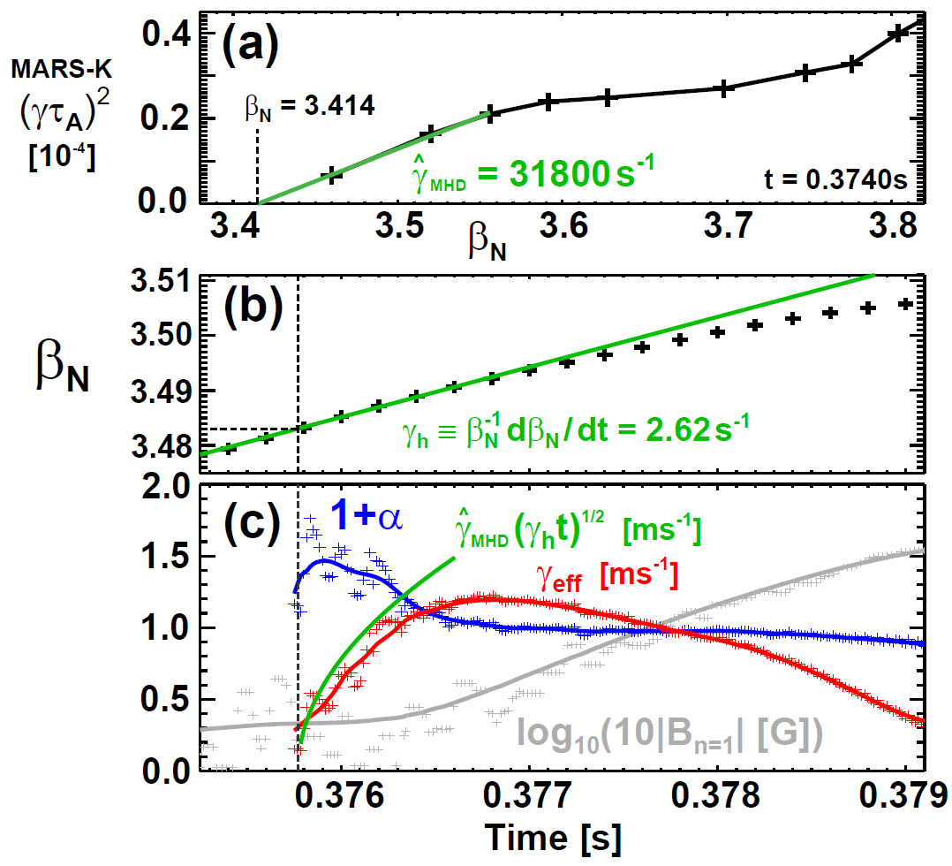

Observed mode initial γ consistent with kink/MARS-K
Fit to MARS-K γ²
Use Callen method
MARS-K γ² linear in β_{N} near marg. stability
Rate of rise of β_{N} tracked using diamagnetic loop
For first 0.5ms, growth is consistent with Callen hybrid γ model for ideal instability:
α = 0.5 for ideal mode
Fit to β_{N} from diamagnetic

Slide 17
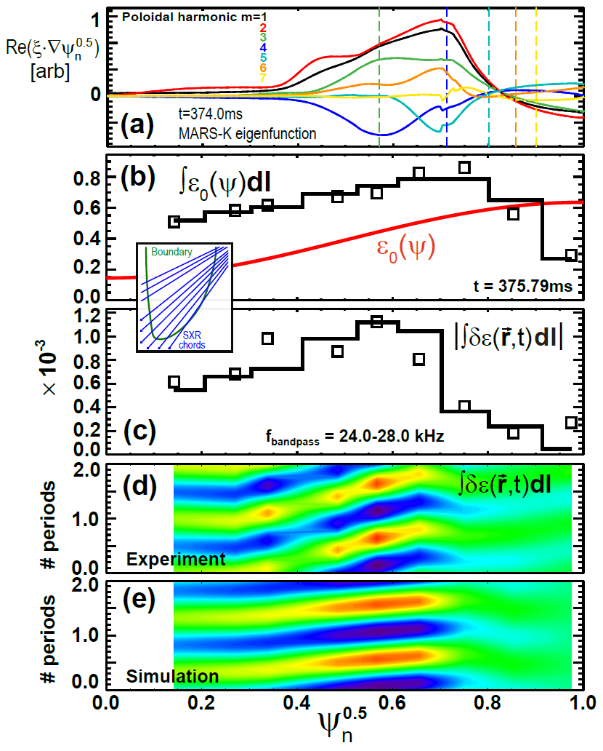
SXR data also consistent with kink/MARS-K at onset
MARS-K IWM kink eigenfunction largest amplitude for r/a = 0.5-0.8
Simple/smooth emission profile ε₀(ψ) can reproduce line-integrated SXR
…and can reproduce line-integrated SXR fluctuation amplitude profile
…and has same kink-like structure vs. time and SXR chord position
  Although the “slope” of the simulated eigenfunction is shallower than measured… rotation or fast-ion effect?
Later in time, SXR better fit to 2/1 TM (not shown)

Slide 18
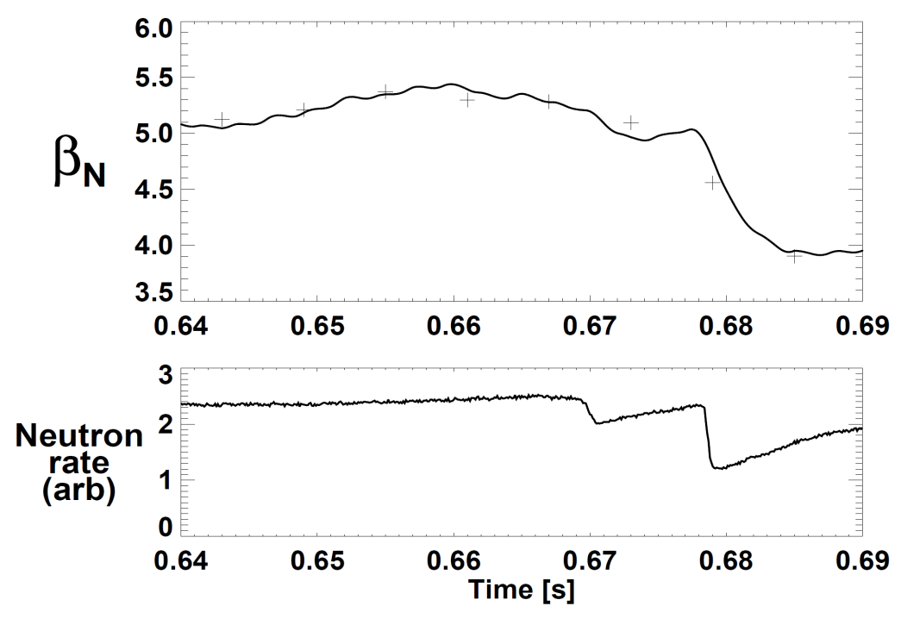
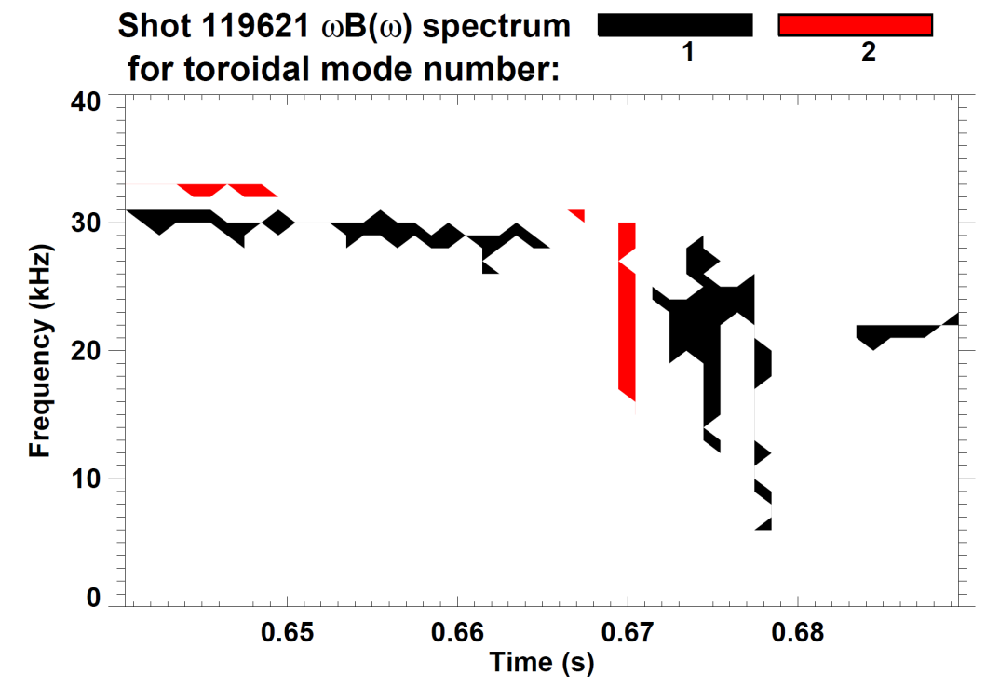
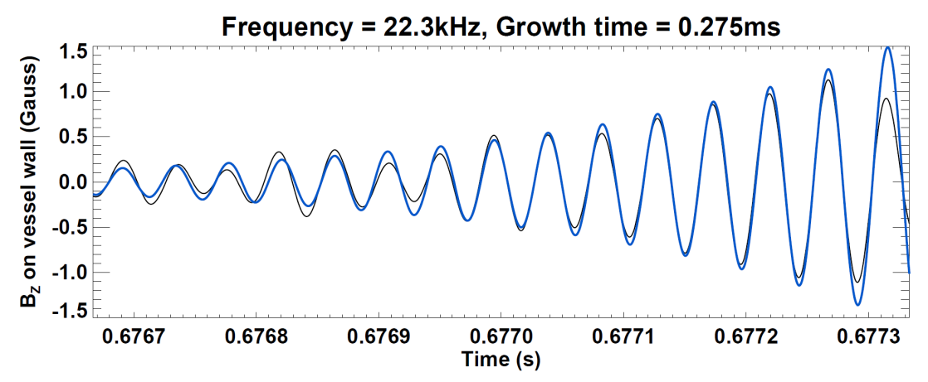
Intermediate β_{N} limit ~ 5: Small f=30kHz continuous n=1 mode precedes larger 20-25kHz n=1 bursts
First large n=1 burst →
20% drop in β_{N}
50% neutron rate drop
Later n=1 modes → full disruption
γ_{eff} τ_{A} ~ 4×10⁻³

Slide 19
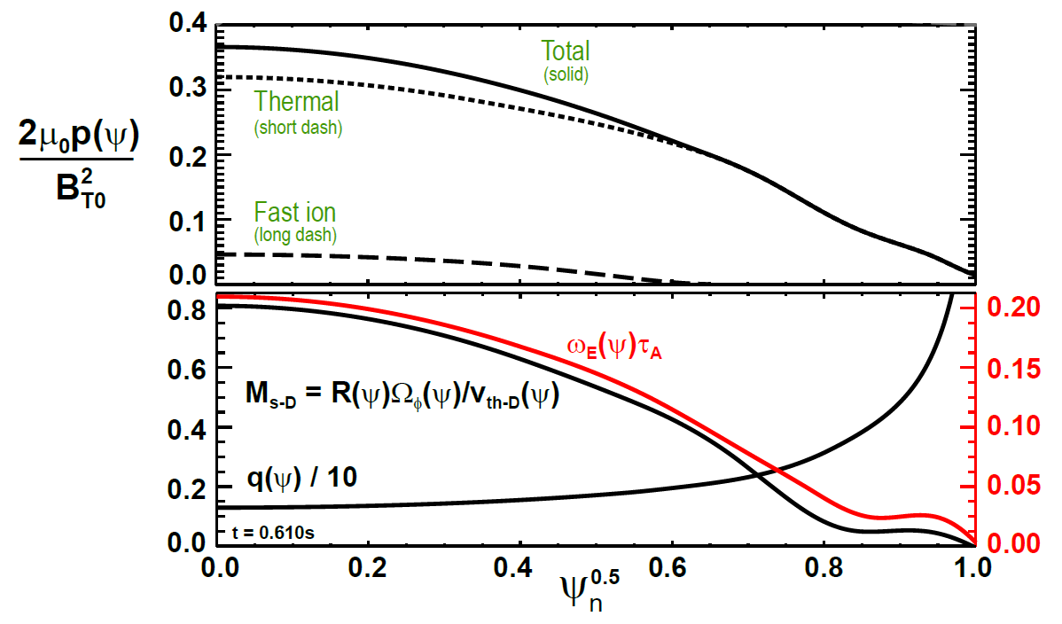

Kinetic profiles used in analysis
Fast ion pressure lower in this shot due to higher n_{e}
Compute fast-ion from reconstructed total - thermal
q ≈ 1.3 in core
D sound Mach number M_{s-D} → 0.8 on-axis → significant drive for rotational instability
But, expect weaker rotational destabilization since M_{s-D} similar, q lower

Slide 20
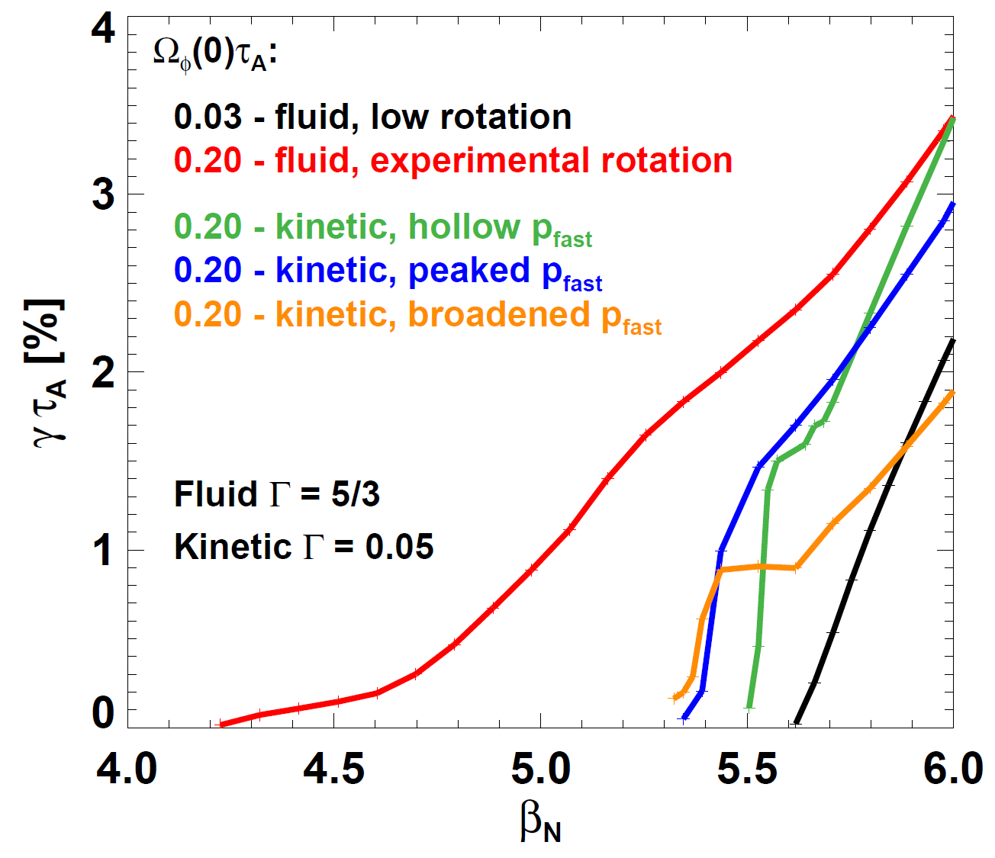
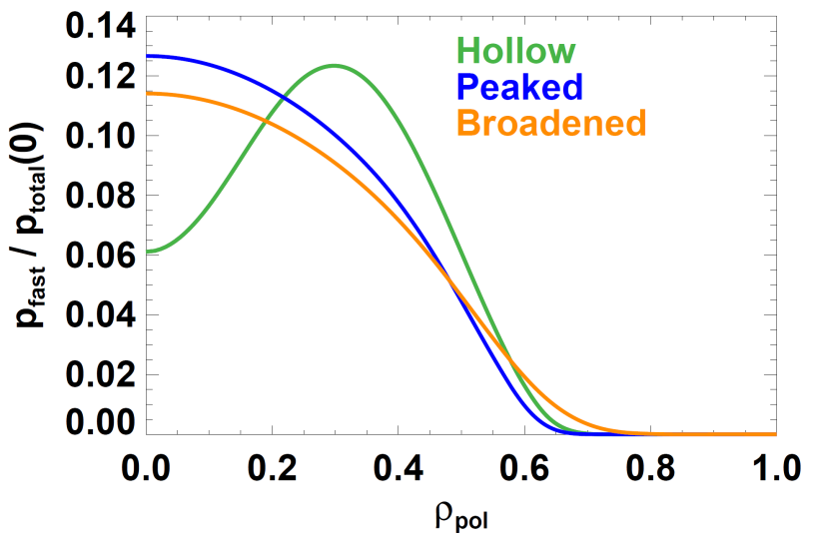
Kinetic IWM β_{N} limit consistent with experiment, fluid calculation under-predicts experimental limit
NSTX shot 119621, t=610ms
Fast-ion p profiles used in kinetic calculations
Fluid β_{N} limit for low Ω_{φ}
Kinetic β_{N} limit for experimental Ω_{φ}
(weakly dependent on fast-ion peaking factor)
Experimental β_{N} for n=1 mode onset
Fluid β_{N} limit for experimental Ω_{φ} (Δβ_{N} = -1.4 vs. low rotation)

Slide 21
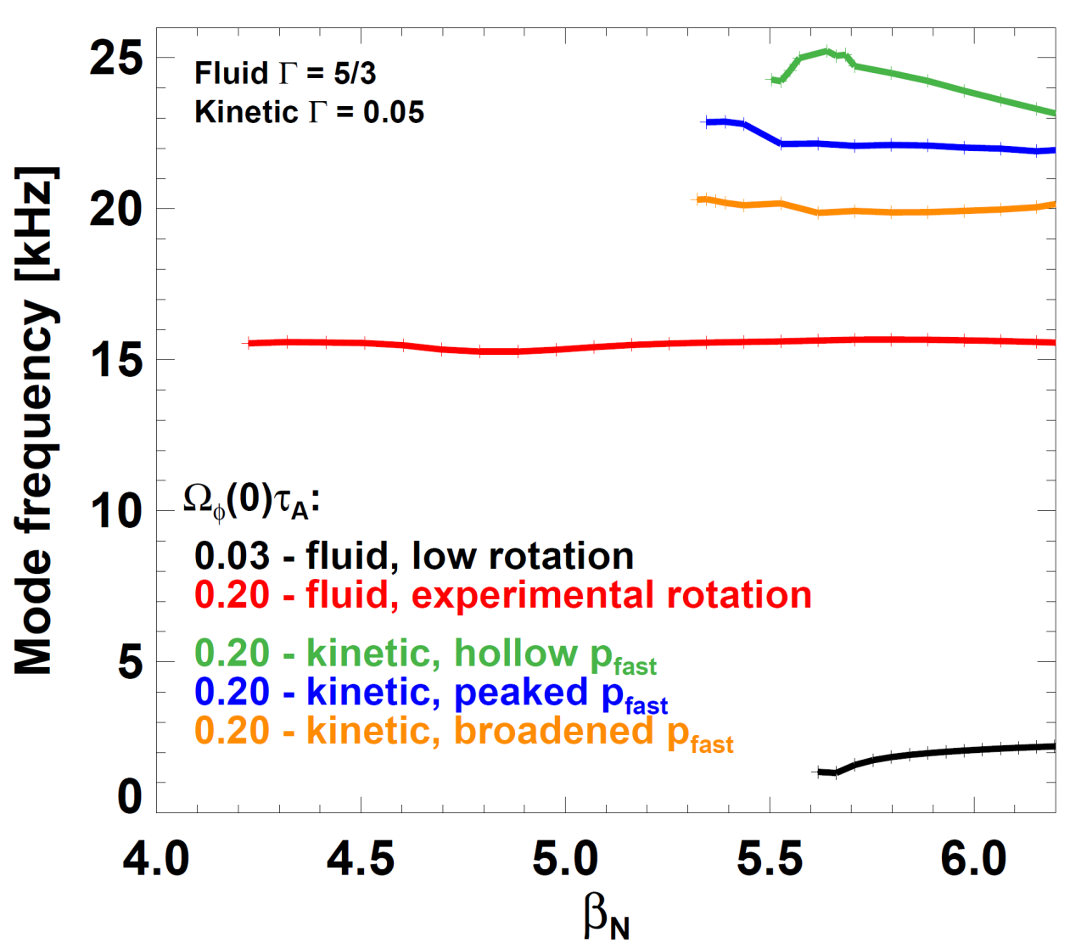
Measured IWM real frequency more consistent with kinetic model than fluid model
Measured mode frequency
NSTX shot 119621, t=610ms
Fast-ion p profiles used in kinetic calculations
f_{E} = ω_{E} / 2π at q=2 →
Not as well matched to measured kink frequency
Smaller / no subsequent tearing triggered

Slide 22
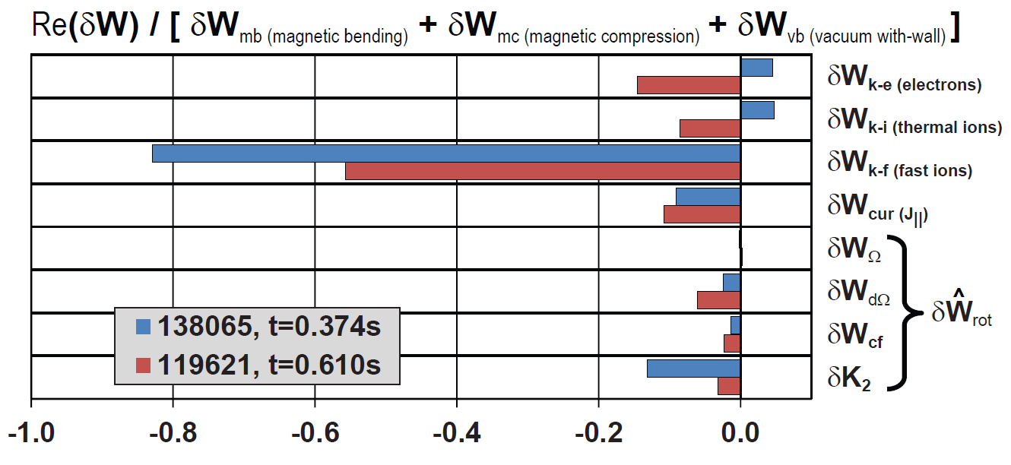
IWM energy analysis near marginal stability elucidates trends from growth-rate scans
Fast-ions in Re(δW_{k}) = dominant destabilization in both shots
  Balanced against field-line bending + compression + vacuum stabilization
Shot 138065 has larger destabilization from fast-ions & rotation
  Consistent w/ larger 55% reduction in β_{N} = 7-8 → 3.5 (vs. 5.5→ 4.2 or 25%)
Kelvin-Helmholtz-like δW_{dΩ} and δK₂ are dominant δW_{rot} terms
  Rotational Coriolis and centrifugal effects weaker

Slide 23
Some theory needs for tearing triggering by IWM, or due to proximity to IWM marginal stability (1)
Hybrid fluid + drift-kinetic MHD → predicts IWM marginal stability, growth rate, real frequency, eigenfunction
But when do IWMs lead to disruption, and/or trigger TMs?
For few cases studied thus far, tearing triggered after kink/IWM onset when f_{kink-IWM} closer to f_{ExB at q=2}
  Hypothesis: Require frequency match, sufficient drive + time
  ω match influenced by rotation shear, thermal / fast-ion ω*
Implications for IWM → TM calculations
  Spontaneous tearing mode calculations likely require modified Δ′ and Γ′ to include rotation/rotation shear, fast ions
    Know from Gerhardt’s 2/1 NTM work rotation shear likely important for Δ′
  Forced reconnection triggering of TM likely requires non-linear treatment including differential ω, shielding effects

Slide 24

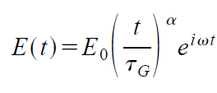
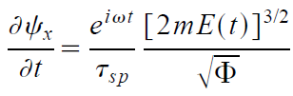


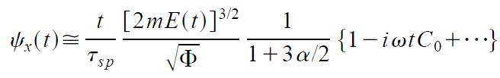



Some theory needs for tearing triggering by IWM, or due to proximity to IWM marginal stability (2)
Example non-linear forced reconnection model:
Can models like this (or more sophisticated) be used:
  To estimate “fast” evolution, amplitude of driven seed island
  Link to MRE to understand stabilization, growth/saturation?
1/ωτ_{sp} shielding from differential rotation

Slide 25
Some theory needs related to fast-ion distribution function representation / modeling (1)
MARS-K has both isotropic and anisotropic (NBI-like) representations for fast-ion distribution function
  Anisotropic model sometimes leads to singular eigenfunctions and/or different mode characteristics
  Isotropic model much better behaved… but why?
    Possible numerical / implementation issues
    Also likely that fast ions could be more isotropic than TRANSP classical slowing down model due to velocity-space redistribution (?)
  Need better constraint on pitch angle → FIDA data will help
Vertical
Tangential
FIDA Views

Slide 26

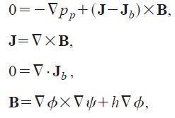
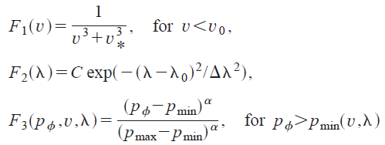




Some theory needs related to fast-ion distribution function representation / modeling (2)
Generalized GS equation including beams developed by E. Belova (PoP 2003):
Need to extend the above model to include rotation
Equilibrium reconstructions may need to include multiple F₀ bases to accurately capture FI effects
  Investigate constraints by FIDA and other FI diagnostics

Slide 27
Summary
Hybrid fluid + drift-kinetic MHD model significantly improves predictive capability for linear IWM stability
  Rotation, fast-ion, kinetic effects can strongly modify IWM
Accurate reconstructions of fast-ion redistribution by other modes very important for understanding IWM
  Need improved models of fast-ions in reconstructions and low-n stability codes to understand IWM and related MHD
  Need to include rotation for self-consistency
Tearing mode triggering by IWM (or near limits) will need improvements in models:
  Rotation, rotation shear, fast-ion effects on Δ′ and MRE
  NL / forced reconnection with differential ω and shielding

