Slide 1



NSTX-U
Supported by
NSTX-U Granule Injector XMP,
XP1527, & XP1530
Coll of Wm & Mary
Columbia U
CompX
General Atomics
FIU
INL
Johns Hopkins U
LANL
LLNL
Lodestar
MIT
Lehigh U
Nova Photonics
ORNL
PPPL
Princeton U
Purdue U
SNL
Think Tank, Inc.
UC Davis
UC Irvine
UCLA
UCSD
U Colorado
U Illinois
U Maryland
U Rochester
U Tennessee
U Tulsa
U Washington
U Wisconsin
X Science LLC
R. Lunsford, J Lore, J. Canik
and the NSTX-U Research Team
Culham Sci Ctr
York U
Chubu U
Fukui U
Hiroshima U
Hyogo U
Kyoto U
Kyushu U
Kyushu Tokai U
NIFS
Niigata U
U Tokyo
JAEA
Inst for Nucl Res, Kiev
Ioffe Inst
TRINITI
Chonbuk Natl U
NFRI
KAIST
POSTECH
Seoul Natl U
ASIPP
CIEMAT
FOM Inst DIFFER
ENEA, Frascati
CEA, Cadarache
IPP, Jülich
IPP, Garching
ASCR, Czech Rep

Slide 2
Granule Injector XMP
Granule Injector Subsystem | Required Actions
Timing and Triggers | Confirm pulsed dropper operation and time of flight calculations
Injector Alignment | Confirm species specific particle alignment.*
Particle Selectability | Test ability to inject various size particles, this includes a controlled access event
Full Systems Check | Confirm Operational Readiness
* Will need to be reconfirmed when switching to Lithium from harder granules
While the final four items require an active plasma, there are minimal restrictions on discharge characteristics.
However, discharge must be robust enough to withstand granule impact without total collapse
XMP : 0.5 Day

Slide 3
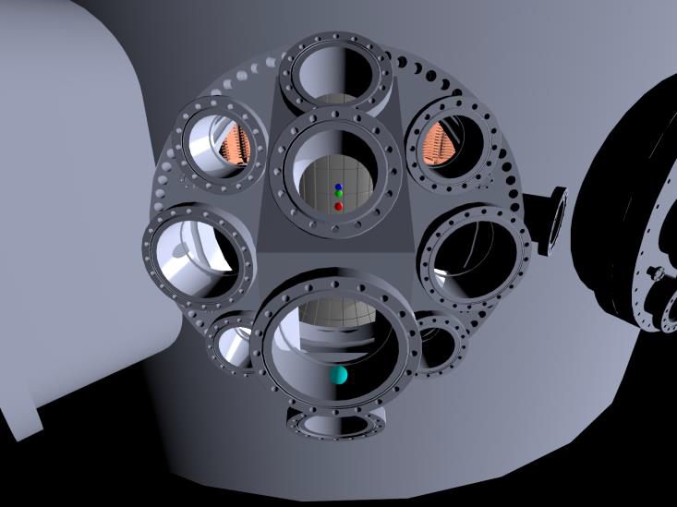
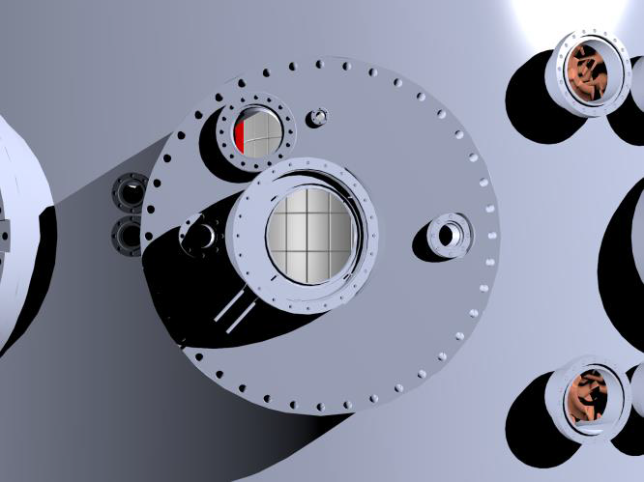
Granule Injector XMP : Camera Alignment
External Optics
Plasma Camera Locations for LGI Experiments
12 o’clock port (6” flange) on Bay J midplane with ~ 18 cm field of view
11 o’clock port on Bay F midplane (MPTS inspection window)
LGI Location
Imaging and Camera setup credit : F. Scotti (LLNL)

Slide 4
Granule Injector : Diagnostic camera location
Granule ablation imaging
Color camera Miro 640
80x64, 40 kHz
top view
Impeller frequency
Photodiode
Towards
NSTX-U
Impeller/dropper operation
monochrome camera
Phantom 7.3
306x106, 20 kHz
Condensed illumination
halogen bulb + lens (2X)
Figure Credit :ELM pacing by injection of low-Z impurity pellets
A. Bortolon / GA, FES Workshop on Transients / April 1st, 2015

Slide 5
XP1527: ELM pacing via multi-species granule injection and 3D field application for main ion control
XP1530: Triggering ELMs with lithium granule injection and 3-D fields in lithiated discharges

Slide 6
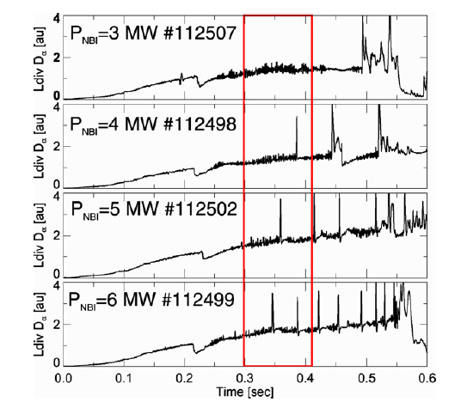
Granule Injector XP1527: ELM pacing via multi-species granule injection and 3D field application for main ion control
Goal : Comparison of Boron Carbide and Carbon injection into low frequency ELM-y H-modes for ELM pacing (pre-Lithium).
Examine ablation rates and penetration depths of multiple granule species.
Compare characteristics of stimulated ELMs to both spontaneous ELMs and the simulation code JOREK.
Are ELMs paced at 3-5 times the spontaneous natural frequency sufficient for divertor heat flux mitigation?
Experimental Plan
Achieve NSTX-U discharges with low natural ELM frequency, based on NSTX results.
Inject 500 μm and 900 μm pellets to observe ablation physics, determine pacing efficacy and monitor impurity transport
Compare characteristics of spontaneous and stimulated ELMs.
  Examples : ELM duration, magnetic signature, PFC wetted area, divertor heat load and energy deposition profile

Slide 7
XP1527: ELM pacing via multi-species granule injection and 3D field application for main ion control
3D field ELM pacing shot plan
Baseline plasma with ramping main ion density and low (~10Hz) natural ELM frequency (1-3 shots).
Determine the triggering threshold.
  Apply square wave n=3 binary pulse trains, 50% duty cycle, 10-80ms period with the amplitude increasing each pulse (anticipate 1-2kA).
  Apply pulse train on top of Error Field Coils if there is sufficient headroom in current (max 3.3kA).
  Reduce pulse length and amplitude if confinement degradation is strong or tearing modes triggered.
  Monitor effect on main ion and impurity diagnostics. (1-3 shots)
Demonstrate reliable triggering.
  Choose field level above threshold determined in step 1.
  Start with long pulses (50% duty cycle, ~30-60 ms period)
  Decrease duty cycle as justified by time between 3D field application and first ELM.
  Vary amplitude as necessary to improve triggering.
  Monitor effect on main ion and impurity diagnostics. (2-5 shots)
Decrease duty cycle and increase 3D pulse frequency to increase triggered ELM frequency.
  Push for single ELM triggering without natural ELMs.
  Monitor effect on main ion and impurity diagnostics. (2-5 shots).

Slide 8
XP1527: Granule Injector Shot Plan
Shot Number | Granule Species | Granule Size | Impeller frequency | Piezo Voltage | Drop Duration*
1 (fiducial) | None
2 | B₄C | 600 μm | 125 Hz | 3 V | 500 ms
3 | B₄C | 600 μm | 125 Hz | 8 V | 500 ms
4 | B₄C | 600 μm | 250 Hz | 3 V | 500 ms
5 | B₄C | 600 μm | 250 Hz | 8 V | 500 ms
6 (Contingency) | B₄C | 600 μm | TBD | TBD | 500 ms
7 (Contingency) | B₄C | 600 μm | TBD | TBD | 500 ms
Controlled Access
8 (fiducial) | None
9 | C | 600 μm | 125 Hz | 1 V | 500 ms
10 | C | 600 μm | 125 Hz | 4 V | 500 ms
11 | C | 600 μm | 250 Hz | 1 V | 500 ms
12 | C | 600 μm | 250 Hz | 4 V | 500 ms
13 (Contingency) | C | 600 μm | TBD | TBD | 500 ms
14 (Contingency) | C | 600 μm | TBD | TBD | 500 ms
Controlled Access
15 (fiducial) | None
16 | C | 900 μm | 125 Hz | 1 V | 500 ms
17 | C | 900 μm | 125 Hz | 4 V | 500 ms
18 | C | 900 μm | 250 Hz | 1 V | 500 ms
19 | C | 900 μm | 250 Hz | 4 V | 500 ms
20 (Contingency) | C | 900 μm | TBD | TBD | 500 ms
Additional Shots | C | 900 μm | Single pacing method exemplar shots

Slide 9
XP1527: Granule Injector and 3D field decision points
Contingency shots may be used to reverse order of 3D field pulses and granule injection to determine effect (if any) of granule injection prior to 3D field application based on effectiveness of each technique.
Impeller frequency and piezo voltage values are guidelines; these values may need to be adjusted if the particle load adversely affects plasma performance.
Inability to generate reliable pacing with a particular species may adjust the timing of the controlled access points depending upon the discharge characteristics.
It is anticipated based on NSTX results that square waves will be used for 3D field pulse trains; however it is possible that some tailoring of the waveform may lead to better performance.
If n=3 pulses are ineffective, n=1 or 2 pulses may be attempted.
If results warrant, ensure that a shot or set of shots is taken with a single pacing method per shot to determine maximum pulse length achievable and to have clean comparison for presentation and/or publication.
Synergistic application of granule injection and 3D field pulses may be explored if both methods have been optimized quickly. It is possible that combining techniques may allow for reliable triggering with reduced perturbation from either method individually.

Slide 10
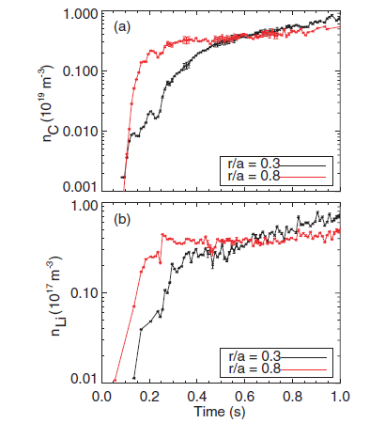
XP1530: Triggering ELMs with lithium granule injection and 3-D fields in lithiated discharges
Goal : Locate minimum edge perturbation required to initiate ELMs in a naturally ELM-free lithiated discharge.
Comparison of C and Li core evolution in NSTX ELM free H-Modes
Empirical study to determine the minimal size, frequency and input velocity required for reliable ELM triggering.
Monitor core impurity transport caused by granule instigated bursting in naturally ELM free lithiated discharges.
  Look at impurity clamping within the core as a result of stimulated ELMs
  Is there an effective size/frequency threshold for efficient impurity flushing?
  Examine Li transport into the core as the carbon impurities are flushed
High speed camera measurements of granule ablation and plasmoid formation to locate mass seeding within pedestal. Compare to pellet ablation models.
Establish NSTX-U threshold for ELM triggering with solid granules.
Compare to limitations found elsewhere with D2 pellet triggering
Experimental Plan
Access ELM-free NSTX-U H-Modes through lithium wall conditioning
Inject Lithium Granules (700 μm, 500 μm, 300 μm) to determine lower mass density limit
Reduce injection frequency to determine cumulative edge density effects
Reduce impeller velocity to look for lower input velocity limit
F. Scotti, Nucl. Fusion 53 (2013)

Slide 11
Granule Injector XP1530: Triggering ELMs with lithium granule injection and 3-D fields in lithiated discharges
3D fields shot plan
Re-establish ELM destabilization by 3D fields (4 shots)
  Re-create the destabilization of ELMs by the application of 3D fields
  Pulse trains of 100ms on, 100ms off will be applied with an RWM coil currents beginning at 500 A and increasing in increments of 500A until triggering is observed.
  Failure: Should ELM triggering not be observed even at the highest allowed n=3 field strength, the discharge parameters will be adjusted to more closely match an NSTX discharge in which reliable triggering has been established (e.g., 133816)
Optimize 3D field waveform for ELM pacing and impurity flushing (12 shots)
  The goal is to apply pulses such that a) each pulse triggers and ELM, b) the frequency of the pulses is as high as possible, and c) the impact on the core plasma (e.g., rotation) is as small as possible.
  Apply short (~5-10ms) high amplitude (1.5-2.5kA) pulses. The initial frequency of the pulses will be fairly low (20 Hz). The duration and amplitude will be adjusted to ensure reliable triggering with the minimum time-integrated applied field.
  The frequency will then be increased in increments of 10 Hz with a final goal of 50 Hz pacing for comparison to LGI. At the highest frequency where some degree of successful pacing is observed, the pulse duration and amplitude will be readjusted if necessary to improve reliable triggering.
Time permitting, consider combining interspersing LGI and 3D field pacing to increase net ELM frequency. OR adjust plasma parameters towards long-pulse scenario and do initial ELM triggering scoping.

Slide 12
Backup

Slide 13
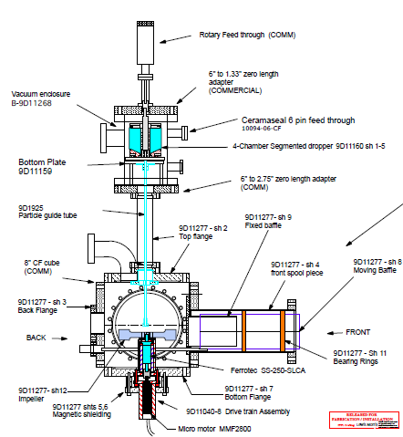
NSTX-U Granule Injector
Target granules are housed within the 4-chamber segmented dropper.
Particle drop rates are controlled by voltage applied to a piezoelectric disk.
The granules travel down a guide tube where they are impacted by a pneumatic rotary impeller and driven into the plasma.
Available sizes (approximate)
900μm, 700μm, 500μm, 300μm
Proposed Granule Composition
Lithium, Boron Carbide, Vitreous Carbon
Injection Velocity
50 – 150 m/sec
Granule to Granule Injection Frequency
50 – 500 Hz

Slide 14
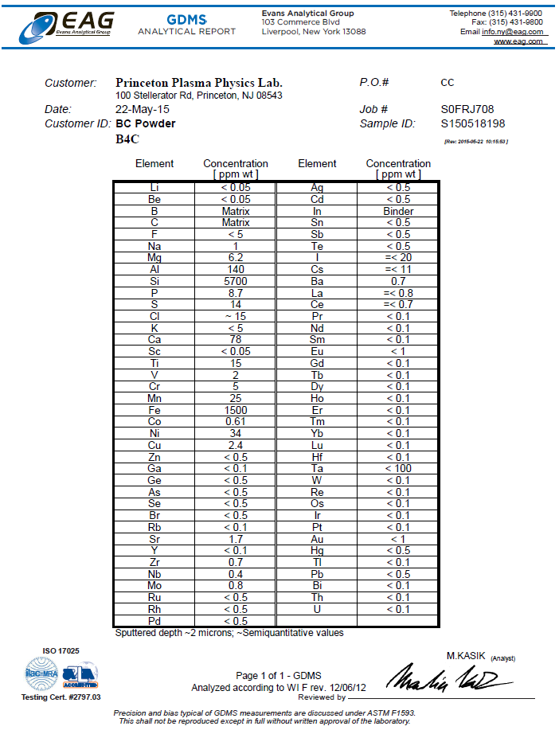
Boron Carbide Granules Impurity Classification

Slide 15
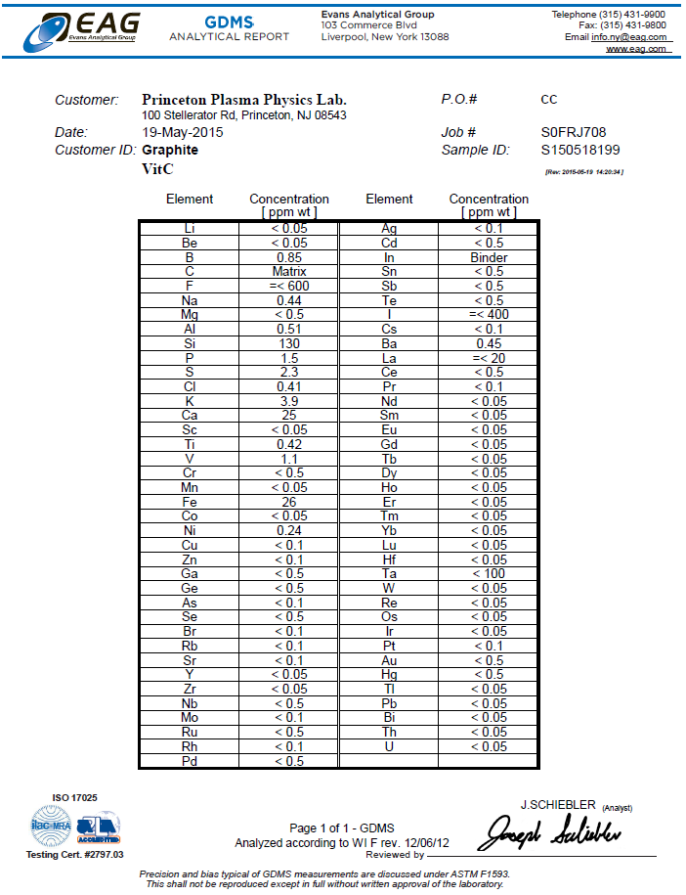
Carbon Granule
Impurity Classification

Slide 16
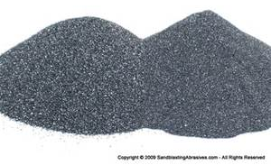
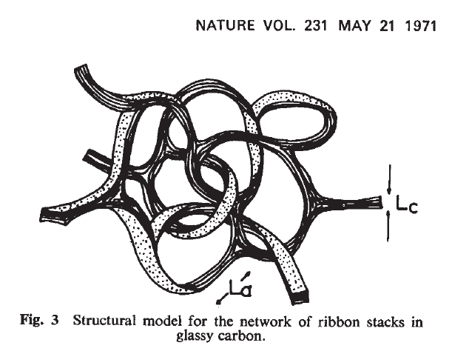

Electron inventory calculation for multi-species particle injection
 | Deuterium Slush | Lithium | Boron Carbide | Carbon (Vitreous)
Density | .237 g/cm ³ | .534 g/cm ³ | 2.52 g/cm ³ | 2.09 – 2.23 g/cm ³
Mass in a 1mm sphere (mg) | 0.993 | 2.237 | 10.556 | 9.09
Atomic Weight (g/mol) | 4.028 | 6.94 | 55.255 | 12.011
Number of atoms/molecules | 1.484E+20 | 1.941E+20 | 1.150E+20 | 4.557E+20
Number of electrons | 1.484E+20 | 5.823E+20 | 2.991E+21 | 2.734E+21
Deuterium Multiplier | 1.00 | 3.92 | 20.15 | 18.42
Sublimation Energy (eV/atom) | 0.0155 | 1.65 | 5.3 (B) | 7.5
Sublimation Energy Per Granule (J) | 0.4 | 51.3 | 529.0 | 547.6
First Ionization Energy (eV) | 13.6 | 5.3917 | 8.2980 (B) | 11.2603
Second Ionization Energy (eV) |  | 75.64 | 25.1548 (B) | 24.3833
B₄C
C
Li
Mansfield NF 53 (2013)

Slide 17
Activities requiring controlled access
Rotating the dropper door from one chamber to another is done manually and requires a controlled access
Granule Change Procedure
Rotate door to empty chamber or space between chambers
Run piezo to clear inventory
Rotate door to new chamber to fill inventory
Return door to blanked condition
Run piezo to clear inventory
Rotate door to new chamber
Injector Re-alignment
When changing to granules with substantially different hardness (i.e.. lithium) the dropper portion will need to be reset. This operation requires a vent of the injector assembly.

Slide 18
XMP Form Population
Title of Proposal : Granule Injector operational readiness assessment
Proposer First Name : Robert
Proposer Last Name : Lunsford
E-mail : rlunsfor@pppl.gov
Co-Authors : L. Roquemore, R. Kaita, M. Jaworski
Home Country : United States
Home Institute : PPPL
NSTX-U group assessing : “Cross-cutting and enabling”
Contributions to milestones : ITPA Pedestal and Edge Physics Joint Experiment #30
Machine time requested : 0.5 Days
Pre-Lithium time: 0.5 Days
Minimum Useful time : Piggybacked end of shots acceptable
Goal, importance and plan of proposal : Prior to experiments utilizing the NSTX-U granule injector it will be necessary to confirm operational readiness of the constituent components. While most of this can be done offline, a plasma is required to fully confirm dropper operation and time of flight calculations as well as the species specific particle alignment. Readiness check to be done with boron carbide particles to maintain a lithium free test cell. While an additional readiness check and possible impeller re-alignment will be necessary prior to lithium injection, we anticipate this to be a minor issue.
Special Requirements : Granule injector operation can be assessed with any plasma robust enough to ablate the injected particles.

Slide 19
XP1 Form Population
Title of Proposal : Multi-species particle injection for ELM pacing and impurity transport
Proposer First Name : Robert
Proposer Last Name : Lunsford
E-mail : rlunsfor@pppl.gov
Co-Authors : L. Roquemore, M. Jaworski, R. Kaita, R. Maingi, J. Wang et al
Home Country : United States
Home Institute : PPPL
NSTX-U group assessing : Particle Control Task Force
Contributions to milestones : ITPA PEP Joint Experiment #30
Machine time requested : 1.5 Days
Pre-Lithium time: 1.5 Days
Minimum Useful time : 1.0 Day
Goal, importance and plan of proposal :
The mitigation of peak heat flux due to edge localized modes is critical to preventing material erosion in plasma facing components. As there is evidence for an inverse relation between ELM frequency and the energy contained within the mode, the instigation of rapid small ELMs is being investigated as a method for managing this heat flux. This XP will extend the “ELM control by pellet pacing” joint experiment (ITPA PEP #30) by exploring the injection of multiple species of non-fueling solid granules. We propose to inject boron carbide, carbon and lithium granules of multiple sizes into low frequency ELM-y H-modes to examine ablation rates and penetration depths as it relates to ELM pacing efficiency. In addition we plan to characterize the impurity driven stimulated ELMs and compare these measurements to those generated by spontaneous ELMs. We will also examine the effect of increased ELM frequency on the ELM size and divertor peak heat flux. These findings will be compared to current results achieved elsewhere with deuterium pellet pacing.
Special Requirements : This effort can be combined with the controlled introduction of lithium by the particle control task force. If a segmented dropper housing is not available for this XP, the experiment will need to be split up into 3 half day segments to allow time to change the granule species within the dropper. In addition, a realignment of the impeller will be necessary prior to lithium injection due to granule malleability.

Slide 20
XP2 Form Population
Title of Proposal : Lithium granule injection into ELM free H-modes with lithium conditioned walls
Proposer First Name : Robert
Proposer Last Name : Lunsford
E-mail : rlunsfor@pppl.gov
Co-Authors : L. Roquemore, M. Jaworski, R. Kaita, R. Maingi, J. Wang et al
Home Country : United States
Home Institute : PPPL
NSTX-U group assessing : Particle Control Task Force
Contributions to milestones : ITPA PEP Joint Experiment #30
Machine time requested : 1.0 Days
Pre-Lithium time: 0.0 Days
Minimum Useful time : 0.5 Days
Goal, importance and plan of proposal : The introduction of lithium conditioning to the PFC’s of NSTX led to ELM free H-Modes. While this generated enhanced confinement it has also led to a concomitant buildup of carbon impurities within the core of the plasma. The use of solid granule injection has been shown as a method for generating controlled ELMs and clamping core impurities. This XP will attempt to locate the minimum edge perturbation required to reliably initiate ELMs in a naturally ELM-free lithiated discharge. Lithium granules of decreasing sizes will be injected into a baseline ELM free discharge to determine the minimum mass required to reliably trigger an ELM, in addition once this lower limit has been acquired, the granule injection frequency and velocity will be reduced until an approximate perturbative limit has been determined. We will also look at ELM instigated clamping or flushing of core impurity buildup and if this also has an efficacy threshold in size and frequency. Injection of boron carbide and/or vitreous carbon granules will also be considered if time and conditions warrant.
Special Requirements : Reliable reproduction of NSTX ELM free H-modes are a prerequisite

Slide 21

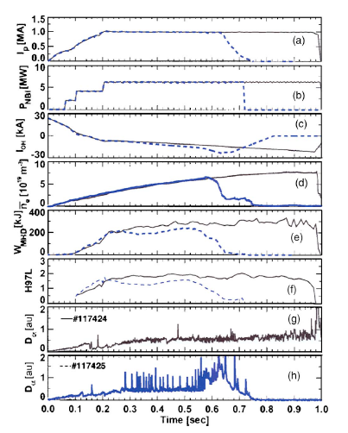

NSTX ELM-y H-mode Boronized Discharges

Slide 22
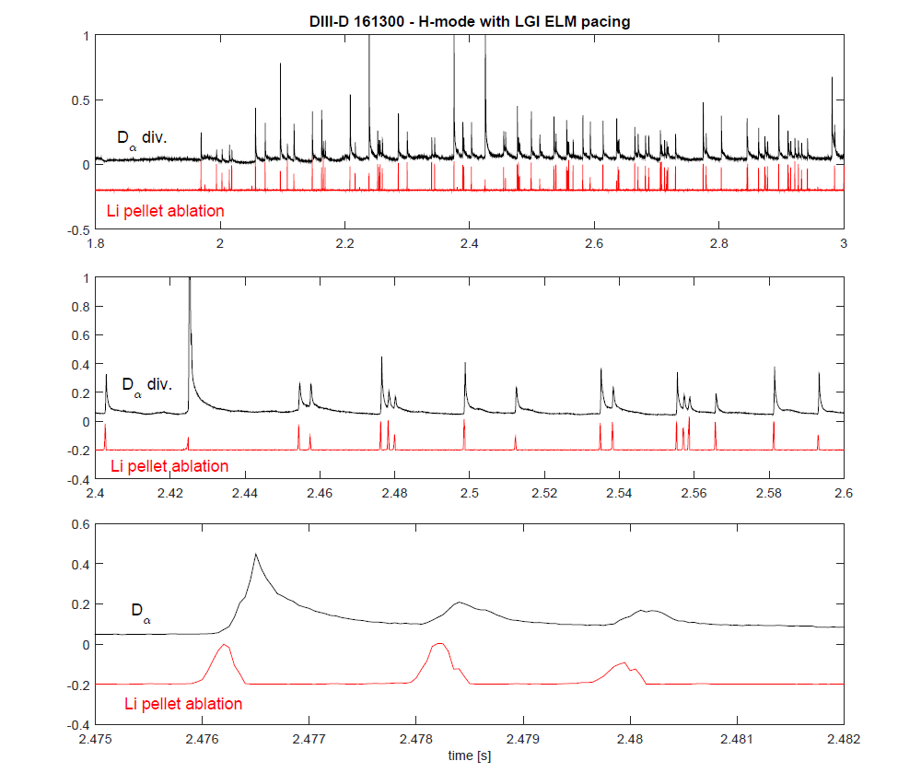

DIII-D LGI ELM pacing into super H-Mode plasmas
By A.Bortolon for the LGI team

Slide 23
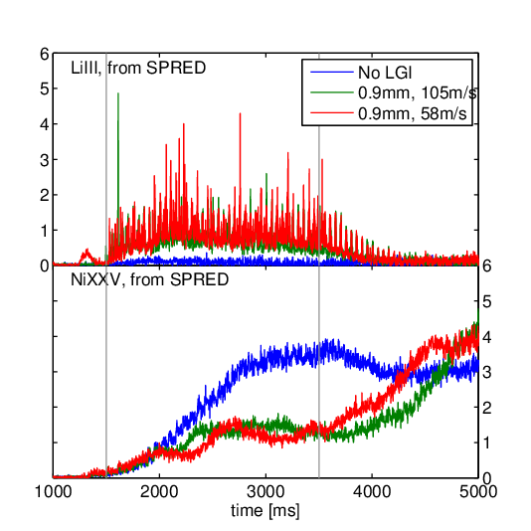
Ni impurity clamping with LGI at DIII-D
Charge exchange emission from Li III indicates Li reaches the core
  Previously observed in dropper discharges
  Potential for dilution effect
Nickel “intrinsic” impurity tends to accumulate
  During LGI operation the Ni density is clamped to low values
  Accumulation resumes as LGI turns off
LGI
By A.Bortolon for the LGI team
Presented to NSTX-U group at PPPL Jan 5th 2015

Slide 24

Anomalous Lack of Lithium Core population in NSTX ELM free H-Modes
F. Scotti, Nucl. Fusion 53 (2013)

Slide 25
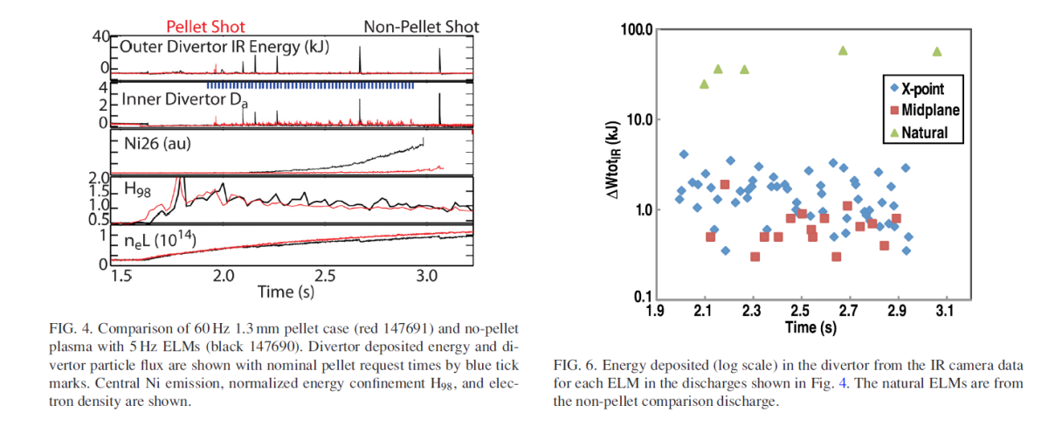
D2 pellet pacing experiments and divertor heat flux mitigation

Slide 26
Non linear MHD code JOREK
Slide from G Kocsis EFTSOMP (2009)
JOREK has been developed with the specific aim to simulate ELMs
  domain with closed and open field lines
  non-linear reduced MHD in toroidal geometry
    Density, temperature, electric potential (perp. flow),
    parallel velocity, poloidal flux
    Ideal wall conditions on walls
    Mach one, free outflow at divertor target
  Aim of the pellet related simulations is to answer the following questions:
  ELM occurs when plasma crosses linear MHD limit after which plasma returns to stable state
  How can a pellet trigger an ELM in the stable inter-ELM phase?
  Is pellet a trigger or a cause for an ELM?
flux-aligned grid
(reduced resolution)
Huysmans, EPS 2009
Notes:
Example grid, Reduced by factor 2 in all directions, typically 9000 elements

Slide 27
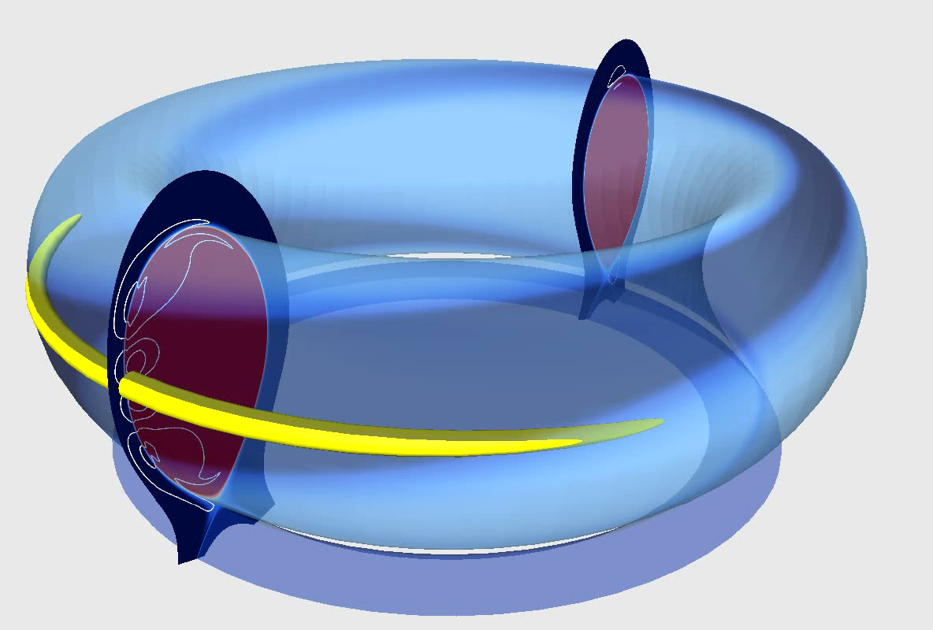
Non linear MHD code JOREK: modelling of pellet ELM triggering: Slide from G. Kocsis EFTSOMP (2009)
Pellets are approximated as an initial perturbation
to the density profile:
  poloidally and toroidally localised
    Amplitude typically 25 times central density
    Total amount of added particles 3-6%
  constant pressure (i.e. low temperature)
Pellet triggered MHD in H-mode pedestal:
  Initial non-linear MHD simulations of pellets injected in H-mode pedestal show:
    Destabilisation of medium-n ballooning modes
    High pressure in pellet plasmoid drives MHD instability forming a single helical perturbation at the pellet position
  suggests pellets can cause ELMs (instead of being a trigger)
x
~0.5μs
Huysmans, EPS 2009

