Slide 1
NSTX-U Status
J. Menard, S. Gerhardt, S. Kaye, C. Neumeyer

Slide 2
Outline
Motivations for NSTX-U
Research Highlights
Recovery Project Progress and Plans
Introduction

Slide 3
NSTX-U Will Address Critical Scientific Issues
  Understanding plasma confinement in a spherical torus at temperatures closer to fusion reactor
  Increased understanding of (electron) turbulence
    Critical for any magnetic confinement experiment
  Increased understanding of how to predict confinement of fast-ions from fusion reactions
    Critical for all future burning plasma experiments
  Study liquid metals to increase energy confinement and protect walls (longer-term)
NSTX-U Motivation

Slide 4
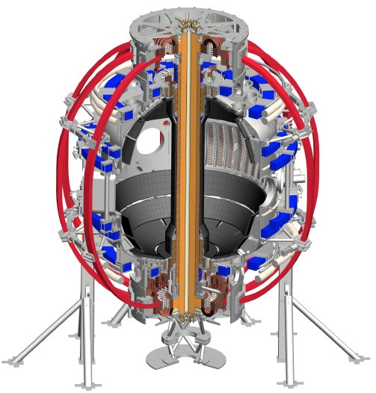
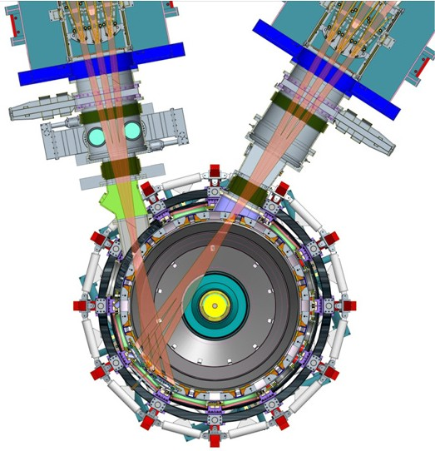
NSTX-U will be highest performance ST
1. New Central Magnet
2. Tangential 2nd Neutral Beam
➢ Highest magnetic field, highest temperatures
Providing key technical results for next generation of fusion energy experiments including ITER
NSTX-U Motivation

Slide 5
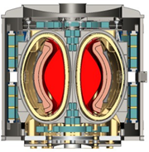
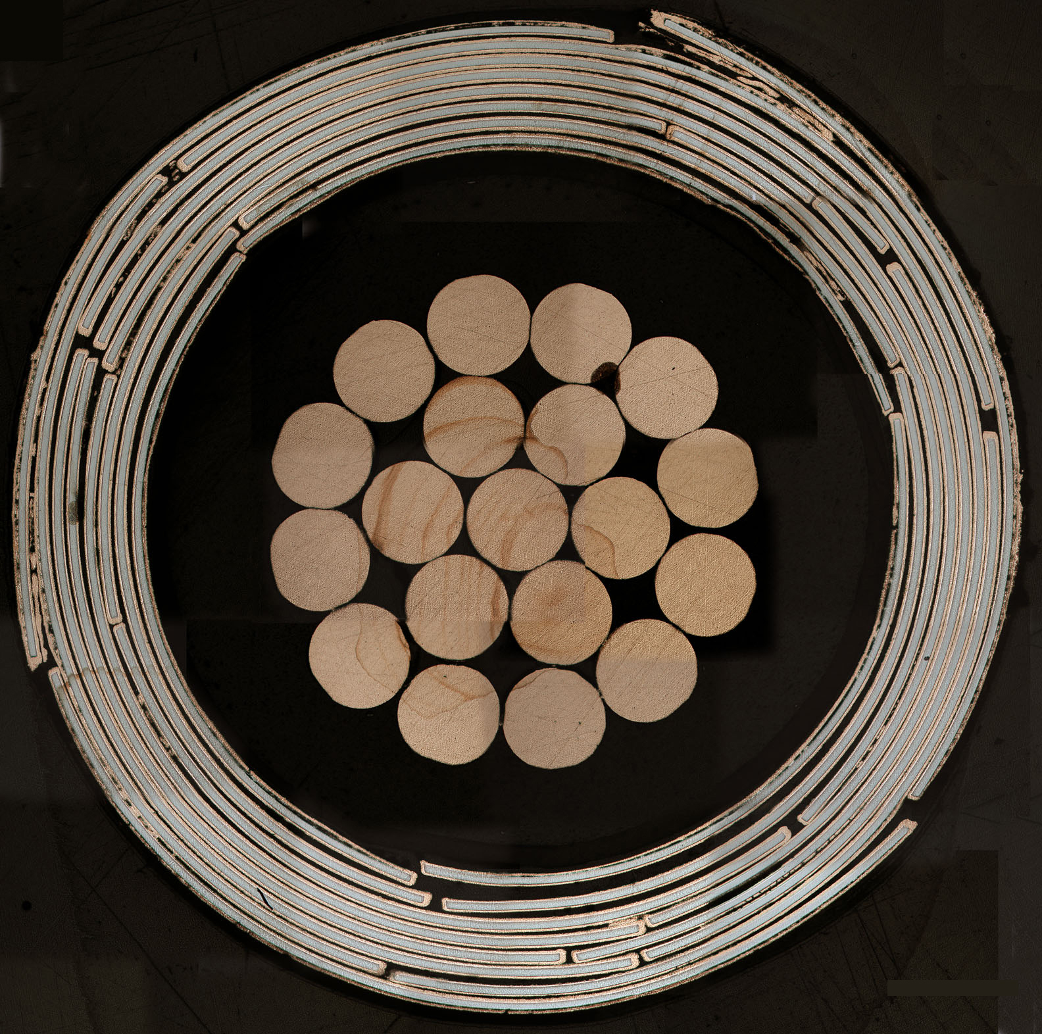
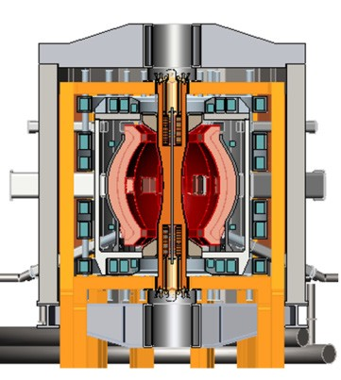
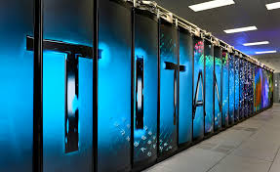
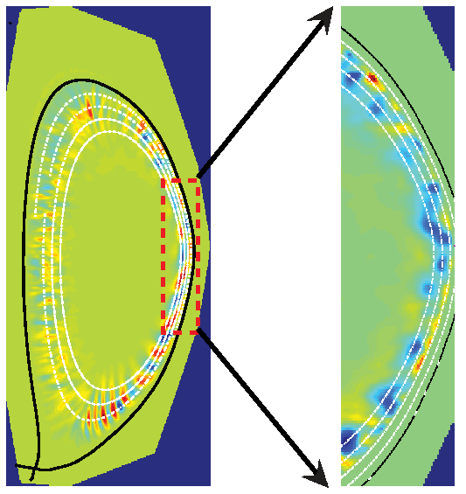
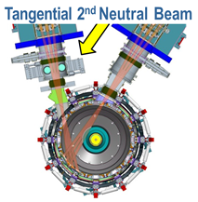
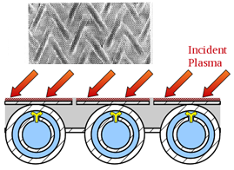
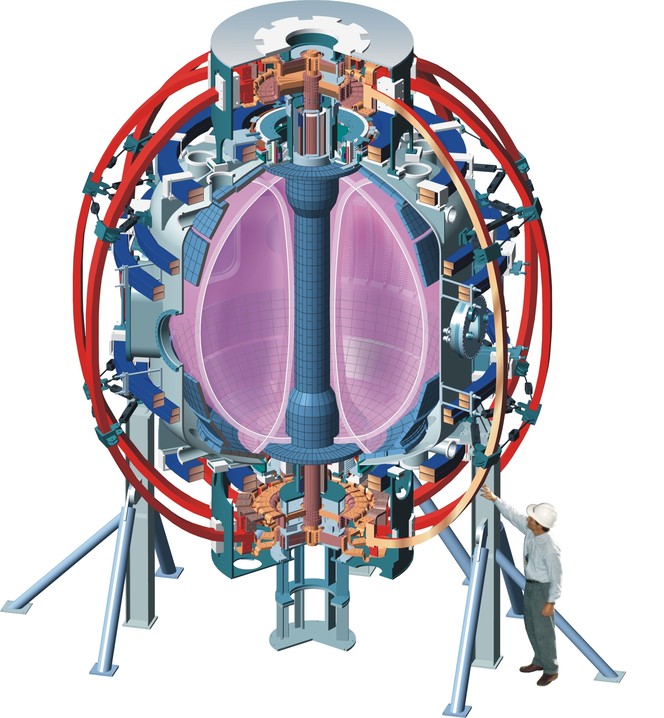
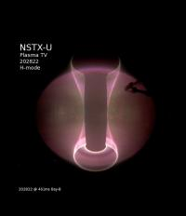
NSTX-U Role in Fusion Development
ST = Spherical Torus:
A magnetic confinement configuration that could lead to a smaller and more cost-competitive fusion energy source
High-temperature superconductors for compact and efficient ST fusion core
ST Pilot Plant for
net electricity
ST-based fusion neutron source
Provide steady-state fusion neutron environment for nuclear material and component R&D
Liquid metal blankets for high thermal efficiency
Fusion Technology and Performance
NSTX Upgrade Facility and Research Program
Extend ST confinement understanding to fusion-relevant temperatures
Demonstrate sustainment for future steady-state operation
High-power NSTX-U
tests of liquid metals as transformative wall solution
Advanced diagnostics + computation provide fundamental understanding and basis for next-step ST devices
NSTX
Explored ST stability and confinement
NSTX-U Motivation

Slide 6
Research Highlights

Slide 7
First NSTX-U Experiments Already Impactful
New tangential neutral beam injection can suppress Global Alfvén Eigenmodes (GAEs)
  associated with plasma and fast ion energy loss.
Predicted unstable Alfvén Eigenmodes and fast ion response to these modes.
HPC simulations of the plasma edge predict turbulence that will serve to spread the heat flux footprint and lower the peak heat fluxes on plasma facing components.
Sources and magnitudes of magnetic field asymmetries due to coil misalignments were identified, and their effect on the plasma was determined by HPC modeling.
All have implications for future burning plasmas!
NSTX-U Research Highlights

Slide 8
NSTX-U validating advanced energetic particle models
Fast-ion confinement critical issue for burning plasmas/ITER
New tangential NBI suppresses Global Alfven Eigenmode (GAE)
HYM code predicts frequencies and stability of observed modes
E. Fredrickson, Phys. Rev. Lett. 2017, APS-DPP invited 2017

Slide 9
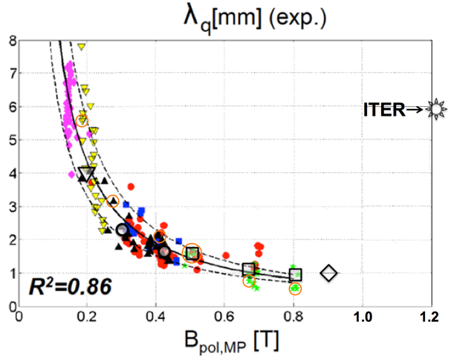
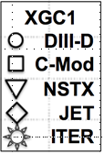
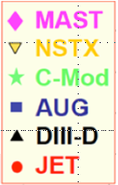
NSTX-U important for understanding power exhaust
Heat-flux width = major driver for power plant size and cost
XGC1 simulations predict turbulence will widen edge heat flux in ITER
C.S. Chang et al 2017 Nucl. Fusion 57 116023
1MA NSTX-U
2MA NSTX-U
XGC1 predicts turbulence will also widen heat flux in full current (2MA) NSTX-U
NSTX-U can access and study new regime of turbulent edge exhaust
NSTX-U Research Highlights

Slide 10
Show something on TF-EF or halo-current rotation

Slide 11
NSTX-U Team Collaborative Research
Expt. leadership in 8 dedicated run days on DIII-D in FY17
  Experiments prioritized based on: relevance to NSTX-U research goals, minimal scenario development, Early Career considerations
  Worked closely and cooperatively with DIII-D researchers
Strong international collaboration participation
  QUEST: NICD studies (startup and sustainment)
    CHI: steady progress increasing startup current from 29 to 48 kA
    ECCD: generated 85 kA during sustainment phase
  HL-2A: Dedicated run time for NSTX-U researcher-led expts.
    Effect of LHW on ELMs: decrease in amplitude observed, analysis ongoing
    Effect of NTMs on fast ion distribution
  MAST-U: collaboration starting: ops in Summer 2018
    Startup scenario development: researcher visited CCFE for 2 months
    Involvement also in Core, EP, Pedestal and Exhaust physics areas
  JET: plasma ramp-down scenario development for disruption-free discharge termination

Slide 12
Recovery Progress

Slide 13
NSTX-U greatly expands ST performance, challenges
2x higher magnetic field, plasma current, power
4x higher plasma pressure
4x higher forces
5x longer pulse durations
10x higher energy input
Challenge: Provide access to highest ST performance while also providing reliable facility operations to a wide user community
NSTX-U Recovery Progress

Slide 14
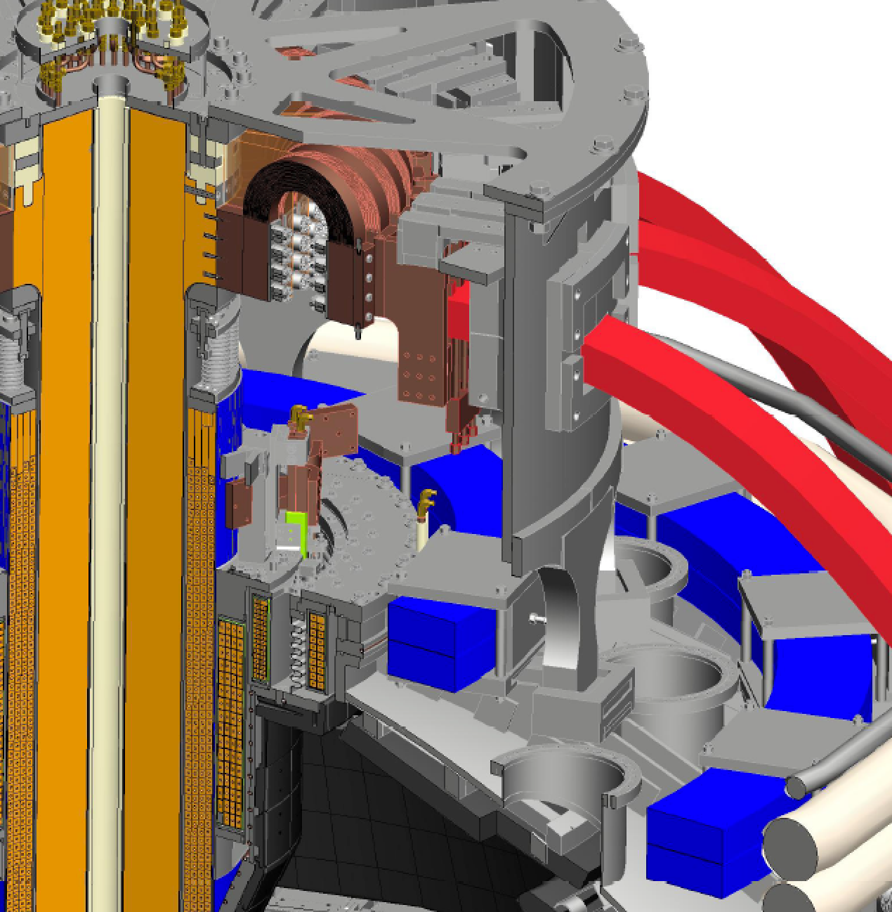
What is NSTX-U “Recovery”?
OH Ground Braid
FY2017: DOE requested PPPL to review “Extent of Condition” and submit Corrective Action Plan (CAP)
Extent of Condition motivated by:
  4/15: OH “Arc Flash” incident
  9/15: Inadequate inboard divertor bake
  5/16: CS cooling tubes wrong material, induced current/motion, breaches
  5/16: Bent PF1AU bus bar
  6/16: Internal short in PF1AU coil
Recovery = Implementation of Extent of Condition CAP
PF1B
PF1C
Inboard Divertor
OH Coil
PF1A
Cooling tubes

Slide 15
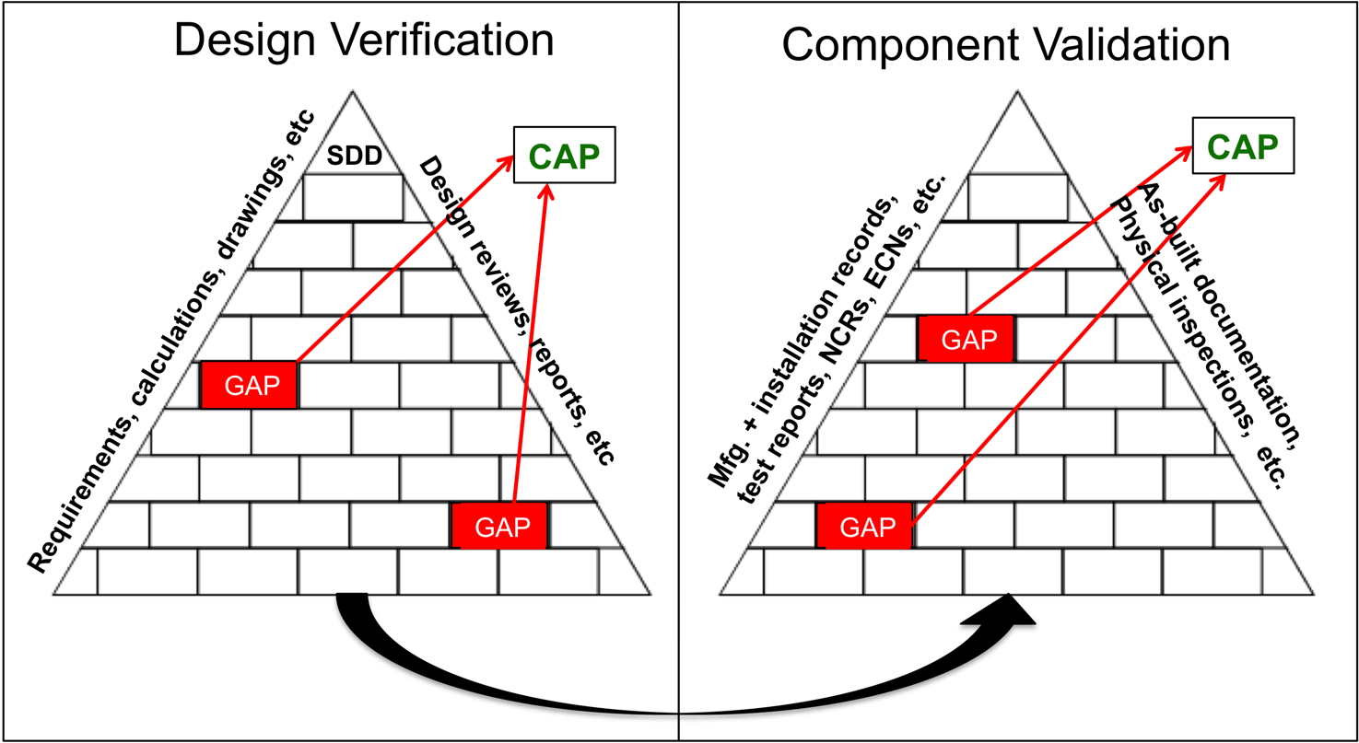
Developed DVVR Process
DVVR = Design Verification and Validation Reviews
Is the design adequate?
Is installed component consistent with the intent of the design?
Prepared System Design Descriptions (SDDs) providing linkage to design-basis documentation
Gathered manufacturing, installation, and test documents (dating back to the beginning of the NSTX project circa 1998)

Slide 16
NSTX-U Held 17 Reviews in FY2017
12 Design Verification and Validation Reviews (DVVRs)
  1170 “chits” covering entire NSTX-U technical scope → 443 “DVVR Issues”
  Then evaluated issue/event probability, duration, and severity → categorize / prioritize
2 Extent of Condition Reviews
  Assessed issues and conclusions of the DVVRs and the PPPL planned response
  Issued 2 reports → recommendations to ensure safety and reliability of the ST core
Design Integration Review
Conceptual Design Review
Cost and Schedule Review
→ 346 page report submitted: Recovery scope + CAP
Total of 47 external reviewers between Extent of Condition Reviews and DVVRs

Slide 17
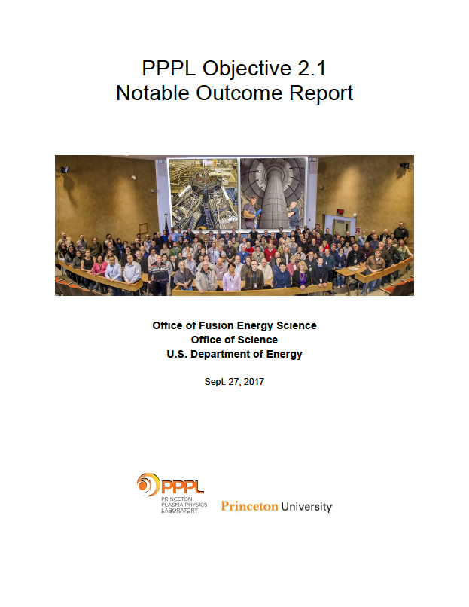
Notable Outcome Report: Extent of Condition
Submitted to FES in September 2017
Plan for returning NSTX-U to full performance with increased core reliability
  Includes cost and schedule estimates
NSTX-U Recovery Progress

Slide 18
6 Major Scope Areas Define Recovery
Improved Reliability Safety and Compliance
Rebuild all six inner-PF coils with a mandrel-free design
Replace plasma facing components that cannot be qualified for the full range of mechanical and projected thermal loads
Improve the “polar regions” (machine top and bottom)
Implement mechanical instrumentation to assess quality of mechanical models, trend machine behavior
Eliminate the safety issues identified with the medium temperature water system used during bakeout, improve He distribution system
Improve the neutron shielding of the test cell

Slide 19
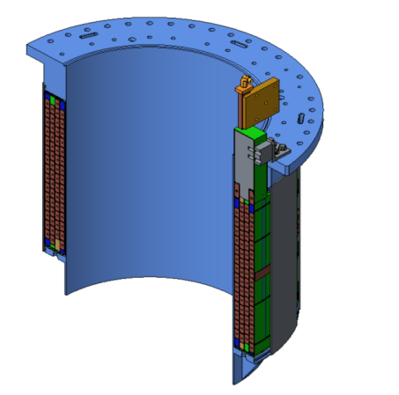
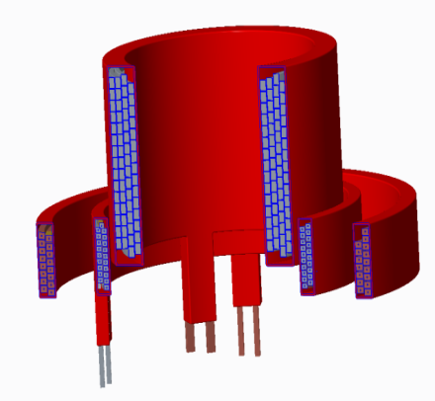
New Inner PF Coils
Designed to Improve Testability and Manufacturability
Previous coils fabricated on permanent mandrels
  Advantages: Precision winding surface, VPI mold, intrinsic structural support
  Disadvantages: mandrel is passive conductor
    Impacts turn-to-turn acceptance tests
    Deemed unacceptable during extent of condition review
New coils: removable mandrels
  Requires winding tooling
  Major schedule impact: had been intending to use permanent mandrels until mid-May 2017
New coil design simplifies fabrication
  Pure spiral winding (no “joggles”)
  Single continuous Cu extrusion (no joints)
  Softer copper (easier winding)
Original PF1A Coil with Mandrel
Three Mandrel-Free Coils
PF1A
PF1B
PF1C

Slide 20
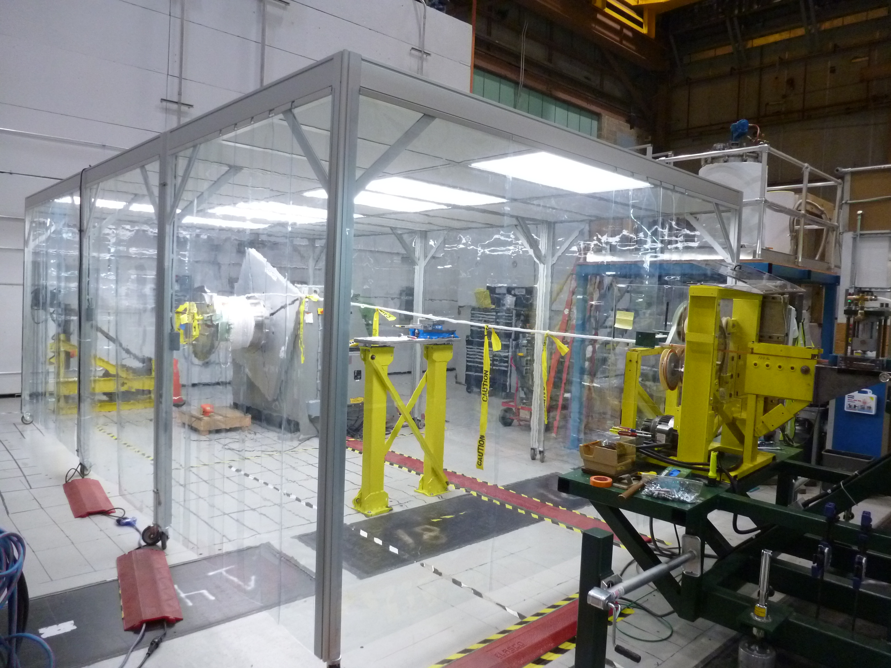
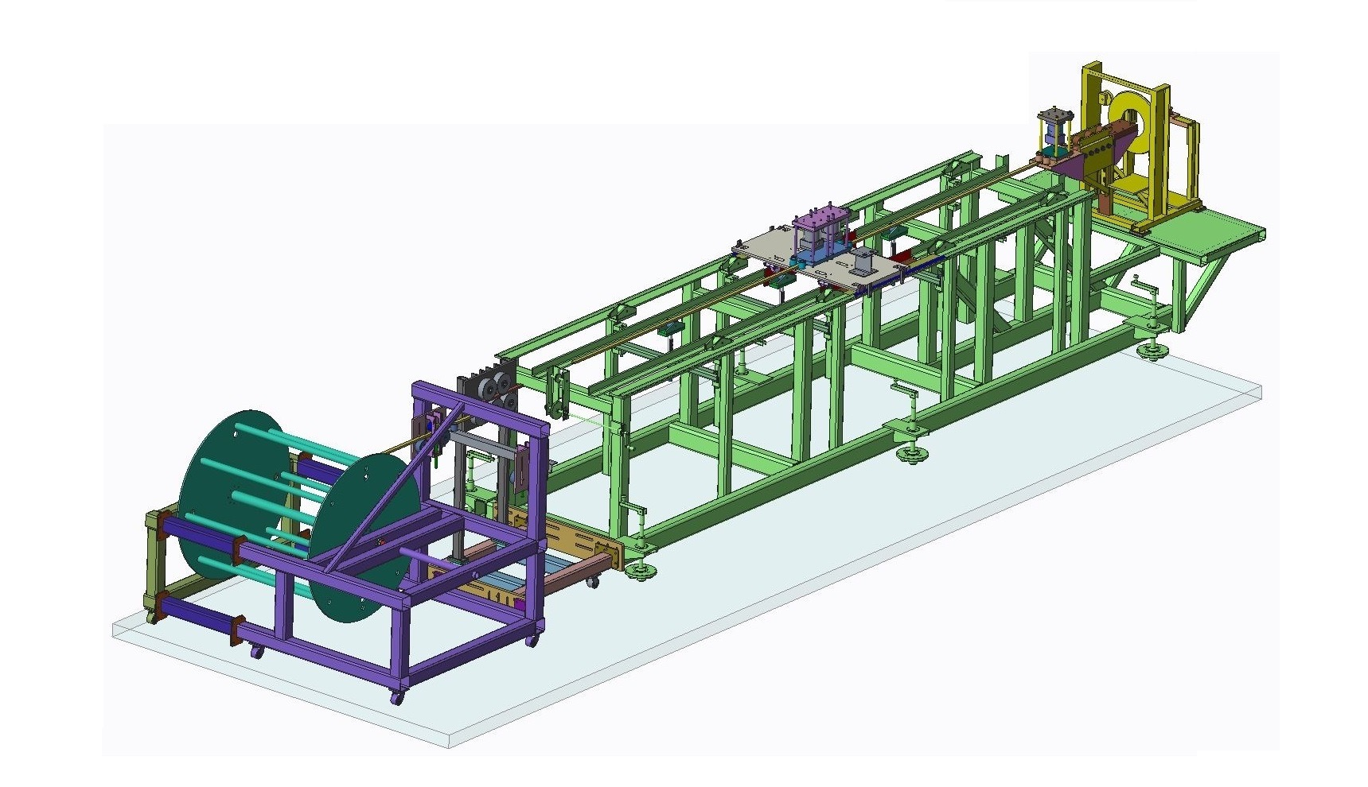
New Inner PF Coils
Fabrication Strategy Devised to Ensure Quality
Address quality concerns: All coil manufacturers must first successfully produce a prototype PF1A coil
  Quality will be assessed by:
    On-site surveillance
    High-pot and turn-to-turn testing
    Destructive testing (sectioning)
Will use 4 manufacturers
  Three industrial + PPPL
  Will have on-site surveillance for industrial suppliers
All production coils will be tested to full current and full I²t on a custom test-stand before installation on NSTX-U
Portable Clean Room at PPPL
Winding line at PPPL

Slide 21
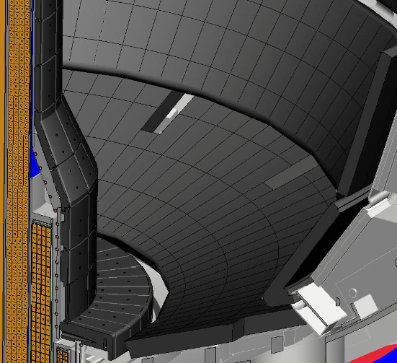
Improved PFC Designs
Two significant issues found with as-installed PFC designs
  Halo loads not fully accounted for in initial tile fixturing design
  Narrower SOL width now projected
Path Forward
Halo loads revisited based on NSTX, NSTX-U, MAST, other tokamak data
5 year plan research objectives + most recent SOL width models → updated heat flux specs
Divide tile scope into 2 regions:
  “Targeted Improvement” to chamfers, fixture scheme, material
  “Full Redesign” to enhance thermal performance → castellated tiles
All tiles will be designed to withstand B_{T}= 1.0 T, I_{P}=2.0 MA disruptions
Targeted Improvements
Full Redesign

Slide 22
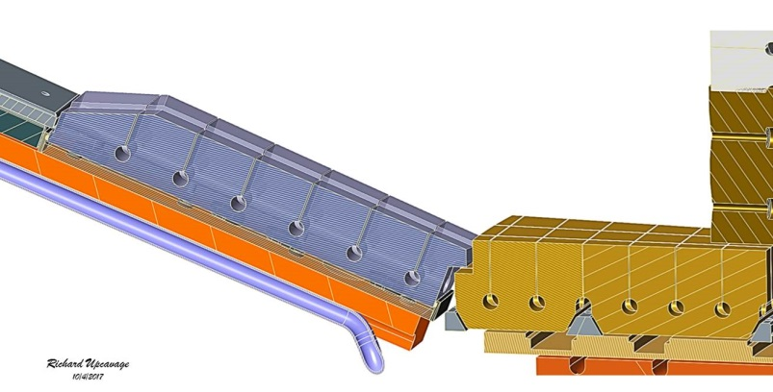
Improving Design of Polar Regions to Ensure High Performance and Reliability
Issues identified
  PF1B coil limited divertor bakeout temperature
  2 large ceramic insulators potential vacuum risk
  Use of single O-rings → potential for leaks
  Plasma can sometimes impinge on PF1C can
Solutions
  PF1B supported by slings → thermally isolated
  Lower ceramic insulator eliminated
  Double O-rings with pumped interspaces
  Tiles will bridge the CHI gap
Tile gap between inner and outer vessels only large enough to accommodate thermal and mechanical motion, fit-up tolerances
Castellated Outboard Tile
Castellated Inboard Tile
Research / Programmatic Impact:
Coaxial Helicity Injection (CHI)
as previously implemented is now excluded
Closed CHI Gap

Slide 23
Recovery Progress – Interim Summary
Reviews have determined what needs to be repaired / replaced
Developed new designs to repair and improve components
Improving cost and schedule estimates
  Following DOE O413.3B Program and Project Management guidelines
  FY2017 / present NSTX-U operations budget ≈ sufficient to fund Recovery
    Cost & Schedule Review estimated “Recovery” costs: $48M base + $15M contingency
    Normal/planned outage costs for “Maintenance and Run Preparation”: $34M + $4M cont.
  New PF1 coils are critical path, followed by PFCs
  Resume operations between fall 2019 and summer 2020
Recovery will significantly enhance NSTX-U reliability & safety, provide highest-performance ST device as a robust user facility

Slide 24
Recovery Plans
FY2018 Notables, Risks, Mitigation

Slide 25
PF1ABC Coil FDRs Objective 2.1
FES: For the NSTX-U recovery project, complete final design reviews for six inner poloidal magnetic field coils (viz., PF1A-upper, PF1A-lower, PF1B-upper, PF1B-lower, PF1C-upper, and PF1C-lower) by
March 31, 2018. (Objective 2.1)
Risk: Late change in coil design delays design review(s)
Mitigation: Preliminary Design Review (PDR) scheduled for mid-November. Ensure this is a rigorous and robust process to ensure the design is solid before approaching Final Design Review (FDR)- limiting need to change design.
NSTX-U Recovery

Slide 26
Fabricate Prototype/Test Objective 2.2
FES: For the NSTX-U recovery project, build at least one prototype PF1A inner poloidal magnetic field coil. Qualify the coil by operating it at both the maximum required current and at maximum joule heating. Verify the quality of the coil's insulation system through electrical testing followed by destructive sectioning and inspection. Submit a final report documenting the results by July 15, 2018. (Objective 2.2)
NSTX-U Recovery

Slide 27
Fabricate Prototype/Test Objective 2.2 continued
Risk:
  Coil is not qualified as a result of testing – fails test
  Coil prototype fabrication schedule does not support completion by need date
Mitigation:
  If first prototype is not qualified, test the second prototype fabricated……or third….or fourth
  PPPL Coil prototype winding scheduled to begin in early November with completion in January. Evaluation through mid-March – this leaves 4 months of float to complete testing/section/documentation. If PPPL coil fails, all three vendor prototype schedules will leave time for testing.
  Training for vendor coil fab oversight (discussions initiated)
NSTX-U Recovery

Slide 28
Test PF Coils Objective 2.2
FES: For the NSTX-U recovery project, build and test at least one of each type of production inner poloidal magnetic field coil (viz., PF1A, PF1B, and PF1C). Qualify a PF1A coil by operating it at both the maximum required current and at maximum joule heating by September 30, 2018. (Objective 2.2)
NSTX-U Recovery

Slide 29
Test PF Coils Objective 2.2
Continued
Risk:
  Fabrication dates from vendors do not support completion in-time for September 30, 2018 test date.
  Coil fails electrical test
Mitigation:
  Award tooling/Manufacturing Process Outline development at completion of FDR, then award production coil fabrication once prototype is evaluated. May need to start winding production coils immediately after winding (before VPI/ evaluation) vendor prototype to support this completion date.
  Either accept risk or consider having other vendors fabricate production coils in parallel + effective vendor oversight
NSTX-U Recovery

Slide 30
Baseline Project Objective 4.2
SC/FES: The University, in concert with PPPL leadership, shall ensure that the necessary support is provided for efficient and effective management of the NSTX-U Recovery effort, such that this project can be ready to be baselined by April 30, 2018. (Objective 4.2)
Risk: Difficulty bringing-on leadership to support the project
Mitigation: Project/Lab leadership continue effort to bring on an experienced/qualified Project Manager
  Project Manager interviews initiated
NSTX-U Recovery

Slide 31
Initiated weekly coil management meeting
Identifying means to accelerate coil fab without sacrificing quality
Dedicating P&C resources only to coils → visualize work-flow
NSTX-U Recovery

Slide 33
NSTX-U Research and Recovery Summary
Making important scientific contributions through NSTX/NSTX-U analysis, collaborations
Recovery scope, cost, schedule well defined – (much more to be done)
FY2018 will be critical year for new PF1 coil construction and demonstrating improved engineering outcomes

Slide 34
Recovery: Repair Device, Improve Core Reliability
Magnets ($7.9M)
  Designs w/ improved manufacturability and testability
Plasma Facing Components ($11.5M)
  Implementing tiles that can handle 2 MA, 1 T disruptions, w/ substantially higher heat flux handling capability
Polar Region ($3.1M)
  Improved coil supports w/ thermal isolation from the vessel, improve vacuum via double O-rings
Machine Instrumentation ($1.5M)
  Ability to compare measured displacements to design models (ANSYS), trend behavior as loads are increased
NTC Shielding ($2M)
  Improved shielding to support full power operations
Bakeout ($1.8M)
  Improved bakeout feedthroughs, improved He flow control, mitigation of safety issues with hot water system.
Machine Reassembly ($2.3M)
Project Management ($7.3M)
Costs August 2017 – September 2019
Scope | Cost ($M)
Scope described on left | 37.4
Additional Recovery Scope | 10.8
Total Estimated Cost | 48.2
Contingency | 14.5
Total Recovery Cost | 62.7
NSTX-U Recovery

Slide 35
Maintenance and Run Preparation Scope
Neutral Beam Maintenance ($6.1M)
  Reliable beam restart → Refurbish three ion sources, more molybdenum shielding in the NB#2 duct, refrigerator maintenance, replacement of EoL telemetry, calorimeter repairs,…
Central Instrumentation and Control ($1.4M)
  Improved reliability → Data link improvements, EPICS modernization, Network Segregation
Power Systems ($1.1M)
  Maintenance to ensure smooth startup
Operations
  energy + allocations ($6.9M),
  continued data serving, necessary maintenance, supervision ($7.8M)
  machine commissioning ($5.4).
Costs August 2017 – September 2019
Scope | Cost ($M)
Scope described on left | 28.7
Additional Maintenance and Run Preparation Scope | 5.8
Total Estimated Cost | 34.5
Contingency | 3.6
Total Cost | 38.1
Note: Does not presently include a significant component of HHFW maintenance/upgrade except on the antenna
NSTX-U Recovery

Slide 36
Goal 1.0 - Mission Accomplishment
FES: Provide leadership, coordination, and support to the FES joint research target (JRT) with the goal of testing predictive models of fast-ion transport by multiple Alfven eigenmodes. (Objective 1.2)
NSTX-U Research

Slide 37
Actions to achieve Notable
PPPL Leader identified in FY2017 – Mario Podestà
Coordinating committee:
  M. Podestà, N. Gorelenkov – NSTX-U/PPPL
  W. Heidbrink, C. Collins – DIII-D/GA
  Y. Lin – MFE/MIT
Milestones submitted and accepted by FES last week
  Q1: Review previous modeling activities on NSTX/NSTX-U and DIII-D data to identify candidate predictive models. Discuss and develop a detailed analysis plan for existing data. Discuss potential collaborative experiments on DIII-D during FY-18.
  Q2: Begin analysis and modeling activities for NSTX/NSTX-U and DIII-D data identified during Q1. Complete a plan for collaborative experiments on DIII-D, including specific measurements that are required to support the modeling and validation activities.
  Q3: Conduct collaborative experiments on DIII-D according to the plan developed in Q1 and Q2. Complete analysis of previous NSTX/NSTX-U and DIII-D data and present a draft progress report. Begin analysis of completed collaborative experiments on DIII-D.
  Q4: Consolidate results from the analysis of NSTX/NSTX-U and DIII-D data, including results from collaborative experiments from FY-18. Prepare a joint report documenting the progress made toward the JRT goals. Identify open issues and provide guidance for future work based on the JRT results.
NSTX-U Research

Slide 38
JRT Risks, Communication Plan
Risks:
  DIII-D cannot provide new data
    Mitigation: use prior data (already doing for NSTX/NSTX-U)
  Mario is experienced at running JRTs (low risk leader)
Tracking: NSTX-U will have quarterly reviews of research milestone progress, and this JRT will be included, and I&T will also assist in management and data contributions.
Communication:
  Reports submitted quarterly to FES + final report
NSTX-U Research

Slide 39
FY2018 NSTX-U Research Milestones
R(18-1): Develop and benchmark reduced heat flux and thermo-mechanical models for PFC monitoring
R(18-2): Develop simulation framework for spherical tokamak breakdown and current ramp-up
R(18-3): Validate and further develop reduced transport models for electron thermal transport in ST plasmas
R(18-4): Optimize energetic particle distribution function for improved plasma performance
Will track with quarterly meetings for status/plan
NSTX-U Research

Slide 40
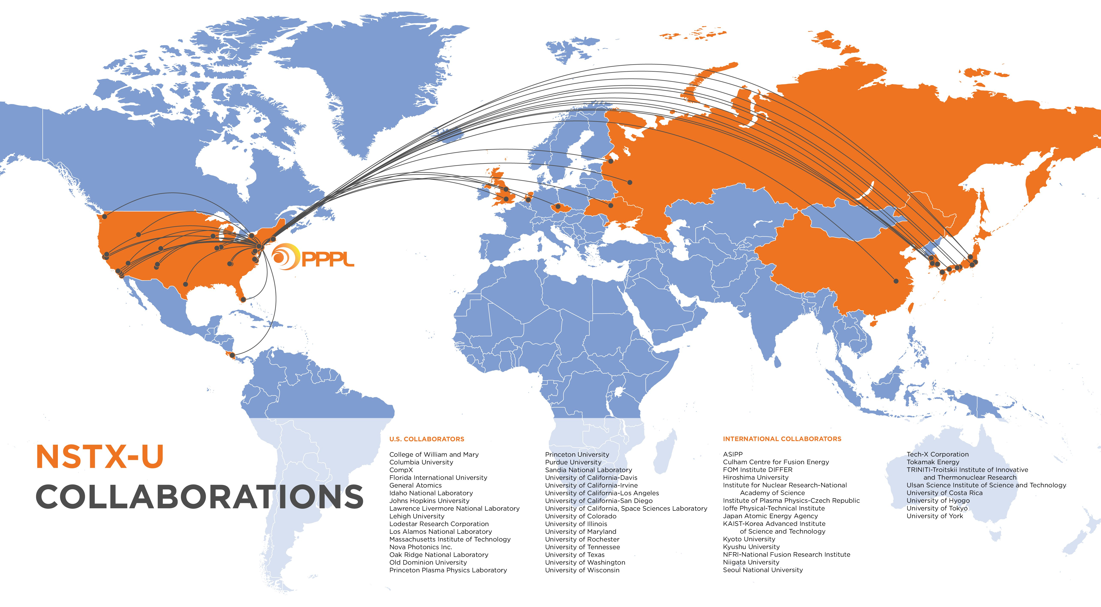
NSTX-U Research is Highly Collaborative
362 data users
40 international
54 collaborating institutions
32 domestic, 22 international
29 graduate students
25 post-doctoral researchers

Slide 41
Strong Focus on the Project Following EoC Reviews
Began the preparation of Work Approval Forms for all approved scope throughout the NSTX-U technical domain.
Assigned all scope to one of three categories
Formed a preliminary Risk Registry
Scope Category -> | Recovery Scope | Maintenance and Run Preparation | Operations Enhancement for Improve Reliability
Definition -> | All effort on the six major elements. Many minor scope items from DVVRs impacting the tokamak core. | Work we would have been doing in any case to prepare for operations. | DVVR issues that require additional funding to address.
Examples -> | New coils, new tiles | Neutral beam maintenance | MG#2 weld repair

Slide 42
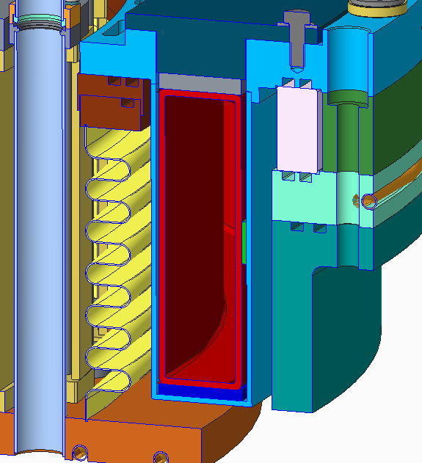
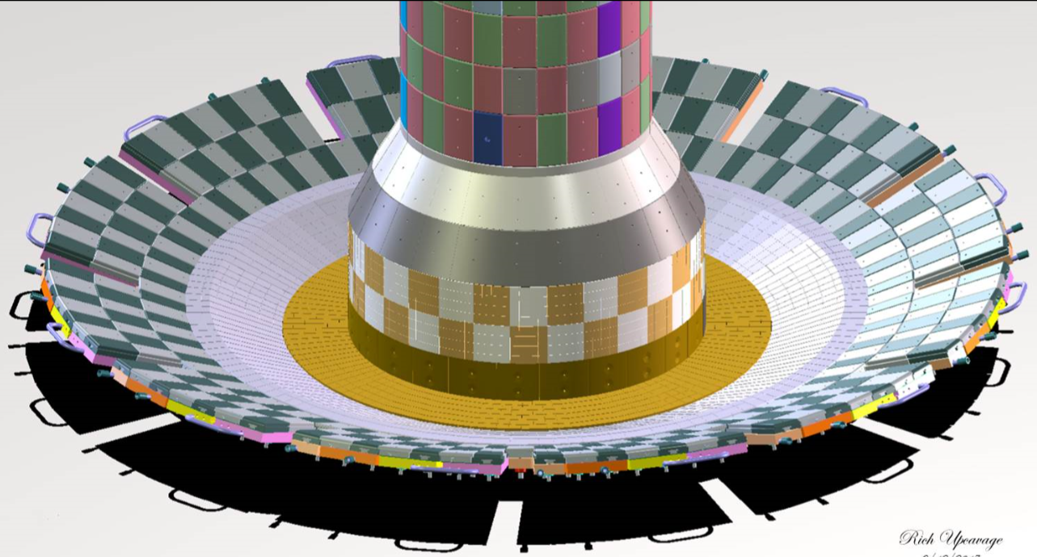
Updating Design of the Polar Region
Coils thermally isolated from the vessel.
Lower ceramic break eliminated.
PF-1c shielded from plasma.
All single O-rings eliminated in favor of double O-rings.
Top of Machine: Double O-Rings + Ceramic Break
<- CHI Gap Totally Closed

Slide 43
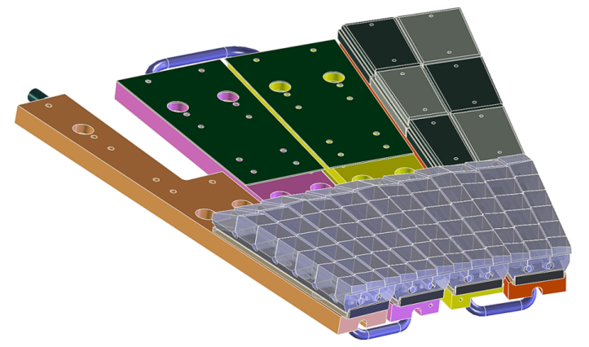
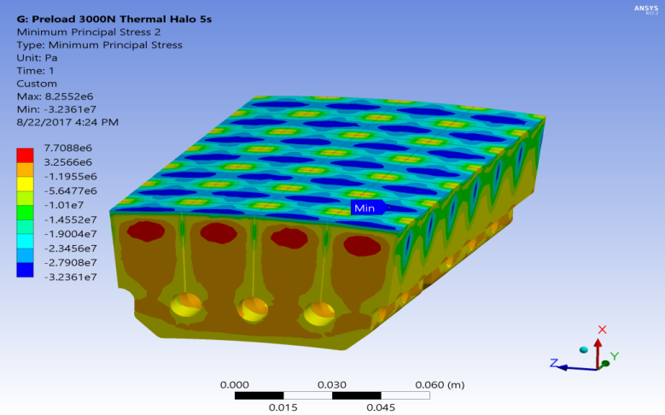

New “Castellated” Design Provides For High Heat Handling Capacity and Ease of Implementation
Design allows individual castellation to thermally expand under heat flux w/o exceeding compressive stress limits
→ Lower material stress for a given tile surface temperature
Outer divertor assembly with castellated tiles and exagerated fish-scale angles
Fully Assembled Divertor
Materials
Considering a range of isotropic graphites
Planning high heat flux tests using e-beam facilities at Applied Research Labs
Study both isolated samples and full tile modules
In collaboration with GA, ORNL
PFCs Being Updated

Slide 44
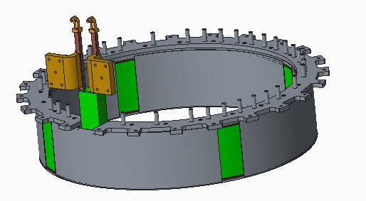
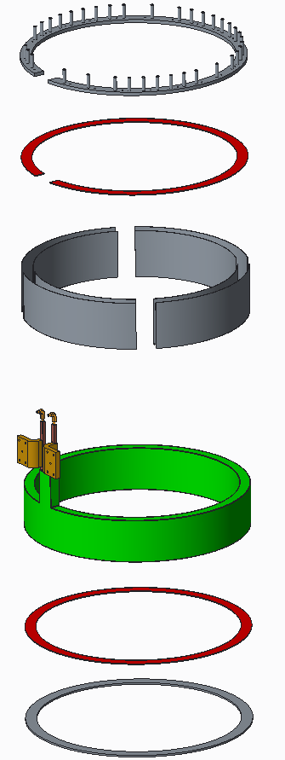
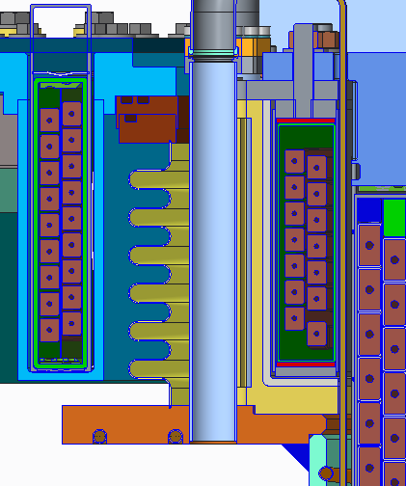
Improving Design of Polar Regions to Ensure High Performance and Reliability
Issues identified
  Mechanical connection of PF1B coil to limited divertor bakeout temperature
  2 two large ceramic insulators deemed a risk to reliability / vacuum integrity
  Use of single O-rings → potential leaks
  Plasma can sometimes impinges on PF1C can
Solutions
  PF1B supported by “slings”, thermally isolated
  Lower ceramic insulator eliminated
  Double O-rings with pumped interspaces
  Tiles will bridge the CHI gap
Mandrel-free coil mounted in slings, isolated from hot flanges
Thermal Isolation

Slide 45
Improving Design of Polar Regions to Ensure High Performance and Reliability
Issues identified
  Mechanical connection of PF1B coil to limited divertor bakeout temperature
  2 two large ceramic insulators deemed a risk to reliability / vacuum integrity
  Use of single O-rings → potential leaks
  Plasma can sometimes impinges on PF1C can
Solutions
  PF1B supported by “slings”, thermally isolated
  Lower ceramic insulator eliminated
  Double O-rings with pumped interspaces
  Tiles will bridge the CHI gap
Top of Machine: Double O-Rings + Ceramic Break

Slide 46
Improving Design of Polar Regions to Ensure High Performance and Reliability
Issues identified
  Mechanical connection of PF1B coil to limited divertor bakeout temperature
  2 two large ceramic insulators deemed a risk to reliability / vacuum integrity
  Use of single O-rings → potential leaks
  Plasma can sometimes impinges on PF1C can
Solutions
  PF1B supported by “slings”, thermally isolated
  Lower ceramic insulator eliminated
  Double O-rings with pumped interspaces
  Tiles will bridge the CHI gap
Tile gap between inner and outer vessels only large enough to accommodate thermal and mechanical motion, fit-up tolerances
Castellated Outboard Tile
Castellated Inboard Tile
Research / Programmatic Impact:
Coaxial Helicity Injection (CHI)
as previously implemented is now excluded
Closed Gap

Slide 47
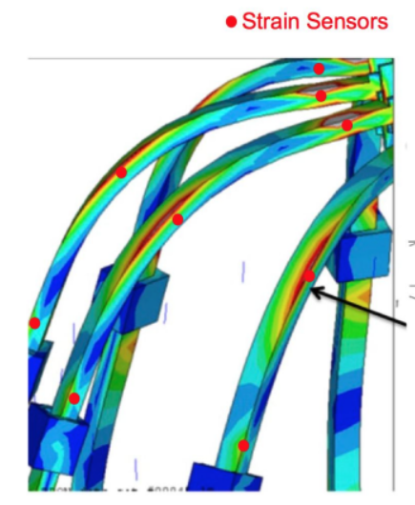
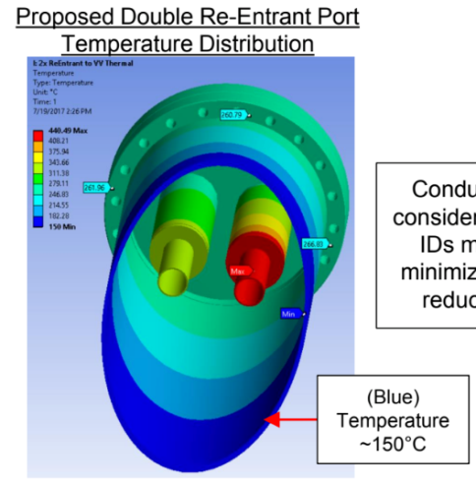
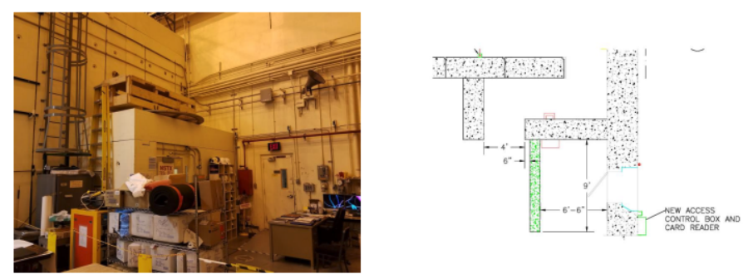
Bakeout, Instrumentation, and Shielding Scope will Improve Reliability and Safety
Bakeout Improvements
Improved hot helium feed-throughs, flow control, and instrumentation
Improved safety features on heated water system
Machine Instrumentation
Model validation and trending
Qualify design for full performance
Shielding Improvements
Construct/improve labyrinths at doors
Shielding in or in front of penetrations

Slide 48
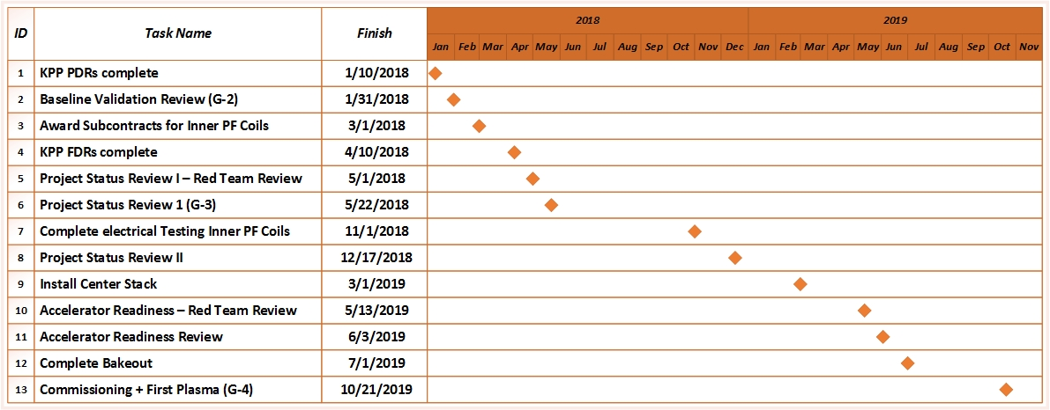
Recovery Project Milestones (Preliminary)
NSTX-U Recovery

