Slide 1




NSTX-U
Supported by
NSTX-U Disruption Prediction, Avoidance, and Mitigation Working Group – Initial Meeting
Coll of Wm & Mary
Columbia U
CompX
General Atomics
FIU
INL
Johns Hopkins U
LANL
LLNL
Lodestar
MIT
Lehigh U
Nova Photonics
ORNL
PPPL
Princeton U
Purdue U
SNL
Think Tank, Inc.
UC Davis
UC Irvine
UCLA
UCSD
U Colorado
U Illinois
U Maryland
U Rochester
U Tennessee
U Tulsa
U Washington
U Wisconsin
X Science LLC
S. A. Sabbagh and R. Raman
Department of Applied Physics, Columbia University, New York, NY
University of Washington, Seattle, WA
Culham Sci Ctr
York U
Chubu U
Fukui U
Hiroshima U
Hyogo U
Kyoto U
Kyushu U
Kyushu Tokai U
NIFS
Niigata U
U Tokyo
JAEA
Inst for Nucl Res, Kiev
Ioffe Inst
TRINITI
Chonbuk Natl U
NFRI
KAIST
POSTECH
Seoul Natl U
ASIPP
CIEMAT
FOM Inst DIFFER
ENEA, Frascati
CEA, Cadarache
IPP, Jülich
IPP, Garching
ASCR, Czech Rep
NSTX-U DPAM Working Group Meeting
January 30th, 2015
PPPL
V1.4

Slide 2
Initial meeting of the Disruption Prediction, Avoidance, and Mitigation (DPAM) Working Group - OUTLINE
Mission statement and Scope
Recent History
Present Charges
Structure and Organization
Initial Approach and Summary of Elements
Open Discussion

Slide 3
DPAM WG – Mission Statement and Scope
Mission statement
  Satisfy gaps in understanding prediction, avoidance, and mitigation of disruptions in tokamaks, applying this knowledge to move toward acceptable levels of disruption frequency/severity using quantified metrics
Scope
  Location: Initiate and base the study at NSTX-U, expand to a national program and international collaboration
  Timescale: Multi-year effort, planning/executing experiments of various approaches (leveraging the 5 NSTX-U Year Plan) to reduce plasma disruptivity/severity at high performance
  Breadth: High-level focus on quantified mission goal, with detailed physics areas expected to expand/evolve within the group, soliciting research input/efforts from new collaborations as needed

Slide 4
Recent history regarding the DPAM Working Group
DPAM is a top priority research element (one of two) identified by recent FESAC Strategic Planning Panel
  We championed this effort in July 2014 FESAC talk / white paper (S.A. Sabbagh, et al.)
    Talk and white paper available at:
    http://nstx.pppl.gov/DragNDrop/Working_Groups/DPAM/Repository
NSTX-U 5 Year Plan committee recommendation supporting this effort
  NSTX-U should lead a multi-machine prediction/avoidance effort
For NSTX-U, we are a “working group” – will also have a wider scope
  Initial charges for NSTX-U created for the group
  Roger Raman deputy lead - focus on mitigation

Slide 5
Near 100% disruption avoidance is an urgent need for ITER, FNSF, and future tokamaks
This is the new “grand challenge” in tokamak stability research
  Can be done! (JET: < 4% disruptions w/C wall, < 10% w/ITER-like wall)
    ITER disruption rate: < 1 - 2% (energy load, halo current); << 1% (runaways)
  Disruption prediction, avoidance, and mitigation (PAM) is multi-faceted, best addressed by focused, national effort (multiple devices/institutions)
  Serves FES strategic planning charge; pervades 3 of 5 ReNeW themes
Strategic plan summary: Utilize and expand upon successes in stability and control research – synergize elements
  Add focused, incremental support for US research programs to show near 100% disruption PAM success using quantifiable figures of merit
  Leverage upgraded facilities with heightened focus on disruption PAM
Leverage US university expertise, international collaborations
  e.g. JET high power operation, KSTAR long-pulse operation above ideal MHD stability limits, US university scientists, post-docs, and students
A relatively modest incremental investment will greatly enhance quantifiable progress

Slide 6
DPAM WG - Present NSTX-U Charges
Physics
  What are leading causes of disruptions in NSTX & initial NSTX-U ops?
  How can tokamaks practically minimize disruption frequency and severity? (initial focus on NSTX-U)
  What prerequisites / tools are needed to prepare NSTX-U to operate a large # of sequential shot-seconds (say 1-5 shot minutes) without a disruption?
Communication of results
  How will NSTX-U interface to the upcoming (~June) FES workshops, and address the FESAC/FES Tier 1 issue of “Transients" generally?
    In which disruption research areas can NSTX-U make leading contributions?
    What are the associated long-term resource needs from NSTX-U?
  What are the leading/highest priority NSTX-U contributions to JRT-16?
    What are the required resources during FY15-16 to support JRT-16?

Slide 7
NSTX-U DPAM WG – Structure and Organization
Working Group
  Focused physics research, cross-cutting NSTX-U TSGs or SGs
  Does not allocate run time – rather, advises SGs and TSGs regarding XP priority and needs related to the group’s mission
Communication of results / group discussion
  Specific DPAM WG meetings will be held with appropriate frequency
  To reduce the number of meetings, DPAM WG discussions on specific science elements will often be conducted in coordination with NSTX-U Macroscopic Stability TSG (or other TSGs)
  Interface to USBPO through established channels
  Interface to ITPA through MHD Stability Group, et al., and established joint experiment / analysis groups (e.g. MDC-19, 21, 22, etc.)
Aid research efficiency and collaboration
  Communicate researcher points of contact to avoid duplication of effort

Slide 8
DPAM WG Initial Approach to Disruption Prediction and Avoidance – related physics Elements
Initial Approach
  Define disruption criteria, characterization, severity
  Define a characterization for disruption causes, with related quantitative evaluations
    Start by adopting a formalization similar to JET, altered as appropriate for NSTX-U, which includes connections between categorized elements
Elements
  Significant research efforts presently exist (and/or are part of the NSTX-U 5 Year Plan) that cover these elements
    Engage, utilize, communicate these efforts related to DPAM mission
  As progress is made, identify important research elements not being covered and solicit additional effort in these areas (from within group, and/or from new collaborations), including potential hardware needs

Slide 9
Example of disruption physics elements interconnected to describe paths toward disruption
Elements
  Provide a logical and quantifiable set of components in the disruption chain, with underlying physics
Connections
  Shows interrelations of the elements, arrow thickness showing relative probability of path
  Can have multiple inputs / outputs
Example: Disruption Elements and Connections Diagram (JET)
P.C. de Vries et al., Nucl. Fusion 51, 053018 (2011)

Slide 10
(Incomplete) List of physics elements tied to disruption prediction, avoidance (highlighting individual involvement)
Impurity control (NC)
  bolometry-triggered shutdown (SPG); "tailoring” radiation-induced TM onset (LD, DG)
  change plasma operational state / excite ELMs, etc. (TBD – perhaps JC)
Greenwald limit (GWL)
  density/power feedback, etc. (DB)
Locked TM (LTM)
  TM onset and stabilization conditions, locking thresholds (JKP,RLH,ZW)
  TM entrainment (YSP)
Error Field Correction (EFC)
  NSTX-U EF assessment and correction optimization (CM,SPG)
  NSTX-U EF multi-mode correction (SAS, YSP, EK)
Current ramp-up (IPR)
  Active aux. power / CD alteration to change q (MDB, SPG)
Shape control issues (SC)
  Active alteration of squareness, triangularity, elongation – RFA sensor (SPG,MDB)
Transport barrier formation (ITB)
  Active global parameter, V_{φ}, etc. alteration techniques (SAS,JWB,EK)
H-L mode back-transition (HLB)
  Active global parameter, V_{φ}, etc. alteration techniques (SAS,JWB,EK)
Approaching vertical instability (VSC)
  Plasma shape change, etc. (SPG, MDB)
Resistive wall mode (RWM)
  Active global parameter, V_{φ}, etc. alteration techniques (SAS,JWB)
  Active multi-mode control (SAS,YSP,KT)
Ideal wall mode (IWM)
  Active global parameter, V_{φ}, etc. alteration techniques (JEM)
Internal kink/Ballooning mode (IKB)
  Active global parameter, V_{φ}, etc. alteration techniques (SAS,JWB)
  Active multi-mode control (SAS, YSP, KT)
Abbreviations:
JWB: Jack Berkery
AB: Amitava Bhattacharjee
DB: Devon Battaglia
MDB: Dan Boyer
JC: John Canik
LD: Luis Delgado-Aparicio
DG: Dave Gates
SPG: Stefan Gerhardt
MJ: Mike Jaworski
EK: Egemen Kolemen
RLH: Rob La Haye
JEM: Jon Menard
CM: Clayton Myers
JKP: Jong-Kyu Park
YSP: Young-Seok Park
RR: Roger Raman
SAS: Steve Sabbagh
KT: Kevin Tritz
ZW: Zhirui Wang
TBD: (To be decided)
Interest from Theory
  Amitava Bhattacharjee, Allen Boozer, Dylan Brennan, Bill Tang have requested involvement

Slide 11
Disruption mitigation research can also be used to quantify disruption severity reduction
Power handling and shutdown
  Heat / radiation / plasma parameter variation criteria for handoff from normal operation to disruption mitigation (SPG)
  Heat / radiation load characteristics (including asymmetry) in NSTX-U (RR, ORNL (JC?))
  MGI characteristics in NSTX-U, incl. acceleration of gas penetration to core plasma (RR)
  Innovative techniques for mass deposition, incl. electromagnetic particle injection (RR)
  MGI effectiveness as a function of poloidal position of injection (RR)
  Influence of wall conditions on disruptions and their mitigation (SPG)
  Innovative first wall applications, including sacrificial limiters and liquid metal PFC (SPG,MJ?)
Halo currents
  Halo current characteristics during NSTX-U disruptions (SPG,CM,AB)
  Active control of disrupting plasma and halo currents (SPG,CM,SAS)
Runaways
  Criteria for runaway electron generation (SPG)
(red text: individuals involved)
Joint Research Target for FY16 (JRT16) focused on disruption mitigation (with prediction/avoidance elements)

Slide 12
DPAM is a grand challenge problem – help make the solution a reality
Status
  NSTX-U DPAM research efforts have already started among individuals and small groups on the NSTX-U Team
Action Items
  Please contact Steve and Roger (sabbagh@pppl.gov; rraman@pppl.gov) to join and contribute to the group
  Open discussion (now) regarding the DPAM WG as summarized in this talk
    Please send further constructive comments to Steve and Roger by email as desired
Next Step
  Meeting to discuss DPAM physics elements related to NSTX and initial NSTX-U operation (focus on 5 Year Plan) (to be announced)

Slide 13
Important Links for NSTX-U DPAM Working Group
General
  DPAM Working Group - meetings folder area
    http://nstx.pppl.gov/DragNDrop/Working_Groups/DPAM/2015
  General repository file area
    http://nstx.pppl.gov/DragNDrop/Working_Groups/DPAM/Repository
NSTX-U specific
  NSTX-U 5 Year Plan
    http://nstx-u.pppl.gov/five-year-plan/five-year-plan-2014-18
  NSTX-U diagnostics
    http://nstx-u.pppl.gov/diagnostics
  NSTX-U DPAM group - summary page
    http://nstx-u.pppl.gov/program/working-groups/disruption-pam

Slide 14
Supporting slides follow

Slide 15
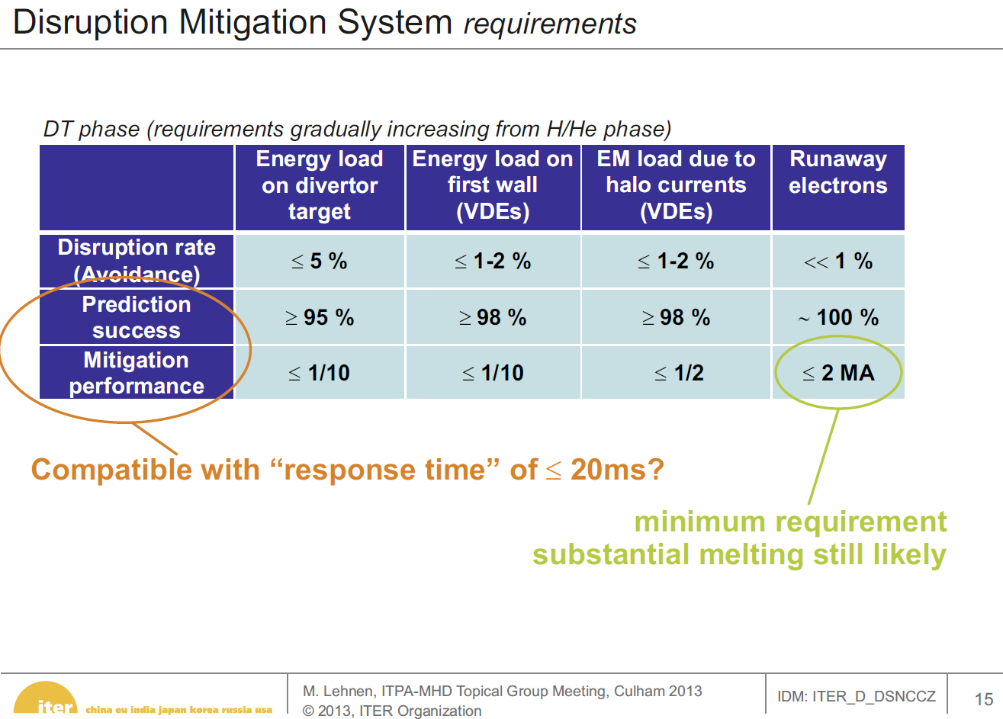
ITER Disruptivity Requirements (Lehnen 2013)

