Slide 1
New Tool to generate Surface Heat Flux Data to 3D-shaped PFCs
Andreas Wingen
PFC working group meeting
May 21. 2018

Slide 2
New tool: Surface Heat Flux Tracer
Import a standard class of CAD output format.
Import equilibria from standard GEQDSK format.
Run double & near double null geometries and specify the power sharing separately between all four divertor regions. (Enhanced: also 3D equilibria or snowflake)
Specify the heat flux profile to the PFCs, e.g. [Eich, PRL 2011].
Complete the computation of the heat flux pattern for a single equilibrium in < 5 minutes. (Enhanced: < 60s)
Deployable and maintainable for computing systems similar to those available at PPPL. (Enhanced: scalable on Cluster)
(Enhanced: Add radiative heat flux)
Reads STL file.
Reads standard EFIT g-files.
Runs with any NSTX geometry. (3D & snowflake too)
Uses Eich profile for now. Other can easily be added.
Grid generation: 40s Field line tracing: 60s Heat flux: 7s
Uses C++ and Python 2.7 on Linux cluster (fully parallel with MPI)
20
CPUs
PFCR-MEMO-020-00

Slide 3
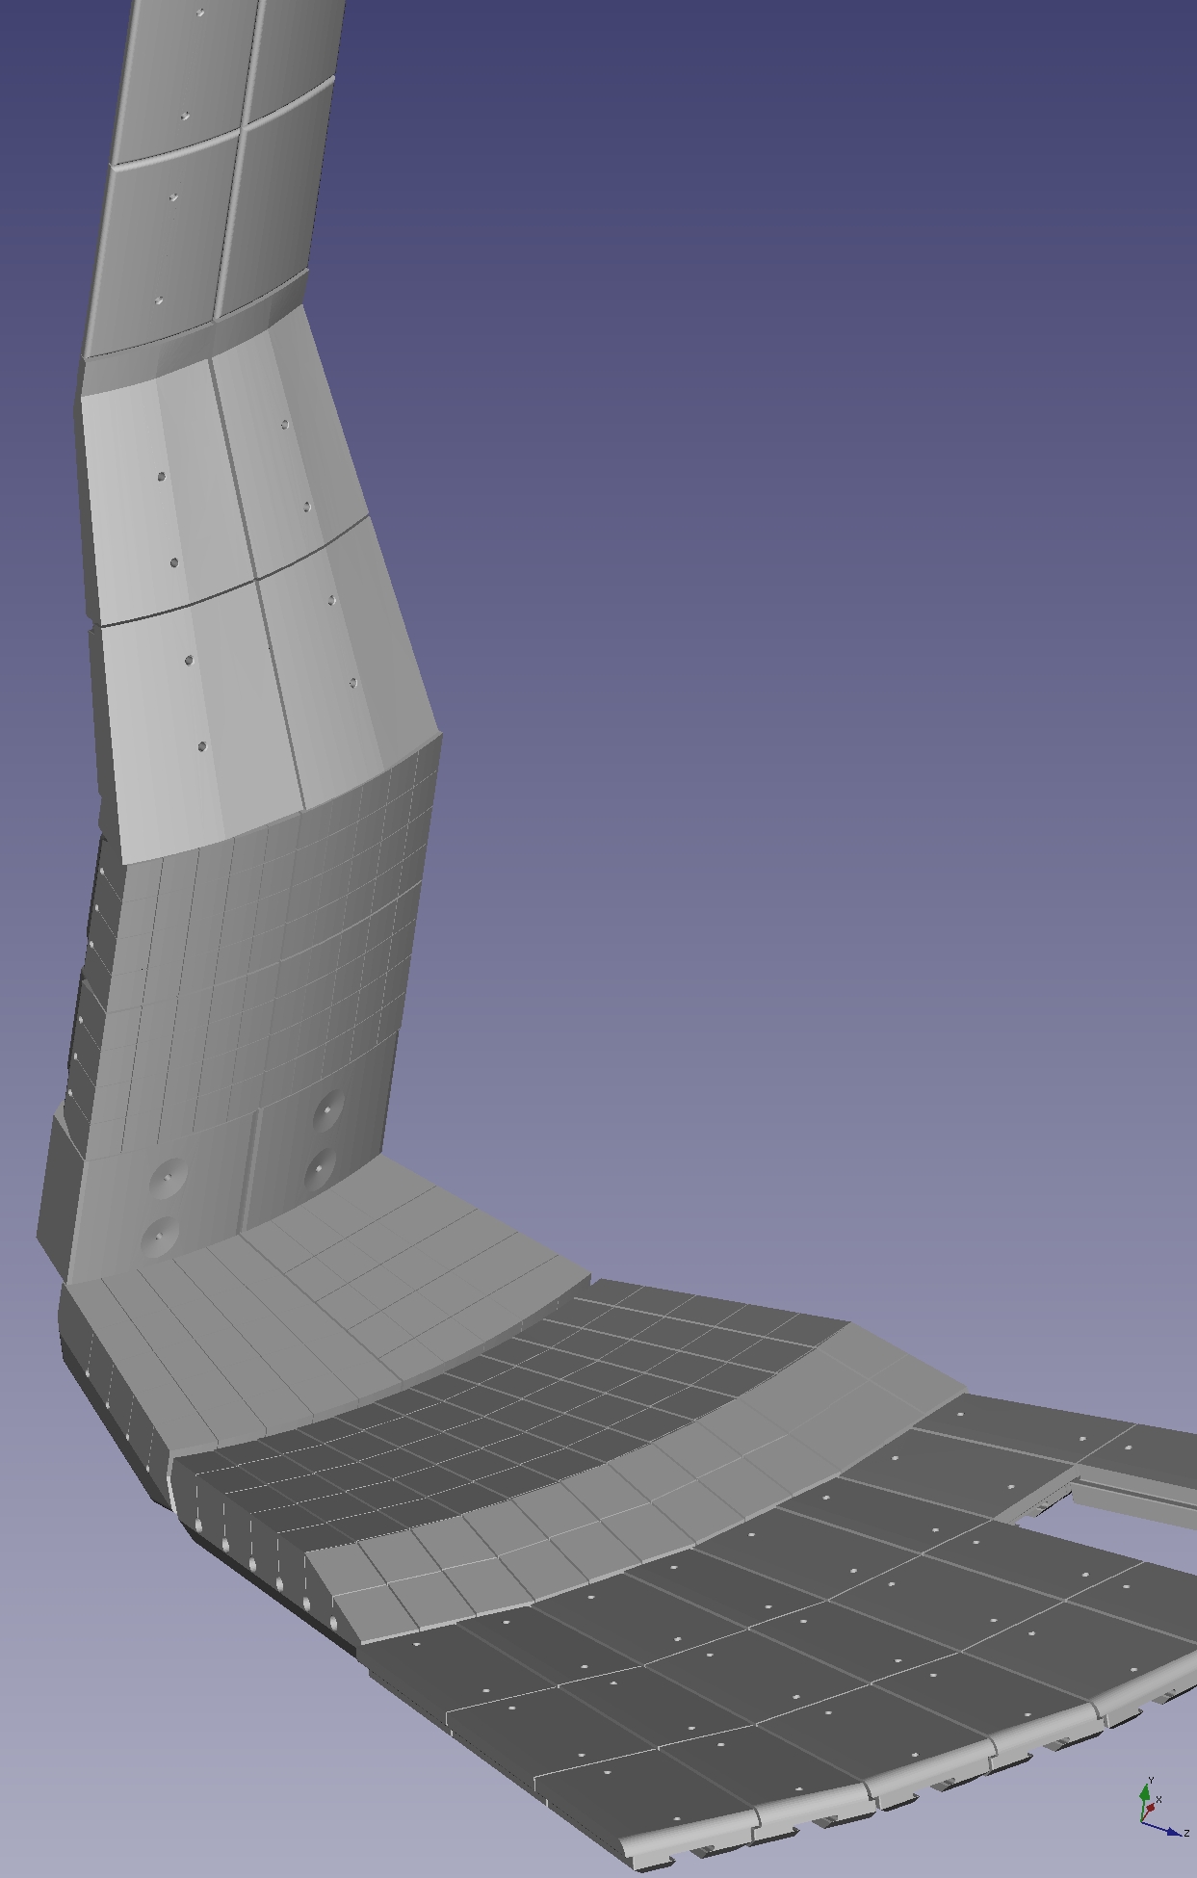
Use NSTX-U CAD models in generation of surface heat flux data
Inner half of the wall, up-down symmetric
~30° toroidal segment
Hundreds of thousands of faces represent PFCs with holes, gabs and substructures
Outer target PFCs have small fishscaling to counteract leading edge heating.
Inner target tiles are curved cylindrically, outer target tiles are mostly flat.

Slide 4
New tool consists of 3 distinct steps
Generate grid points on top of the PFCs using a CAD
the STL format represents the CAD as a mesh of triangles (faces), here: 150 000
typically independent of equilibrium → one-time task
Trace field lines from each grid point to determine penetration depth (ψ_{min})
include 3D wall structure for trace termination to capture shadow effects.
generated from CAD in a one-time preprocessing task
Assign heat flux from profile q(ψ)

Slide 5
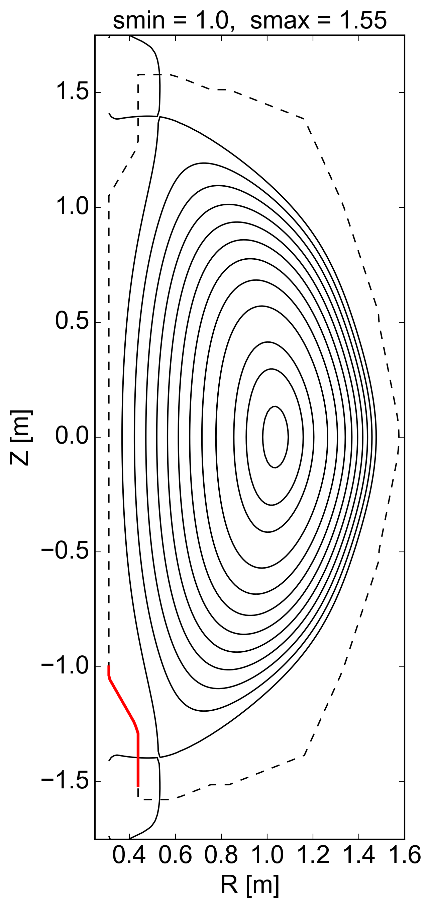
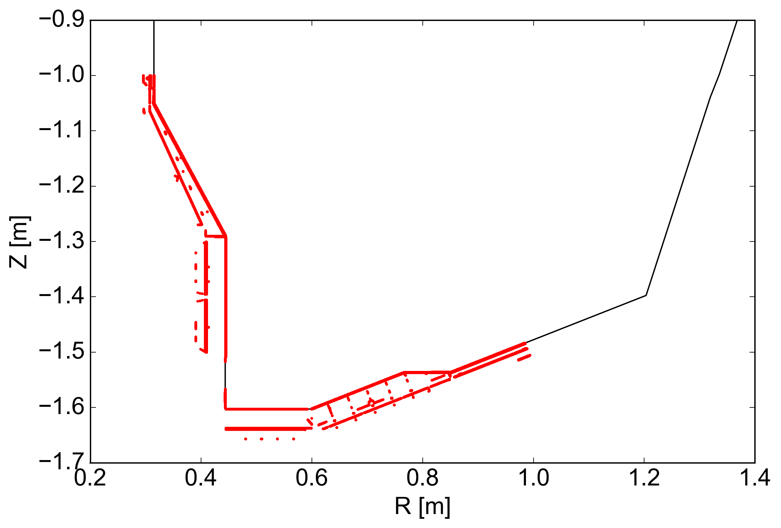
Generate grid points on top of the PFCs using the CAD
inner target
outer target
points in gaps, holes and trenches
Find each grid point within the innermost face
Grid in s_{wall} and toroidal angle φ, here 600x400
Independent of equilibrium

Slide 6
Trace field lines from each grid point to determine penetration depth
Uses existing capability, the MAFOT code [A.Wingen, Nucl. Fusion (2009)] to trace field lines.
see backup slide for details
Independent of how the grid was generated
Runtime depends only on grid size
Fully parallel with MPI
For trace termination only: reads 3D wall data, given as partially linear outlines in (R,Z) at discrete toroidal angles.

Slide 7
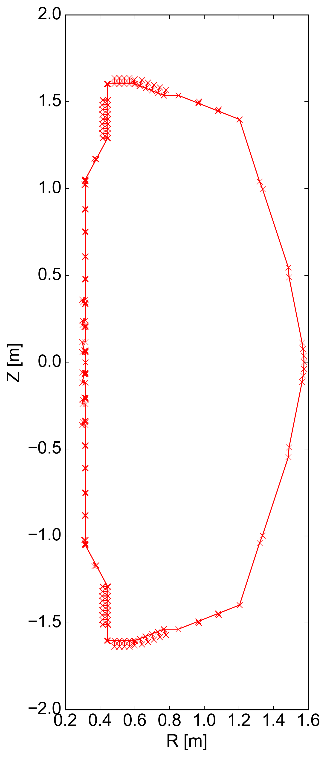
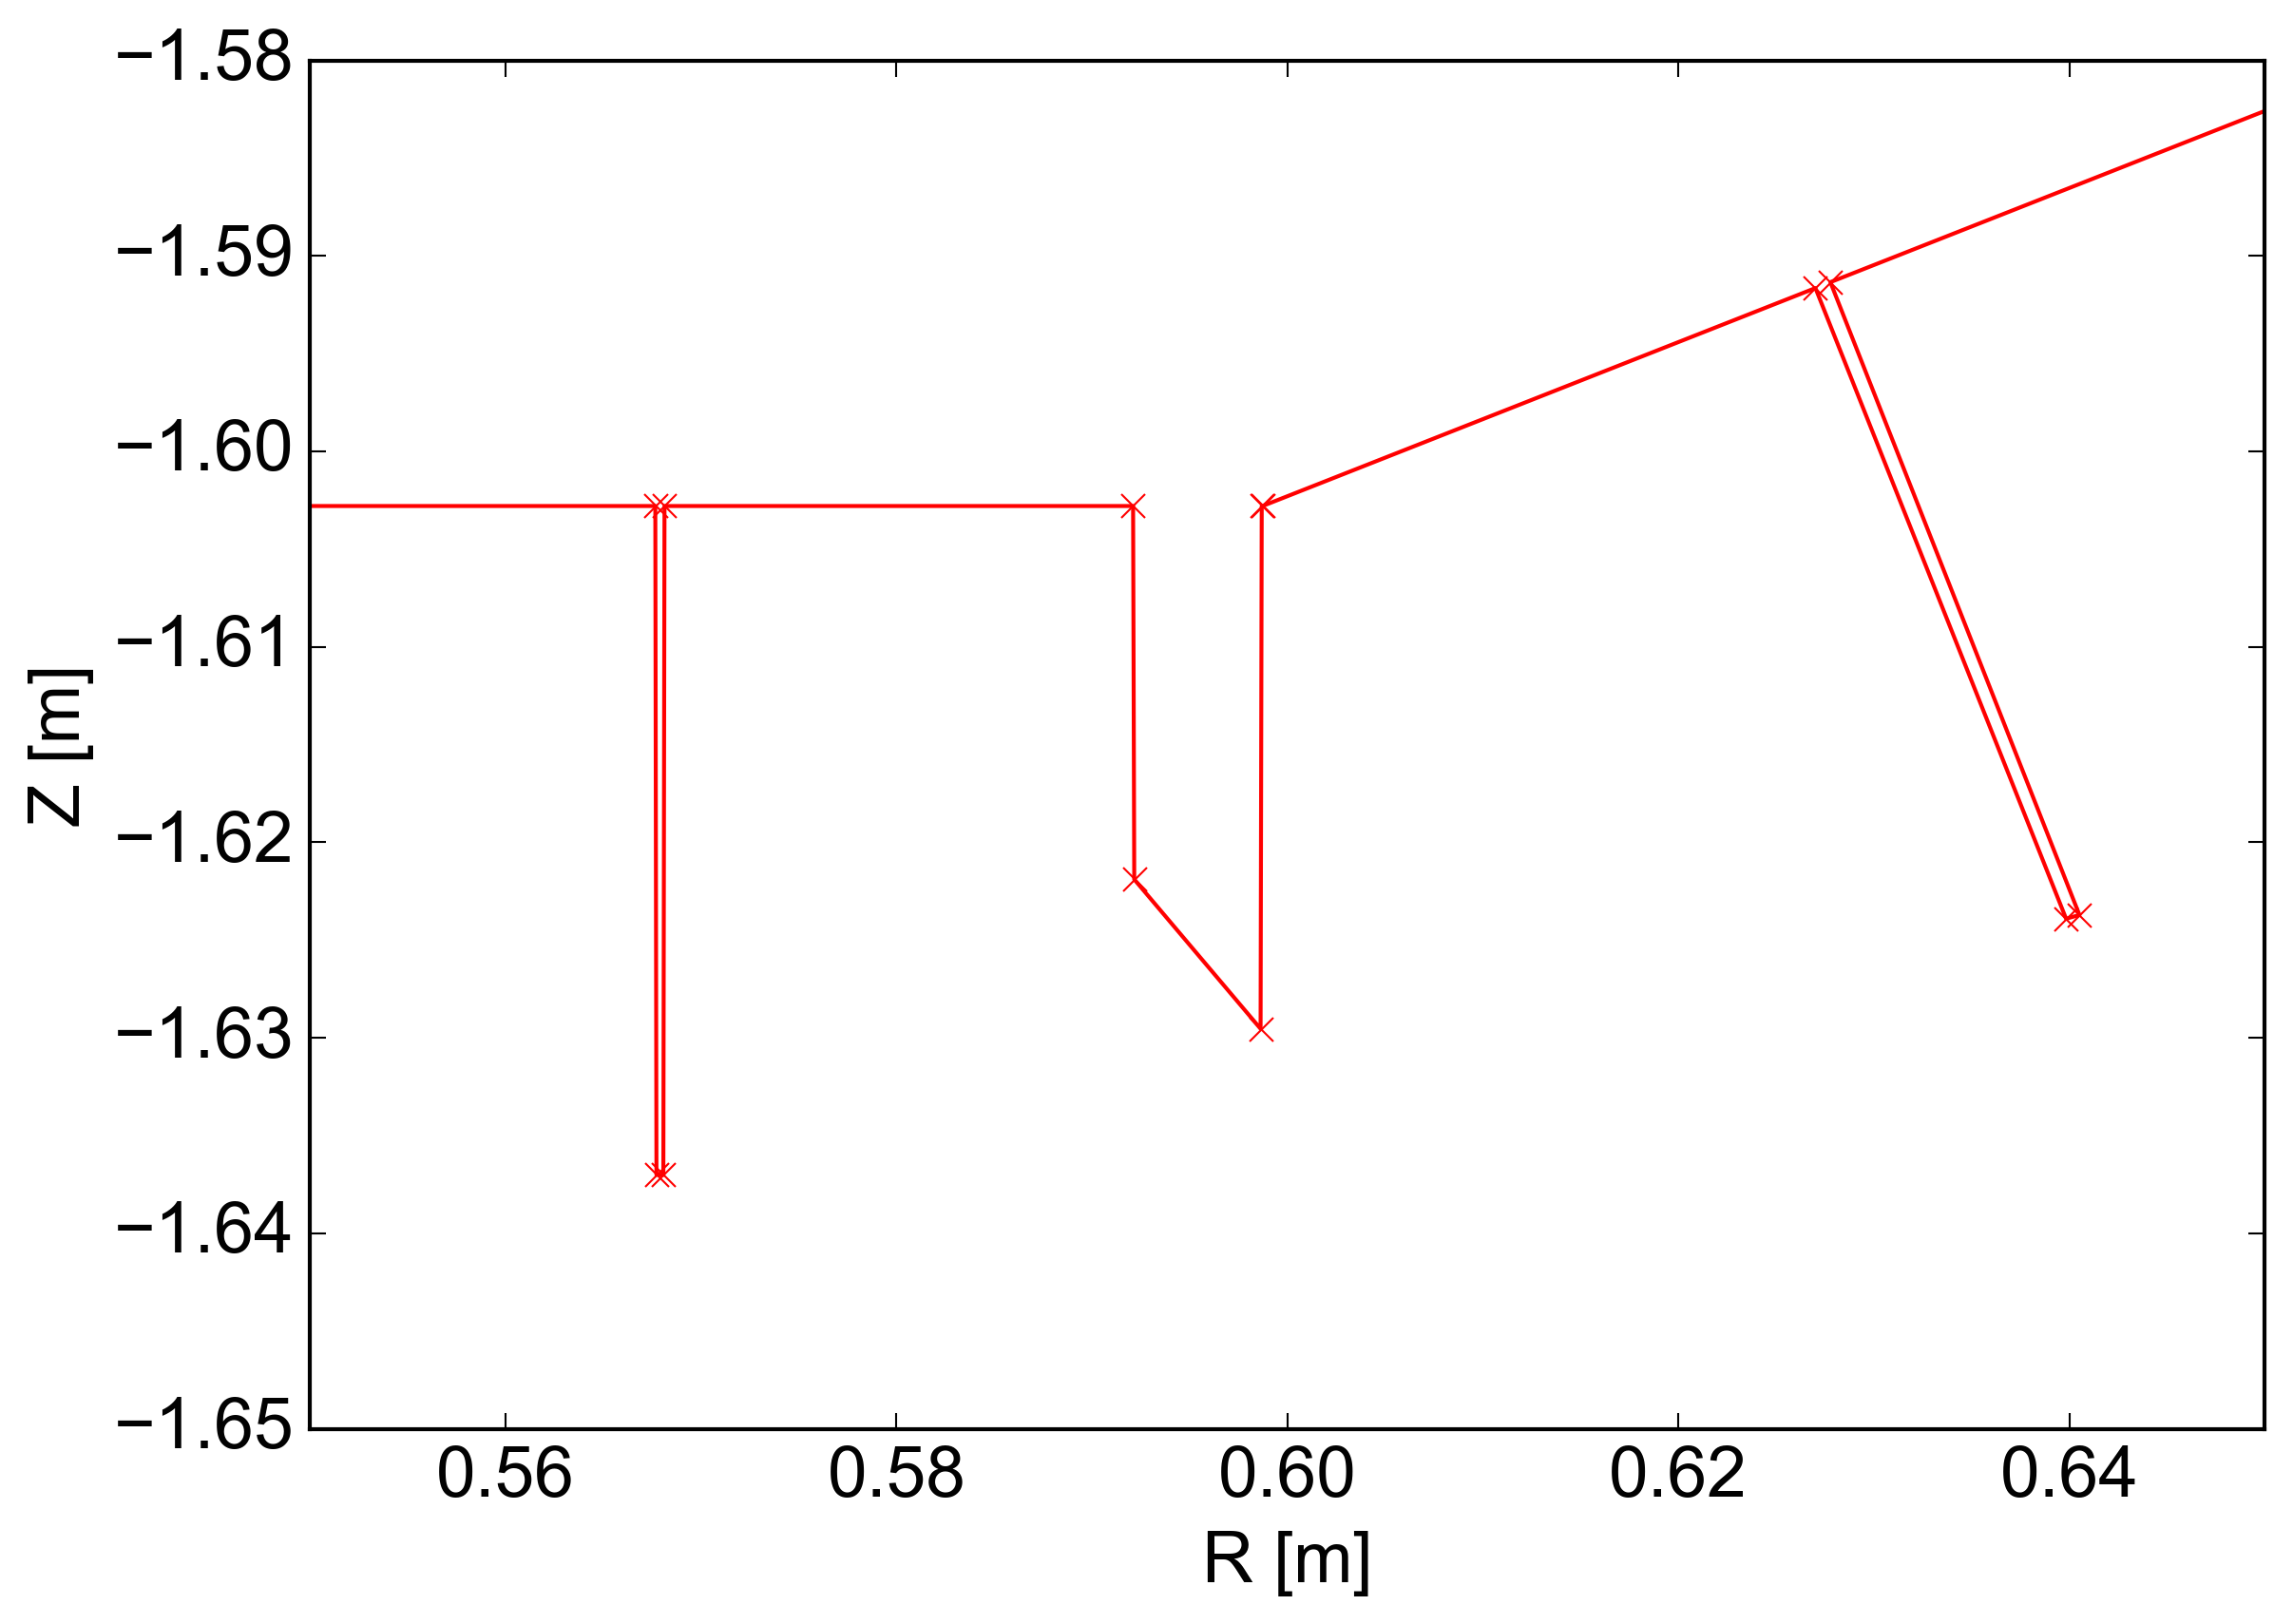
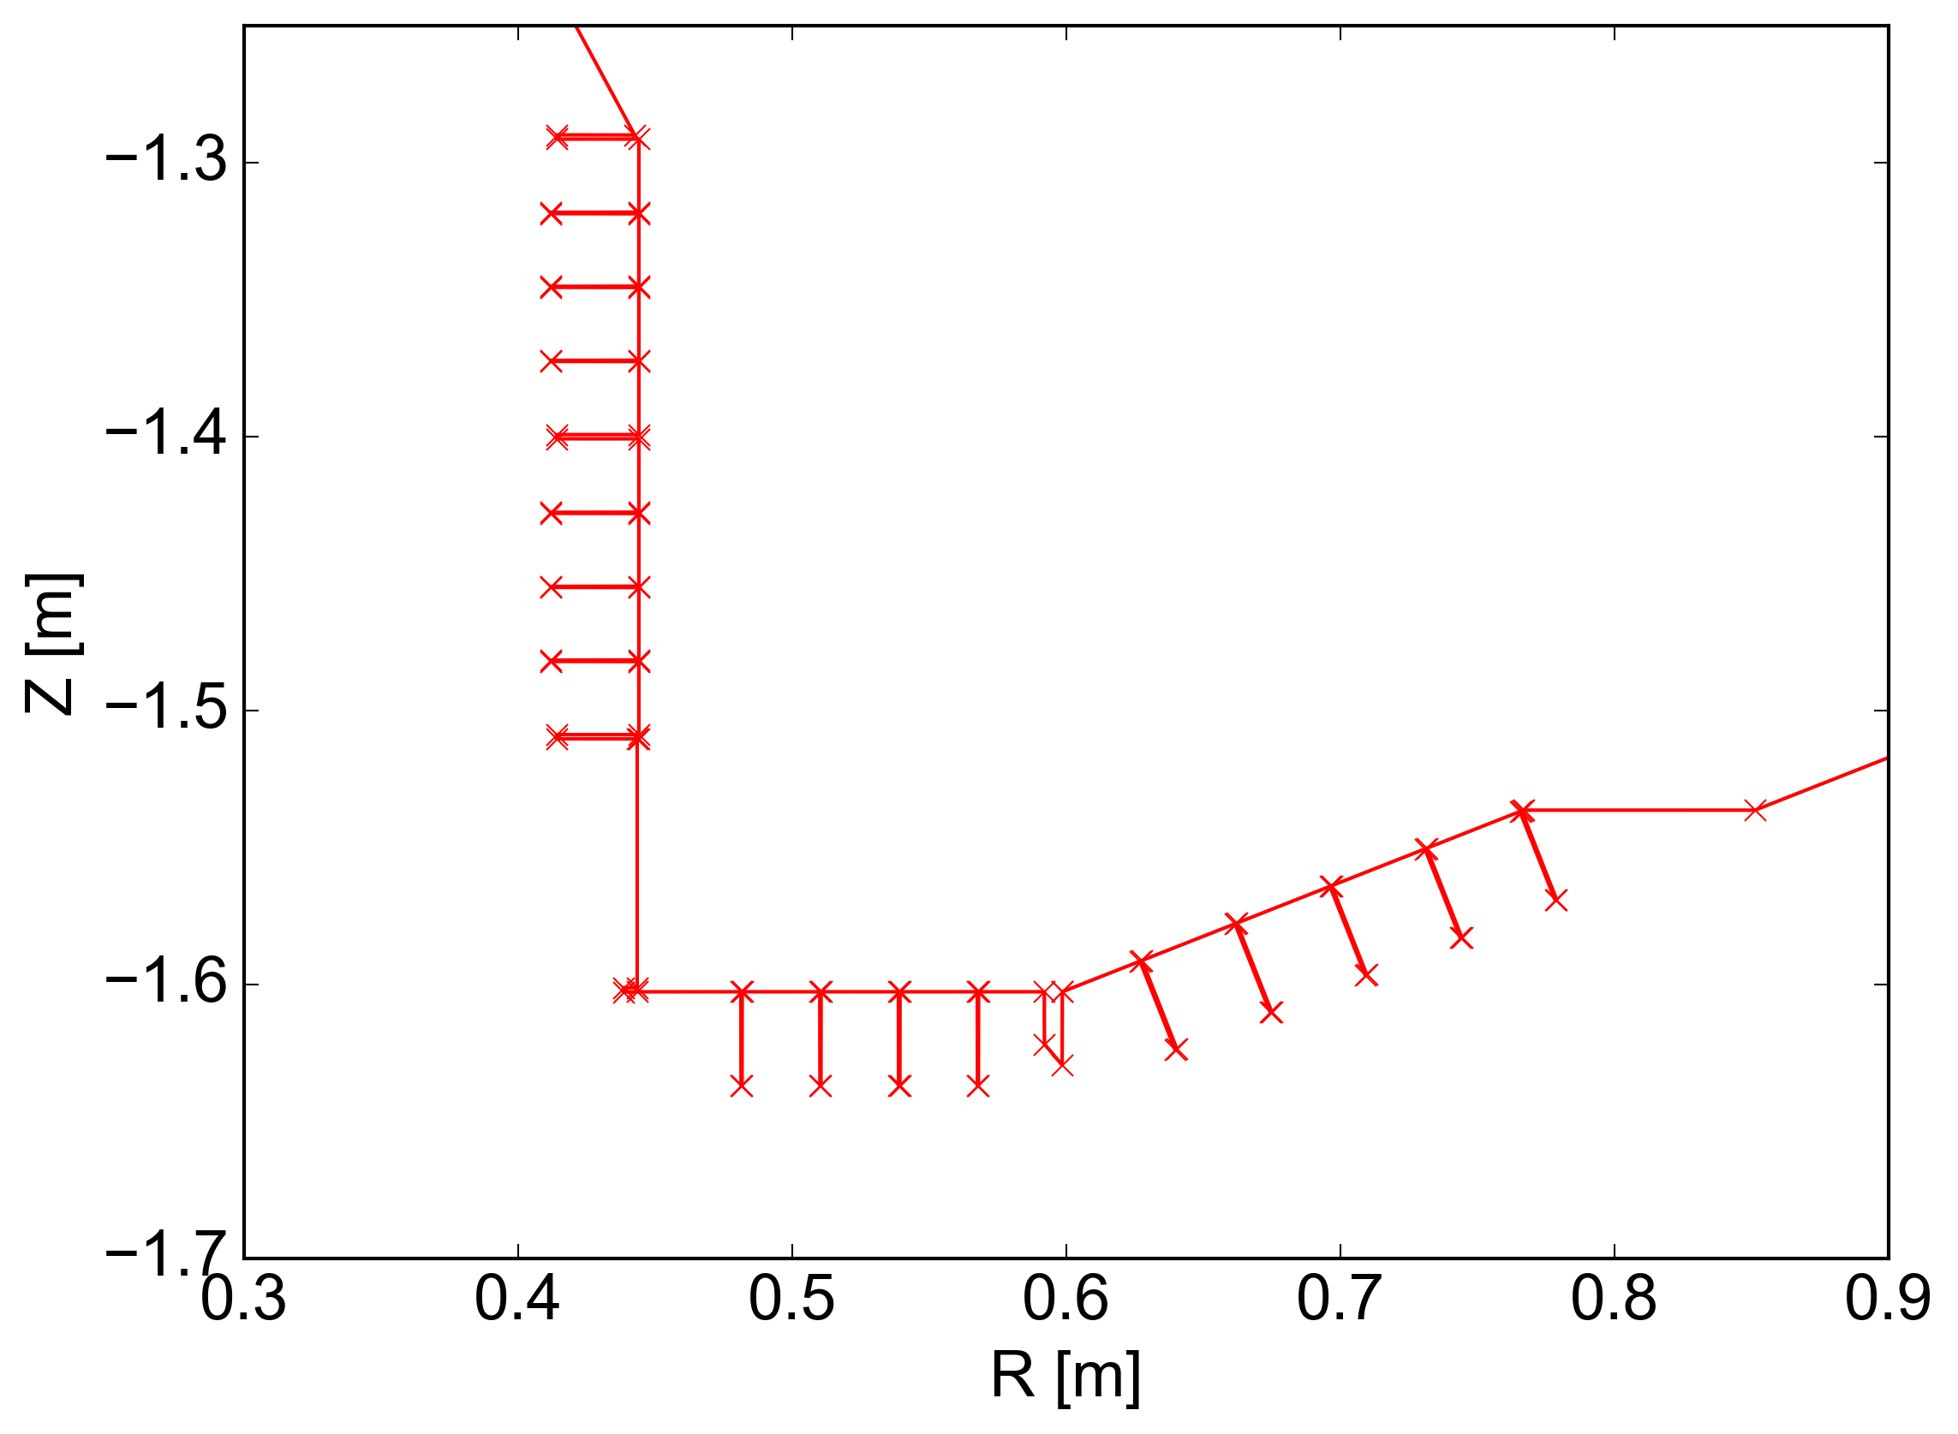
3D wall structure for trace termination to capture shadow effects
Use outline at every
0.1° toroidally
one-time task,
takes about 40 min.
partially linear with all gaps, holes and trenches from CAD

Slide 8
Assign heat flux from profile
Assume upstream profile q||(ψ) at midplane
scaled by power exhaust, here: inner: 0.7 MW outer: 2.8 MW
At each target plate grid point, assign: q = q||(ψ_{min}) n·B / |n·B|
n is normal vector to face, B is magnetic field vector

Slide 9
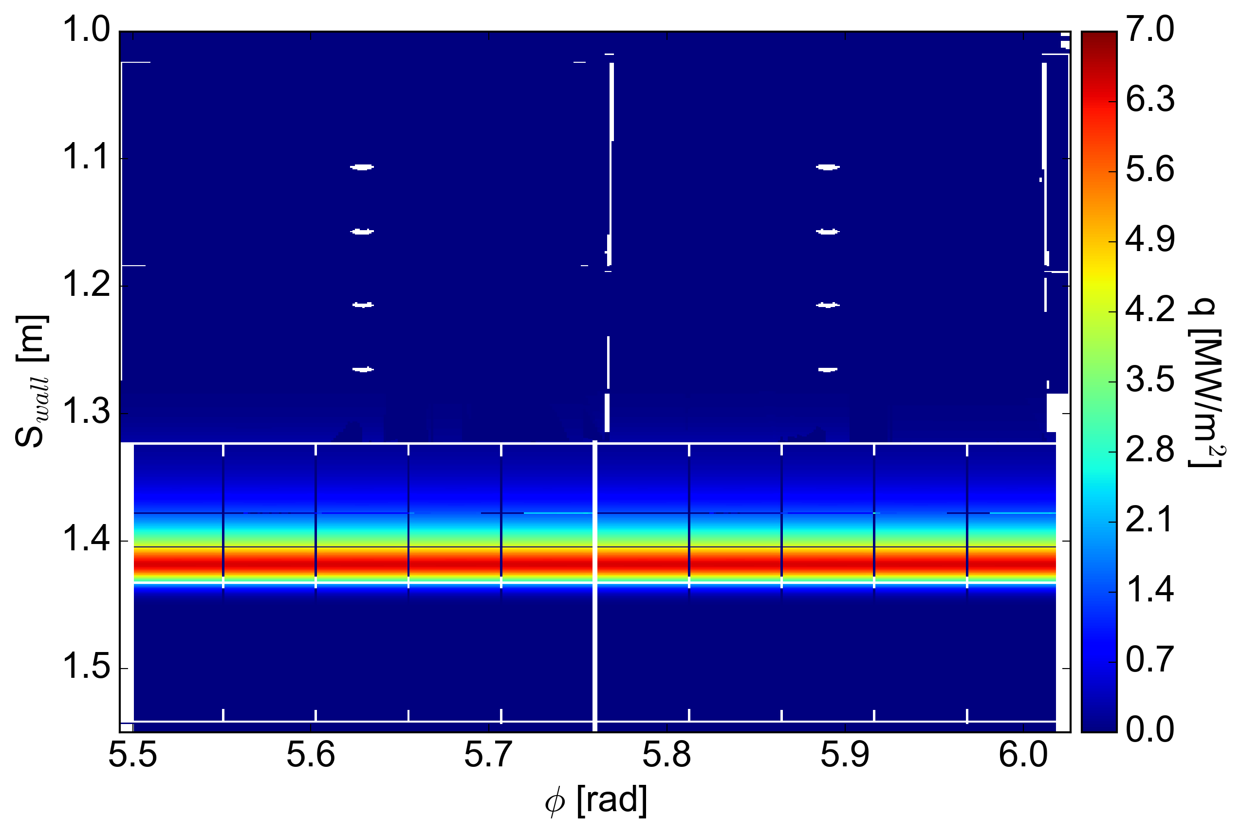
Heat flux is uniform on inner target
white areas are holes and gaps in the CAD

Slide 10
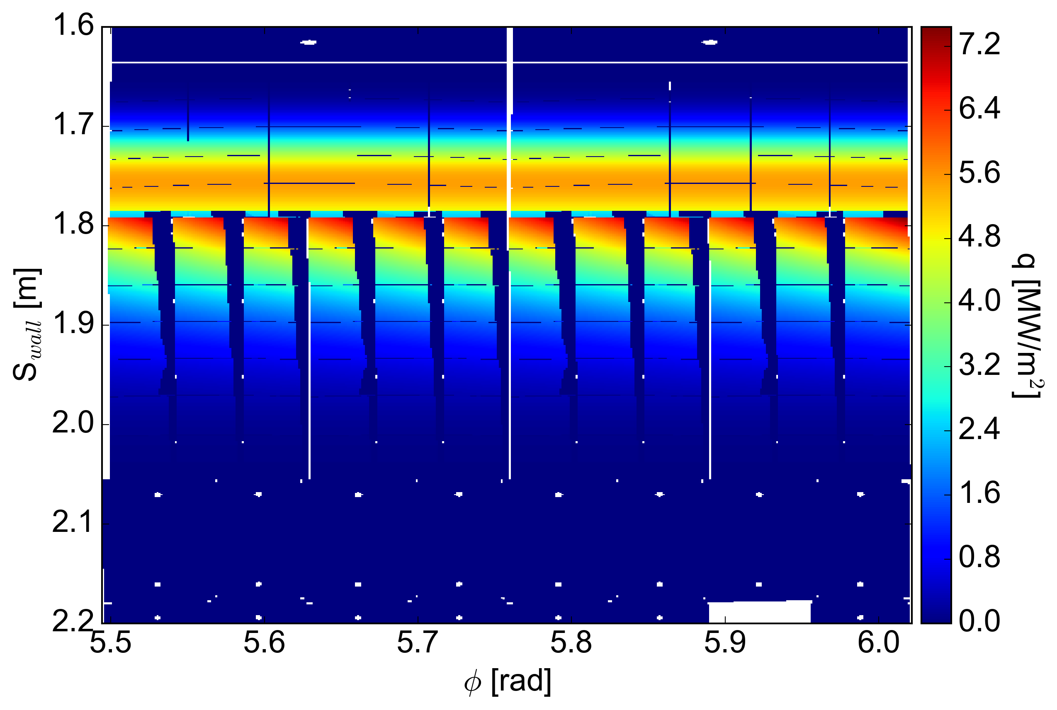
Heat flux varies and is partially shadowed on outer target
fishscaling of tiles causes shadows

Slide 11
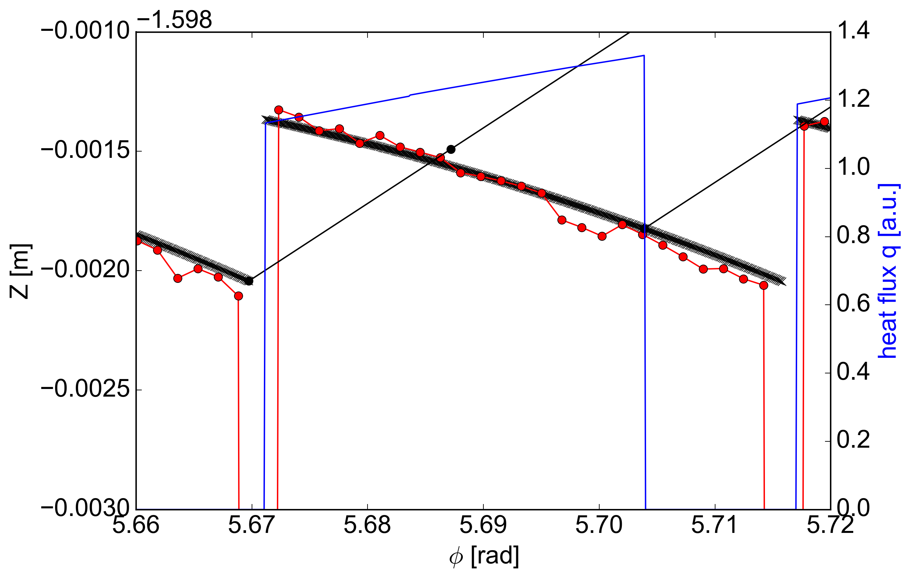
Field lines in shadowed areas intersect with 3D wall during the first trace step
first trace
step
s_{wall} = 1.8 m
R = 0.607 m
field line
initial grid
points
3D wall outline
at 0.1° toroidally
heat flux
Heat flux not constant, because n·B changes toroidally

Slide 12
Future work
Test on relevant equilibria → axisymm., snowflake, 3D
tested on one axisymmetric double-null equilibrium so far
If 3D: NSTX specific model for 3D fields needs to be added to MAFOT
Deploy on PPPL computer systems
Automation → maybe add a GUI
so far all steps are done separately and by hand
Fine tune and/or add models(s) for heat flux profile
Add a model for radiative heat flux
or other desired capabilities

Slide 13
Backup

Slide 14
MAFOT: a parallel field line and drift orbit tracer
MAFOT can calculate:
in:
Poloidal cross-sections: (R,Z) & (θ,ψ) coordinates
Footprints on divertor targets
Poincaré plots
Connection length
Penetration depth
Manifolds of separatrix or island chains
full 3-D orbits
B-fields outside of VMEC & SIESTA last closed surface
for:
magnetic field lines
relativistic particles in a guiding center drift approx.
with:
RMP vacuum fields of coils
M3D-C1 plasma response - linear & non-linear - single & multimode
VMEC & SIESTA B-fields - any configuration
arbitrary individual current filaments
in tokamaks:
DIII-D, ITER, NSTX & MAST
Control GUI available
developed by Andreas Wingen

