Slide 1


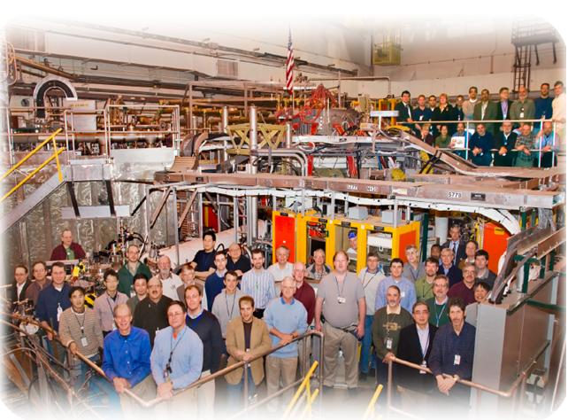
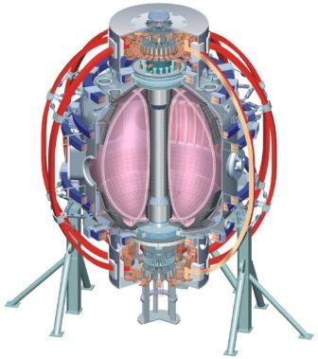
NSTX
Supported by
The impact of elongation and aspect ratio on the global stability of ST plasmas
XP-1142
College W&M
Colorado Sch Mines
Columbia U
CompX
General Atomics
INL
Johns Hopkins U
LANL
LLNL
Lodestar
MIT
Nova Photonics
New York U
Old Dominion U
ORNL
PPPL
PSI
Princeton U
Purdue U
SNL
Think Tank, Inc.
UC Davis
UC Irvine
UCLA
UCSD
U Colorado
U Illinois
U Maryland
U Rochester
U Washington
U Wisconsin
Stefan Gerhardt, et al.
Culham Sci Ctr
U St. Andrews
York U
Chubu U
Fukui U
Hiroshima U
Hyogo U
Kyoto U
Kyushu U
Kyushu Tokai U
NIFS
Niigata U
U Tokyo
JAEA
Hebrew U
Ioffe Inst
RRC Kurchatov Inst
TRINITI
KBSI
KAIST
POSTECH
ASIPP
ENEA, Frascati
CEA, Cadarache
IPP, Jülich
IPP, Garching
ASCR, Czech Rep
U Quebec
MHD TSG Group Review

Slide 2
Big Picture
NSTX has a large database of stability results with A<1.55 and κ<2.4.
  NSTX upgrade will run at larger values of both these parameters, while needing β_{N}~4.5-6.5.
It is hard to scan these parameters independently in NSTX…
Relevant Milestone Text: The maximum sustainable normalized beta will be determined versus aspect ratio (up to A=1.7) and elongation (up to 3) and compared to ideal stability theory using codes such as DCON and PEST.
Propose to do three types of scans:
  Scan #1: Mixed κ & A scan at fixed outer gap and β_{N} (12 shots).
    Use RFA analysis to look for passive instability.
  Scan #2: A scan at fixed kappa (8 shots).
    Test the disruptive β_{N} limit.
    Look for tearing effect…destabilizing the GGJ term in MRE.
  Scan #3: Kappa scan at fixed A (8 shots).
    Test the disruptive β_{N} limit.
  Scan #4: Go to highest possible elongation and aspect ratio (6 shots).
    Test the disruptive β_{N} limit.
Goals:
  Determine if, within the achievable range of A and κ, there is a measurable change in global stability. Does n=0 or n=1 limit the strongly shaped, higher-A, high-β operating space? Do kinetic effects obscure the (somewhat modest) aspect ratio change.
  Collect data validating (or not) the β-limit assumptions for NSTX Upgrade.

Slide 3
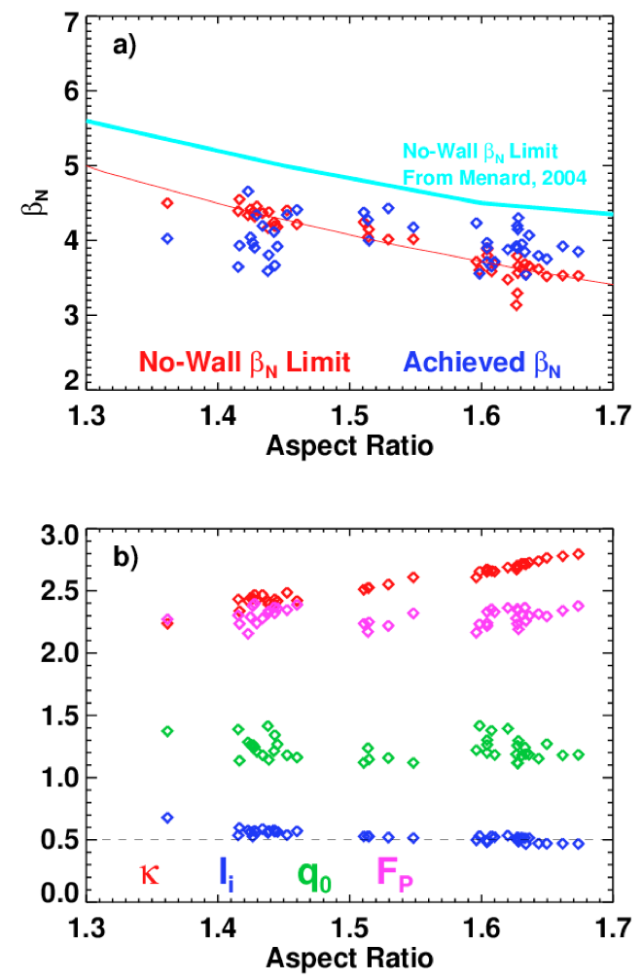
We know that ideal stability limits are reduced as the aspect ratio increases
Discharges from XP-1071. Use experimental shapes and profiles.
No-wall β_{N} limit reduced by 0.75-1 units as the aspect ratio is increased.
No effort made to assess the β_{N} limit in these scans…were run with a constant input of 4 MW.

Slide 4
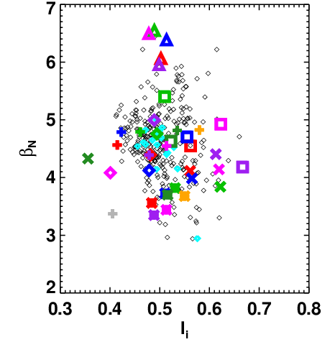
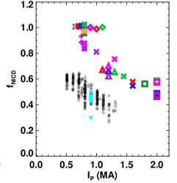
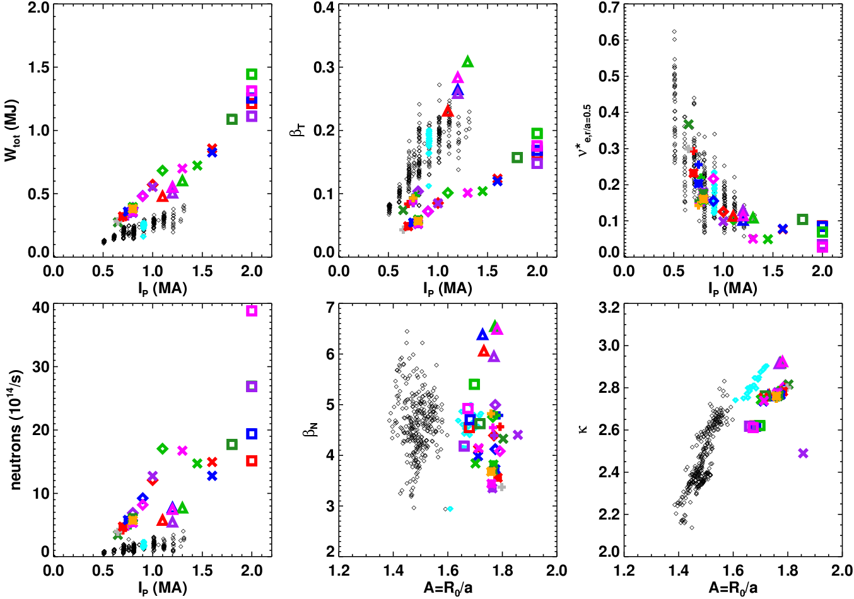
High-Performance Scenarios For NSTX-Upgrade Will Need High β_{N} at Larger A and κ
Optimize for:
High-f_{NI} at large I_{P}
High-β_{T} ( with q_{min}>1)

Slide 5
In General, It is Hard to Scan A and κ Independently
Fundamental Issue: the inner gap is not an independently controlled quantity.

Slide 6
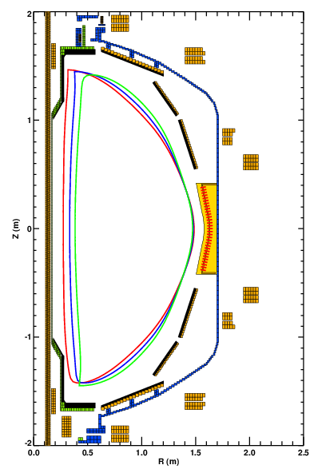
Scan of Kappa and A can be Achieved by Scanning the Inner Gap at Fixed Outer Gap.
This method was used in XP-1071.
  Was able to rapidly complete scan.
  High-A limit set by PF-1A current limit.
This scheme facilitates RFA measurements
  Maintains approximately constant distance between plasma boundary and RWM B_{P} sensors.
  Shapes have 8 cm outer gap to increase signal levels.
A | κ | I_{P} | q₉₅ | I_{PF-1A}
1.71 | 2.63 | 700 | 9.8 | 19.6
1.58 | 2.49 | 700 | 12.48 | 13.3
1.46 | 2.37 | 700 | 18.3 | 7

Slide 7
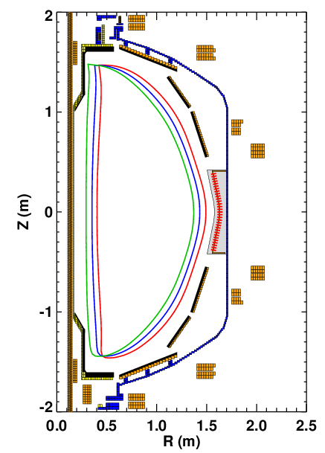
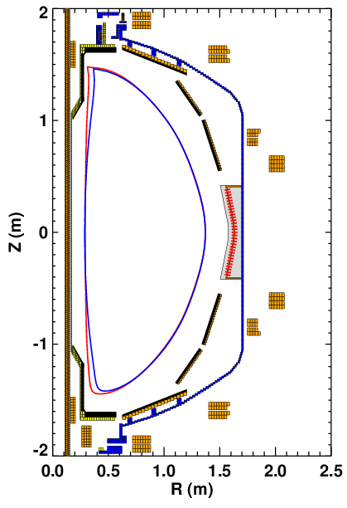
Scan of A at Fixed Kappa
With Constant I_{P} or Constant q₉₅
High aspect ratio limit set by the PF-1A coil current limit.
Scan of A at fixed κ and I_{P}
700 & 1000 kA
A | κ | I_{P} | q₉₅ | I_{PF-1A}
1.53 | 2.64 | 1000 | 9 | 18.9
1.54 | 2.7 | 700 | 18 | 7
1.65 | 2.69 | 700 | 12 | 13.3
1.74 | 2.67 | 700 | 9.5 | 19.6

Slide 8
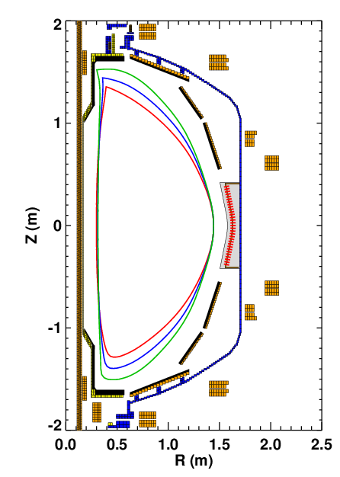
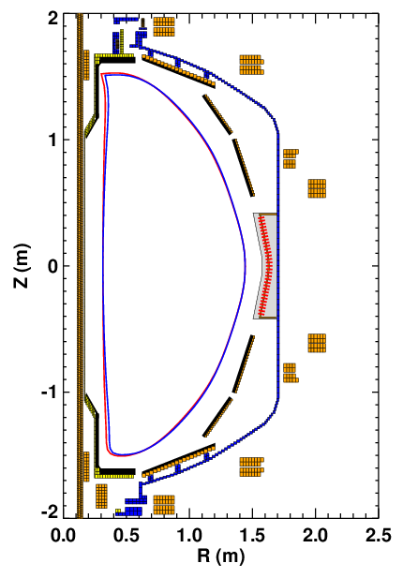
Scan of Kappa At Fixed A.
With Constant I_{P} or Constant q₉₅
Low elongation limit is set by current limit on the PF-1A coil.
  Otherwise the inner gap shrinks
  700 kA plasma need 19.6 kA of PF-1A
Scan of κ at fixed A and I_{P}
A | κ | I_{P} | q₉₅ | I_{PF-1A}
1.56 | 2.66 | 825 | 12.1 | 10.7
1.55 | 2.69 | 700 | 17.9 | 6.3
1.55 | 2.55 | 700 | 13.9 | 11.6
1.52 | 2.3 | 700 | 12.03 | 19.6

Slide 9
XP Plan Summary
Plan
  Step 1: Inner gap scan for RFA measurements. (12 shots)
    Use three shapes.
    Make RFA measurements at β_{N}=4 and 4.5 (or 5?) (use β_{N} controller?).
      30 Hz co-propagating waves. No magnetic breaking.
    Do we see much stronger RFA as the aspect ratio is increased (and no-wall limit is reduced)?
  Step 2: Aspect ratio scan at fixed kappa. (6 shots)
    Use β_{N} controller to ramp to the disruptive β_{N} limit
  Step 3: Kappa scan at fixed A. (6 shots)
    Use β_{N} controller to ramp to the disruptive β_{N} limit.
  Step 4: Go to very high elongation(~3) and aspect ratio (1.75):
    Use β_{N} controller to ramp to the disruptive β_{N} limit.
Questions/Comments
  Should use slow n=1 control only, to better isolate stability limits?
  ASC XPs designed to improve the vertical control system and develop discharge shapes should be attempted before this XP.
Analysis: Experimental equilibrium analysis with EFIT & LRDFIT, TRANSP for data integration, comparison to ideal stability theory (DCON & PEST), something for RFA measurements?

Slide 10
Backup

Slide 11
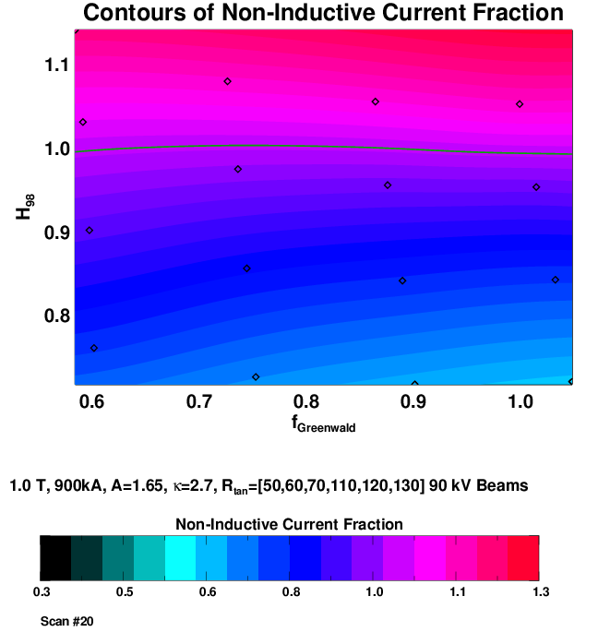
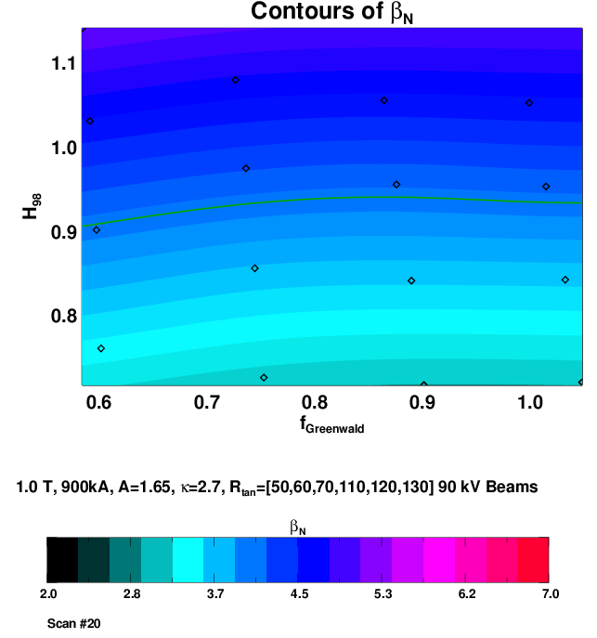
Interesting NSTX-U Scenarios have β_{N}~4.5 (and Greater)
We want to confirm/test that β_{N}~5 is sustainable at the highest κ and A achievable.

