Slide 1
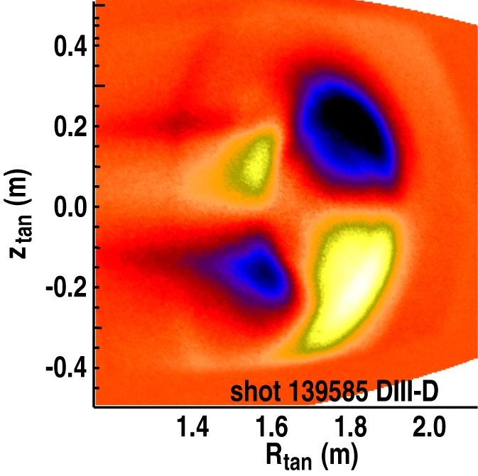



Influence of q profile on Tearing Stability
& Error Field Sensitivity
by Richard Buttery¹
with Stefan Gerhardt², Rob La Haye¹,
Jong-Kyu Park², Steve Sabbagh³
Presented to the
MHD Group Review, May 2011
¹General Atomics, USA
²Princeton Plasma Physics Laboratory, NJ.
³Columbia University, NY.
Work funded by the US DOE.

Slide 2
Tearing Modes are Critically Dependent on the q Profile
2/1 modes come out of the noise
  Intrinsic tearing instability, driven by dJ/dR
  Performance limit that depends on q profile
    Likely source of variation in previous scaling studies
Error field thresholds depend on TM stability
  EF brakes plasma accessing TM instability (←q)
  May further depend on q profile if plasma
  response amplifies fields differently
Need to probe both tearing β limit & error
field threshold (2 effects) vs q profile
  Exploit natural q profile evolution on NSTX
  Ramps in β or error field; Vary ramps to scan q
  Tune to control n_{e} or access higher q_{min}
This is key to developing regimes for future devices
& understanding tearing physics in general

Slide 3
Key Elements of Shot Design
Base on previous TM limit shot, 134071
  Li evaporation to avoid significant ELMS
  Establish H mode with beam peak (when? 200ms)
Once H mode established commence ramps to induce mode
  Either beta or EF ramp
Adjust base levels & ramp rate to access mode at different q_{min}
  Tuning to match density
q_{min}:4→1
NBI 4MW
Various β or EF ramps applied
2MW
0
200
800

Slide 4
Parameters?
Reference was 0.45T 0.9MA – OK?
Base of NBI for EF/ beta ramp ~2MW or under FB: β_{N}=3
  Headroom for ramp
  May need to rise for early high beta cases (with higher qmin)?
EF will be n=1 ramp
  Typically expect to need around ~900A for penetration (ramp to 1.5kA?)
  DEFC? Last year did not do much at starting beta used
Target density (and how to keep it there?) – 4E19?
Discharge length – anticipate late mode case at ~700ms, ramp to 800ms

Slide 5
Run Plan
Optimize front end for H mode and li for ELM suppression (4 shots)
  Deploy ‘usual’ power ramp to access mode and confirm limit late in discharge (~700ms) when q_{min} low
EF scan
Repeat with fixed β_{N} (=3), and n=1 field ramp to reach mode (3)
  Tune to get mode late in discharge
Bring EF ramp sooner to aim for mode at ~550ms (2)
  Tune density if needed
Repeats with mode at ~450ms and ~350ms (4)
  Keep density and β_{N} carefully controlled

Slide 6
Run Plan (2)
β_{N} Scan
Power ramp as shot 1 but more rapid – aim for mode at 550ms (2)
  EF minimized (DEFC?)
  Maintain target density
Repeats attempting modes at 450ms and 350ms (4)
  Maintain target density
Interplay of TM/EF limits, Extension and Fill In:
Repeat low q_{min} EF ramp shot with increased β_{N} (2-6)
  Further repeats desirable at higher q_{min} or with further rise in β_{N}
Fill in points (0-4)
  Will want to look around any ‘resonances’ such as rational qmin
  Total 21-29 shots expected

Slide 7
Contingencies
If mode too hard to access in EF ramps, raise β_{N}
If mode readily accessed too early, lower β_{N}
  β_{N} scan is instructive for EF ramps
If density varies can try: (priority order advice saught)
  Gas puff variation
  Change glow time?
  Change pumping by strike location change
  Other?
Can’t measure q_{min} on the day → use mode timing

Slide 8
Operational
Will want to know as much as possible about q profile intershot
  Intershot MSE (for core q at least)?
  MHD spectroscopy a la Gerhardt code
  Anything else?
Operate under beta control, as developed in 2010 shot 141069 series
‘Usual’ MHD diagnostics – any comments?
  CER, MHD Mirnov, SXR, TS, MSE

Slide 9
Success will look like…
Scan of n=1 EF threshold vs q_{min} (mode timing) with fixed density and β_{N}
  Linear scaling between q_{min}=1 and 2, but possible resonance at q=2
  Worth just checking above q_{min}=2 – what happens
Scan of β_{N} limit vs q_{min} (mode timing) with fixed density and no EF
If time, exploration of how EF threshold changes with β_{N} at low q_{min}, and a higher q_{min} point
Results will help test how q profile impacts tearing stability
& EF sensitivity (for advanced scenarios)
Combined scan helps understand the linkage between intrinsic tearing stability (proximity of TM limit) and EF sensitivity

Slide 10
Questions
Should we aim for higher target density in power ramps (more fuelling from more beams)?
How do we control density? (or will it vary?)
Confirm: timings, density, baseline β_{N}, li evap amount
Any special diagnostic issues. MSE capabilities?
Run order OK?
Physics tests ones desired?
Physics methods OK?

Slide 11
Extra slides for background or discussion…

Slide 12
JET Hybrid Plasmas Sit Above β Limit of Other Devices:
Other parameters coming into play – q profile?
JET sits above DIII-D and JT-60U
trends
  JT-60U lower rotation →lower β_{N}
  But DIII-D high rotation
Possible collisionality role? No:
  JET unstable at low ν*
  But stable at +high and ° low ν*
→Collisionality provides ‘access
condition’ for NTM
  Enables q profile modification
  Can change Δ'
  q profile is the parameter to test…
JET
DIII-D
JT-60U
ν_{i}/εω_{e}*
1
JET
DIII-D
0
0
ρ_{iφ}*
0.16

Slide 13
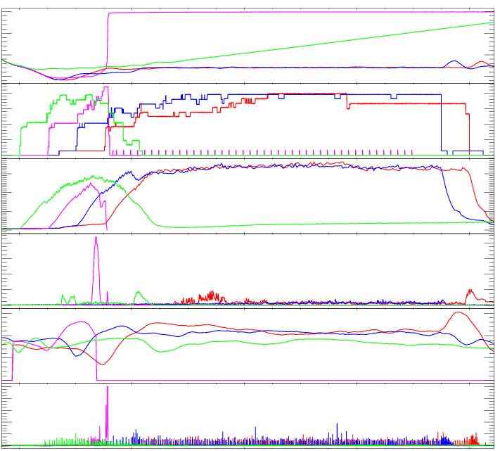
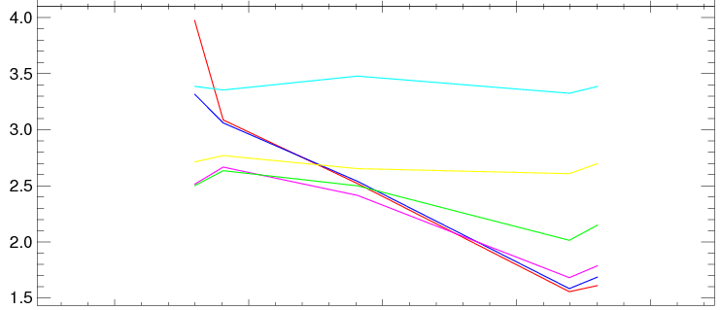
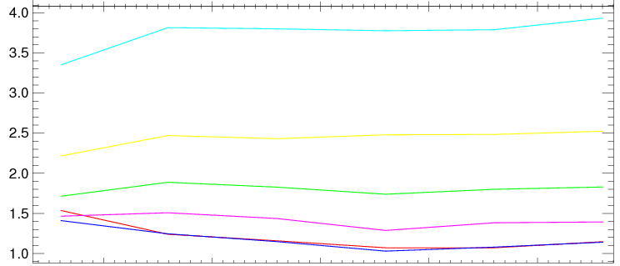
JET shows ‘just right’ degree of relaxation needed to maintain stability at high β_{N}
JET: 77626,77629,77636,77633
Mode if profiles too ‘advanced’:
Fully relaxed plasma also less stable
  Mode at lower β_{N} or occurs later
0
-I_{P}/MA
-1
Early heating, 77633
modes at high q_{min}
20
P_{NBI}/MW
Power drop
+ late on
q at various radii
0
2
3
4
β_{N}
Time (s)
No mode
0
n=1
MHD a.u.
early mode
Relaxed
late mode
early modes
H_{98pby2}
1
q at various radii
Best case, 77629,
q_{min} stays ~1
0
D_{α} a.u.
0
4
8
2
Time (s)
10
Time (s)

Slide 14
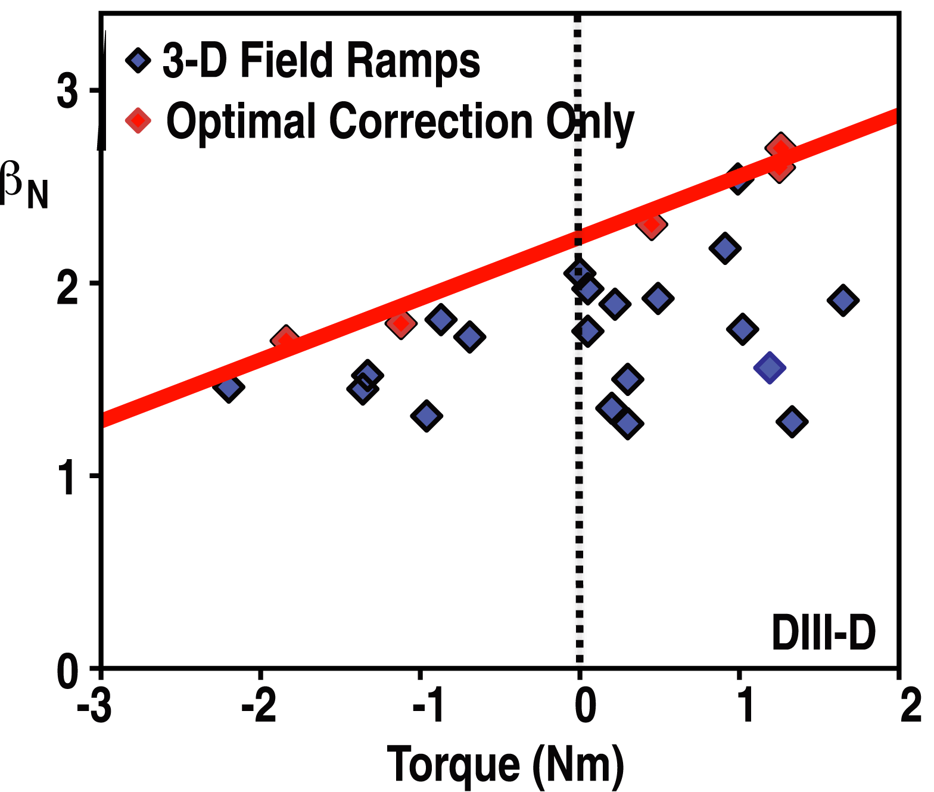
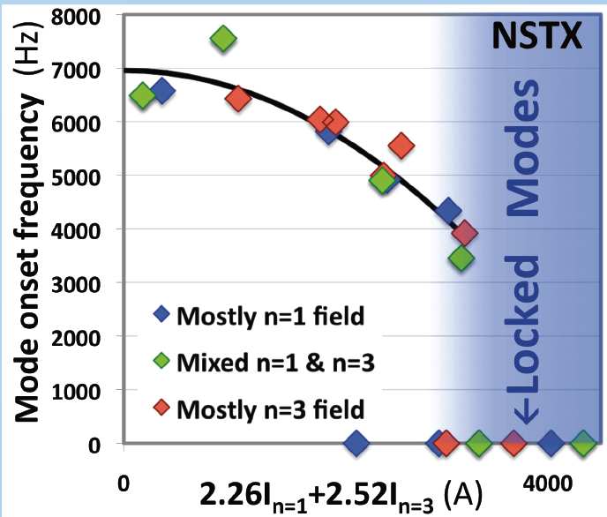
Background: Error Fields Access Tearing Instability by Lowering Rotation Shear
DIII-D shows operational relationship between “natural” & “error field” tearing modes
Natural tearing β limit
~zero rotation
Co-rotation increasing
NSTX shows connection of rotating
and locked mode onset mechanisms

Slide 15
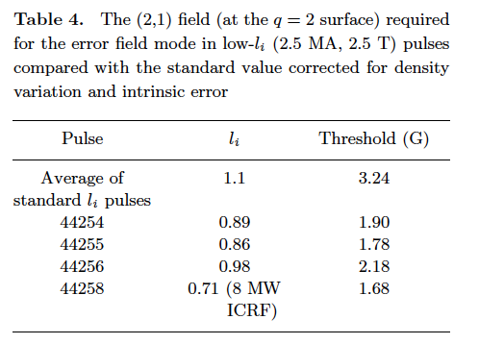
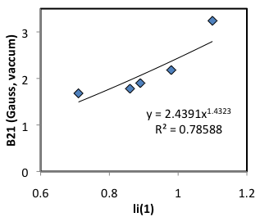
Error Field Thresholds Depend on J Profile
Data from Ohmic plasmas JET:
  Fast current ramp flattens q and moves q=2 further in
[Buttery NF 2000]

Slide 16
Possible ‘Minimal’ Δ’ Model of Tearing Mode Triggering
1. Positive Δ' excites a small island
  Grows till Δ' saturation, w_{Δ}=Δ'₀ / α
NTM physics
Δ'
dw
dt
w_{sat}
Δ'₀
2. Growth becomes “neoclassical” if
island big enough:
  w_{Δ} > w_{crit}
  ⇒ Δ'₀ > α w_{crit}
w
α
w_{crit}< 2ε^{1/2}ρ_{θi}
here bootstrap
hole suppressed by
finite island transport
w_{Δ}
w
Δ'₀
NTM onset
3. Δ'₀ is function of rotation shear and β_{N}
  Increases/decreases in rotation shear will change tearing mode onset β_{N}
  ρ* variation introduced through w_{crit}
  but note much harder to excite
  mode at low β_{N} away from Δ' pole
αw_{crit}
counter
no shear
co shear
β_{N}

Slide 17
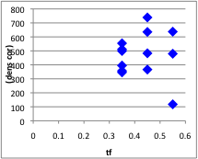
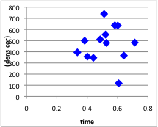
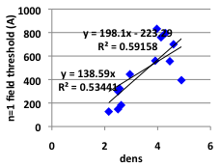
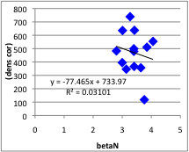
2010 NSTX EF Scaling Study Shows
Considerable Scatter
Use offset linear density fit to
correct out density variation
  No obvious trend in other variables now! ➔
  Can we do better based on
  phenomenology?...
Linear Offset:
Proportional

Slide 18
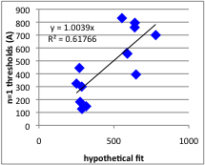
NSTX 2010: Make a fit based on intuition
Hypothesize power law form constructed:
  Positive density dependence seems clear
  Shot phenomenology shows less or no error field needed if higher β_{N} – suggests negative β_{N} exponent
  Arbitrary TF coefficient
Start from this and vary coefficents
by hand to minimise residual
  Actually get a better fit than
  regression fitting!
Form found:
    I_{pen} ~ n_{e} β_{N} ^{-1.25} B_{T}^{0.6}
  Can we constrain more than
  one variable?

Slide 19
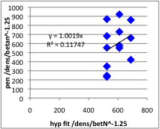
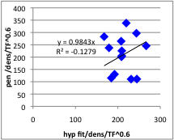
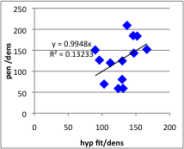
NSTX 2010: Is there a residual dependence in the fit?
Stripping out density dependence ➔
leaves weak correlation
  Further analysis shows might be B_{T} or β_{N},
  but neither is well constrained &
  there may be no further trend!
  Possible further
  hidden variables?
    Keep looking!
    q profile, MHD?
Remaining B_{T} variation:
Remaining β_{N} variation:

Slide 20
Governing Physics – á la old Ohmic theory…
Penetration is about overcoming the plasma rotation
Modes form when resonant surface is braked by resonant response to EF to half it’s natural frequency
  Tiny static island induced by EF
  Viscous forces try to keep bulk plasma rotating slipping past the island - this opposes island growth
  Torque exerted through island and viscosity to brakes plasma
    N=3 NTV effects assist this process?
  If rotation slows enough, island can grow, increasing torque and bifurcating to a locked mode state
  Threshold scales as B_{pen} ~B_{T} ω₀ τ_{A} (τ_{rec} / τ_{v})^{1/2}
    ω₀ often taken to be electron diamagnetic rotation
Criteria could also be regarded/generalised as condition for when we approach rapid rotation change
Critical elements are: what determines ω₀; whether plasma response changes; and how readily plasma rotation is overcome

